Slide 1


DroneTech Challenge
Teaching Innovation Management with Lego Mindstorms
Dr. Ali Junaid Ahmad 24 Sept, 2013

Slide 2
Background: Innovation
Scaleable – lacks strong causal linkages between resources investment and outputs
Is non-linear and non-teleological
Current innovation management models and methods lack efficacy due to high impact of off-model variables
Significant role of highly improbable rare events
Can occur independently and unguided, outside managerial controls
Is quite complex and multi-disciplinary
Is Anti-Fragile

Slide 3
Objectives of the Module
1. Understand the nature of innovation and be able to identify the potential for innovation within an organization and/or network.
2. Understand the innovation management process from a strategic perspective.
3. Be familiar with the key tools and techniques for managing innovation, know where to find information on leading edge approaches, and have the ability to critically select and apply these in actual business situations.
4. Understand the people issues in managing innovation: where there can be political, cognitive and other barriers to overcome.
Notes:
Innovation has a transformative and at times a disruptive quality; influencing business models, managerial processes and technological capabilities at the firm-level, and at the market-industry level, innovation can create new opportunities in niches previously unexplored or even undiscovered. Innovation is the driver of economic growth and change at all levels (organizational, cultural, social and even political), and a frontier for thinking, research and debate. Organisations are finding that in order to succeed in increasingly competitive markets they need to have systematic and holistic programmes of innovation that boost productivity, introduce new revenue streams and open access to lucrative markets. Although, useful insights abound within literature, the body of knowledge on the subject does not offer prescriptive (or intrumentalist) solutions. Within the industry, this has led to the slow adoption of appropriate methodologies for managing innovation. This module aims to help participants enhance their understanding on the subject of innovation, and develop new skills and knowledge that will enhance their ability to contribute to the long-term competitiveness of businesses.

Slide 4
Pedagogical Approaches
Co-Production of Knowledge
Problem-Based Learning
Nintendo Wii Case Study on Disruptive Innovation
Collaborative Learning
StratSim Management
Inquiry Learning
Experience-Led Innovation: Design with Intent
IDEO Method Cards
Project-Based Learning
DroneTech Challenge with Lego Mindstorms
Notes:
Problem-Based Learning: Problem Based Learning (PBL) is one of the pedagogical approaches that encourage the leaner to learn through the structured investigation of a scientific problem. The learner studies in small self-directed teams to define, perform, and reflect upon a research task which can be a ‘real-life’ problem. The tutor acts as a facilitator and resource person from whom the learner can take advice or guidance. With this approach, the learner is able to develop problem-solving skills by being active in the solving this scientific problem. The problems given to the learner is ill-defined with many potential solutions.
Collaborative Learning: Collaborative Learning is grouping or sharing the learners for the purpose of achieving a learning goal. The learners who are at different performance levels can work together in small groups or in pairs in order to succeed a common goal. In this approach, the learners are responsible of others work as well as their own. Therefore, the success of one learner can help the other learners to be successful as well.
Project Based Learning Project Based Learning is "Real" world oriented and learning has value beyond the demonstrated capability of the learner. This approach encourages the learner to use higher order thinking skills and learn concepts with basic facts. The learner need to know concepts that they must learn, understand, and apply in order to complete the project. The teacher is a facilitator in this approach and student’s self-assessment is encouraged.

Slide 5
Assessment
StratSim Management - 15%
DroneTech Challenge - 15%
PMA - 70%

Slide 6
Specific Objectives of the Session
This session will simulate aspects of managing an innovative and technology-based project within a commercial organization.
Students in teams are required to develop an innovative use of “Drone (or robotics) Technology” with commercial potential using Lego Mindstorms.

Slide 7
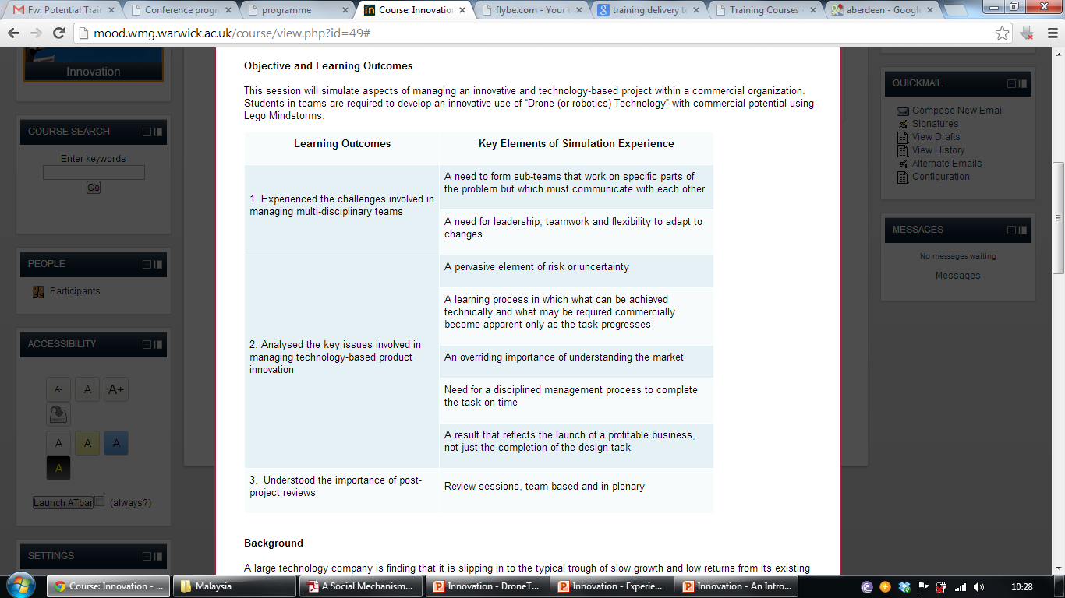

Slide 8
The Briefing
A large technology company is finding that it is slipping in to the typical trough of slow growth and low returns from its existing range of products.
The organization’s Board of Directors (BoD) believes in “drone technology” to serve new market and consumer needs.
Clear expectations from their management: develop an innovative product which has a strong commercial case, requires moderate levels of set-up investment, and can be brought to market quickly
Experts Panel

Slide 9
Outputs for Teams
their ‘drone’ technology works,
they have a strong commercial case, with a 3 year sales forecast accompanied by assumptions, and
the product can be produced within strict time-scales to be first-to-market, on budget, and can scaled-up and adopted/adapted in a commercial setting

Slide 10
Rules
Investment in the project is capped at £500
2) Deadlines must be met as per schedule, no extra time will be given under any circumstances
3) Team Presentations must last 10 minutes

Slide 11
Team Role Distribution
1) Marketing: consumer research, presentation development, guidance to R&D on design features and performance parameters
2) Finance: budget development and management, disbursement and research
3) R&D hardware: physical design, assembly, testing and running the drone
4) R&D software: software interfacing, assembly, testing and running the drone
5) Manufacturing: supplier management, parts procurement
6) General management: coordination, oversight, quality control, leadership

Slide 12
Financial Management
1) Technical advice - @ £5 per-minute rates of experts to be booked 2) Business consultancy - @ £5 per-minute rates of experts to be booked 3) Parts and materials - @ £1 per-component (Lego piece) 4) Manufacturing - @ £1 per-minute of factory time (at actuals) 5) Testing - @ £5 per-minute of track (Lego mat) time; to be booked in advance

Slide 13
Presentation Requirements
1) Describe typical customer
2) Highlight market research findings
3) Suggest all necessary investment requirements
4) Suggest pricing and present a 3-year sales forecast
5) Prepare for BoD scrutiny

Slide 14
Schedule for the Day
0900 - 0930 – Briefing
0930 - 1230 – Team Build-Off
1230 – 1300 – Initial BoD Pitch
1300 – 1400 – Track Testing
1400 – 1500 – Presentation Preparation
1500 – 1600 – Team Presentations
1600 – 1700 – Post Exercise Reflections

Slide 15
Pictures
UK - MSc
Malaysia – Defence
Singapore – Mixed Cohort

