Slide 1
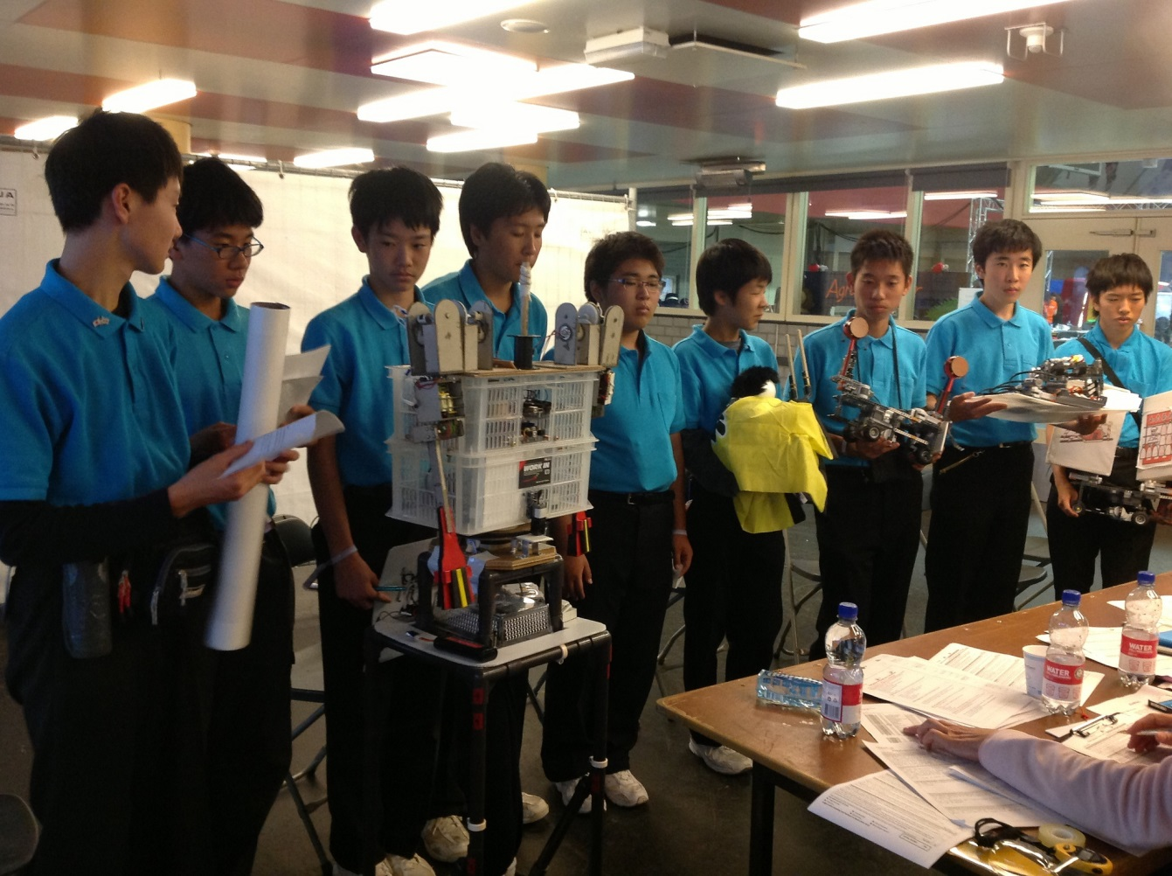

RoboCup and Lego
Nicky Hughes

Slide 3
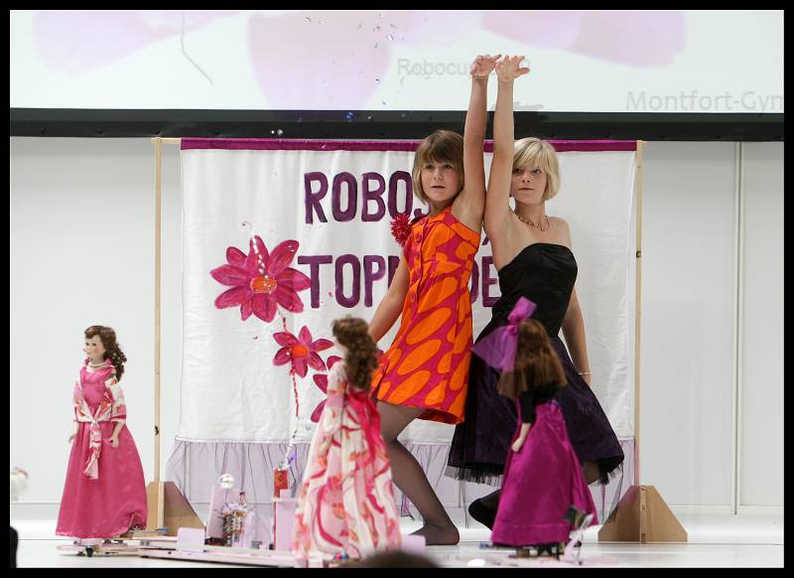
Dr Nicky Hughes
Lego League and RoboCup mentor
Technical committee for RoboCup Dance
Computer Science and ICT Teacher, Bury St Edmunds County Upper School, Suffolk
Edexcel: GCSE CS spec and SOW

Slide 4
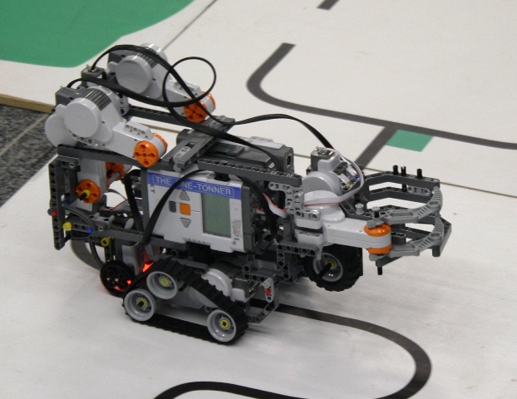
RoboCup and Lego
What is RobCup?
What is RoboCupJunior?
Using Lego in RoboCupJunior
Reflections

Slide 5
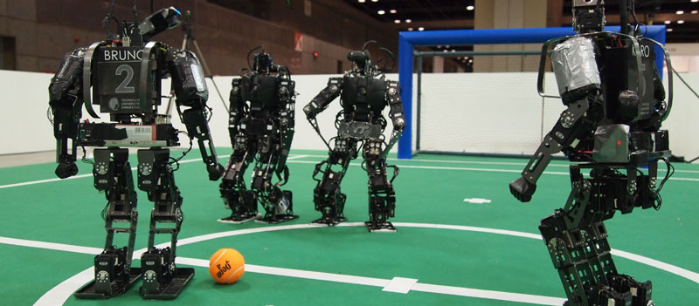
What is RoboCup?
RoboCup is a scientific project created to promote research in intelligent robotics and artificial intelligence
"By 2050 a team of fully autonomous humanoid robot soccer players shall win the soccer game, complying with the official rule of the FIFA, against the winner of the most recent World Cup”

Slide 6
Why football?
“Football has many aspects that next generation technologies need to embrace including team work, real-time perception and decision making, physical agents, and high-level of motion control”
Football is also the most popular sports in the world….
RoboCup is much more than football

Slide 7

RoboCup is a world wide project
Multiple tournaments are held around the world in the different leagues
International finals are held annually
30+ countries take part
  2013 Eindhoven, Netherlands
  2014 Brazil
  2015 Thailand

Slide 8
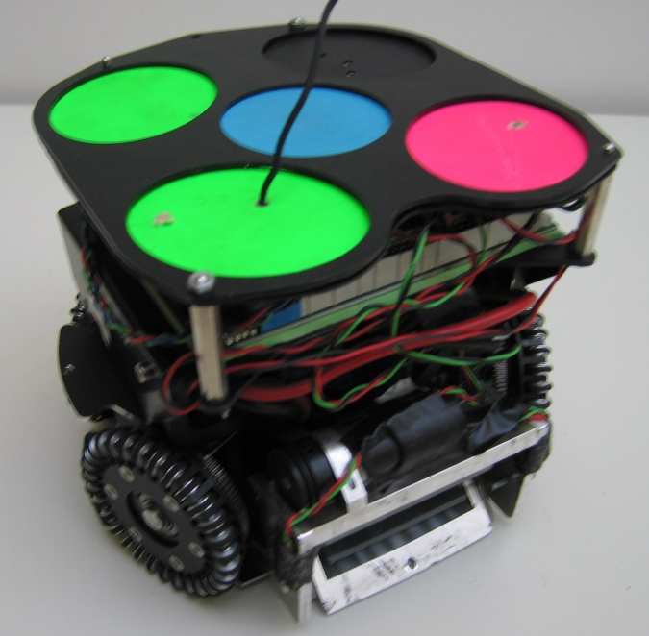
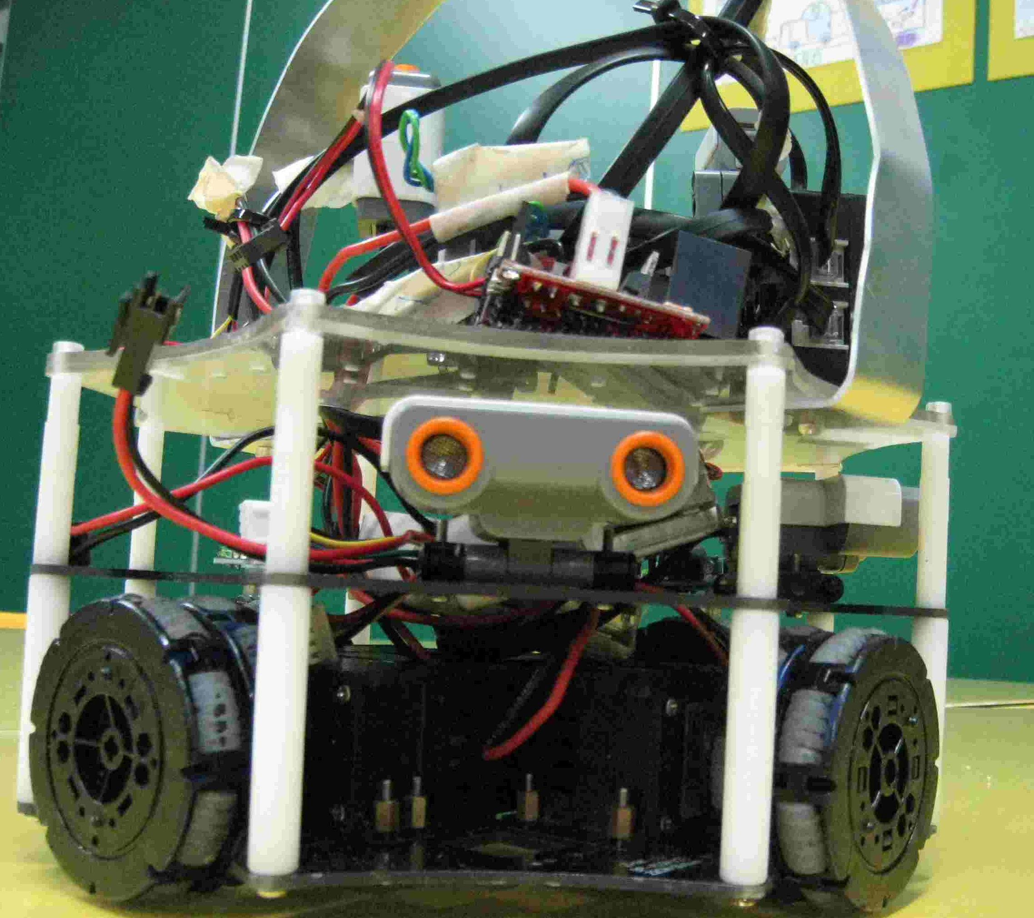
RoboCup Leagues
Senior leagues (University)
  RoboCup Soccer
  RoboCup Rescue
  RoboCup@Home
RoboCupJunior(schools)
  Soccer
  Dance
  Rescue
  Co-space (simulation)

Slide 9
RoboCup Senior Leagues
Senior Leagues – video from Eindhoven 2013
https://www.youtube.com/watch?v=zcDsYD6GJos&feature=player_embedded#t=84
2:58

Slide 10
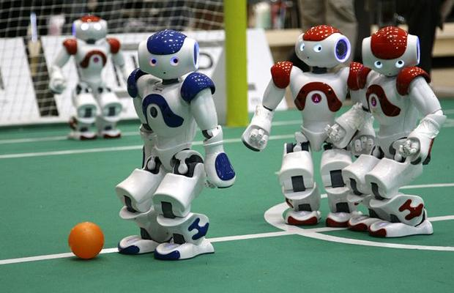
RoboCup soccer

Slide 11
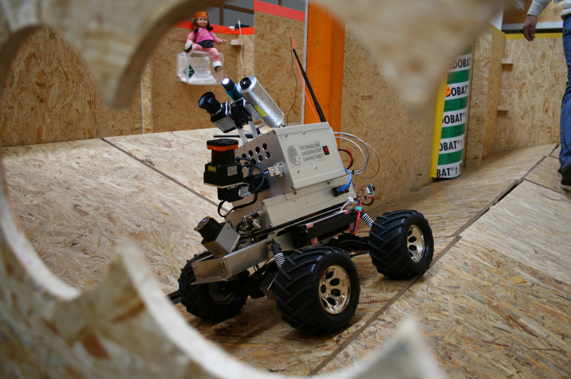
RoboCup Rescue

Slide 12
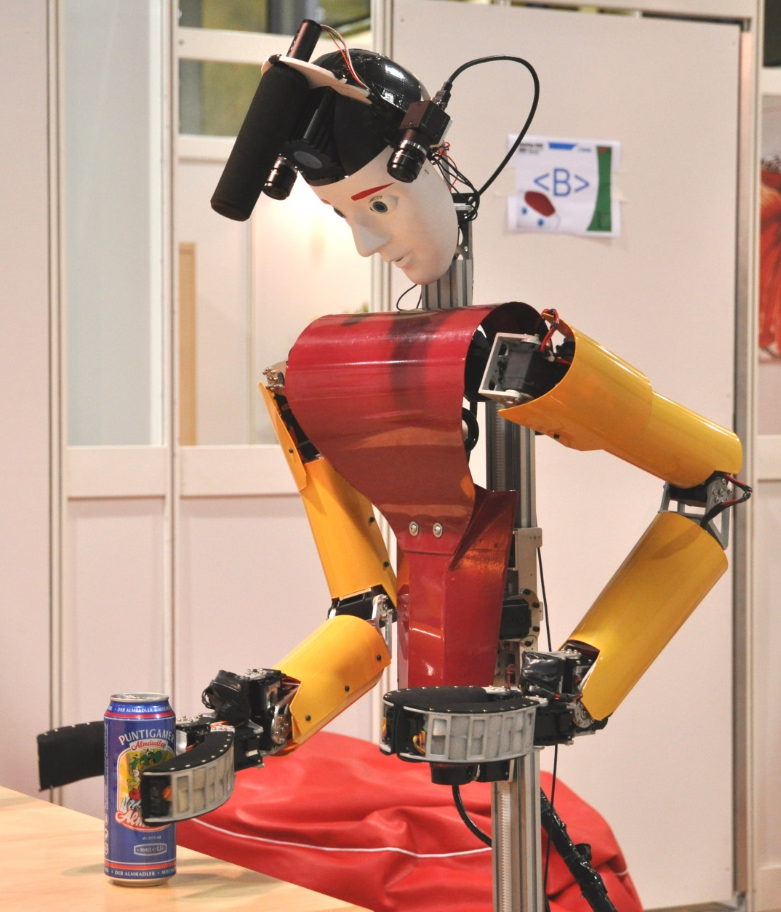
Robocup@Home

Slide 13

RoboCupJunior
Introduces RoboCup and robot technology to school aged children
4 leagues
Soccer
Dance
Rescue
Co-space (simulation)

Slide 14
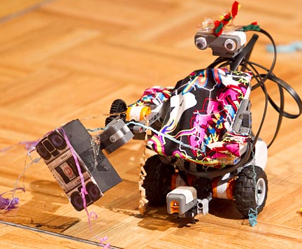
RoboCup and Lego
RoboCupJunior is about designing and building their own robots – teams can select any type of robotic technology to use
Lego kits are used in all the RoboCupJunior leagues by teams from different countries.

Slide 15
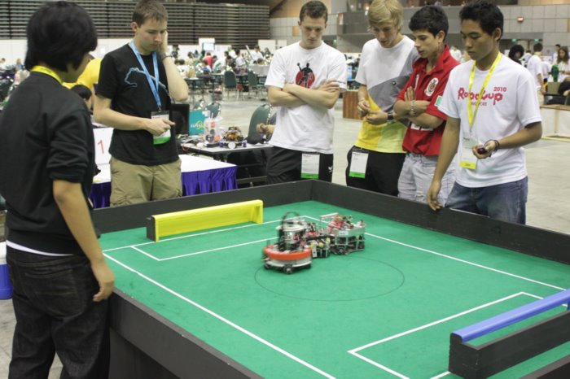
RoboCupJunior Soccer

Slide 16
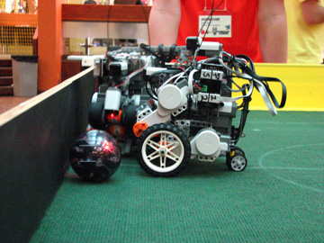
RoboCupJunior Soccer
Teams design and program two robots to compete against an opposing team by kicking an infra-red transmitting ball into a goal (blue or yellow)
Robots are autonomous
Can use Bluetooth or Zigbee communication
Teams can select sensors
20 minute game (2 x 10 mins)

Slide 17
RoboCupJunior soccer
http://www.youtube.com/watch?v=AAj4vUP3GdM

Slide 18
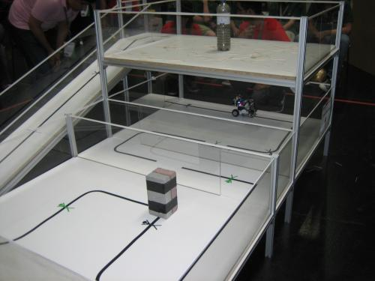
RoboCup Junior Rescue

Slide 19
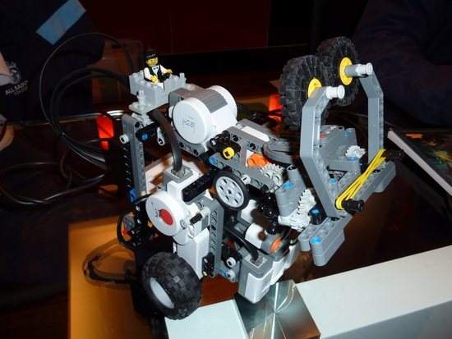
RoboCup Junior Rescue
The mission is a real-word disaster where robotic assistance is needed:
The robot is autonomous and cope with rough terrain (speed bumps) and cross snowstorms (gap in the line)
The robot also has to have the ability to climb mountains (the ramp)
When the robot finds the victim (a can) they have to transport it to a safe area(evacuation point)

Slide 20
RoboCupJunior rescue
https://www.youtube.com/watch?v=n-M-cknpUIs

Slide 21
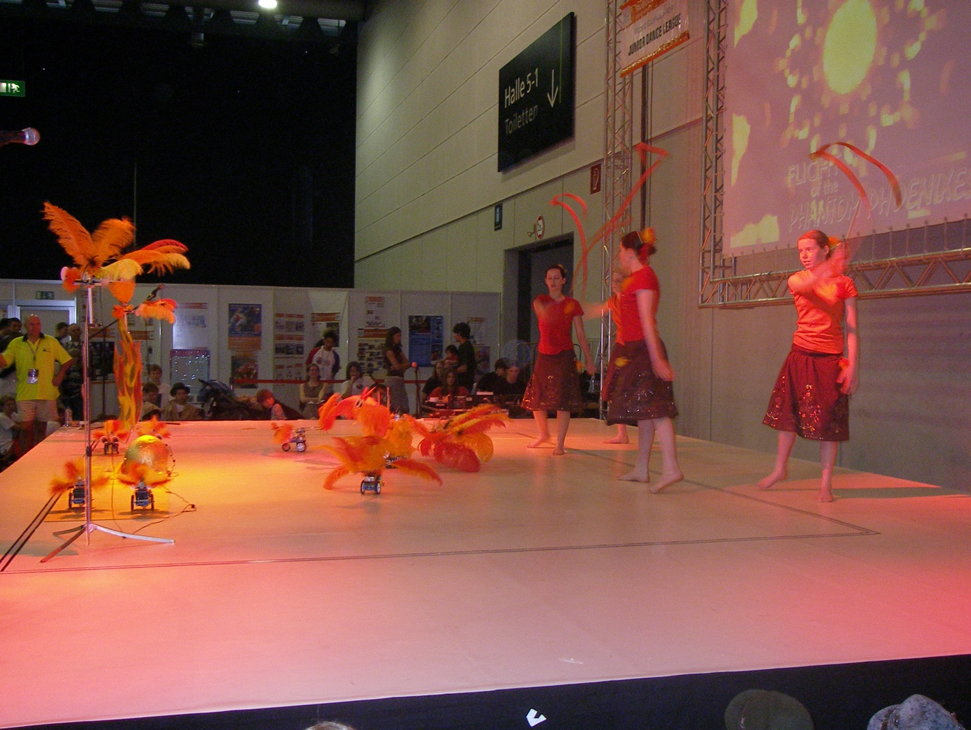
RoboCupJunior Dance

Slide 22
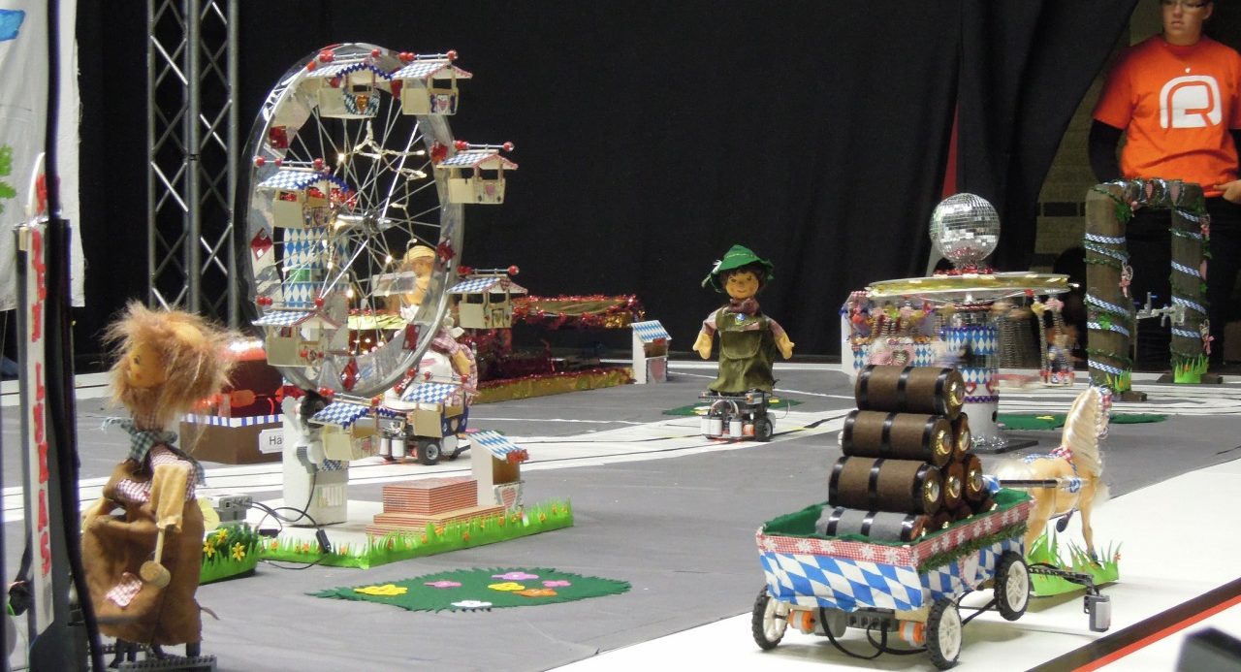
RoboCupJunior Dance
Teams create a 1 to 2 minute creative performance using autonomous robots.
Choose between a dance or a performance that tells a story.
Teams are encouraged to be creative, innovative and to take risks in their use of technology.
Communication via Bluetooth and Zigbee is allowed between robots

Slide 23

RoboCupJunior dance
https://www.youtube.com/watch?v=ks3Y6SwdraM
Flying phoenix
http://www.youtube.com/watch?v=HsP5rYH1HIM
St Trinians

Slide 24
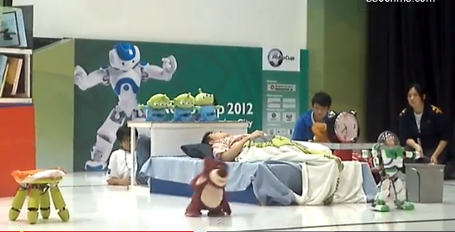
http://www.youtube.com/watch?v=cCqSe7Wbx2w
Toy story

Slide 25
How to get involved in the UK
RoboCup is free to enter and open to all
Rules are available online. The rules are updated annually…. http://rcj.robocup.org/index.html
UK competition is held in March
Primary and secondary events
Top teams represent UK at international competition

Slide 26


Slide 27
Lego and RoboCupJunior
Entry level robotic kits – many teams start with Lego robotic kits
Stable, reliable platform to learn the basics and allows teams to compete up to a high level
Flexible - allowing you to use Lego with other parts
Universally understood construction method

Slide 28
RoboCupJunior 2013 Eindhoven
http://www.youtube.com/watch?v=mR8Zyt33NRY

Slide 29
RoboCup Senior league Bloopers
http://www.youtube.com/watch?v=j9arXtrhZBo

