Slide 1
CS142: Visualisation
Autonomous Agents
Dr Claire Rocks
c.l.rocks@warwick.ac.uk
Notes:
1

Slide 2
Particles with inheritance
class Particle {
PVector position;
PVector velocity;
PVector acceleration;
Particle(PVector l) {
acceleration = new PVector(0,0.05);
velocity = new PVector(random(-1,1),random(-2,0));
position = l.copy();
}
void run() {
update();
display();
}
void update() {
velocity.add(acceleration);
position.add(velocity);
}
void display() {
fill(0);
ellipse(position.x,position.y,8,8);
}
}
Notes:
Covered in CS118

Slide 3
class ParticleSystem {
ArrayList<Particle> particles;
PVector origin;
ParticleSystem(Pvector location) {
origin = location.copy();
particles = new ArrayList();
}
void addParticle() {
float r = random(1);
if (r<0.5){
particles.add(new Particle(origin));
} else {
particles.add(new Confetti(origin));
}
}
void run() {
Iterator<Particle> it = particles.iterator();
while (it.hasNext()) {
Particle p = it.next();
p.run();
if (p.isDead()) {
it.remove();
}
}
}
}
Notes:
We could also add some new features to the particle system itself. For example, it might be useful for the ParticleSystem class to keep track of an origin point where particles are made. This fits in with the idea of a particle system being an “emitter,” a place where particles are born and sent out into the world. The origin point should be initialized in the constructor.
Make the origin point move dynamically. Have the particles emit from the mouse location or use the concepts of velocity and acceleration to make the system move autonomously.

Slide 4
The single particle system
ParticleSystem ps;
void setup() {
size(640,360);
ps = new ParticleSystem(new PVector(width/2,50));
}
void draw() {
background(255);
ps.run();
ps.addParticle();
}
Notes:
stored a single reference to a ParticleSystem object in the variable ps.

Slide 5
Adding Forces
Step 1 – add the applyForce() function
void applyForce(PVector force){ PVector f = force.copy();
f.div(mass);
acceleration.add(f); } void update(){ velocity.add(acceleration); position.add(velocity); acceleration.mult(0);
lifespan -= 2.0; }
Notes:
Our Particle class is structured to have a constant acceleration, one that never changes. A much better framework would be to follow Newton’s second law (F = M* A) and incorporate the force accumulation algorithm we saw yesterday

Slide 6
Apply a force globally
apply the force to the particle system and let it manage applying the force to all the individual particles
PVector gravity = new PVector(0,0.1);
void draw() {
background(100);
ps.applyForce(gravity);
ps.addParticle();
ps.run();
}
Notes:
Apply a force globally every time through draw() to all particles

Slide 7
applyForce() in the ParticleSystem class
void applyForce(PVector f) {
for (Particle p: particles) {
p.applyForce(f);
}
}
Notes:
Apply a force globally every time through draw() to all particles

Slide 8
Particle systems with Repellers
We’re going to need two major additions to our code:
A Repeller object (declared, initialized, and displayed).
A function that passes the Repeller object into the ParticleSystem so that it can apply a force to each particle object.

Slide 9
ParticleSystem ps;
Repeller repeller;
void setup() {
size(640,360);
ps = new ParticleSystem(new PVector(width/2,50));
repeller = new Repeller(width/2-20,height/2);
}
void draw() {
background(100);
ps.addParticle();
PVector gravity = new PVector(0,0.1);
ps.applyForce(gravity);
ps.applyRepeller(repeller);
ps.run();
repeller.display();
}
Notes:
Instead of passing a PVector into a function like we do with applyForce(), we’re going to instead pass a Repeller object into applyRepeller() and ask that function to do the work of calculating the force between the repeller and all particles.

Slide 10
In the particle system class…
void applyRepeller(Repeller r) {
//Calculating a force for each Particle based on a
Repeller
for (Particle p: particles) {
PVector force = r.repel(p);
p.applyForce(force);
}
}
Notes:
We must calculate a custom PVector force for each and every particle and apply that force.
How is that force calculated?

Slide 11
class Repeller {
//How strong is the repeller?
float strength = 100;
PVector location;
float r = 10;
Repeller(float x, float y) {
location = new PVector(x,y);
}
void display() {
stroke(255);
fill(255);
ellipse(location.x,location.y,r*2,r*2);
}
PVector repel(Particle p) {
PVector dir = PVector.sub(location,p.location);
float d = dir.mag();
dir.normalize();
d = constrain(d,5,100);
float force = -1 * strength / (d * d);
dir.mult(force);
return dir;
}
}
Notes:
In a function called repel(), which is the inverse of the attract() function we wrote for the Attractor class.

Slide 12
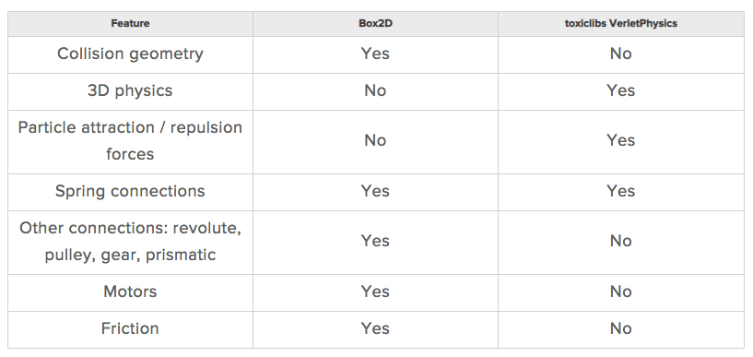
Physics Libraries
https://natureofcode.com/book/chapter-5-physics-libraries/
http://toxiclibs.org/
http://www.jbox2d.org/
Notes:
We should note that toxiclibs was designed specifically for use with Processing. This is great news. The trouble we had with making Box2D work in Processing (multiple coordinate systems, Box2D vs. JBox2D vs. PBox2D) is not an issue here. toxiclibs is a library that you just download, stick in your libraries folder, and use. And the coordinate system that we’ll use for the physics engine is the coordinate system of Processing, so no translating back and forth. In addition, toxiclibs is not limited to a 2D world; all of the physics simulations and functions work in both two and three dimensions. So how do you decide which library you should use? Box2D or toxiclibs? If you fall into one of the following two categories, your decision is a bit easier:
1. My project involves collisions. I have circles, squares, and other strangely shaped objects that knock each other around and bounce off each other.
In this case, you are going to need Box2D. toxiclibs does not handle collisions.
2. My project involves lots of particles flying around the screen. Sometimes they attract each other. Sometimes they repel each other. And sometimes they are connected with springs.
In this case, toxiclibs is likely your best choice. It is simpler to use than Box2D and particularly well suited to connected systems of particles. toxiclibs is also very high performance, due to the speed of the Verlet integration algorithm (not to mention the fact that the program gets to ignore all of the collision geometry).

Slide 13
Today
Steering force
Flow fields
Complex systems
Flocking

Slide 14
Useful reading
Nature of Code Chapter 6
https://natureofcode.com/book/chapter-6-autonomous-agents/

Slide 15
Autonomous agents
Makes its own choices about how to act (move) in the environment
An autonomous agent has a limited ability to perceive environment.
An autonomous agent processes the information from its environment and calculates an action.
An autonomous agent has no leader.
Notes:
Are we designing an all-knowing rectangle that flies around a Processing window, aware of everything else in that window? Or are we creating a shape that can only examine any other object within fifteen pixels of itself? Of course, there is no right answer to this question; it all depends. We’ll explore some possibilities as we move forward. For a simulation to feel more “natural,” however, limitations are a good thing. An insect, for example, may only be aware of the sights and smells that immediately surround it. For a real-world creature, we could study the exact science of these limitations. Luckily for us, we can just make stuff up and try it out.
This will be the easy part for us, as the action is a force. The environment might tell the agent that there’s a big scary-looking shark swimming right at it, and the action will be a powerful force in the opposite direction.
many of these examples will have no leader for an important reason. As we get to the end of this chapter and examine group behaviors, we will look at designing collections of autonomous agents that exhibit the properties of complex systems— intelligent and structured group dynamics that emerge not from a leader, but from the local interactions of the elements themselves.

Slide 16
Braitenburg Vehicles
Notes:
Braitenburg vehicles are one of the simplest examples of biologically inspired robotics. They use simple connections between sensors and motors to produce seemingly complex behaviour.
The sensor-motor connections can be set up in two ways as illustrated. In both cases increased light on the sensor results in the motor turning faster.
In the first state (fear) the sensor on the left is connected to the motor on the left and the sensor on the right is connected to the motor on the right. A vehicle set up like this will speed up when exposed to more light and tend to turn away from a light source.
In the second state (aggression) the sensor-motor connections are crossed. Now if the light source is to one side, the vehicle will turn towards it with increasing speed. This is the most interesting state for interaction as the robot will follow a moving light source.

Slide 17
Reynolds motion of idealized vehicles
Action selection
Steering
steering force = desired velocity - current velocity
Locomotion
Notes:
Reynolds describes the motion of idealized vehicles (idealized because we are not concerned with the actual engineering of such vehicles, but simply assume that they exist and will respond to our rules) as a series of three layers—Action Selection, Steering, and Locomotion.
Action Selection. A vehicle has a goal (or goals) and can select an action (or a combination of actions) based on that goal. This is essentially where we left off with autonomous agents. The vehicle takes a look at its environment and calculates an action based on a desire. Reynolds’s paper describes many goals and associated actions such as: seek a target, avoid an obstacle, and follow a path.
Steering. Once an action has been selected, the vehicle has to calculate its next move. For us, the next move will be a force; more specifically, a steering force. Luckily, Reynolds has developed a simple steering force formula that we’ll use throughout the examples in this chapter: steering force = desired velocity - current velocity.
Locomotion. For the most part, we’re going to ignore this third layer. In the case of fleeing zombies, the locomotion could be described as “left foot, right foot, left foot, right foot, as fast as you can.” In our Processing world, however, a rectangle or circle or triangle’s actual movement across a window is irrelevant given that it’s all an illusion in the first place. Nevertheless, this isn’t to say that you should ignore locomotion entirely. You will find great value in thinking about the locomotive design of your vehicle and how you choose to animate it.
these are a set of building blocks, a foundation from which you can design and develop vehicles with creative goals and new and exciting behaviors. view these examples as pieces of a larger puzzle that you will eventually assemble.

Slide 18
Steering Force
steering force = desired velocity - current velocity
PVector steer = PVector.sub(desired,velocity);
Notes:
A vehicle moving with velocity desires to seek a target.
you might begin by making the target an attractor and apply a gravitational force that pulls the vehicle to the target. This would be a perfectly reasonable solution,
We don’t want to simply calculate a force that pushes the vehicle towards its target; rather, we are asking the vehicle to make an intelligent decision to steer towards the target based on its perception of its state and environment (i.e. how fast and in what direction is it currently moving). The vehicle should look at how it desires to move (a vector pointing to the target), compare that goal with how quickly it///// // currently moving (its velocity), and apply a force accordingly.
velocity is no problem. After all, we’ve got a variable for that.

Slide 19
Steering Force
PVector desired = PVector.sub(target, location);
desired.normalize();
desired.mult(maxspeed);
Notes:
f we’ve defined the vehicle’s goal as “seeking the target,” then its desired velocity is a vector that points from its current location to the target location.
But this isn’t particularly realistic. What if we have a very high-resolution window and the target is thousands of pixels away? Sure, the vehicle might desire to teleport itself instantly to the target location with a massive velocity, but this won’t make for an effective animation. What we really want to say is:
The vehicle desires to move towards the target at maximum speed.
In other words, the vector should point from location to target and with a magnitude equal to maximum speed (i.e. the fastest the vehicle can go).

Slide 20
Steering Force
PVector desired = PVector.sub(target, location);
desired.normalize();
desired.mult(maxspeed);
Notes:
f we’ve defined the vehicle’s goal as “seeking the target,” then its desired velocity is a vector that points from its current location to the target location.
But this isn’t particularly realistic. What if we have a very high-resolution window and the target is thousands of pixels away? Sure, the vehicle might desire to teleport itself instantly to the target location with a massive velocity, but this won’t make for an effective animation. What we really want to say is:
The vehicle desires to move towards the target at maximum speed.
In other words, the vector should point from location to target and with a magnitude equal to maximum speed (i.e. the fastest the vehicle can go).

Slide 21
Steering Force
Notes:
this is not at all the same force as gravitational attraction. Remember one of our principles of autonomous agents: An autonomous agent has a limited ability to perceive its environment. Here is that ability, subtly embedded into Reynolds’s steering formula. If the vehicle weren’t moving at all (zero velocity), desired minus velocity would be equal to desired. But this is not the case. The vehicle is aware of its own velocity and its steering force compensates accordingly. This creates a more active simulation, as the way in which the vehicle moves towards the targets depends on the way it is moving in the first place.

Slide 22
Steering ability can be controlled by limiting the magnitude of the steering force
Notes:
Limiting the steering force brings up an important point. We must always remember that it’s not actually our goal to get the vehicle to the target as fast as possible. If that were the case, we would just say “location equals target” and there the vehicle would be. Our goal, as Reynolds puts it, is to move the vehicle in a “lifelike and improvisational manner.” We’re trying to make it appear as if the vehicle is steering its way to the target, and so it’s up to us to play with the forces and variables of the system to simulate a given behavior. For example, a large maximum steering force would result in a very different path than a small one. One is not inherently better or worse than the other; it depends on your desired effect.

Slide 23
Flow Fields
Notes:
Let’s examine a couple more of Reynolds’s steering behaviors. First, flow field following. What is a flow field? Think of your Processing window as a grid. In each cell of the grid lives an arrow pointing in some direction—you know, a vector. As a vehicle moves around the screen, it asks, “Hey, what arrow is beneath me? That’s my desired velocity!”
Reynolds’s flow field following example has the vehicle predicting its future location and following the vector at that spot, but for simplicity’s sake, we’ll have the vehicle simply look to the vector at its current location.

Slide 24
class FlowField {
PVector[][] field;
int cols, rows;
int resolution;
FlowField() {
resolution = 10;
cols = width/resolution;
rows = height/resolution;
field = new PVector[cols][rows];
init();
}
void init() {
for (int i = 0; i < cols; i++) {
for (int j = 0; j < rows; j++) {
field[i][j] = PVector.random2D(); }
}
}
}
// A function to return a PVector based on a location
PVector lookup(PVector lookup) {
int column = int(constrain(lookup.x/resolution,0,cols-1));
int row = int(constrain(lookup.y/resolution,0,rows-1));
return field[column][row];
}
}
Notes:
we’ll need to build a class that describes the flow field itself, the grid of vectors. The 2D array is convenient because we reference each element with two indices, which we can think of as columns and rows.
defining a third variable called resolution above. What is this variable? Let’s say we have a Processing window that is 200 pixels wide by 200 pixels high. We could make a flow field that has a PVector object for every single pixel, or 40,000 PVectors (200 * 200). This isn’t terribly unreasonable, but in our case, it’s overkill. We don’t need a PVectorfor every single pixel; we can achieve the same effect by having, say, one every ten pixels (20 * 20 = 400). We use this resolution to define the number of columns and rows based on the size of the window divided by resolution
compute the vectors in the flow field itself. Perhaps we want the vectors to point in random directions. Or use 2D Perlin noise (mapped to an angle), or perhaps we want very location in the flow field to points towards the center of a window
Flow fields can be used for simulating various effects, such as an irregular gust of wind or the meandering path of a river. Calculating the direction of your vectors using Perlin noise is one way to achieve such an effect.
Now that we have a two-dimensional array storing all of the flow field vectors, we need a way for a vehicle to look up its desired vector in the flow field. Let’s say we have a vehicle that lives at a PVector: its location. We first need to divide by the resolution of the grid. For example, if the resolution is 10 and the vehicle is at (100,50), we need to look up column 10 and row 5
Because a vehicle could theoretically wander off the Processing window, it’s also useful for us to employ the constrain() function to make sure we don’t look outside of the flow field array. Here is a function we’ll call lookup() that goes in the FlowField class—it receives a PVector (presumably the location of our vehicle) and returns the corresponding flow field PVector for that location.

Slide 25
Complex Systems
A complex system is typically defined as a system that is “more than the sum of its parts.”
Simple units with short-range relationships.
Simple units operate in parallel.
System as a whole exhibits emergent phenomena.
Non-linear relationship between a change in initial conditions and a change in outcome
Presence of both competition and cooperation between the elements
Complex systems often include a feedback loop where the the output of the system is fed back into the system to influence its behaviour
Notes:
Let’s think about a tiny, crawling ant—one single ant. An ant is an autonomous agent; it can perceive its environment (using antennae to gather information about the direction and strength of chemical signals) and make decisions about how to move based on those signals. But can a single ant acting alone build a nest, gather food, defend its queen? An ant is a simple unit and can only perceive its immediate environment. A colony of ants, however, is a sophisticated complex system, a “superorganism” in which the components work together to accomplish difficult and complicated goals.
We want to take what we’ve learned during the process of building autonomous agents in Processing into simulations that involve many agents operating in parallel—agents that have an ability to perceive not only their physical environment but also the actions of their fellow agents, and then act accordingly. We want to create complex systems in Processing.
What is a complex system? A complex system is typically defined as a system that is “more than the sum of its parts.” While the individual elements of the system may be incredibly simple and easily understood, the behavior of the system as a whole can be highly complex, intelligent, and difficult to predict.
Simple units with short-range relationships. This is what we’ve been building all along: vehicles that have a limited perception of their environment.
Simple units operate in parallel. This is what we need to simulate in code. For every cycle through Processing’s draw() loop, each unit will decide how to move (to create the appearance of them all working in parallel).
System as a whole exhibits emergent phenomena. Out of the interactions between these simple units emerges complex behavior, patterns, and intelligence. Here we’re talking about the result we are hoping for in our sketches. Yes, we know this happens in nature (ant colonies, termites, migration patterns, earthquakes, snowflakes, etc.), but can we achieve the same result in our Processing sketches?
Non-linearity. This aspect of complex systems is often casually referred to as “the butterfly effect,” coined by mathematician and meteorologist Edward Norton Lorenz, a pioneer in the study of chaos theory. In 1961, Lorenz was running a computer weather simulation for the second time and, perhaps to save a little time, typed in a starting value of 0.506 instead of 0.506127. The end result was completely different from the first result of the simulation. In other words, the theory is that a single butterfly flapping its wings on the other side of the world could cause a massive weather shift and ruin our weekend at the beach. We call it “non-linear” because there isn’t a linear relationship between a change in initial conditions and a change in outcome. A small change in initial conditions can have a massive effect on the outcome. Non-linear systems are a superset of chaotic systems. In the next chapter, we’ll see how even in a system of many zeros and ones, if we change just one bit, the result will be completely different.
Competition and cooperation. One of the things that often makes a complex system tick is the presence of both competition and cooperation between the elements. In our upcoming flocking system, we will have three rules—alignment, cohesion, and separation. Alignment and cohesion will ask the elements to “cooperate”—i.e. work together to stay together and move together. Separation, however, will ask the elements to “compete” for space. As we get to the flocking system, try taking out the cooperation or the competition and you’ll see how you are left without complexity. Competition and cooperation are found in living complex systems, but not in non-living complex systems like the weather.
Feedback. Complex systems often include a feedback loop where the the output of the system is fed back into the system to influence its behavior in a positive or negative direction. Let’s say you drive to work each day because the price of gas is low. In fact, everyone drives to work. The price of gas goes up as demand begins to exceed supply. You, and everyone else, decide to take the train to work because driving is too expensive. And the price of gas declines as the demand declines. The price of gas is both the input of the system (determining whether you choose to drive or ride the train) and the output (the demand that results from your choice). I should note that economic models (like supply/demand, the stock market) are one example of a human complex system. Others include fads and trends, elections, crowds, and traffic flow.

Slide 26
Flocking
We will use the steering force formula (steer = desired - velocity) to implement the rules of flocking.
These steering forces will be group behaviours and require each particle to look at all the other particles.
We will combine and weight multiple forces.
The result will be a complex system—intelligent group behaviour will emerge from the simple rules of flocking without the presence of a centralized system or leader.
Notes:
Flocking is an group animal behavior that is characteristic of many living creatures, such as birds, fish, and insects. In 1986, Craig Reynolds created a computer simulation of flocking behavior and documented the algorithm in his paper, “Flocks, Herds, and Schools: A Distributed Behavioral Model.”

Slide 27
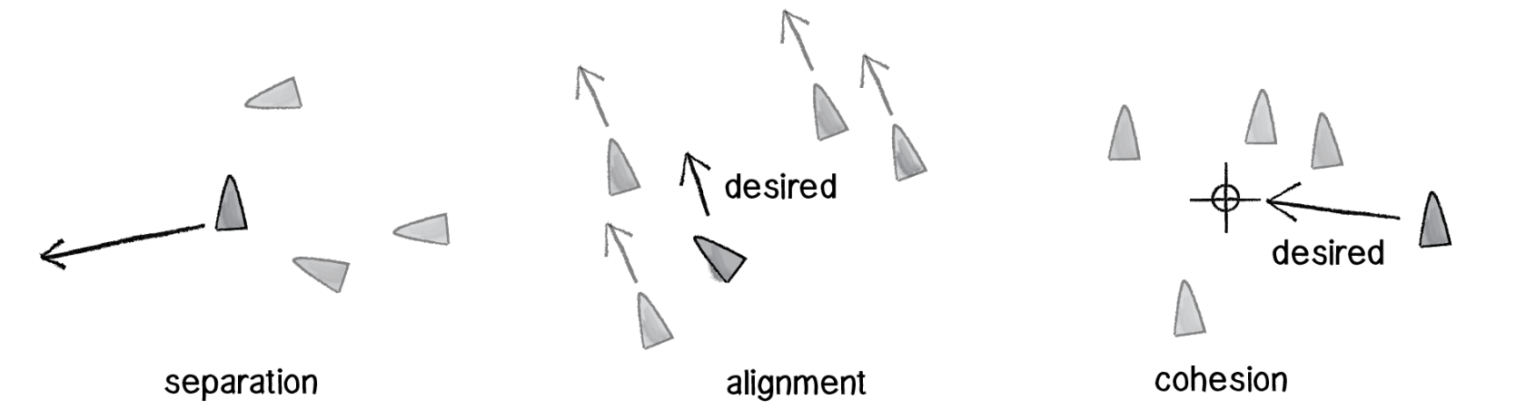
Three rules of flocking
Separation (also known as “avoidance”): Steer to avoid colliding with your neighbours.
Alignment (also known as “copy”): Steer in the same direction as your neighbours.
Cohesion (also known as “centre”): Steer towards the centre of your neighbours (stay with the group).

Slide 28
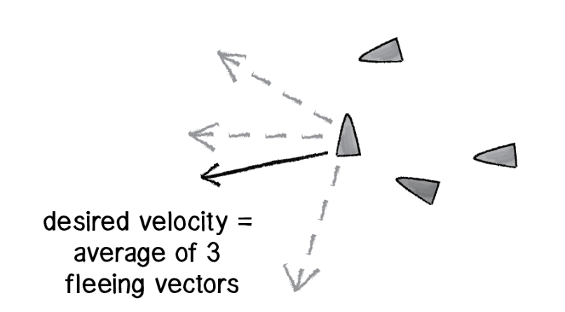
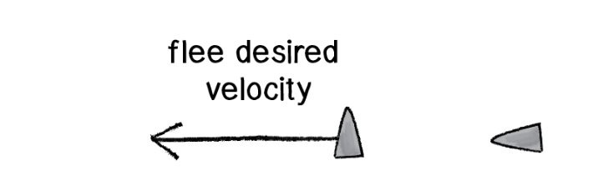
Separation
Notes:
In other words, if a given vehicle is too close to you, steer away from that vehicle. Sound familiar? Remember the seek behavior where a vehicle steers towards a target? Reverse that force and we have the flee behavior.
But what if more than one vehicle is too close? In this case, we’ll define separation as the average of all the vectors pointing away from any close vehicles.
we’re writing a function called separate() that receives an ArrayList of Particle objects as an argument.

Slide 29
void separate (ArrayList<Particle> particles) {
float desiredseparation = r*2;
PVector sum = new PVector();
int count = 0;
for (Particle other : particles) {
float d = PVector.dist(location, other.location);
if ((d > 0) && (d < desiredseparation)) {
PVector diff = PVector.sub(location, other.location);
diff.normalize();
sum.add(diff);
count++;
}
}
if (count > 0) {
sum.div(count);
sum.normalize();
sum.mult(maxspeed);
PVector steer = PVector.sub(sum, vel);
applyForce(steer);
}
}
Notes:
we’re writing a function called separate() that receives an ArrayList of Particle objects as an argument.
Inside this function, we’re going to loop through all of the particles and see if any are too close.
we are not only checking if the distance is less than a desired separation (i.e. too close!), but also if the distance is greater than zero. This is a little trick that makes sure we don’t ask a particle to separate from itself.
Once we know that two particles are too close, we need to make a vector (diff) that points away from the offending vehicle.
We have that vector now, but we need to make sure we calculate the average of all vectors pointing away from close particles. How do we compute average? We add up all the vectors and divide by the total.
Once we have the average vector (stored in the PVector object “sum”), that PVector can be scaled to maximum speed and become our desired velocity—we desire to move in that direction at maximum speed! And once we have the desired velocity, it’s the same old Reynolds story: steering equals desired minus velocity

Slide 30
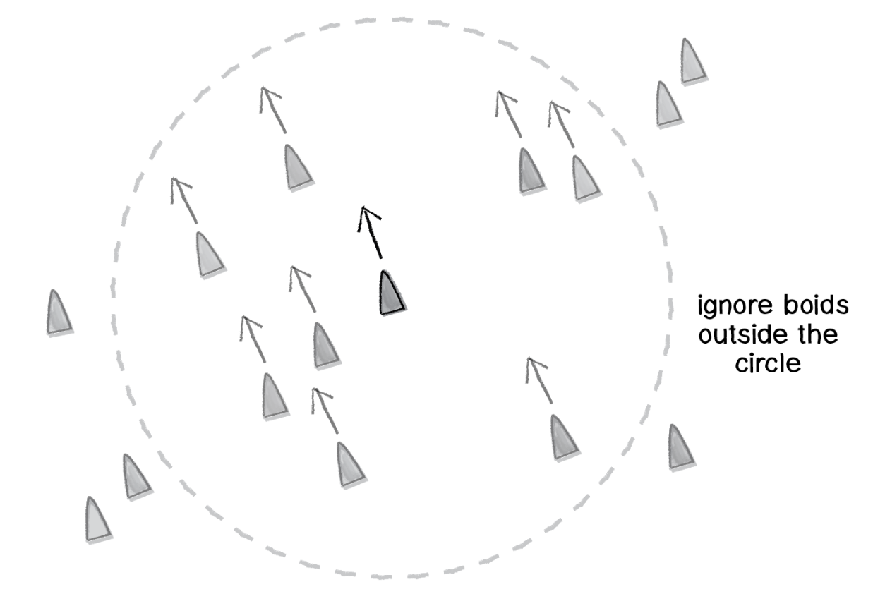
Alignment and cohesion
Alignment - the particle’s desired velocity is the average velocity of its neighbours
Cohesion - instead of calculating the average velocity of the particle’s neighbours, we want to calculate the average location of the particle’s neighbours (and use that as a target to seek).
Notes:
steering in the same direction as your neighbors. As with all of our steering behaviors, we’ve got to boil down this concept into a desire: the boid’s desired velocity is the average velocity of its neighbors.
o our algorithm is to calculate the average velocity of all the other boids and set that to desired
One of the key principles behind complex systems like flocking is that the elements (in this case, boids) have short-range relationships so we should really only be looking at the partciles within a certain distance. That distance threshold is up to you, of course.

Slide 31
Next week
Preparing for Coursework 2

