Slide 1
CS142: Visualisation
Creating Visual Reprentations
Dr Claire Rocks
c.l.rocks@warwick.ac.uk
Notes:
1

Slide 2
New feedback
No new feedback

Slide 3
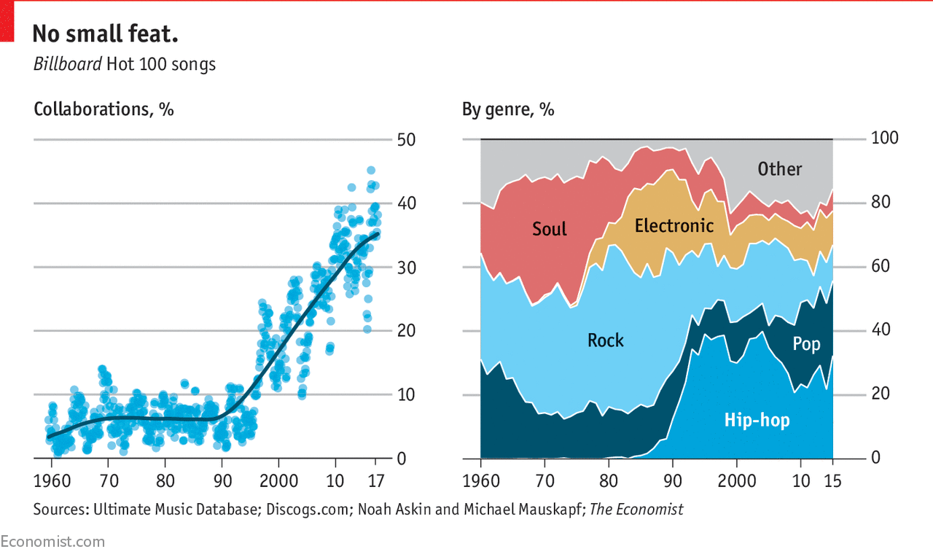
Homework from last time

Slide 4
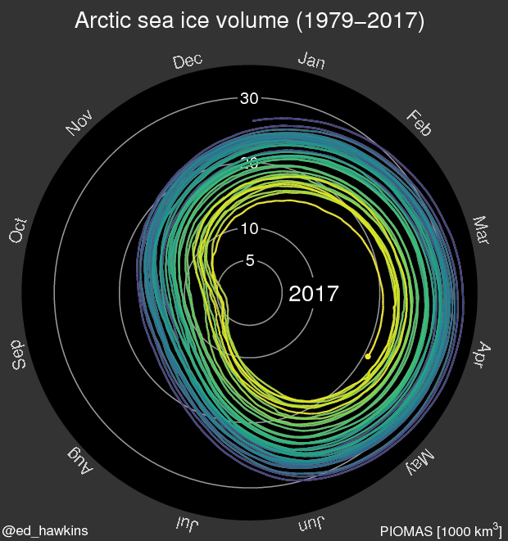

Slide 7
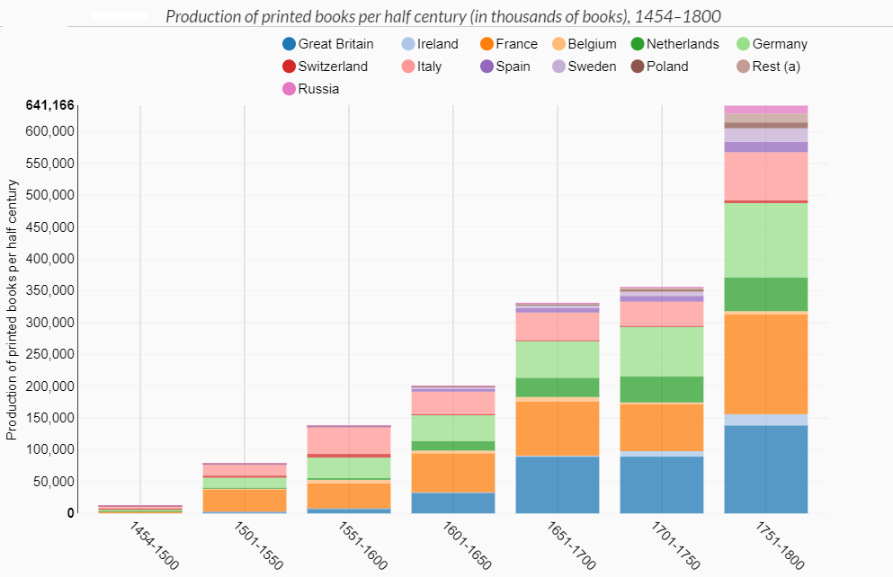

Slide 10
Today
The visualisation wheel
What is the process of generating a visual representation?

Slide 11
Some useful reading
R Mazza (2009), Introduction to Information visualization, Chapter 2. PDF on module webpage
C Ware, Information Visualization: Perception for Design, Chapter 1. PDF on module webpage
B Fry (2008), Visualizing Data, Chapter 1. PDF on module webpage
Cairo, A (2013), The Visual Art, Chapter 3 & 8

Slide 12
The Visualization Wheel, Cairo (2013)

Slide 15
Question + Visual Data + Context = Story
The question contains the premise and the introduction to the story and leads up to a point at which the data can take over the storyline
Present information
Allow users to explore the information
Notes:
The question contains the premise and the introduction to the story and leads up to a point at which the data can take over the storyline

Slide 16
Suppose we have a collection of data on which we’d like to carry out an explorative analysis. What are the stages in creating a visual representation?

Slide 17
Cairo’s creative methodology
Define the focus – the story you want to tell and the key points you want to make. How will the visualization be useful to the viewer?
Gather as much information as you can about the topic
Choose the best graphic form(s)
Complete your research – flesh out your ideas
Think about the visual style – type faces, colour palettes etc
Move the design to the computer
A Cairo, The Visual Art

Slide 18
Designing a visual representation
Want to faithfully represent the data AND facilitate the user in the predetermined goal
  Define the problem
  Examine the nature of the data
  Number of dimensions
  Data structures
  Type of interaction
Notes:
When working with data, start with understanding the story you want to tell or relationship you are trying to highlight. This will aid in selecting the right visualization that will deliver your message.
Define the problem by spending a certain amount of time with potential users of the visual representation. Identify their effective needs and how they work. This is needed to clearly define what has to be represented. Why is a representation needed? Is it needed to communicate something? Is it needed for finding new information? Or is it needed to prove hypotheses? It is necessary to bear in mind the human factors specific to the target audience that the application will address and, in particular, their cognitive and perceptive abilities. This will influence the choice of which visual models to use, to allow users to understand the information.
2. Examine the nature of the data to represent. The data can be quantitative (e.g., a list of integers or real numbers), ordinal (data of a non numeric nature, but which have their own intrinsic order, such as the days of the week), or categorical (data that have no intrinsic order, such as the names of people or cities). A different mapping may be appropriate, according to the data type.
3. Number of dimensions. The number of dimensions of the data (also called attributes) that we need to represent very importantly determines the type of representation that we use. The attributes can be independent or dependent. The dependent attributes are those that vary and whose behavior we are interested in analyzing with respect to the independent attributes. According to the number of dependent attributes, we have a collection of data that is called univariate (one dimension varies with respect to another), bivariate (there are two dependent dimensions), trivariate (three dependent dimensions), or multivariate (four or more dimensions that vary compared to the independent ones).
4. Data structures. These can be linear (the data are codified in linear data structures like vectors, tables, collections, etc.), temporal (data that change in time), spatial or geographical (data that have a correspondence with something physical, such as a map, floorplan, etc.), hierarchical (data relative to entities organized on hierarchy, for example, genealogy, flowcharts, files on a disk, etc.), and network (data that describe relationships between entities). 5. Type of interaction. This determines if the visual representation is static (e.g., an image printed on paper or an image represented on a computer screen but not modifiable by the user), transformable (when the user can control the process of modification and transformation of data, such as varying some parameters of data entry, varying the extremes of the values of some attributes, or choosing a different mapping for view creation), or manipulable (the user can control and modify some parameters that regulate the generation of the views, like zooming on a detail or rotating an image represented in 3D). The model represented in Fig. 2.1 illustrates at which levels of the process these types of interactions come into play

Slide 19
The seven stages of visualizing data
Acquire – obtaining the data
Parse – changing format
Filter – removing irrelevant data
Mine – doing the maths, stats and data mining – this might be as simple as working out the minimum and maximum
Represent – what is the basic form that the dataset will take
Refine – further clarify the representation by calling more attention to particular data
Interact – let the user control/explore
B Fry, Visualizing Data

Slide 20
1. Acquire

Slide 21
Finding data sets
https://data.gov.uk/
http://data.un.org/
https://github.com/BuzzFeedNews
https://www.cia.gov/library/publications/the-world-factbook/geos/uk.html
https://registry.opendata.aws/
https://www.google.com/publicdata/directory#!
http://archive.ics.uci.edu/ml/index.php

Slide 22
Data Scraping
Taking data from a web page into a format you can work with
You will find many methods/tutorials online e.g. https://www.dataquest.io/blog/web-scraping-tutorial-python/

Slide 23
2. Parse
3. Filter
4. Mine

Slide 24
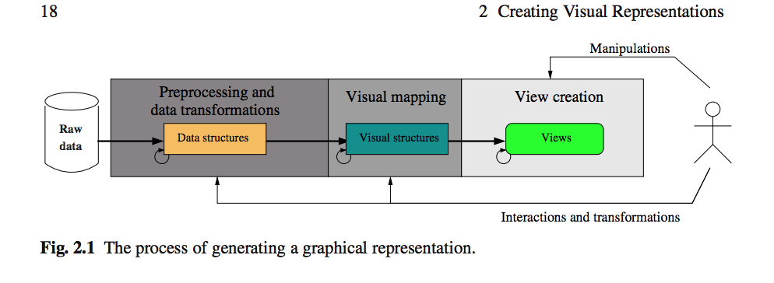
R Mazza, Introduction to Information visualization
Notes:
Data are rarely in a format that is suitable and so must be processed appropriately

Slide 25
Preprocessing and data transformations
Need to give raw data a structured format for use by the visualisation software
  need to understand and parse to get out of it what we want
  Add attributes (tags) – metadata
Filtering – eliminate unnecessary data
Calculations (mine) – obtain new data
Notes:
Data sets rarely supplied with a logical structure

Slide 26
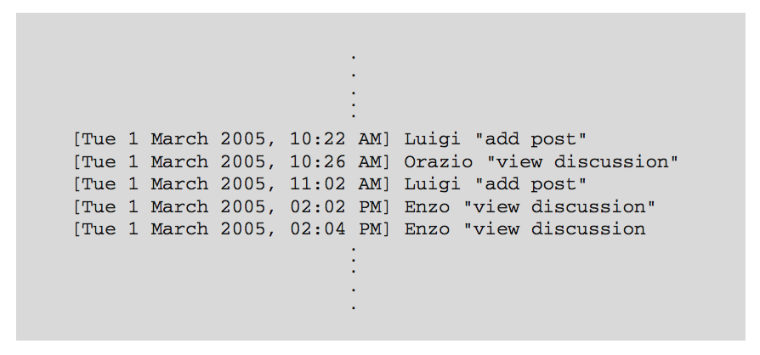
R Mazza, Introduction to Information visualization
Notes:
we want to study how people communicate in a discussion forum. The users can write a message on the forum, which all other users of the service can read. Anyone can reply to the message
Suppose we wish to quickly single out both the most active users (or, rather, those who read and write a high number of messages in the forum), as well as the users who silently read all of the messages and don’t take an active part in the discussion.
The tools that offer this type of service usually record every action carried out by the system’s users in an appropriate file: the log file. A typical log file of the discussions could have this format:

Slide 27
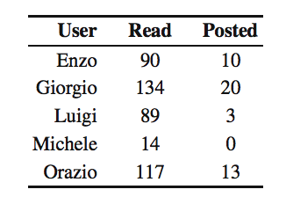
R Mazza, Introduction to Information visualization
Notes:
The preprocessing phase should convert these data into a tabular format. The data structures can also be enriched with additional information or preliminary processing. In particular, filtering operations to eliminate unnecessary data and calculations for obtaining new data, such as statistics to be represented in the visual version, can be performed; furthermore, we can add attributes to the data (also called metadata) that may be used to logically organize the tabular data. The intermediate data structure, of the example we are processing, could therefore look like the following:
In this structure in particular, we have filtered out some information, such as the date and time of each logged event, as they are irrelevant to the current problem. The attributes read and posted are calculated from the data featured in the log file.

Slide 28
5. Represent

Slide 29
Visual mapping
Choose a basic visual model
Three structures must be defined
  Spatial substrate – physical space where representation is created – defined in terms of axes
  Graphical elements – everything visible (points, lines, surfaces and volumes)
  Graphical properties – properties of the graphical element to which the human eye is sensitive (retinal variables) – size, orientation, colour, shape , texture
R Mazza, Introduction to Information visualization
Notes:
Defining which visual structures to use to map data and location in the display area
Abstract data don’t necessarily have a location in space
The spatial substrate defines the dimensions in physical space where the visual representation is created. The spatial substrate can be defined in terms of axes. In Cartesian space, the spatial substrate corresponds to x- and y-axes. Each axis can be of different types, depending on the type of data that we want to map on it. In particular, an axis can be quantitative, when there is a metric associated to the values reported on the axis; ordinal, when the values are reported on the axis in an order that corresponds to the order of the data; and nominal, when the region of an axis is divided into a collection of subregions without any intrinsic order.

Slide 30
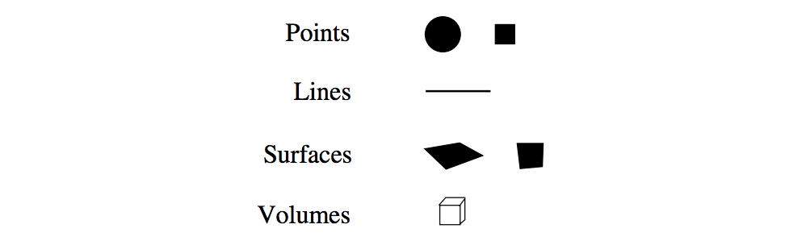
Graphical elements
R Mazza, Introduction to Information visualization
Notes:
The graphical elements are everything visible that appears in the space. There are four possible types of visual elements: points, lines, surfaces, and volumes

Slide 31
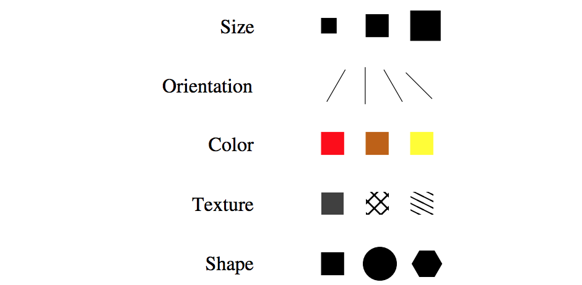
Graphical properties
R Mazza, Introduction to Information visualization
Notes:
The graphical properties are properties of the graphical elements to which the retina of the human eye is very sensitive (for this reason, they are also called retinal variables). They are independent of the position occupied by a visual element in spatial substrate. The most common graphical properties are size, orientation, color, texture, and shape. These are applied to the graphical elements and determine the properties of the visual layout that will be presented in the view (see Fig. 2.3). In terms of human’s visual perception, not all graphical properties behave in the same way. Some graphical properties are more effective than others from the viewpoint of quantitative values.

Slide 32
What are people able to decode most accurately?

Slide 33
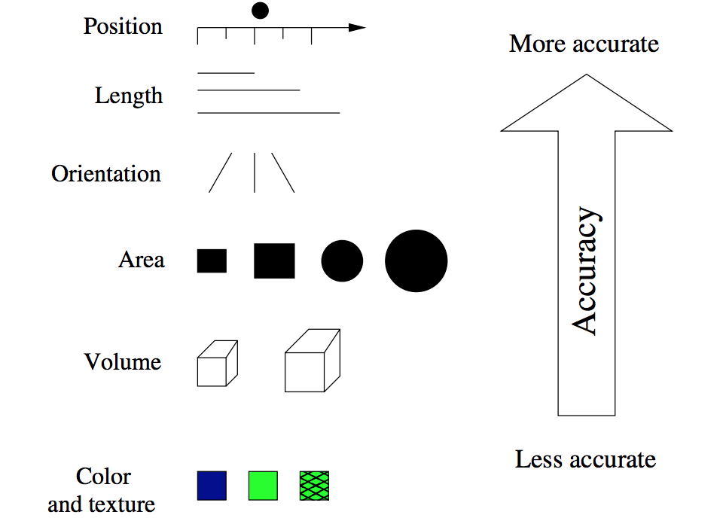
Cleveland and McGill (1984), Graphical Perception: Theory, Experimentation, and Application to the Development of Graphical Methods
R Mazza, Introduction to Information visualization
Notes:
Cleveland and McGill studied what people are able to decode most accurately and ranked them in the following list.
Position along a common scale e.g. scatter plot
Position on identical but nonaligned scales e.g. multiple scatter plots
Length e.g. bar chart
Angle & Slope (tie) e.g. pie chart
Area e.g. bubbles
Volume, density, and color saturation (tie) e.g. heatmap
Color hue e.g. newsmap
Now before you go shunning everything that isn’t in the top three, keep in mind this list isn’t meant to be a definitive answer on what to use and what not to in your data graphics. Cleveland and McGill note, “The ordering does not result in a precise prescription for displaying data but rather is a framework within which to work.”

Slide 34
Colour
Black, white, red, green, yellow and blue – colours to map a category attribute to
  can add pink, brown, cyan, orange and purple
Use of primary colours is not advised when mapping quantitative attributes or where there is an ordering of values
  Could use a colour scale or vary the colour intensity
Colour blindness
  Red-green colour blindness is the most common form, followed by blue-yellow colour blindness
Notes:
Color has to be given particular attention. In fact, color is the only graphical property in which perception can depend on cultural, linguistic, and physiological factors. Some populations, for example, use a limited number of terms to define the entire color spectrum (in some populations, there are only two words to describe the colors: black and white). It is therefore possible that two people from different cultures may use diverse terminology to identify the same color or may even have different perceptions, given that they might not have a specific term for identifying a determined color on a cognitive level. Studies on perception [65] have demonstrated that, even taking the cultural differences into account, the colors that can be considered primary are white, black, red, green, yellow, and blue. These are the only colors that have the same name all over the world and, consequently, are the colors that must be chosen when it is necessary to map a category attribute to a maximum of six colors. Colin Ware [65] suggests limiting any mapping of categorical attributes to these six primary colors, but, if necessary, it is possible to extend the list by adding pink, brown, cyan, orange, and purple. To represent quantitative attributes, or where there is an ordering of values, the use of primary colors is not advisable, because (1) there might not be enough primary colors, and (2) our culture does not adopt any convention on the ordering of colors (does blue come before or after yellow?). A clever idea might be to use a convention on a color scale, to be clearly explained in the application (from green to red, for example), or to vary the color intensity to codify the various levels of values (Fig. 2.5). It is also necessary to bear in mind that a large percentage of the population (in Australia, 8% of males and 0.4% of females) has a particular ocular visual perception problems: daltonism. 1 People who suffer from this condition are generally unable to distinguish between red and green, or (less frequently) between yellow and blue. It is therefore important to consider that there are some people with this visual defect and to develop applications in which it is possible to change the color mapping.

Slide 35
6. Refine

Slide 36
View creation
Improve the representation to make it clearer and more visually engaging
Should allow for efficient responses to questions
Final result – requires good design – balance of many things

Slide 37
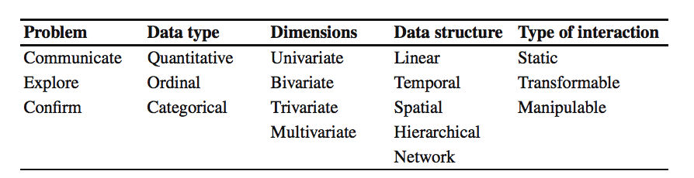
Variables to consider when designing a visual representation
R Mazza, Introduction to Information visualization
Notes:
The elements just described, to be considered during the design stage, are summarized

Slide 38
7. Interact

Slide 39
Let the user control or explore the data e.g
  Selecting a subset of data
  Changing viewpoint
  Providing more information/callouts

Slide 40
Interactions between the seven stages
B Fry, Visualizing Data

Slide 41
Homework
https://www.perceptualedge.com/articles/visual_business_intelligence/the_chartjunk_debate.pdf

Slide 42
Next time…
Data relationships

