Slide 1

Modelling and Simulation using CA
Dr Claire Rocks C.L.Rocks@warwick.ac.uk
Dr Thomas Popham T.Popham@warwick.ac.uk
Dr James Archbold J.Archbold@warwick.ac.uk

Slide 2
Agenda
What is simulation and modelling?
Probabilistic Cellular Automata
SIR model

Slide 3
Why create a simulation?

Slide 4
Why create a simulation?
Ultimately, science is most often about experiments.
Experiments allow us to predict and estimate the outcomes of interactions, environments and interventions.
CS has a particular advantage over other sciences - computer’s are often faster than the natural world!
If we can create an accurate simulation, it allows us to get results and potential solutions very quickly.

Slide 5
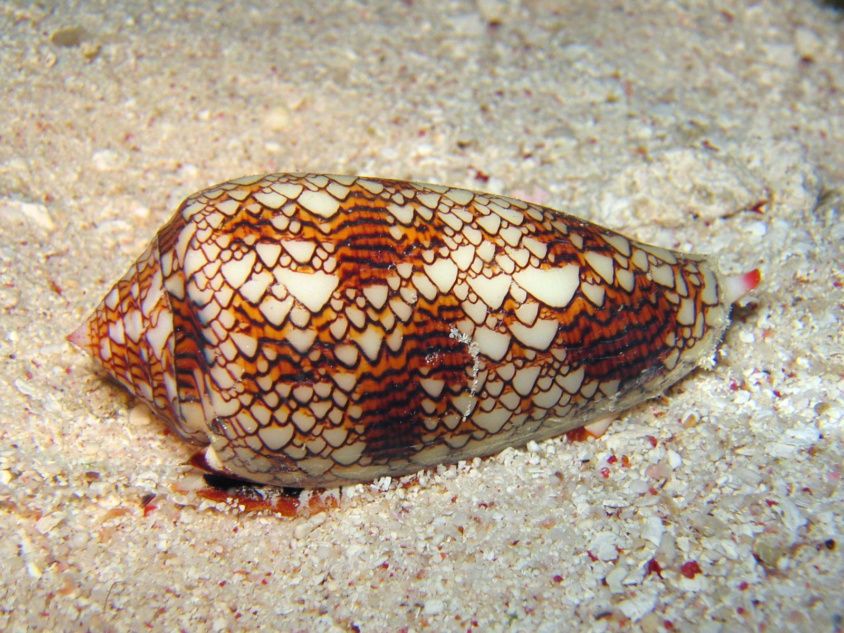
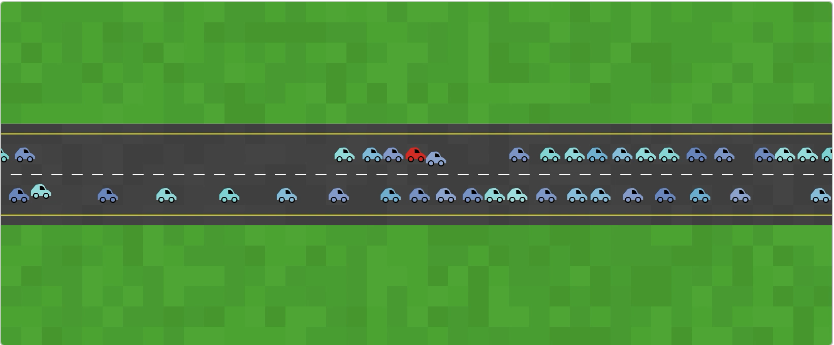
The goal of simulations is to take naturally occurring behaviour, phenomena and environments and then accurately recreate those situations using computer code.
Video 1 – NASA rocket exploding
Notes:
What is simulation and modelling
Here we are talking about modelling complex systems

Slide 6
Uses of Simulation
The main one that has been in the news in recent years, and the one you’ll explore today, is disease.
The response to COVID-19 was massively influenced by simulations.
Outbreaks were simulated, much like you’ll do today.
With sufficiently advanced models, the idea of lockdown and its impact could also be explored.
Moreover, possible vaccines could be simulated along with how molecules may interact with each other.

Slide 7
Uses of Simulation
The ‘outbreak’ model is quite versatile.
It can be used to simulate many different things:
News and rumour spread
Viral media prediction
Unhealthy behaviours
Pregnancy
Voting habits

Slide 8
Uses of Simulation
Let’s go even deeper!
We can utilise multiple simulations at once.
For instance, the spread of one disease (flu) could impact the spread of another (COVID).
We then need to define how these simulations interact.
This is where we start to hit computational limits and need make a trade off between accuracy and run time.

Slide 9
Uses of Simulation
One great example of this is social influence.
We have a number of models for representing the spread of ideas between people.
They are extremely simple - working much like the SIR model you’ll see later.
However, the scope of the problem (simulating an idea spreading between hundreds of thousands of people) means that we still can’t efficiently solve problems such as ‘who is the most influential person in a social network’.

Slide 10
Uses of Simulation
We can even get more complex - for instance modelling how different ideas encourage and suppress others and figuring out the best places in a network to target to stop the spread of a rumour / fake news.
Currently, I’m working on a project to simulate the spread of four health-related behaviours and how that affects the prevalence of cardio-vascular events. We’re hoping to be able to simulate the effects of possible health interventions to save lives!

Slide 11
Creating a simulation
Simulations are great ways to gain intuitive understanding of complex systems
They are used to describe, understand and predict a system’s behaviour
It is too hard to make a perfect simulation of the world.
As we’ve seen, you need to make some assumptions and simplifications, without making it too simple and losing the behaviours that we want to model.

Slide 12

Building your toolbox
Video 1 – NASA rocket exploding
Notes:
we might examine topics that come from physics or biology, but it won’t be our job to investigate these topics with a particularly high level of academic rigor. Instead, we’re going to glance at scientific concepts and grab the parts that we need in the service of building a particular software example.
The rules of your system will be designed by you
Really what my section of the summer schoois about is starting to build the toolbox you have available to you to create systems and simulations

Slide 13
What is a cellular automata?
A cellular automaton (CA) is a collection of cells arranged in a grid
Each cell changes state as a function of time, according to a defined set of rules driven by the states of neighbouring cells.
CAs have been suggested for possible use in modelling geography, anthropology, political science, sociology and physics, among others.

Slide 14
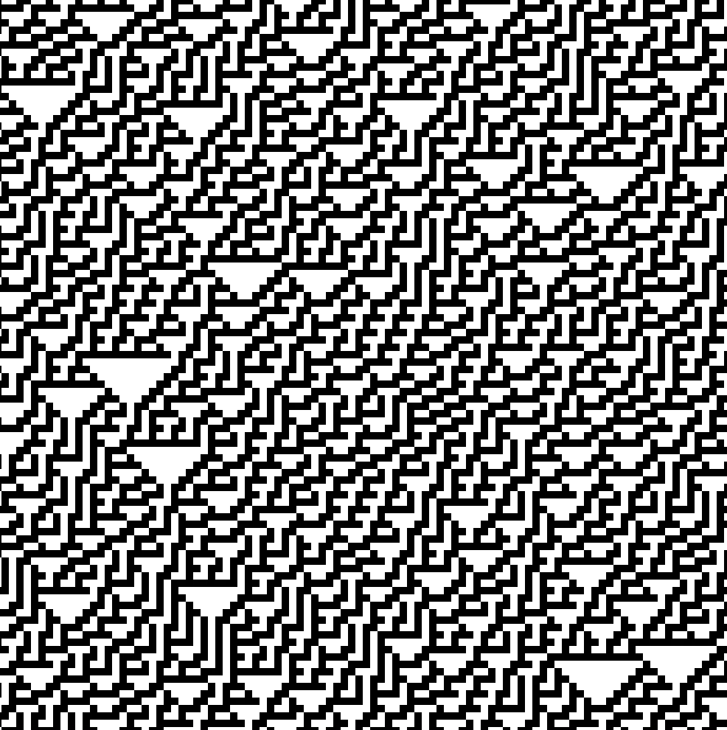
Elementary Cellular Automata
There are many types of CA. The simplest type is a binary, nearest-neighbour, one-dimensional automaton called elementary cellular automata.

Slide 15
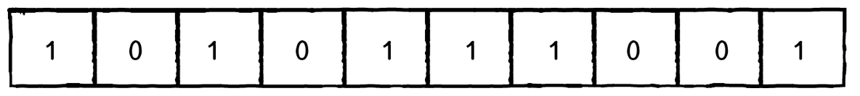
Elementary Cellular Automata
It is one-dimensional.
Cells can have only one of two possible values: 0 or 1.
The state a cell will have in the next generation is based on the value of:
the cell to its left
the cell itself
the cell to its right

Slide 16
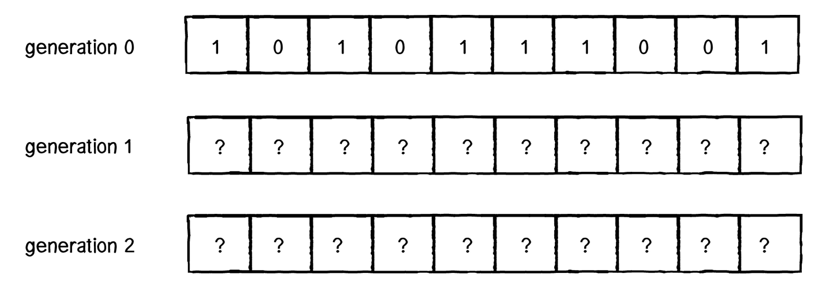
Elementary Cellular Automata
How do we compute the states for all cells at generation 1? And generation 2? And so on?

Slide 17
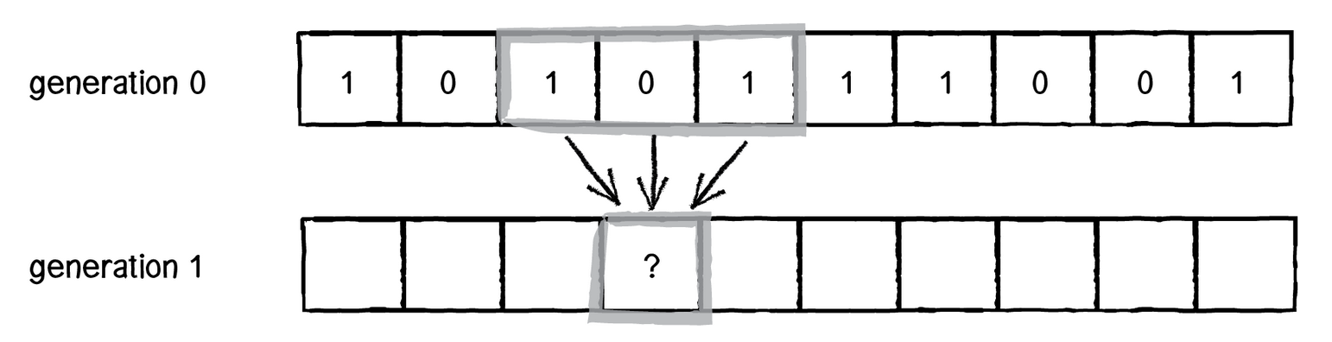
Elementary Cellular Automata
We calculate a new state value by looking at all the previous neighbour states.

Slide 18
Elementary Cellular Automata
We have three cells, each with a state of 0 or 1. How many possible configurations are there?
Three cells define a 3-bit number, and how high can you count with 3 bits?

Slide 19
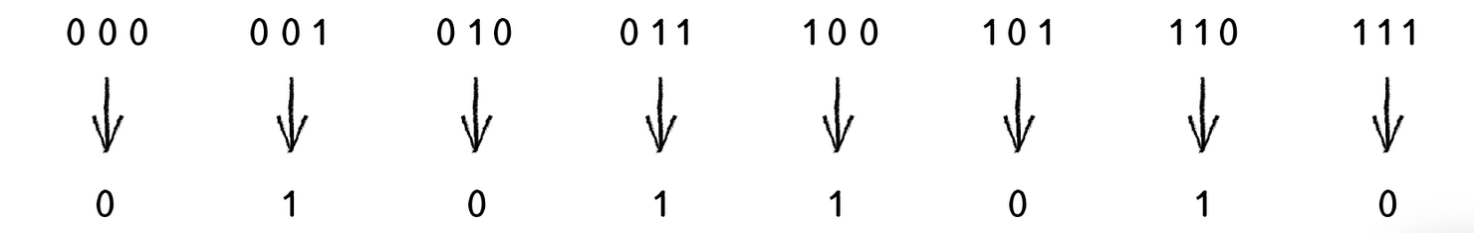
Elementary Cellular Automata
Once we have defined all the possible configurations, we need to define an outcome (new state value: 0 or 1) for each – this is known as the rule set

Slide 20
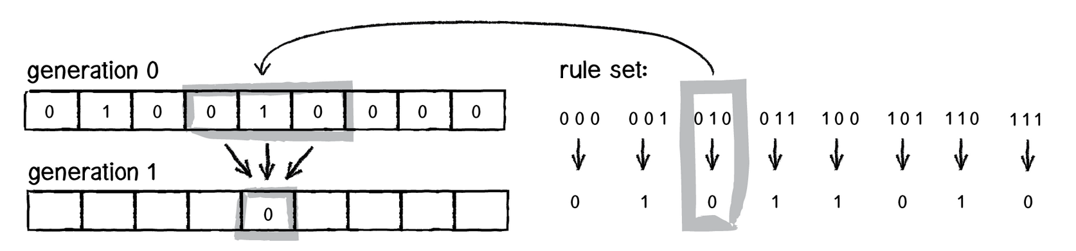
Elementary Cellular Automata
Try applying the same logic to all of the cells above and fill in the empty cells

Slide 21
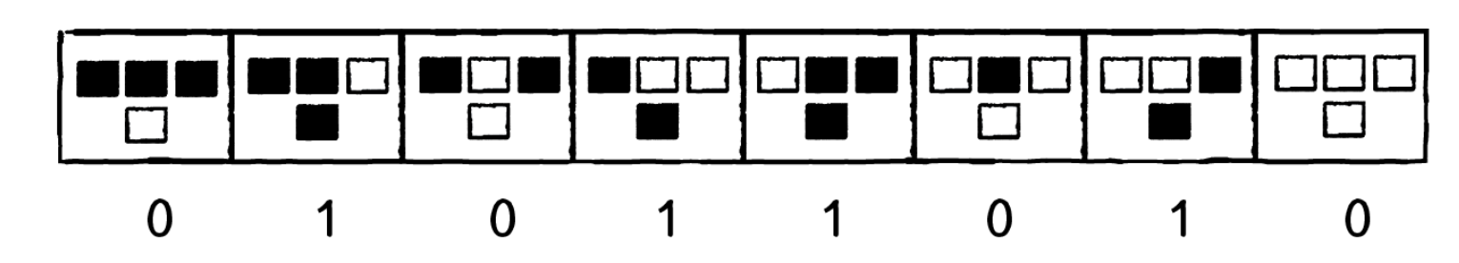
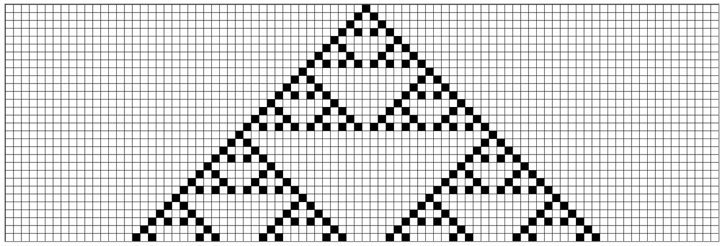
Visualising the output
Rule set:
Output:
There are eight possible neighbourhood configurations; we therefore define a “ruleset” as a list of 8 bits. This is rule 90.

Slide 22
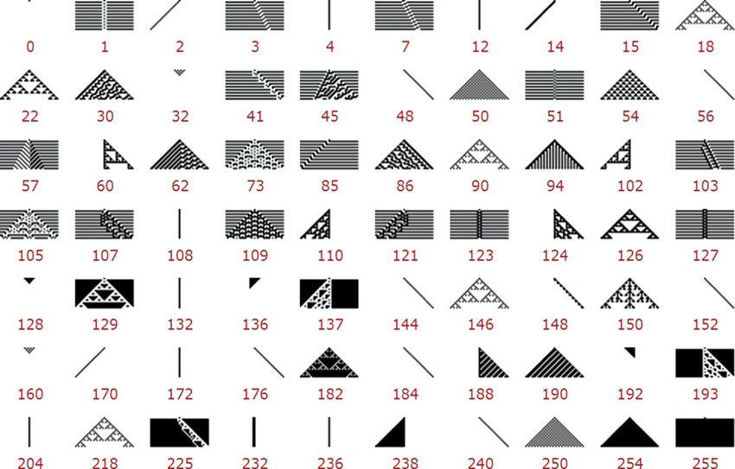

Slide 23
Moving to two dimensions
This will introduce some additional complexity; each cell will have a bigger neighbourhood, but that will open up the door to a range of possible applications.

Slide 24
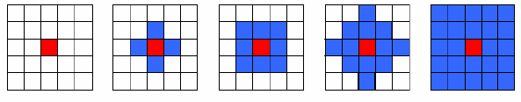
Neighbourhoods
Cellular automata neighbourhoods: (a) Empty, (b) Von Neumann, (c) Moore, (d) MvonN, (e) Extended.

Slide 25
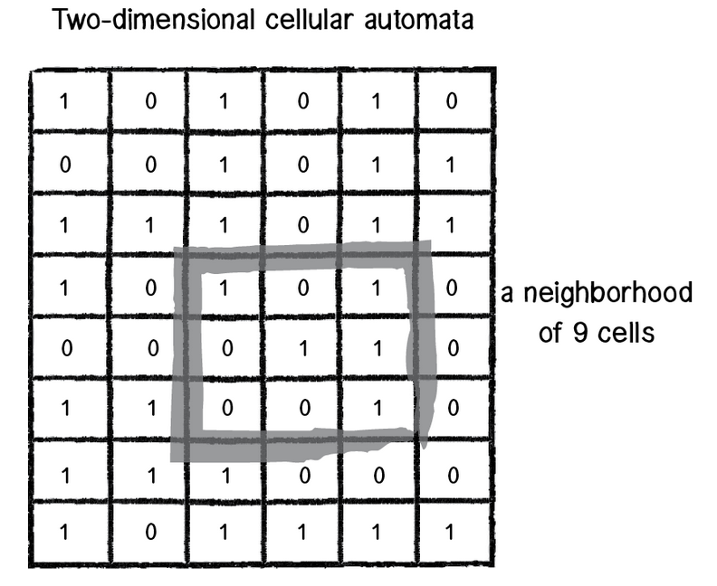
Game of Life
First, instead of a line of cells, we now have a two-dimensional matrix of cells. As with the elementary CA, the possible states are 0 or 1. Only in this case, since we’re talking about “life," 0 means dead and 1 means alive.
The cell’s neighbourhood has also expanded.

Slide 26
Rule Set
With nine cells, we have 9 bits, or 512 possible neighbourhoods. In most cases, it would be impractical to define an outcome for every single possibility.
The Game of Life gets around this problem by defining a set of rules according to general characteristics of the neighborhood.

Slide 27
Rule Set
Death. If a cell is alive (state = 1) it will die (state becomes 0) under the following circumstances:
Overpopulation: If the cell has four or more alive neighbours, it dies.
Loneliness: If the cell has one or fewer alive neighbours, it dies.
Birth. If a cell is dead (state = 0) it will come to life (state becomes 1) if it has exactly three alive neighbours (no more, no less).
Stasis. In all other cases, the cell state does not change. To be thorough, let’s describe those scenarios.
Staying Alive: If a cell is alive and has exactly two or three live neighbours, it stays alive.
Staying Dead: If a cell is dead and has anything other than three live neighbours, it stays dead.

Slide 28
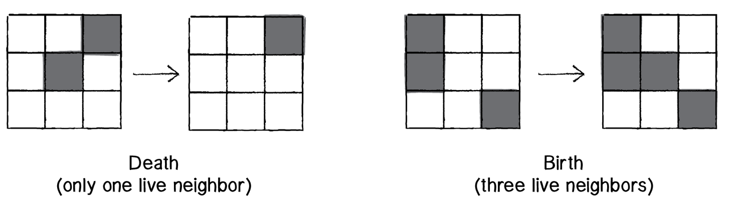
Examples

Slide 29
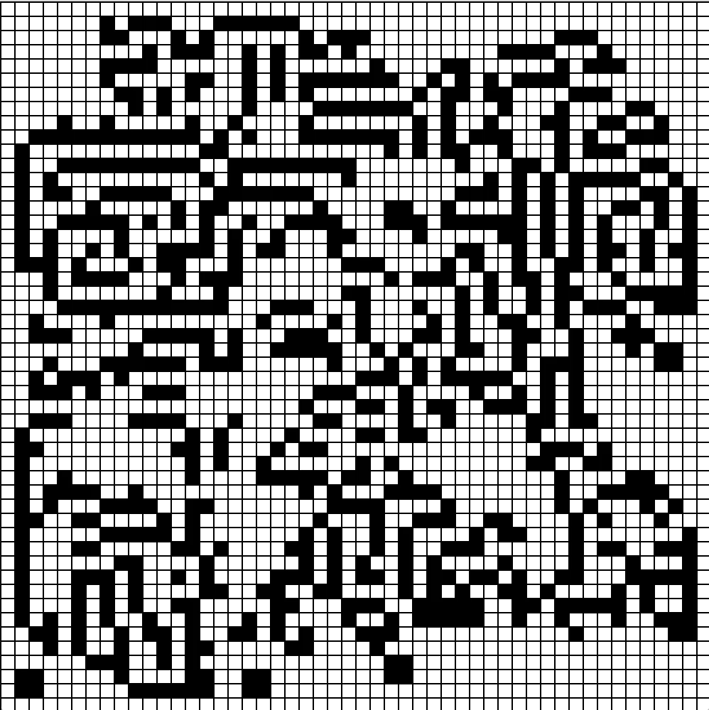
Visualising the output
The CA itself is in two dimensions. We could try creating an elaborate 3D visualization of the results and stack all the generations in a cube structure.
However, the typical way the Game of Life is displayed is to treat each generation as a single frame in an animation.

Slide 30
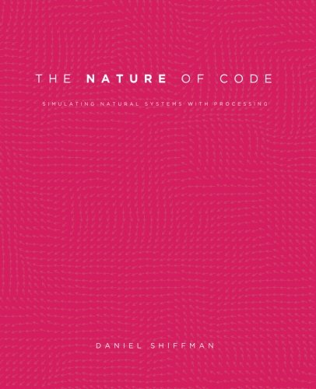
https://natureofcode.com/

Slide 31
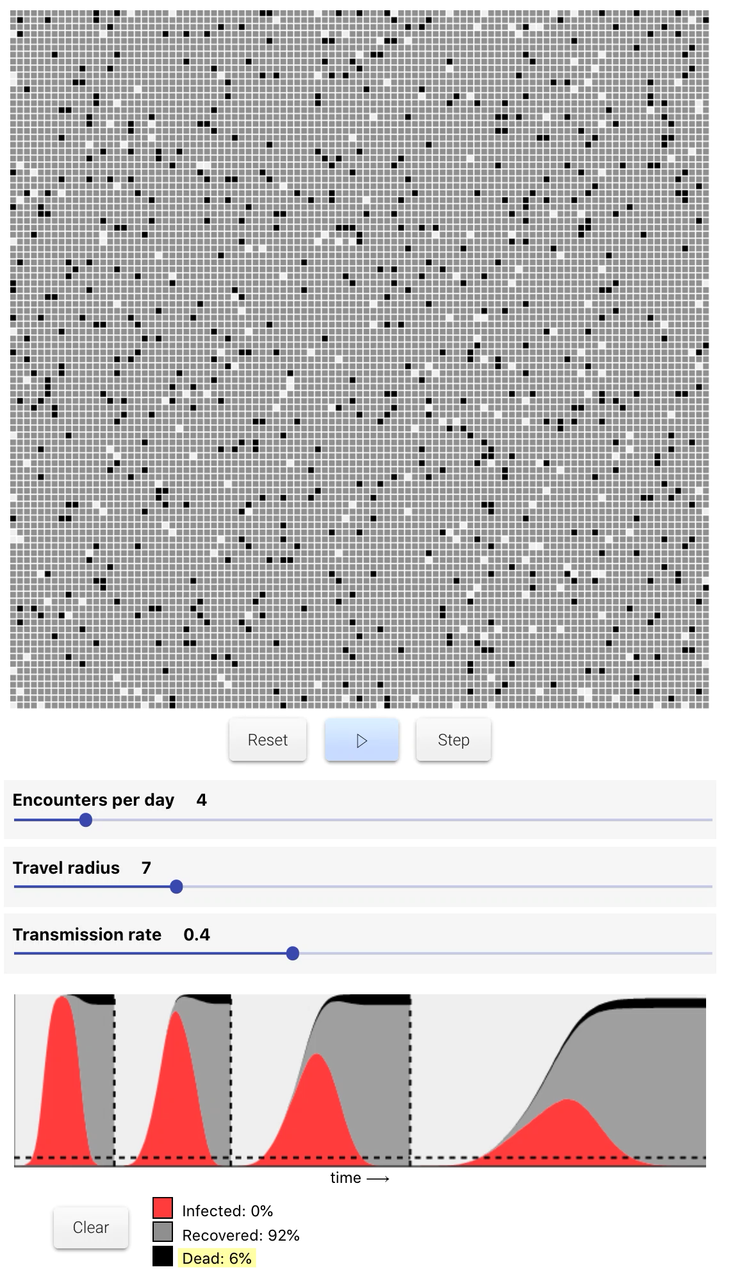
https://meltingasphalt.com/interactive/outbreak/

Slide 32
Probabilistic Cellular Automata
The rules of a CA don’t necessarily have to define an exact outcome.
For example, we could rewrite the Game of Life rules as follows:
A live cell with < 2 live neighbours dies with the probability of 90%
A live cell with >3 live neighbours dies with the probability of 92%
A live cell with 2 or 3 live neighbours stays alive
A dead cell with exactly 3 live neighbours comes alive with the probability of 95%
This is a probabilistic Cellular Autonoma

Slide 33
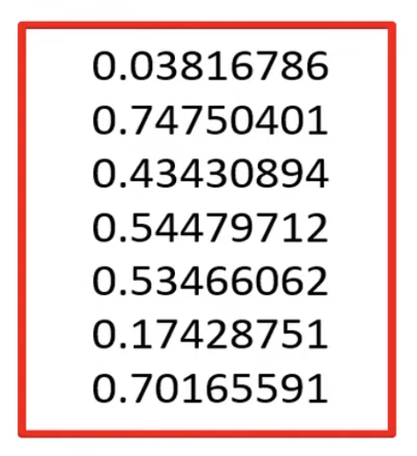
Random numbers
We can evaluate rules involving probabilities by drawing a random number from a uniform distribution (every number is equally likely to be observed in a certain range, e.g. between 0 and 1)

Slide 34
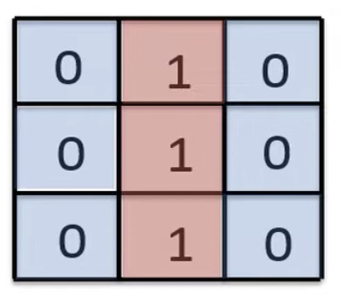
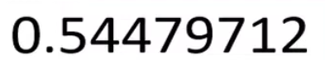
An example
Update this cell located next to an edge based on the rule
A live cell with < 2 live neighbours dies with the probability of 90%
To update the cell based on this rule we (1) evaluate the number of neighbours and (2) generate a random number between 0 and 1. Suppose we get the number shown.
As this number is <0.9 (90%) the cell dies (becomes 0)
If the number was >0.9 the cell would not die (remain a 1)

Slide 35
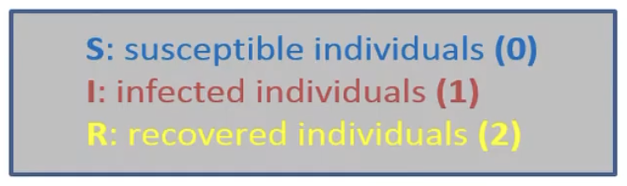
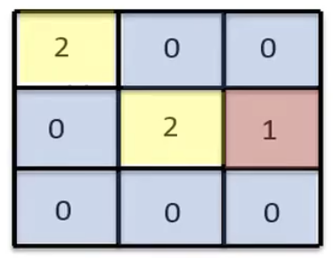
Probabilistic CA for the SIR model
SIR model has 3 possible states
Susceptible individuals can become infected if they are in close contact to infected people i.e. a neighbour is infected (Moore neighbourhood)
After a while an infected individual will recover
Each timestep = 1 week

Slide 36
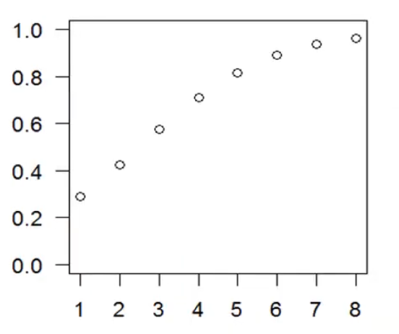
P_{infect}
Use a simple logistic function to compute the probability of being infected as a function of the number of infected neighbours
$$P_{infect}=\frac{1}{1+e^{−(a+bx)}}$$
where a = -1.5, b = 0.6 and
x = num of infected neighbours
$$P_{infect}$$
num of infected neighbours

Slide 37
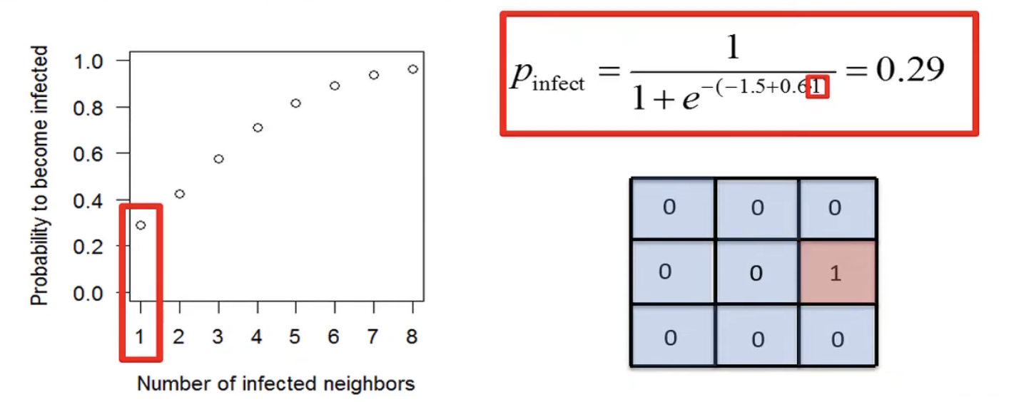

Slide 38
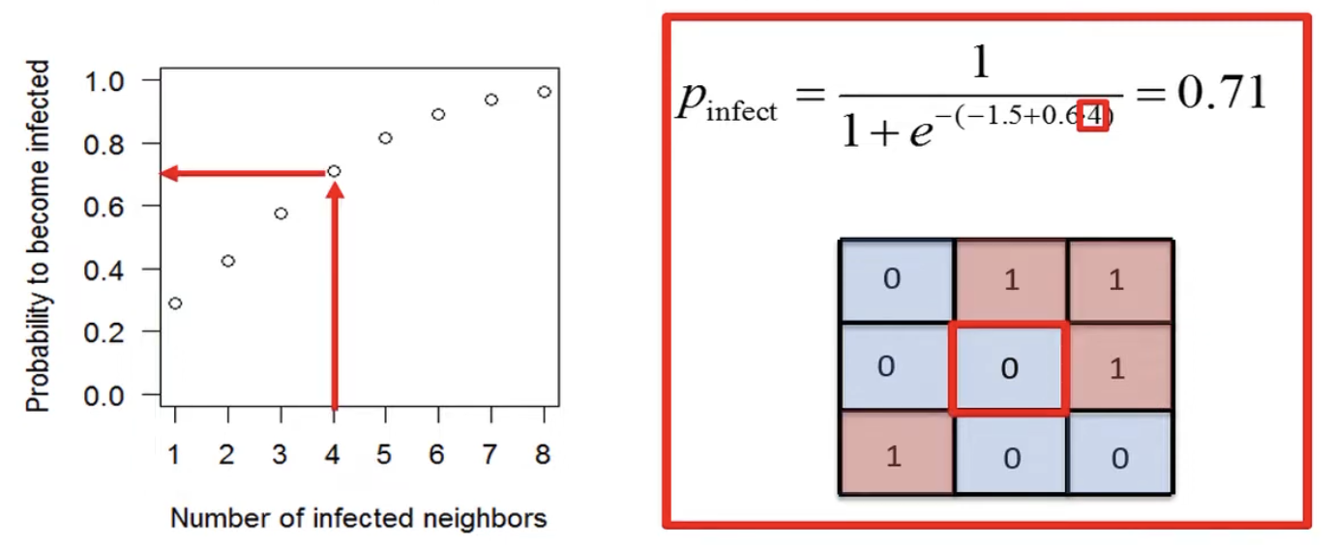

Slide 39
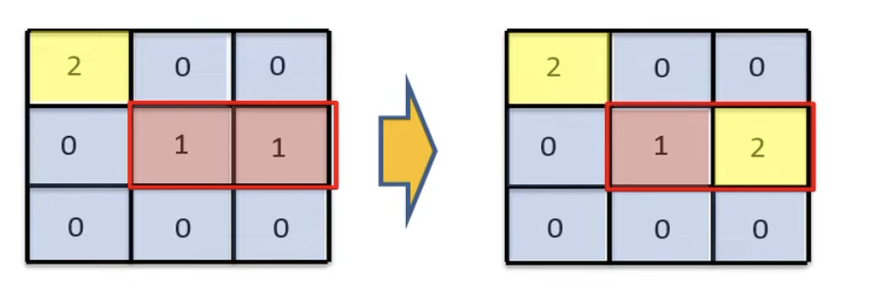
P_{recover}
Probability that an infected individual recovers
$P_{recover}=0.5$ each week
Expect that half the infected individuals will recover in each timestep and that most infected individuals will stay infected for 1-3 weeks

Slide 40
Writing this in code…
Use Jupyter Notebooks
The Jupyter Notebook is an open source web application that you can use to create and share documents that contain live code, equations, visualizations, and text.
https://realpython.com/jupyter-notebook-introduction/

Slide 41
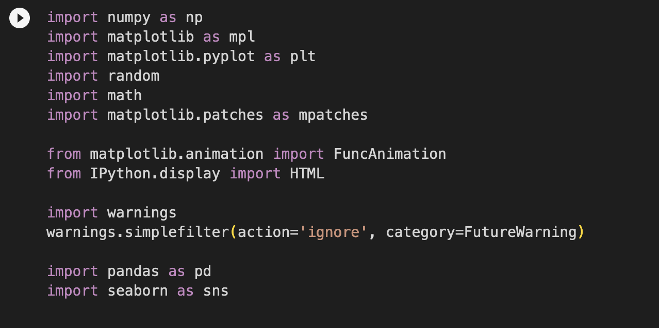
Importing libraries
In this lab we need to use several python packages:
numpy - allows for advanced math functions
matplotlib - helps us draw plots
random - used to generate random numbers
math - provides access to the mathematical functions
seaborn - data visualization library based on matplotlib
To run code in a Jupyter notebook you need to press

Slide 42
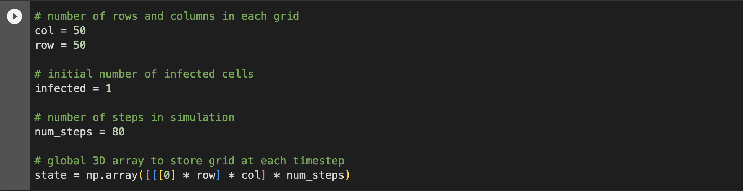
Setting up the grid
Set up a grid of cells (in this case 50*50), with a single infected individual and a simulation of 80 steps.

Slide 43
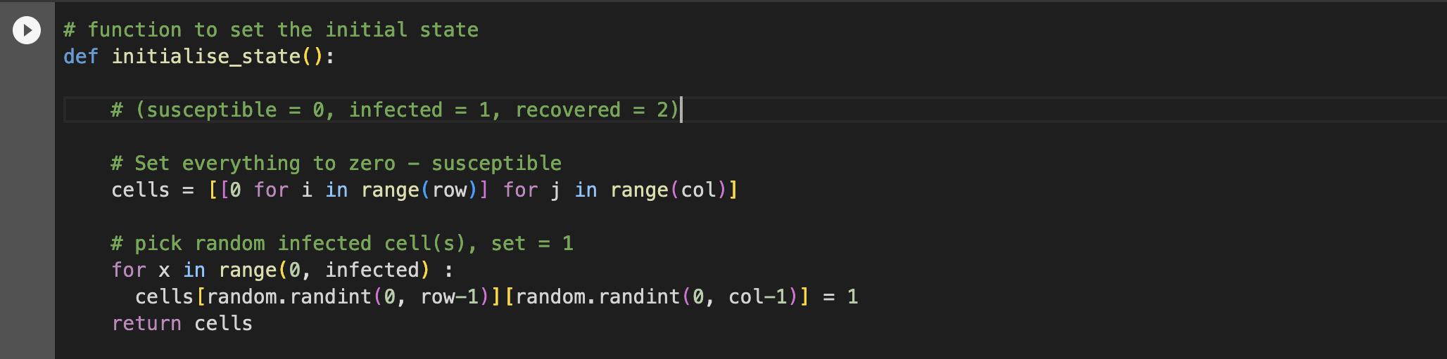
Initialise the grid
Set all cell values to 0 (susceptible)
Pick num_infected random cell(s) and set to 1 (infected)

Slide 44
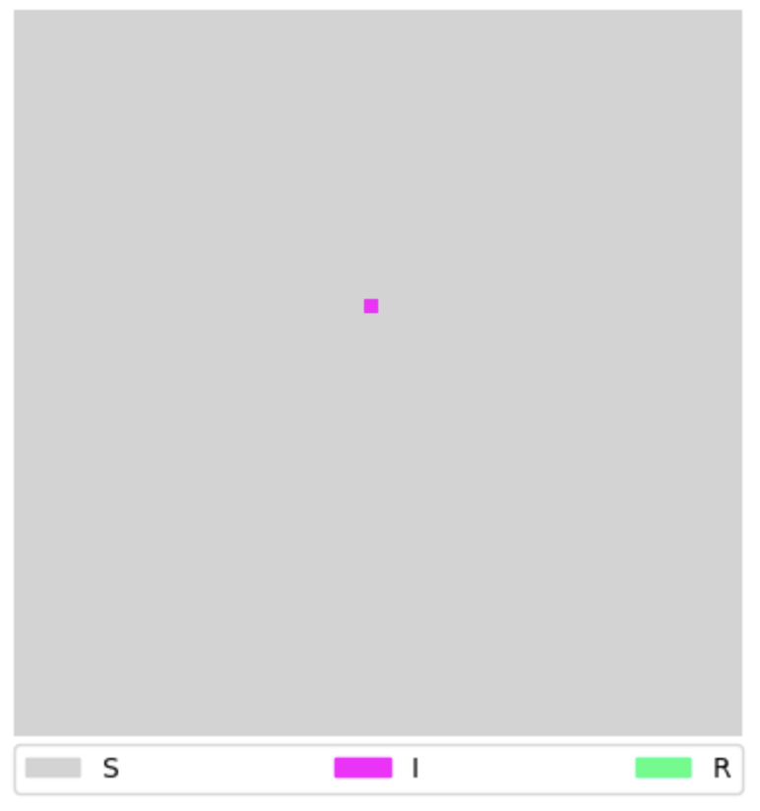

Slide 45
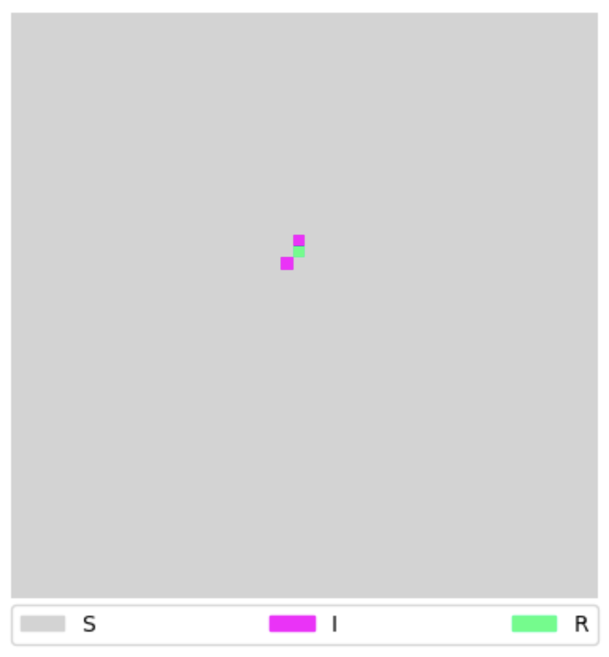
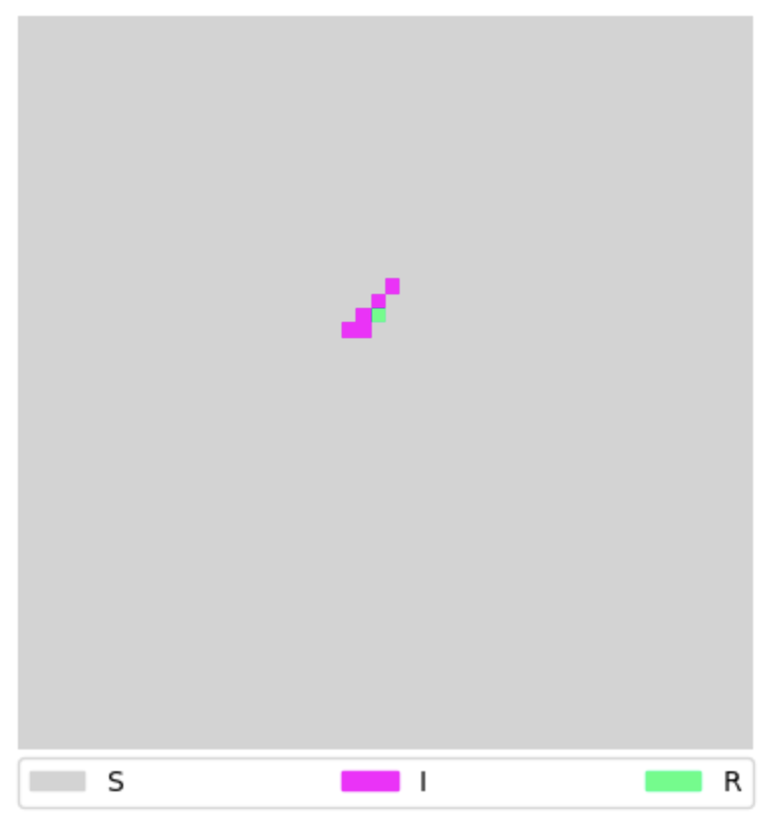
Generation 0
Generation 1
Generation 2

Slide 46
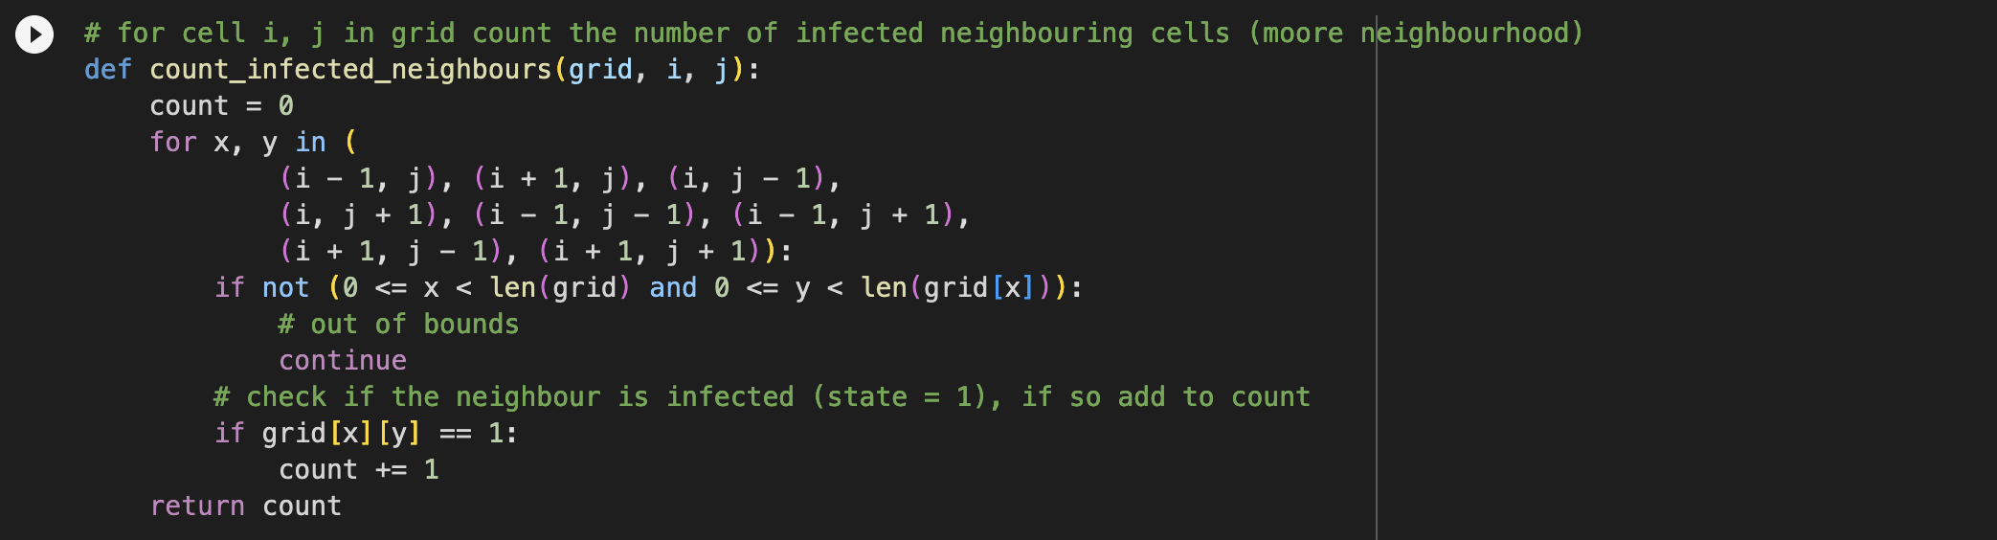
Counting neighbours
In order to update the state, we need a function that will count the number of infected neighbours.
(i-1, j-1) | (i, j-1) | (i+1, j-1)
(i-1, j) | (i, j) | (i+1, j)
(i-1, j+1) | (i, j+1) | (i+1, j+1)

Slide 47
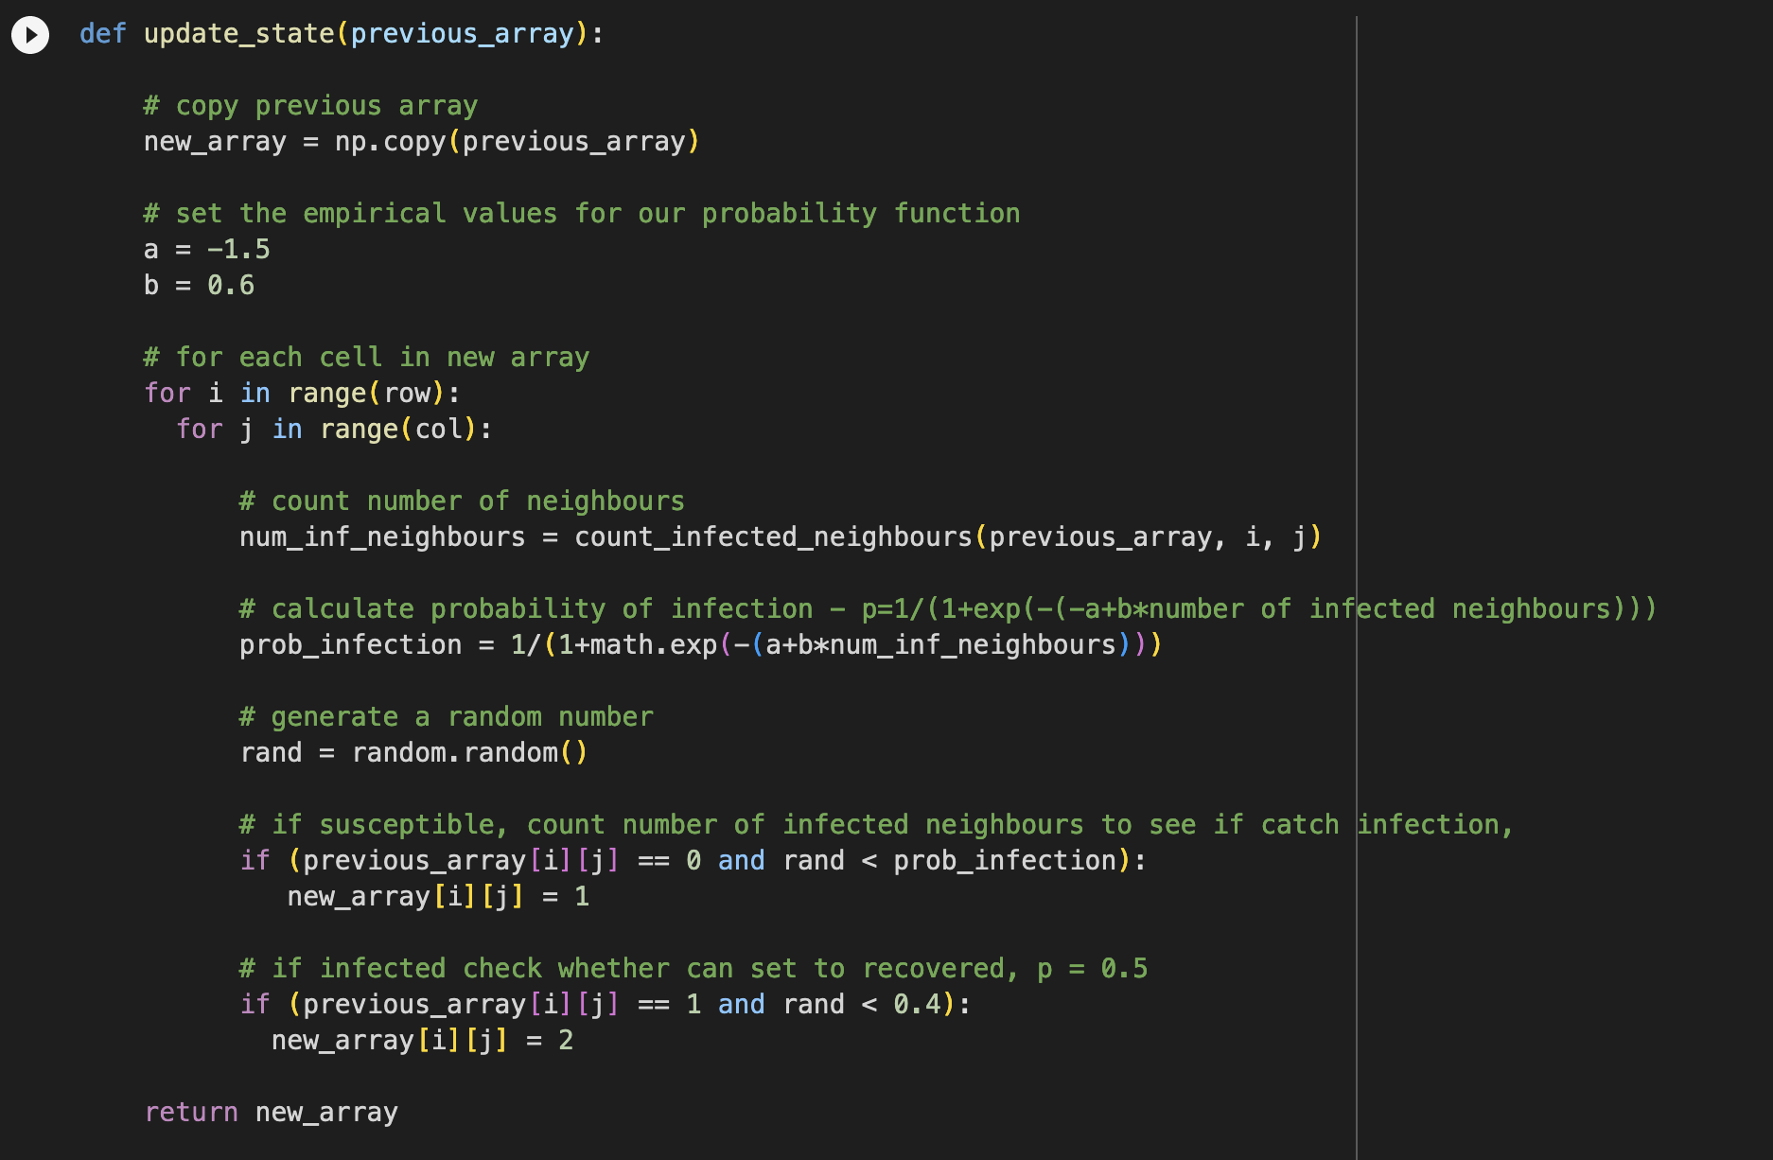
Updating the state

Slide 48
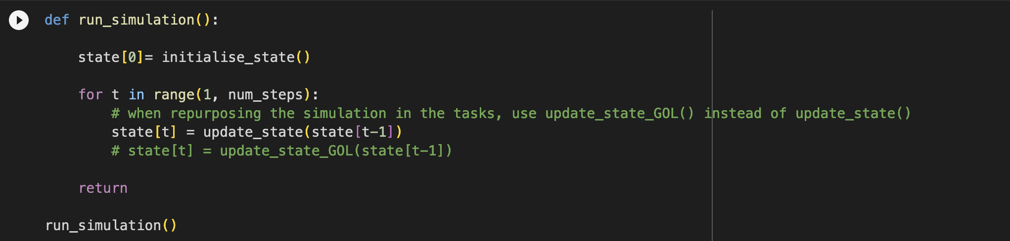
Run simulation
Now we can run the simulation. We first create the initial state (generation 0), then call update_state() to create a new array for each generation, creating num_steps generations in total.

Slide 49
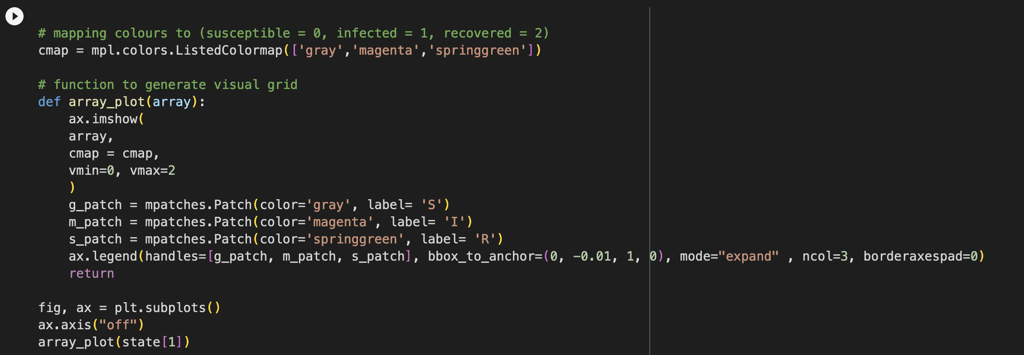
Visualise a grid
This next bit of code lets us visualise a grid

Slide 50
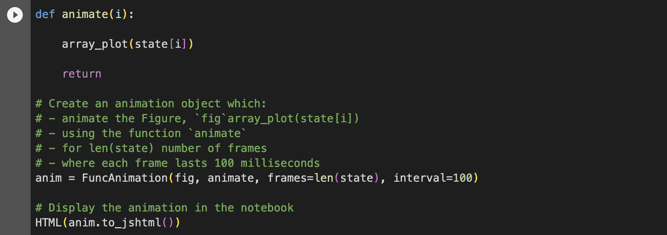
Stitch the visualisations together in an animation
This next bit of code, joins each of the grid visualisations together in an animation

Slide 51
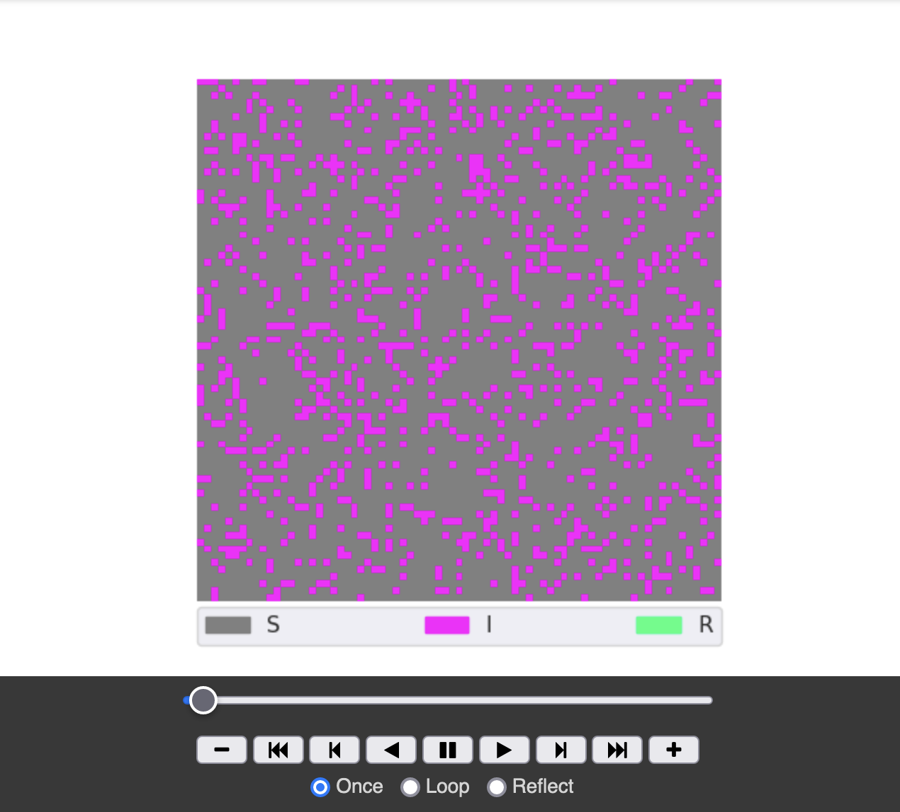
Pauses the animation
Plays the full simulation
Lets you step forwards through each generation

Slide 52
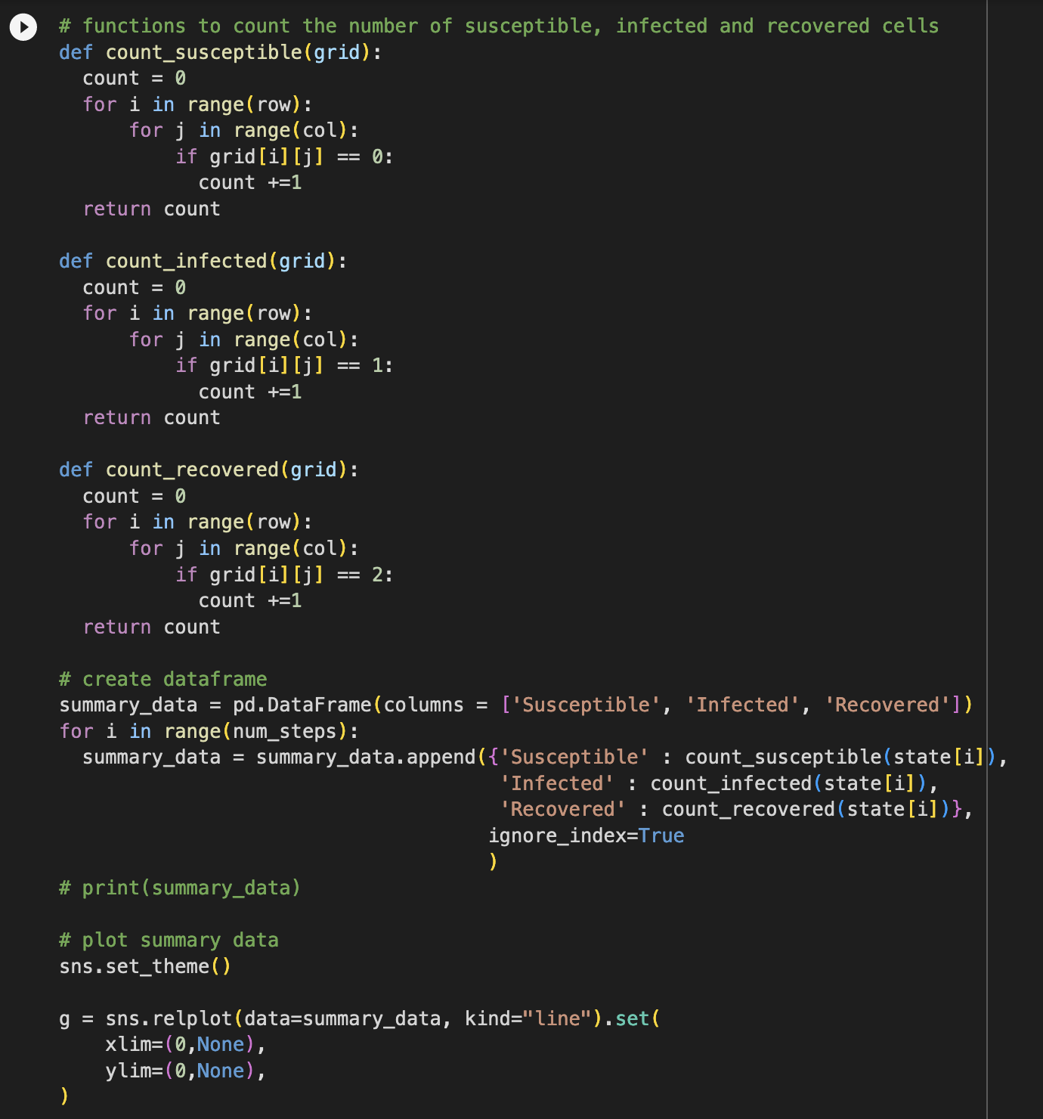
Summary statistics
The final bit of code creates a plot of the summary statistics. for each generation it:
Counts the number of susceptible, infected and recovered cells
Adds the counts to a pandas dataframe
uses the seaborn library to create a line graph of the values at each generation

Slide 53
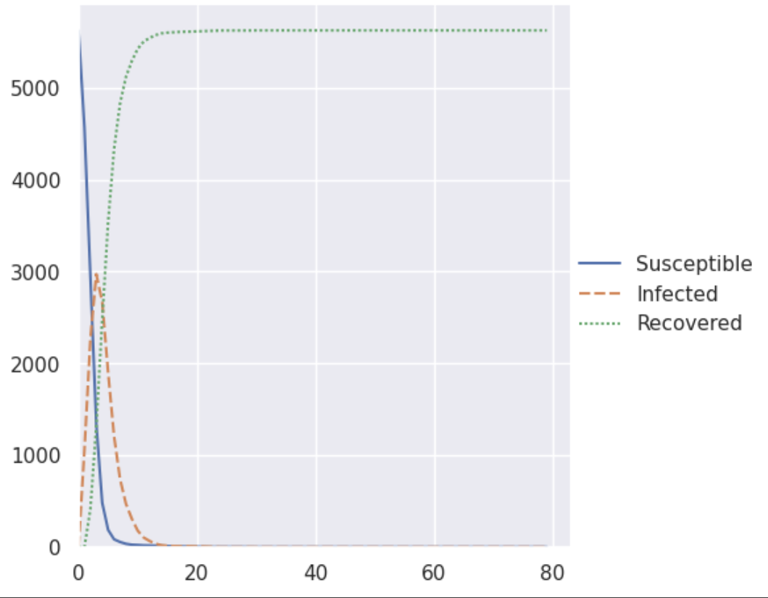

Slide 54
Tasks
Have a look at what happens between state[0] and state[1]. Can you see that in state 1, lots of cells become infected even though they have no infected neighbours. Why do you think this is? Can you write an if statement to fix this?
In the code above the rate of recovery is wrong. Can you fix this?
Change the value of the initial number of infected cells, both increasing and decreasing it. How does that affect the spread of the disease?
Can you increase the array size to 75*75 (you could go much higher but it may take some time to run the simulation and the animation)
Edit the infection probability (the easiest way to do this is to change the values of a and b)

Slide 55
Some more difficult tasks
The previous tasks, encouraged you to tweak some of the parameters of the simulation. These next tasks involve you adding to the update function we provided
Alter the update_state(previous_array) function, so that recovered cells have a 10% probability of becoming susceptible again
Add a new state - "dead". If a cell is infected, and it does not recover, there should be a 5% probability that the individual dies. Don’t forget to update the bit of code lets us visualise a grid and provides the summary statistics too

Slide 56
Repurposing the Simulation
Can you adapt the code to simulate the Game of Life. Recall the rules:
A live cell with less than 2 live neighbours dies with the probability of 90%
A live cell with greater that 3 live neighbours dies with the probability of 92%
A live cell with 2 or 3 live neighbours stays alive
A dead cell with exactly 3 live neighbours comes alive with the probability of 95%
Don’t forget to have an appropriate number of live and dead cells in the initial generation
Don’t forget to update the bit of code lets us visualise a grid and provides the summary statistics too

Slide 57
Introducing a second disease
We don't expect you all to finish the tasks we have set, but for those of you who are very confident in python, you may want to:
Update the code to introduce a second disease.
Make it so that being infected with the second disease increases the probability you will become infected with the first disease.

Slide 58

Resources

