Slide 1
Quantum Computers: What are they and why am I talking about tensors

Slide 2
I only have 1 minute, what is a Quantum computer?!
Practically: A big, extremely cold fridge with lasers and mirrors (some of the time)
Theory:
Everything gets Quantum or Qu- slapped on the front (e.g. quantum bit is a Qubit)
Store probability distributions* on qubits instead of just a singular bitstring.
Can’t make copies of qubits in general
Why do we care: Quantum Fourier transform (QFT) is faster than classical Fourier transform

Slide 3
Plan
Please update when I have a plan, or explain that I do have a plan and forgot to write anything in this slide

Slide 4
What is a tensor?
Generalisation of a matrix
Rank of a tensor is how many indices/“inputs”/ “legs” it’s over
  I.E. Rank 0 is a scalar, rank 1 tensor is a vector, rank 2 is a matrix
Assigning values to legs gives a value

Slide 5
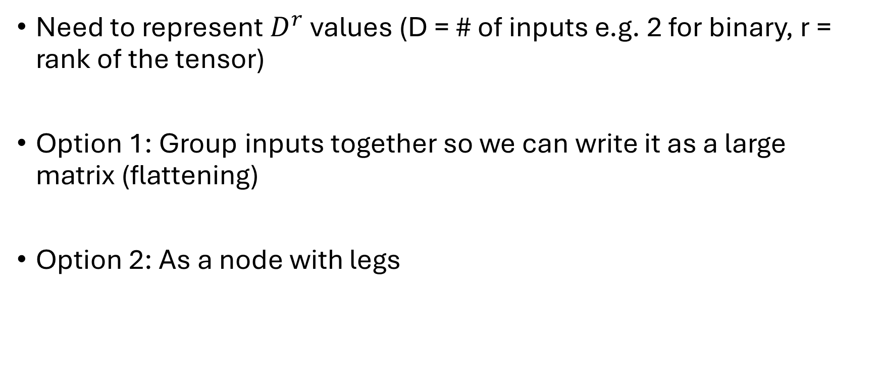
How do I represent a tensor?
Need to represent $D^{r}$ values (D = # of inputs e.g. 2 for binary, r = rank of the tensor)
Option 1: Group inputs together so we can write it as a large matrix (flattening)
Option 2: As a node with legs

Slide 6

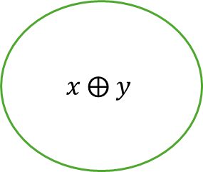
Example: XOR
$$x ⨁ y$$
=
= 1
:=
x y
1 0
0 1
And 0 otherwise
$$x, y ∈\{0,1\}$$

Slide 7

Tensor networks
Connect one tensor to at least one other
Congrats, we have a tensor network
L
R
L
R
=
= 1
Where
b
b
x y
b
1-b
$$b∈\{0,1\}$$

Slide 8

Contraction
Select an edge (u,v)
Merge it’s two endpoint together to make v’
$v^{′}\left(x,y\right)≔\sum_{i}{u\left(x,i\right)v\left(y,i\right)}$
Cost of a contraction = deg(v)+deg(u) -2 = deg(v’)
u
v
v’
x1 x2 x3 y1 y2
x1 x2 x3 y1 y2

Slide 9
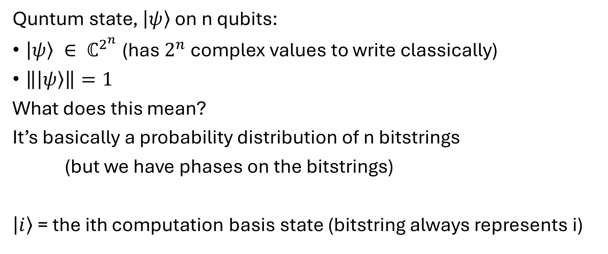
Whistle stop tour through quantum computing
Quntum state, $\left.\left|ψ\right.\right\rangle$ on n qubits:
$\left.\left|ψ\right.\right\rangle ∈ ℂ^{2^{n}}$ (has $2^{n}$ complex values to write classically)
$\left\|\left.\left|ψ\right.\right\rangle \right\|=1$
What does this mean?
It’s basically a probability distribution of n bitstrings
(but we have phases on the bitstrings)
$\left.\left|i\right.\right\rangle$ = the ith computation basis state (bitstring always represents i)

Slide 10
It’s not just a phase
2 types:
Global
  All share the phase
  Can’t be detected so we ignore it
Relative
  Different “bitstrings” have different phases
  Can be detected
  Normally set the 0 bitstring’s phase to 0

Slide 11


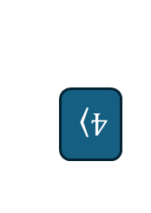


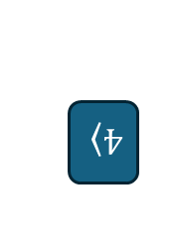
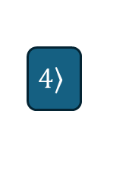
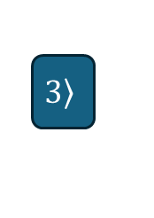





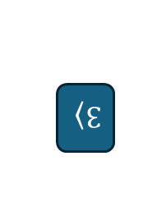







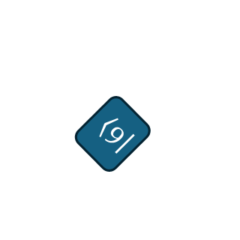
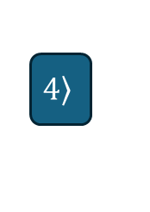






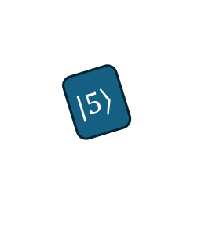

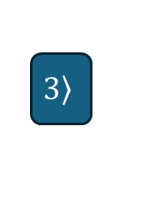


Phase is just rotation
Global
Relative
$$\left.\left|0\right.\right\rangle$$
$$\left.\left|1\right.\right\rangle$$
$$\left.\left|2\right.\right\rangle$$
$$\left.3\right\rangle$$
$$\left.4\right\rangle$$
$$\left.\left|5\right.\right\rangle$$
$$\left.\left|6\right.\right\rangle$$
$$\left.\left|7\right.\right\rangle$$
$$\left.\left|0\right.\right\rangle$$
$$\left.\left|1\right.\right\rangle$$
$$\left.\left|2\right.\right\rangle$$
$$\left.3\right\rangle$$
$$\left.4\right\rangle$$
$$\left.\left|5\right.\right\rangle$$
$$\left.\left|6\right.\right\rangle$$
$$\left.\left|7\right.\right\rangle$$
$$=$$
$$≠$$
$$\left.\left|0\right.\right\rangle$$
$$\left.\left|1\right.\right\rangle$$
$$\left.\left|2\right.\right\rangle$$
$$\left.3\right\rangle$$
$$\left.4\right\rangle$$
$$\left.\left|5\right.\right\rangle$$
$$\left.\left|6\right.\right\rangle$$
$$\left.\left|7\right.\right\rangle$$
$$\left.\left|0\right.\right\rangle$$
$$\left.\left|1\right.\right\rangle$$
$$\left.\left|2\right.\right\rangle$$
$$\left.3\right\rangle$$
$$\left.4\right\rangle$$
$$\left.\left|5\right.\right\rangle$$
$$\left.\left|6\right.\right\rangle$$
$$\left.\left|7\right.\right\rangle$$

Slide 12

The start of the payoff
Can represent a state with a tensor network
Each qubit gets a node e.g. on 4 qubits, the state $\left.\left|3\right.\right\rangle$ looks like
u
v
x2 x3 y1 y2

