Slide 1
ProjectManager Plugin

Slide 2
Objective
Enable web-based storage for construals
  Save construals without having to copy script generator text to notepad
  Load files directly from database instead of having to copy/paste existing files
Provide public access to construals
  Allows sharing of construals by url
  Allows versioning of construals, with timestamps

Slide 3
Versioning Scenario
User A sends version 1 of a construal to User B, then modifies construal.
  Instead of overwriting version 1, the new version 2 of the construal is linked to the previous version.
  User B visits version 1 of the construal, but can also see that it’s since been updated by version 2.
  User B can also create their own versions, and save them on the server (either publicly/privately).

Slide 4
Example of Versions
Meurig’s Original Construal
Steve’s version
Meurig’s update
Elizabeth’s modification to Steve’s version
Nick’s modification
Meurig’s modification to Elizabeth’s version
Jonny’s interactions (recorded as a new version)
Nick’s second modification
Each of these updates only requires only a link to the parent construal, and the changes made in this version – thus creating a (simple) version management system.
Focus will be on user-friendliness (rather than a fully featured version control system).
Allow users to ‘play back’ differences between construals, and choose between different versions to visualise the changes made
Auto saving scripts automatically to allow users to ‘undo’ changes (e.g., restore the state from 10 minutes ago).

Slide 5
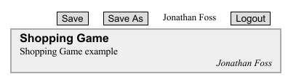
Implementation
Login system implemented with OpenID, currently allows sign in via Google accounts
  Makes security slightly easier, and more convenient for users
  Will soon add Facebook and Twitter logins
Display will be similar to current project list, but will also have save buttons.
Project list will have sections for ‘My projects’ and ‘Featured Projects’ (similar to current project list)
All models stored in a central MySQL database accessed by a PHP backend (hosted on the same server as JS-Eden due to ‘cross-site’ security restrictions)

Slide 6
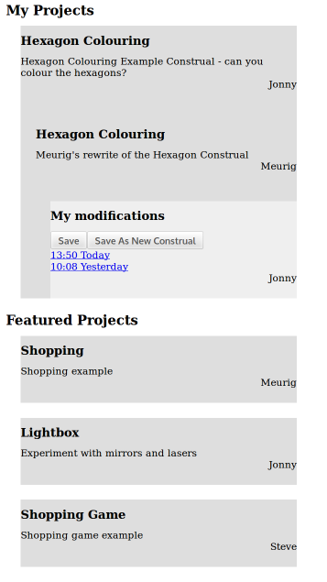
Visualisations
Different visualisations of the project list to optionally show the origins/history of a construal
Default view ‘flat’, similar to current project list
Or hierarchical (very rough mock-up shown)
Could have directed graph style views (like the dependency map)
Save button saves current construal state in the project manager database
Save As button saves current construal under a new name (‘promotes’ it to a standalone construal rather than just a modification of an existing one)

Slide 7
Other Ideas
Elizabeth has worked on other I/O functionality, e.g.:
  File exporters
  Cloud-based storage
These functions can also be linked in with the new ProjectManager, by adding ‘Export’ buttons
Could also add ‘Share’ functionality – user can click to generate a URL that goes directly to the construal, that can be shared on social media

