Slide 1
Discussion for C7
What are construals and what have we learnt about making them?

Slide 2
Curriculum for making construals
Scope of the curriculum (“six claims”):
Accessibility
Comprehensibility
Scope for collaborative development
Scope for assessment and evaluation
Serving as a resource for creating OERs
Wide applicability across disciplines

Slide 4
“Construal”?
‘my explanation’ for phenomenon X
how I think about X
how I think X works
how I think X is constructed / put together

Slide 5
Why do construals matter?
What difference does it make that we attribute sickness to a virus or a bacterium or to the sinfulness of our forefathers?
It doesn’t necessarily mean that we can cure a patient/ stop an epidemic etc but it orients in a more appropriate way to this task
What difference does it make that we have a post-Aristotelian view of the heavens?
> We can integrate our understanding of physical events better and can exploit this to do things

Slide 6
Varieties of construal we make …
… of things we understand very well e.g. how a internal combustion engine works
… of unexpected occurrences for which we have no ready explanation
… of how learning activities take place
… of what it might be possible or desirable to construct

Slide 7
Examples of construals
A car engine [enginewithgearsSidbury2010]
Shopping
Solar system
Adventures in a lift ...
Playing noughts-and-crosses [oxoGardner1999]
A design for a room [roomdemolabShao2012]

Slide 8
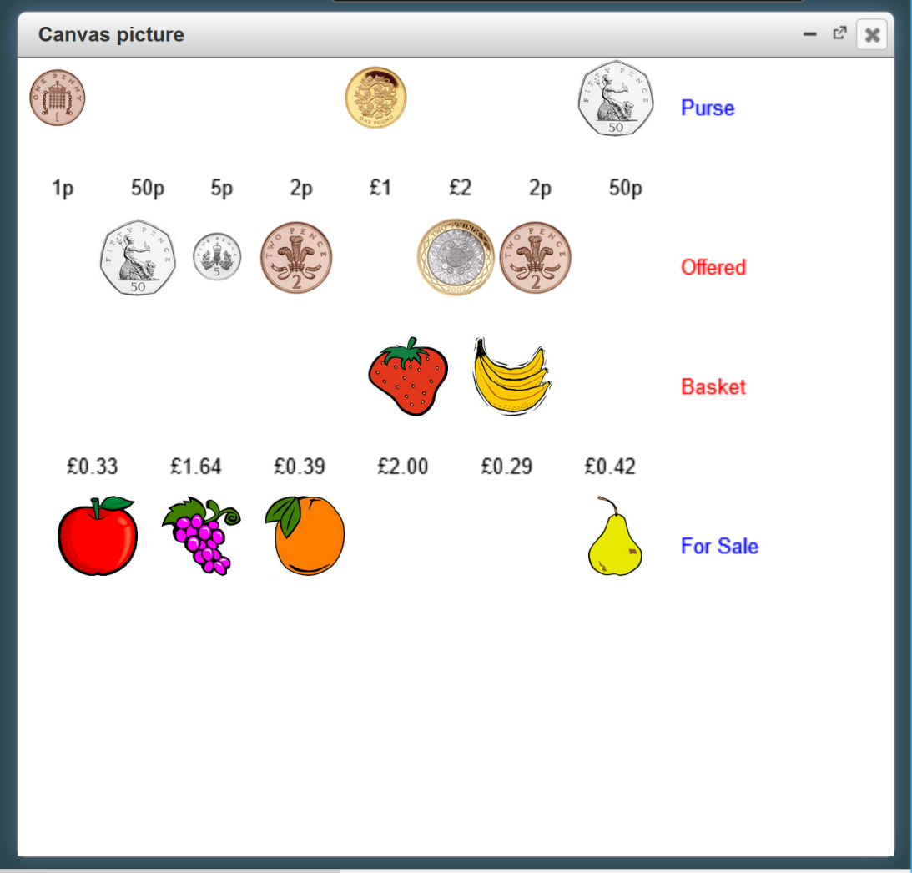
http://jseden.dcs.warwick.ac.uk/latest-master/index-dev.html?load=jseden1/public/ShoppingReadme&tag=3786

Slide 9
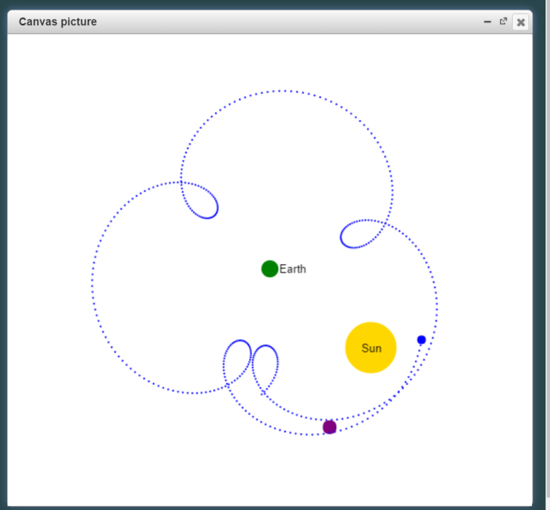
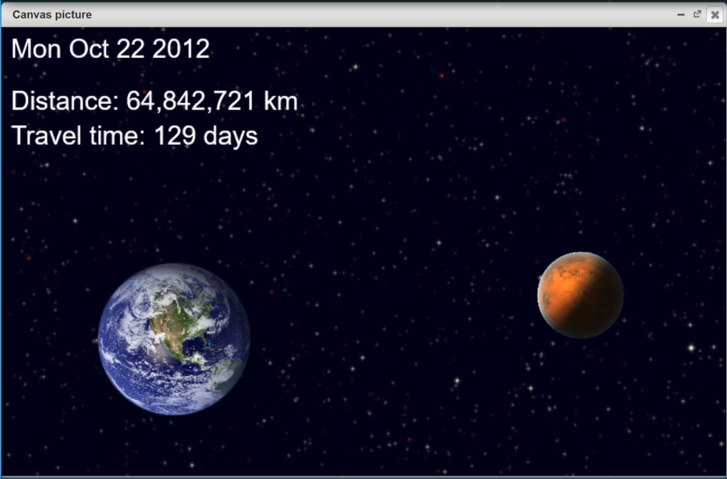
Solar system exercises ...
Walkthrough version of introductory worksheet
MC and the MCE worksheet
Mars launcher
Recession of planets
Moons of Jupiter
Construals with 3D graphics
Mechanical construals
http://jseden.dcs.warwick.ac.uk/latest-master/index-dev.html?load=jseden1/public/Solar&tag=3691

Slide 10
The lift adventure

Slide 11
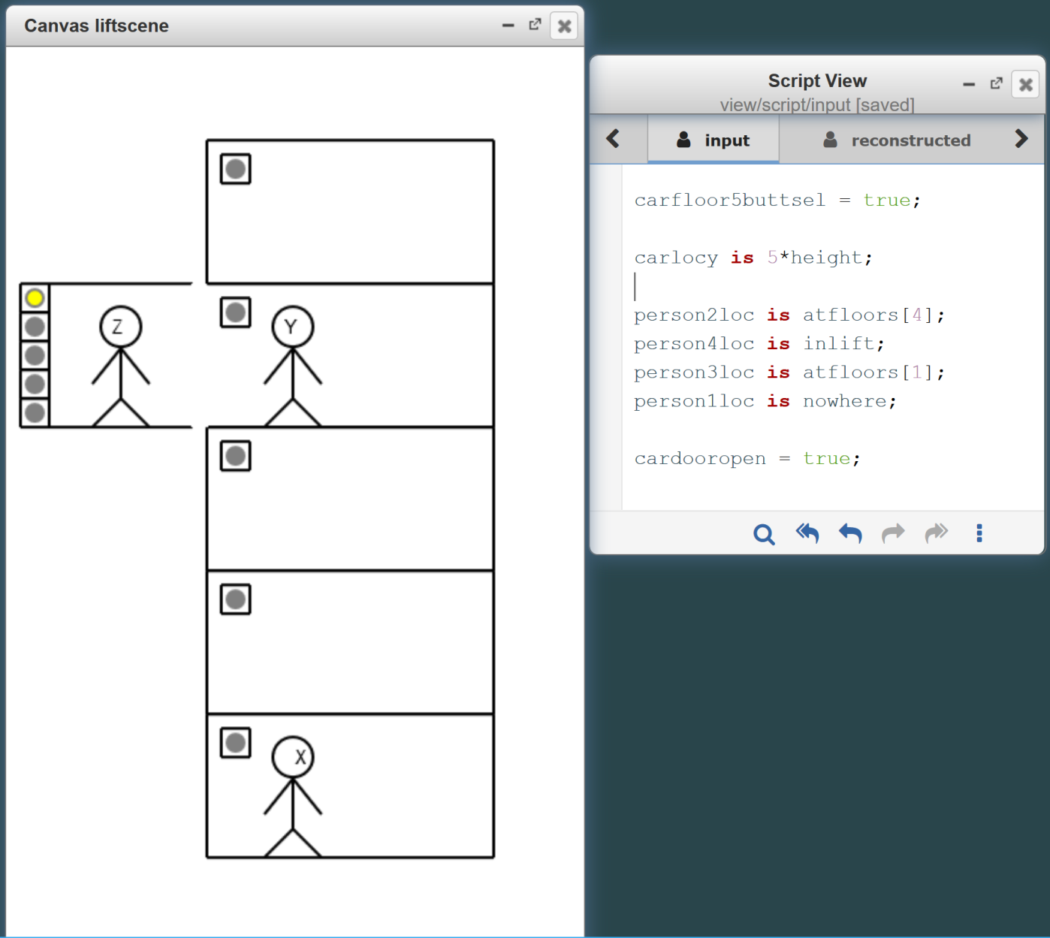
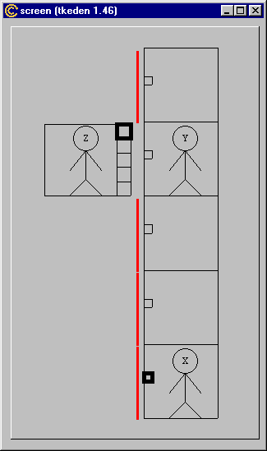
2003
2016

Slide 12
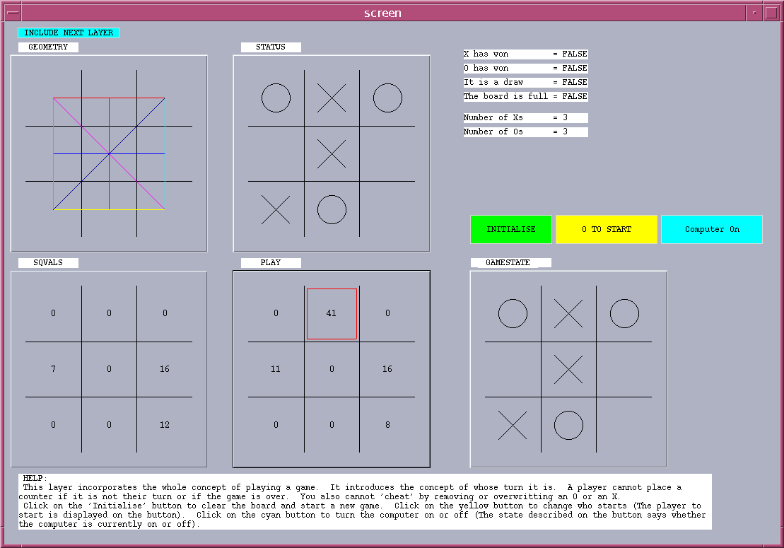
Simon Gardner: The original OXO laboratory (1999)
based on Mike Joy: The first OXO construal prototype (1994)
Status of an
arbitrary
OXO position
Winning lines
State of OXO
board in play
Square evaluation
and chosen move
Beynon, M. and Joy, M. “Computer programming for noughts-and-crosses: New frontiers”, in Proceedings of PPIG’94, 1994, pp. 27–37.

Slide 13
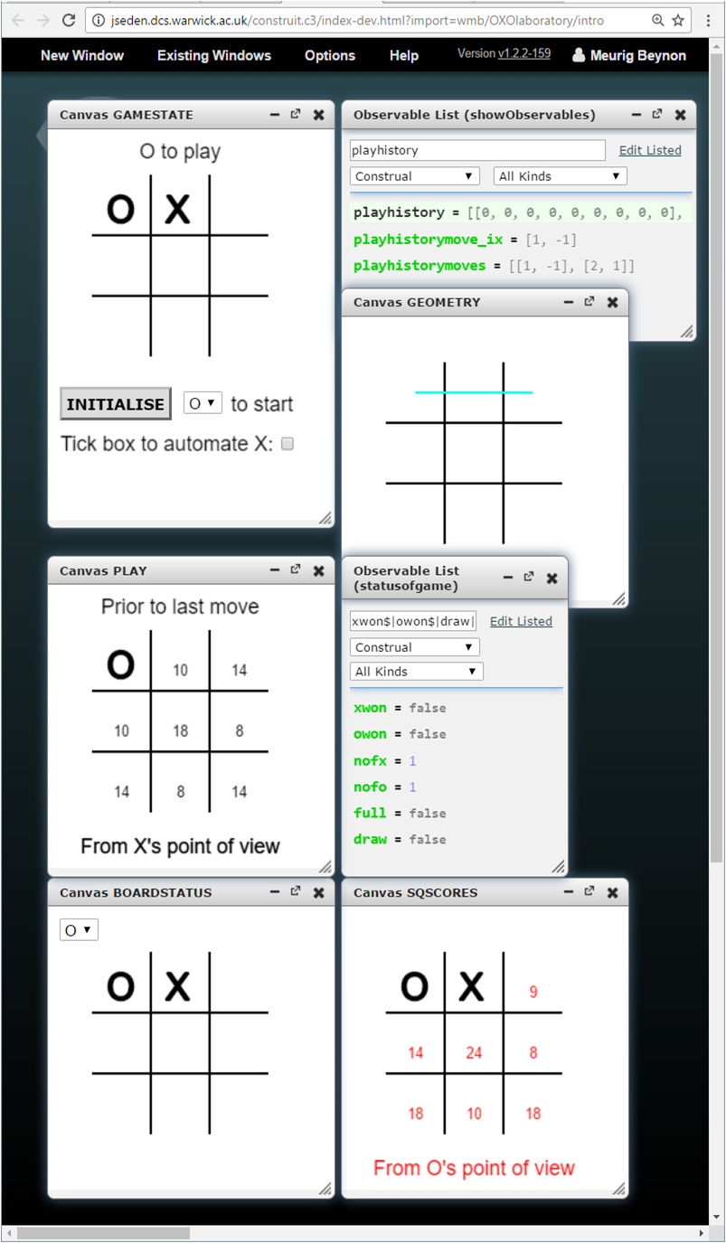
The OXO laboratory in “the MCE”: the environment for making construals

Slide 14
Open educational resources
Making construals as a new digital skill for creating interactive open educational resources ...
... user → modder → maker perspectives
... How to introduce this concept to schools?

Slide 15
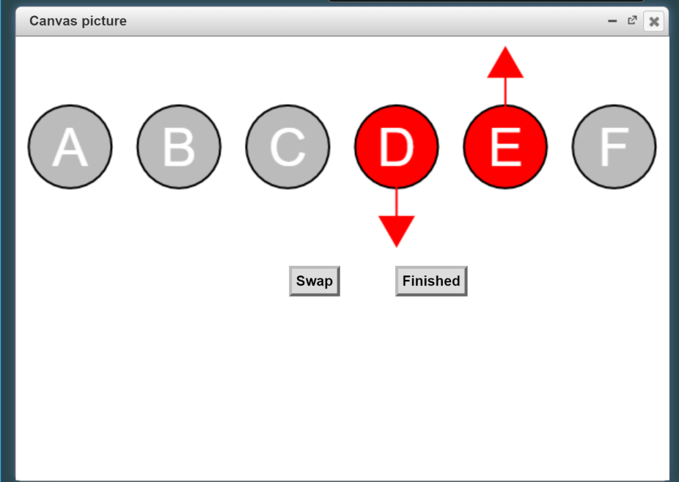
Gary Shearn’s ‘unplugged’ sorting
Add scales
Infer the order from random comparisons (making the order visible to the human viewer)
Sort by random comparisons
Sort in reverse order
Blend with trigonometric construals so as to sort sin, cos and tan and display graphs
See http://community.computingatschool.org.uk/resources/4516

Slide 17
Making construals
Having a specification of something may not help us to construct it cf. programming/modelling
Knowing what a construal ideally is is valuable, but doesn’t account for how construals are made
Construals are actually very hard to define cf. a genuine construal can be a misconstrual
“once bitten, twice shy”

Slide 18
A working definition for CONSTRUIT!
A construal of X is anything that somebody can experience as connected with X

Slide 19
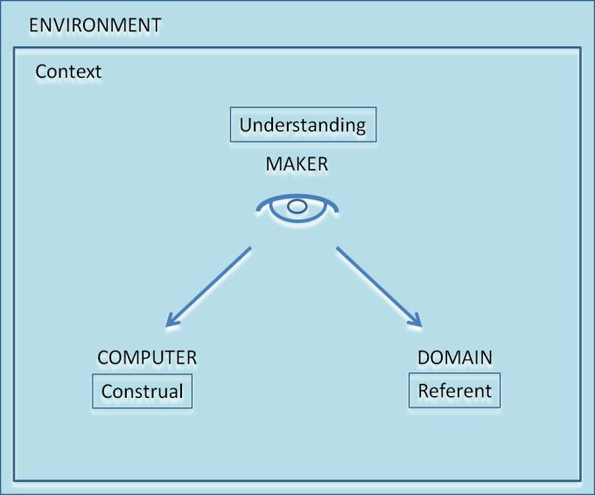
Making a (“digital”) Construal
From which perspective is the maker making the construal e.g. Agents? Constraints?
What interactions and interpretations is the maker familiar with? Convinced of? puzzled about?
What external subject does the maker have in mind when interacting with the construal?
Script of definitions of observables
with associated network of dependencies
A connection experienced by the maker

Slide 20
Key notions
There is no right construal [some might wish to say ‘in general’]
The fundamental diagram is about capturing what we understand partially, provisionally, personally and quite possibly mistakenly
Confronting confusion and making mistakes is of the essence in making construals

Slide 21
Summary
The fundamental diagram expresses the way in which meaning is captured through interaction
Construals can be expressed using a script of definitions and an associated cloud of interactions in the form of re-definitions
Which interactions are meaningful depends on who/what is making the re-definitions and in what context

Slide 22
Summary
The fundamental diagram expresses the way in which meaning is captured through interaction
Construals can be expressed using a set of dependencies between observables and a cloud of interactions in the form of re-definitions
Which interactions are meaningful depends on who/what agent is making the re-definitions and in what context

Slide 23
Orientation
Experience
  Awareness of experience [Dewey]
Classification of experience
  observables / dependency / agency
Concrete and situated examples informing key abstractions in making construals

Slide 24
Abstractions from experience
Ingredients common to all three examples:
  you as maker
  your construal
  its referent
  your context
... the fundamental diagram

Slide 25
Character of the diagram
A slice through an ongoing interactive experience:
the construal
its referent
the maker’s understanding
the context
are all co-evolving

Slide 27
Nature of making construals
Construction through conjunction as seen in:
  relating construals to programs
  identifying observables through interaction
  realising understanding as a stream-of-thought
  commonsense perception of concurrence
as horizontal, vertical and orthogonal relations illustrated by sample construals

Slide 28
… Behaviour as programmed state change
GAME DESIGNER
INTERNAL STATE
OXO GAME
PLAYER
VISUALISATION
PROGRAMMER
Static and dynamic elements of state

Slide 29
3 ingredients in construal development:
engineering the states within which the agency of the user and the computer operate;
crafting the behaviours which these agents then play out;
projecting meanings on to the agent actions
"Vertical", "horizontal" and "orthogonal" dimensions of state

Slide 30
Different kinds of conjunction
Perceived as concurrent – ‘vertical’ dimension
Flowing one into another – ‘horizontal’
Evoking associations with a referent – ‘orthogonal’
Relate to the annotated fundamental diagram: resp. developing context cf. D, patterns of interaction B +C, and semantic link A

Slide 31
Key features of making a construal
opens up such a profusion of possible interpretations, stimulating the model-builder's imagination and creativity.
is an open-ended activity that resembles organic growth rather than building to a specification

Slide 32
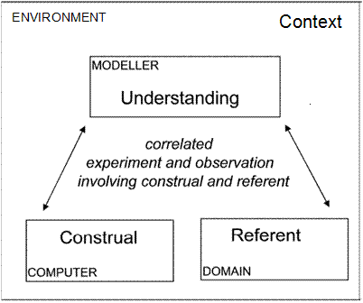
The “Fundamental Diagram of EM”
A - correlation in experience
C
D
B - construal as embodied in latent patterns of meaningful interaction
MAKER
C - understanding as awareness of patterns of meaningful interaction
B
D - context subject to evolve, or to be revised by the maker at will
A
A –the semantics of construals cf. digit-cabinet, lines
B – cf. malaria / lift adventure
C – what it means to play a game of noughts and crosses / using vi editor
D – the experimental paradox / making the transition from construal to program

Slide 34
An environment for making construals
Symbol list comprising
Definition list – observables + dependencies
Function list – framing dependencies
Action list – automating agency
Abstract dependency relationships
dependency map

Slide 35
Definitive scripts as “germs of a construal”
≡ a definitive script
≡ a nonsense redefinition
≡ a plausible redefinition
≡ a ritualised definition
Plausible : could open the desk drawer
– note continuous spectrum of redefinitions
Ritualised : door automatically closes after being opened
Nonsense : opening the drawer makes the room smaller

Slide 36
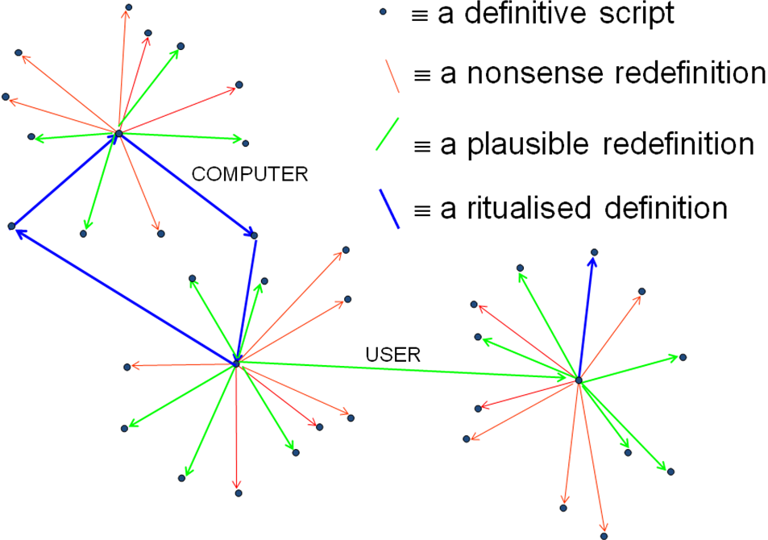

Slide 38
Issues for practice
Key claims for making construals are not justified by our practical implementation:
  It is not easy for a non-technical person to comprehend a construal in the MCE
    Scripts are too long
    Names are too obscure
    Scripts cannot easily be searched
    It’s hard to know what the current definition of an observable is
!! The connections in experience aren’t easy to appreciate directly in the MCE: in addition
!! JavaScript programming as practised illustrates some of the characteristics of making construals better than working in the MCE does

Slide 39
Necessary improvements ...
documentation through automatic processing of appropriately commented scripts
walkthrough techniques such as apply to the Lift Adventure
the with construct as a way of capturing richer modes of observation
when's and management of concurrency: reflecting the personal informal nature of action
loops and script generation

