Slide 1
Dependency and its role in modern programming languages
Antony Harfield
8th January 2010

Slide 2



Background
Warwick, UK: Empirical Modelling Research Group
Joensuu, Finland: EdTech Research Group
Notes:
Academic background: Phd, post doc, research fellow

Slide 3

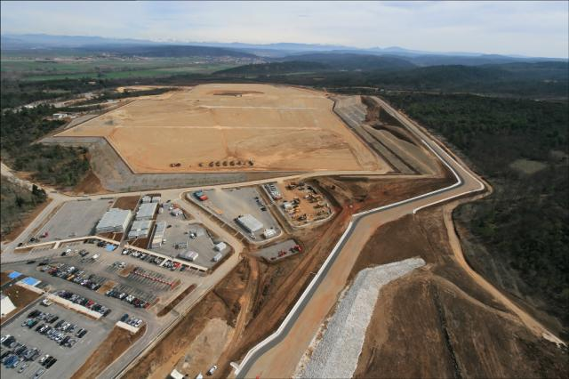
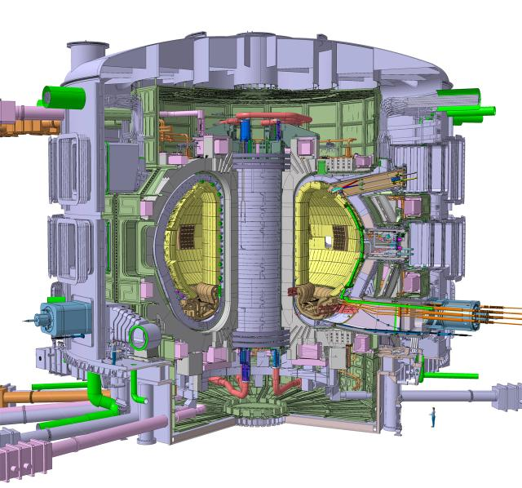

Current work
France: international project to develop fusion as a renewable energy source
Notes:
Starting to use some of the latest technologies and discovering that they are beginning to use dependency…
This pres brings together my academic work, with new technologies that you can find in industry.
I think it is very important to be learning about the latest technologies that are being used in industry.

Slide 4
A bit of history
A long time ago, before Java and .NET existed…
People have been using dependency in software
Computer scientists at Warwick developed principles for using dependency and tools for building software that use dependency
Notes:
A bunch of Warwick computer scientists were using dependency to build software artefacts.
They developed principles by which you can think about dependency, and tools to model using dependency.
They were not the only ones to use dependency, lots of applications like Spreadsheets did too.

Slide 5
What is dependency?
Values (e.g. a total) dependent on other values

Slide 6
What is dependency?
Another example of values dependent on other values from relational databases
Customer
CustomerId, Name
ValuableCustomers
Name, TotalSpent
Order
OrderId, CustomerId, Amount
CREATE VIEW ValuableCustomers AS
SELECT Name, Sum(Amount) TotalSpent
FROM Customer INNER JOIN Order ON
Customer.CustomerId = Order.CustomerId
WHERE Sum(Amount) > 1000
GROUP BY Name

Slide 7
What is dependency?
Properties (e.g. cell colour) dependent on values

Slide 8
What is dependency?
Properties dependent on other properties?
A bit more difficult
Requires a notion of dependency at a low level in the application/programming language
But, it gives the freedom to create dependencies between any objects, properties, and variables

Slide 9
Key ingredients of dependency
Observable (Variable, property or object)
Definition (Formula or function)
For example, in a spreadsheet:
The observable is the cell or the value displayed in a cell
The definition is the formula of the cell (e.g. the sum of a column of cells)

Slide 10
Empirical Modelling Tools
EDEN – a general purpose modelling environment in which any variable/property can depend on other variables/properties
Web EDEN – a web-based version of EDEN currently in development
DOSTE – another general purpose dependency environment
ADM – a tool for defining agents with dependency
JAM – a tool for adding dependency to Java
Dependency is the key principle behind all these tools!

Slide 11
EDEN example
1.
2.
3.
4.
5.
6.
7.
8.
9.
10.
11.
12.
13.
14.
myexample = window {
title = "Listbox Example: " // mylistbox_selecteditems[1];
content = [mylistbox]
};
mylistbox = listbox {
selectmode = "browse";
items = [ "blue", "red", "green", "yellow" ];
selecteditems = [ "red" ];
background = mylistbox_selecteditems[1];
font = "Verdana 32";
width = myexample_width;
height = mylistbox_items#
};
Spot the dependencies

Slide 12
The rise of WPF
Windows Presentation Foundation is Microsoft’s latest API for creating Windows applications
Much richer interfaces than existing Windows Forms UIs
Because it uses DirectX
WPF 3.5 (in .NET Framework 3.5) is considered mature – reasonable VisualStudio integration
Notes:
Who knows what WPF is?

Slide 13
What can you do with WPF?
Groovy user interfaces!
The usual GUI components
Rich drawing model for 2D and 3D
Animation, audio, video
Styles, templating, layouts
In a variety of formats:
Traditional windows application
Packaged web app
Silverlight RIAs (Rich Internet Applications)

Slide 14
How do you write WPF applications?
User interfaces can be written in XML, using a language called XAML
Code behind in any of the CLR languages (C#, VB.NET, etc)
Or you could write it all in code – but XAML is much cleaner and allows you to separate your presentation logic from your business logic

Slide 15
WPF Example
<Window x:Class="CoolShapedWindow.Mickey"
xmlns="http://schemas.microsoft.com/winfx/2006/xaml/presentation"
xmlns:x="http://schemas.microsoft.com/winfx/2006/xaml"
Title=“Mickey" AllowsTransparency="True" WindowStyle="None" Background="Transparent">
<Grid>
<Image Source=“famousmouse.png" MouseLeftButtonDown="Image_MouseLeftButtonDown" MouseRightButtonDown="Image_MouseRightButtonDown"/>
</Grid>
</Window>

Slide 16
EM technologies and WPF
What is the connection between WPF and Empirical Modelling?
Dependency!
Or more precisely, Microsoft’s implementation of .NET dependency properties

Slide 17
Normal properties
In OOP, classes usually have fields and methods
But in .NET classes also have ‘properties’ that wrap getters and setters:
private String name;
public String Name {
get { return name; }
set { name = Value; }
}

Slide 18
Dependency properties
Look like normal properties, but…
Support change notification -> dependency
Bind one property to another
Triggered actions
Default value inheritance
Efficient storage

Slide 19
Dependency properties
Most properties in WPF are dependency properties
Therefore you can create dependencies between almost every aspect of your GUI
You can create dependency properties in your custom classes so that you can make your GUI ‘depend’ upon your business objects

Slide 20
Binding
A ‘binding’ is what creates the actual dependency
For example:
<Slider Name=“SourceSlider" Value="20" />
<TextBlock Name=“TargetTextBlock“
Text=“Sawasdee Naresuan!“
FontSize="{Binding ElementName=SourceSlider, Path=Value}"/>

Slide 21
Binding
Equivalent binding in code:
Binding binding = new Binding();
binding.Source = SourceSlider;
binding.Path = new PropertyPath(“Value”);
binding.Mode = BindingMode.OneWay;
TargetTextBlock.SetBinding(FontSize, binding);
Binding is nothing new: it has been used to bind domain objects to user interfaces for some time
But (I think) WPF has brought out (or will bring out) the power of binding…

Slide 22
Examples
Simple dependency
Two way dependency
Triggers
Animation

Slide 23
Examples
<Window …
Title="{Binding ElementName=MyTextBox, Path=Text}">
<StackPanel>
<TextBox Name="MyTextBox" />
<TextBlock Name="MyTextBlock" Text="{Binding ElementName=MyTextBox, Path=Text}" />
…

Slide 24
Examples (two-way binding)
<Slider Name="FontSizeSlider" Minimum="10" Maximum="50" Value="20" Margin="3" />
<TextBlock Name="MyTextBlock" Text="Hello World!" FontSize="{Binding ElementName=FontSizeSlider, Path=Value, Mode=TwoWay}" Margin="3" />
<StackPanel Orientation="Horizontal">
<Button Click="Click_SetSliderValue" Margin="5">Set Slider Value</Button>
<Button Click="Click_SetTextBlockFontSize" Margin="5">Set TextBlock FontSize</Button>
</StackPanel>

Slide 25
Examples (triggers)
<Style.Triggers>
<Trigger Property="Control.IsMouseOver" Value="True">
<Setter Property="Control.Foreground" Value="White" />
<Setter Property="Control.Background" Value="Red" />
</Trigger>
</Style.Triggers>

Slide 26
Examples (animation)
<Button Name="MyButton" HorizontalAlignment="Center" Width="100" Height="30">
<Button.Triggers>
<EventTrigger RoutedEvent="Mouse.MouseEnter">
<BeginStoryboard>
<Storyboard>
<DoubleAnimation Storyboard.TargetProperty="Width" To="120" Duration="0:0:1" />
<DoubleAnimation Storyboard.TargetProperty="Height" To="50" Duration="0:0:1" />
</Storyboard>
</BeginStoryboard>
</EventTrigger>
<EventTrigger RoutedEvent="Mouse.MouseLeave">
<BeginStoryboard>
<Storyboard>
<DoubleAnimation Storyboard.TargetProperty="Width" To="100" Duration="0:0:1" />
<DoubleAnimation Storyboard.TargetProperty="Height" To="30" Duration="0:0:1" />
</Storyboard>
</BeginStoryboard>
</EventTrigger>
</Button.Triggers>
Button 1
</Button>
<ProgressBar Minimum="100" Maximum="120" Value="{Binding ElementName=MyButton, Path=Width}" Height="20"/>

Slide 27
EM / WPF comparisons
Types of dependency
WPF has 4 types of binding:
One time
One way
Two way
One way to source – nasty
EM has one type of dependency
E.g. a = b + c

Slide 28
EM / WPF comparisons
2. Complexity of definitions
WPF makes it easier to do one-to-one bindings, but ‘multi-bindings’ require a bit code
If you want to do a = f(x,y,z) then you need to write an IMultiValueConverter class for your function f
EM languages allow functional definitions for dependencies
Simply create a definition a = f(x,y,z)

Slide 29
EM / WPF comparisons
3. Triggered actions
Enable you to write (ADM-like) definitions such as ‘when this condition occurs, make this state change’
WPF has good support (see button hover example)
Triggers are fundamental concepts in EM

Slide 30
EM / WPF comparisons
4. User interface layout
WPF is really the first technology that encourages laying out your user interface with dependency
Make the size and position of your components dependent on each other
EM has been doing this for a while, but the graphics were quite primitive
Visual effects in WPF are impressive (full power of DirectX)

Slide 31
EM / WPF comparisons
5. Transformations
WPF has some support
E.g. ‘VisualBrush’ that uses dependency/binding to paint components that are transformed
In DoNaLD (Definitive Notation for Line Drawing), there are transformations that fully use the power of dependency

Slide 32
EM / WPF comparisons
6. Animations
Very similar ways of doing animation
Create an iterator
Make positions, sizes, colours, styles dependent on the iterator (or some other component that is dependent on the iterator)

Slide 33
EM / WPF comparisons
7. Interactivity
The biggest area of difference!
WPF is compiled from XAML/C#
The dependencies are fixed
EM technologies are interactive environments
Dependencies can be changed on-the-fly

Slide 34
EM / WPF summary
WPF has excellent graphical capabilities
WPF’s dependency properties allow developers to build software artefacts that are more concise
BUT…
The complexity of the definitions and types of dependency could be much better
It is never going to be an interactive environment

Slide 35
Flex has dependency too
But they are not called ‘dependency properties’…
<?xml version="1.0" encoding="utf-8"?>
<mx:Application xmlns:mx="http://www.adobe.com/2006/mxml" layout="vertical">
<mx:TextInput id="input" />
<mx:Label text="{input.text}" />
</mx:Application>

Slide 36
Animation through dependency (Flex)
<?xml version="1.0" encoding="utf-8"?>
<mx:Application xmlns:mx="http://www.adobe.com/2006/mxml" creationComplete="init()" layout=“absolute”>
<mx:Script>
[Bindable]
public var counter:int = 0;
public function init() {
setInterval(function(){ counter++; }, 1000);
}
</mx:Script>
<mx:Text text="Hello" x="{counter}" scaleY="{counter/10}“
color="{counter*1024}" />
</mx:Application>

Slide 37
Running the examples
To run the WPF examples you will need Visual Studio 2008
Create new project -> WPF Application
To run the Flex examples you can download a trial version of Flex Builder from Adobe

Slide 38
More information
Empirical Modelling: www.warwick.ac.uk/go/em
WPF: pick up a book, or Google for “wpf dependency properties”
Flex: go to the Adobe Developer Connection (www.adobe.com/devnet/flex) or Flex After Dark (www.flexafterdark.com)

Slide 39
Thank you for your patience
Questions?
Antony Harfield
ant@dcs.warwick.ac.uk

