Slide 1

An Adaptive Sublinear-Time Block Sparse Fourier Transform
Volkan Cevher Michael Kapralov Jonathan Scarlett
Amir Zandieh
EPFL

Slide 2
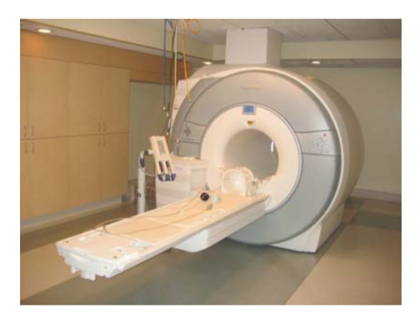
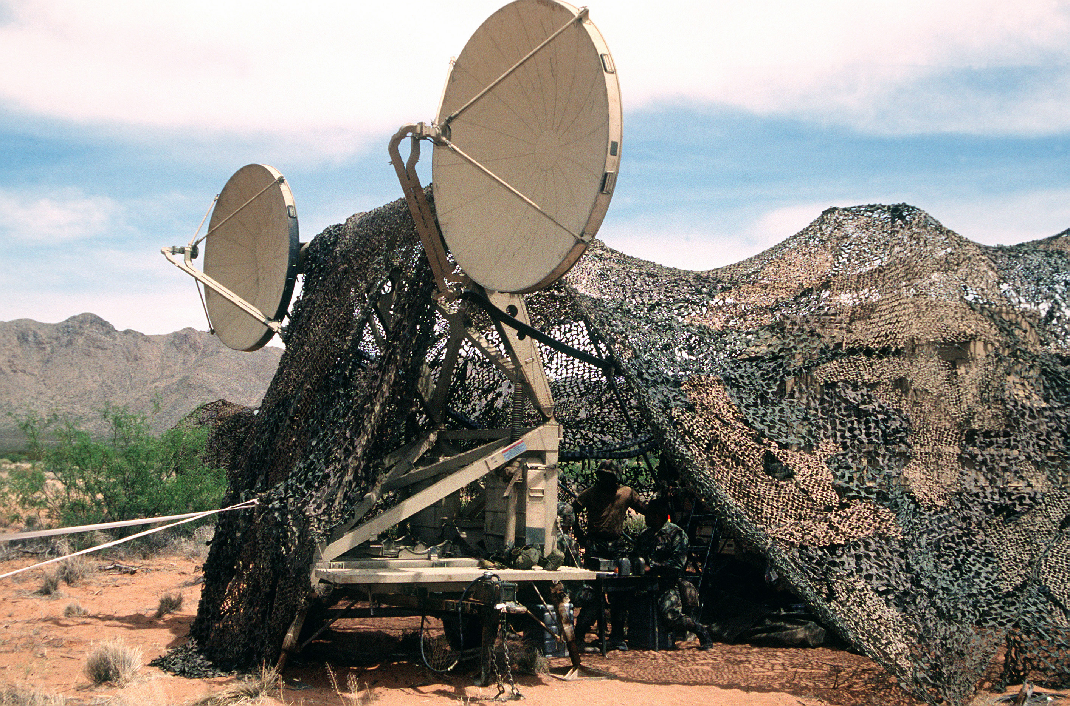
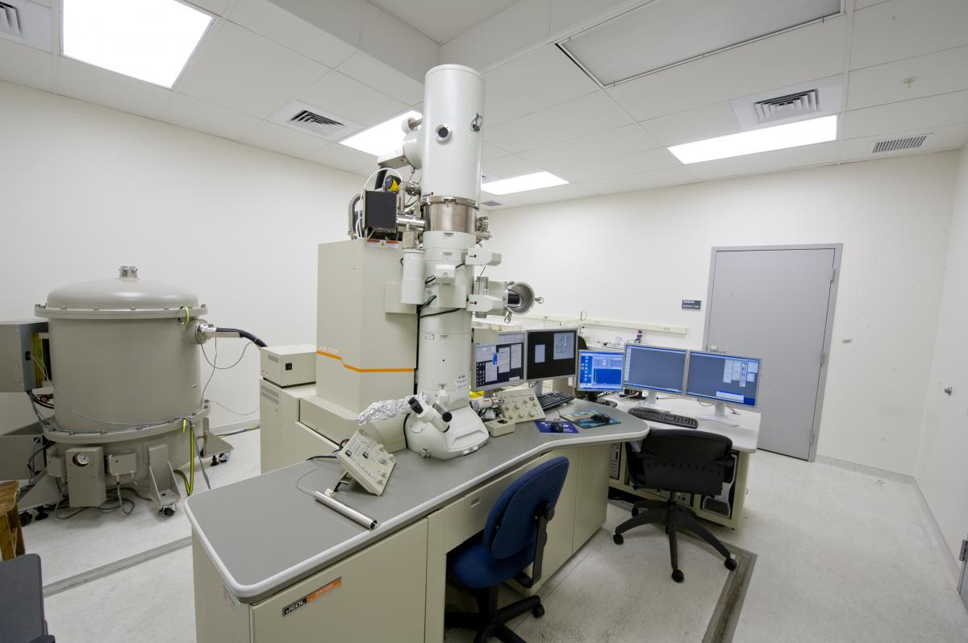
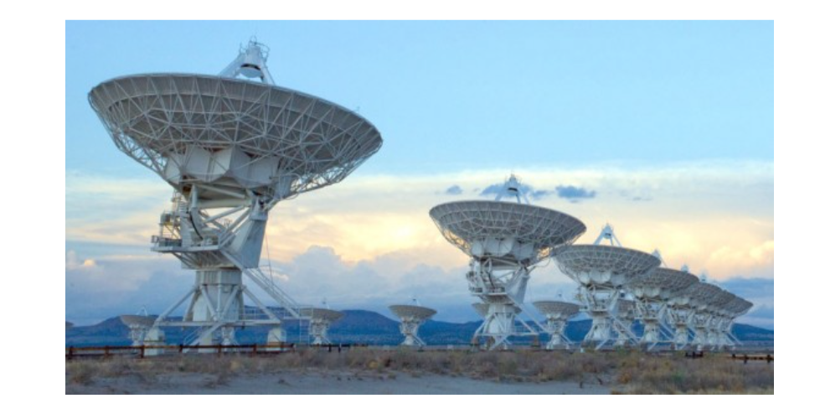

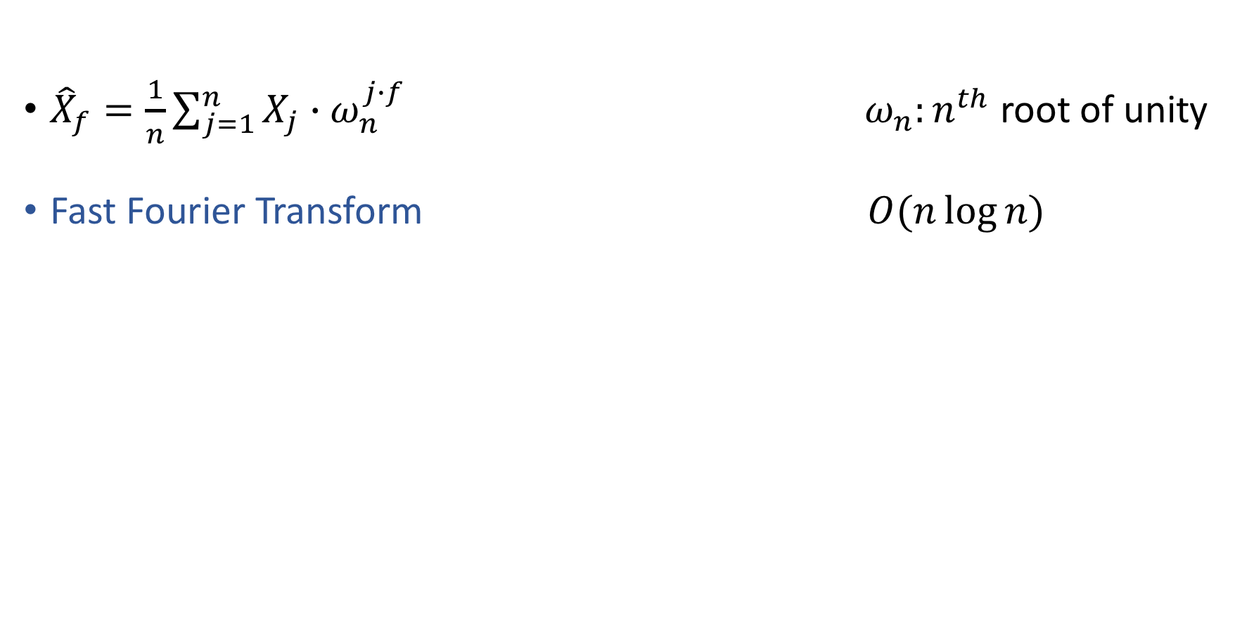
Discrete Fourier transform
${\hat{X}}_{f}=\frac{1}{n}\sum_{j=1}^{n}{X_{j}∙ω_{n}^{j∙f}}$ $ω_{n}:n^{th}$ root of unity
Fast Fourier Transform $O(n\log{n})$
Notes:
Interested in DFT of length n signal x. x we denote the dft of signal x by x hat which is defined on the slides. Omega nth root. Assume n is a power of two
FT plays a fundamental role in many scientifc and technological fields. important tool for many applications. Such as
The fastest way of computing dft is FFT.

Slide 3
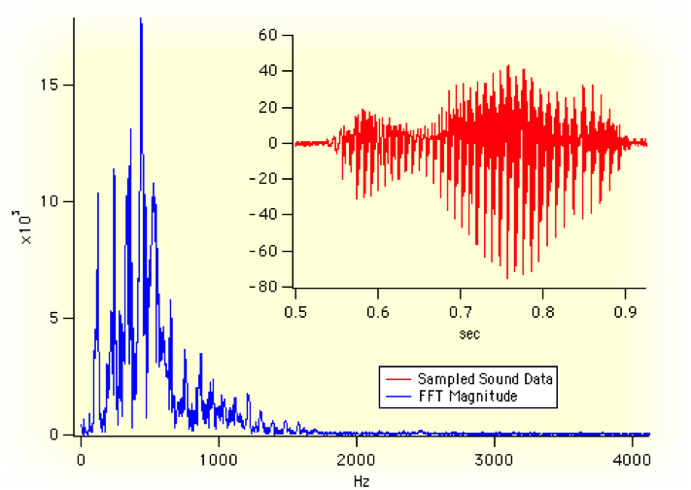
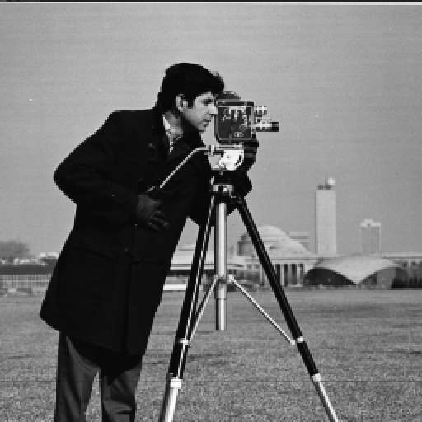
Sparse approximation
Many real world signals are (approximately) sparse
Notes:
FFT is a general purpose algorithm but But many of the real world signals are sparse or approx sparse in freq domain, meaning that their energy is concentrated on a small fraction of the spectrum. For example both audio and image signals are approx. sparse in freq domain. The sparsity has enabled compression algorithms to work.

Slide 4
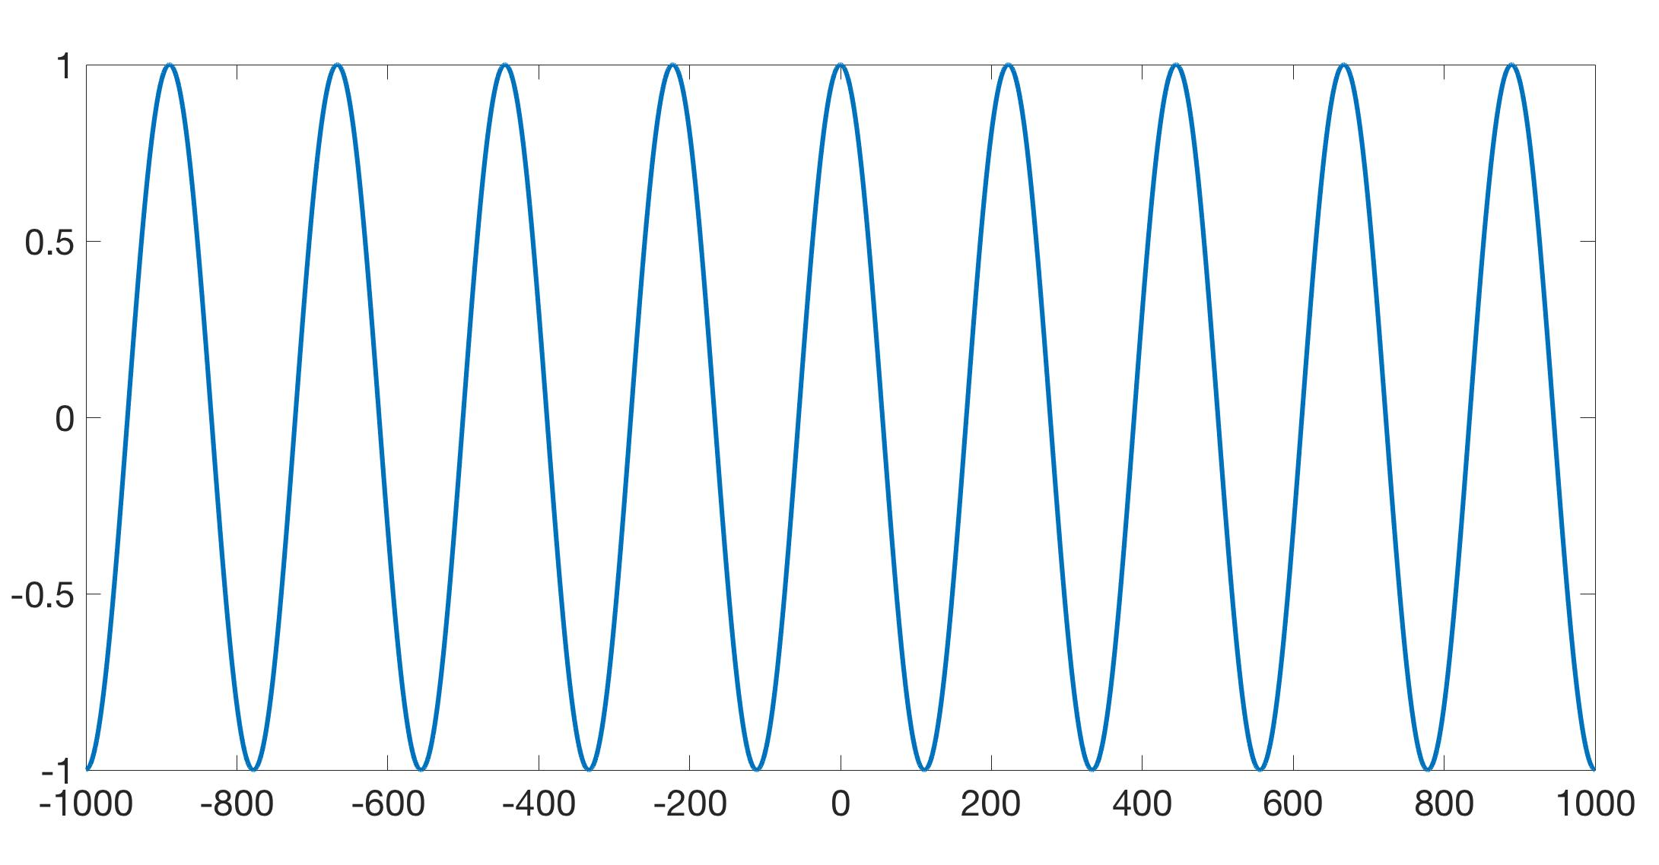
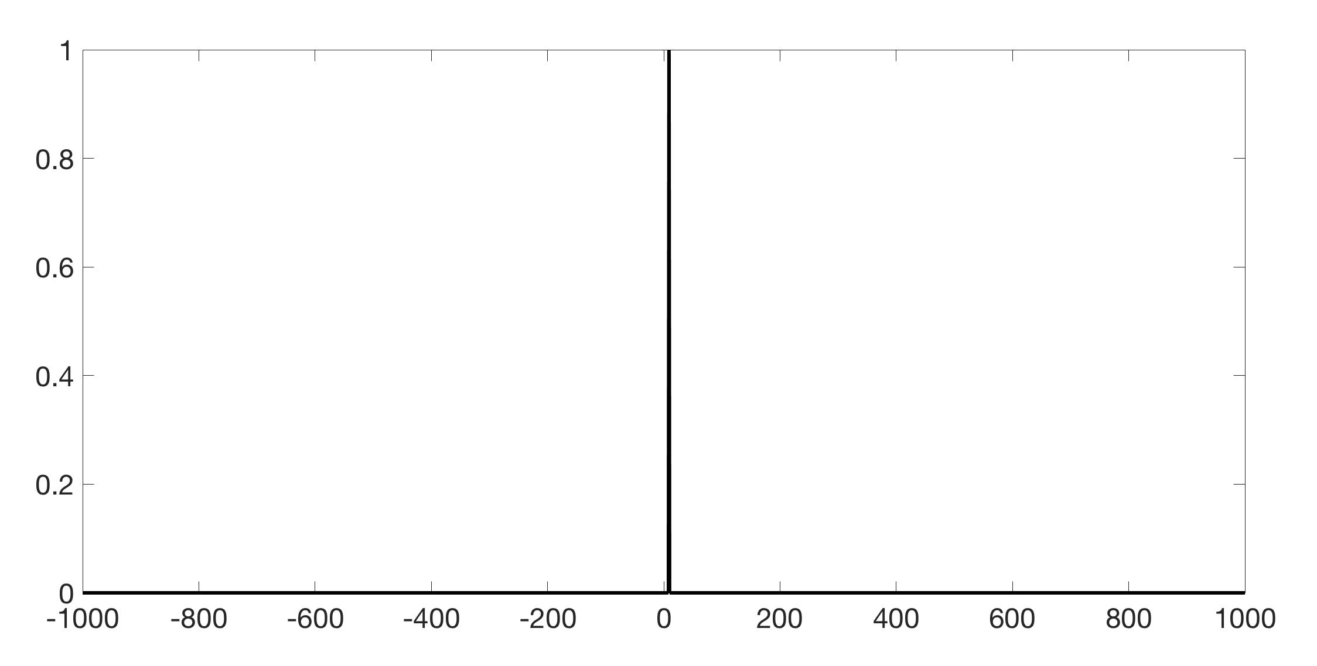
Sparse approximation
Many real world signals are (approximately) sparse
Notes:
For example on the slides you see a one sparse signal in the freq domain on the right and its time representation on the left.

Slide 5
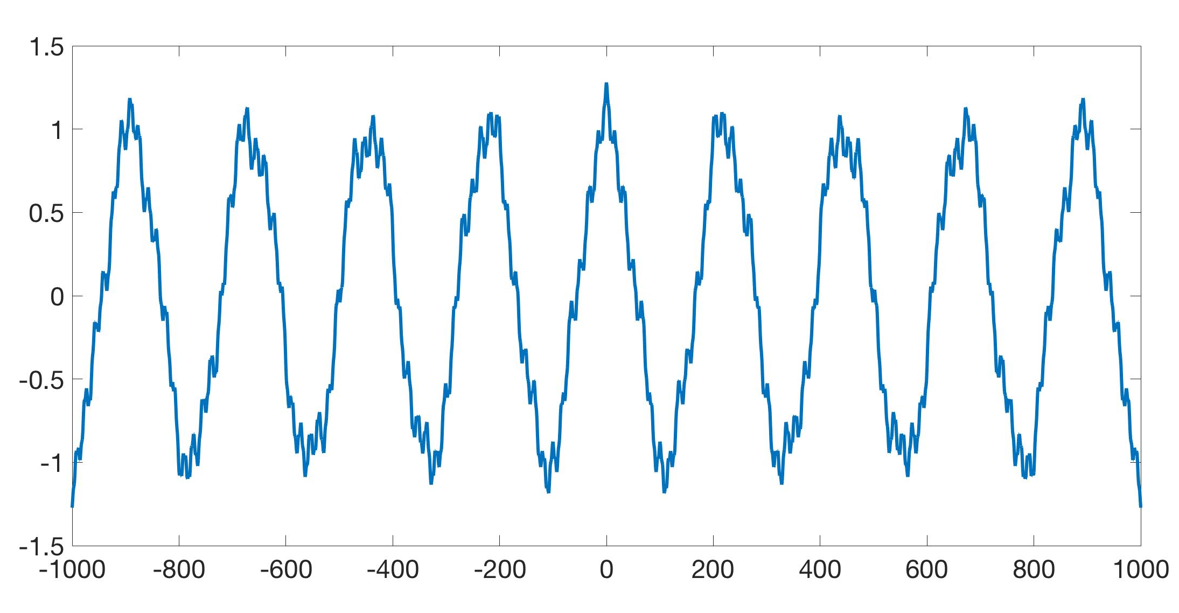
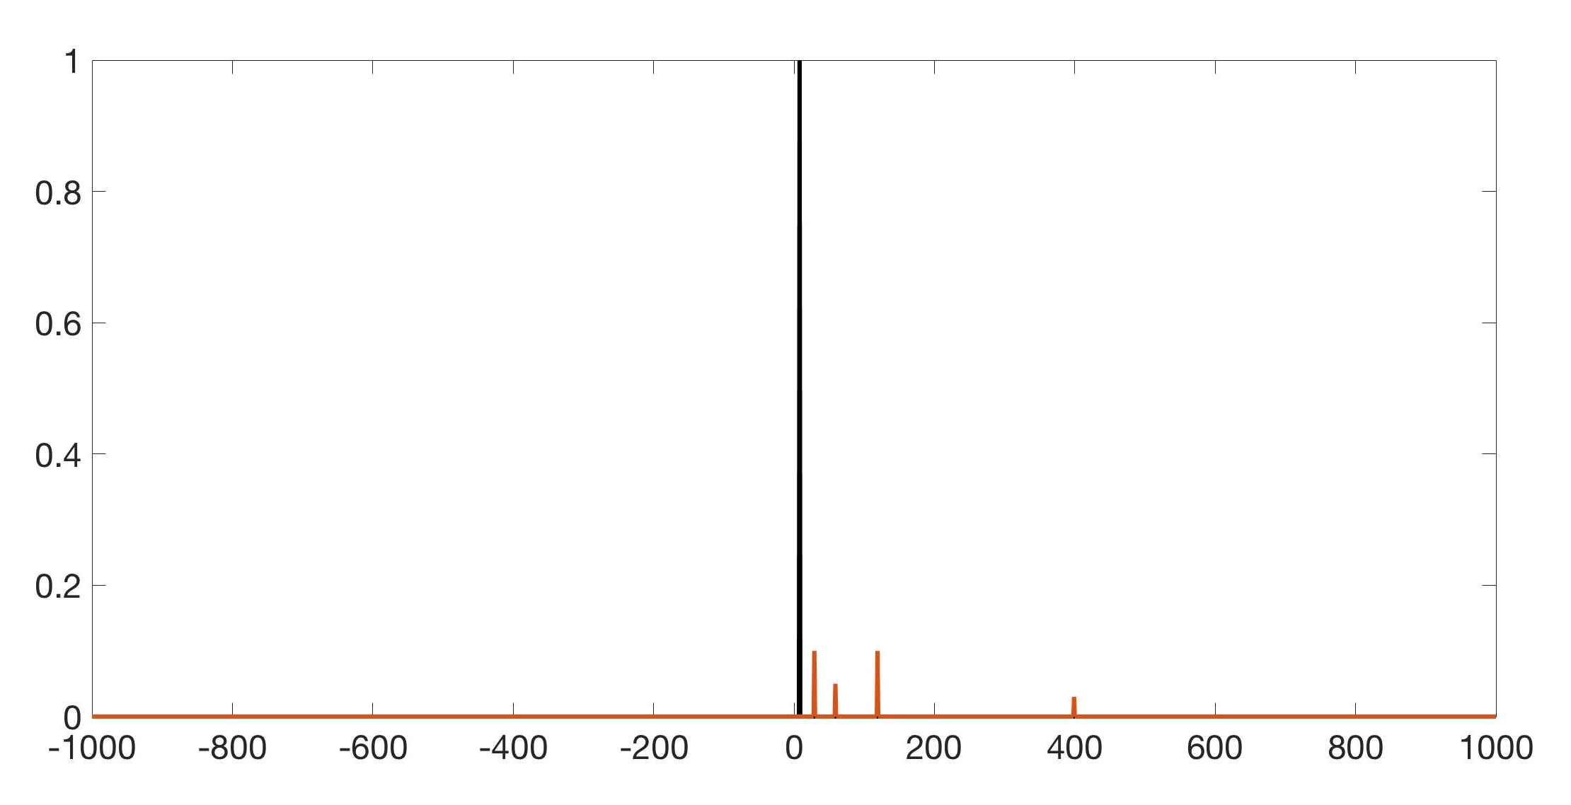
Sparse approximation
Many real world signals are (approximately) sparse
Notes:
We need more robust notion of sparsity so we introduce the approximate sparsity. We say that a signal is approx sparse if it is close to a sparse signal in some metric, this talk euclidean distance.

Slide 6
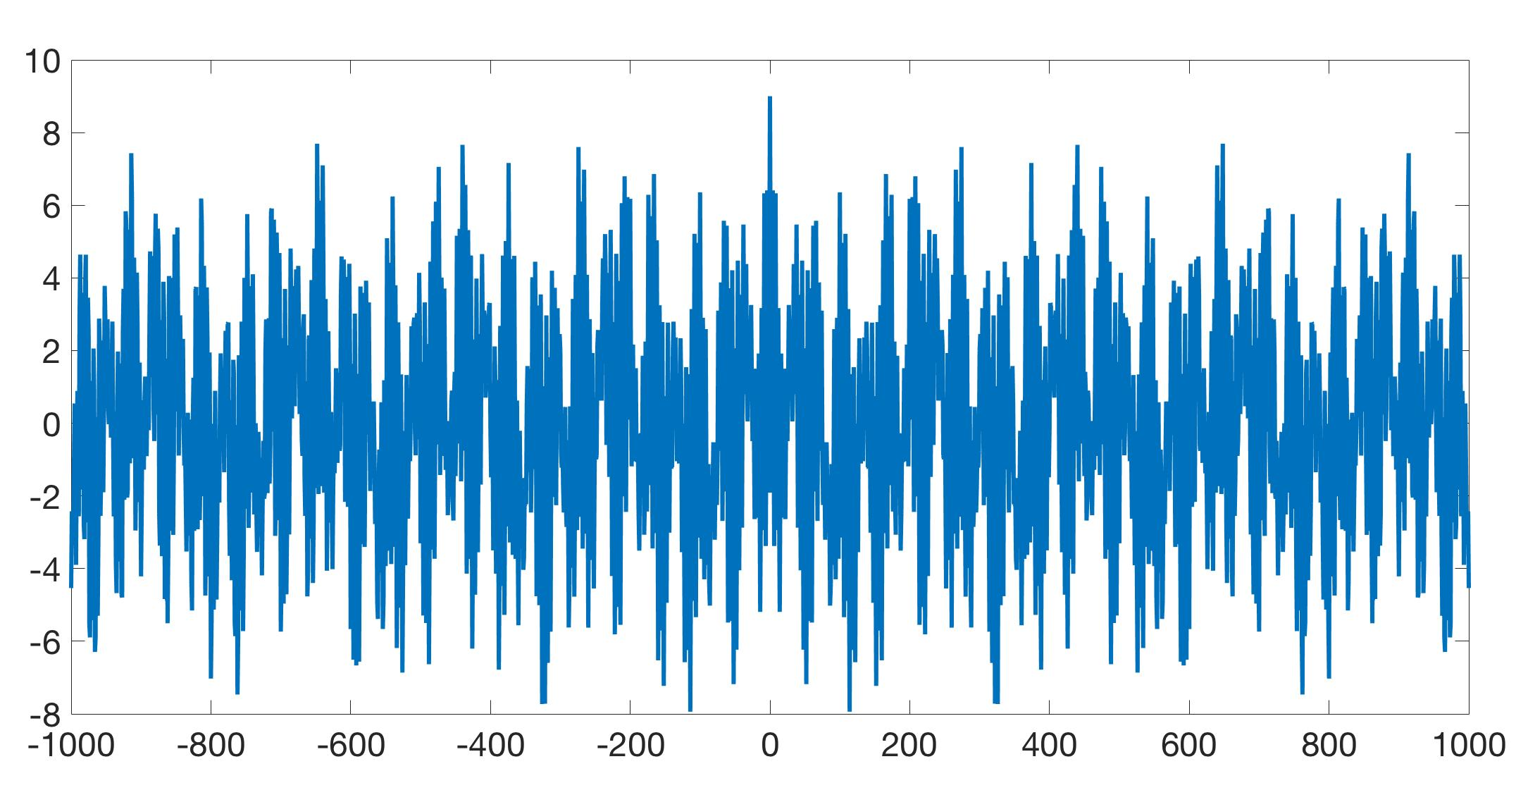
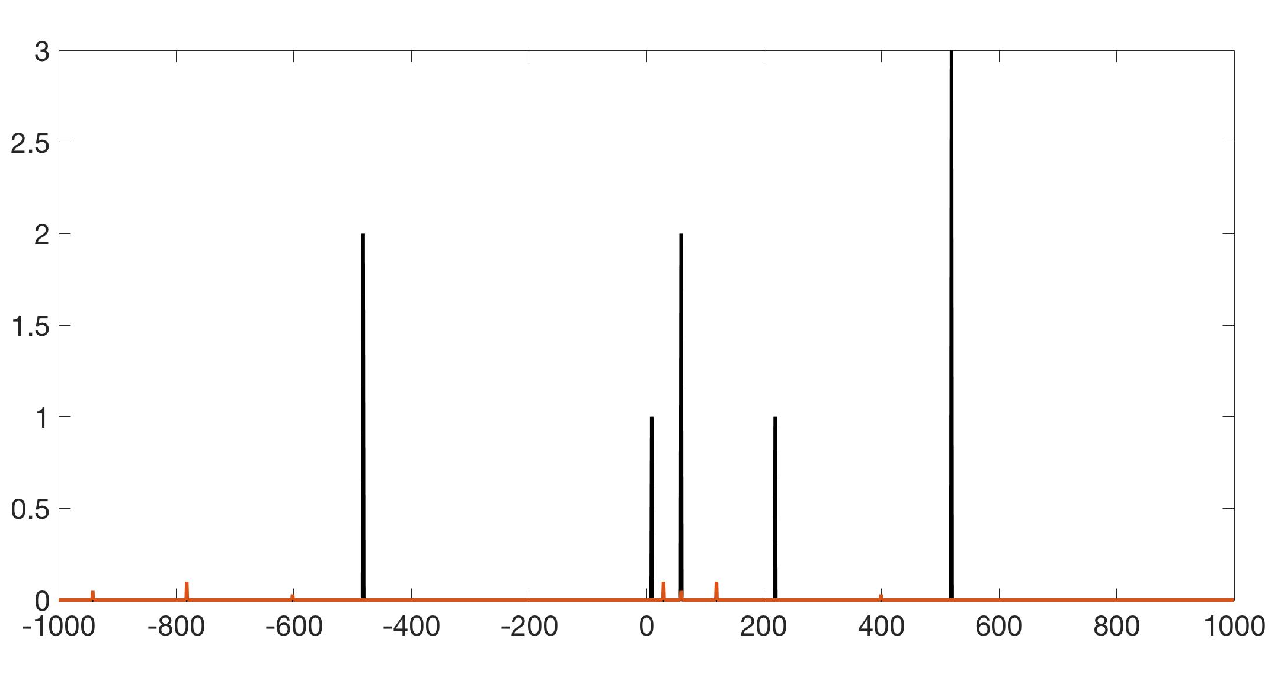
Sparse approximation
Many real world signals are (approximately) sparse
Notes:
In general we are interested in approximately k sparse signals. K dominant coefficients which contain at least a constant fraction of energy. Call Dominant freq.s head.

Slide 7
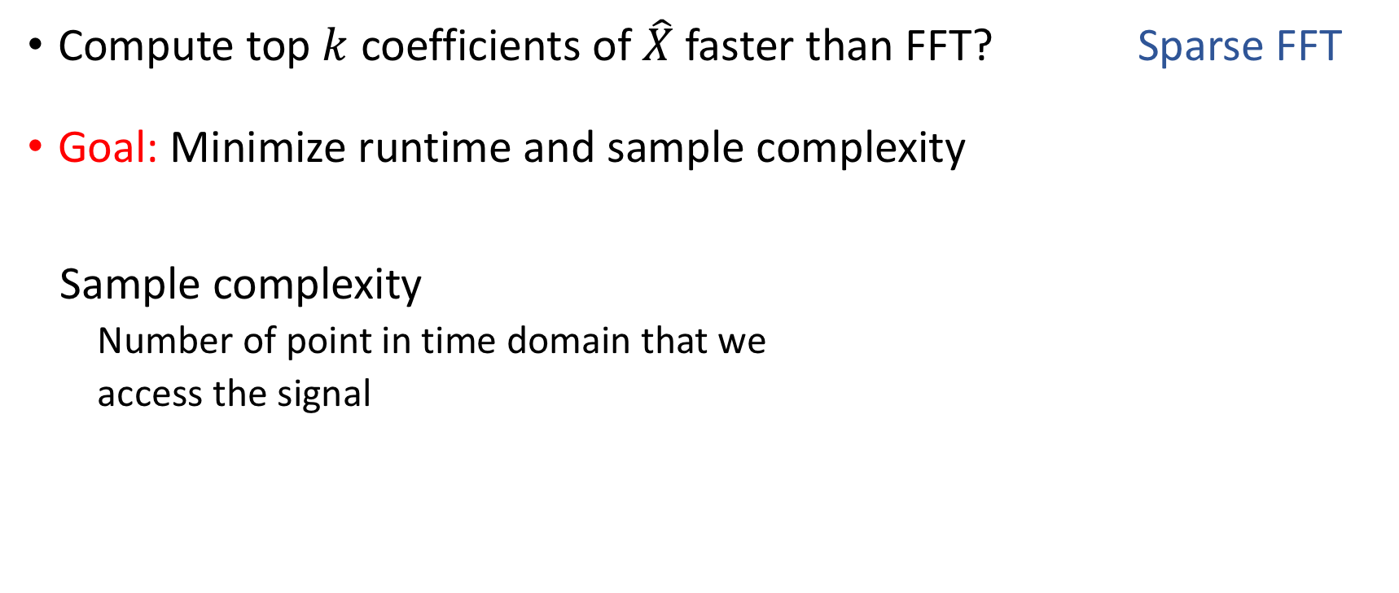
Sparse Fourier Transform
Compute top $k$ coefficients of $\hat{X}$ faster than FFT? Sparse FFT
Goal: Minimize runtime and sample complexity
Sample complexity
Number of point in time domain that we
access the signal
Notes:
If we have a sparse or approx sparse signal then it makes sense to think about approximating the top k faster than FFT -> Sparse FFT.
Sample complexity: number of samples accessed in time domain.

Slide 8
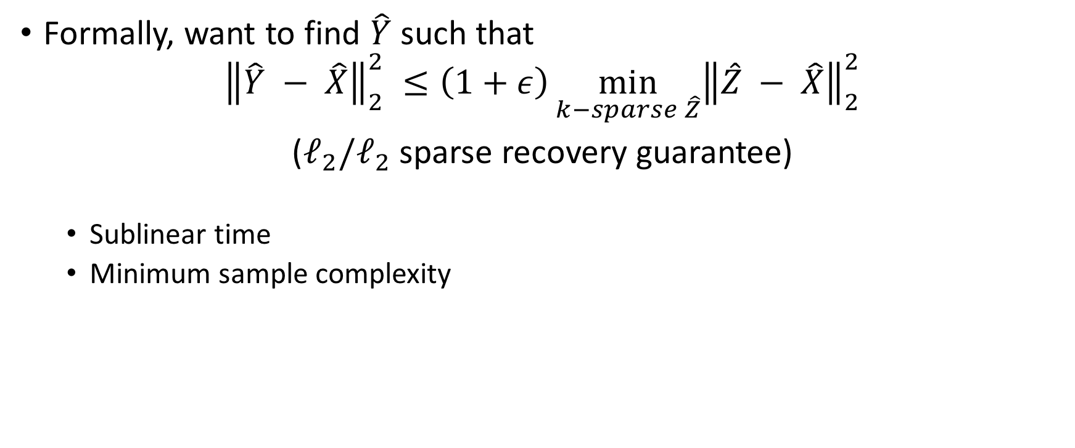
Sparse Fourier Transform
Formally, want to find $\hat{Y}$ such that
$${\left\|\hat{Y} − \hat{X}\right\|}_{2}^{2} ≤\left(1+ε\right)\min_{k−sparse \hat{Z}}{{\left\|\hat{Z} − \hat{X}\right\|}_{2}^{2}}$$
($ℓ_{2}/ℓ_{2}$ sparse recovery guarantee)
Sublinear time
Minimum sample complexity
Notes:
Formally, we want to have an algorithm to compute a sparse signal, y hat, such that the l2 distance from y hat to x hat is at most (1+eps) times the l2 distance from best possible sparse approximation to x hat. We want algorithms that find such y in sublinear time and use few samples.

Slide 9
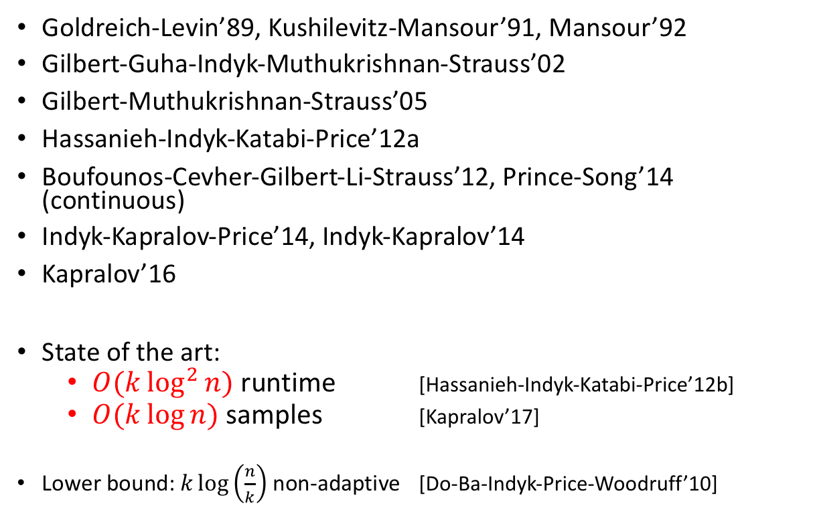
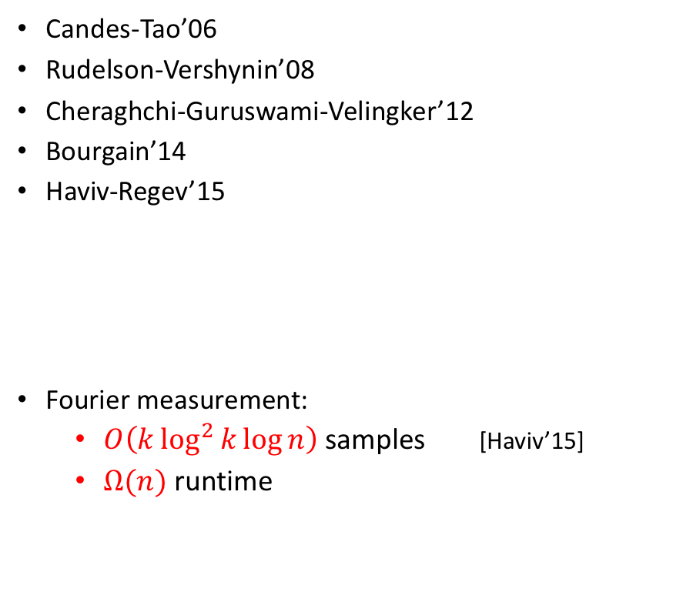
Non-uniform bounds
Uniform bounds
Candes-Tao’06
Rudelson-Vershynin’08
Cheraghchi-Guruswami-Velingker’12
Bourgain’14
Haviv-Regev’15
Fourier measurement:
$O\left(k\log^{2}{k}\log{n}\right)$ samples [Haviv’15]
$Ω(n)$ runtime
Goldreich-Levin’89, Kushilevitz-Mansour’91, Mansour’92
Gilbert-Guha-Indyk-Muthukrishnan-Strauss’02
Gilbert-Muthukrishnan-Strauss’05
Hassanieh-Indyk-Katabi-Price’12a
Boufounos-Cevher-Gilbert-Li-Strauss’12, Prince-Song’14 (continuous)
Indyk-Kapralov-Price’14, Indyk-Kapralov’14
Kapralov’16
State of the art:
$O(k\log^{2}{n})$ runtime [Hassanieh-Indyk-Katabi-Price’12b]
$O(k\log{n})$samples [Kapralov’17]
Lower bound: $k\log\left(\frac{n}{k}\right)$ non-adaptive [Do-Ba-Indyk-Price-Woodruff’10]
Notes:
This problem is a very well studied problem. There are basically two approaches to solve this problem. One of the categories has the rip based methods in it. These methods are deterministic provide uniform bounds. The other one is randomized with non-uniform bound.
Essentially tight bounds for signals with vanilla sparsity structure. Rip based approaches are deterministic provide uniform bound

Slide 10
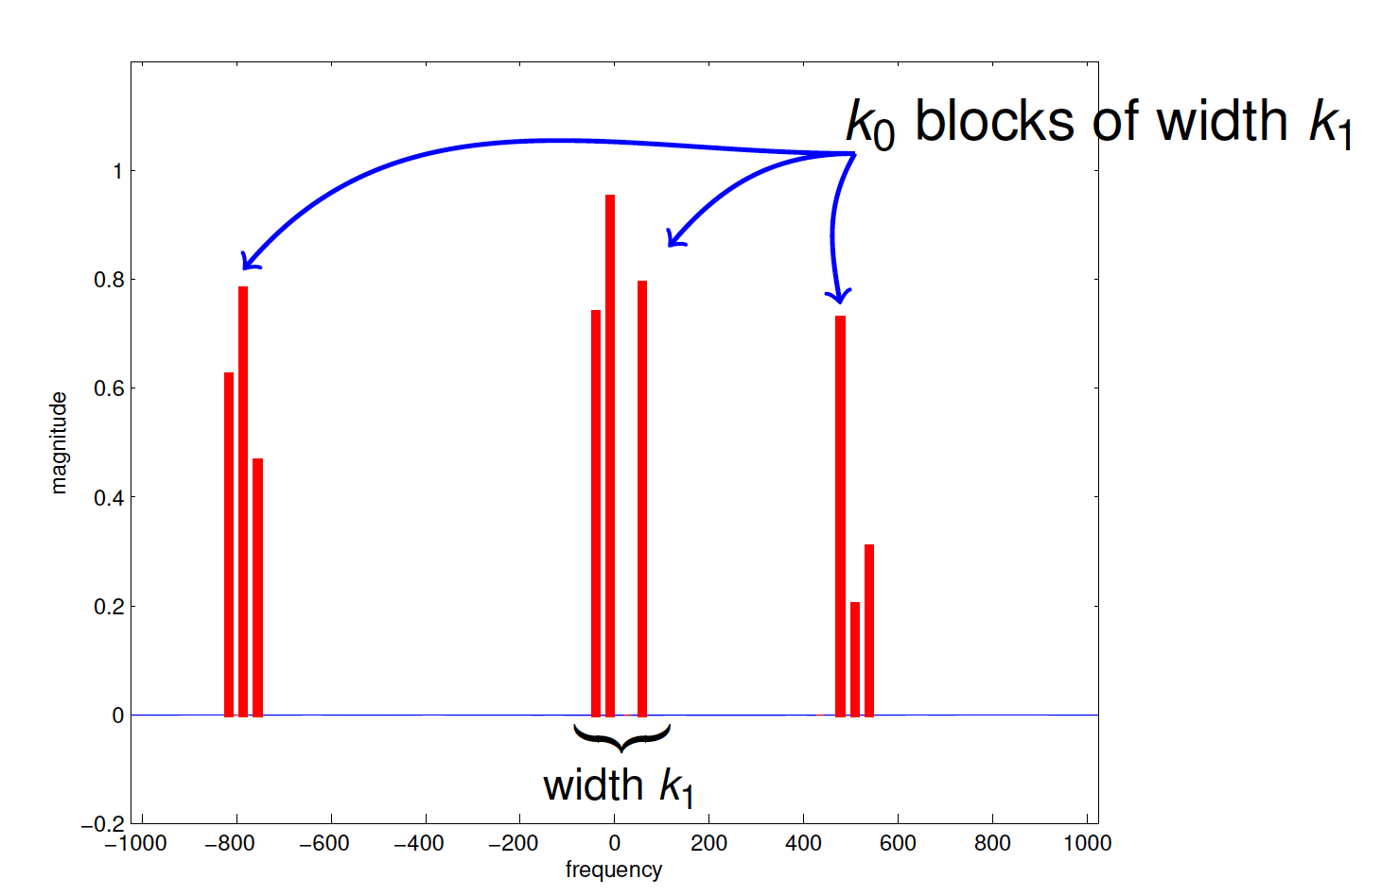

Structured Sparsity?
Signals arising in applications often have structure beyond sparsity
Structured Sparsity: Block Sparsity
Dominant frequencies contained in $k_{0}$ clusters of length $k_{1}$
Notes:
However we often know more about the signals. In some application signals have structures beyond sparsity.
Common type of structure that arisese in the signals. / Practice: Cognitive radio
Can we exploit further structure to reduce sample complexity and runtime? / Can we do better for structured signals?

Slide 11
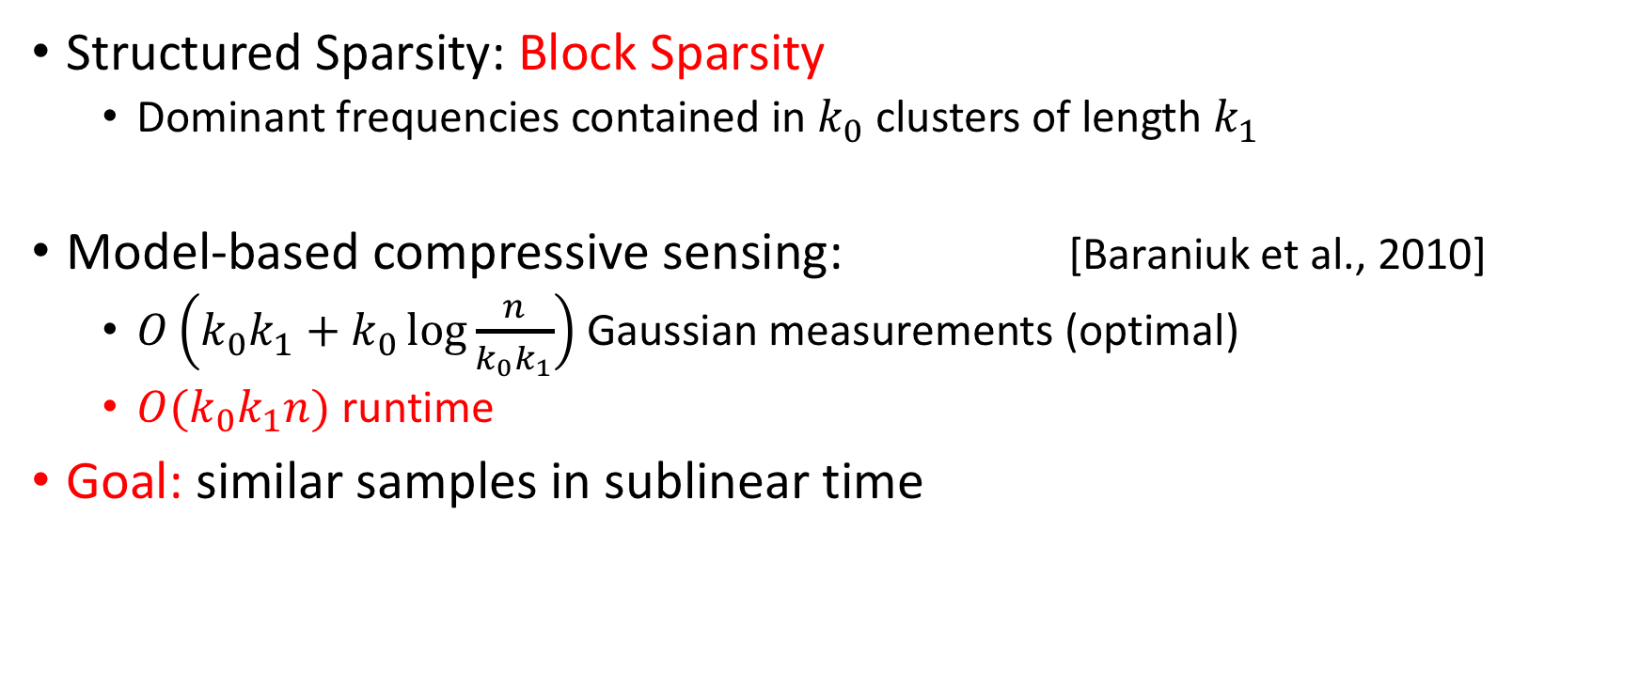
Model based compressed sensing
Structured Sparsity: Block Sparsity
Dominant frequencies contained in $k_{0}$ clusters of length $k_{1}$
Model-based compressive sensing: [Baraniuk et al., 2010]
$O\left(k_{0}k_{1}+k_{0}\log{\frac{n}{k_{0}k_{1}}}\right)$ Gaussian measurements (optimal)
$O(k_{0}k_{1}n)$ runtime
Goal: similar samples in sublinear time
Notes:
Structured sparse recovery has been studied before. It was introduced as model base compressive sensing in a seminal paper by baraniuk in 2010.
One of the signal models they introduce in their paper is actually block sparsity. They give a sample optimal algorithm for block sparse signals. This is their sample complexity which is strictly better than what can be done for general spars signals.
Their result uses Gaussian measurements so it’s runtime is super linear in n.
Our goal is to get same sample complexity in sublinear time.

Slide 12
Outline
Sparse FFT techniques
Main results

Slide 13
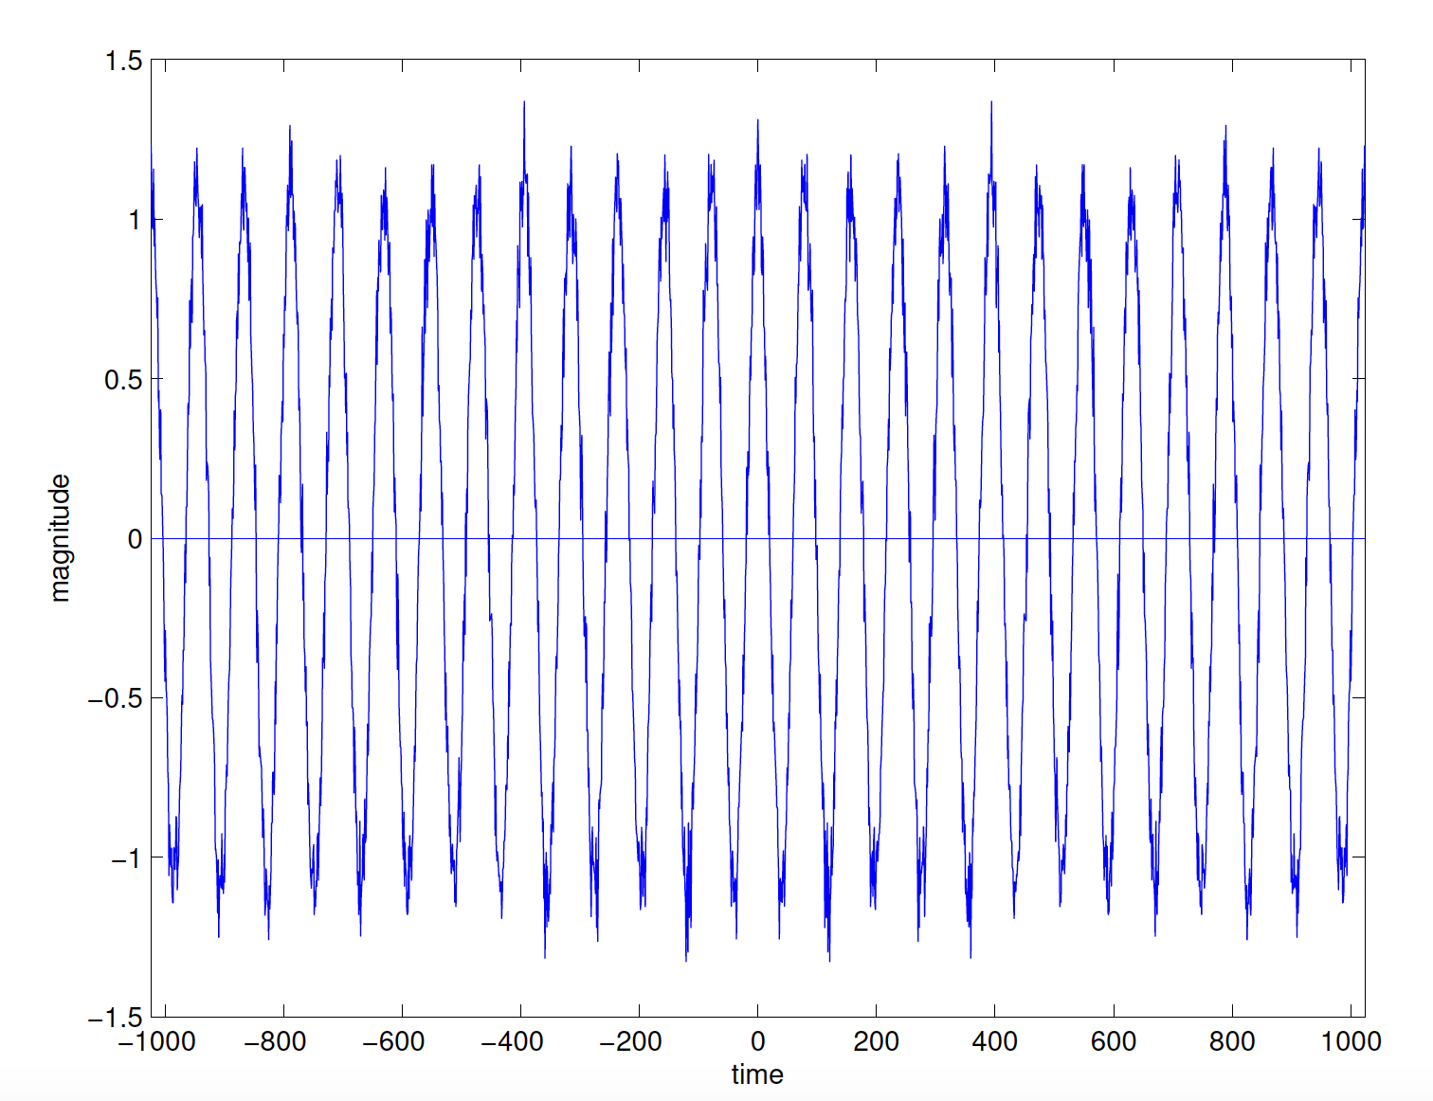
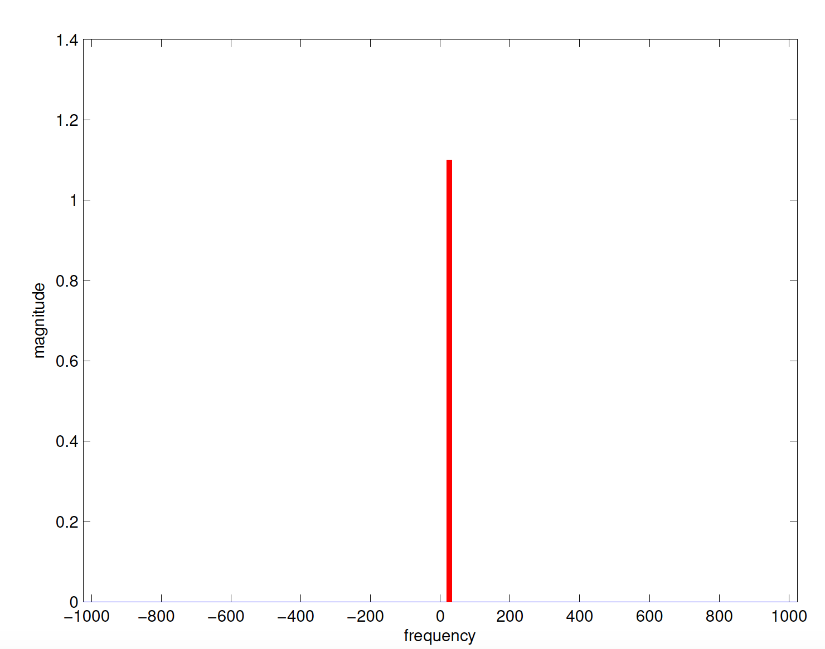

Overview of Sparse FFT algorithms
$O\left(\log{n}\right)$ samples from $x$ suffices
Notes:
If we have a one sparse signal we can approximate its fft using log n samples. This is optimal up to constant factos.

Slide 14
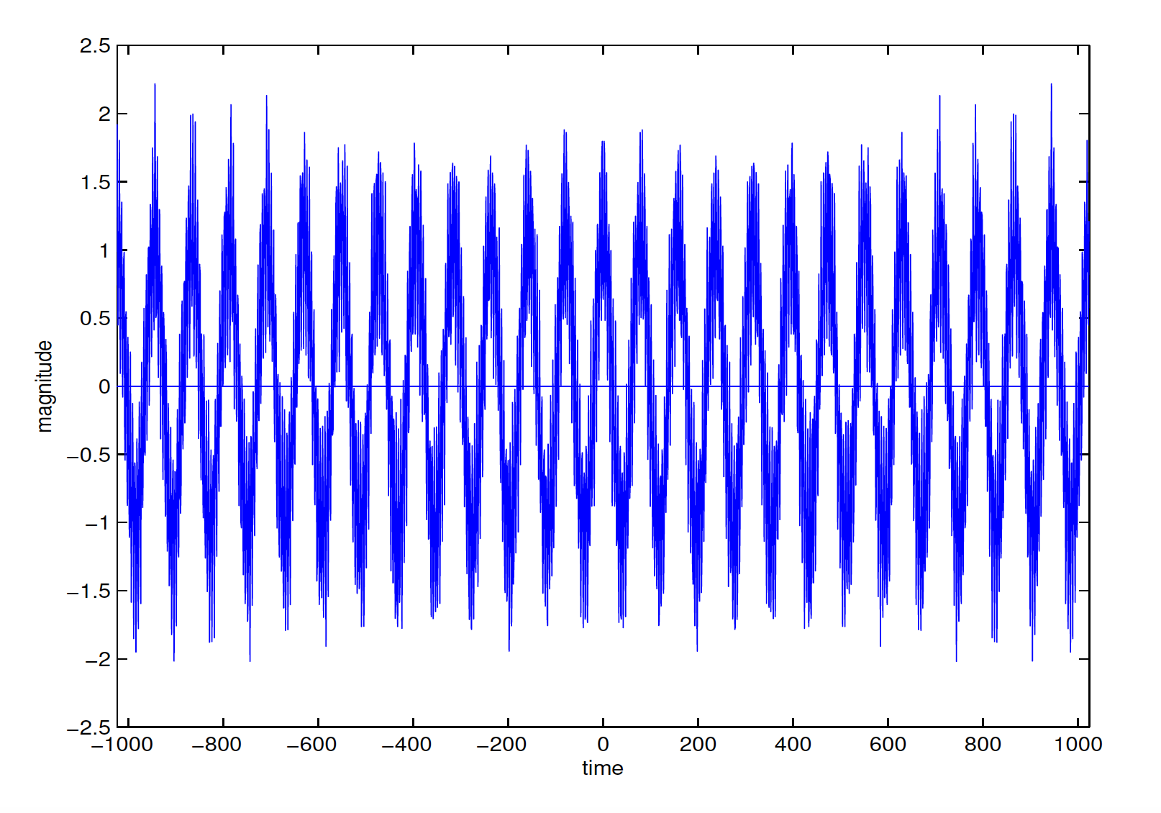
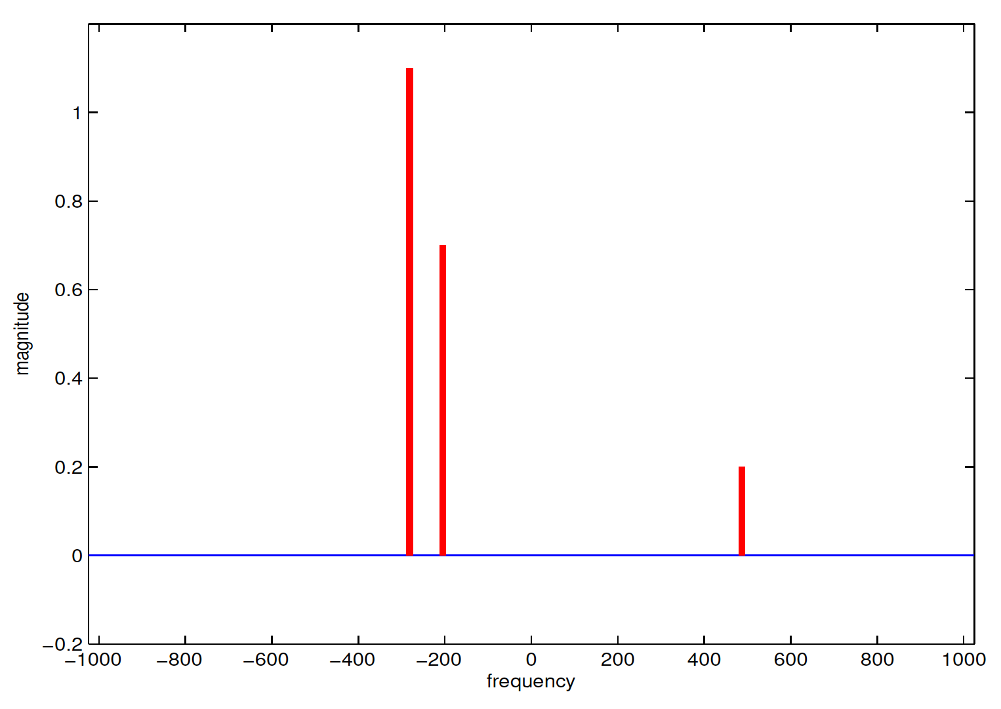
Overview of Sparse FFT algorithms
Idea: random hashing in the frequency domain
Notes:
What if we have a k sparse signal. Well if we have a k sparse signal the idea is to reduce it to k instances of one sparse fft.
If we hash the spectrum into k buckets then on average each bucket will be one sparse.

Slide 15
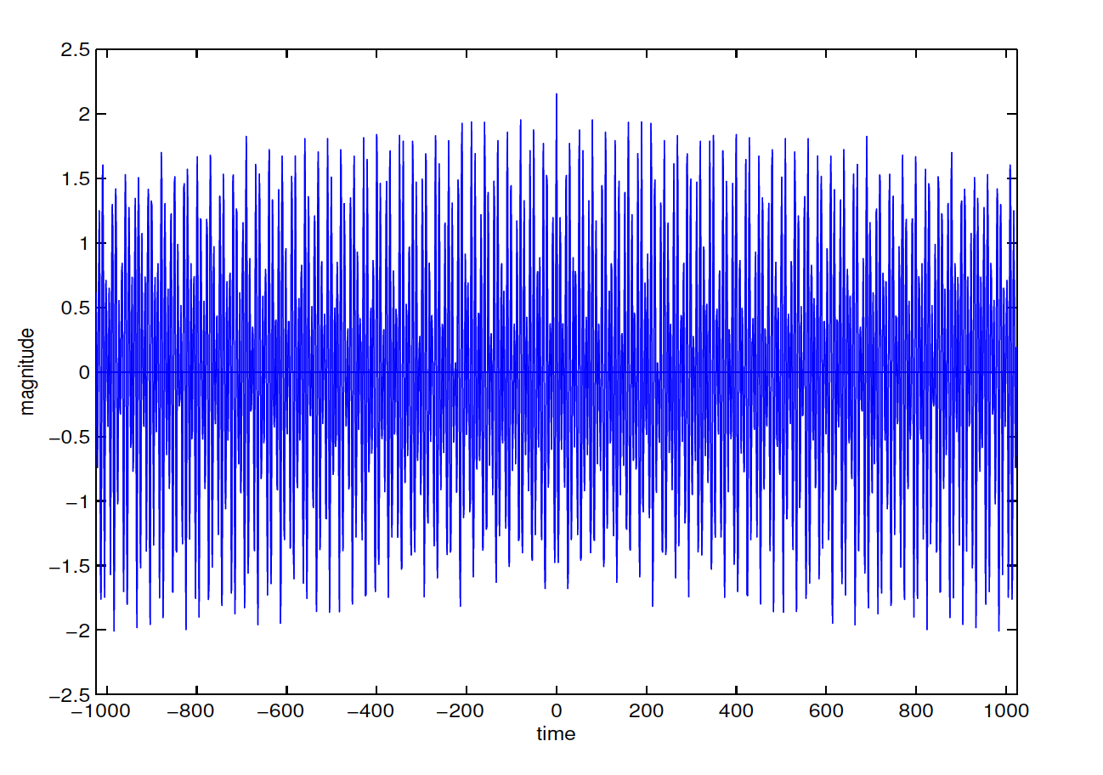
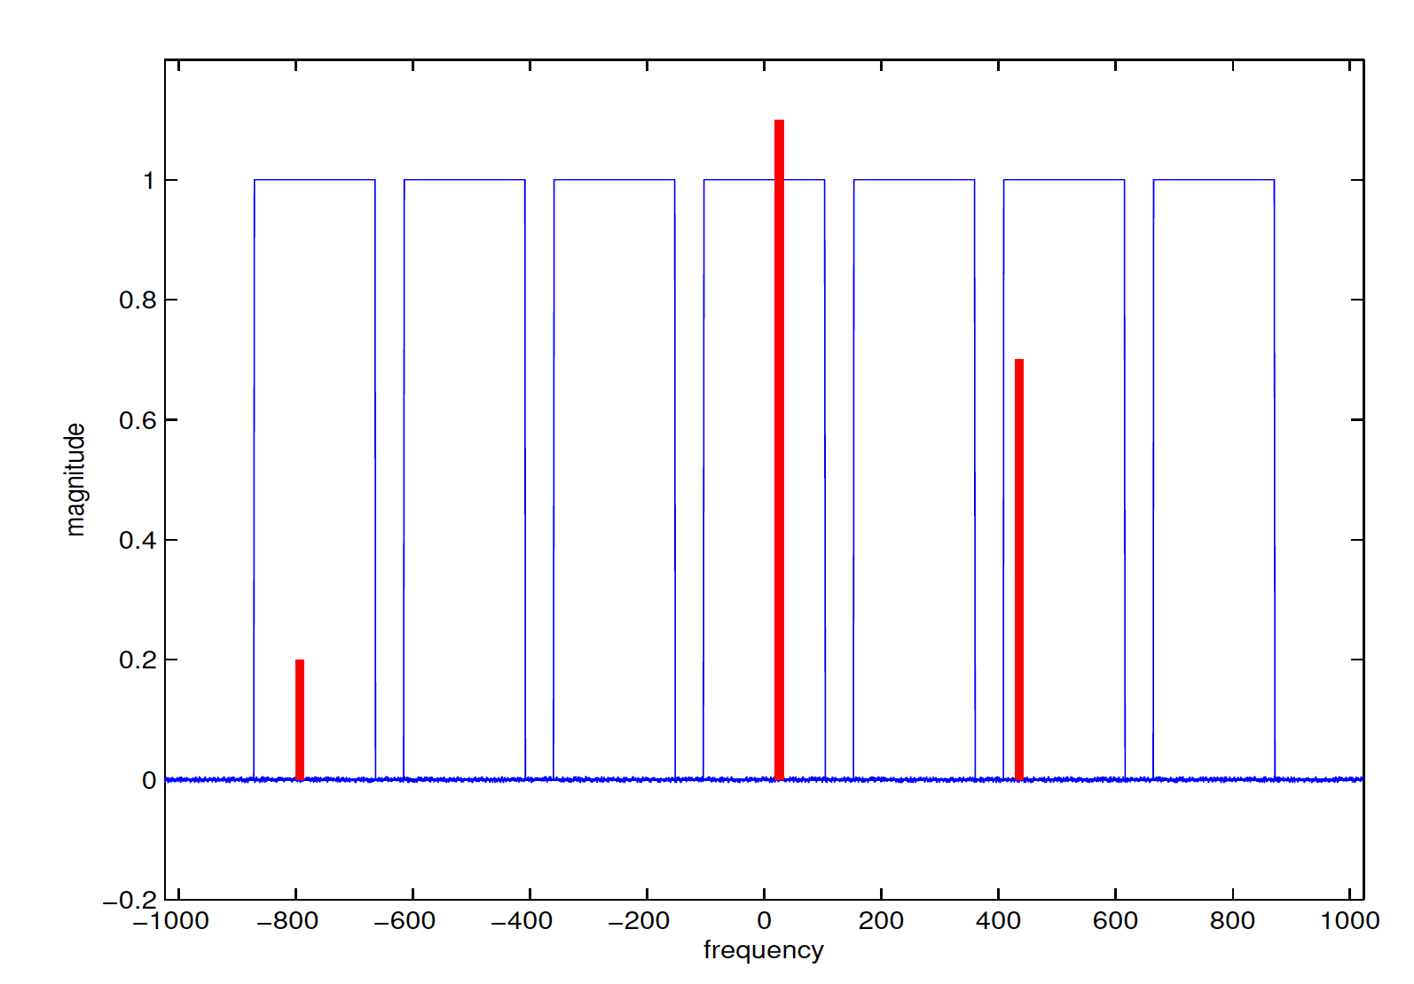
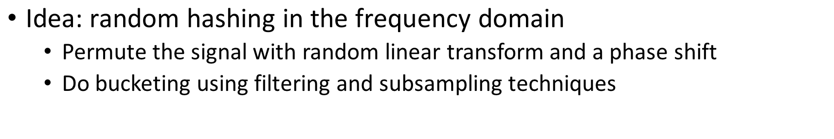
Overview of Sparse FFT algorithms
$\text{Idea}\text{: }\text{random} \text{hashing} \text{in} \text{the} \text{frequency} \text{domain}$
Permute the signal with random linear transform and a phase shift
Do bucketing using filtering and subsampling techniques
Notes:
The random hashing of the spectrum can be implemented efficiently by first permuting the spectrum and then using filtering and subsampling.

Slide 16
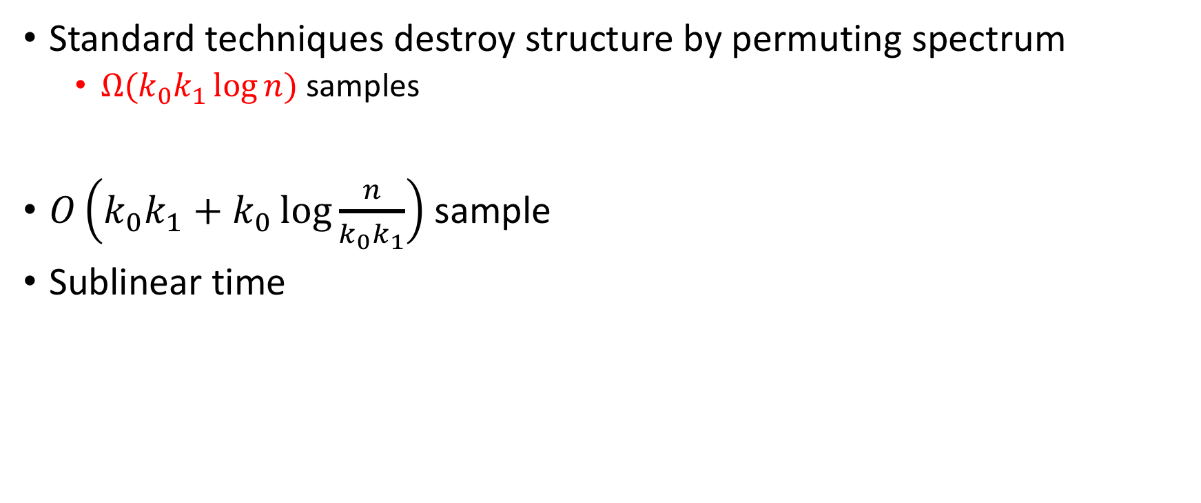
Block Sparsity
Standard techniques destroy structure by permuting spectrum
$Ω(k_{0}k_{1}\log{n})$ samples
$O\left(k_{0}k_{1}+k_{0}\log{\frac{n}{k_{0}k_{1}}}\right)$ sample
Sublinear time
Notes:
If we have a block sparse signal and apply the standard techniques to it, the random permutation will destroy the block sparse structure and so the sample complexity will be k0k1 log n which is no improvement at all.

Slide 17
Outline
Sparse FFT techniques
Main results

Slide 18
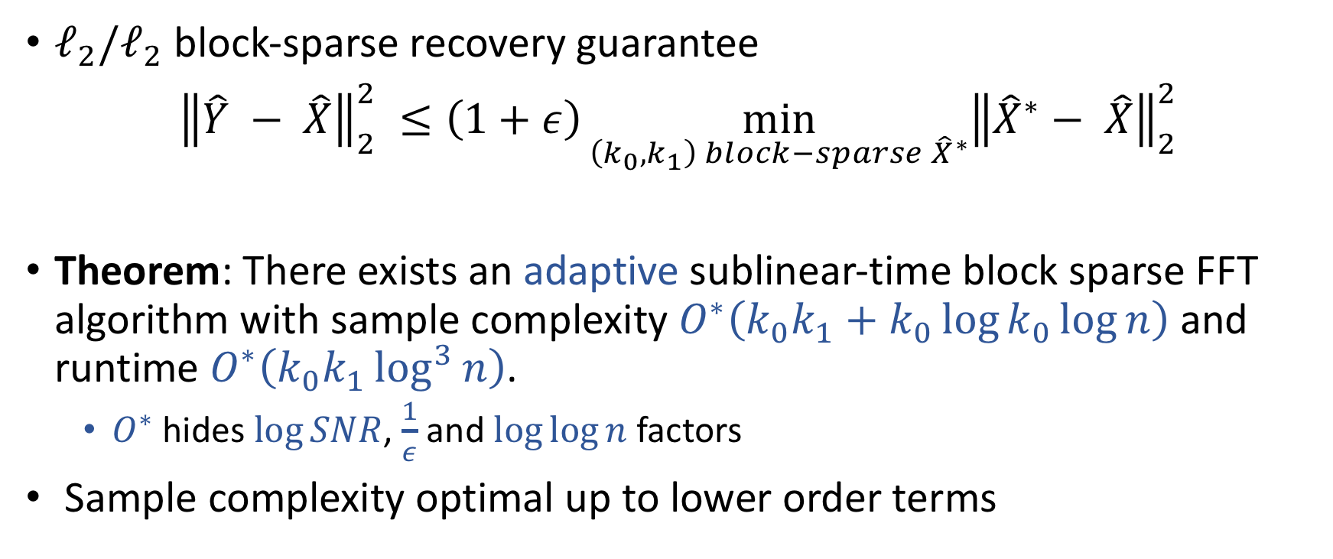
Main Results
$ℓ_{2}/ℓ_{2}$ block-sparse recovery guarantee
${\left\|\hat{Y} − \hat{X}\right\|}_{2}^{2} ≤\left(1+ε\right)\min_{\left(k_{0},k_{1}\right) block−sparse {\hat{X}}^{∗}}{{\left\|{\hat{X}}^{∗}− \hat{X}\right\|}_{2}^{2}}$
Theorem: There exists an adaptive sublinear-time block sparse FFT algorithm with sample complexity $O^{∗}\left(k_{0}k_{1}+k_{0}\log{k_{0}}\log{n}\right)$ and runtime $O^{∗}\left(k_{0}k_{1}\log^{3}{n}\right)$.
$O^{∗}$ hides $\log{SNR}$, $\frac{1}{ε}$ and $\log{\log{n}}$ factors
Sample complexity optimal up to lower order terms
Notes:
We propose an algorithm which satisfies the l2/l2 guarantee with constant probability. Our algorithm is adaptive with this sample complexity and this runtime. O* hides the log log factors. We are sublinear in n whith a weak poly logarithmic dependence on n. our sample complexity is optimal up to lower order terms.

Slide 19

Main Results
Our algorithm is crucially adaptive
Theorem: Any non-adaptive algorithm must take $Ω\left(k_{0}k_{1}\log{\frac{n}{k_{0}k_{1}}}\right)$ samples
Notes:
Although the adaptiveness might seem like a weakness, we show that it is actually necessary to be adaptive. We prove that any non-adaptive block sparse algorithm is unable to have improved sample complexity.

Slide 20
Main Results
First sublinear time model based compressed sensing
Separation between adaptive vs non-adaptive Sparse FFT
Adaptive algorithm: its signal access pattern is guided by samples taken
All Sparse FFT and compressed sensing results mentioned so far are non-adaptive
Fourier vs Gaussian measurements in model based compressed sensing
Notes:
This work provides the first results along several important directions.
We show for the first time that it is possible to do model base compressive sensing in sublinear time.
We give the first proven gap between the power of adaptive and non-adaptive sparse FFT algorithms
By adaptive algorithm we mean an algorithm whose sampling pattern is guided by samples that were previously taken.
We also show the first proven gap between the power Fourier and random Gaussian matrices for model-based compressive sensing -> Gaussian doesn’t need adaptiveness but fourier does

Slide 21
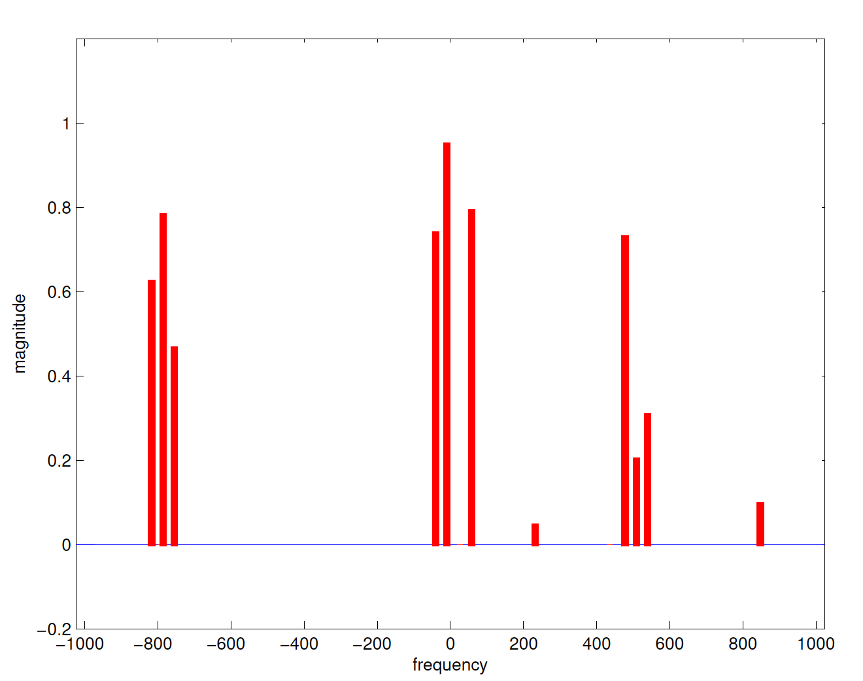


Natural Idea
Replace each block with a single element that represents the block somehow
$k_{0}$ blocks of width $k_{1}$
Notes:
Now lets assume that we are given a block sparse signal. Let k0 be the number of blocks and let k1 be the size of each block. The natural idea here is to try and replace each block with a single element that somehow represents that block.

Slide 22
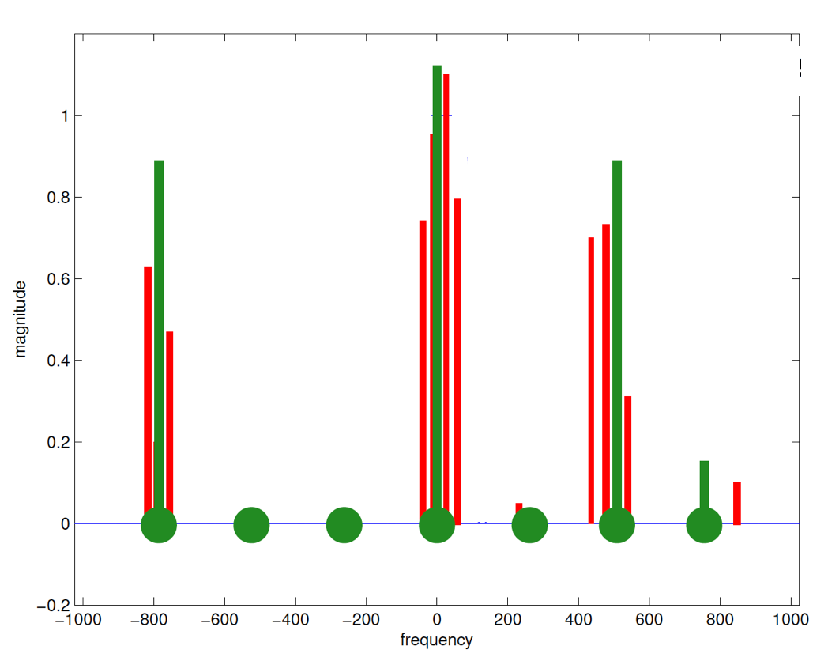
Natural Idea
Replace each block with a single element that represents the block somehow
Notes:
More specifically we want to replace each block with one of these green bins. For example if a block is empty like this one the corresponding bin is zero and if a block has a large energy like this one its corresponding element would have a large value.

Slide 23
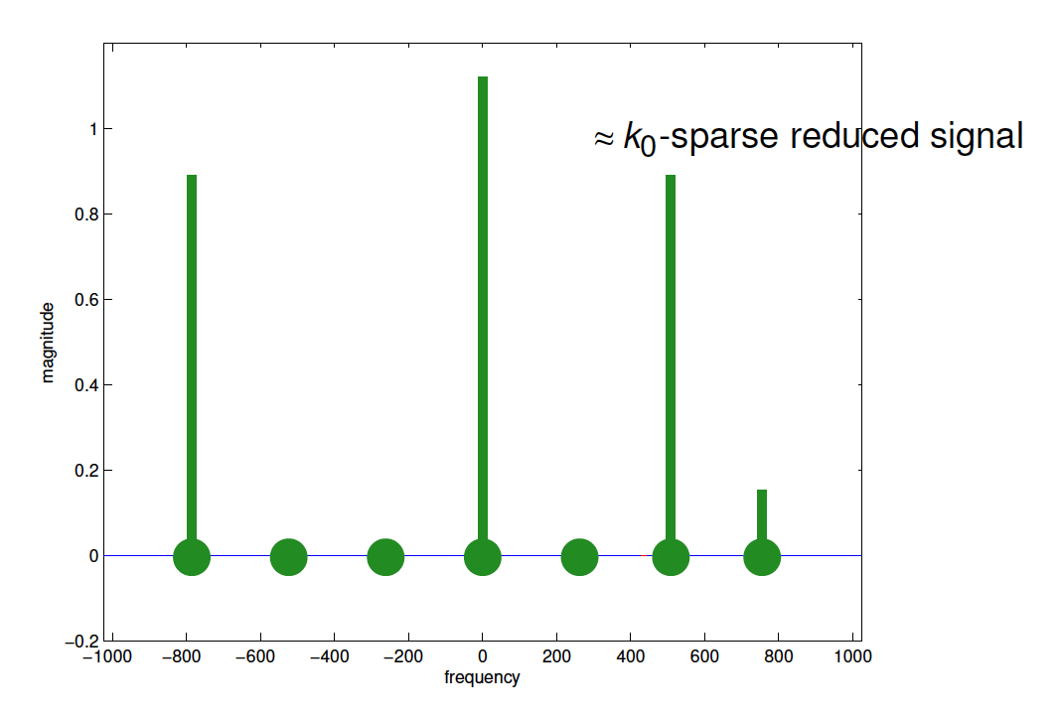
Natural Idea
Replace each block with a single element that represents the block somehow
Notes:
So if we could replace the blocks with single element, our problem would reduce to a standard sparse fft with sparsity k0. k0 was the number of blocks.

Slide 24

Main Ideas
$\hat{X}$: $\left(k_{0} , k_{1}\right)$-block sparse
$k_{0}$ blocks of width $k_{1}$
Notes:
This idea of reducing to standard sparse case can be done using filtering and subsampling.

Slide 25
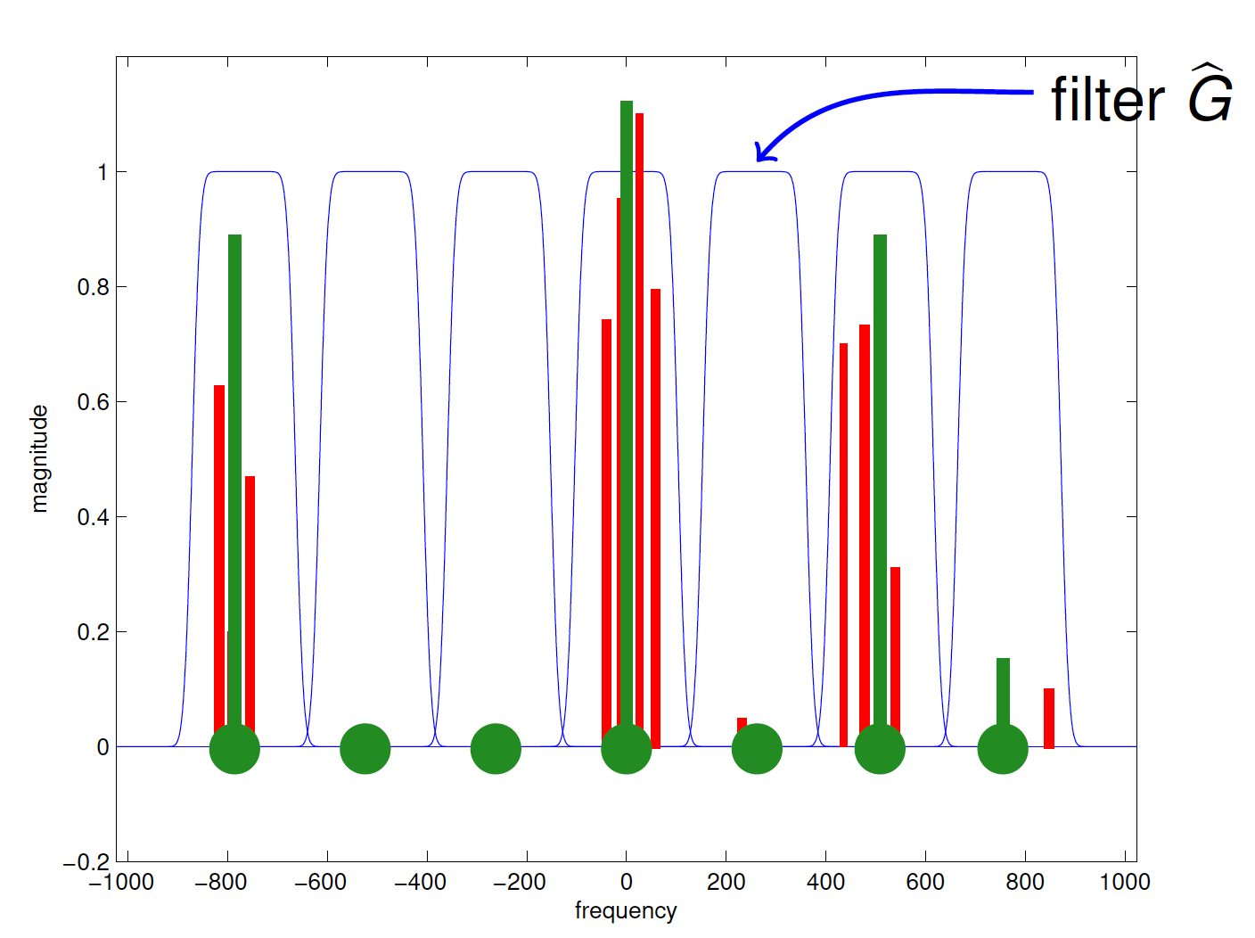
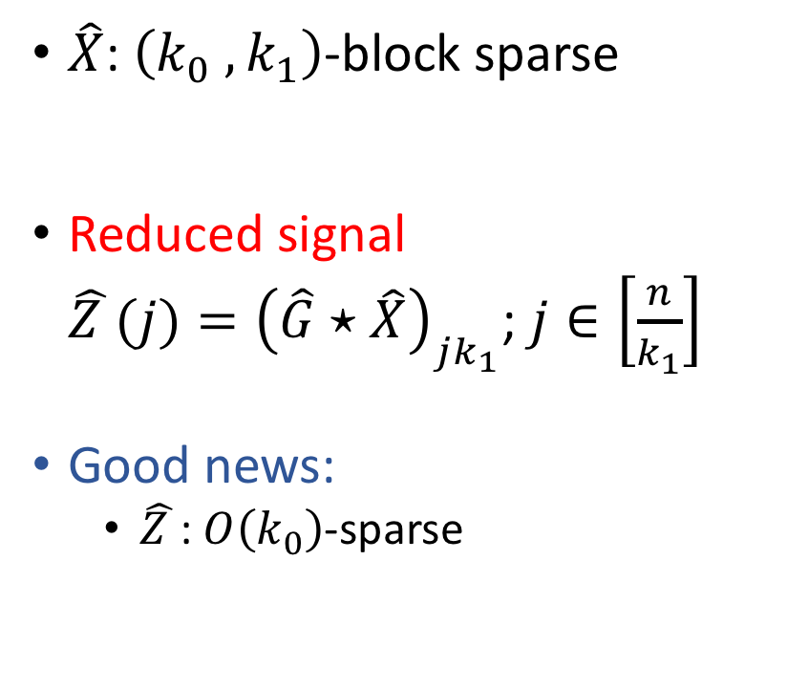
Main Ideas
$\hat{X}$: $\left(k_{0} , k_{1}\right)$-block sparse
Reduced signal $\hat{Z }(j)={\left(\hat{G}⋆\hat{X}\right)}_{jk_{1}}$; $j∈\left[\frac{n}{k_{1}}\right]$
Good news:
$\hat{Z }$: $O\left(k_{0}\right)$-sparse
Notes:
Let G hat be a filter that looks like the indicator of an interval of size k1. if we convolve our signal with G hat and then subsample it at rate 1/k1 then we get a reduced signal. This is the definition of the reduced signal. Good new is that Z hat is k0 sparse.

Slide 26
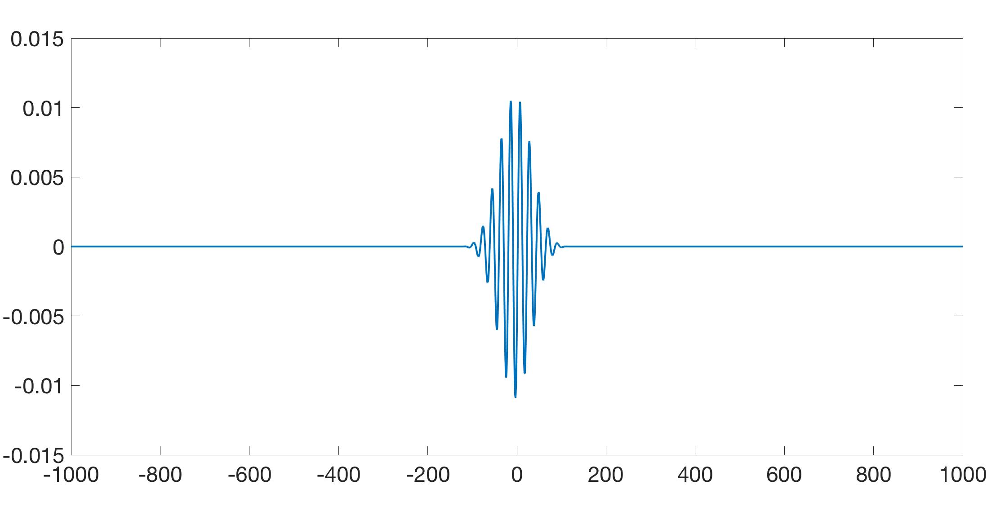
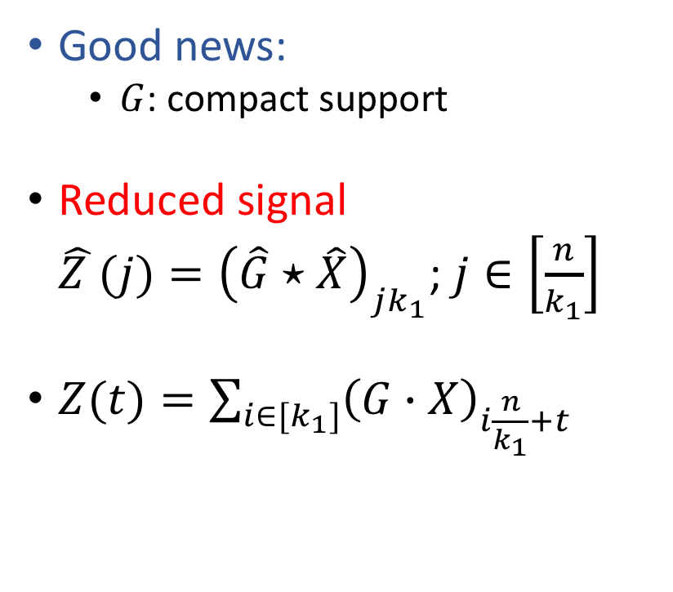
Main Ideas
Good news:
$G$: compact support
Reduced signal $\hat{Z }(j)={\left(\hat{G}⋆\hat{X}\right)}_{jk_{1}}$; $j∈\left[\frac{n}{k_{1}}\right]$
$Z(t)=\sum_{i∈[k_{1}]}{{\left(G∙X\right)}_{i\frac{n}{k_{1}}+t}}$
Notes:
We defined reduced signal Z hat in the Fourier domain. It was convolution with G hat and subsampling. In time domain it corresponds to multiplying X by G and then aliasing it. Here is the definition. There seem to be an issue here because each sample of Z could potentially require k1 samples from X.
But fortunately there exists a filter G with a very compact support in time domain. G looks like this.
Because such filter G exists we can access reduced signal at cost of a constant number of samples from X.

Slide 27
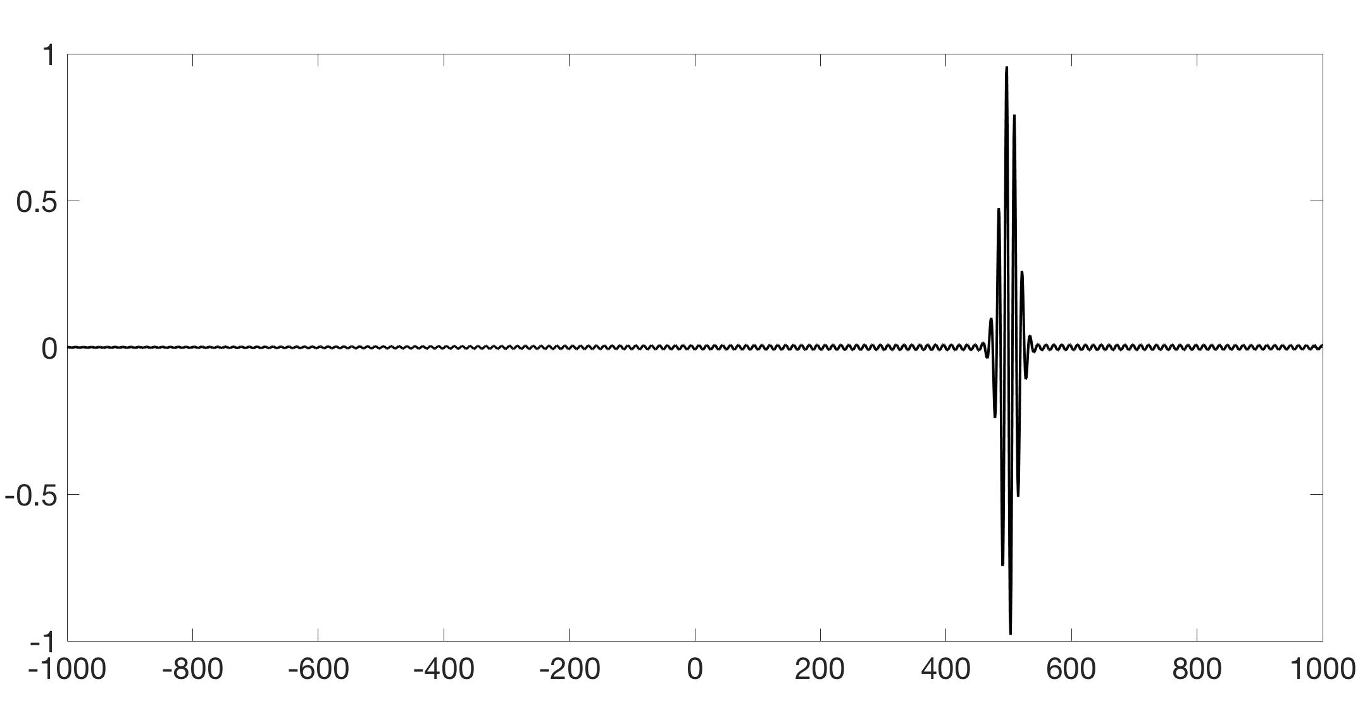
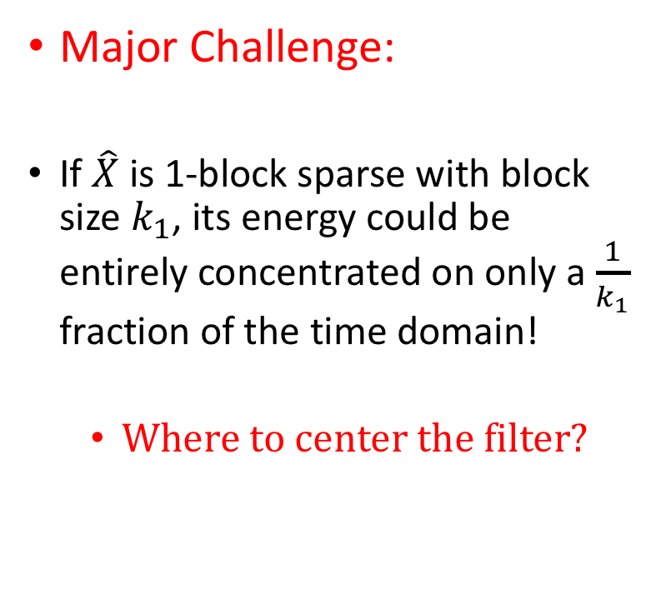
Main Ideas
Major Challenge:
If $\hat{X}$ is 1-block sparse with block size $k_{1}$, its energy could be entirely concentrated on only a $\frac{1}{k_{1}}$ fraction of the time domain!
Where to center the filter?
Notes:
There is a challenge for this approach. A block sparse signal can be very concentrated in time domain. In fact its energy can be concentrated on a small fraction of the time domain at some time t which we don’t know. For example here the signal to noise ration is so tiny if we are away from the time at which the signal is concentrated. Therefore if we multiply this signal by our compact filter G it is very likely that the product will be zero unless wehave centered G at time t where the signal is nonzero.

Slide 28
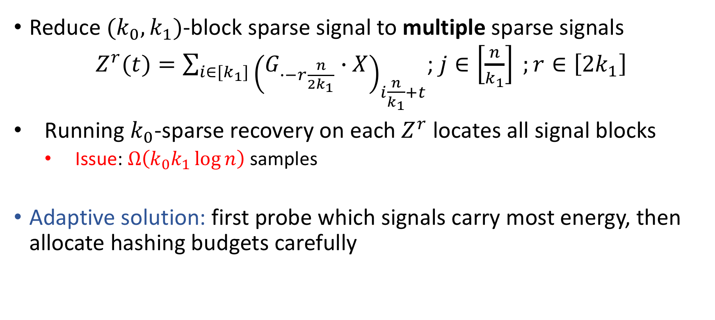
Main Ideas
Reduce $(k_{0}, k_{1})$-block sparse signal to multiple sparse signals
$Z^{r}(t)=\sum_{i∈[k_{1}]}{{\left(G_{∙−r\frac{n}{2k_{1}}}∙X\right)}_{i\frac{n}{k_{1}}+t}}$; $j∈\left[\frac{n}{k_{1}}\right] ;r∈\left[2k_{1}\right]$
Running $k_{0}$-sparse recovery on each $Z^{r}$ locates all signal blocks
Issue: $Ω\left(k_{0}k_{1}\log{n}\right)$ samples
Adaptive solution: first probe which signals carry most energy, then allocate hashing budgets carefully
Notes:
To fix this issue we should use multiple reductions. We consider a uniform grid with 2k1 points on the time domain and for each point on this grid we shift G to that grid point and then do the reduction. This way we are covering the whole time domain. Therefore, by Shannon Nyquist theorem, all the reduced signals together will preserve the energy of each individual block.
One obvious way for locating the blocks is to run k0 sparse fft on each of the reduced signals bu this way we will be back to k0k1 log n samples.
So here is where we should take advantage of adaptiveness. So instead of running k0 sparse fft on each reduced signal we estimate the energy of each reduced signal first. Then we allocate some budget to each reduced signal base on the energy and run sparse fft with respect to that budget.

Slide 29
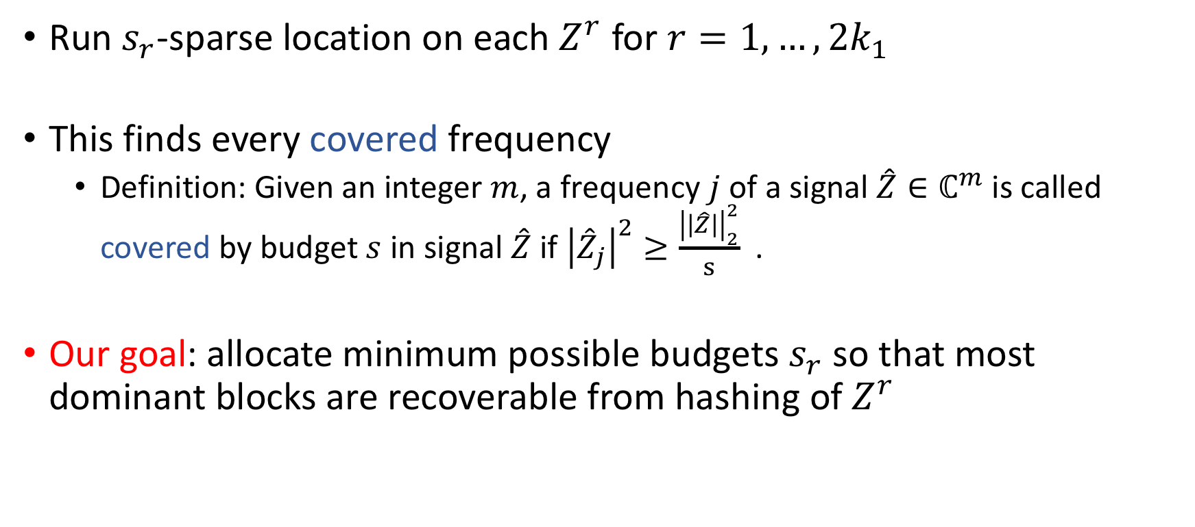
Main Ideas
Run $s_{r}$-sparse location on each $Z^{r}$ for $r=1,…, 2k_{1}$
This finds every covered frequency
Definition: Given an integer $m$, a frequency $j$ of a signal $\hat{Z}∈ℂ^{m}$ is called covered by budget $s$ in signal $\hat{Z}$if ${\left|{\hat{Z}}_{j}\right|}^{2}≥\frac{{\left|\left|\hat{Z}\right|\right|}_{2}^{2}}{s}$ .
Our goal: allocate minimum possible budgets $s_{r}$ so that most dominant blocks are recoverable from hashing of $Z^{r}$
Notes:
So we allocate budget sr to each reduced signal and the goal is to choose use the minimum total budgets such that most of the signal blocks are recoverable by these budgets.

Slide 30
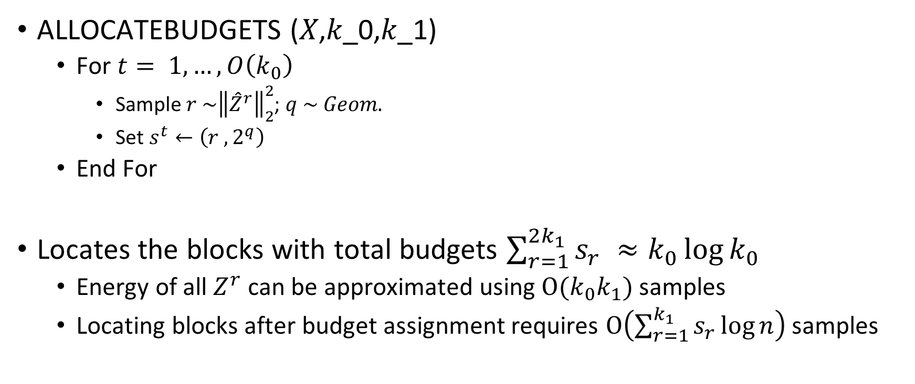
Energy based sampling
ALLOCATEBUDGETS (𝑋,𝑘_0,𝑘_1)
For $t= 1,…,O\left(k_{0}\right)$
Sample $r \sim {\left\|{\hat{Z}}^{r}\right\|}_{2}^{2}$; $q \sim Geom.$
Set $s^{t}←\left(r ,2^{q}\right)$
End For
Locates the blocks with total budgets $\sum_{r=1}^{2k_{1}}{s_{r}} ≈k_{0}\log{k_{0}}$
Energy of all $Z^{r}$ can be approximated using $O(k_{0}k_{1})$ samples
Locating blocks after budget assignment requires $O\left(\sum_{r=1}^{k_{1}}{s_{r}}\log{n}\right)$ samples
Notes:
We can find the optimal budgets up to log k0 factor by random sampling. The algorithm for budget allocation is very easy. First sample each reduced signal with probability proportional to its energy and the allocate a random budget from a geometric distribution.

Slide 31
Main Results
First sublinear time model based compressed sensing
Separation between adaptive vs non-adaptive Sparse FFT
Fourier vs Gaussian measurements in model based compressed sensing

Slide 32
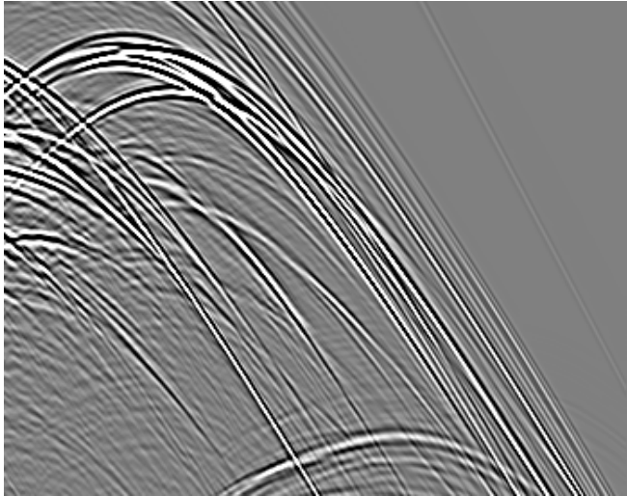
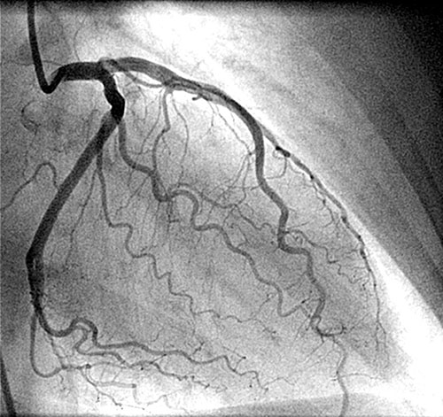
Open Problems
Our sample complexity degrades with signal to noise ratio – remove dependence on SNR?
Sublinear time algorithms for other popular models?

