Slide 1

Massively Parallel Algorithms and Hardness of Single-Linkage Clustering
Joint work with Adithya Vadapalli (Indiana University)
Grigory Yaroslavtsev
http://grigory.us

Slide 2





Algorithms for Big Data
User’s perspective: paradigm shift brought by cloud services
  Outsourcing computation and data storage is great for both businesses and researchers
  Cloud service providers: Amazon EC2, Google Compute Engine, Microsoft Azure, …
  Open source stacks/frameworks: MapReduce/Hadoop, Apache Spark, etc.

Slide 3
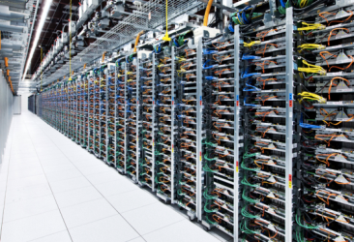
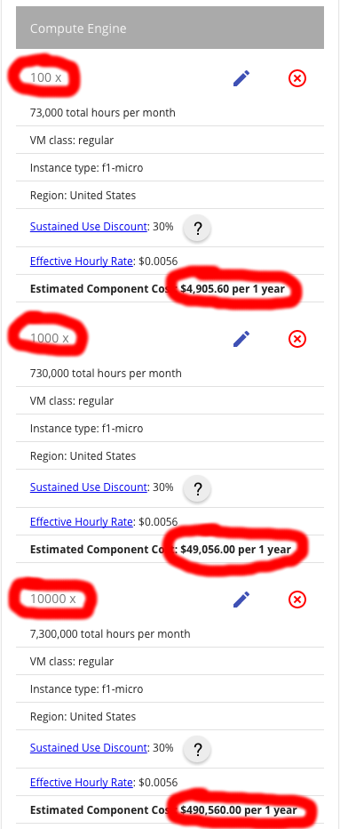

Business perspective
Pricings:
  https://cloud.google.com/pricing/
  https://aws.amazon.com/pricing/
$\sim L$inear with space and time usage
  100 machines: 5K $/year
  10000 machines: 0.5M $/year
You pay a lot more for using provided algorithms
  https://aws.amazon.com/machine-learning/pricing/

Slide 4
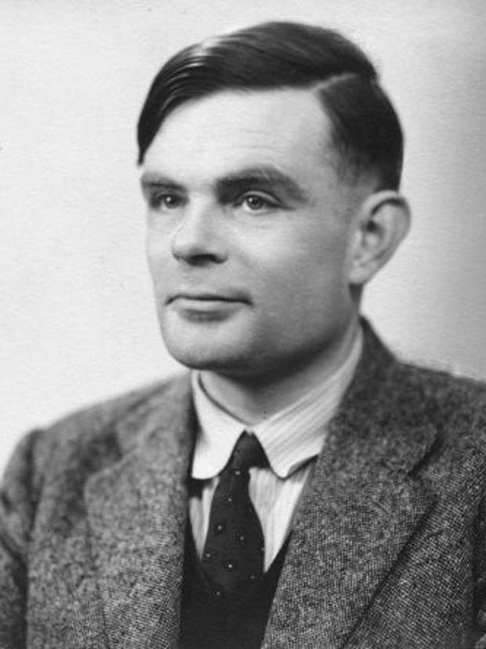

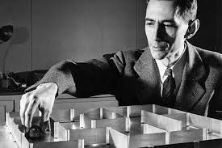

“Big Data Theory” = Turing meets Shannon
CPU time / Computational Complexity
$$=$$
+
Network Time /
Information and Communication Complexity

Slide 5
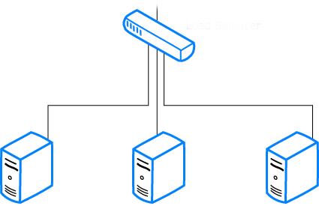

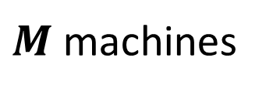

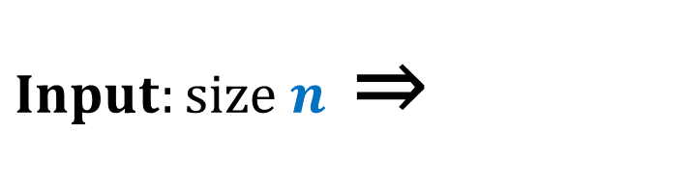
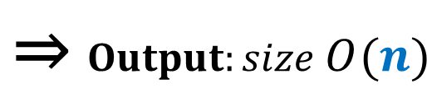
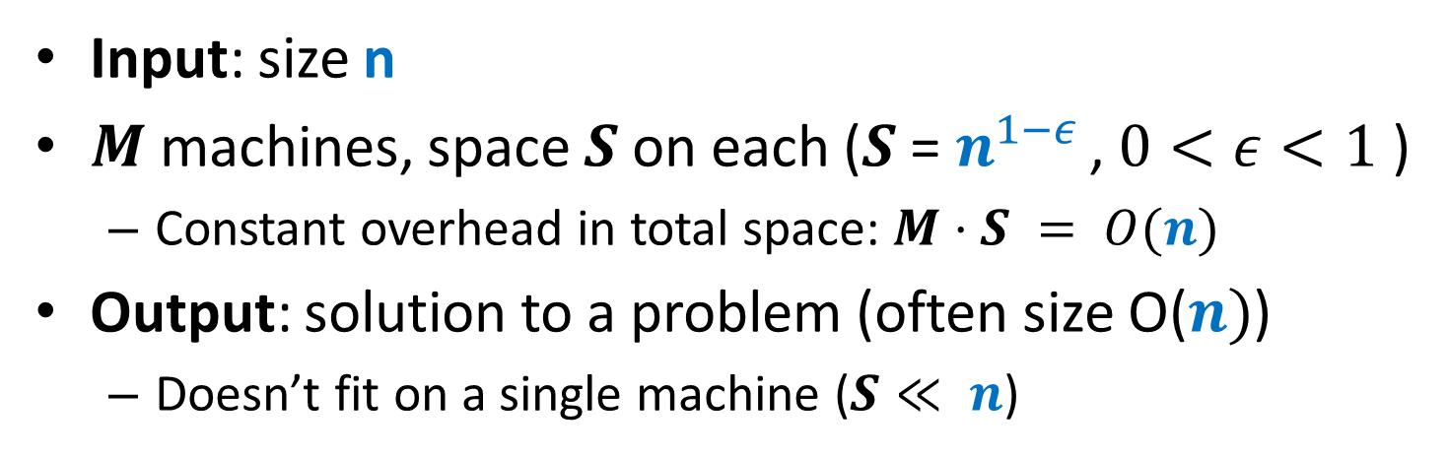
Computational Model
Input: size n
$M$ machines, space $S$ on each ($S$ = $n^{1−ε }$, $0<ε<1$ )
  Constant overhead in total space: $M⋅S = O(n)$
Output: solution to a problem (often size O($n)$)
  Doesn’t fit on a single machine ($S≪ n$)
$Input:size n$ ⇒
$$\text{⇒} Output:size O(n)$$
$M$machines
S space

Slide 6


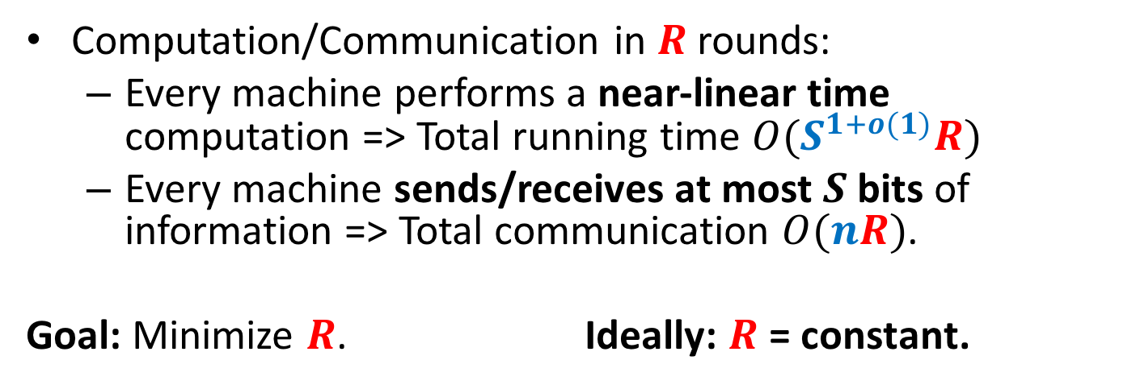
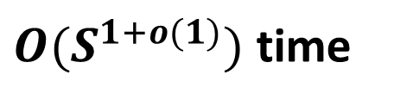

Computational Model
Computation/Communication in $R$ rounds:
  Every machine performs a near-linear time computation => Total running time $O(S^{1+o(1)}R)$
  Every machine sends/receives at most $S$ bits of information => Total communication $O(nR)$.
  Goal: Minimize $R$. Ideally: $R$ = constant.
$≤S$ bits
$M$machines
S space
$O(S^{1+o(1)})$ time

Slide 7
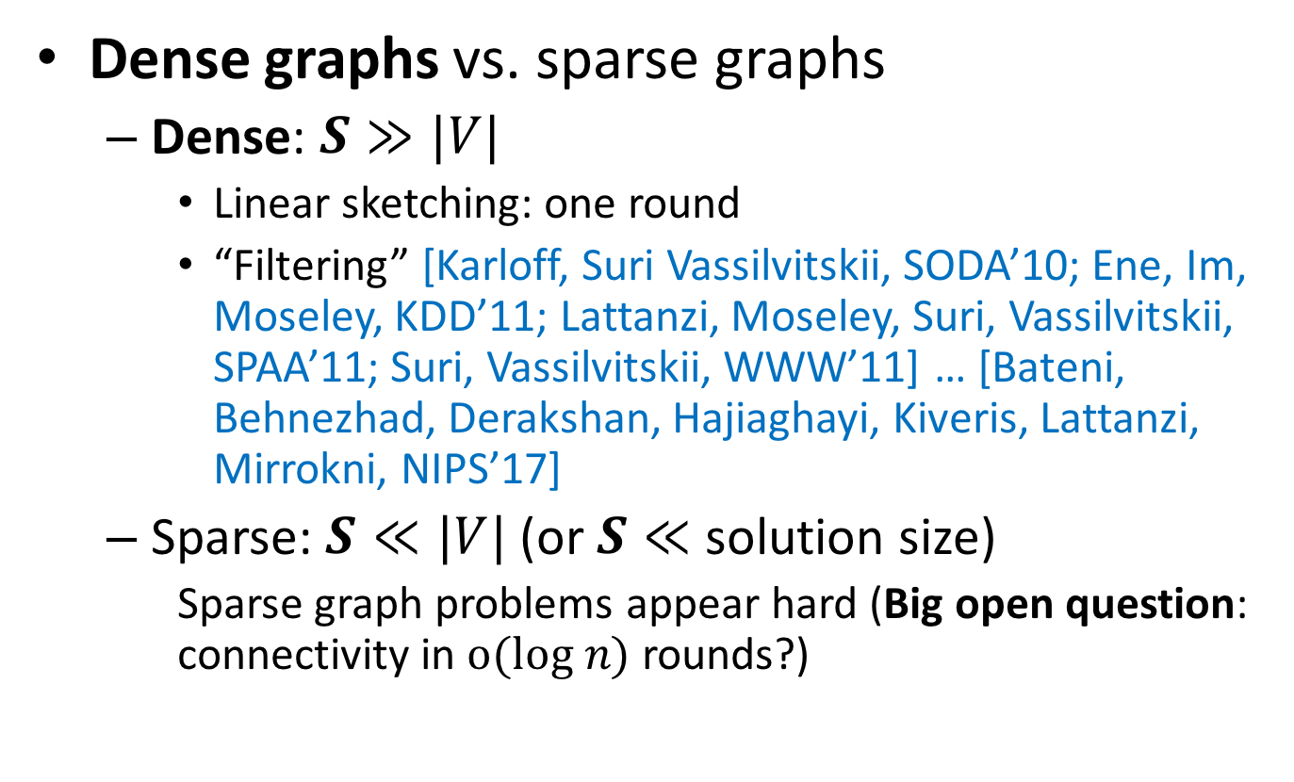
Algorithms for Graphs
Dense graphs vs. sparse graphs
  Dense: $S≫|V|$
    Linear sketching: one round
    “Filtering” [Karloff, Suri Vassilvitskii, SODA’10; Ene, Im, Moseley, KDD’11; Lattanzi, Moseley, Suri, Vassilvitskii, SPAA’11; Suri, Vassilvitskii, WWW’11] … [Bateni, Behnezhad, Derakshan, Hajiaghayi, Kiveris, Lattanzi, Mirrokni, NIPS’17]
  Sparse: $S≪|V|$(or $S≪$ solution size)
    Sparse graph problems appear hard (Big open question: connectivity in $o(log n)$ rounds?)
VS.

Slide 8
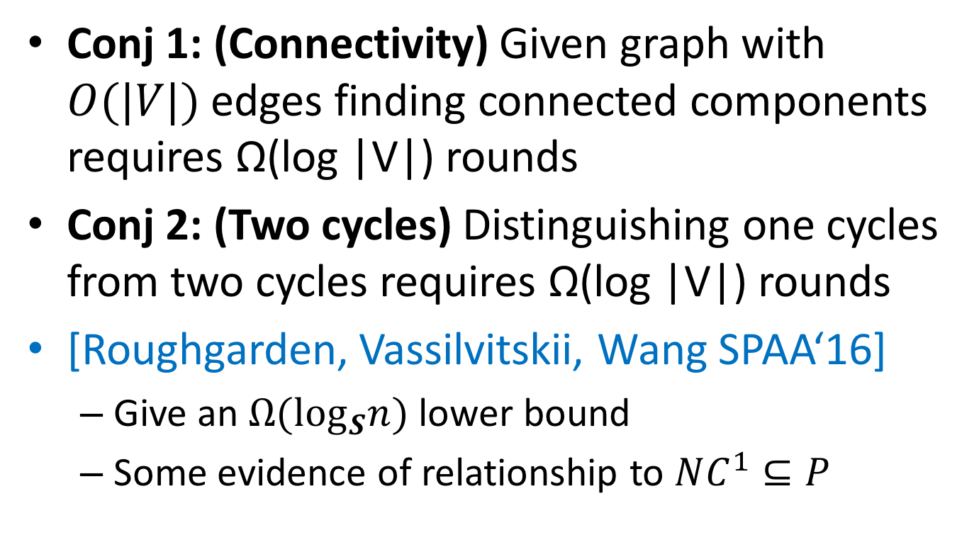
Two Conjectures
Conj 1: (Connectivity) Given graph with $O(|V|)$ edges finding connected components requires Ω(log |V|) rounds
Conj 2: (Two cycles) Distinguishing one cycles from two cycles requires Ω(log |V|) rounds
[Roughgarden, Vassilvitskii, Wang SPAA‘16]
  Give an $Ω(\log_{S}n)$ lower bound
  Some evidence of relationship to $NC^{1}⊆P$

Slide 9
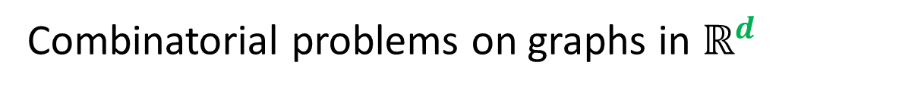


Geometric Graph Problems [ANOY’14]
Combinatorial problems on graphs in $ℝ^{d}$
Polynomial time (“easy”)
Minimum Spanning Tree
Earth-Mover Distance =
Min Weight Bi-chromatic Matching
NP-hard (“hard”)
Steiner Tree
Traveling Salesman
Clustering (k-medians, facility location, etc.)
Need new theory!
Arora-Mitchell-style “Divide and Conquer”, easy to implement in Massively Parallel Computational Models, but bad running time

Slide 10

MST: Single Linkage Clustering
[Zahn’71] Clustering via MST (Single-linkage):
$k$ clusters: remove $k−1$ longest edges from MST
Maximizes minimum intercluster distance
Objective: min(a,b,c)
Notes:
“”

Slide 11



MST vs. Single Linkage Clustering
[ANOY’14]: $(1+ε)$-approx MST (in expectation)
Single-linkage clustering can be arbitrarily bad:
1
1
1
1
1
100
$$n$$
$$εn≫100$$
X
X
1
1
1
1
1
100
$$n$$

Slide 12
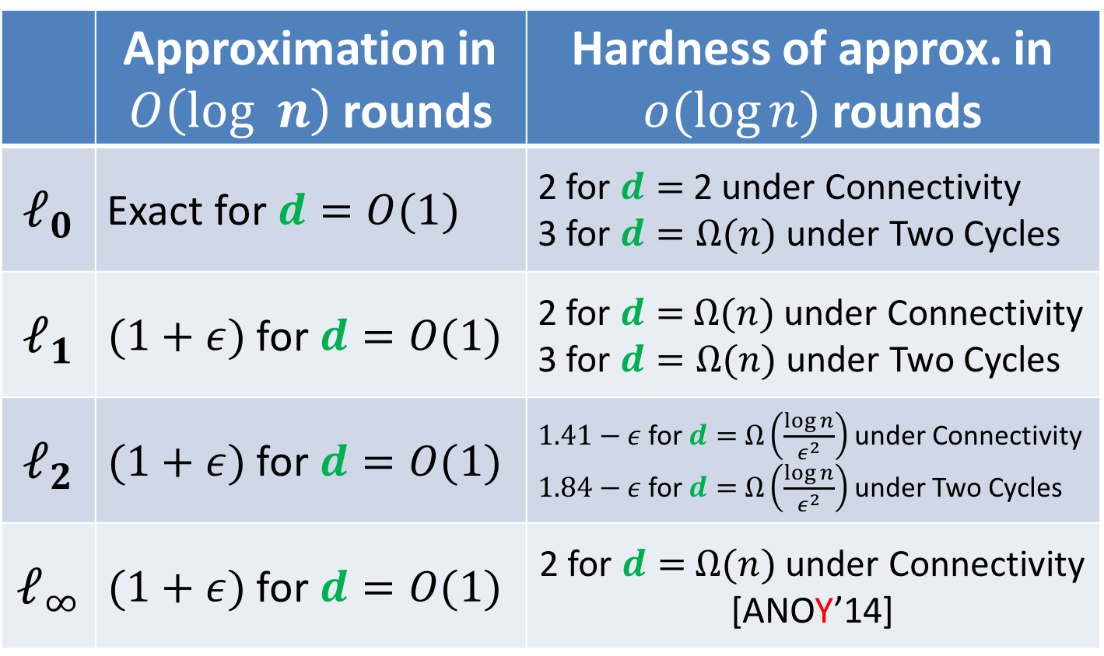
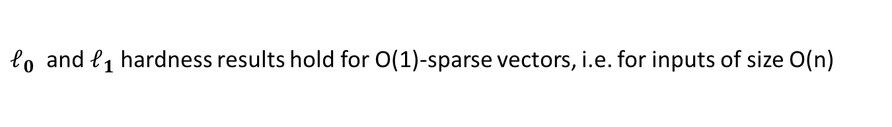
Our Results
 | Approximation in $O\left(log n\right)$ rounds | Hardness of approx. in $o(log⁡n)$ rounds
$$ℓ_{0}$$ | Exact for $d=O(1)$ | 2 for $d=$ 2 under Connectivity 3 for $d=Ω(n)$ under Two Cycles
$$ℓ_{1}$$ | $(1+ε)$ for $d=O(1)$ | 2 for $d=$ $Ω(n)$ under Connectivity 3 for $d=Ω(n)$ under Two Cycles
$$ℓ_{2}$$ | $(1+ε)$ for $d=O(1)$ | $1.41−ε$for $d=$ $Ω\left(\frac{\log{n}}{ε^{2}}\right)$ under Connectivity $1.84−ε$for $d=$ $Ω\left(\frac{\log{n}}{ε^{2}}\right)$ under Two Cycles
$$ℓ_{∞}$$ | $(1+ε)$ for $d=O(1)$ | 2 for $d=$ $Ω(n)$ under Connectivity [ANOY’14]
$ℓ_{0}$ and $ℓ_{1}$hardness results hold for O(1)-sparse vectors, i.e. for inputs of size O(n)

Slide 13

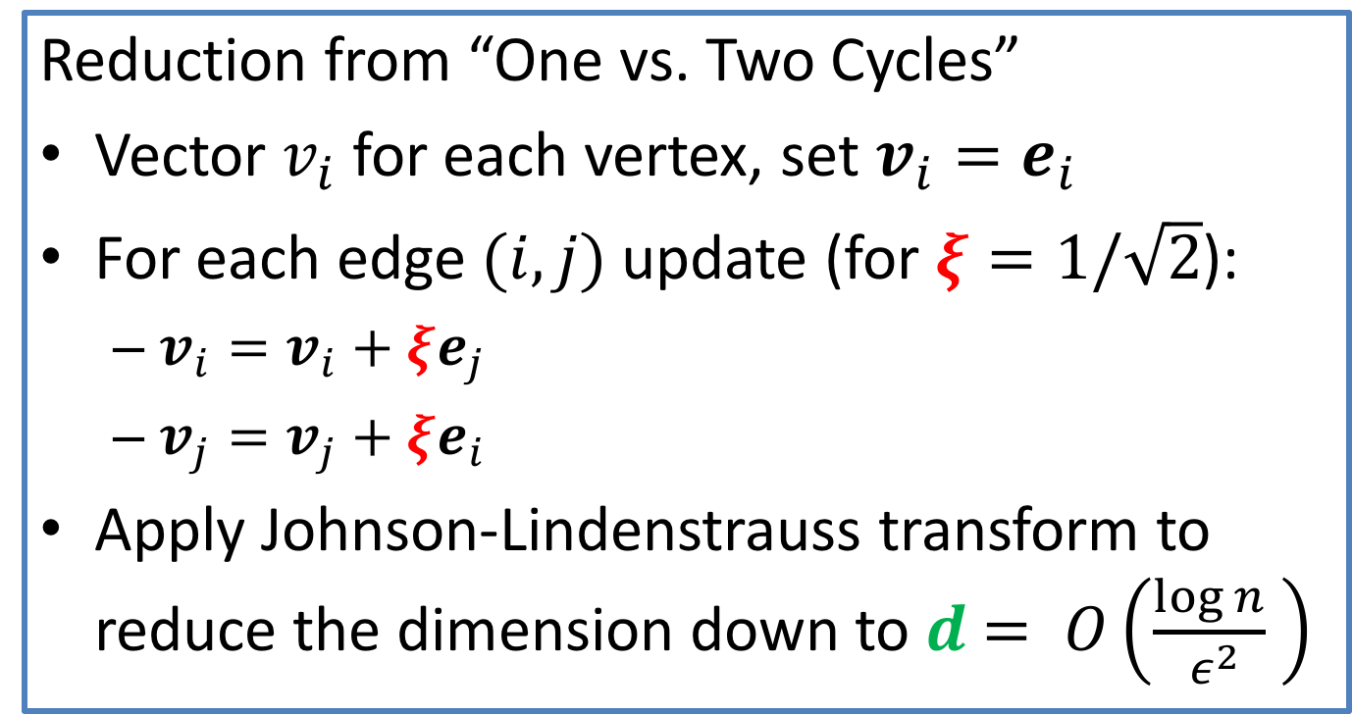
Hardness for $ℓ_{2}$
Reduction from “One vs. Two Cycles”
Vector $v_{i}$ for each vertex, set $v_{i}=e_{i}$
For each edge $(i,j)$ update (for $ξ=1/\sqrt{2}$):
  $v_{i}=v_{i}+ξe_{j}$
  $v_{j}=v_{j}+ξe_{i}$
Apply Johnson-Lindenstrauss transform to reduce the dimension down to $d$ $= O\left(\frac{\log{n}}{ ε^{2}} \right)$
Important that reduction can be done in O(1) rounds

Slide 14
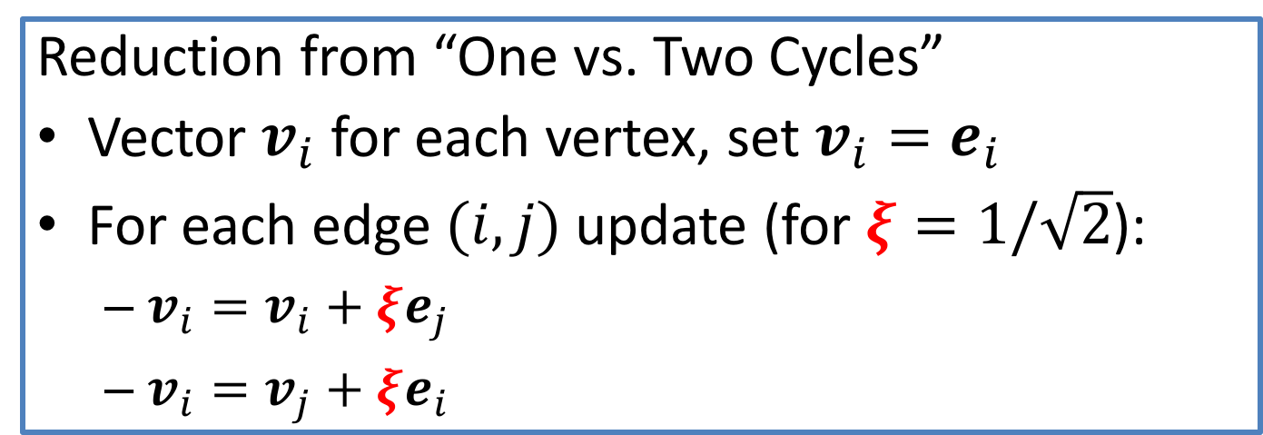
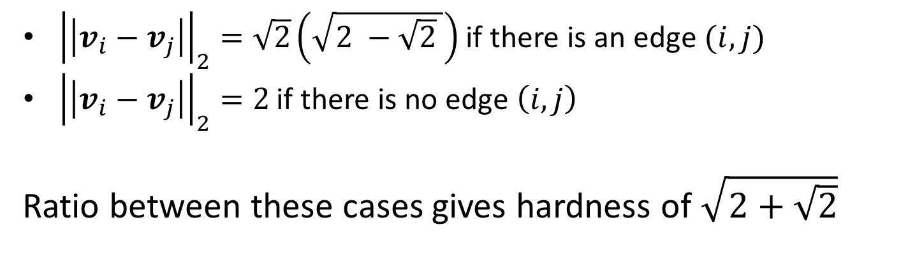
Hardness for $ℓ_{2}$
Reduction from “One vs. Two Cycles”
Vector $v_{i}$ for each vertex, set $v_{i}=e_{i}$
For each edge $(i,j)$ update (for $ξ=1/\sqrt{2}$):
  $v_{i}=v_{i}+ξe_{j}$
  $v_{i}=v_{j}+ξe_{i}$
${\left|\left|v_{i}−v_{j}\right|\right|}_{2}=\sqrt{2}\left(\sqrt{2 −\sqrt{2} }\right)$ if there is an edge $(i,j)$
${\left|\left|v_{i}−v_{j}\right|\right|}_{2}=2$if there is no edge $\left(i,j\right)$
Ratio between these cases gives hardness of $\sqrt{2+\sqrt{2}}$

Slide 15
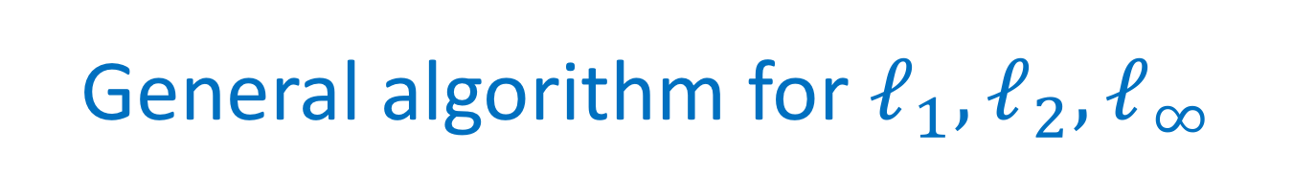
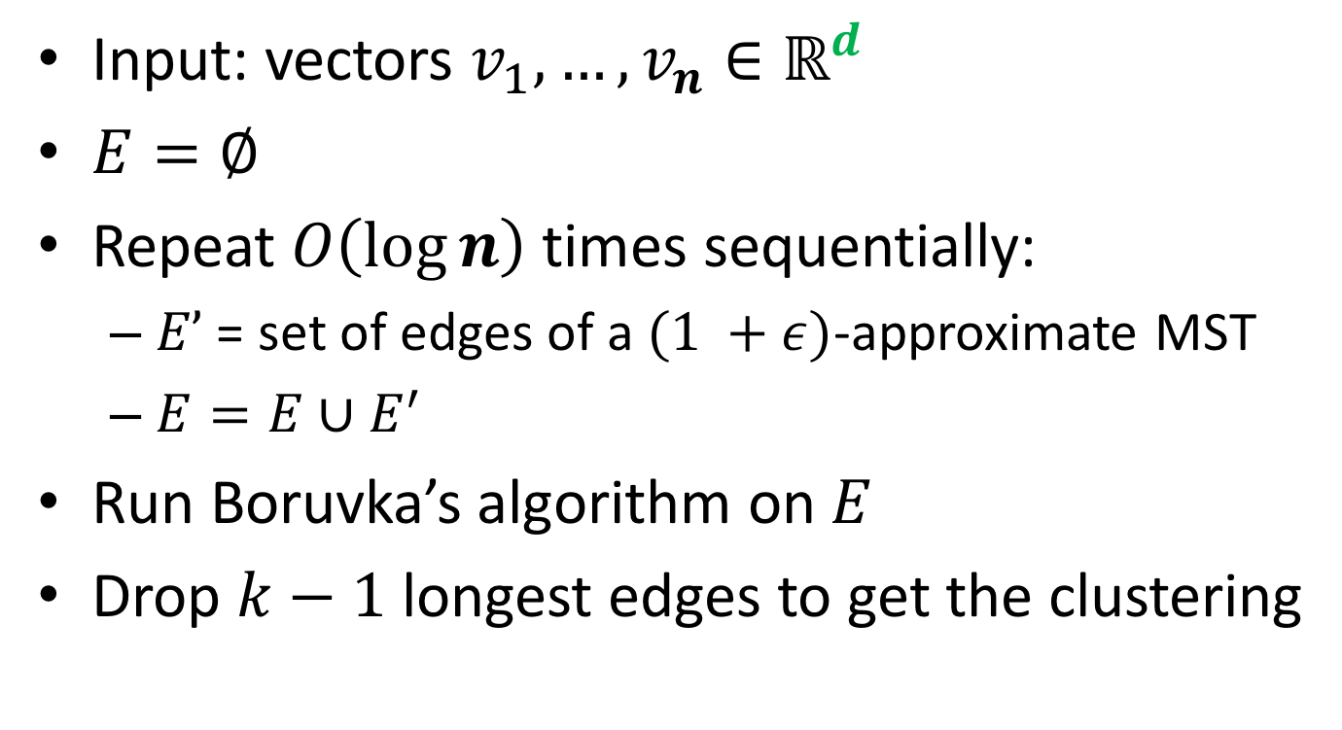
General algorithm for $ℓ_{1},ℓ_{2}, ℓ_{∞}$
Input: vectors $v_{1},…, v_{n}∈ℝ^{d}$
$E=∅$
Repeat $O\left(\log{n}\right)$times sequentially:
  $E’$ = set of edges of a $(1 +ε)$-approximate MST
  $E=E∪E^{′}$
Run Boruvka’s algorithm on $E$
Drop $k−1$ longest edges to get the clustering

Slide 16

Large geometric graphs
Graph algorithms: Dense graphs vs. sparse graphs
  Dense: $S≫|V|$.
  Sparse: $S≪|V|$.
Our setting:
  Dense graphs, sparsely represented: O(n) space
  Output doesn’t fit on one machine ($S≪ n$)
Today: $(1+ε)$-approximate MST [ANOY’14]
  $d=2$ (easy to generalize)
  $R=\log_{S}{n}\text{= }\text{O}\text{(1) }$rounds ($S=n^{Ω(1)}$)

Slide 17
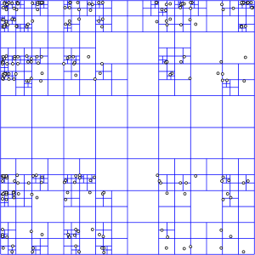
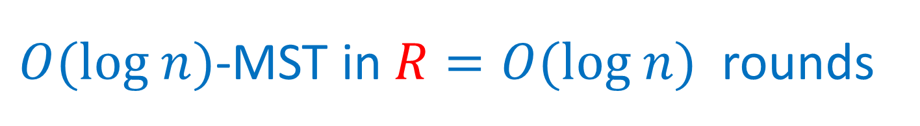

$O(log n)$-MST in $R=O(log n)$rounds
Assume points have integer coordinates $\left[0, …,Δ\right]$, where $Δ=O\left(n^{2}\right) .$
Impose an $O(log⁡n)$-depth quadtree
Bottom-up: For each cell in the quadtree
  compute optimum MSTs in subcells
  Use only one representative from each cell on the next level
Wrong representative:
O(1)-approximation per level

Slide 18





$εL$-nets
$εL$-net for a cell C with side length $L$:
  Collection S of vertices in C, every vertex is at distance <= $εL$ from some vertex in S. (Fact: Can efficiently compute $ε$-net of size $O\left(\frac{1}{ε^{2}}\right))$
Bottom-up: For each cell in the quadtree
  Compute optimum MSTs in subcells
  Use $εL$-net from each cell on the next level
Idea: Pay only $O(εL$) for an edge cut by cell with side $L$
Randomly shift the quadtree: $\operatorname{Pr}\left[cut edge of length ℓ by L\right]∼ℓ/L$ – charge errors
Wrong representative:
O(1)-approximation per level
$$L$$
$$εL$$
$$L$$

Slide 19

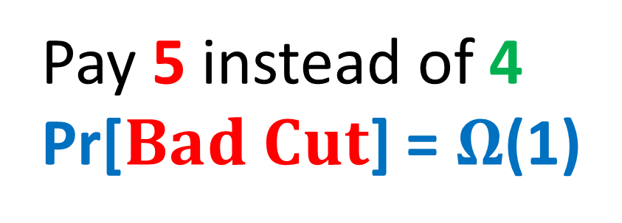


$$Randomly shifted quadtree$$
Top cell shifted by a random vector in ${\left[0,L\right]}^{2}$
Impose a randomly shifted quadtree (top cell length $2Δ$)
Bottom-up: For each cell in the quadtree
  Compute optimum MSTs in subcells
  Use $εL$-net from each cell on the next level
Pay 5 instead of 4
Pr[$Bad Cut$] = $Ω$(1)
2
$$Bad Cut$$
1

Slide 20

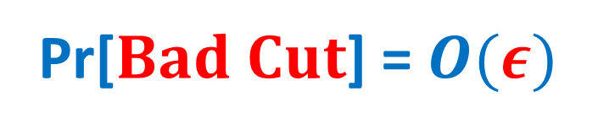
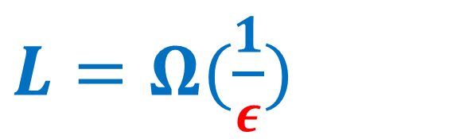
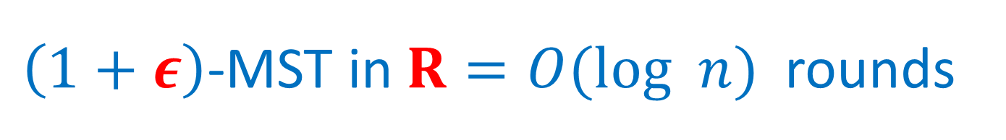
$\left(1+ε\right)$-MST in $R=O(log n)$rounds
Idea: Only use short edges inside the cells
Impose a randomly shifted quadtree (top cell length $\frac{2Δ}{ε }$ )
Bottom-up: For each node (cell) in the quadtree
  compute optimum Minimum Spanning Forests in subcells, using edges of length $≤εL$
  Use only $ε^{2}L$-net from each cell on the next level
$L=Ω(\frac{1}{ε})$
2
Pr[$Bad Cut$] = $O(ε)$
1

Slide 21



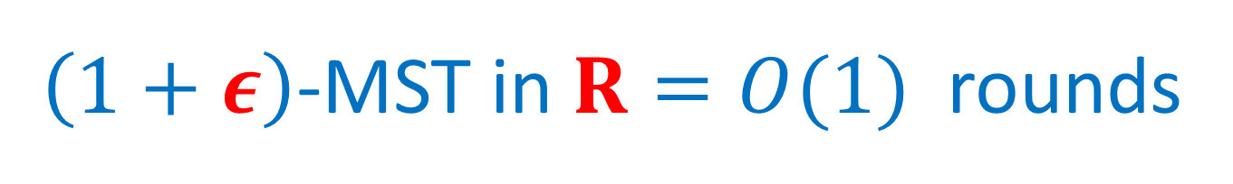
$\left(1+ε\right)$-MST in $R=O(1)$rounds
$O(log n)$ rounds => O($\log_{S}{n}$) = O(1) rounds
  Flatten the tree: ($\sqrt{M}×\sqrt{M}$)-grids instead of (2x2) grids at each level.
Impose a randomly shifted ($\sqrt{M}×\sqrt{M}$)-tree
Bottom-up: For each node (cell) in the tree
  compute optimum MSTs in subcells via edges of length $≤εL$
  Use only $ε^{2}L$-net from each cell on the next level
$$\sqrt{M}=n^{Ω(1)}$$
⇒

Slide 22
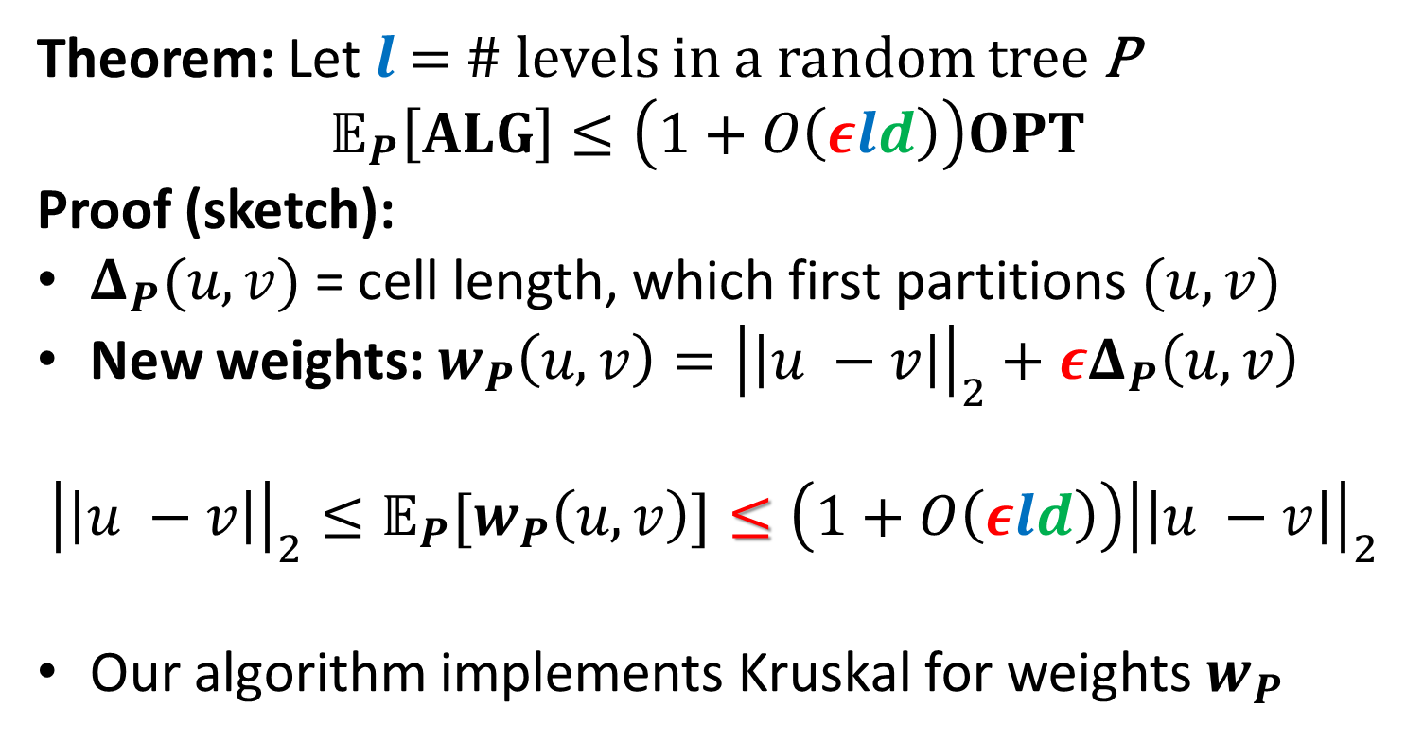



$\left(1+ε\right)$-MST in $R=O(1)$rounds
Theorem: Let $l$ = # levels in a random tree P
$$𝔼_{P}\left[ALG\right]≤\left(1+O\left(εld\right)\right)OPT$$
Proof (sketch):
$Δ_{P}(u,v)$ = cell length, which first partitions $(u, v)$
New weights: $w_{P}\left(u,v\right)={\left|\left|u −v\right|\right|}_{2}+εΔ_{P}\left(u,v\right)$
$${{\left|\left|u −v\right|\right|}_{2}≤𝔼_{P}[w}_{P}\left(u,v\right)]≤\left(1+O\left(εld\right)\right){\left|\left|u −v\right|\right|}_{2}$$
Our algorithm implements Kruskal for weights $w_{P}$
$$u$$
$$v$$
$$Δ_{P}\left(u,v\right)$$

Slide 23
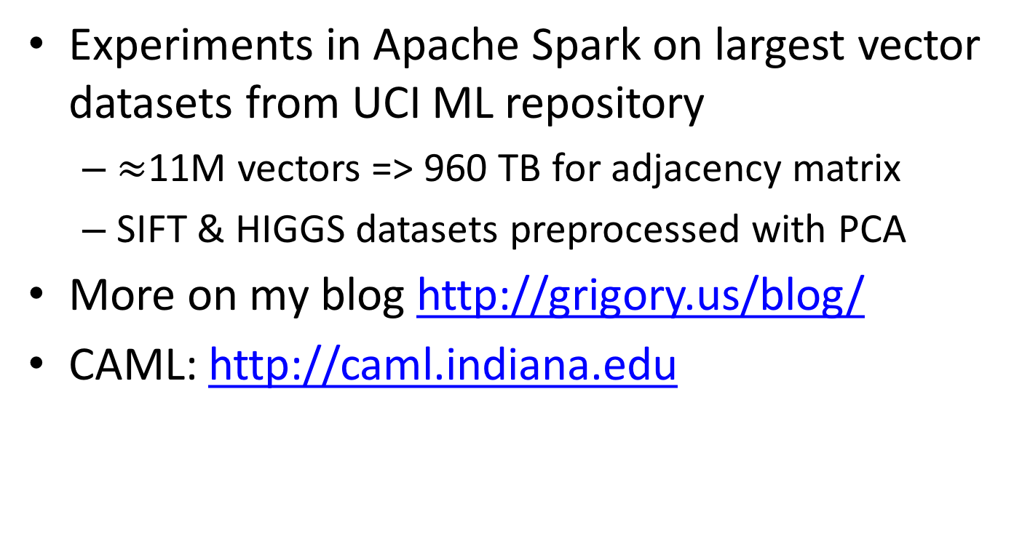
Thank you!
Experiments in Apache Spark on largest vector datasets from UCI ML repository
  $≈$11M vectors => 960 TB for adjacency matrix
  SIFT & HIGGS datasets preprocessed with PCA
More on my blog http://grigory.us/blog/
CAML: http://caml.indiana.edu

