Slide 1
Testability of Homomorphism Inadmissibility: Property Testing Meets Database Theory
Yuichi Yoshida
NII
(Joint work with Hubie Chen)

Slide 2
Outline
Our results in terms of hypergraphs
Our results in terms of relational structures
Proof sketch
Conclusions

Slide 3
Outline
Our results in terms of hypergraphs
Our results in terms of relational structures
Proof sketch
Conclusions

Slide 4



Homomorphism
Consider two hypergraphs $G$, $H$.
$h:V(H) →V(G)$ is a homomorphism if $\{f\left(v_{1}\right),…,f\left(v_{k}\right)\}∈E(G)$ for any $\left\{v_{1},…,v_{k}\right\}∈E(H)$.
$$H$$
$$G$$

Slide 5

Homomorphism
Consider two hypergraphs $G$, $H$.
$h:V(H) →V(G)$ is a homomorphism if $\{f\left(v_{1}\right),…,f\left(v_{k}\right)\}∈E(G)$ for any $\left\{v_{1},…,v_{k}\right\}∈E(H)$.
$G$ is $H$-free if there is no homomorphism from $G$ to $H$.
$$H$$
$$G$$

Slide 6

Homomorphism
$H$-freeness (in this talk) ≠ having no $H$ as a subgraph
$G$ is injective $H$-free if there is no injective homomorphism from $G$ to $H$.
Injective $H$-freeness = having no $H$ as a subgraph
$$H$$
$$G$$

Slide 7
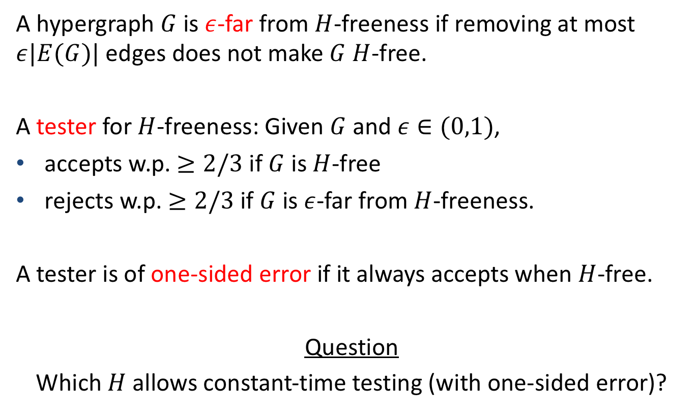

Testing $H$-freeness
A hypergraph $G$ is $ε$-far from $H$-freeness if removing at most $ε|E(G)|$ edges does not make $G$ $H$-free.
A tester for $H$-freeness: Given $G$ and $ε∈(0,1)$,
accepts w.p. $≥2/3$ if $G$ is $H$-free
rejects w.p. $≥2/3$ if $G$ is $ε$-far from $H$-freeness.
A tester is of one-sided error if it always accepts when $H$-free.
Question
Which $H$ allows constant-time testing (with one-sided error)?

Slide 8
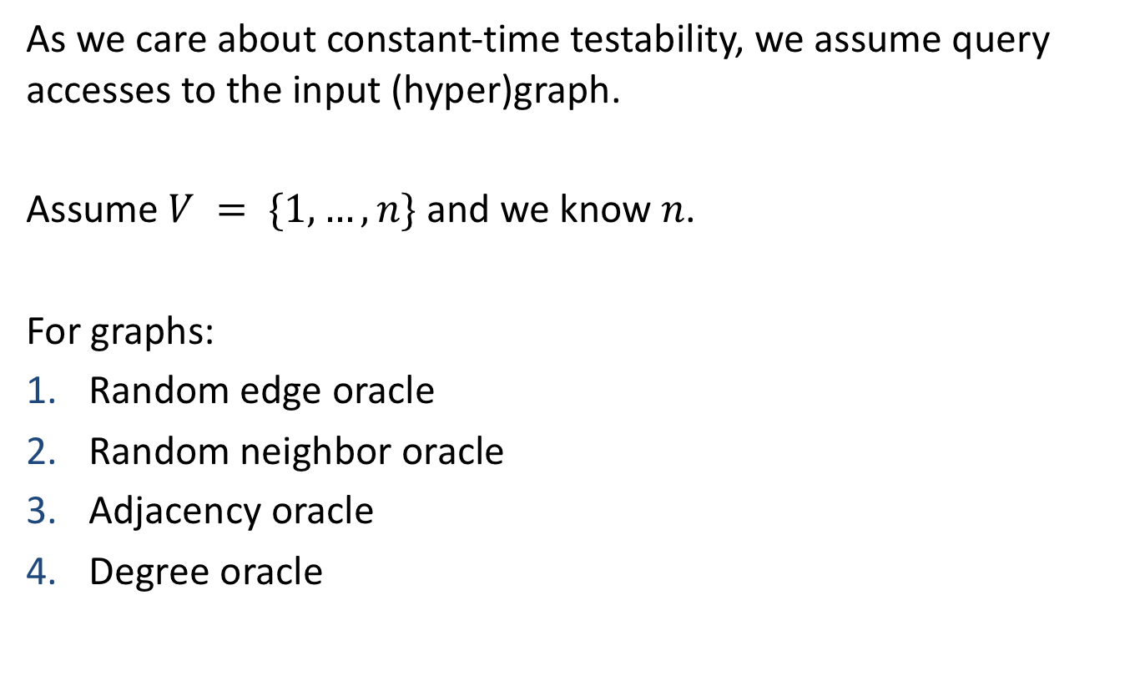
Model
As we care about constant-time testability, we assume query accesses to the input (hyper)graph.
Assume $V = \{1,…,n\}$ and we know $n$.
For graphs:
Random edge oracle
Random neighbor oracle
Adjacency oracle
Degree oracle

Slide 9
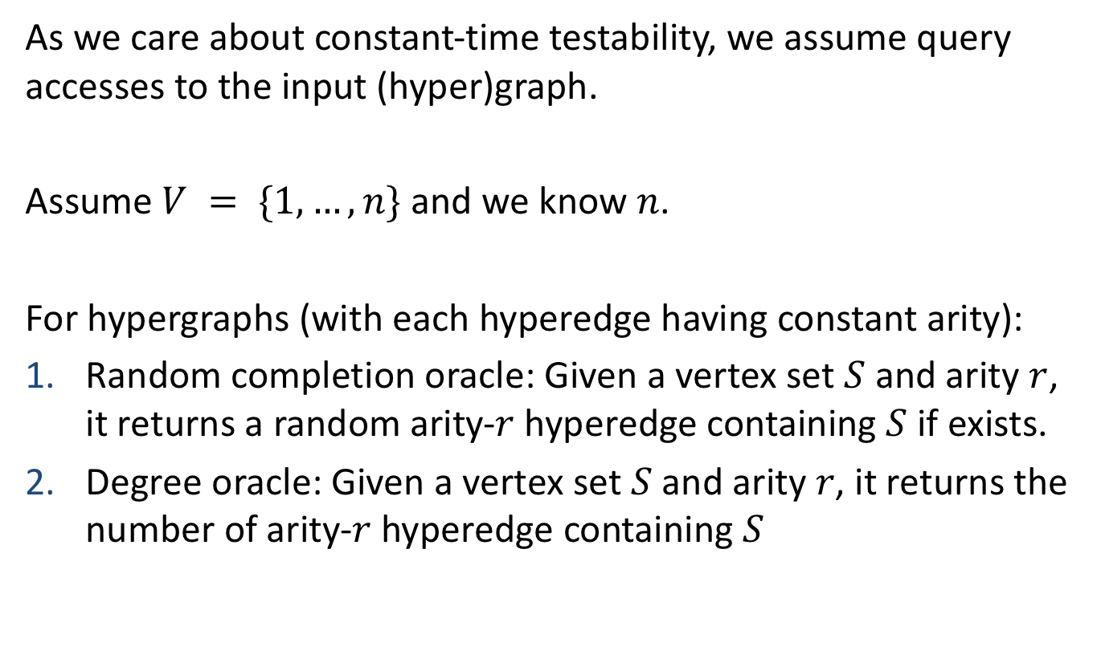
Model
As we care about constant-time testability, we assume query accesses to the input (hyper)graph.
Assume $V = \{1,…,n\}$ and we know $n$.
For hypergraphs (with each hyperedge having constant arity):
Random completion oracle: Given a vertex set $S$ and arity $r$, it returns a random arity-$r$ hyperedge containing $S$ if exists.
Degree oracle: Given a vertex set $S$ and arity $r$, it returns the number of arity-$r$ hyperedge containing $S$

Slide 10
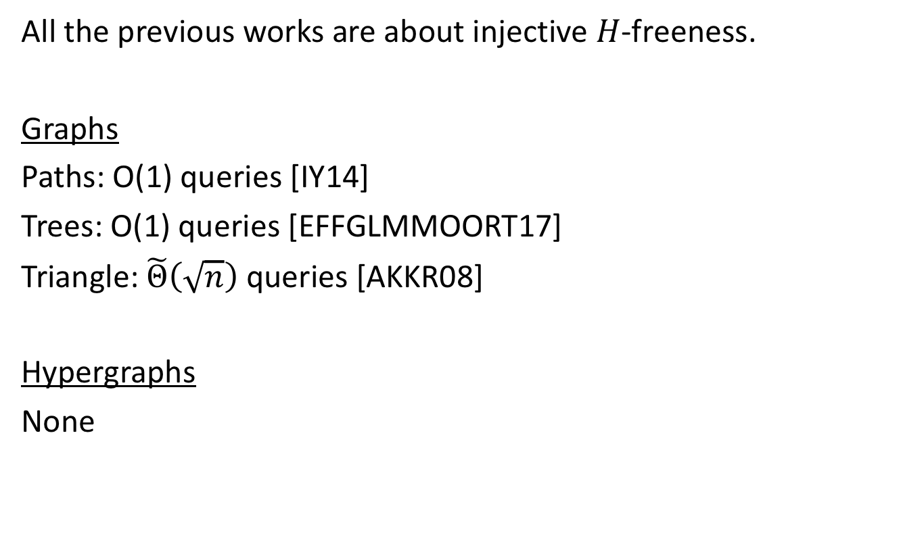
Previous Work
All the previous works are about injective $H$-freeness.
Graphs
Paths: O(1) queries [IY14]
Trees: O(1) queries [EFFGLMMOORT17]
Triangle: $\tilde{Θ}\left(\sqrt{n}\right)$ queries [AKKR08]
Hypergraphs
None

Slide 11

Main Results in Terms of Hypergraphs
Dichotomy for testing $H$-freeness with one-sided error:
if the “core” of $H$ is “α-acyclic”, then constant-query testable.
Otherwise, requires $Ω(n^{c})$ queries for some $c >0$.
If $H$ is “α-acyclic”, then injective $H$-freeness is constant-query testable with one-sided error.
(Lower bounds: Open)
What are the core and α-acyclicity?

Slide 12
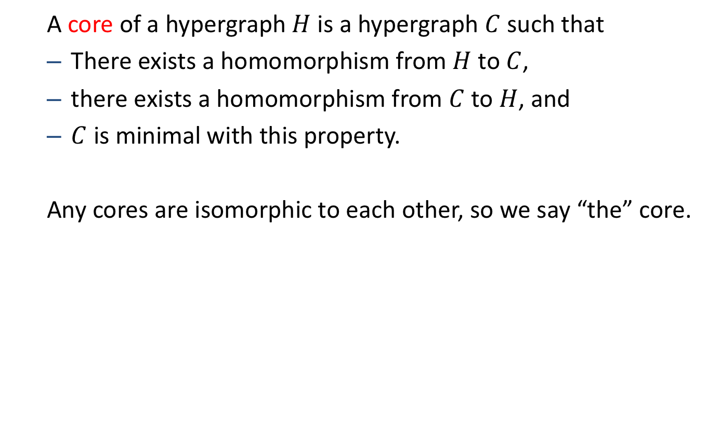
Core
A core of a hypergraph $H$ is a hypergraph $C$ such that
There exists a homomorphism from $H$ to $C$,
there exists a homomorphism from $C$ to $H$, and
$C$ is minimal with this property.
Any cores are isomorphic to each other, so we say “the” core.

Slide 13

Examples
Any complete graph is a core.
A cycle of odd length is a core.
The core of a bipartite graph is $K_{2}$.

Slide 14
Examples
Any complete graph is a core.
A cycle of odd length is a core.
The core of a bipartite graph is $K_{2}$.

Slide 15

Examples
Any complete graph is a core.
A cycle of odd length is a core.
The core of a bipartite graph is $K_{2}$.
When discussing testability of $H$-freeness, we can always replace $H$ with its core.

Slide 16

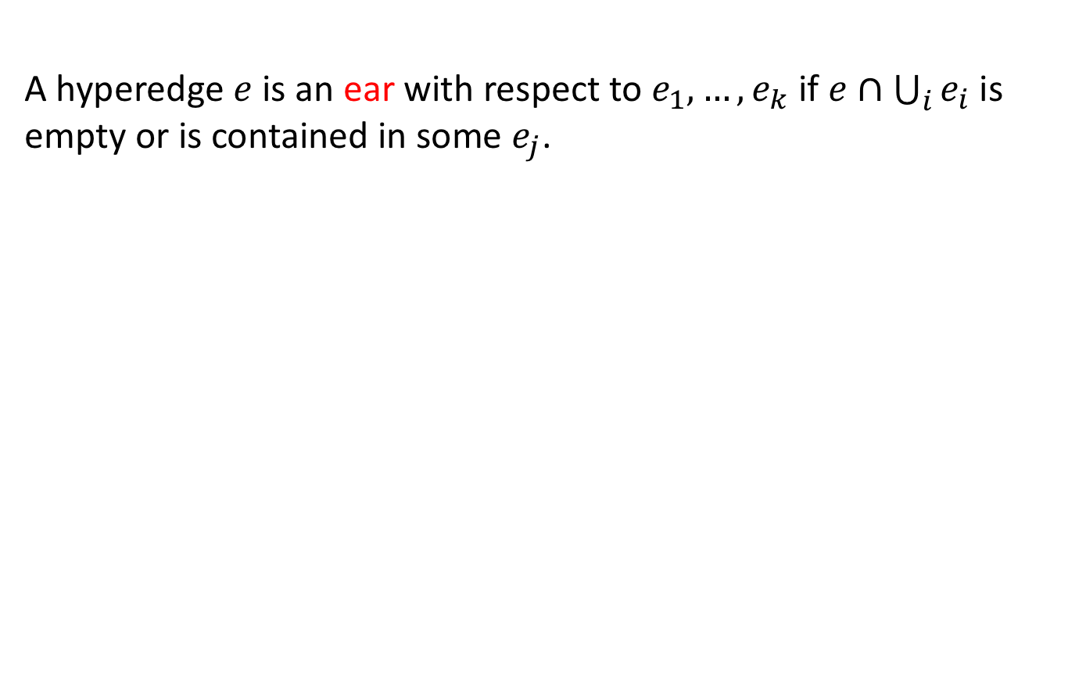








α-acyclicity
A hyperedge $e$ is an ear with respect to $e_{1},…, e_{k}$ if $e∩\bigcup_{i}{e_{i}}$ is empty or is contained in some $e_{j}$.
Ears
Non-ears
$$e_{1}$$
$$e_{2}$$
$$e_{1}$$
$$e_{2}$$
$$e_{1}$$
$$e$$
$$e_{1}$$
$$e_{2}$$
$$e$$
$$e$$
$$e$$

Slide 17
α-acyclicity
A hyperedge $e$ is an ear with respect to $e_{1},…, e_{k}$ if $e∩\bigcup_{i}{e_{i}}$ is empty or is contained in some $e_{j}$.
Ears
Non-ears
$$e_{1}$$
$$e_{2}$$
$$e_{1}$$
$$e_{2}$$
$$e_{1}$$
$$e$$
$$e_{1}$$
$$e_{2}$$
$$e$$
$$e$$
$$e$$

Slide 18

α-acyclicity
A hypergraph $G$ is α-acyclic if it can be obtained by iteratively adding ears.
A graph is α-acyclic ⇔ it is a tree.
α-acyclic
Non-α-acyclic

Slide 19
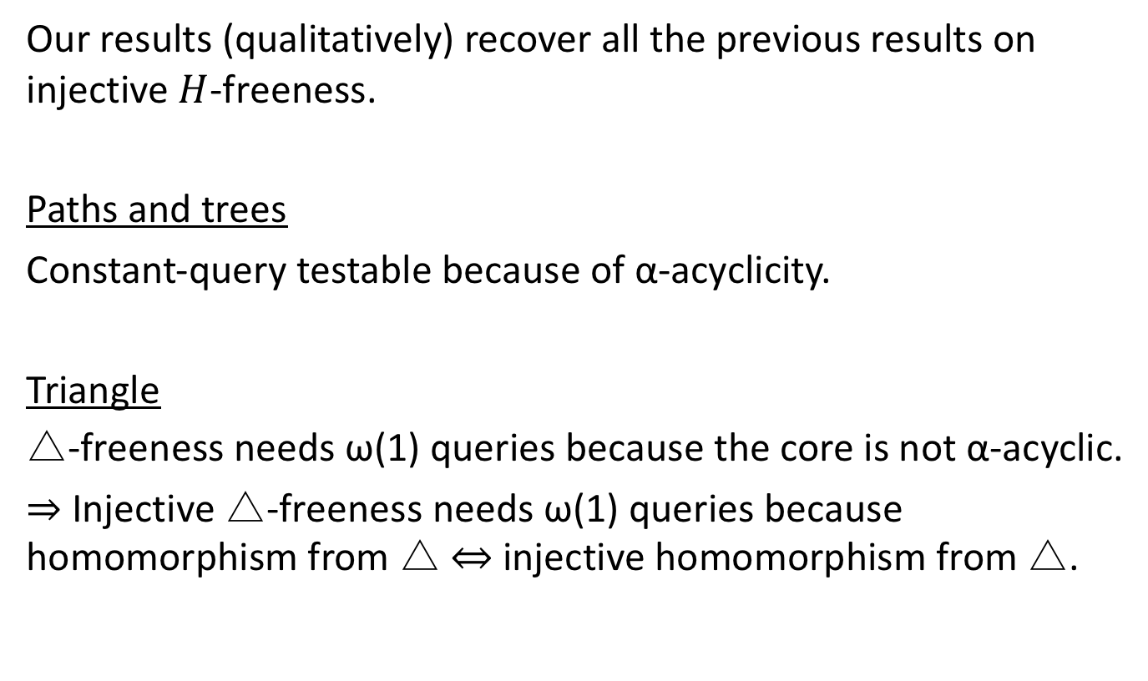
Implications of Our Results
Our results (qualitatively) recover all the previous results on injective $H$-freeness.
Paths and trees
Constant-query testable because of α-acyclicity.
Triangle
△-freeness needs ω(1) queries because the core is not α-acyclic.
⇒ Injective △-freeness needs ω(1) queries because homomorphism from △ ⇔ injective homomorphism from △.

Slide 20
Outline
Our results in terms of hypergraphs
Our results in terms of relational structures
Proof sketch
Conclusions

Slide 21




(Relational) Structure
A (relational) structure $A=(A;R_{1}, …, R_{k})$
$A$: a finite set (domain)
$R_{i}$: a set of tuples of elements in $A$ (relation)
$$R_{1}$$
$$R_{2}$$
a | b
a | c
b | a
b | c
c | a
c | b
a | a | c
a | c | b
b | a | c
b | b | a
c | a | a
c | b | c
$$A=\{a,b,c\}$$

Slide 22
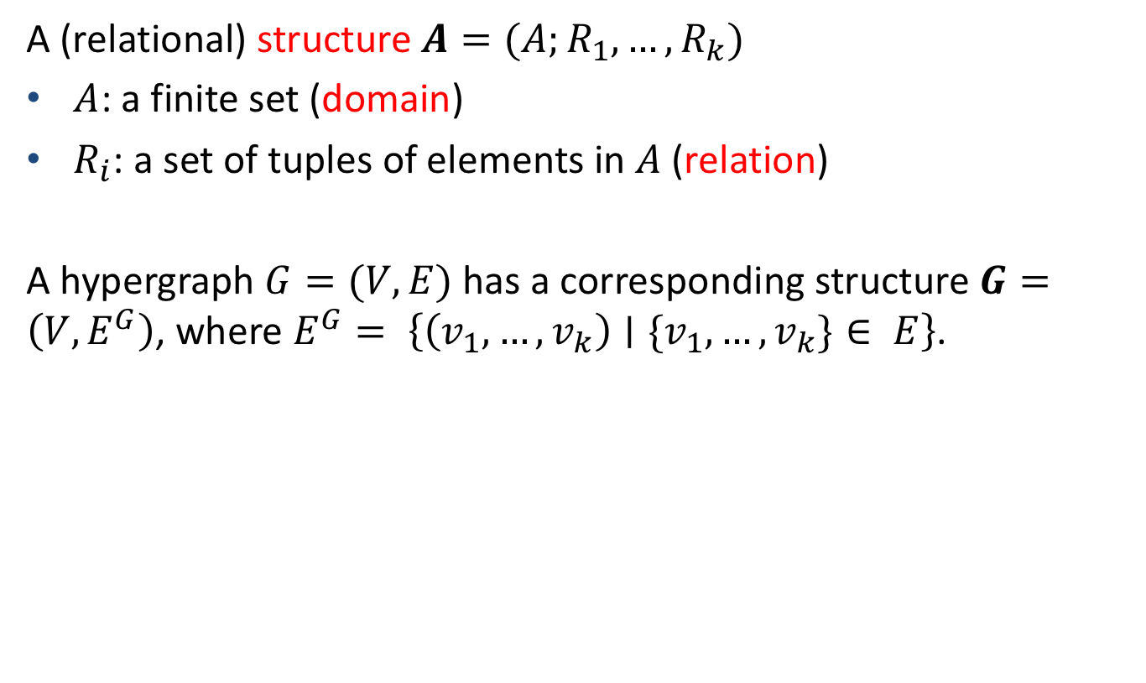
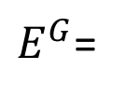



(Relational) Structure
A (relational) structure $A=(A;R_{1}, …, R_{k})$
$A$: a finite set (domain)
$R_{i}$: a set of tuples of elements in $A$ (relation)
A hypergraph $G=(V,E)$ has a corresponding structure $G=\left(V,E^{G}\right)$, where $E^{G}= \left\{\left(v_{1},…,v_{k}\right)∣\{v_{1},…,v_{k}\}∈ E\right\}$.
a | b
a | c
b | a
b | c
c | a
c | b
$$a$$
$E^{G}$=
$$b$$
$$c$$

Slide 23
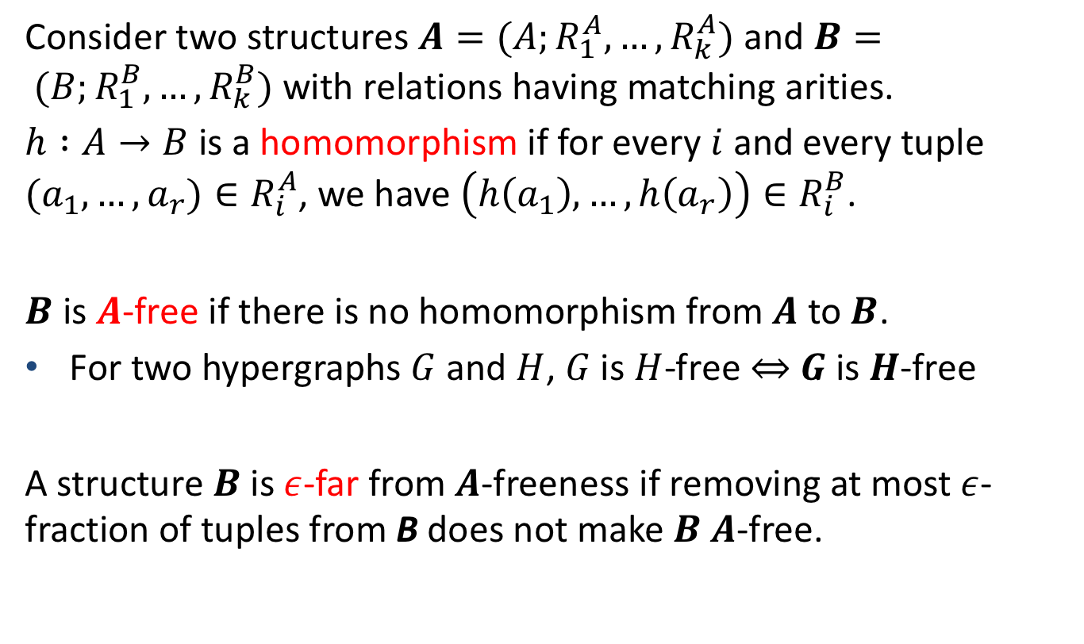

Homomorphism and $A$-freeness
Consider two structures $A=(A;R_{1}^{A},…,R_{k}^{A})$ and $B= (B;R_{1}^{B},…,R_{k}^{B})$ with relations having matching arities.
$h :A→B$ is a homomorphism if for every $i$ and every tuple $(a_{1}, …, a_{r})∈R_{i}^{A}$, we have $\left(h\left(a_{1}\right), …, h\left(a_{r}\right)\right)∈R_{i}^{B}$.
$B$ is $A$-free if there is no homomorphism from $A$ to $B$.
For two hypergraphs $G$ and $H$, $G$ is $H$-free ⇔ $G$ is $H$-free
A structure $B$ is $ε$-far from $A$-freeness if removing at most $ε$-fraction of tuples from B does not make $B$ $A$-free.

Slide 24
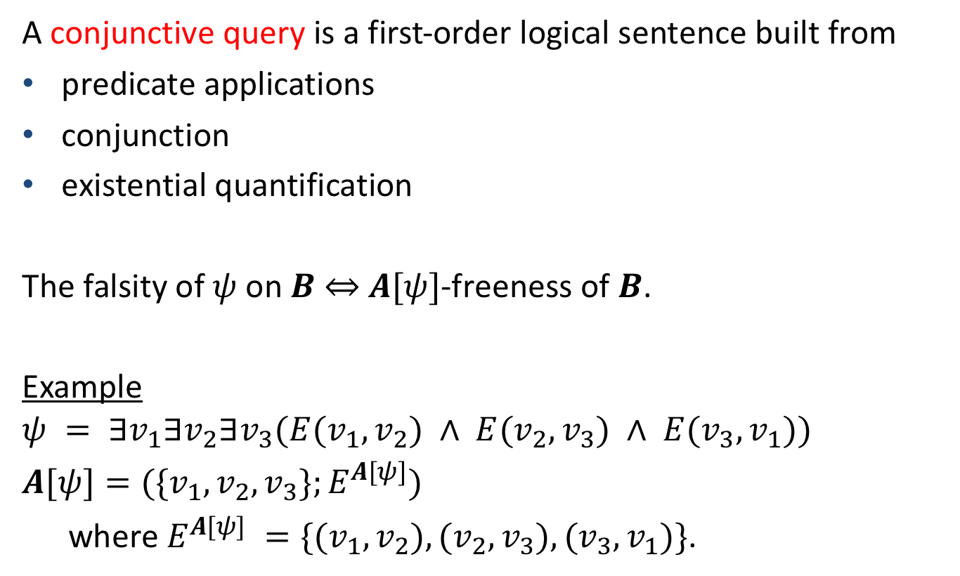
Database Interpretation
A conjunctive query is a first-order logical sentence built from
predicate applications
conjunction
existential quantification
The falsity of $ψ$ on $B$ ⇔ $A[ψ]$-freeness of $B$.
Example
$$ψ = ∃v_{1}∃v_{2}∃v_{3}(E(v_{1}, v_{2}) ∧ E(v_{2}, v_{3}) ∧ E(v_{3}, v_{1}))$$
$A[ψ]=(\{v_{1}, v_{2}, v_{3}\};E^{A[ψ]})$
where $E^{A[ψ]} =\{(v_{1},v_{2}),(v_{2},v_{3}),(v_{3},v_{1})\}$.

Slide 25
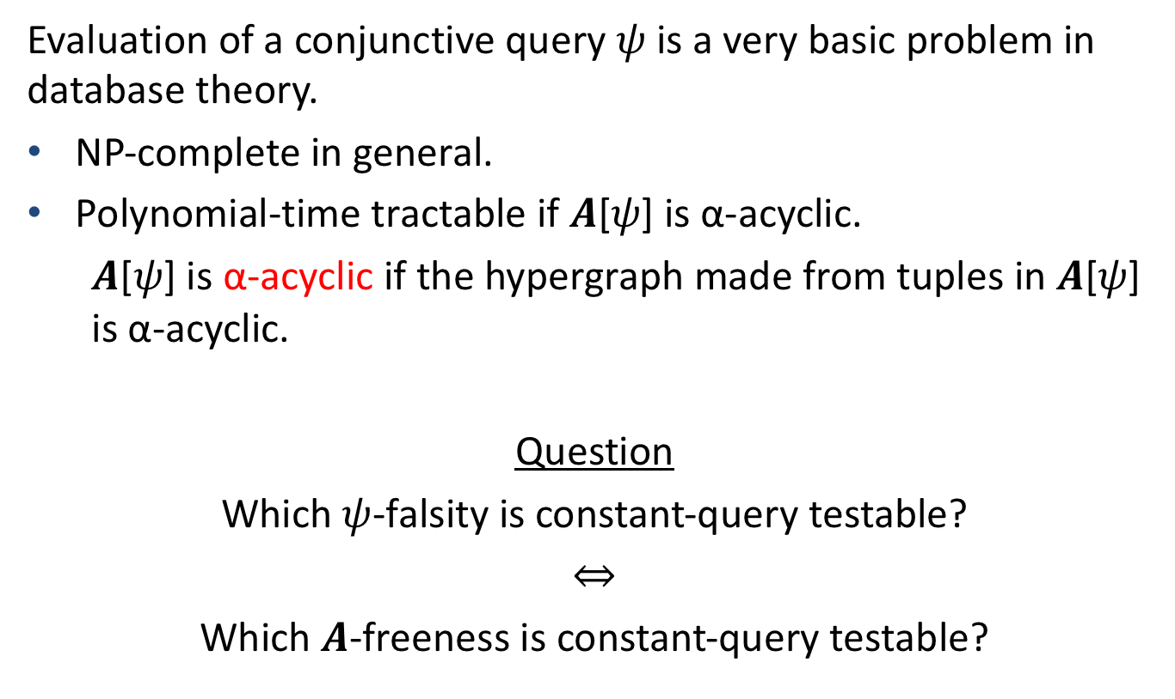
Database Interpretation
Evaluation of a conjunctive query $ψ$is a very basic problem in database theory.
NP-complete in general.
Polynomial-time tractable if $A\text{[}ψ\text{]}$ is α-acyclic.
$A\text{[}ψ\text{]}$ is α-acyclic if the hypergraph made from tuples in $A\text{[}ψ\text{]}$ is α-acyclic.
Question
Which $ψ$-falsity is constant-query testable?
⇔
Which $A$-freeness is constant-query testable?

Slide 26



Model
We assume the following query accesses to B.
Random completion oracle
Size oracle
Input: a relation $R^{B}$ of arity $r$ and a tuple $q=\left(q_{1},…,q_{r}\right)∈ {\left(B∪\left\{∗\right\}\right)}^{r}$
$$R^{B}$$
a | a | c
a | c | b
b | a | c
b | b | a
c | a | a
c | b | c
$$q=\left(∗,a, ∗\right)$$

Slide 27

Model
We assume the following query accesses to B.
Random completion oracle
Size oracle
Input: a relation $R^{B}$ of arity $r$ and a tuple $q=\left(q_{1},…,q_{r}\right)∈ {\left(B∪\left\{∗\right\}\right)}^{r}$
$$R^{B}$$
a | a | c
a | c | b
b | a | c
b | b | a
c | a | a
c | b | c
Random
completion
oracle
One of $\left(a,a,c\right), \left(b,a,c\right), (c,a,a)$
$$q=\left(∗,a, ∗\right)$$
Size
oracle
3

Slide 28

Main Results in Terms of Structures
Dichotomy for testing $A$-freeness with one-sided error:
if the core of $A$ is α-acyclic, then constant-query testable.
Otherwise, requires $Ω(n^{c})$ queries for some $c >0$.
Dichotomy for testing conjunctive queries with one-sided error.
$ψ$ is easy to evaluate for polynomial-time algorithms
⇔ $ψ$ is easy to test for constant-time algorithms.
Dichotomy for testing “unions of conjunctive queries” with one-sided error.

Slide 29
Outline
Our results in terms of hypergraphs
Our results in terms of relational structures
Proof sketch
Conclusions

Slide 30
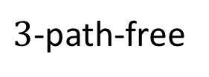


Upper Bounds
For simplicity, let’s focus on testing $k$-path-freeness.
(The idea generalizes to general relational structures, though the details become quite complicated.)
$3$-path-free
not $3$-path-free

Slide 31

Testing k-path-freeness
Algorithm
Repeat the following ${\left(k/ε\right)}^{O(k^{2})}$ times．
Randomly select an edge $\{u,v\}$ and a vertex $s∈\{u, v\}$
Perform a $k$-step random walk from $s$.
If a $k$-path is found then reject.
Accept.
Clearly always accept if $G$ is $k$-path-free.
$p(G)$: prob. that a random walk finds a $k$-path.
Claim: $ε$-far from $k$-path-freeness ⇒ $p(G)≥{\left(ε/k\right)}^{O(k^{2})}$

Slide 32

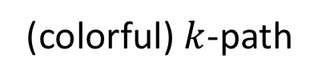
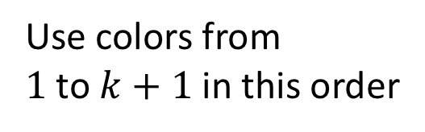

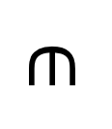

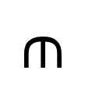
Color Coding
Consider finding a colorful $k$-path from a randomly colored $G$ with $k+1$ colors.
k-path
(colorful) $k$-path
Use colors from
$1$ to $k+1$in this order
$$∈$$
?
$$∈$$
?
$$G$$
$$G’$$

Slide 33
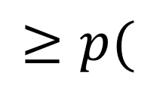
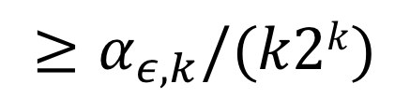
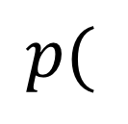
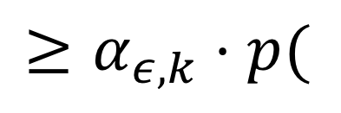
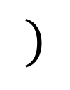
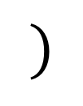
Reduction
$$p($$
$$)$$
$$≥p($$
$$)$$
$$≥α_{ε,k}⋅p($$
$$)$$
w.h.p.
$$≥α_{ε,k}/(k2k)$$

Slide 34
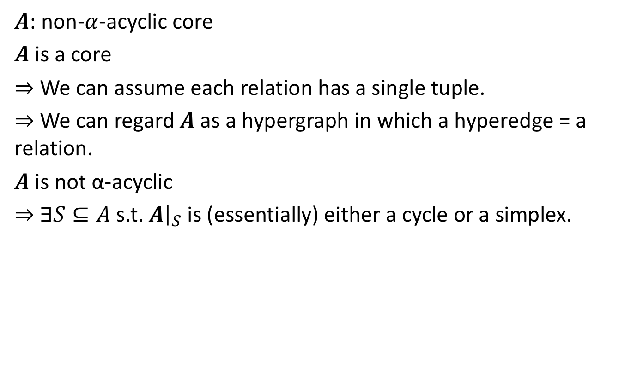
Lower Bounds
$A$: non-$α$-acyclic core
$A$ is a core
⇒ We can assume each relation has a single tuple.
⇒ We can regard $A$ as a hypergraph in which a hyperedge = a relation.
$A$ is not α-acyclic
⇒ ∃$S⊆A$ s.t. $A{\left.​\right|}_{S}$ is (essentially) either a cycle or a simplex.
cycle
simplex

Slide 35
Outline
Our results in terms of hypergraphs
Our results in terms of relational structures
Proof sketch
Conclusions

Slide 36
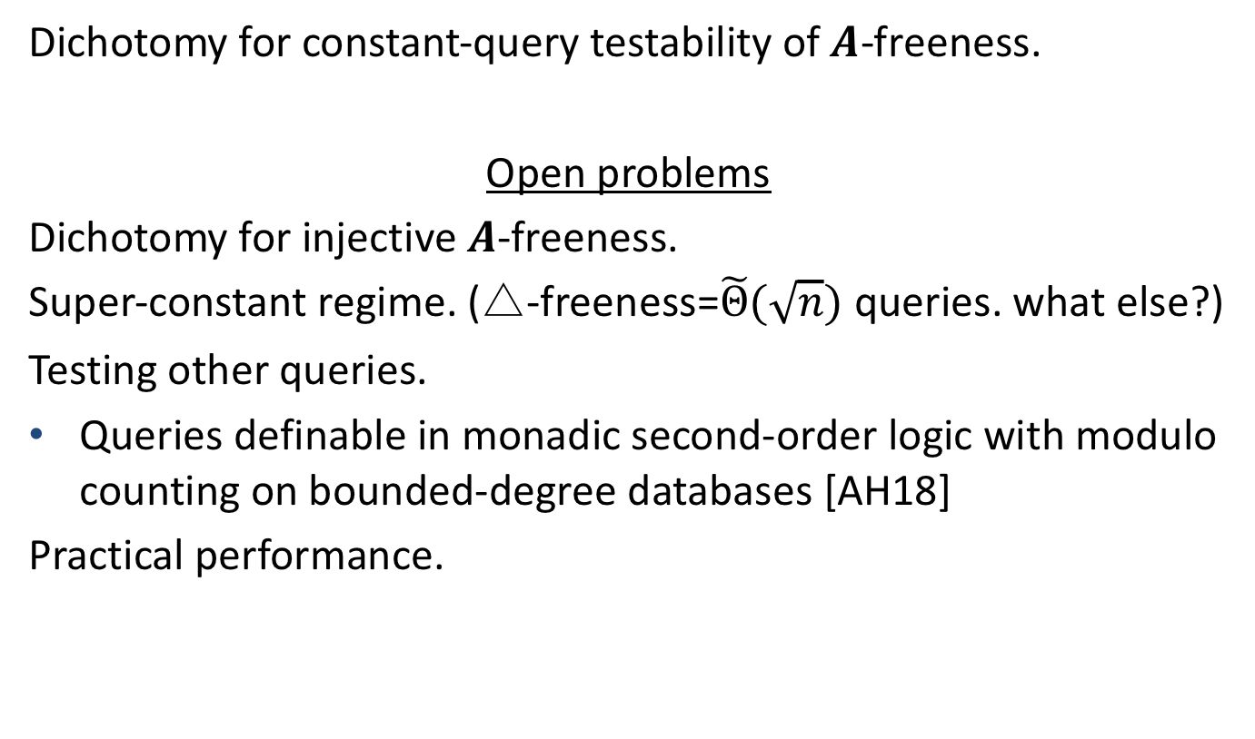
Conclusions
Dichotomy for constant-query testability of $A$-freeness.
Open problems
Dichotomy for injective $A$-freeness.
Super-constant regime. (△-freeness=$\tilde{Θ}(\sqrt{n})$ queries. what else?)
Testing other queries.
Queries definable in monadic second-order logic with modulo counting on bounded-degree databases [AH18]
Practical performance.

Slide 37



Our Results in a Slide
Relational Structure (Database)
Query:$∃x∃y (R_{1}(x, y) ∧R_{2}(x, x,y))$?
$$R_{1}$$
$$R_{2}$$
a | b
a | c
b | a
b | c
c | a
c | b
a | a | c
a | c | b
b | a | c
b | b | a
c | a | a
c | b | c

Slide 38

Our Results in a Slide
Relational Structure (Database)
Query:$∃x∃y (R_{1}(a, c) ∧R_{2}(a, a,c))$?
$$R_{1}$$
$$R_{2}$$
a | b
a | c
b | a
b | c
c | a
c | b
a | a | c
a | c | b
b | a | c
b | b | a
c | a | a
c | b | c

