Slide 1

The Computing for Teachers MOOC
TEL 20th January 2014
Claire Rocks and Jane Sinclair (but more later!)
Department of Computer Science
University of Warwick
United Kingdom
j.e.sinclair@warwick.ac.uk
c.l.rocks@warwick.ac.uk
Notes:
Who we are (but more people later.)
Our aim is to tell you a bit about the context for this MOOC, how it’s going, what it’s REALLY required for us to get this all up and running and our assessment of all this.
It’s certainly taken more than just me and Claire – we’re just the ones talking today. Will introduce you to other key players and the wider cast later.

Slide 2
Plan for the talk
Background
- not all MOOCs are the same! Why this MOOC? Aims. The team!
The MOOC
- how it’s structured; how it’s going so far.
The outreach story
Lessons learned/skills needed
Cost and other resources
Where we are now and future plans.

Slide 3
CfT MOOC – background
For a specific target audience and identified need
To help support UK teachers in preparation for the new computing curriculum
Previous twilight course – need to reach more people, provide more resources
Distinct advantages
- identified community
- competent autonomous learners
- might assume some relevant digital skills
- highly motivated
(Some) funding from Google
Notes:
The cMOOC is where it all began. It’s about using the facilities and connections provided by online networking as the basis for a learning community.
But it’s more than that – it’s based on a theory of knowledge which holds that learning is all about identifying and making connections.
Knowledge exists in lots of places in a network: and learning is seen as the ability to construct and navigate networks in which the nodes are very diverse: people, information, pictures, tools, emotions,organisations.
Technology is all-important here because it’s the possibilities afforded by the web and by the interconnections of social networking which support this.
There don’t seem to be many of them about. I’d like to experience one but I had a look recently and couldn’t find one.
I hope I’m not infringing copyright – but it’s between friends! I do like this – in an affectionate way!

Slide 4
What is a MOOC?
from 5 - 300,000+
massive for context
more than would otherwise have the opportunity
Massive
free – cheaper - neither?
no barrier to enrolment, no geographical limitations
open resources
no prerequisites
Open
Online
natural development into offline communities
taking advantage of physical space
structured program for learning
assessment/feedback
role of instructor/community support
accreditation
Course
First applied to “Connectivism and Connective Knowledge” course in 2008
(Downes and Siemens)
Notes:
The term MOOC has been used to refer to many different things. It’s obviously become very well-known with the Coursera and EdX style of course. Perhaps the most usual expectations currently are:
courses from high profile universities
often, adapted version of their own course
no payment, but very little support
no prerequisite requirements
short videos, quizzes, forums
survival of the fittest

Slide 5
Decisions in planning the CtF MOOC
Moodle as a platform – Vimeo for video hosting
Course to cover Teaching Agency requirements for trainee teachers and to teach Python programming
Material divided into 8 main sessions - plus a “pre” session as an intro
Sessions to be released fortnightly (with a break over Christmas) (teachers very keen on this!)
Three strands – concepts, programming and teaching
Materials: header videos, teaching videos, slides, transcripts, quizzes, labs (and solutions), forums, lots of links to other resources
These materials all freely available to all registered – they can download, reuse etc.
Notes:
A long story and anguish behind each decision!
FutureLearn – we were a bit too soon but the intention is to migrate in the future.
Vimeo – a late decision but saved a lot of grief. Ask Russ.
We wanted to keep the materials under our control a little bit – registration required. Partly so we can evaluate.
We will be taking them down shortly after the end of the course – we have to rethink server space for videos then anyway – but teachers on the course can download and use them as Creative Commons.

Slide 6
Supported mode
To help students learn programming
“Real time” lab sessions with tutors online using Google hangout
Postgrad/postdoc tutors working with small groups of teachers
For this mode also – special forum, final assessment and workshop
Needs to be sustainable – we are charging a nominal amount for teachers on this mode
Access to all materials and other parts of the course – the same
Notes:
The supported mode didn’t make life easy – it’s perhaps caused our biggest headaches so far.
We did it because we thought it would be very useful (and perform a similar role to our own labs).
Also, wanted to investigate this – noone’s ever done it before.

Slide 7
A cast of thousands (nearly!)
Initial development and teaching team
Russ Boyatt, Matt Leeke, Claire Rocks and Jane Sinclair
Making it work (editing, reviewing – generally everything!)
Jonny Foss
Infrastructure
Russ with kind allocation of time by Amber Thomas
Video team
With thanks to Ray and all the team at WBS.
Also, Emily Little for training
continued…

Slide 8
… and more!
PhD team (and Jonny)
A group of our finest (lab experience), developing labs, facilitating hangouts.
Transcription
Lee Prangnell (PhD student)
Admin staff
Departmental admin staff, eg help setting up registration/payment. Lots of admin input from Claire too
Input to “teaching” strand”
Teachers, LA CS coordinator, Computing at Schools, BCS, Cyber Security Challenge UK, e-skills.com,…
Notes:
It’s really been a team effort!

Slide 9
How it’s going so far
Launched intro at the very end of October 2013
Registration
Traditional 618
Supported 30
Total 648
Further requests to register turned down
200 have never logged in
Currently, coming up to release of Session 4
A tough timetable for both us and the students!
Notes:
Lots of stats captured by Moodle and Vimeo where we’re hosting videos.

Slide 10
Preliminary evaluation: programming background

Slide 11
Preliminary evaluation: teaching background

Slide 12
Preliminary evaluation: online learning experience

Slide 13
Preliminary evaluation: demographic data - age

Slide 14
Participation: accesses for sessions 0 - 2
 | Concepts |  |  | Programming |  |  | Labs
Header | Slides | Trans | Quiz | Slides | Trans | Quiz | Lab a | Lab b | Lab c
 | 282 | 184 |  | 202 | 70
125 | 210 | 145 | 504 | 207 | 47 | 365 | 453 | 313 | 271
45 | 109 | 84 | 299 | 105 | 57 | 260 | 249 | 157 | 146
Session 0
Session 1
Session 2
Notes:
Figures for video plays follow a similar pattern

Slide 15
Participation: quizzes
 | Concepts |  | Programming
 | Number submitted | Average score | Number submitted | Average score
Session 1 | 125 | 7.65 | 99 | 7.93
Session 2 | 83 | 9.18 | 72 | 7.83
Several topics of difficulty uncovered (using hex, units of storage in practice, types)
One area of misunderstanding/question probably not appropriate

Slide 16
Hangouts
Numbers vary between 0 and 4 per session
Disappointing!
Need to investigate further

Slide 17
Session evaluations so far - introduction
Introductory session (40 responses)
Right level – strongly agree/ agree 98%
Well produced – strongly agree/ agree 98%
Provided a good intro – strongly agree/agree 100%
Examples of positive comments
good to see “faces”
gentle intro, not too overwhelming
use of simple examples, avoidance of computing jargon
Examples of negative comments
would have liked overview of topics and timetable
more formal assignment to introduce themselves on forum
an initial exercise to get on with

Slide 18
Session evaluations so far – session 1
Introductory session (27 responses)
Right level – strongly agree/ agree 100%
Well produced – strongly agree/ agree 93%
Helpful for learning these topics – strongly agree/agree 100%
Examples of positive comments
the programming steps
practicals and quizzes
although covering basics, it was non-patronising and challenging
Examples of negative comments
shorter videos
snappier presentation
a handy quick look-up guide would be good
struggling to get through everything

Slide 19
Linking to our outreach agenda
There are lots of changes to the way computing is taught in schools
A major part of the department’s outreach activity is to support teachers through those changes
CAS & Network of Excellence
Building relationships and reputation with teachers, professional bodies, awarding bodies, colleagues at other universities

Slide 20
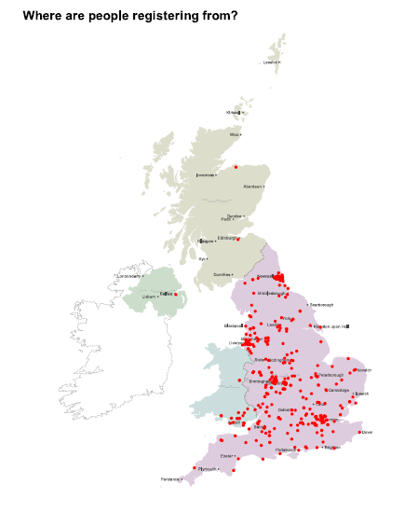
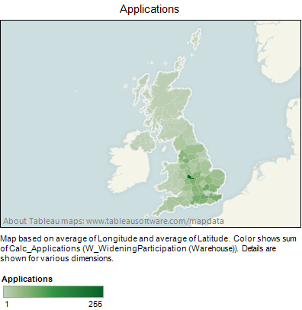
Linking to our outreach agenda

Slide 21
Skills needed
Pedagogical
Different way of teaching. Having to be more structured up front. Mapping to the Teaching Agency requirements. Different audience. Not able to respond to instant feedback in the classroom. Sense checking of sessions
Technical
Getting to grips with Moodle and features. Making and editing video/audio recordings
Management & Administrative
Planning and coordination of activity, setting up the logins, weekly emails, taking payment, keeping motivated

Slide 22
What it really cost
Finger in the air… approx. £22,000
Staff time/in-kind support more than 1.5x funding
Based on approx. 15 hours staff time to create single session (not including edits or lab development or hangouts) + technical support + weekly meetings + administration

Slide 23
What resources did we need?
Camera & tripod/audio recorder + microphones + suitable locations
Presentation software and template – mostly PowerPoint
Lecture capture & microphone (USB soundcard?) – mostly CamStudio
Video/audio editing software
Somewhere to host the video – Vimeo Pro
Platform – Moodle
Server
Programming environment – custom made but using Skulpt
Resource email account

Slide 24
What we’ve been learning
It’s a great thing to do – but don’t underestimate the effort/resources
Get buy-in (and dedicated time, commitment to resources) from line management
Issues of platform – “doing it yourself” obviously means more effort
Project management needed!
We needed to develop skills (eg: making video recordings, different ways of teaching, subject/audience). Different way of working.
Our ideas may not be what is most useful for what teachers want or how they work – what do students find useful?

Slide 25
What we’ve learned about the teachers
They don’t have much time (in general, schools are not releasing them, sometimes not even crediting the CPD)
Many are not keeping up with the materials (even though we think it’s quite gentle and well-spaced)
Even a number of those on the paid mode haven’t really engaged from the start
The supported mode is not really working. Why?
Assumptions about their preparedness/digital skills may not be right
Wide range of abilities and existing skills
Notes:
Time issues: you can’t learn a subject with no effort! If we space out further, momentum gets lost.

Slide 26
Where next?
First task is to complete the remaining sessions of the current course
Evaluate data collected during this run of the course teachers
Gather further feedback
Reconsider possibilities for a future run :
Adapt according to evaluation
Discontinue supported mode?
More effort into support for main mode (forums, emails)
More resources
Link to accreditation

