Slide 1
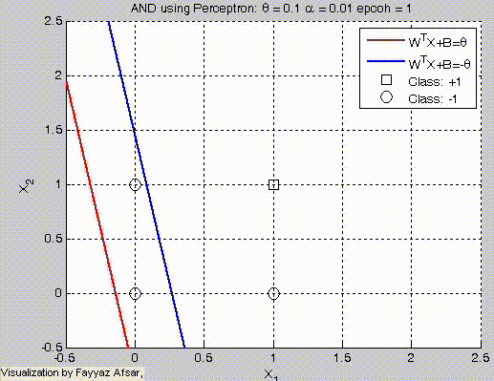
How a perceptron's classification boundary (red) changes with learning at a rate of 0.01
This video shows a single perceptron to solve the classic AND classification problem, i.e., there are 4 examples as follows:
(0,0) with label -1
(0,1) with label -1
(1,0) with label -1
(1,1) with label +1
We start off with initial weights W=[0.1;0.1] and B=0 with learning rate alpha=0.01 and perform gradient descent updates

Slide 2
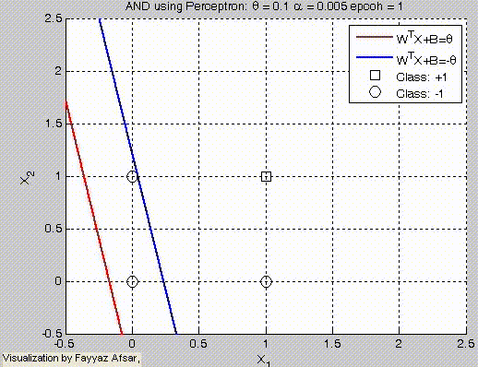
How a perceptron's classification boundary (red) changes with learning at a rate of 0.005
This video shows a single perceptron to solve the classic AND classification problem, i.e., there are 4 examples as follows:
(0,0) with label -1
(0,1) with label -1
(1,0) with label -1
(1,1) with label +1
We start off with initial weights W=[0.1;0.1] and B=0 with learning rate alpha=0.01 and perform gradient descent updates

Slide 3
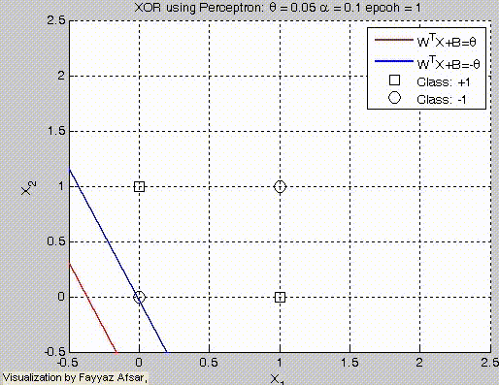
How a perceptron's classification boundary fails to learn XOR
This video shows a single perceptron to solve the classic XOR classification problem, i.e., there are 4 examples as follows:
(0,0) with label -1
(0,1) with label +1
(1,0) with label +1
(1,1) with label -1
We start off with initial weights W=[0.1;0.1] and B=0 with learning rate alpha=0.1 and perform gradient descent updates.
As the XOR classification problem is not linearly separable, the perceptron fails to learn.

