Slide 1

Dr Alireza Rezaei

Slide 2
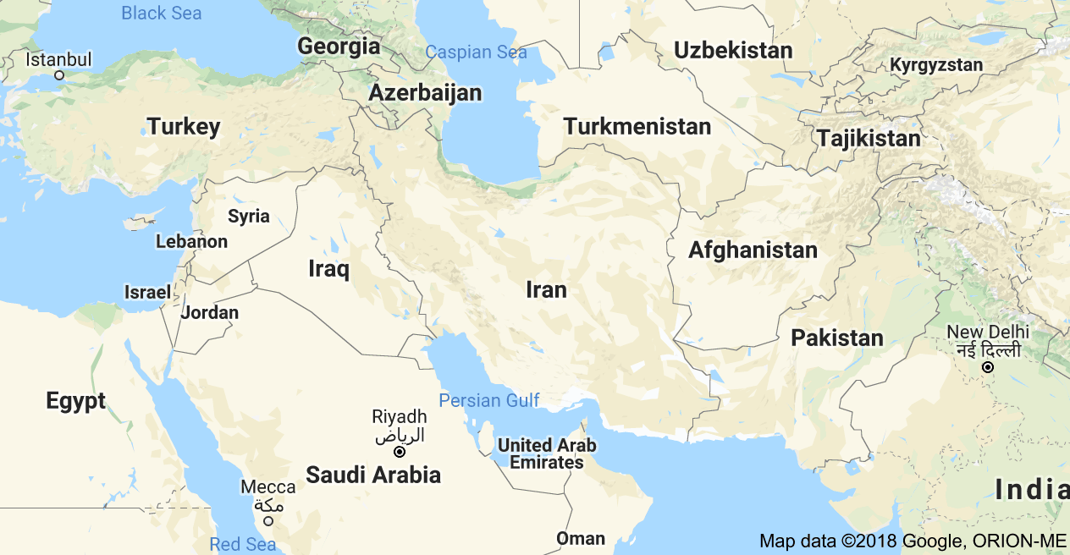



General
Tabriz
Babol
Sari
Famagusta
Tehran
Born in Tehran, Iran
Education
  BSc in Civil Engineering
  MSc in Civil Engineering, Structural Mechanics
  MSc in Real Estate Management
  PhD in Civil Engineering, Construction Management

Slide 3

Academic Experience
Part-time Instructor, Civil Engineering Department, Islamic Azad University, Qaemshahr, Iran (2001-2003)
Research Assistant, Civil Engineering Department, Eastern Mediterranean University, Famagusta, North Cyprus (2004-2006)
Part-time Instructor, Civil Engineering Department, Islamic Azad University, Rudehen, Iran (2008)
Full-time Assistant Professor, Civil Engineering Department, Eastern Mediterranean University, Famagusta, North Cyprus (2011-2014)
Full-time Assistant Professor, Civil Engineering Department, Cyprus International University, Nicosia, North Cyprus (2015-2017)
Visiting Lecturer, School of the Built Environment, Birmingham City University, Birmingham, UK (2018)
Tutor, Project Management Workshops, South Africa, Malaysia, North Cyprus (2005-2014)

Slide 4


Research & Teaching Areas of Interest
Construction Management
  Time Management
  Cost and Financial Management
  Risk Management
  Health & Safety Management
  Quality Management
  Performance Management
  Waste Management
  Concrete Construction
Structural Mechanics
Structural Analysis
Real Estate

Slide 5





Industrial Experience
General Manager, Sari Armeh Co. (Since 1997)
Contractor, 5000 m² RC structure (1999-2000)
CEng, Iranian Society of Building Engineers (Since 2000)
  Structural Design
  Construction Supervision
Contractor, Mazandaran Governor, Monument Project (2001-2003)
Project Manager, Abad Felez Pars, Mass Housing Project (2010)

Slide 6
Thank You

