Slide 1
Dr Merih Kucukler
merih.kucukler@warwick.ac.uk
Assistant Professor in Structural Engineering
Joined University of Warwick mid-September, 2018
Research into stability and design of steel structures
Author of number of technical papers
Development and assessment of Eurocode 3

Slide 2
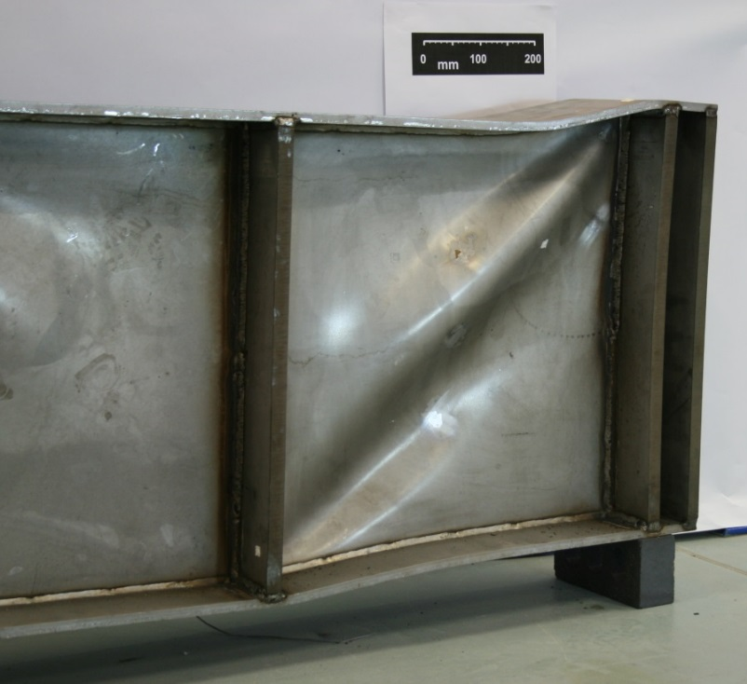
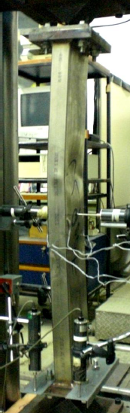
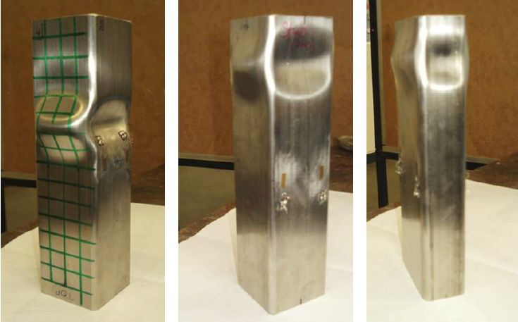
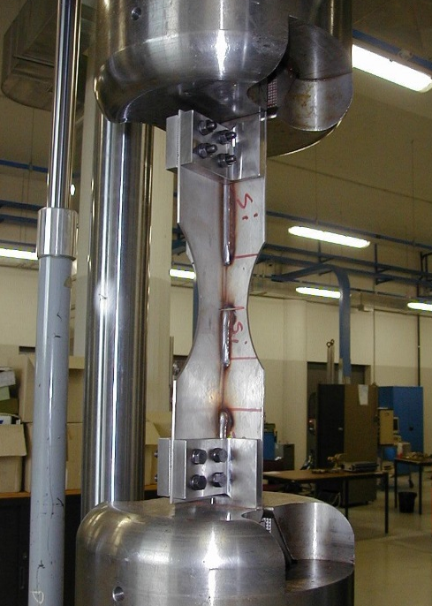
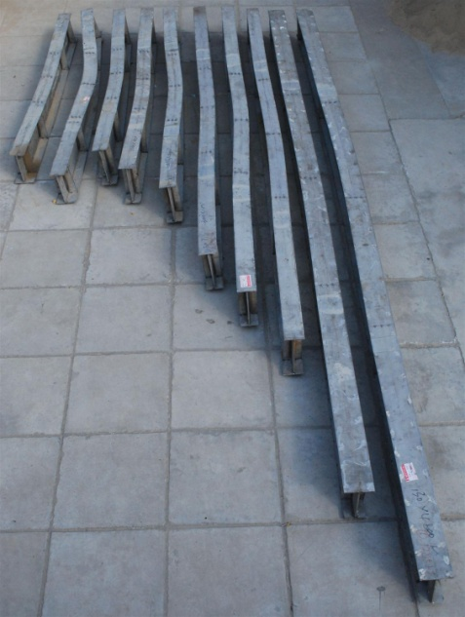
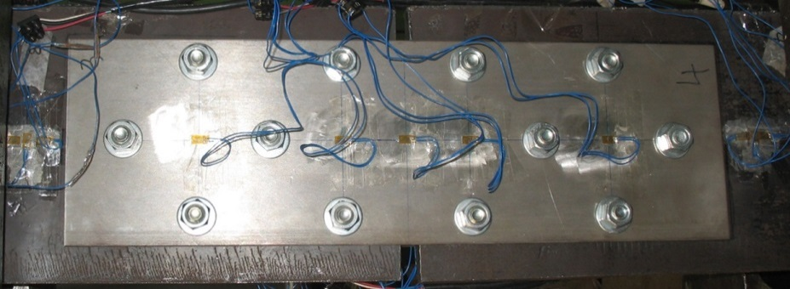
Dr Merih Kucukler
merih.kucukler@warwick.ac.uk

Slide 3
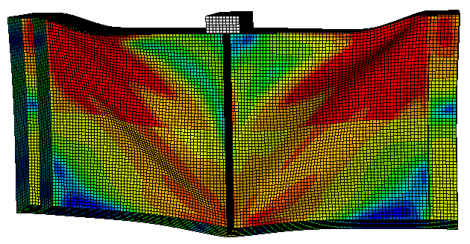
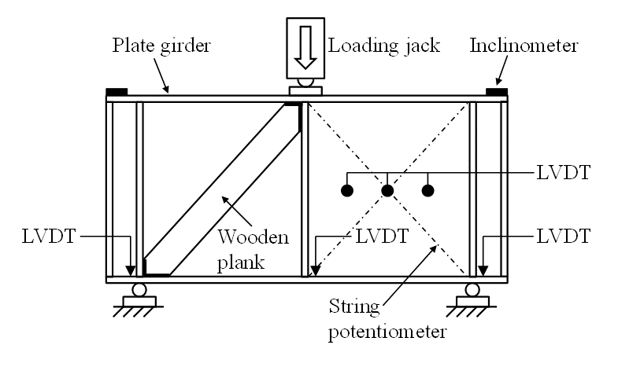
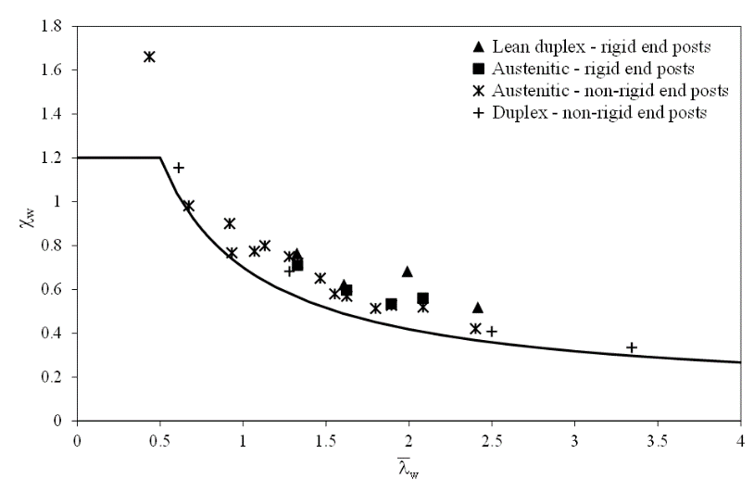
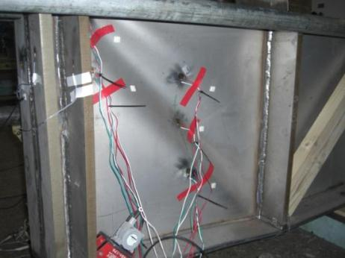
Stability and design of steel structures
Dr Merih Kucukler
merih.kucukler@warwick.ac.uk
Laboratory testing of steel components
Finite element analysis and design guidance

