Slide 1
About myself and my research
Dr Reyes Garcia
Assistant Professor in Structural Engineering
The University of Warwick

Slide 2
About myself
Construction Technician (MX) - ‘93-’96
Civil Engineering degree (5 years, MX) - ’96-’01
Design Engineer (MX) – ’00-’05
MSc in Earthquake Engineering (IT) – ‘05-’06
MEng in Engineering Seismology (FR) – ‘06-’07
PhD in Earthquake and Structural Engineering (UK) - ’07-’13
Post-Doctoral Researcher (UK) – ’13-’18
Assistant Professor in Structural Engineering, Warwick University (UK) – ’18-?
My goal is to make this world a better place to live in!

Slide 3
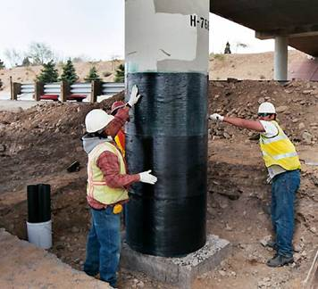
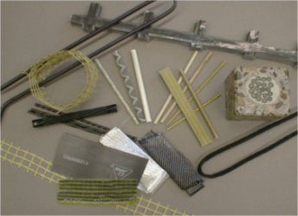
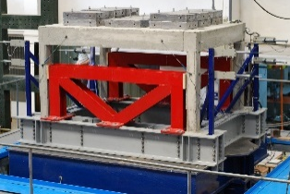
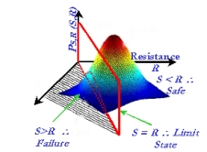
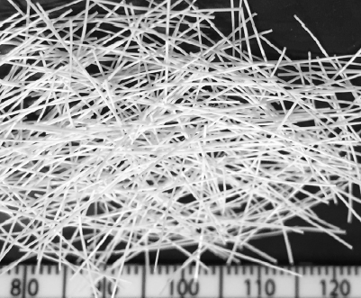
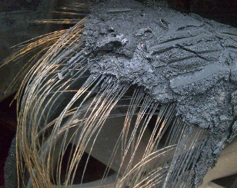
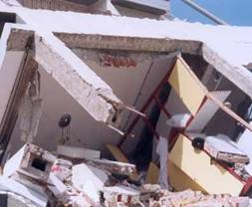
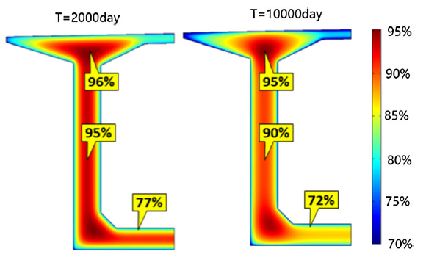
Areas of research interest
FRPs in Construction
Strengthening
Structural Engineering
Dynamic testing
Earthquake Engineering
New & more cost-effective design solutions
Fibre Reinforced Concrete
Recycled materials in concrete
Seismic Risk Assessment
Vulnerability Assessment
Long-term behaviour of concrete

