Slide 1

Career Planning for Engineers
David Molyneux– Senior Careers Consultant

Slide 2
Workshop aims
To help you to identify what is important to you, what motivates you and what you have to offer
To help you to recognise what you’re gaining from your academic studies and extra-curricular activities
To help you understand how to generate ideas and research options
To identify what graduate recruiters are looking for
To build your confidence through gaining an understanding how to translate and articulate your skills, achievements and attributes
To encourage you to take charge of your career planning

Slide 3


How confident do you feel about making a career choice/planning?
0………………………………10

Slide 4
“The thought once occurred to me that if one wanted to crush and destroy a person…all one would have to do would be to make them do work that was completely and utterly devoid of meaning.”
Fyodor Dostoyevsky

Slide 5
What can make work meaningful?
‘Extrinsic’ motivating factors: Money, achieving status
‘Intrinsic’ motivating factors: Making a difference, following our passions, using our talents

Slide 6
What is career planning?
Identifying where you want to go and how to get there
Thinking about your skills, interests, values and experience in relation to job requirements
Using this information to take and implement career decisions

Slide 7
As a Masters Student
I may be someone…
with experience but looking for a new direction
Interested in a key area and looking to explore more
Looking to do a course that adds to my degree and helps me move towards to chartership

Slide 8
Know Yourself
Explore Options
Make decisions
Take Action

Slide 9

Know Yourself

Slide 10

Where are you now?
Values
Strengths/Skills
Interests
Personality

Slide 11

What is important to me?
Family
Money
Prestige
Self Development/Growth
‘Making a Difference’

Slide 12
Work Values Matrix What do you want from a job?
Essential
Very important
Quite important
Not Important
Try to tick no more than 5 under Essential.
Rank those ‘essential’ in order of importance with 1 being most essential.
Consider if your values make sense
Working in a stable, well-known organisation and shaping my own business?
Valuing a job that requires a steady predictable performance and valuing regular challenges to stretch my abilities and skills?

Slide 13
Reflections on values?

Slide 14

Skills
Highlight the skills you have
Which skills do you want to develop?

Slide 15
What skills do you have?
Use the Skills selector worksheet to identify the skills that you have
Are there any that you don’t have that you want to work on?

Slide 16

Identifying your skills
A useful exercise to revisit over time
Helps you to think about your strengths & weaknesses
Informs your decisions
Helpful in future application process: CV, applications, interviews.
Continuing professional development (CPD)
Keep a log of evidence ( Blog)
Notes:
Your skills base will develop and change over time so should conduct a self assessment exercise regularly
Strengths / weaknesses: important to know about these as you need this self awareness to decide what specialties may suit you and which wouldn’t.
Applications: You need to be able to articulate your skills when applying for training positions / jobs. You could be asked about you strengths and weaknesses at a future interview.
CPD – a big feature of most professions now. You are expected to reflect and think about how you will improve and what you have learnt from your experiences and again this can feature in application questions and at interview.
Evidence- you will be expected to provide evidence of your skills and competences so get a head start and keep an ongoing log now!

Slide 17

How to develop skills?
Work experience
Voluntary activities
Student Union activities
Course Reps
Sports
Enterprise activities

Slide 18
How to articulate skills?
Context
Action
Result
Evaluation
Take one of the skills that you have identified and try to think of an example of when you have used this skill effectively.
Work with the person next to you and use the CARE model to describe the time you used your skill

Slide 19



Slide 20

Exploring the labour market
www.prospects.ac.uk
www.targetjobs.co.uk
www.careerplayer.com
www.gradcracker.com
https://www.newcivilengineer.com/
www.greenjobs.co.uk

Slide 21
International Opportunities
http://www.prospects.ac.uk/country_profiles.htm
www.goinglobal.com

Slide 22
Exploring the labour market
Prospects Planner and Target jobs careers report
http://www.prospects.ac.uk/myprospects_planner_login.htm
http://targetjobs.co.uk/careers-report
Student Careers and Skills website
Sector pages http://www2.warwick.ac.uk/services/careers/findingajob/jobsectors/

Slide 23
Graduate Recruitment Cycle v Small business recruitment
Large recruiters recruit in stages
Smaller companies as and when they need to – open to networking
www.applegate.co.uk
SME resource
Notes:
What do you know about smaller companies ? Research them via www.applegate.co.uk

Slide 24
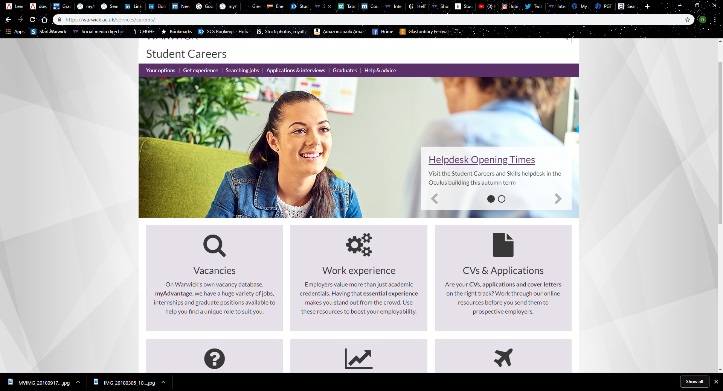
Student Careers and Skills
Notes:
Event, talks, fairs
Online Resources: databases, destinations, films, career stories etc.

Slide 25
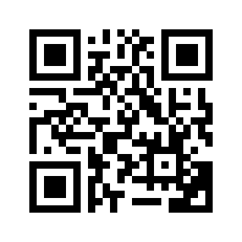
Engineering Science & Technology Fair, Options in Engineering
Tue 13 Nov 2018, 12:00 PM - 4:00 PM Panorama Room Top Floor, Rootes Building
Thu 25 Oct 2018, 6:30 PM - 8:30 PM Digilab Mezzanine - International Digital Laboratory (IDL building)
SIGN UP for Options in Engineering via MyAdvantage from next week
Notes:
MWJ is a package of academic and personal skills development and Careers and Employability services we provide to enable every student to fulfil their potential.

Slide 26
Some event dates
Careers in the Public Tue 30 Oct 2018, 6:30 PM - 8:30 PM H0.52, Humanities Building, Ground Floor
Technology in Professional Services Tue 6 Nov 2018, 6:30 PM - 8:30 PM OC0.02, Oculus Building
Discovering Careers in the Creative Industries 2018 Mon 22 Oct, 6:30 PM - 8:30 PM Panorama Suite, Top Floor, Rootes Building

Slide 27


Exploring the labour market
Network – and keep in touch!
Social networking on line (LinkedIn...)
Work experience – keep in touch – may need referees
Shadowing
Information Interviewing
Professional magazines and newspapers
Books
Twitter

Slide 28

Make decisions

Slide 29
How do you make decisions?
How did you make the decision to come to this university to study the course you are studying?
What is your decision making style?
Are you impulsive? Do you trust your instinct?
Are you a careful planner? Do you gather all the evidence and weigh up the pros and cons?

Slide 30



Slide 31

Setting your goal…
Define YOUR goal: Why do want it?
How? Set specific targets, achievable, time bound
Who can help?
What will show me the target has been achieved?

Slide 32
Setting objectives
Specific
Measurable
Achievable
Realistic
Timed

Slide 33
Step by step…
Create a plan – time your actions
Use careers and skills resources: visit website and myAdvantage, www.careersblog.warwick.ac.uk
Attend careers workshops about CVs, cover letters, interviews
Attend workshops/employer fairs and sector events on campus
Careers guidance – book a 30minute 1;1 appointment with a careers consultant.

Slide 34

“Where the needs of the world and your talents cross, there lies your vocation…”
Aristotle

Slide 35
Thank-you for attending
Any Questions?

