Slide 1





Presentation: the development of a mobile search and rescue robot
8th May 2009

Slide 2
Contents
Page 2
Page 3
Highlight the relevant section before each section

Slide 3
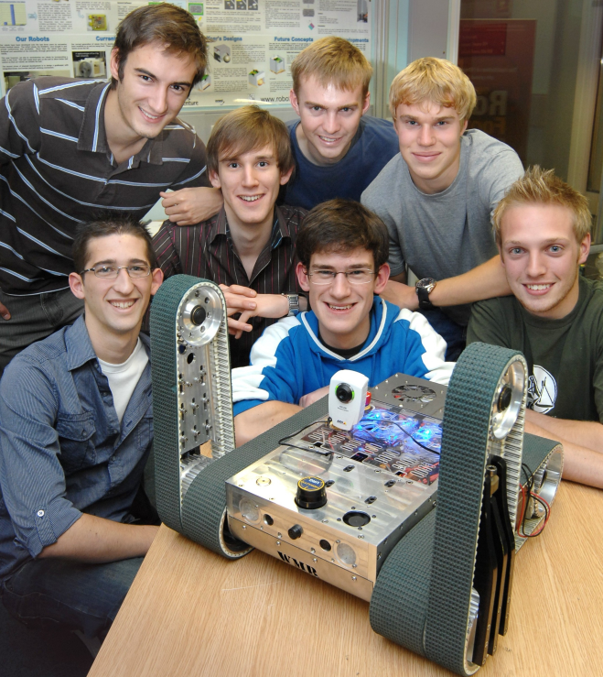
Warwick Mobile Robotics
Eight 4th Year MEng Undergraduates
Design and build an USAR robot capable of competing at RoboCup Rescue
Raise the profile of WMR and sponsors through continually developing marketing strategy
Increase awareness of Engineering both at the University of Warwick and as a profession
Showcase Warwick innovation to the world
Notes:
Group project undertaken as a business/research group, therefore find funds and manage money internally.
The group has a number of aims as a whole, these are mainly publicity orientated – though the research aim to produce a USAR robot is clear.

Slide 4


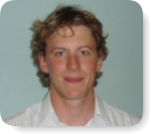


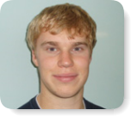

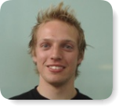
Warwick Mobile Robotics
 | Timothy Fletcher Mechanical Engineer |  | Reuben Williams Mechanical Engineer
 | Julian Faulkner Mechanical Engineer |  | Oliver Vogel Electronic Engineer
 | Matthew Rooke Systems Engineer |  | Stefan Winkvist Electronic Engineer
 | James Williams Systems Engineer |  | Alex Bunn Mechanical Engineer
Notes:
Group project undertaken as a business/research group, therefore find funds and manage money internally.
The group has a number of aims as a whole, these are mainly publicity orientated – though the research aim to produce a USAR robot is clear.

Slide 5

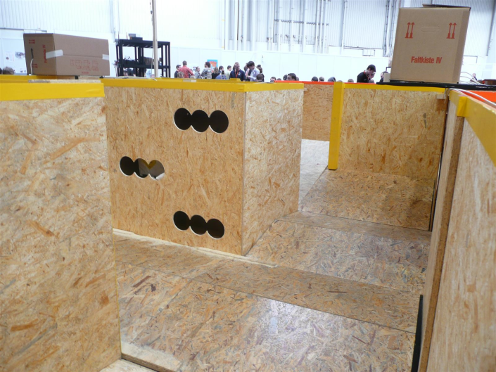
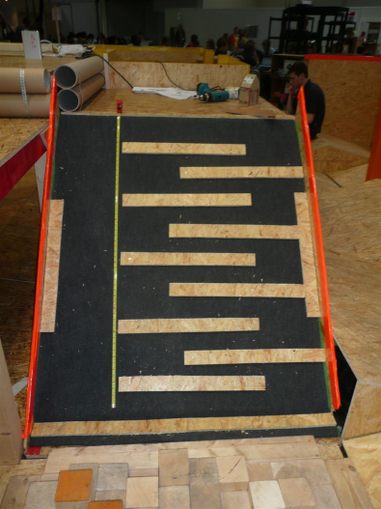
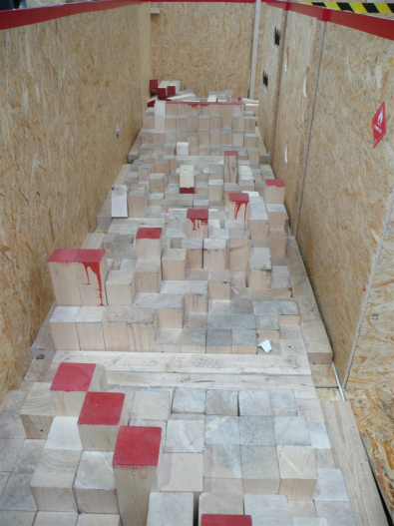
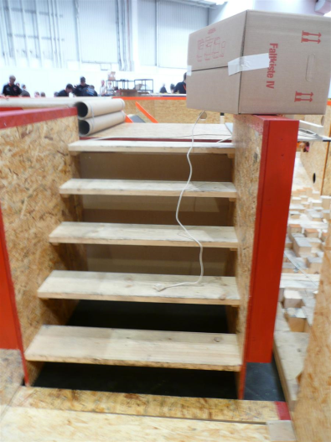
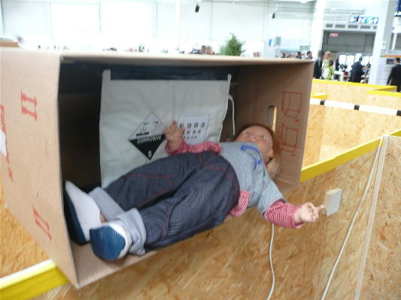
RoboCup
International competition fostering development of USAR robots
Simulated disaster area
  Aim to find “survivors” whilst mapping the arena
Yellow – Orange – Red arena obstacles
Notes:
RoboCup Rescue is a competition aimed at fostering the development of robots for urban search and rescue applications. Specifically, the competition aims to:
“Increase awareness of the challenges involved in search and rescue applications, provide objective evaluation of robotic implementations in representative environments, and promote collaboration between researchers.” (4) The competition is based on a simulated disaster area; robots must negotiate, and produce a map of, the terrain in this environment. Points are awarded for locating simulated victims and placing the locations of these victims on the map of the terrain. The competition has several regional open (including the European German Open) competitions and an invitation World Final. It is part of the larger RoboCup which incorporates robot football, rescue and home robotics. The competition terrain consists of three areas of increasing difficulty, each containing simulated victims:
Yellow arena: consists of a maze like structure with sloping floors. Within this arena the robot must operate autonomously.
Orange arena: as above with the addition of step-fields and confined areas under low ceilings. Within this arena the robot is tele-operated.
Red arena: as above with the addition of stairs, ramps and more challenging step fields.

Slide 6
Robot Aims & Objectives
Aims
Build on the success of 2008
  Optimise tele-operation
  Implement mapping and autonomy
  Investigate further victim identification
Objectives
Achieve Best in Class for Mobility at RoboCup Rescue German Open
Qualify for the international final in Austria
Notes:
Self explanatory really.

Slide 7
Contents
List of contents
Page 2
Page 3
Highlight the relevant section before each section

Slide 8
Finance and Marketing
Finance
  Sponsorship
  Budgeting
  Record keeping
Marketing
  Attract sponsors
  Deliver on project aims
Notes:
WMR is a very capital intensive project, last years team spend XXX and from our budgeting (which will be discussed shortly) we estimated at the outset of the project that we would need £14,580. This necessitated large capital inflows, robust budgeting and accurate financial record keeping.
Additionally, a marketing strategy was needed to attract sponsorship finance and deliver key project aims [and I will talk about this aspect first].
<time = 25s>

Slide 9
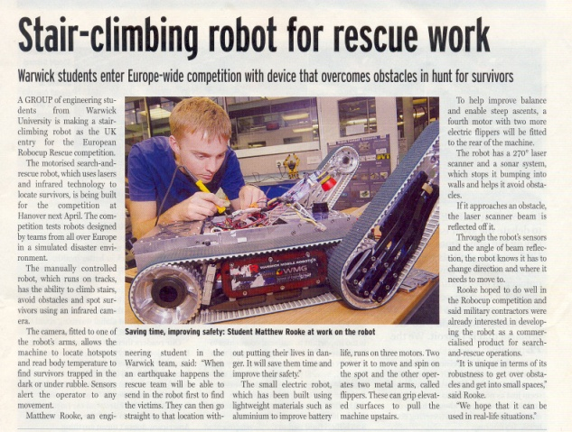
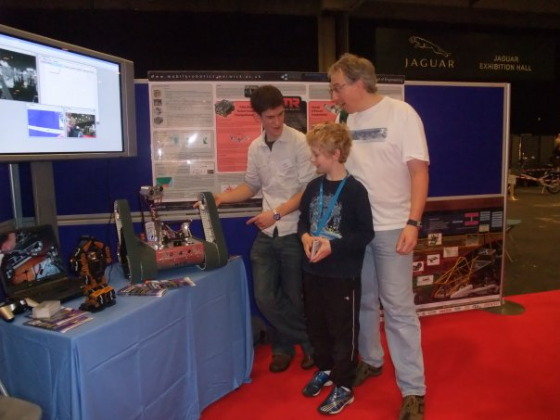



Publicity
Press release
Promotional pack
Demonstrations and presentations
Notes:
As search and rescue robotics is new to WMR it was important for the team to raise the profile of the work to gain both academic and sponsorship interest. Additionally, three of the project aims stated earlier pertain to publicity therefore this is an important area for the team.
To generate exposure for the project, a press release was organised generating national press coverage. Promotional packs outlining the project and the sponsorship opportunities (yes Michael – opportunities) were sent to potential sponsors. The team also took many opportunities to demonstrate their work to a variety of audiences from specific industry and academic events such as the Sellafield Remote Technology Open Day and the Forum of Mobile and Autonomous Robots at the Hannover Messe, to general technology events such as a Consultation event for a technology installation in Southend all the way the demonstrating to school kids at the Imagineering Fair.
<time = ~1min>

Slide 10




Sponsorship
WIS
Notes:
To finance the project sponsorships deals were sought with both University R&D bodies and external partners.
The project marketing campaign was targeted at specific institutions who had shown an interest in the work of WMR either in this project or previous ones. This resulted in project contributions from many organisations, giving a total project budget of £18,036.64 .
Given this large budget it was important to integrate sponsors as part of the WMR brand in all promotional activities. Sponsor logos were laser etched onto the robot, used in presentation banners, team polo shirts and the team demonstration equipment. Presentations and demonstrations thus helped raise the profile of partner organisations with the university, and in the case of RoboCup Rescue, internationally.

Slide 11
Budgeting
Initial Budget
  Driven by requirements capture
Constantly updated
  Used to guide technical decisions
Notes:
Budgeting was employed throughout the project to ensure efficient use of financial resources.
An initial budget was drawn up at the start of the project based on the capability analysis and requirements capture performed as part of the systems approach adopted during this project. This was used to guide sponsorship efforts as well as forming part of feasibility analysis by checking design options against available financial resources.
The budget was maintained throughout the project as used to guide technical decisions by providing cost – benefit analysis. For example, pick and place functionality was dropped from the requirements during the feasibility analysis as the cost of implementation outweighed the benefits of the functionality (better example anyone? Motor selection....?)
Comparison of budgeted versus actual expenditure (excluding both budget & actual for world final) shows very good agreement – total spend was only 7% over the 28/01/09 budget.
<time = 1 min>

Slide 12
Financial Record Keeping
  Multiple accounts
  Potential risk
  Record of expenditures
Batteries and Power
Description | Total Exp. (inc. VAT) | Quantity | Expendee | Date | Contractor/Supplier | Part Number/Notes | Account | Delivered?
Evolite 5350mAf 6s 22.2v | £164.07 | 1 | J.Faulkner | 28.11.2008 | Heliguy | 53506S | Eng | Yes
Heliguy postage | £6.40 | 1 | J.Faulkner | 28.11.2008 | Heliguy | Postage | Eng | N/A
LiPo battery bags | £23.95 | 1 | J.Faulkner | 14.01.2009 | Hyperflight | LS2 | WMG | Yes
Equalizer Adapter | £3.08 | 1 | J.Faulkner | 15.01.2009 | Midland Helicopters | RB8215 | WMG | Yes
LiPo equalizer 12S | £58.72 | 1 | J.Faulkner | 15.01.2009 | Midland Helicopters | RB8484 | WMG | Yes
Midland Helicopters Postage | £5.38 | 1 | J.Faulkner | 15.01.2009 | Midland Helicopters | Postage | WMG | N/A
Notes:
Having numerous accounts meant further information was required in order to distinguish which account each expenditure was charged to further reducing any accidental overspends. By keeping an accurate record of which account all the expenditures came from it became possible to create a spreadsheet showing how the total outgoings and incomings of each account.
With a project of this financial size it was deemed necessary to compile a comprehensive list of any expenditures that were performed throughout the project duration, this was regularly updated whenever a new purchase was completed. This not only reduced the chance of any over expenditures, as the financial data was always kept up to date allowing account funds to be readily and accurately available but will also provide a useful source of information for next year’s team in case they need to order duplicate parts as all the information required for the purchase requests will be available to them.
Having numerous accounts was identified as a risk at the start of the project due to delays in receiving sponsorship capital and thus detailed record keeping reduced the risk of spending money that had not yet been credited to an account. Whereas at the penultimate stages of the project the accounts inevitably became low on funds so in order to avoid overspends the need for such financial records to be easily available was more present.

Slide 13
Project Costing
  Equipment costs
  Materials, parts and competition
  HR and production
  Not paid for by WMR
Expense | Total Cost
Equipment, Parts and Consumables | £13,164.19
Human Resource Costs | £54,510.00
Production Costs | £27,420.00
Total Project Cost | £95,094.19
Notes:
In addition to expenditure on components, equipment and consumables throughout the project a log of man hours spent in consulting academic and technicians by group members, although the group had access to these free of charge it would not be a fair representation of true project costs. These have been accounted for by creating a table with consultation and group work hours with varying costing amounts

Slide 14
Project Management
Organisational structure created to clarify individual roles within the project.
Structure not rigid and functional working groups formed to aid development of sub-system progress.
Team members assigned work according to speciality and areas of interest.
Systems based approach to resource management.
Notes:
Human resources were allocated in a manner in keeping with the systems approach
applied to design work (see the Systems Design Report Section 1.4). Functional working
groups were formed around the delivery of a particular capability or subsystem. These
teams changed during the course of the project and crossed disciplinary borders.
Examples of teams included a team consisting of a mechanical and a systems engineer
focused on delivering the central section of the robot (see Systems Design Report
Section 4.5). This approach has led to “capability owners” – individuals or teams tasked
with delivering a particular capability.

Slide 15
Contents
List of contents
Page 2
Page 3
Highlight the relevant section before each section

Slide 16
Systems Design Approach
Capability Analysis
Process
Design review & Governance
DDP
Control Plans
Requirements Capture
Interface Control
Defect Reporting
System Testing
Engineering Change Control
System Budgets
Feasibility and Analysis
Sub System Testing
Sub-Contractor
Partner Management
FMEA
Architectural Integration
Architectural Design
Sub-Contractor
Partner Management
System Safety Case
Component Testing
Equipment/Sub-System Specifications
Support Plan
Design Verification Testing
Design Phase
System Design Definition
Equipment Design
System Verification
Northrop Grumman Remotec
Notes:
APPROACH
WMR utilised a Systems Design philosophy for the entire project, in contrast to the 2008 robot development which focussed on delivering the technology needed to meet the goals.
Systems Engineering is a modern approach to delivering an engineering solution, and is used by Northrop Grumman Remotec in their product development.
Before beginning any detailed design the capabilities of the robot were considered. This is what the robot needs to be able to do; to be capable of.
The feasibility is considered, in this case with respect to the 2008 robot and its development potential. Leading to requirements for the overall system.
LEFT SIDE ANALYSES
This approach defines the group working practice and ensured cross-discipline collaboration deliver solutions to meet the capabilities (Control Plans)
System budgets were considered. These are both financial and technical such as power, weight. The effects of new ideas were considered.
FMEA and Safety consideration at this early stage meant that critical safety features were not overlooked and designed into the system, rather than added on later.
Focus on capability requirements – different to 2008 which was a technology focus
Analysis and Design (left side)
What the robot needs
The functional requirements to achieve this
Feasibility – considered the current state of 2008 robot and how it could be developed to achieve the aims
Mention left side analyses such as FMEA and safety
Control plans – time management and team interaction, discipline cross-over and reporting
Budgets from financial and technical (e.g power)

Slide 17
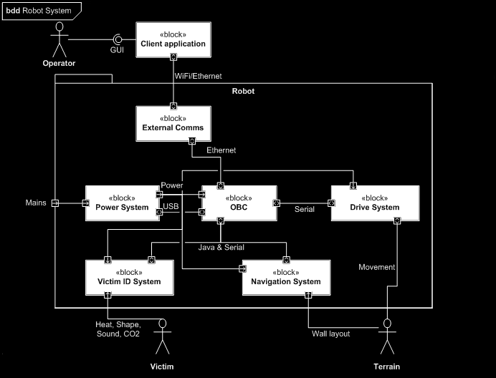
System Architecture
Notes:
The requirements allow the robot architectural design, which identifies the robot structure and allows preliminary design work to establish the direction to the solution. This included decisions made on rear flippers and speed control on the drive tracks.
This SysML diagram identified the subsystems to be further defined. Some areas (sensors, OBC) were already defined from the 2008 robot and building the architecture allowed their integration into the new robot to be considered.
Detailed specifications are made for each subsystem, breaking down the requirements for the overall system.
Now the actual detailed design begins
Architectural design (very quick slide, just to show a BDD diagram)
Used tools like SysML to identify the robot structure (“architecture”) and preliminary work to establish design direction
Prelimany decisions on solutions to requirements made (flippers)
Some areas were already defined (e.g sensors) from previous year
Subsystems identified from architecture Block Definition Diagrams and detailed specifications made for each subsystem

Slide 18
Systems Design Approach
Capability Analysis
Process
Design review & Governance
DDP
Control Plans
Requirements Capture
Interface Control
Defect Reporting
System Testing
Engineering Change Control
System Budgets
Feasibility and Analysis
Sub System Testing
Sub-Contractor
Partner Management
FMEA
Architectural Integration
Architectural Design
Sub-Contractor
Partner Management
System Safety Case
Component Testing
Equipment/Sub-System Specifications
Support Plan
Design Verification Testing
Design Phase
System Design Definition
Equipment Design
System Verification
Northrop Grumman Remotec
Notes:
After the design, the right side of the V-diagram is followed.
Design verification testing was part of the design process. This iterative design was especially useful for robot software tested through simulation.
Component testing took place when parts were assembled. The power distribution board, flipper drive and sensors were tested.
The architectural blocks were built and each one tested independently against the subsystem specifications.
Finally the entire system was verified and evaluated against the requirements at the competition.
Validation and Verification (right side)
During design ongoing tests were made – iterative process (esp. software via simulation)
After component assembly, tests were performed (e.g. power board, flipper drive, sensors [microphone])
Subsystems built to give architecture blocks
Tested each one independently
Entire system verified at the competition

Slide 19
Contents
List of contents
Page 2
Page 3
Highlight the relevant section before each section

Slide 20
2008 Design

Slide 21
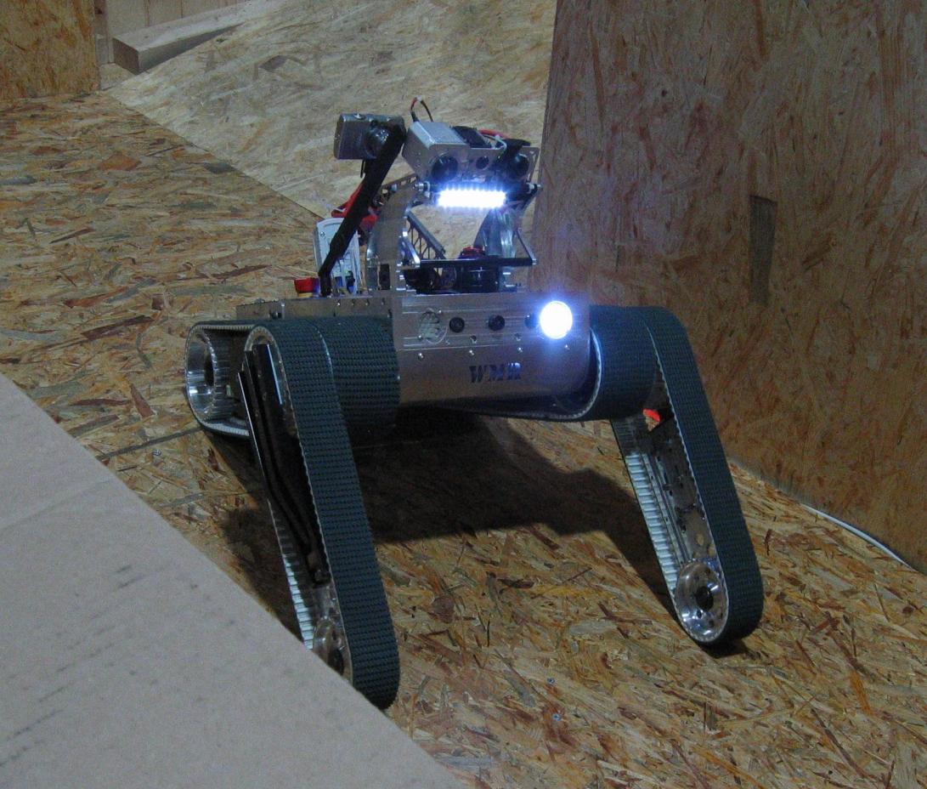
Mobility
Requirements
Stair / ramp climbing
Bi-directional operation
Maintain CoG within footprint during climbs
Minimise weight increase
Solution
Chain drive
Rear flippers
Weight reduction
Profiled Tracks
Notes:
Looked at 08 robot shortcomings
Good orange ability good CoG - no red or stairs but ramp ok
Flaw with flipper drive belts shearing under load – replace system
Restricted footprint
08 design smaller than machines with comparable mobility
Limited obstacle attack direction

Slide 22
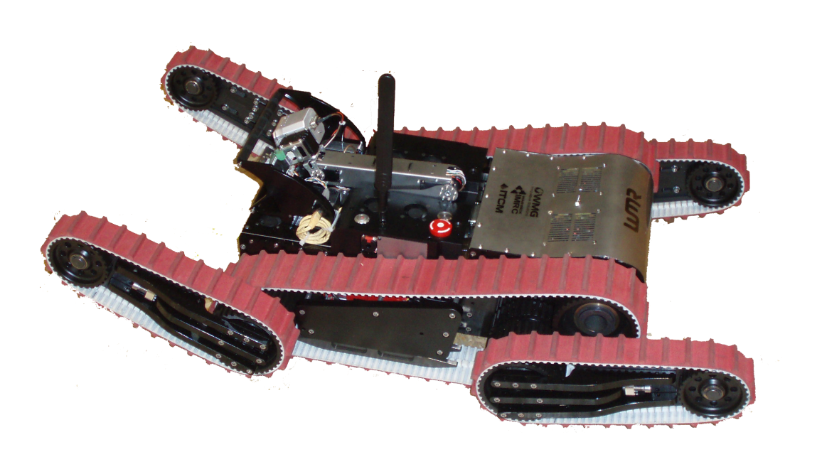
Mobility Components
Notes:
CHANGE FOR SOLIDWORKS IMAGE

Slide 23
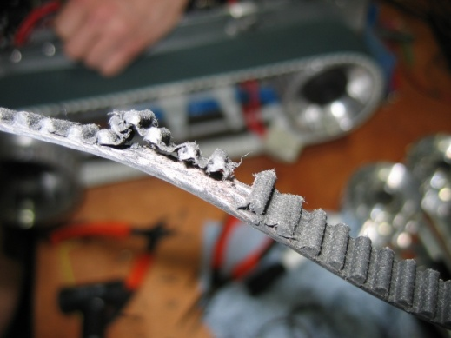
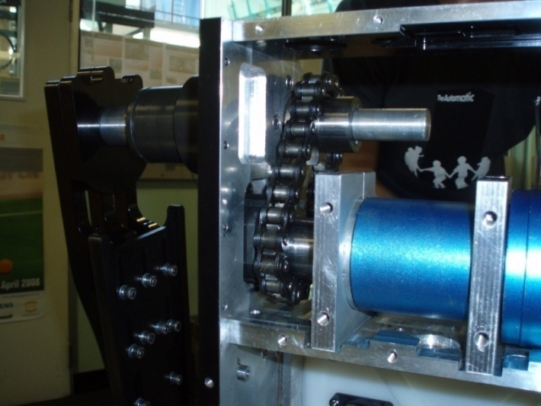
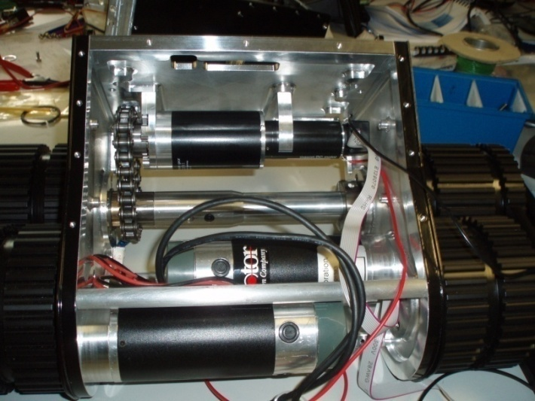
Chain Drive
Notes:
Knew needed fixing from 08 robot to see mobility potential from 08 design
Timing belt shear – limited reasonable mobility to little – risk of flipper loss lifting robot weight
High tension required to stop skipping teeth
Chain no tension, much larger teeth and strength much greater – introduces system slack – 5-10°
Maintain rotation speed and step movement

Slide 24
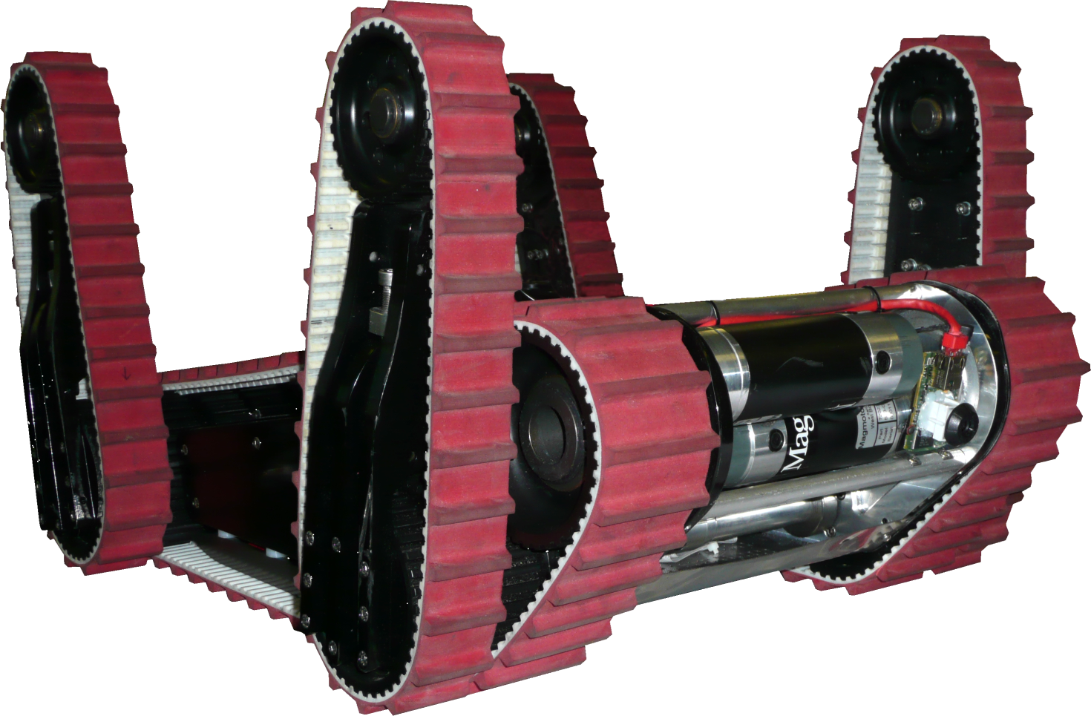
Rear Flippers and Chassis
Design and Features
Maintain stability e.g. stair climbing
Develop new housing for added hardware
Notes:
Creating a system which allows for adjustment of robot footprint to maintain a stable Co G.
Maintain CoG of the robot through an increased range of climb angles by adjusting the footprint to match the terrain
Important when climbing stairs and ramps and to allow more controlled manoeuvrability across red step fields
Bi-directional operational capability when combined with rear view webcam

Slide 25
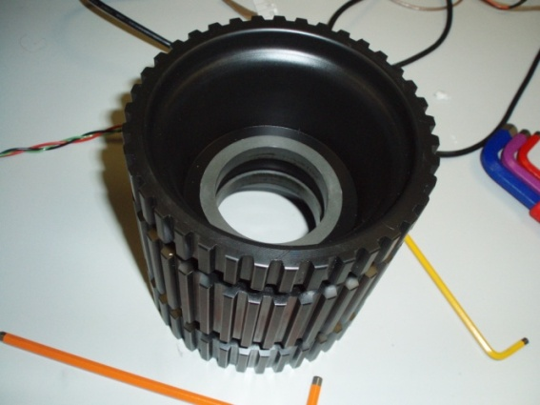
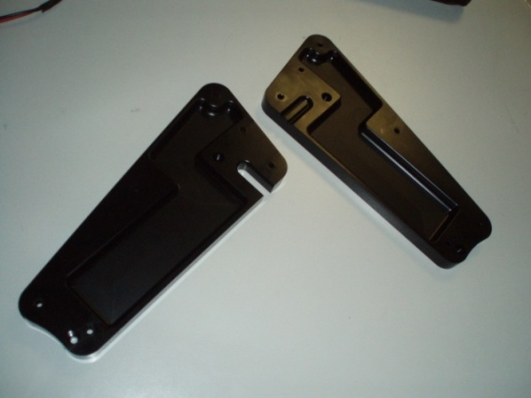
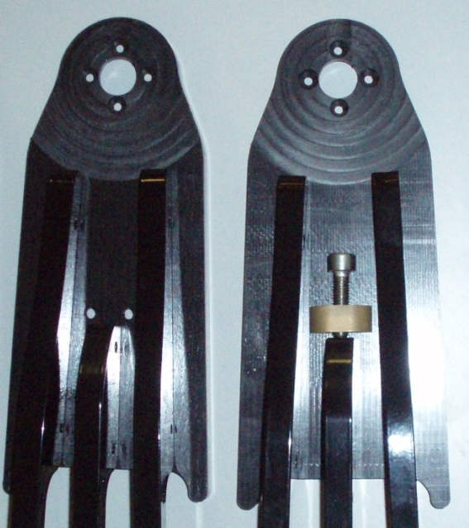
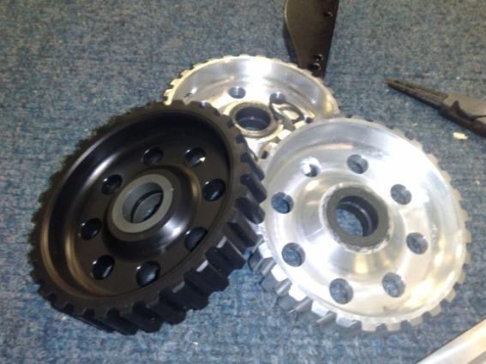
Weight Reduction
Motivation
Minimise power demand
Solution
Acetal Copolymer
Nylon 66 – hygroscopic
Material | Specific Gravity
Aluminium | 2.7
Acetal | 1.9
Nylon 66 | 1.18
Notes:
Some nylon used -not on running surfaces – risk of moisture absorption / swelling
Acetal for more complex parts – pulleys where swelling could affect performance
Nylon edges less defined –
heating of tool during cycle as no coolant used
high co-eff of thermal expansion (3x aluminium)
Acetal – good chem resistance
Dimensional stability
good resistance to wear – T10 belt rub
Long and complex milling patterns

Slide 26
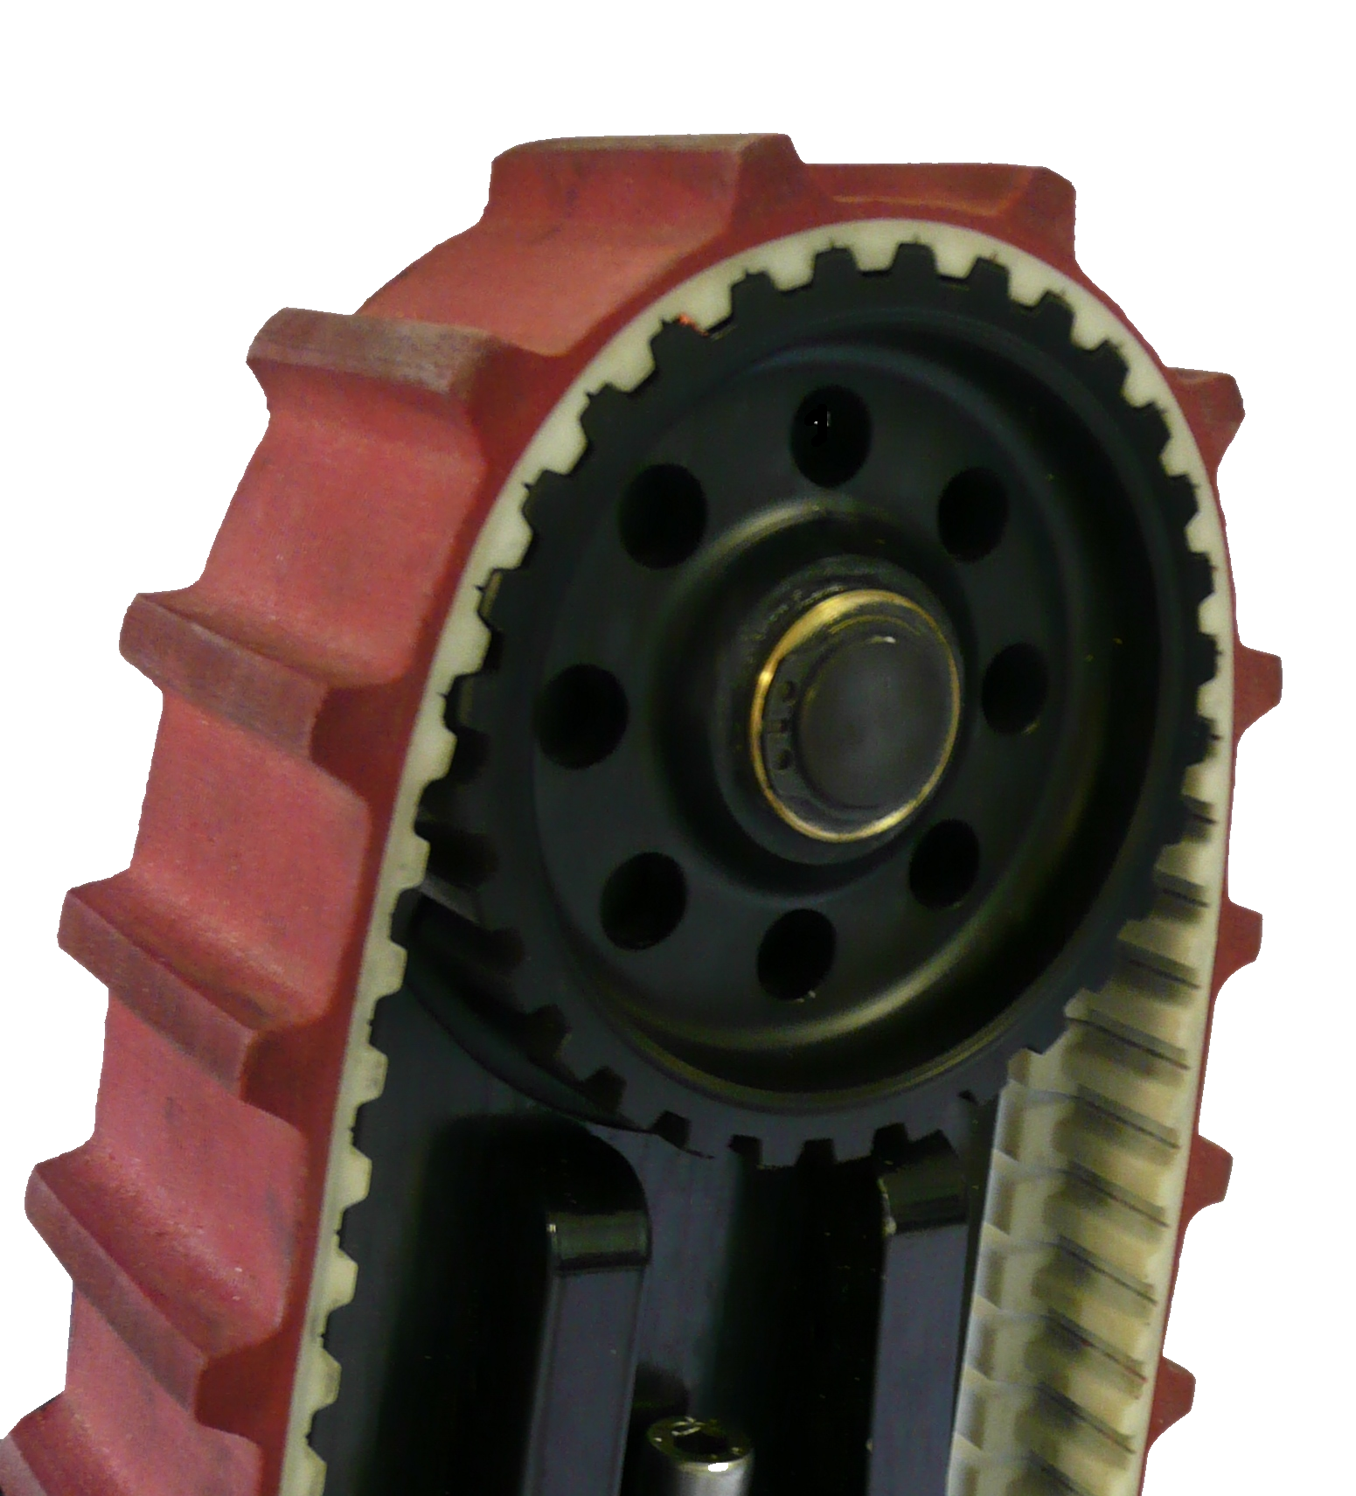
Profiled Tracks
Motivation
Rely on friction surface to pull up on edges
Poor stair climb control as belts slip
Solution
Maintain T10 and K13 internal tracking profile
Toothed profile on external face
Medium density rubber compound
Notes:
Tracks slip when climbing stairs – make remote operation difficult and unpredictable
Aid progress over red step fields
Ease of operation
Impact protection for computer hardware – fuse hitting RAM in 08
solved but still desire protection for hardware – not problem for solidstate HD

Slide 27
Contents
List of contents
Page 2
Page 3
Highlight the relevant section before each section

Slide 28
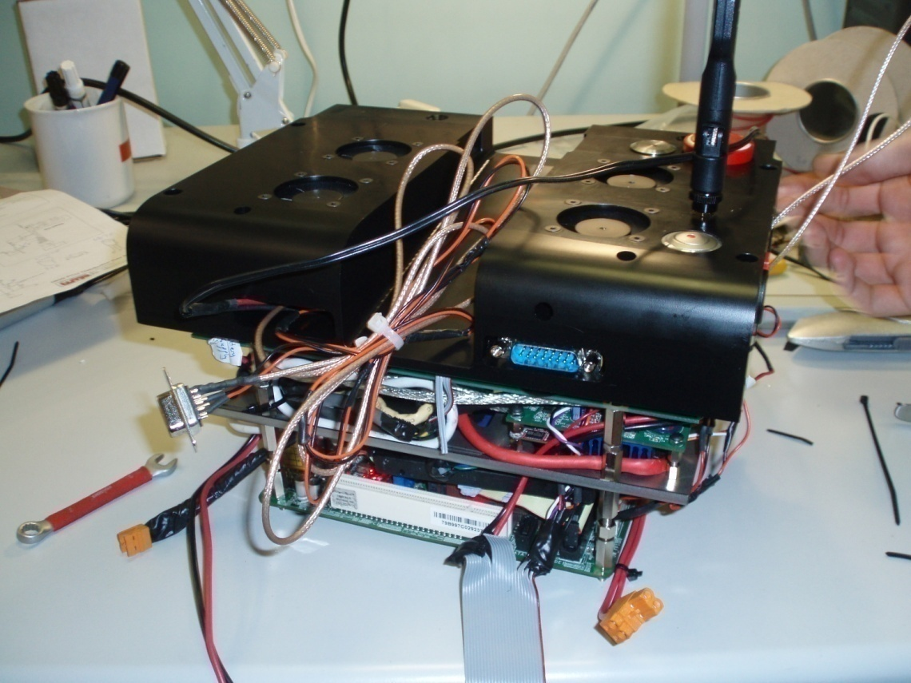
Central Compartment
Motivation
Independently separable subsystem requirement
Central robot section contains computer, router, power control and sensory processing devices
Frequent need to remove computer
Solution
A self contained unit to hold computer and other electronics
Operates outside the robot
Lifts out with robot lid
No hard wiring, connectors used
Access panel/computer port access
Lid fans work with robot base fans to create airflow inside tight central compartment
Notes:
The central section of the robot chassis (point on robot image) holds the onboard computer.
In 2008 all the electronics had to be separated and taken out one at a time, and disconnected. On a prototype something frequently needs to be changed that requires access to the electronics.
A framework was constructed so the electronics could be removed as a unit, allowing it to operate outside the robot.
Attempts were made to minimise the number of connections using D connector with lots of pins.
A panel in the side was intended for access to the computer ports but during the competition these connectors were removed to give an access panel. Ethernet connection was possible using the cable intended for the arm webcam.
Major decisions included the acetal lid to minimise weight (custom designed and machined) and laser cut plates for the framework to allow airflow and for wiring.
The lid fans work with robot base fans to create airflow and the CPU is cooled better when the unit is inside the robot.
Further work is to reduce the volume to make insertion easier. The motherboard USB pins should be used rather than the USB sockets.
Attempt to minimise connections using the D connectors
Port access abandoned since space was tight but Ethernet still possible from arm
Airflow is better inside the robot, base fans blow hot air out from CPU
Acetal lid minimises robot mass
Laser cut sheets for airflow used to mount devices
Further work, reduce volume. Use motherboard USB pins rather than socket and smaller framework to make insertion easier

Slide 29
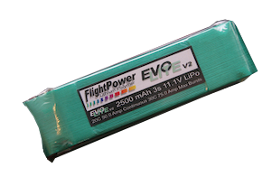
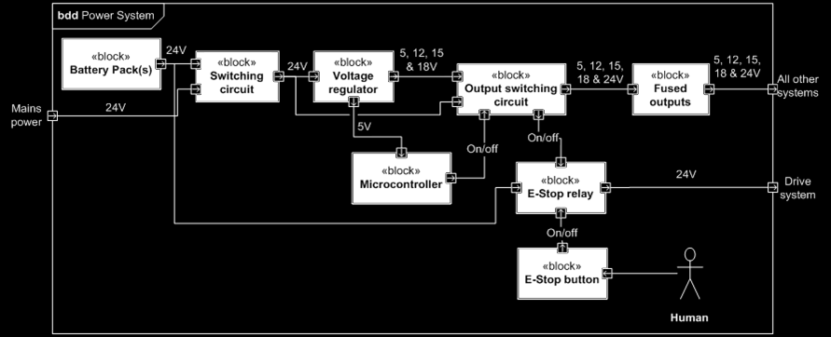
Power Systems
Requirements
25 minute competitive run time
2 hour run-time for casual, flat-ground use
Deliver power to drive system to overcome obstacles
Independent remote power cycling of all electronic devices
Hardware and software emergency stop
Notes:
25 minute total run time for old nickel-metal hydride (NiMH) batteries after deterioration
Need 2 hours for demonstrations
Lightweight protective housing for LiPo (stop explosions!)
Polymer parts reduce mass to increase runtime
Problems
motors not rated at such high power for extended periods
Relay (on diagram) rated to 70 A and safety system locked up. New relay needed

Slide 30
Lithium Polymer (LiPo) Batteries
Battery Tests – Motor Stall
NiMH (Nickel Metal Hydride) only delivered 350 W
One LiPo delivers combined drive motor power of 970 W
Two LiPo batteries in parallel allow the motors to reach their 1 kW peak rating
Two LiPo batteries gives the same capacity as the NiMH batteries (10 Ah)
Notes:
Robot can use the NiMH packs with an extra wiring loop through the chassis
Summary of success of central section and power
Drive motors (upgrade or limit)
E-stop (new relay)
Access/connectors
PowerPoles

Slide 31
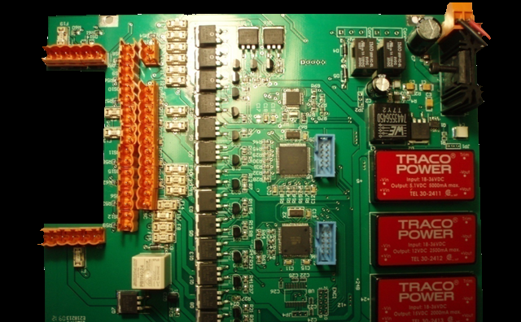
Power Distribution Board
Requirements
Remote power cycling on all outputs and software Emergency Stop
Provide range of voltages for robot devices
Solution
Custom circuit board housed in central section as a layer in the stack
Atmel AVR microcontrollers
USB communication with PC
MOSFET switching circuit
DC-DC converters
Fused outputs with LED indicators
Notes:
The Power Distribution Board was designed for <Motivation>
Allowing the reset of non-responsive devices and energy saving (e.g. LEDs)
Partially implemented in 2008 but never fully operational.
(Point to features on image)
AVR microcontrollers with in-circuit programming capability for rapid development. These read ASCII characters sent via USB from the onboard computer. A reply is sent and these characters are used to signal the output switching. The AVR has 5V outputs and an N-channel device pulls the gate on P-channel low to provide high voltage on the outputs.
High efficiency DC-DC regulators are used. Battery operated robot so the low efficiency of a linear regulator could not be afforded. Four regulation circuits, one for each voltage, with quickblow fuses on each output to protect devices.
Board designed by WMR and manufactured externally, population and testing by WMR
Further work
It could be smaller for better airflow and the SMD devices give scope for area reduction, there is plenty of space.
Reads ASCII characters and replies
In-circuit programming capability
High efficiency regulation (DC-DC converters rather than linear regulators)
Quick-blow fuse issues
5V from AVR uses N-channel device to pull gate on P-channel low to provide high voltage on output
Could be smaller for airflow, SMD devices provides scope for reducing area, there is plenty of space
Backup board and testing
Board designed by WMR and manufactured externally, population and testing by WMR

Slide 32
Robot Arm

Slide 33
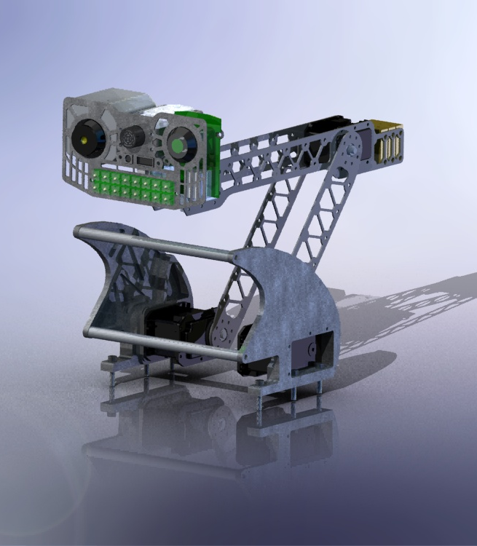
07/08 Design
Requirements
Main Sensor Platform
  IR camera
  CO₂ Sensor
  Webcam
  Issues
  Unstable in movement
  Difficult to dock safely
  Arm control not finished
Notes:
The robot arm is the main sensor platform housing important life-recognising sensors such as the Infra-red camera and CO2 sensor.
The webcam used for operator vision is on the head so that the user can look around and manoeuvre the robot.
Last years design was a fairly unstable structure that was a tight fit when docked in the roll cage, which is needed to protect the head sensors and the LiDAR in case the robot is overturned.

Slide 34
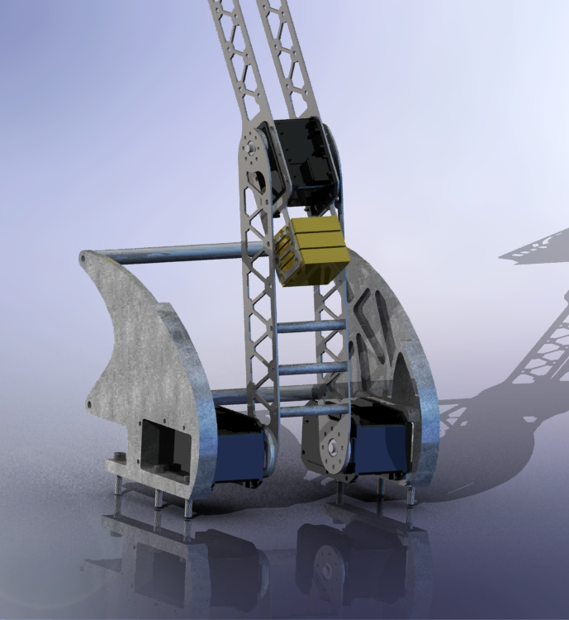
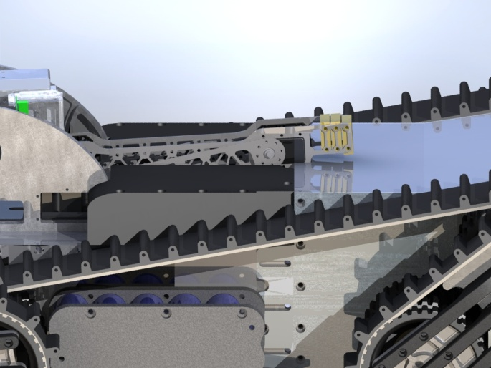
Issues for Re-design
Few lower arm braces
Counterbalance clash
Notes:
A main reason for the instability of the structure was there were only 3 connecting braces on the lower arm section, to allow room for the counterbalances to swing through as the head was raised.
The counterbalances caused further difficulty as they obstructed the newly design rear section for housing the drive motors and rear-flipper control.

Slide 35
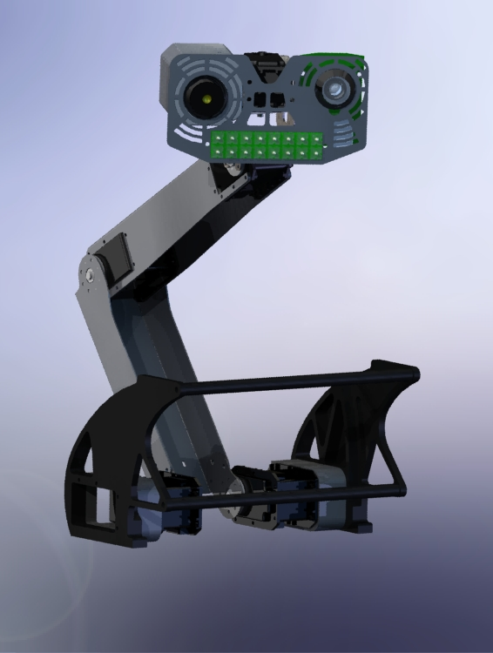
08/09 Design
Main features
New RX64 at elbow joint
Strengthened arm sections
Folded from sheet metal
Wider roll-cage for safer head docking
Notes:
Overall the main design has remained the same in terms of the same joints for the arm control
The counterbalances have been removed and replaced with a powerful servomotor,
The arm sections have been strengthened by manufacturing them from folded sheet metal,
And the roll-cage has been widened to allow safer docking of the robot head.

Slide 36
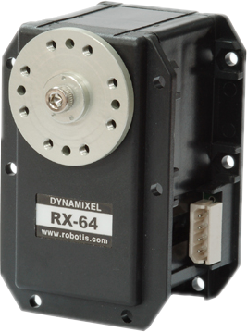
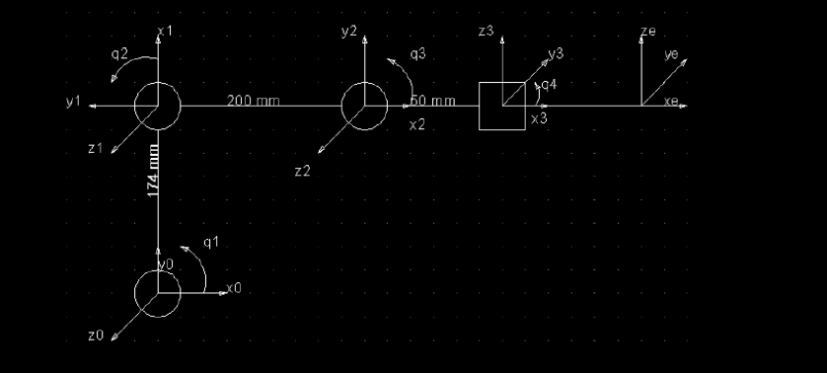
Robot Arm Control
Dynamixel Servomotors
Bus System
Kinematic control achieved
Notes:
We chose to keep the same dynamixal servomotor models from the previous year as they provided the sufficient torque, we increased the power at the elbow joint and invested in a new RX64 motor similar to the base motors, since we had removed the counterbalances.
All signals and power are sent through a bus system linking all the servomotors together.
Below is the kinematic model used to program the arm.
Head, and 3 main joints. (base, elbow, neck)
When the head (TCP) is sent to a co-ordinate in x,y space; the kinematic model calculates the joint angles required and is able to perform linear movement to the new co-ordinate for the head.

Slide 37
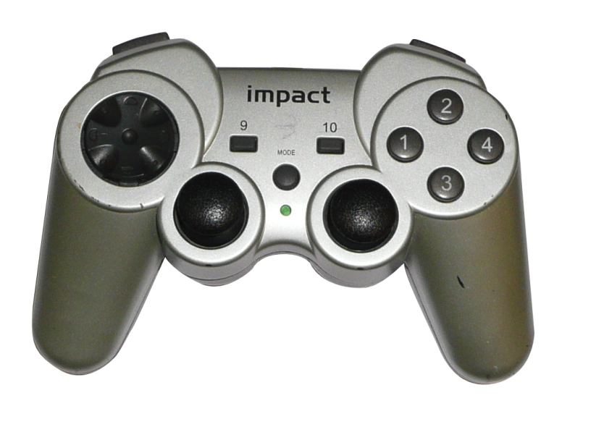
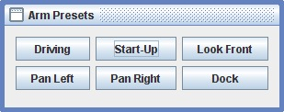
Operator Control
Manually “flying the head”
using the game controller
Selecting presets
Notes:
(Left) Look around
(Right) Move around
We established a need for some preset positions of the robot arm to aid the user control.
These are:

Slide 38
Communications
Resolving lag issues with 07/08 communications
Object Stream | DataSocket
Added transmission delays due to increased data transfer and processing. | Less data and processing reduces transmission delays
Robot and Client both have to use identical libraries to interpret the data. | Commands can be sent in plain text
Easy to set-up and to transfer data | Newly developed commands can be tested without modifying the client

Slide 39
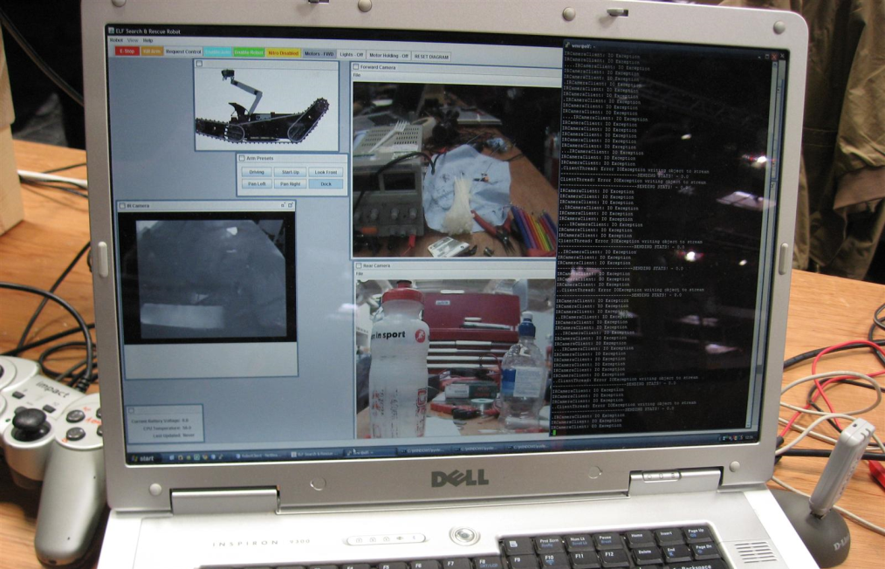
Client
Displays information to operator
Efficient control of robot functions
Easy to use

Slide 40
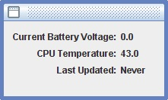
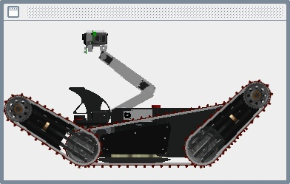
Client
Reporting of critical system variables
Position of all moving parts on the robot
Easy access to safety controls etc.
Quick access to commonly used arm positions

Slide 41
Simulator
Allows the autonomous functions tested independently from the robot
Can simulate 3-D arenas
Developed to be compatible with the robot’s server commands.
Video of simulator running!

Slide 42
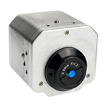
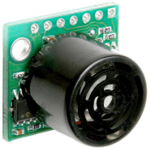


A.I. – Starting State & Aims
Starting state:
  No autonomy implemented
  Suitable sensors identified: Sonar, IR, LiDAR
Aims:
  Enable autonomous navigation around competition standard terrain
  Develop automated Victim ID method

Slide 43
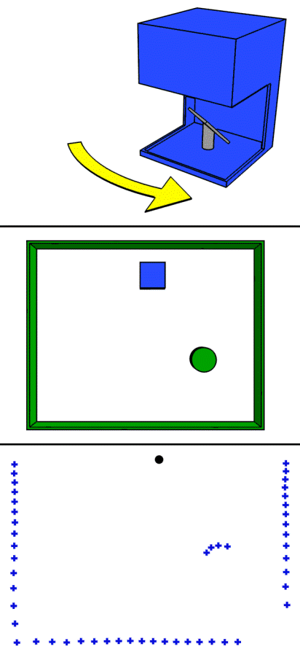
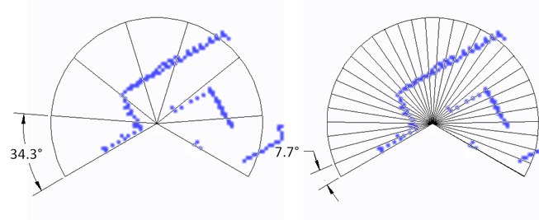
Autonomous Navigation
Navigation concept – “PieEye”
  Based on LiDAR sensor data
  Reactive navigation framework
  Splits sensor data into segments
  Basic multi-layer neural network
  Flexible
Notes:
The LiDAR (Light Detection And Ranging) sensor was quickly identified as the most powerful tool for navigation, as it produces an accurate 2D scan comprising the distances to 682 discrete points across its 240° range at 100msec per scan. This is also the primary method of autonomous navigation used by other similar autonomously navigated mobile robots used in industry and research.
The sonar modules can also provide useful information about the robot’s surroundings but it was decided to focus less on these sensors as they have disadvantages compared to LiDAR in terms of accuracy and resolution. Reflections of the ultrasound from uneven surfaces can also cause spurious results.
A reactive style navigation method which outputs the best course to steer.
The decision logic resembles that of a multi-layer neural network, of which the weightings are currently set by hand.
The LiDAR scan is simplified by averaging measurements into groups (“slices”). Each of the slices being an input to the neural-net style structure.
Although it was decided to focus upon LiDAR as the primary ranging sensor, a conscious effort was made to ensure that any navigation solution was flexible enough to incorporate data from other sensors at a later date, if deemed necessary.

Slide 44
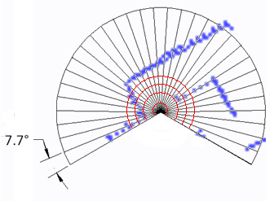
Navigation Improvements
Collision severities & Dynamic biasing
  Each ‘collision’ assigned severity level
  Biases dynamically applied to pathfinder
Intelligent Turning
  Problems with slip during turn
  Finds turn angle by cross-correlation of LiDAR data
  Combines collision detection

Slide 45
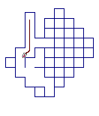
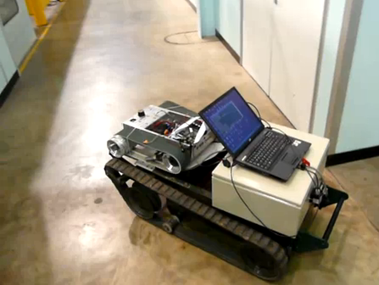
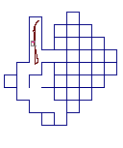
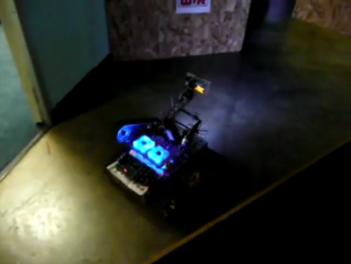
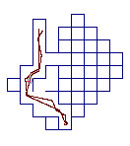
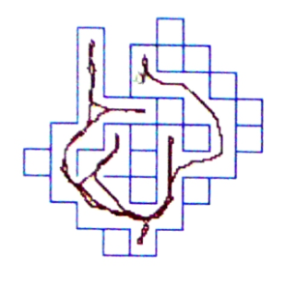
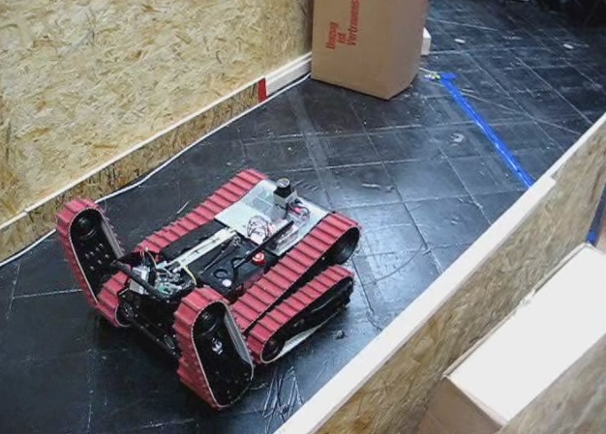
Testing
Iterative development
Simulator used initially
Concurrent testing with hardware, when available

Slide 46


Mapping
Builds up map from successive LiDAR scans
Correlates current LiDAR scan against map so far
Finds best fit and overlays LiDAR scan
Pixel intensity increases with further scans as confidence increases

Slide 47


Victim ID
Uses thermal imaging camera to find heat spots
Takes grayscale image
Thresholds by temperature(brightness)
Finds large blobs -returns size and location
GUI - client interaction
  Remote start & stop
  Real-time monitoring
  On-the-fly calibration

Slide 48
Victim ID
00000000000000000000
00000000000000000000
00000000000000001000
00000000000000000000
00000222222000000000
00022222222200000000
00222222222000000000
00222222200000000000
00022000000000333300
00000000000000333300
00000000000000033000
00000000000000000000
00000000000000000000
00000040000055555500
00000000000055555060
00000000000050555500
00007000000000555550
00000000000000055550
00000000000000000000
00000000000000000000

Slide 49



Some title
Motivation
Improve mobility
  Red stepfield capability
  Ramps and stairs
Solution
New tracks
Rear Flippers
Notes:
Passed all red obstacles
Reached top of stair set
Managed ramp
Edgeless step
Best in class mobility – 3rd overall

Slide 50


Outcomes OR Restate aims and Objectives
The objectives of the project:
  Achieve Best in Class for Mobility at RoboCup Rescue German Open
  Gain an invitation to the World Finals in Graz
Notes:
Two major objectives, both achieved, in achieving these, must have furthered the project in terms of overall aims.
Design as shown with following developments
AI and Software developed in …. Major areas.
Electronics ?

Slide 51





Mobility

Slide 52
Autonomy

Slide 53
Mapping

Slide 54
Publicity
Picture of Hannover and newspapers

Slide 55
Further Work
Chassis
  Reduce robot weight
Robot Arm
  Produce larger, stiffer arm capable of pick and place
Mapping
  Develop mapping capabilities
Comms
  Reduce lag
  Reliability
Autonomous navigation
  Develop system on sloped floors

Slide 56
Software Roadmap

Slide 57
Mechanical Roadmap

Slide 58



