Slide 1
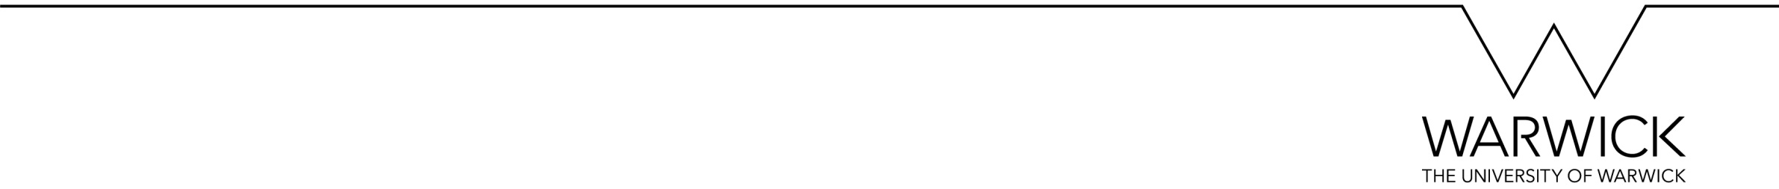
Biofilm Life Cycle Updated
By Yanahan Paramalingam

Slide 2
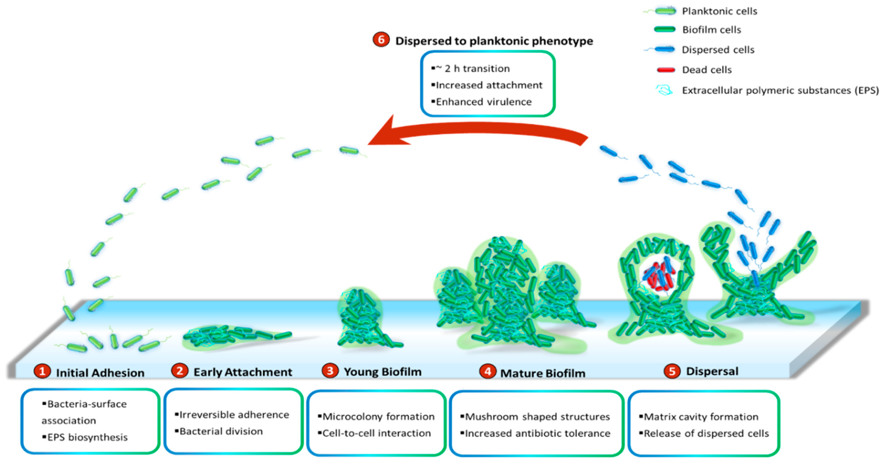
Figure 1. Life cycle of P aeruginosa biofilm [1].

Slide 3
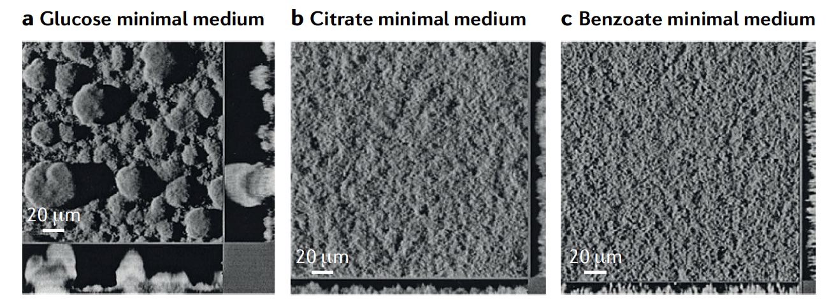
Figure 2. Pseudomonas aeruginosa PAO1 grown in same conditions with different carbon sources.

Slide 4
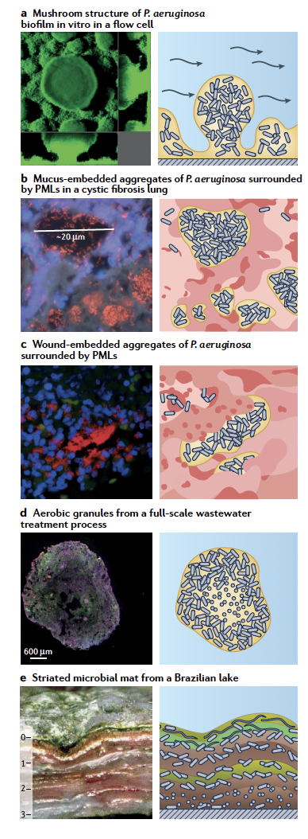
PMLs - Polymorphonuclear leukocytes (type of immune cell).
Figure 3. Diverse surface-attached and non-surface attached
biofilm structures [2].

Slide 5
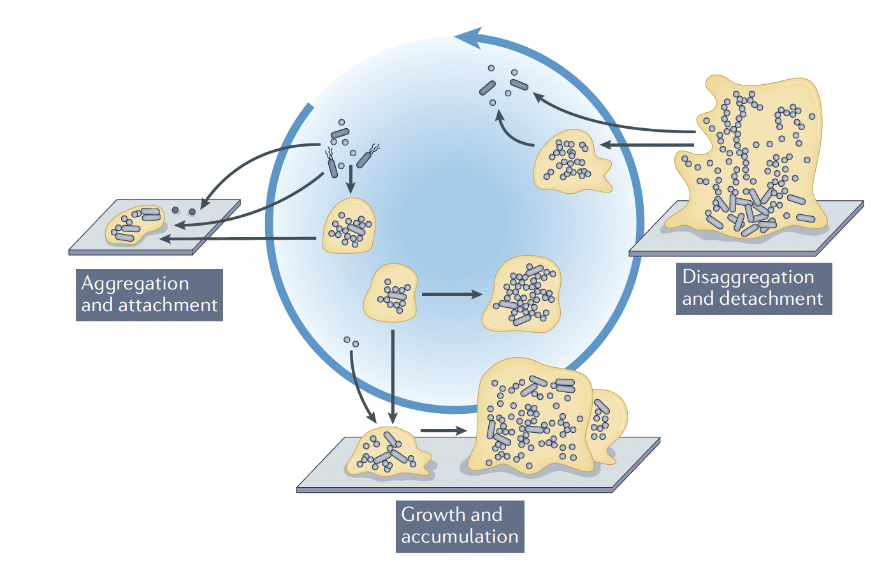
Figure 4. Expanded conceptual model of biofilm formation [2].

Slide 6
Thi MT, Wibowo D, Rehm BH. Pseudomonas aeruginosa biofilms. International journal of molecular sciences. 2020 Nov 17;21(22):8671.
Sauer K, Stoodley P, Goeres DM, Hall-Stoodley L, Burmølle M, Stewart PS, Bjarnsholt T. The biofilm life cycle: expanding the conceptual model of biofilm formation. Nature Reviews Microbiology. 2022 Aug 3:1-3.
Reference

