Slide 1

Tagging BDNF with Fluorophores
Lab Presentation 3
Mahir Taher,
Supervised by Adam Noel and Anne Straube

Slide 2
BDNF
Tagging BDNF with Fluorophores
Lab Presentation 3
Mahir Taher,
Supervised by Adam Noel and Anne Straube

Slide 3
Contents
Recap
Recent developments
Next steps
Model Scheme
Experimental aims
Lab work (getting relevant DNA)
Experimental expression of BDNF
Further fluorophore tagging

Slide 4
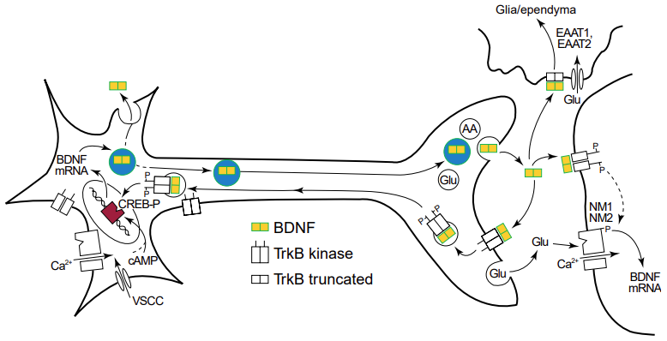

Recap – Upscaling Model
Expand to whole neuron
Cell body
Axon
Synapse

Slide 5
Recap – Experimental Aims
Extracellular relative concentrations of BDNF isoforms
Imaging of different isoforms to see uptake + processing
Manipulating the movement of BDNF
Experiments:

Slide 6
Recap – Experimental Aims
Extracellular relative concentrations of BDNF isoforms
Imaging of different isoforms to see uptake + processing
Manipulating the movement of BDNF
Experiments:
Imaging of different isoforms to see uptake + processing

Slide 7
Recent Development – Isolating relevant DNA
Extract out BDNF mRNA and convert it to complementary cDNA
Insert BDNF DNA into a vector fused with GFP DNA
Transform the vector into bacteria to make more DNA
Transfect relevant cell line with vector DNA
Workflow

Slide 8
Recent Development – Isolating relevant DNA
Extract out BDNF mRNA and convert it to complementary cDNA

Slide 9
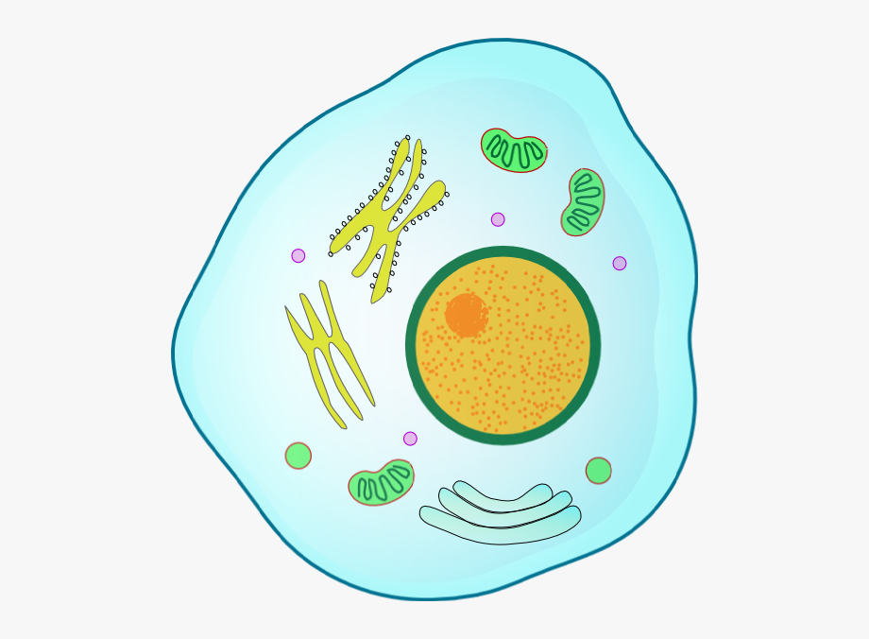

Recent Development – Isolating relevant DNA
Extract out BDNF mRNA and convert it to complementary cDNA

Slide 10
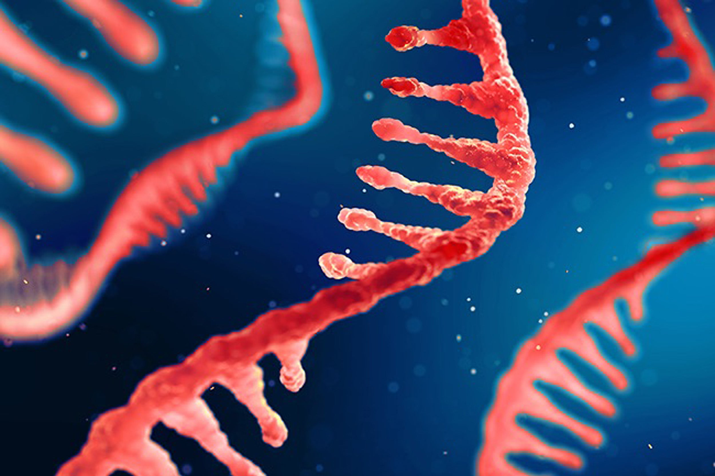
Recent Development – Isolating relevant DNA
Extract out BDNF mRNA and convert it to complementary cDNA

Slide 11
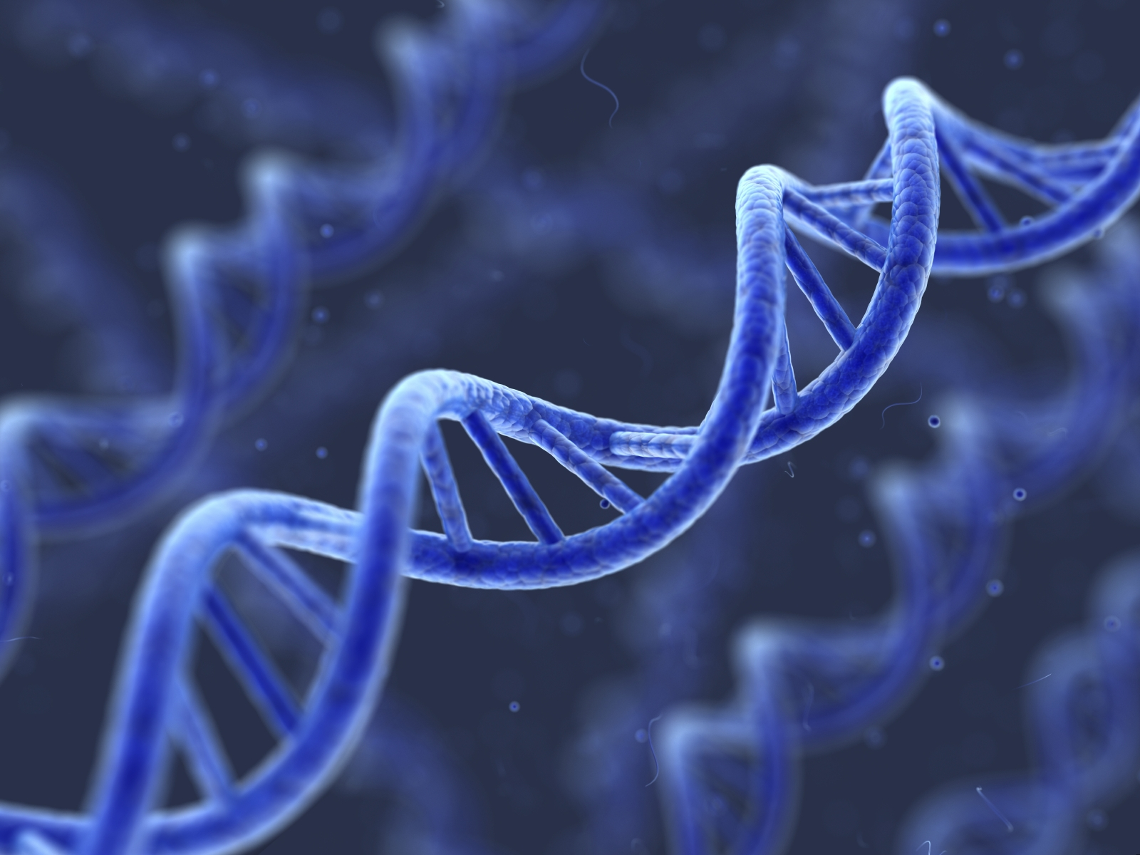
Recent Development – Isolating relevant DNA
Extract out BDNF mRNA and convert it to complementary cDNA

Slide 12
Recent Development – Isolating relevant DNA
2. Insert BDNF DNA into a vector fused with GFP DNA

Slide 13
Recent Development – Isolating relevant DNA
2. Insert BDNF DNA into a vector fused with GFP DNA

Slide 14
Recent Development – Isolating relevant DNA
2. Insert BDNF DNA into a vector fused with GFP DNA

Slide 15
Recent Development – Isolating relevant DNA
2. Insert BDNF DNA into a vector fused with GFP DNA

Slide 16
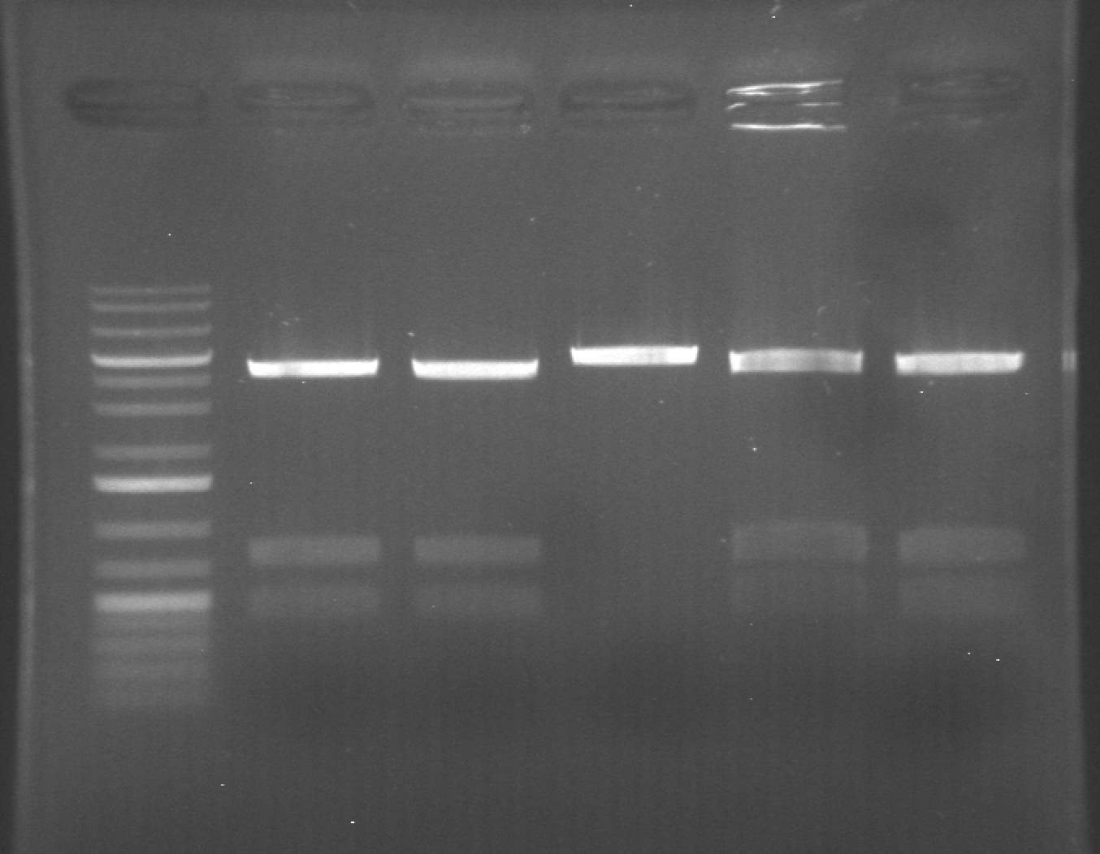
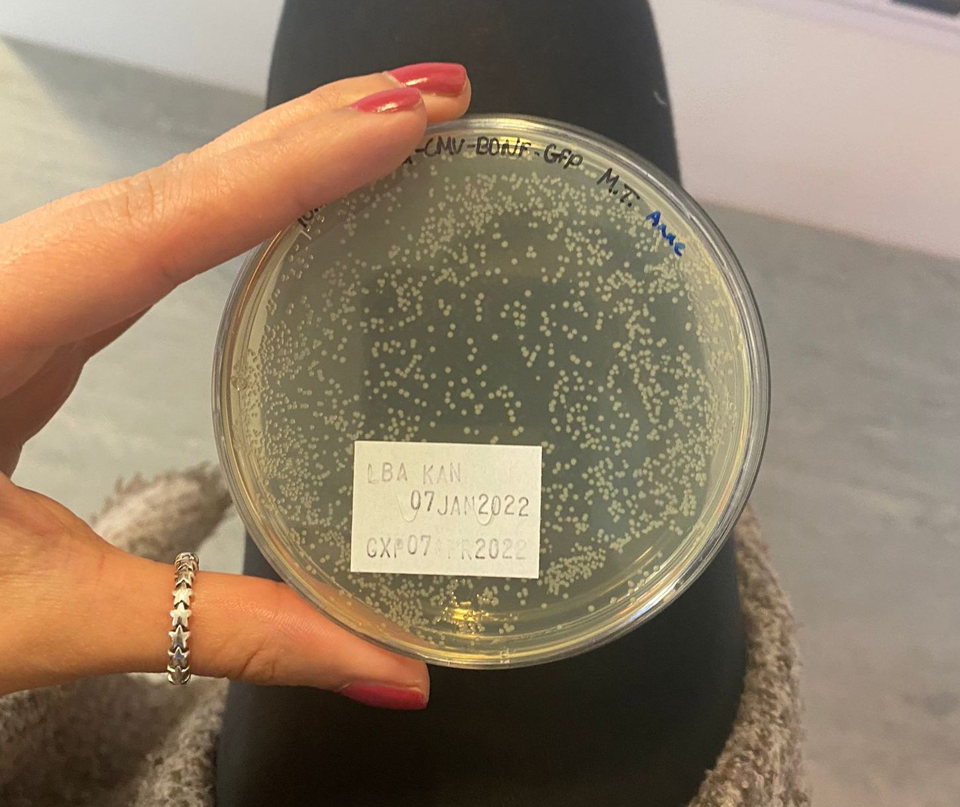
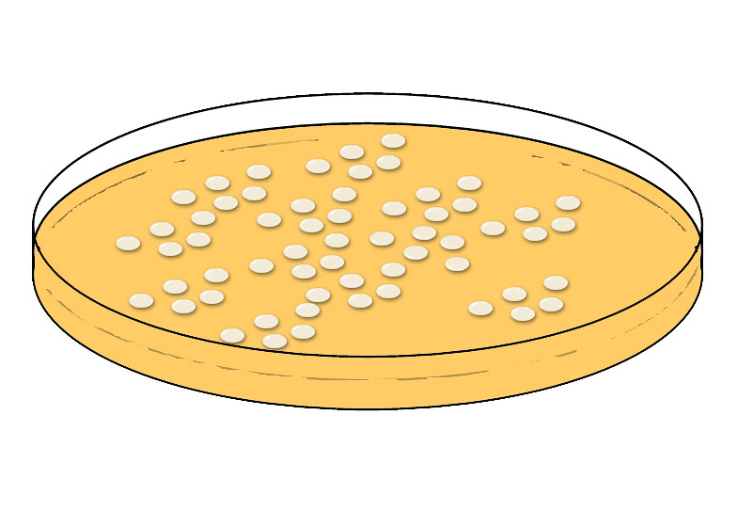
Recent Development – Isolating relevant DNA
3. Transform the vector into bacteria to make more DNA

Slide 17
Recent Development – Isolating relevant DNA
3. Transform the vector into bacteria to make more DNA

Slide 18
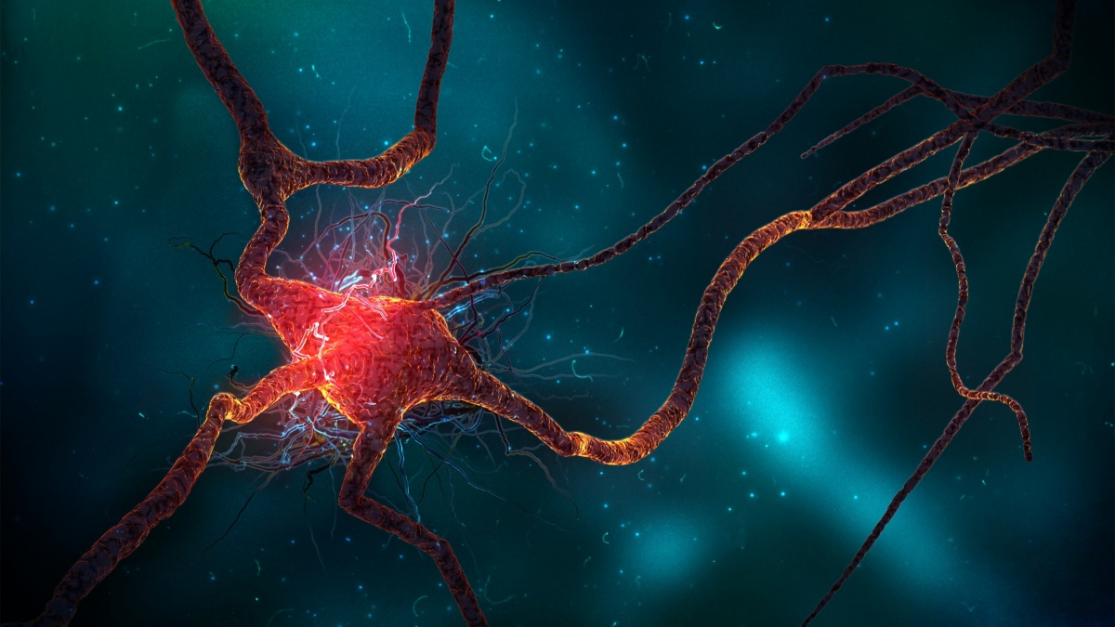
Recent Development – Isolating relevant DNA
4. Transfect relevant cell line with vector DNA

Slide 19
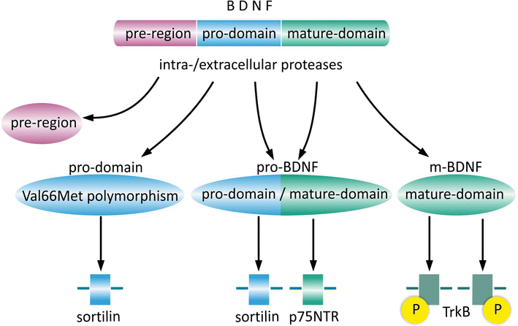
Next Steps
Transfect neurons with BDNF-GFP and image
Tag other isoforms with different colours
Experiments

