Slide 1

Progress review 5
Mahir Taher,
Supervised by Dr Adam Noel and Dr Anne Straube

Slide 2
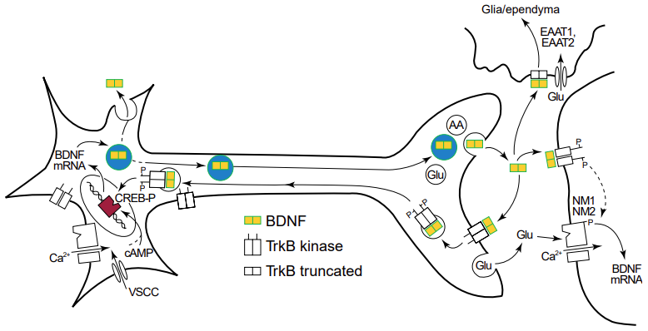
BDNF Signalling

Slide 3


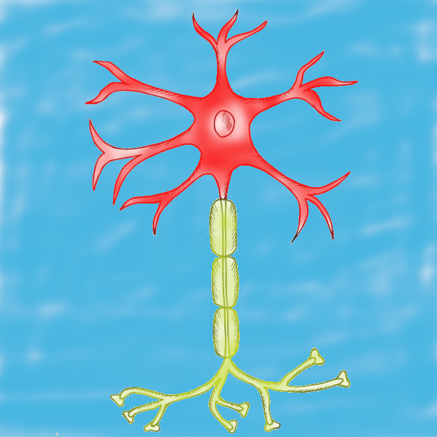
Broader model scheme
Inputs
Outputs
Spatial BDNF isoform concentrations
Axonal model
Spatial secretion of BDNF after FAT
Expressed and processed BDNF cargos for FAT
Somatic model
Exogenous model
BDNF signalling -> synapse and neuron state metrics
Spatial dendritic BDNF secretion
BDNF expression rate
Endocytosed BDNF
BDNF cargos for FAT
Spatial secretion of BDNF from dendrites and post-FAT

Slide 4
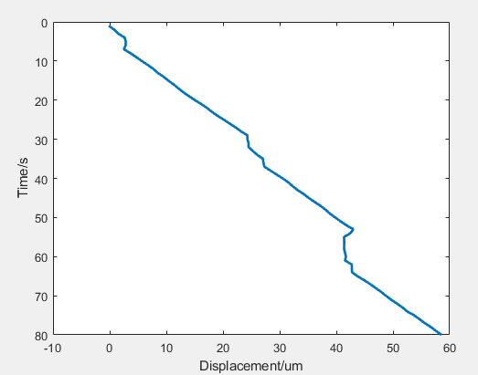
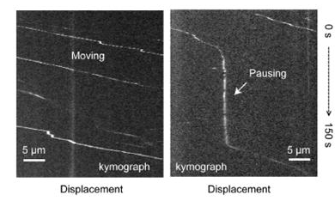
Previous axonal transport model

Slide 5
Broader model scheme
Inputs
Outputs
Spatial BDNF isoform concentrations
Axonal model
Spatial secretion of BDNF after FAT
Expressed and processed BDNF cargos for FAT
Somatic model
Exogenous model
BDNF signalling -> synapse and neuron state metrics
Spatial dendritic BDNF secretion
BDNF expression rate
Endocytosed BDNF
BDNF cargos for FAT
Spatial secretion of BDNF from dendrites and post-FAT

Slide 6
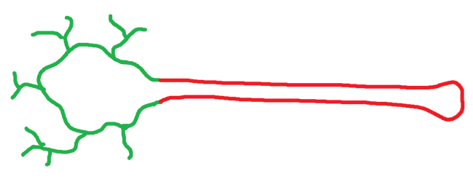
Current method

Slide 7
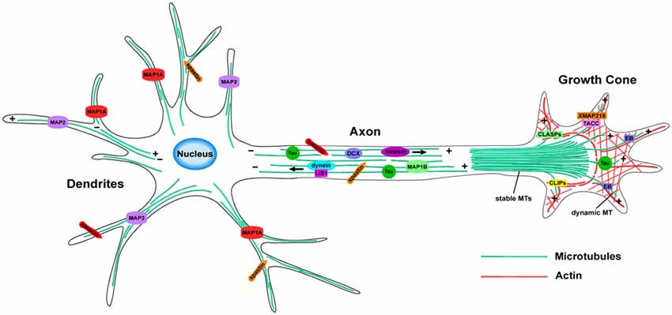


Current method

Slide 8
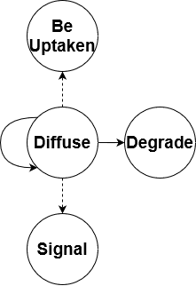
Current method

Slide 9
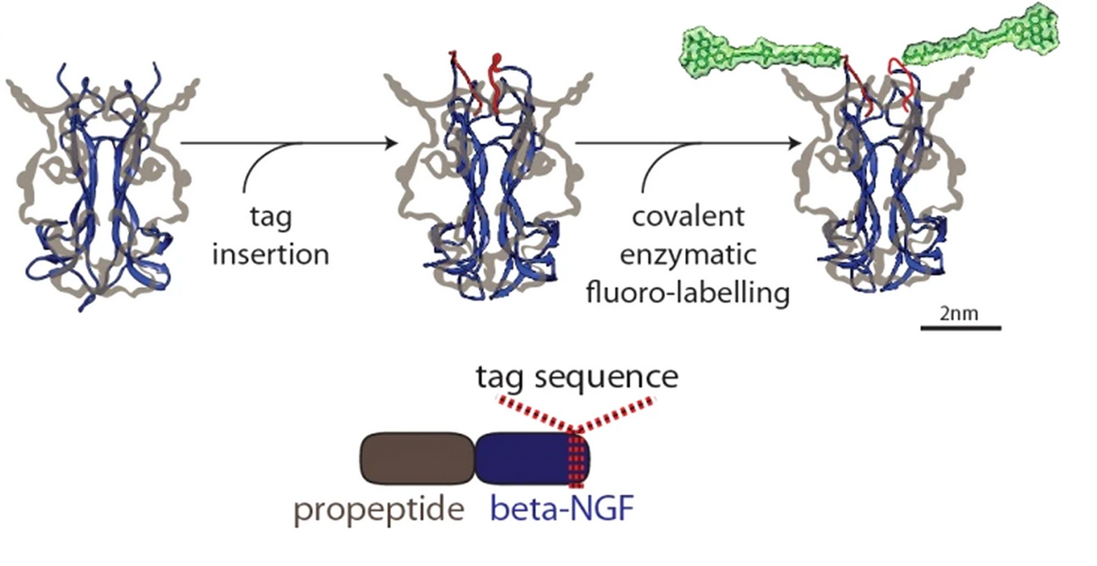
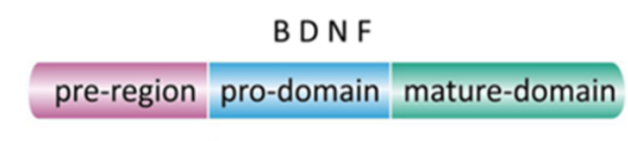

Experimental plans
Current agenda
Tagging BDNF isoforms for live imaging
Transfecting tagged BDNF into cells
Imaging BDNF-DCVs for training FAT model

