Slide 1

Progress review 7
Mahir Taher,
Supervised by Dr Adam Noel and Dr Anne Straube

Slide 2


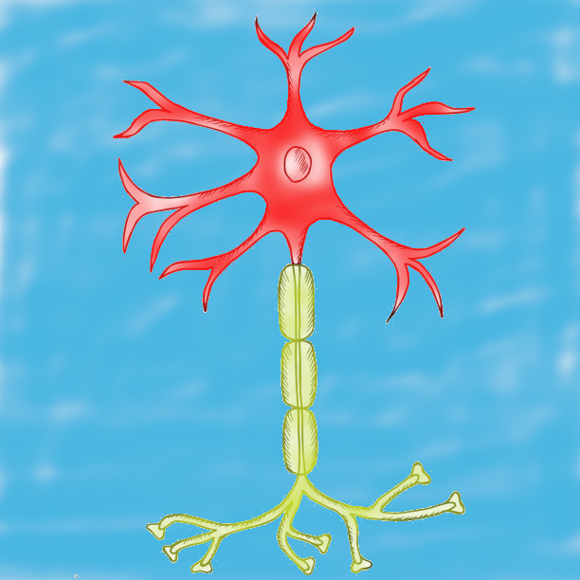
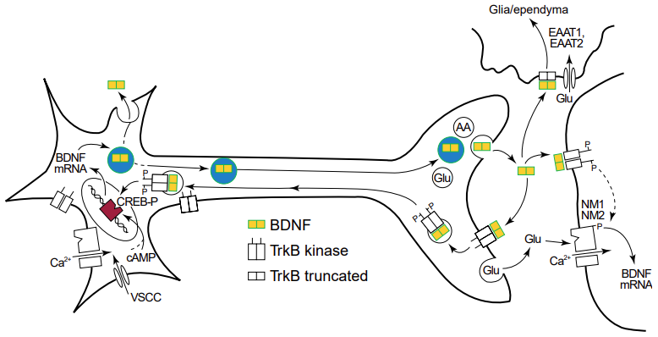
Broader model scheme
Inputs
Outputs
Spatial BDNF isoform concentrations
Axonal model
Spatial secretion of BDNF after FAT
Expressed and processed BDNF cargos for FAT
Somatic model
Exogenous model
BDNF signalling -> synapse and neuron state metrics
Spatial dendritic BDNF secretion
BDNF expression rate
Endocytosed BDNF
BDNF cargos for FAT
Spatial secretion of BDNF from dendrites and post-FAT

Slide 3

Conceptualised method

Slide 4
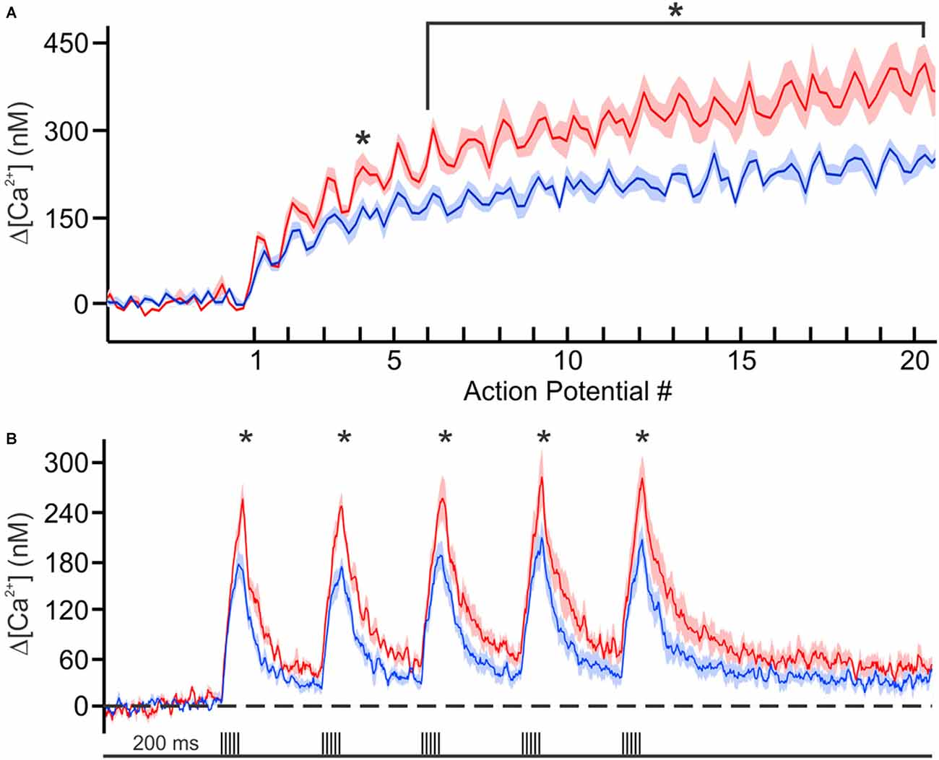
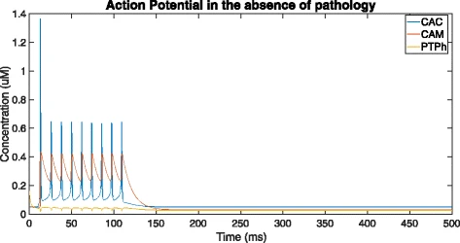
Action potential and calcium concentration relationship

Slide 5
Action potential and calcium concentration relationship

Slide 6
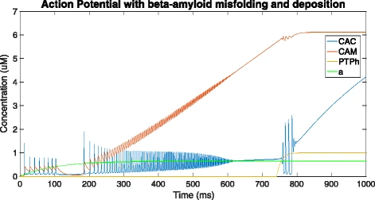
Action potential and calcium concentration relationship

Slide 7
Action potential and calcium concentration relationship
Are fewer vesicles released under Alzheimer’s pathology?
Does vesicle fusion require a spike in calcium or just action potential spikes?
Does transient increase in calcium cause more release of DCVs
Unresolved questions

Slide 8

Restriction enzyme digest

Slide 9
