Slide 1

Progress review 7
Mahir Taher,
Supervised by Dr Adam Noel and Prof Anne Straube

Slide 2


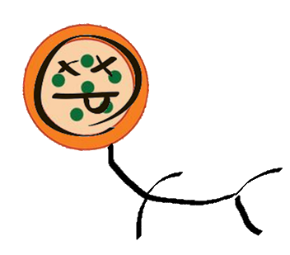
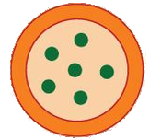






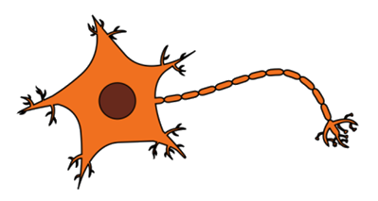
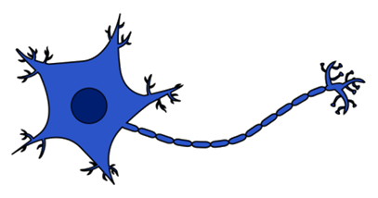


Neuron connection strength + number
Neuron growth
Cell-programmed death

Slide 3

Neuron connection strength + number
Neuron growth
Cell-programmed death

Slide 4


Neuron connection strength + number
Neuron growth
Cell-programmed death

Slide 5


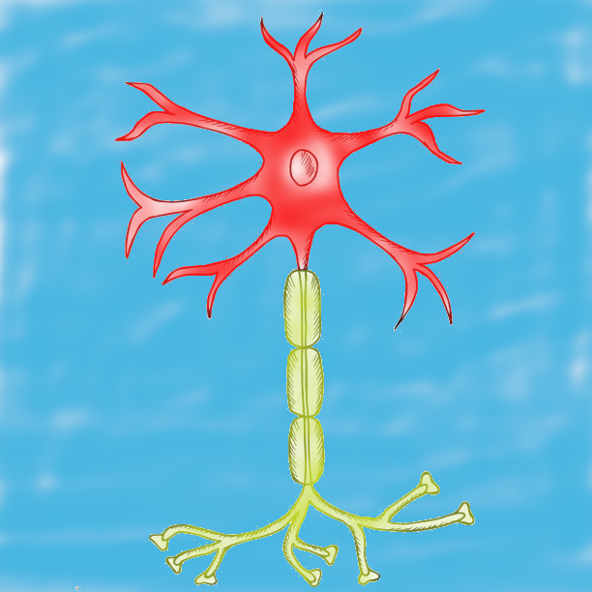
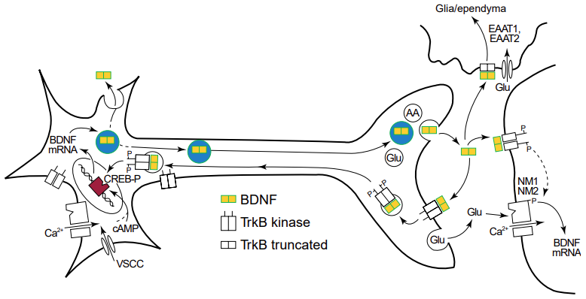
Broader model scheme
Inputs
Outputs
Spatial BDNF isoform concentrations
Axonal model
Spatial secretion of BDNF after FAT
Expressed and processed BDNF cargos for FAT
Somatic model
Exogenous model
BDNF signalling -> synapse and neuron state metrics
Spatial dendritic BDNF secretion
  BDNF expression rate
  Endocytosed BDNF
  BDNF cargos for FAT
  Spatial secretion of BDNF from dendrites and post-FAT

Slide 6
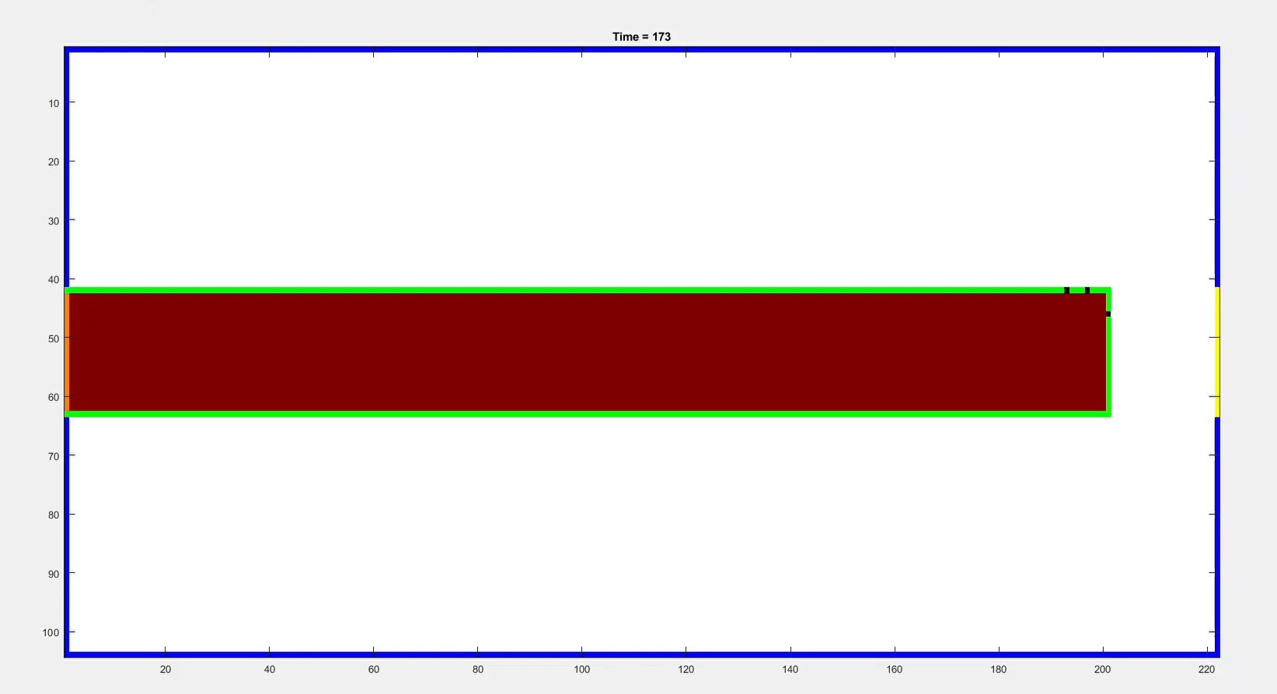
Current 2D Simulation Space

Slide 7

Conceptualised method
+ model extracellular action with an MCM
+ convert axonal transport to 2D
+ make signalling linked to LTP <-> LTD and neurite length/health
+ make fusion dependent on intracellular calcium/action potential propagations

Slide 8
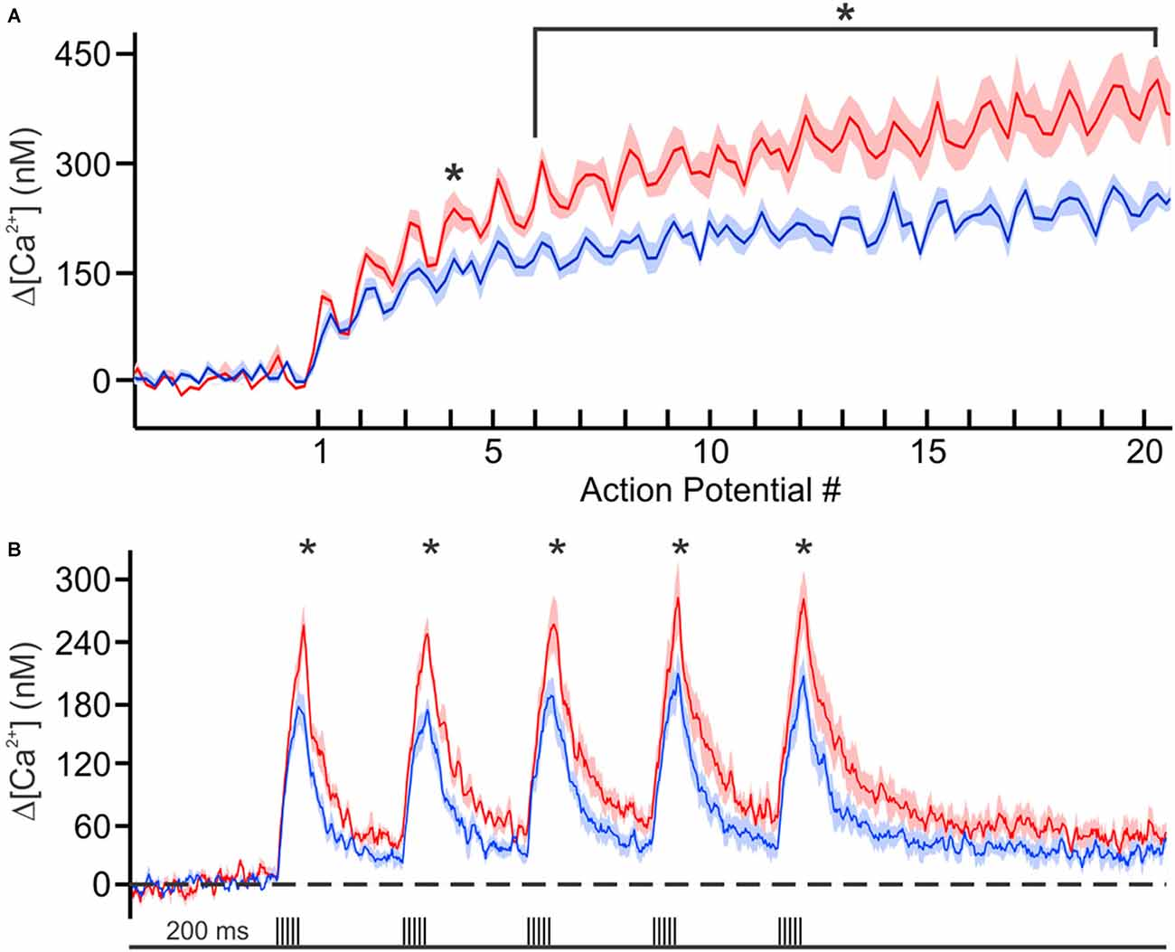
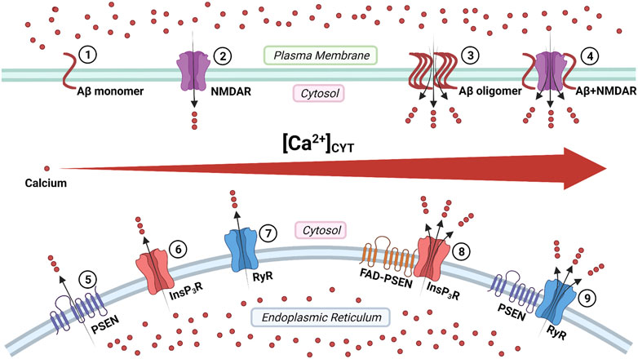
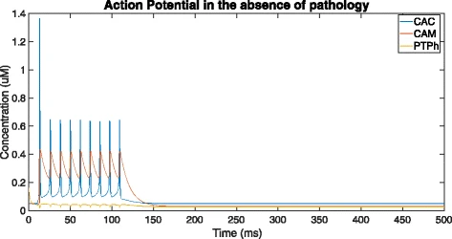
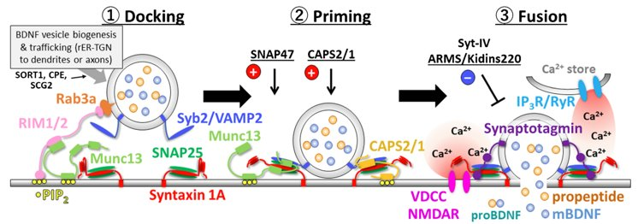
Action potentials, intracellular calcium and Alzheimer’s
Notes:
https://www.frontiersin.org/articles/10.3389/fcell.2022.834962/full

Slide 9
Action potentials, intracellular calcium and Alzheimer’s
Notes:
https://www.frontiersin.org/articles/10.3389/fcell.2022.834962/full

Slide 10
Action potentials, intracellular calcium and Alzheimer’s
Notes:
https://bmcsystbiol.biomedcentral.com/articles/10.1186/s12918-018-0529-2

Slide 11
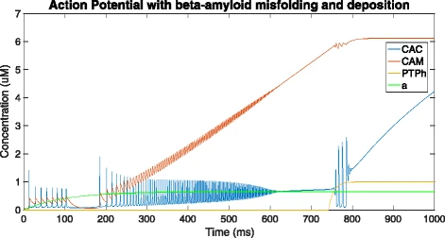
Action potentials, intracellular calcium and Alzheimer’s

Slide 12
Action potentials, intracellular calcium and Alzheimer’s
Are more vesicles released under Alzheimer’s pathology?
Does vesicle fusion require a spike in calcium or just action potential spikes?
Does a transient increase in calcium cause more release of DCVs
Unresolved questions

Slide 13
Action potentials, intracellular calcium and Alzheimer’s
Are more vesicles released under Alzheimer’s pathology?
Does vesicle fusion require a spike in calcium or just action potential spikes?
Does a transient increase in calcium cause more release of DCVs
Unresolved questions

Slide 14
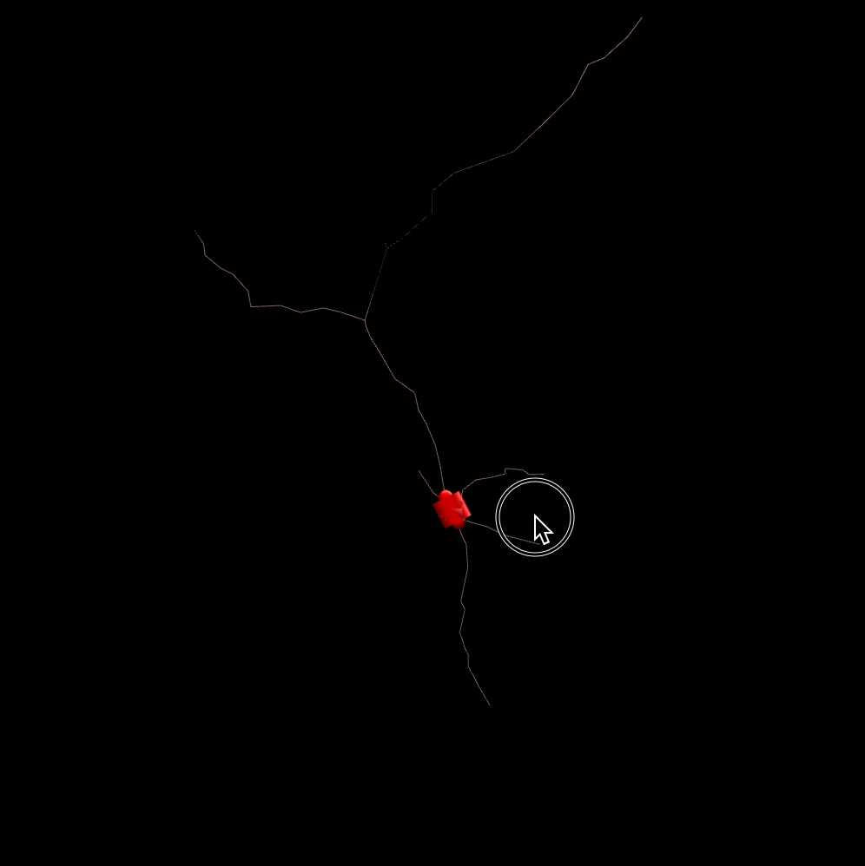
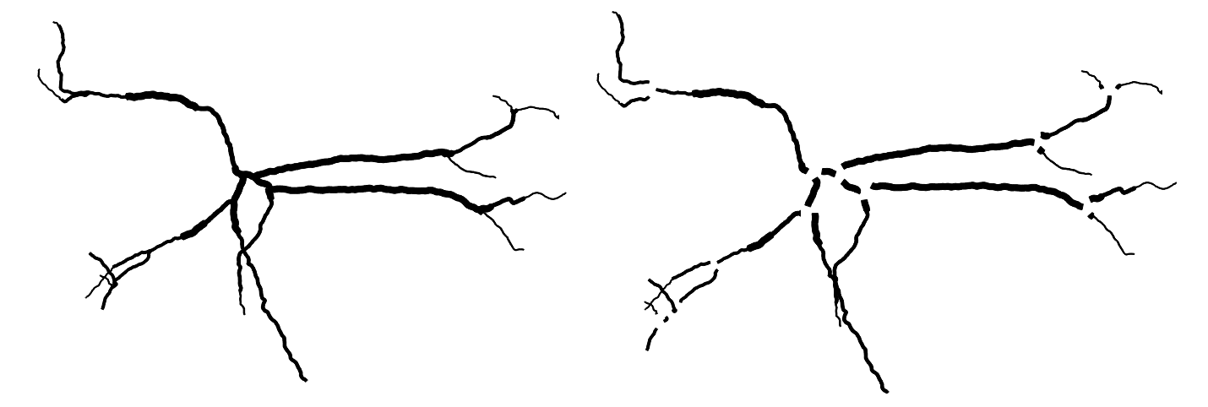
Yale ‘NEURON’ simulator
Notes:
https://www.jstage.jst.go.jp/article/bpb/43/7/43_b20-00082/_html/-char/en

Slide 15
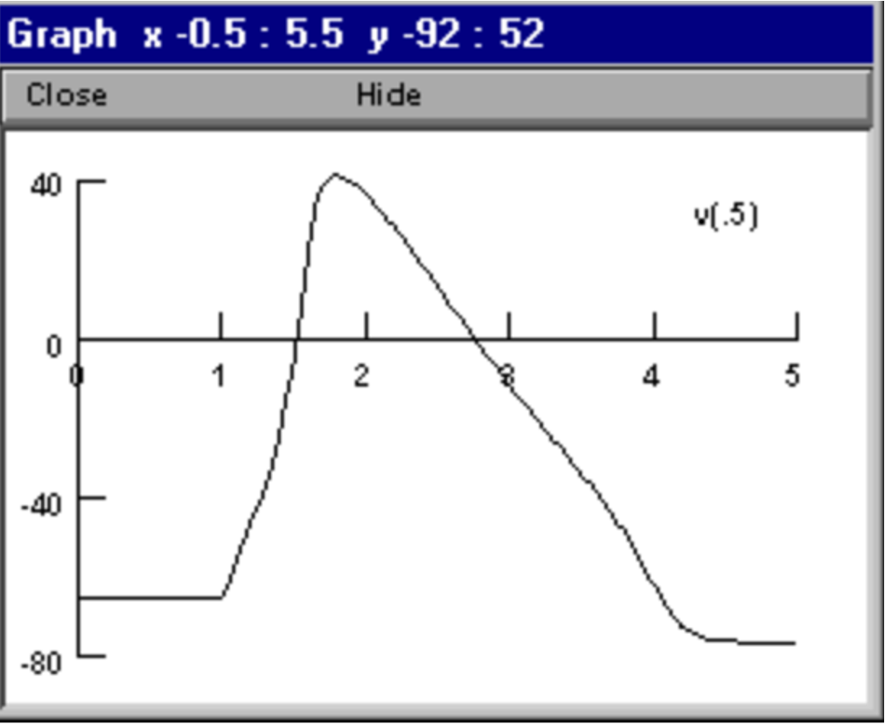
Yale ‘NEURON’ simulator
Notes:
https://www.jstage.jst.go.jp/article/bpb/43/7/43_b20-00082/_html/-char/en

Slide 16
Yale ‘NEURON’ simulator
Notes:
https://www.jstage.jst.go.jp/article/bpb/43/7/43_b20-00082/_html/-char/en

Slide 17
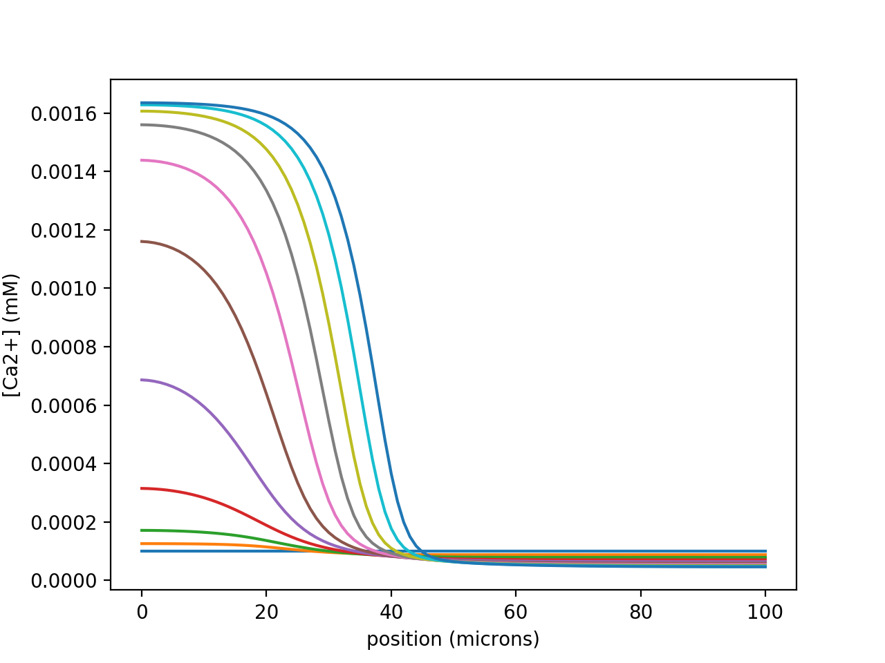
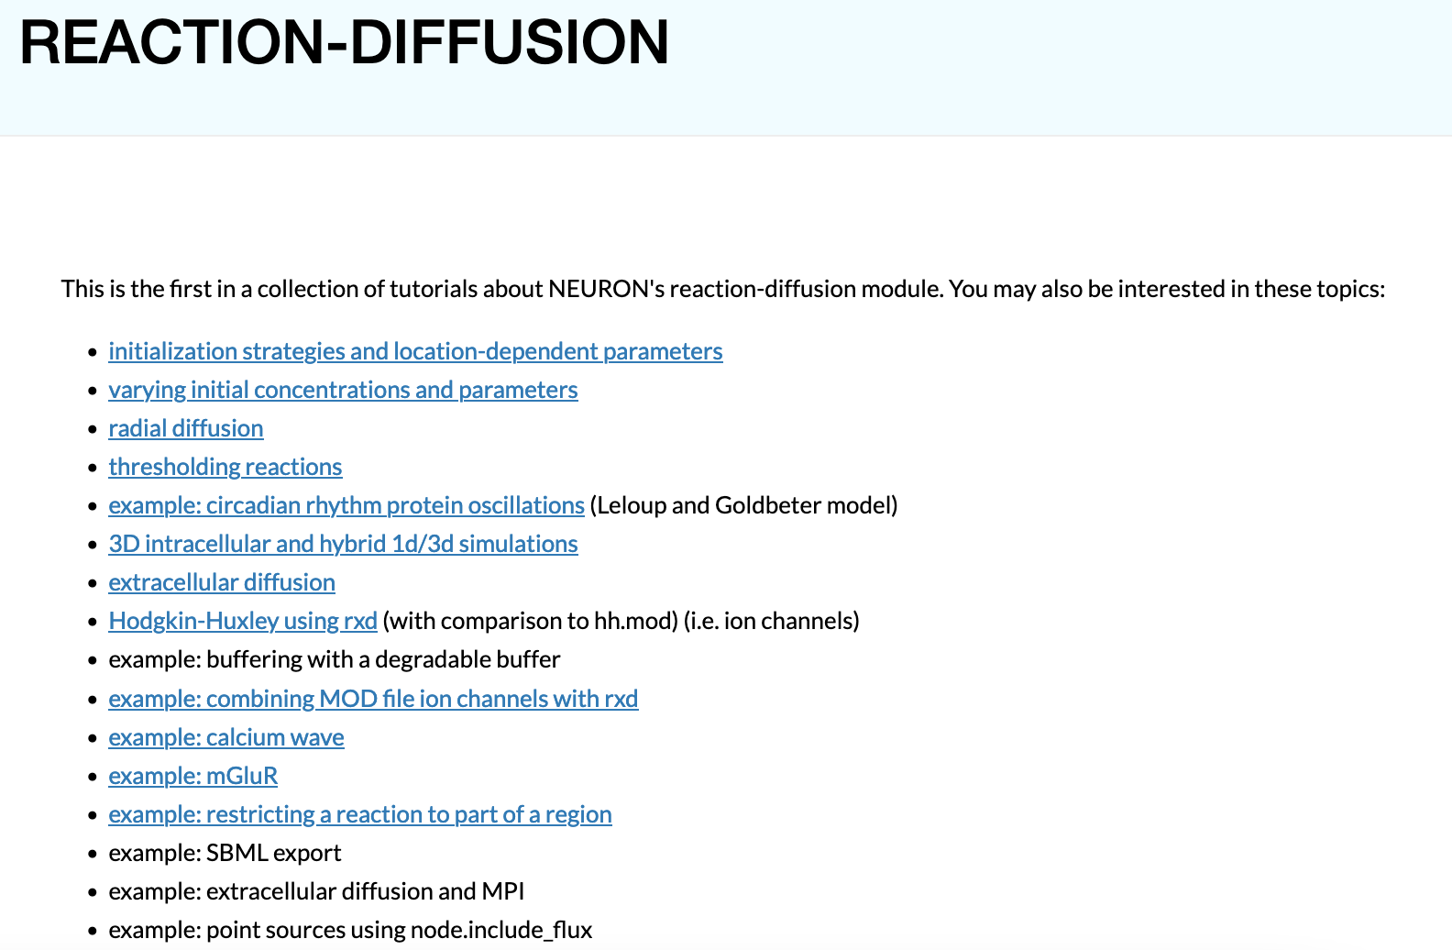
Yale ‘NEURON’ simulator
Notes:
https://www.jstage.jst.go.jp/article/bpb/43/7/43_b20-00082/_html/-char/en

Slide 18
Yale ‘NEURON’ simulator
Notes:
https://www.jstage.jst.go.jp/article/bpb/43/7/43_b20-00082/_html/-char/en

Slide 19
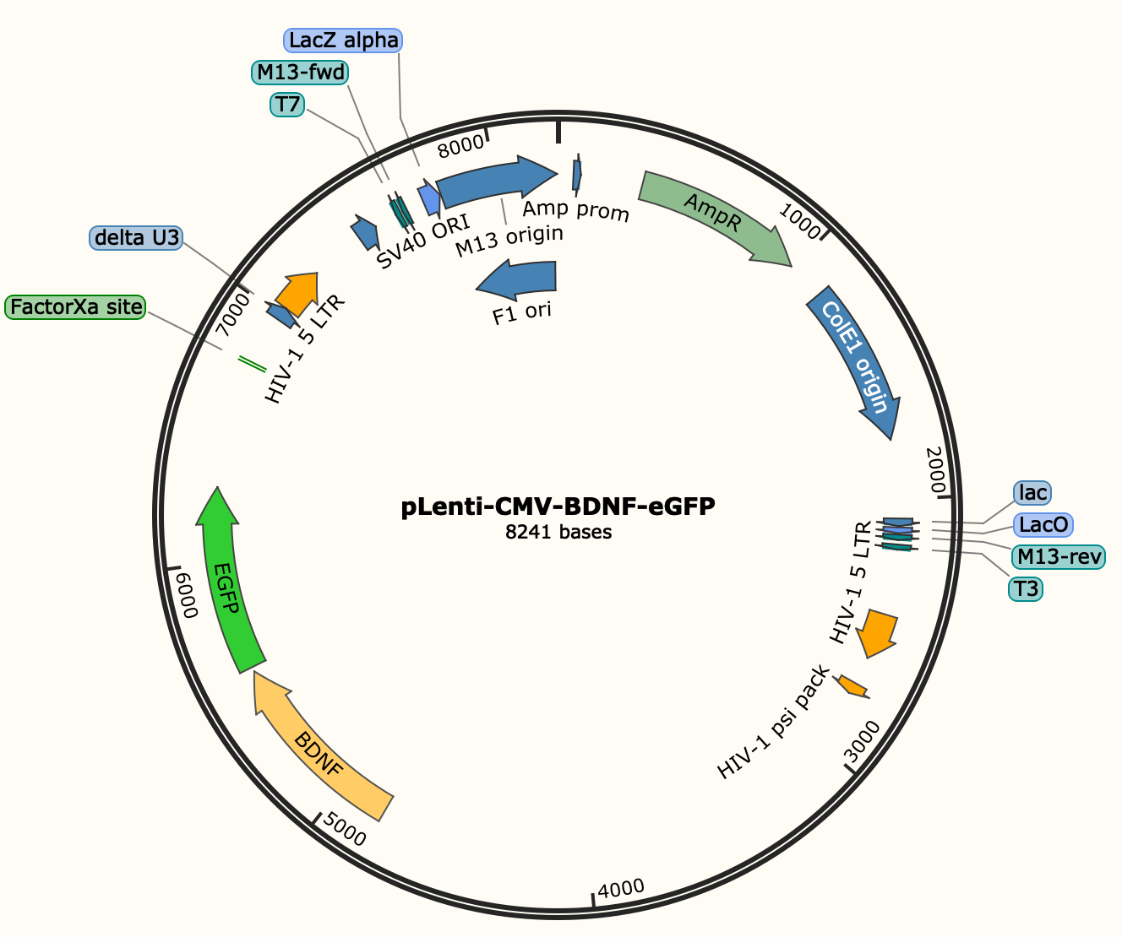

Slide 20



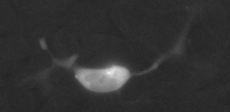
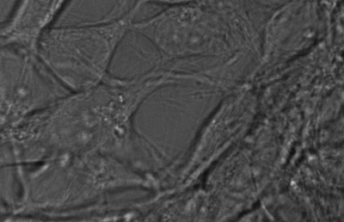
Transient transfection

Slide 21
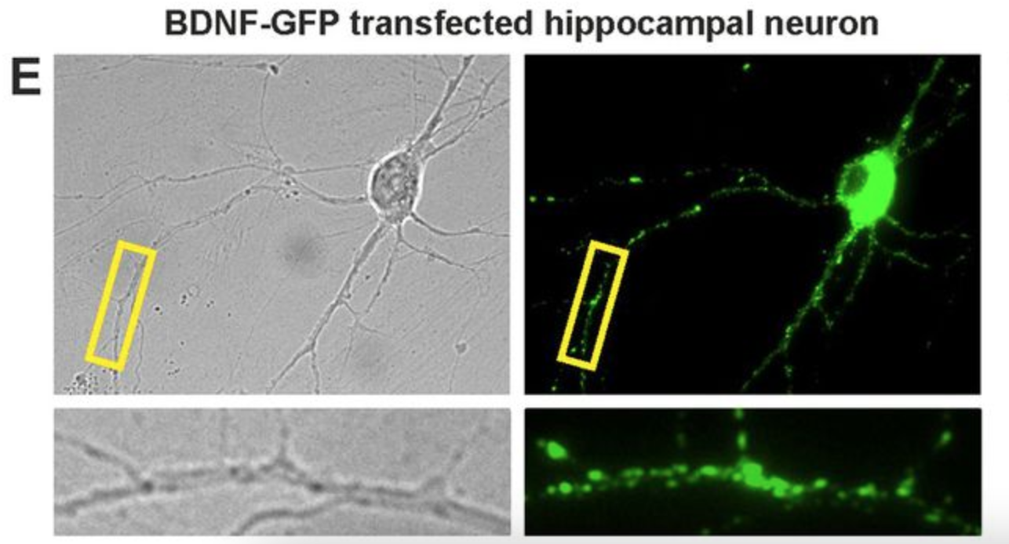
Notes:
https://journals.biologists.com/jcs/article/126/21/5062/54106/Embryonic-stem-cells-stably-expressing-BDNF-GFP

Slide 22
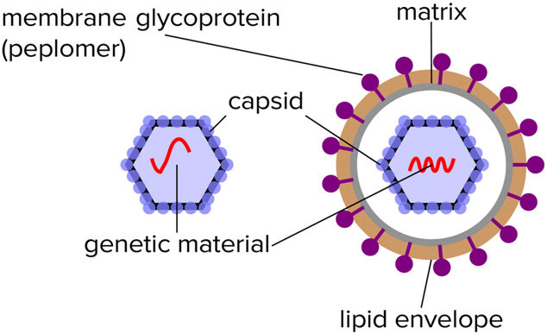
VIRAL INFECTION!

