Slide 1
Measurement of human energy expenditure: the Human Metabolic Research Unit (HMRU)
J. Hattersley

Slide 2
Outline
All about me!
Why are we concerned with measuring human EE?
What is the HRMU?
Facilities
HMRU/WISDEM
BODPod
Respiratory Rooms
From gas exchange to EE
Current research

Slide 3
All about me
Biog:
Use to be a ‘real’ engineer (mechanical/electrical/software)
U/G Software Engineering
MSc Advanced Biomed (Warwick)
PhD Biomed Modelling (Chappell/Evans)
Short-term fellowships (Warwick)
Currently employed by University Hospitals Cov Warwick with honorary position in School of Engineering
Note//not clinical in any way shape or form.
HMRU has clinical collaborators

Slide 4
Why Measure Energy Expenditure?
Importance of understanding EE
25% of the UK adult population now being classed as obese
15% of children and young adults
Co-morbidity: type 2 diabetes, cancer, hypertension
cost NHS of £0.5bn in 2003; £4.2bn in 2007; £6.3bn by 2015.
Immediate medical requirements: we need measure EE to assess the patients
Metabolic requirements
Fuel utilisation
Thermic effect of foods/drink/drugs
emotional state
In a clinical setting, under or over, feeding can be detrimental to patient recovery and long term health. Examples:
Malnutrition of dialysis/transplant patients
Obesity/diabetes and antipsychotic drugs
PCOS and weight gain

Slide 5
How do we Measure Energy Expenditure?
What is calorimetry?
“Measurement of the amount of heat given off or absorbed by a reaction or group of reactions (as by an organism).”
Three Methods in Human Subjects:
Direct
Measurement of heat actually produced by the organism which is confined in a sealed chamber or calorimeter.
Equipment: body suits, injected isotope, chambers
Indirect
Estimation of the heat produced by means of the respiratory differences of oxygen and carbon dioxide in the inspired and expired air.
Equipment: metabolic carts, chambers, hand-held devices …
Non-calormetric
Estimation from phenotype measurements (e.g. height, weight, etc)
Equipment: scales, callipers,…,BODPod.

Slide 6
Why use a respiratory chambers?
Indirect calorimeter is the gold standard for measuring metabolic rate and energy expenditure.
UHCW has built respiratory rooms, chambers are the gold standard for indirect calorimetry:
Only method available for long term measurement (24 hr).
Removes environmental impact on EE.
Subject is mobile (if limited) allowing aspects of daily life to be evaluated:
eating
sleeping
physical activity
Subject is not physical restrained by device, e.g. face mask or ventilation hood. Biases EE:
anxiety
comfort

Slide 7
Energy Expenditure
Definitions:
Total Energy Expenditure (TEE) – amount of energy used for daily function of human body.
Basal Metabolic Rate (BMR) – energy required to maintain basic cellular function.
Diet Induced Thermogenesis (DIT) – energy used to metabolise substrate.
Activity Energy Expenditure (AEE) – energy used to perform a specific
Therefore,
TEE(t) = BMR(t) + DIT(t) + AEE(t)

Slide 8
Energy Expenditure
Condition for Metabolic Measurement:
Basal Metabolic Rate (BMR):
Absence of gross muscular activity.
Post-absorptive state (12 hrs).
Thermal neutrality.
Emotional disturbance must be minimal.
Wakefulness.
Phase of the female sexual cycle.
Resting Metabolic Rate (RMR):
Post-absorptive state (8-12 hr).
Abstinence from exercise (12 hr).
Sleep Metabolic Rate (SMR):
The lowest observed EE for 3 consecutive hours during the night, generally between 3 and 6 AM.
Which one? The one you can achieve
Approximations: SMR ≈ 0.9 BMR, BMR ≈ RMR. (?)

Slide 9
Human Metabolic Research Unit
Part of Warwick InStitute for Diabetes, Endochrinology and Metabolism (WISDEM)
Combines:
Inpatient ward.
An outpatient clinic.
A large research group at Warwick Medical School.
Human Metabolic Research Unit
Focus on phenotype and whole-body metabolic measurement.
Equipment:
Respiratory Rooms*
Respiration Hoods
BODPod*
Activity Monitors
Sleep monitoring equipment
CPEX Machines

Slide 10
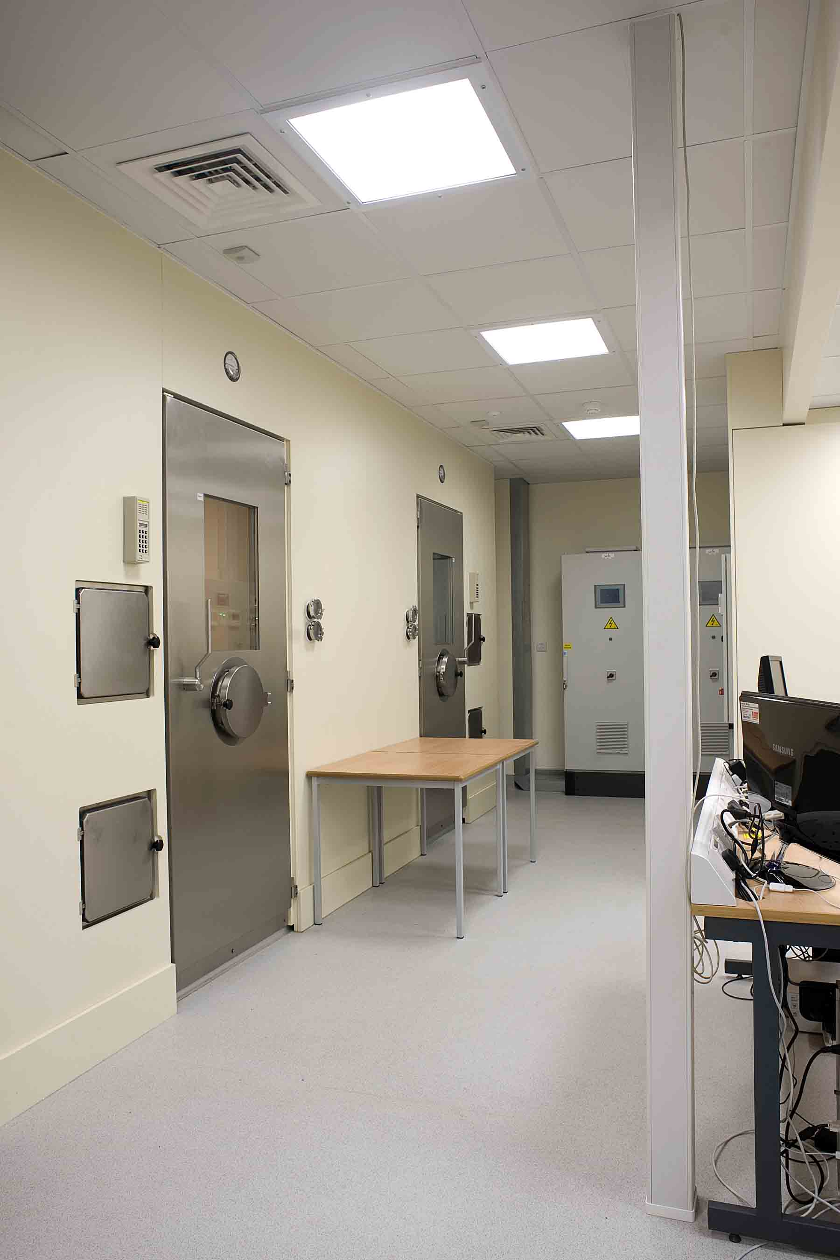
Respiratory Rooms
(Diagram)
Two ‘air-tight’ rooms (under pressured)
Fresh air is drawn from the top of the hospital, passes through the rooms
Recirculation through A/C
Environment PLC/PID controlled
Pressure, Through-flow
Temp, RH, Humid/Dehumid
Gases sampled on input and output of chambers
Three modes of operation:
Normal, Rest and Sports
Two settings
Day and night

Slide 11
Respiratory Rooms

Slide 12
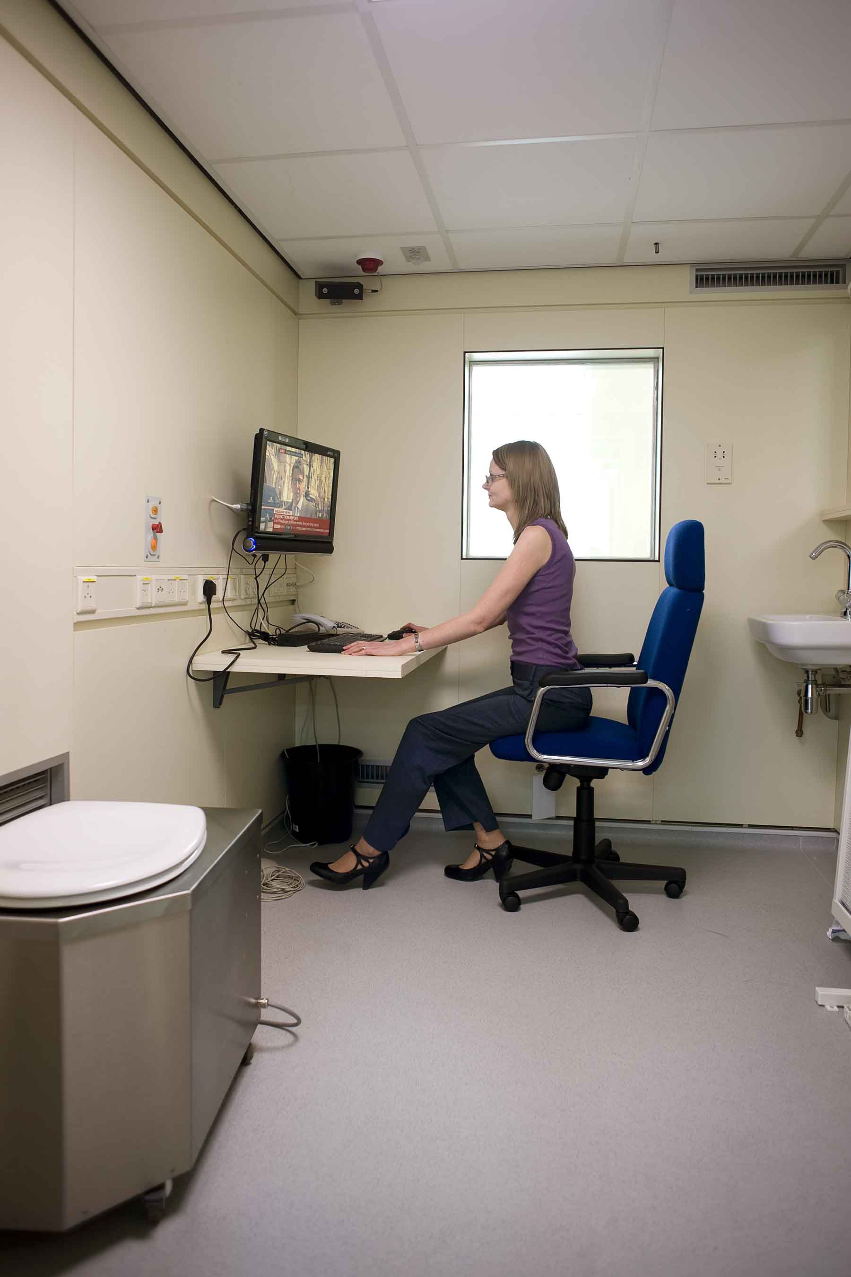
Respiratory Rooms
Of note:
Temp pressure sensor
TV/Internet/Phone
Nurse-call
Toilet
Activity Sensor
Vents
Bed

Slide 13
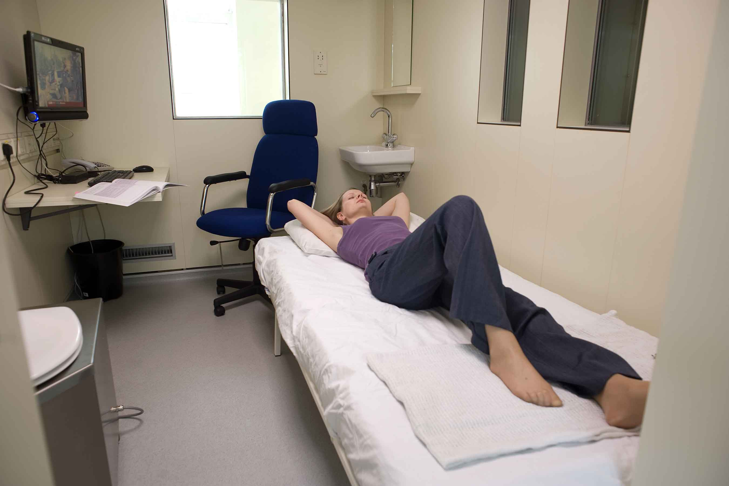
Respiratory Rooms

Slide 14
System IO
Controlled variables (inputs)
Environment (Temp, RH, Pressure).
Ambient Conditions (light, sound)
Subject behaviour (physical exercise/sleep patterns/mental activity/human interaction)
Diet/drug regime (oral, intravenous)
Directly measured (outputs)
Flow-rates in and out.
Gas concentration inflow, outflow (O2,CO2).
Environment inside chamber (temp, RH and pressure).
Environment outside chamber (temp, RH and pressure).
Toilet (faeces, urine) for Nitrogen.
Blood samples (hole in door!).
Activity (motion sensors).
Perspiration/condensate from the air con unit.

Slide 15
EE from O₂, CO₂ and Urea nitrogen
From VO₂ and VCO₂ Energy Expenditure can be calculated through a variety of equations.
Modified Weir equations (with urinary nitrogen (NM))
EE (KJ/d) = 16.18 VO₂ + 5.02 VCO₂ – 5.99 NM
Abbreviated Weir equations (without nitrogen*)
EE (KJ/d) = 16.62 VO₂ + 4.51 VCO₂
* Nitrogen accounts for <4% of EE in critically ill patients; 1-2% inpatients/outpatients.

Slide 16
Substrate Utilisation
Several equations developed to estimate which substrate is used. They differ depending on the nutritional state, e.g. fasting, post-absorptive, excess.
For fasting state:
Carbohydrate (g/min) = -2.91VO₂ + 4.12 VCO₂ - 2.56 NM
Fat (g/min) = 1.69 VO₂ - 1.69 VCO₂ - 1.94 NM
Proteins (g/min) = 6.25 NM
VO_{2,} VCO₂ in l/min and NM g/min

Slide 17
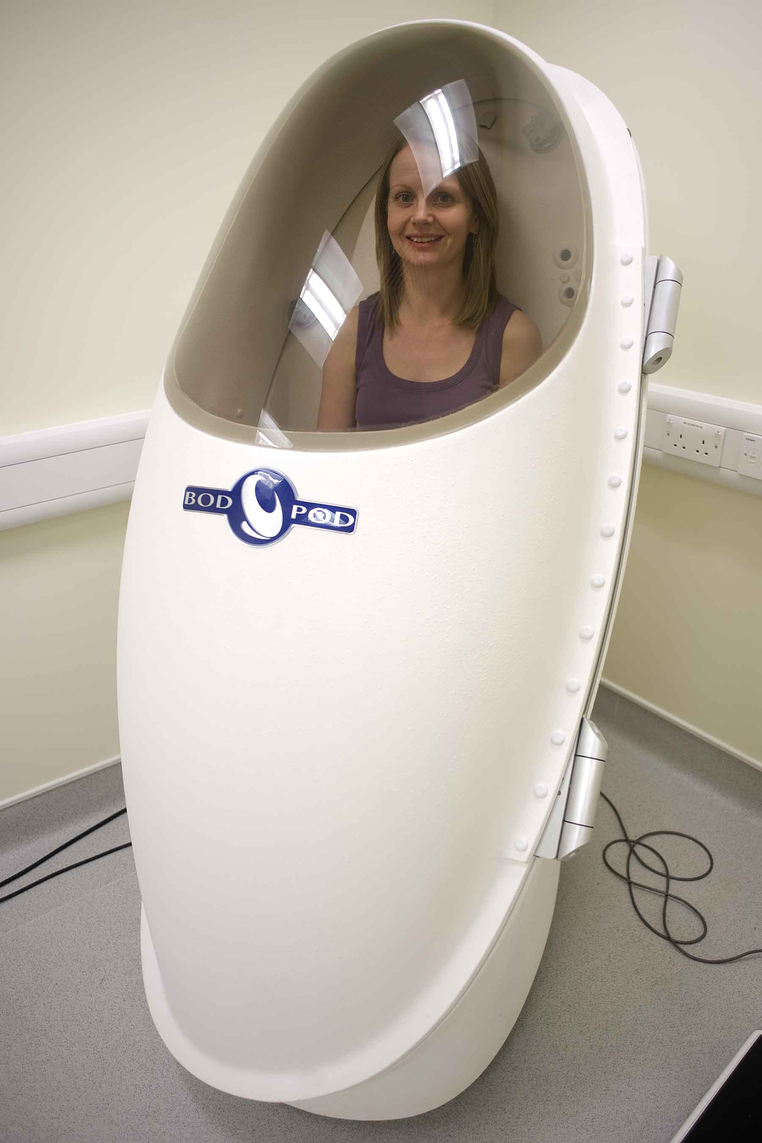
BODPod
A system for accurately measuring body composition
Two compartment model, assumes body consists of:
Fat
Fat free (Water, bone, non-bone, protein)
Referred to as practical gold standard!
Equipment for Measuring:
volume (egg)
weight (scales)
Height (stadiometer)
Estimates body composition through predictive equations (e.g. Siri)
%Fat = (4.95/Density – 4.50)*100
%Fat Free = 100 - %Fat

Slide 18
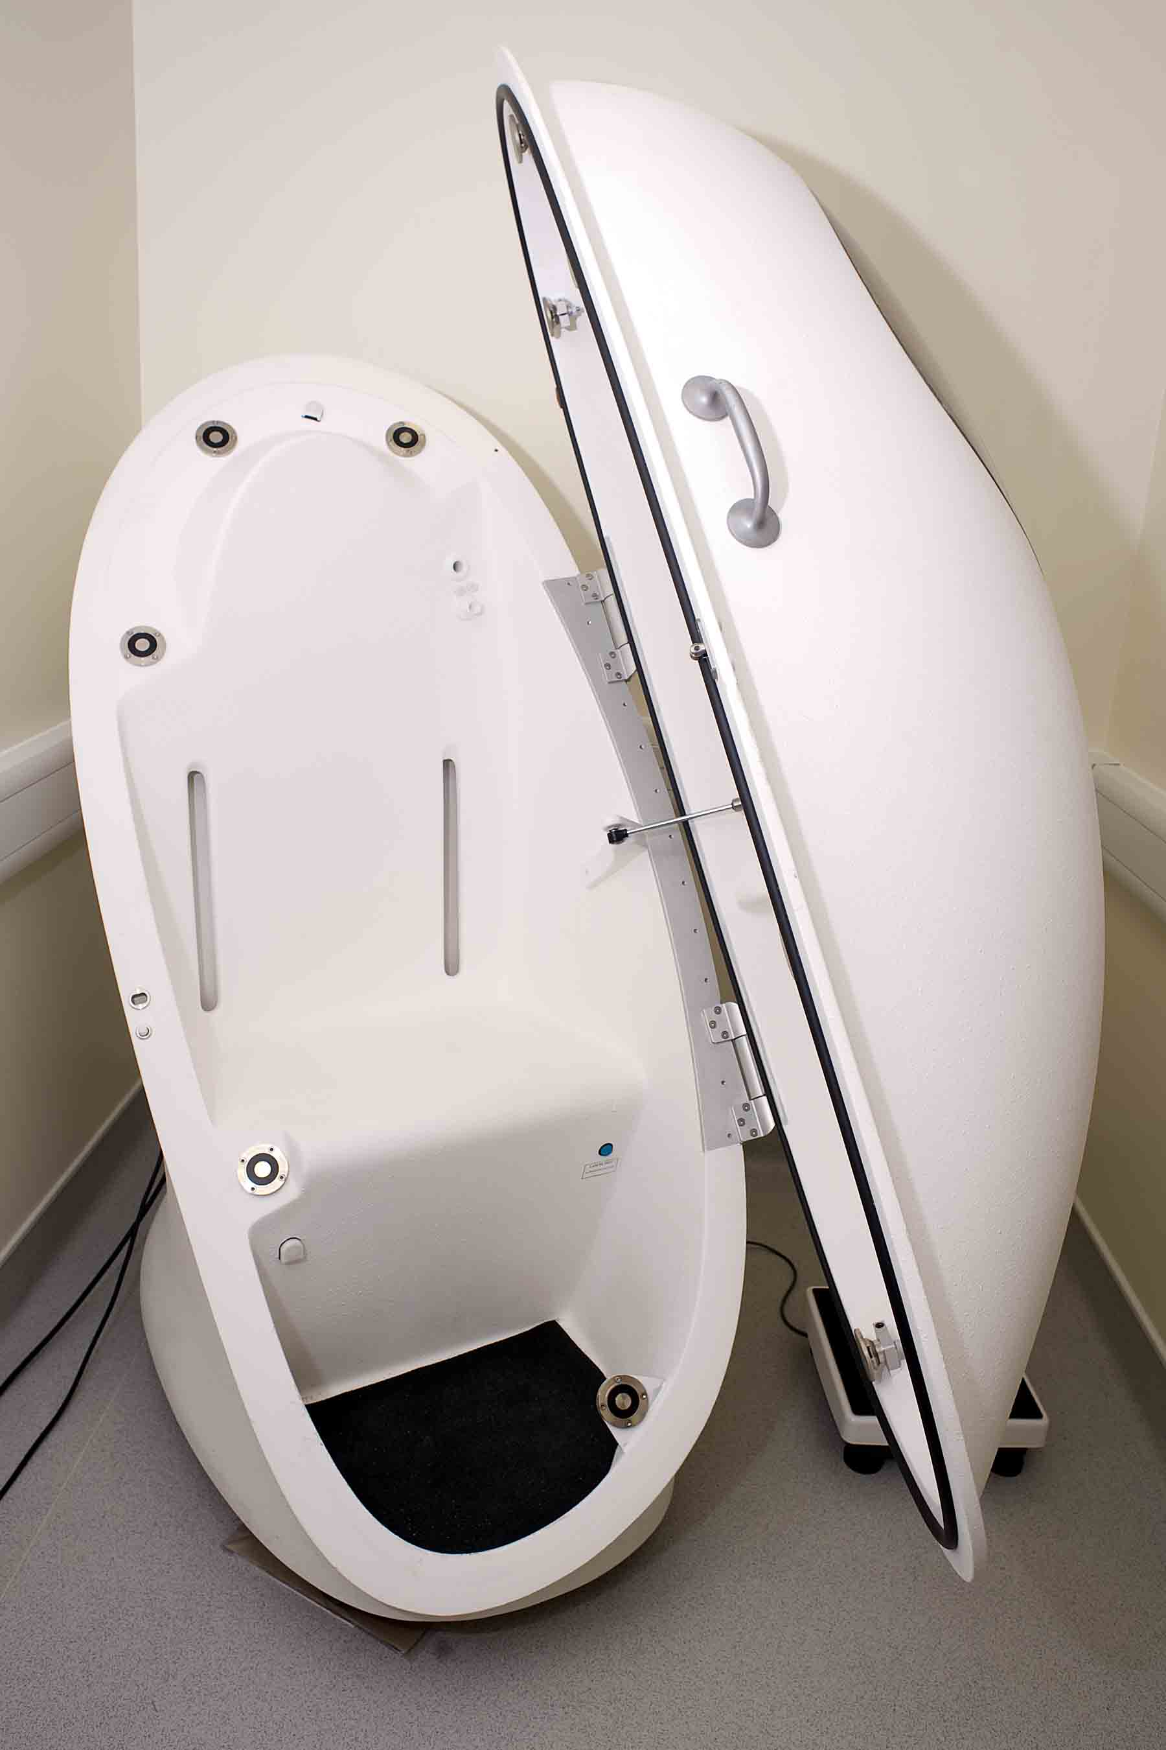
BODPod
Models based on ethnicity, size and age.
From this estimates for EE are available:
EE (kcal/day) = 370 + 21.6*FFM (kg)
Use to create isocaloric meals to ensure subjects energy stable during calorimetry studies.
Problems:
Swimsuit + cap
Highly control pressure environment.

Slide 19
Current Research
HMRU is in its infancy
Current studies:
Free-living EE measurement devices
Metabo-bank
Short-term estimates of BMR in respiratory rooms
Hypoxia/Metabolism (altering the gas concentrations in the chambers).
Brown Fat Activation and Location.
Sleep depravation and energy expenditure
Models of Endogenous Glucose Production from substrate utilisation
PCOS and metabolic rate

Slide 20
Things omitted
Chamber Calibration
Subject preparation (Obese and non-obese)
Lab environment
Power requirements and UPS
Data storage
Diet creation
Taking blood samples and storage
Ethics!
Crash team
Many, many, more…

Slide 21
End
Projects?
Arrange a visit?
Volunteer for a study? (Seriously)
Questions?
John.Hattersley@uhcw.nhs.uk (02476 966068) or J.Hattersley@warwick.ac.uk

