Slide 1

Lecture Capture Usage in SO242
Presentation of Survey Results

Slide 2
Outline
Basic Data
Relevance of Lecture Capture (LC)
LC Usage
LC Evaluation

Slide 3
General Data

Slide 4
Respondent Demographics
24 respondents (non-representative)
19 female, 3 male, 2 non-binary
19 UK, 3 EU, 2 overseas

Slide 5
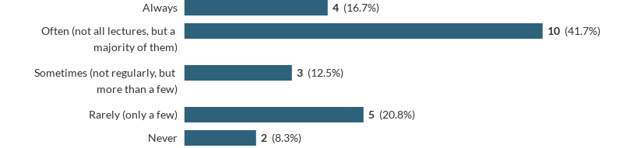
Lecture Attendance
How often did you attend lectures for SO242?

Slide 6

Frequency of LC Usage
How many videos of SO242 lectures did you watch on LC (at least partly)?

Slide 7
Lecture Capture Relevance
What were reasons for and against using LC?

Slide 8

Purpose of LC
For what purpose(s) did you use Lecture Capture in SO242?
Other specified:
Notes on slides which would then be revised
LC used to refresh on a topic prior to a written assessment

Slide 9
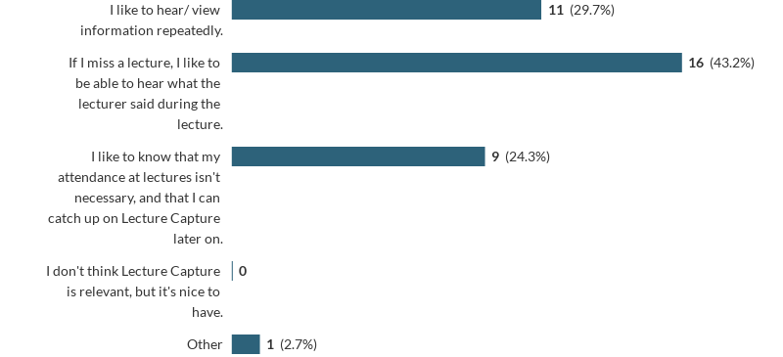
Relevance of LC
Why is the use of LC relevant to you?
Participant 23: “[I’m] dyslexic so going back helps a lot”

Slide 10
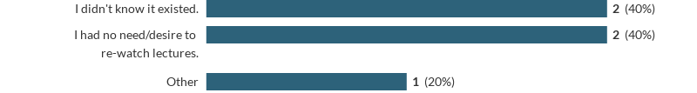
Non-users
Why did you not use LC for SO242?

Slide 11
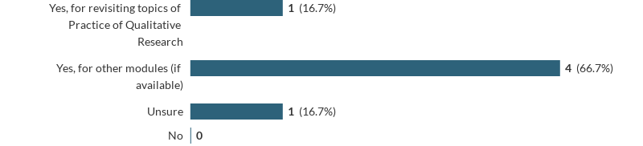
Non-users
Do you plan on using LC in the future?

Slide 12
Breakdown of LC Usage
How was LC used by respondents?

Slide 13
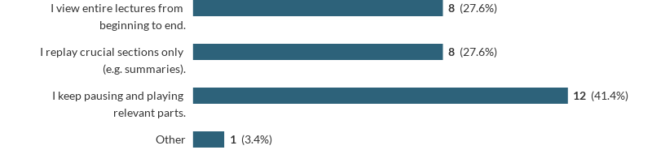
LC Usage
How did you use LC?

Slide 14
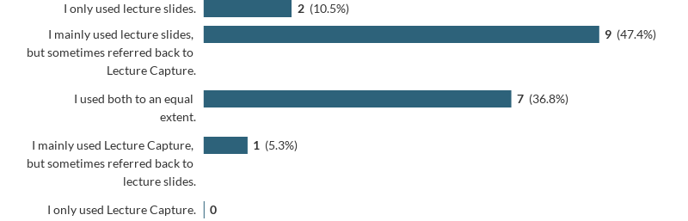
LC and Lecture Slides
Between LC and lecture slides for download, which did you use more?

Slide 15
Evaluation of LC
What did respondents think about LC?

Slide 16
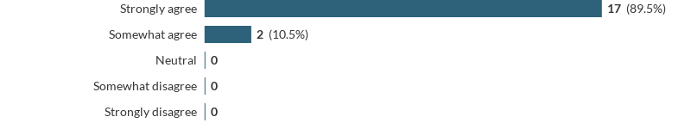
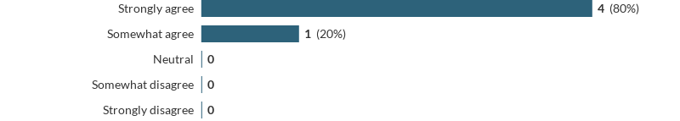
Usefulness of LC
Do you think LC is a useful tool? (top: LC users; bottom: non LC users)

Slide 17
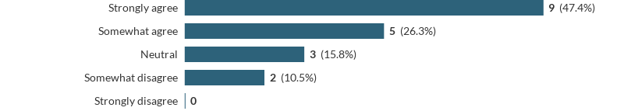
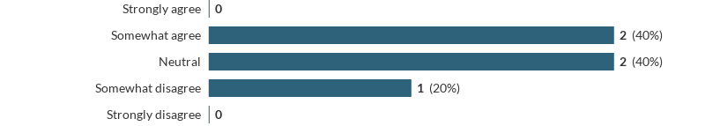
LC as a Course Requirement
Do you think that the use of LC is a course requirement?

Slide 18
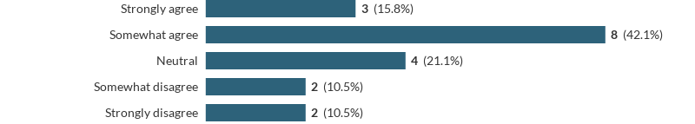
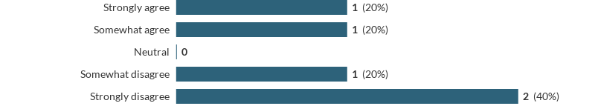
LC as Attendance Substitute
Do you think that watching LC videos can replace attending lectures?

Slide 19
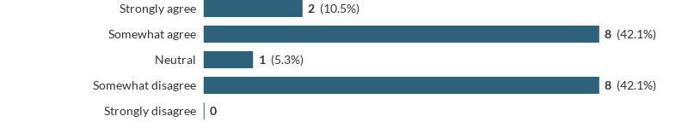
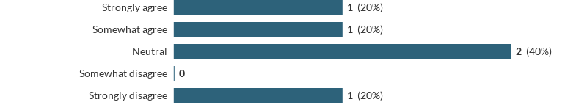
Attendance Decrease
Do you think that the use of LC decreases lecture attendance?

Slide 20
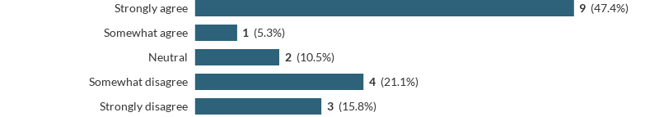
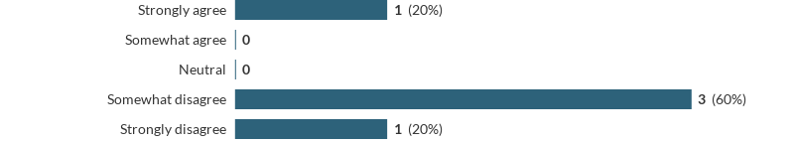
Further Question
Should seminars be made available on LC?

Slide 21
Further Comments
“As someone who has been very ill this term lecture capture is invaluable” (Participant 8)
“Lecture Capture is also a very useful tool for anyone with SEN” (Participant 12)

Slide 22
WIHEA Student Engagement
Project
Project Team:
Dr Peter Brommer (Engineering, lead), Nirmisha Bhatt (Eng), Eimantas Puscius (Eng), Yara Richter (Sociology), Dr Amy Hinterberger (Soc), Dr Robert O’Toole (ITS)
Presentation:
Yara Richter, Peter Brommer
Further information: https://www.warwick.ac.uk/pbrommer/stayorgo

Slide 23
Copyright
This work is licensed under the Creative Commons Attribution-ShareAlike 4.0 International License. To view a copy of this license, visit http://creativecommons.org/licenses/by-sa/4.0/.

