Slide 1
Power and Control Systems Research Laboratory
Professor Jihong Wang
School of Engineering, University of Warwick
Coventry CV4 7AL, UK

Slide 2

Location
In Coventry, very central – at the “heart of England”
In the centre of the manufacturing region
60 minutes from London by train

Slide 3
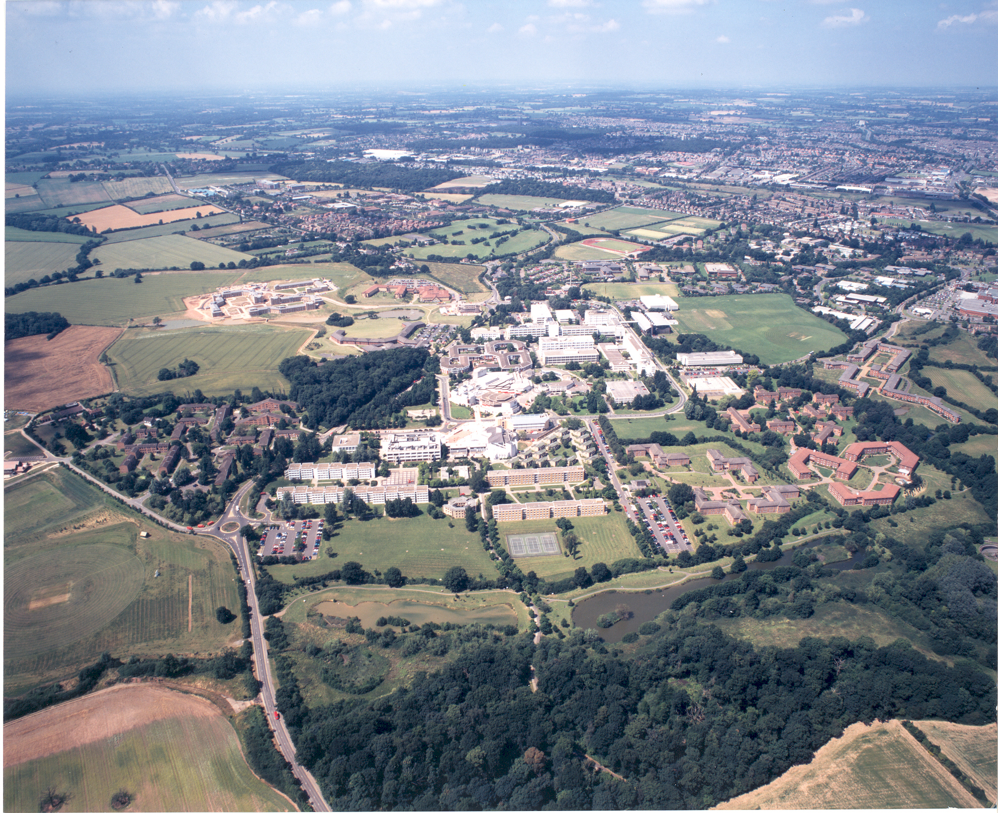
Notes:
3
Aerial shot of campus looking NW
City to right – about 3 miles
Warwickshire countryside to left – walks in fields and woodland within minutes.
Point out Westwood – accommodation and running track
Point out path through nature reserve to East Site – home of Bio Sci and Medicine

Slide 4
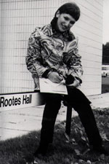
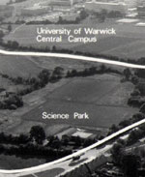
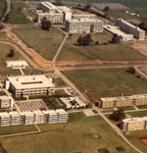
History of the University
Established in 1965
First student intake: 450

Slide 5
The University – fact
Consistently ranked in the top 10 of UK universities:
3rd - The Guardian, June 2010
6th - The Independent, April 2010 8th - The Times Good University Guide, June 2010 5th - The Times Good University Guide, June 2012.
The results of the 2008 Research Assessment Exercise (RAE) reiterate Warwick’s position as one of the UK’s leading research universities, with Warwick ranked at 7th overall in the UK. 65% of Warwick's research is 'world-leading' or 'internationally excellent' (Quality level of either 3* or 4*)
The best modern university in the UK!

Slide 6


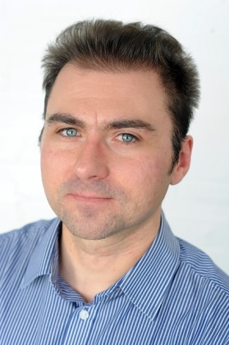

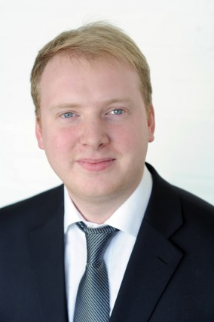
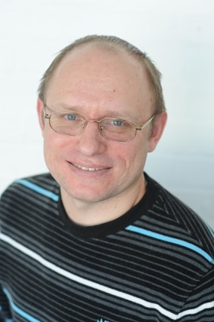
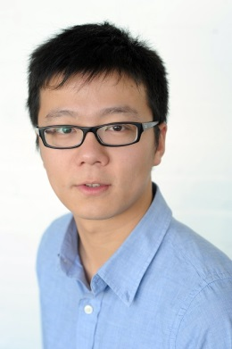
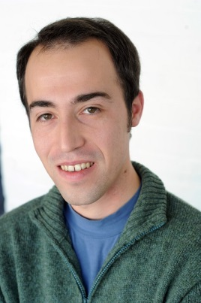



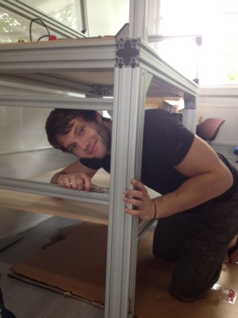
The Team
Staff
Prof. J Wang Dr X Luo Dr J Wojcik Mr H Sun Dr J Clarke Dr O Kiselychnyk
Research Students
H Liu M Draganescu S Guo Y Wang M Dooner C Krupke

Slide 7
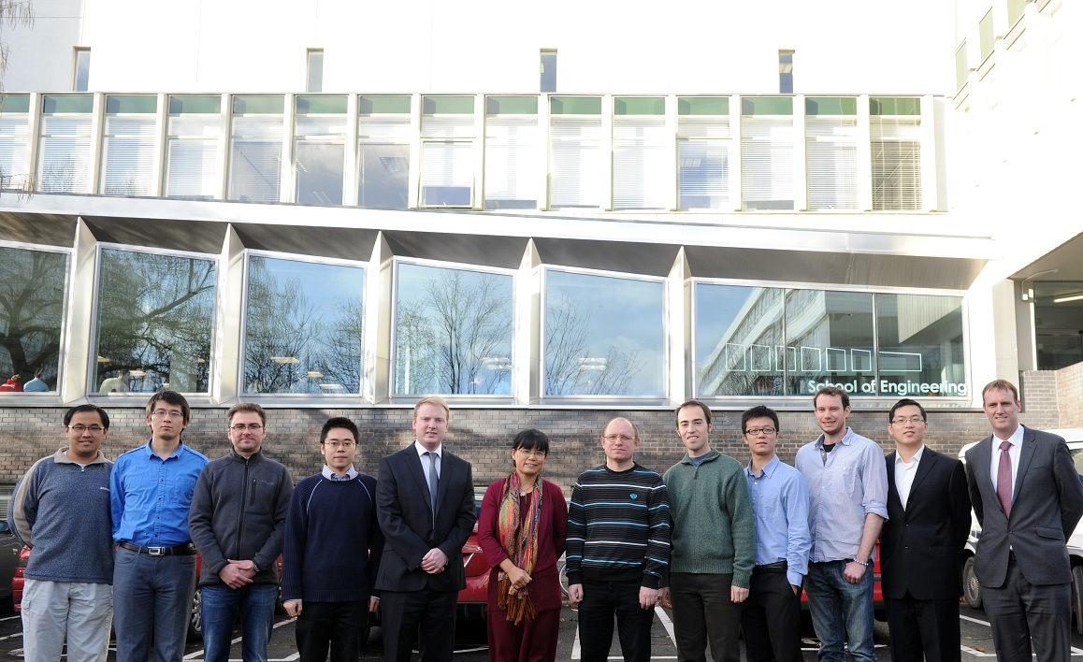
The Team

Slide 8


Research Areas
Energy efficiency: systems, drives and control
Power system modelling and control
Nonlinear system control theory and applications

Slide 9

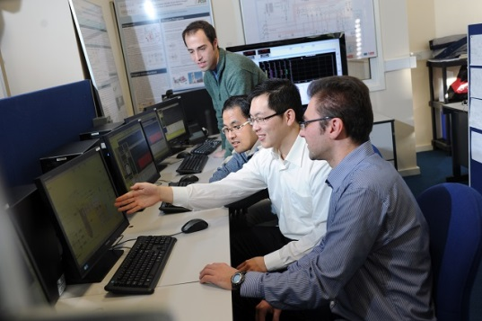
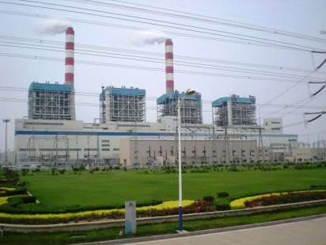
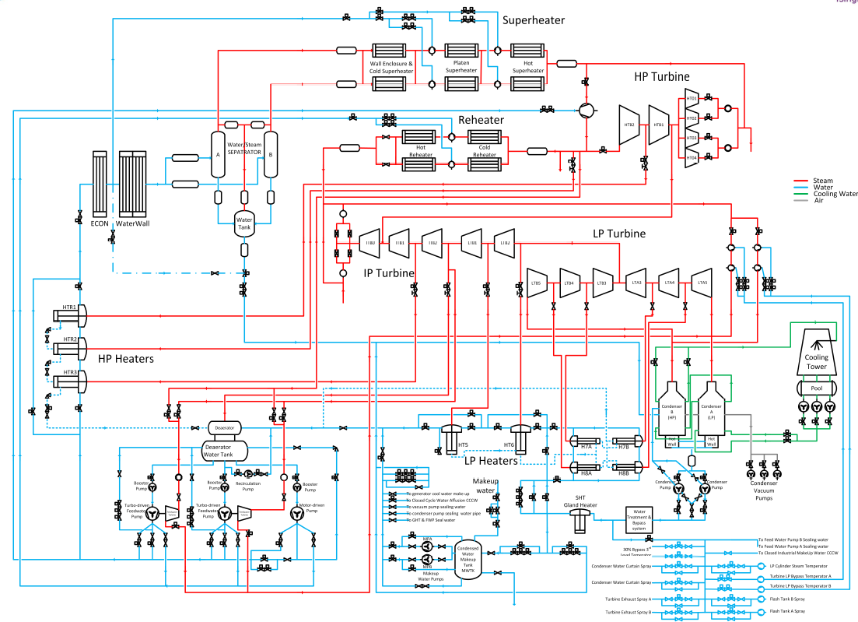
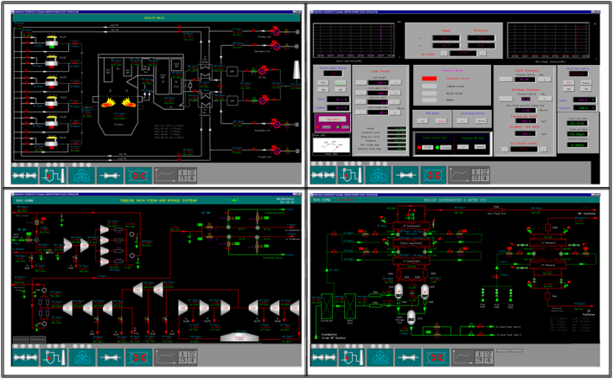

Research Project
Supercritical coal fire power plant modelling, simulation and control, gird code compliance study
A joint project with Birmingham University, Tsinghua and NCEPU

Slide 10
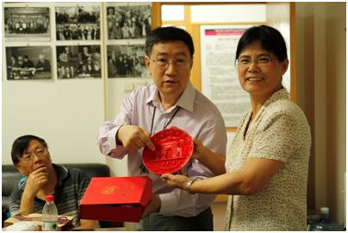
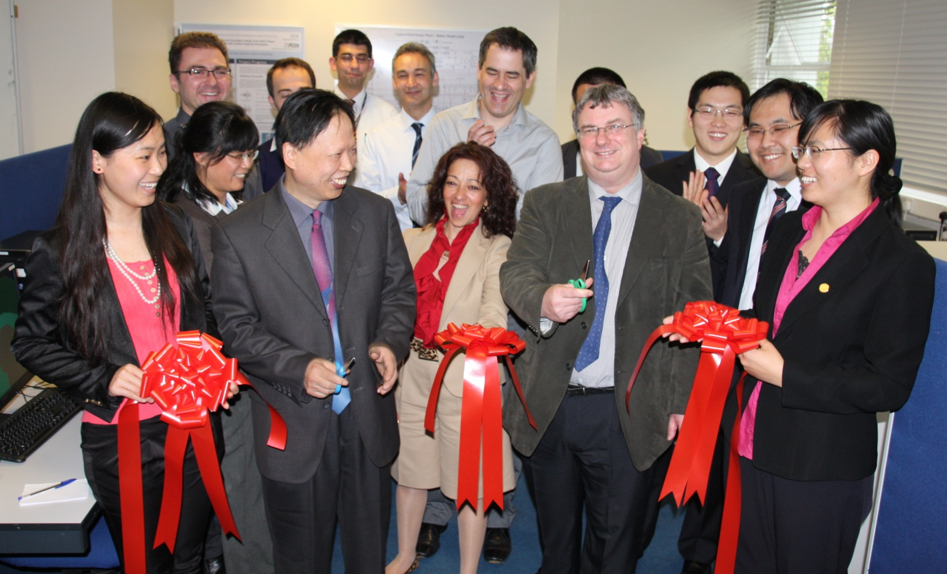
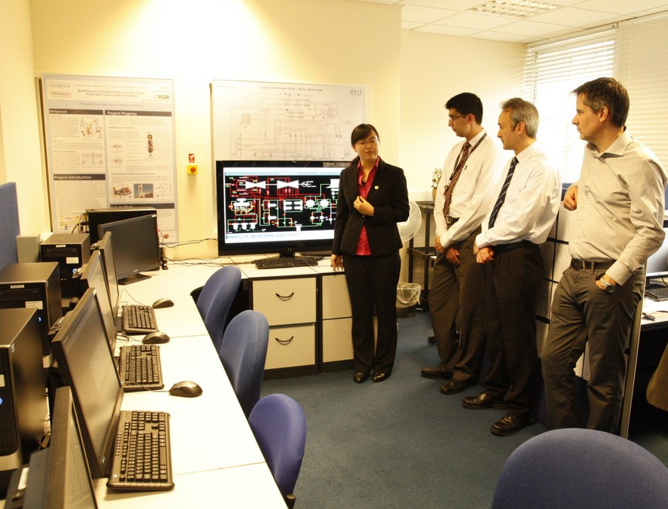
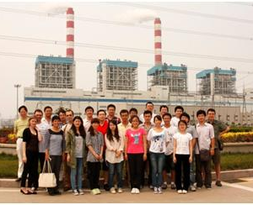
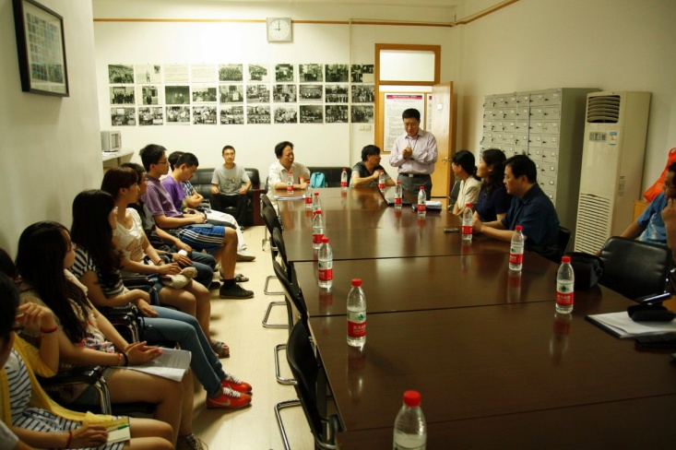
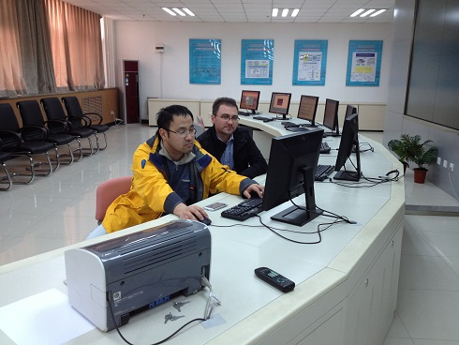
Warwick and Tsinghua joint
Thermal Power Plant Modelling and Simulation Laboratory

Slide 11
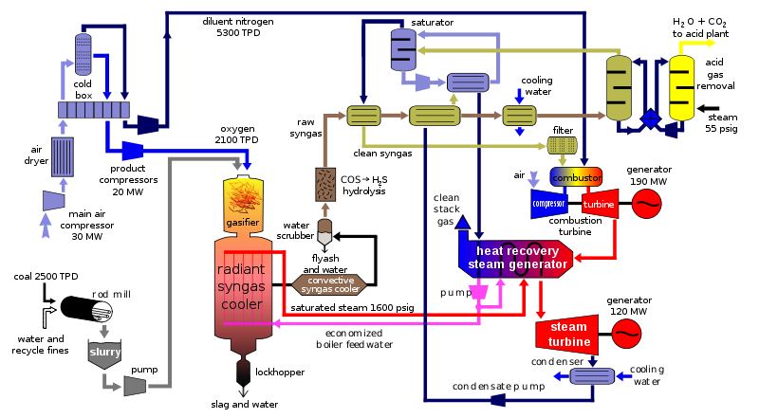
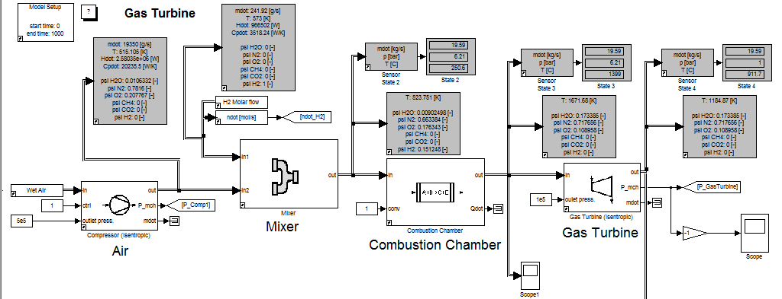
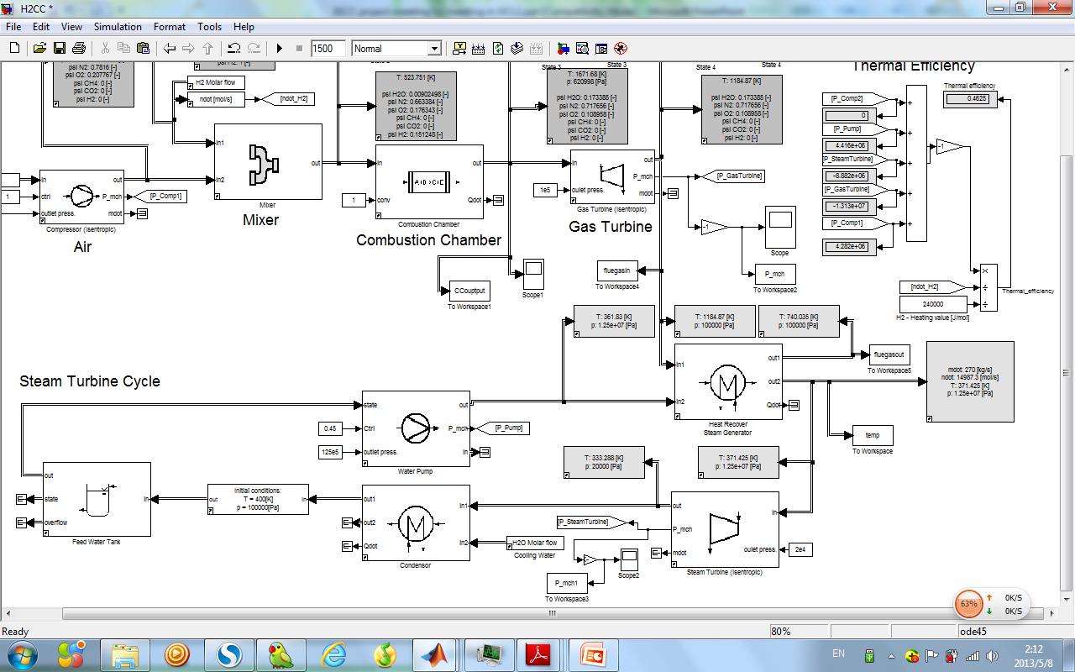
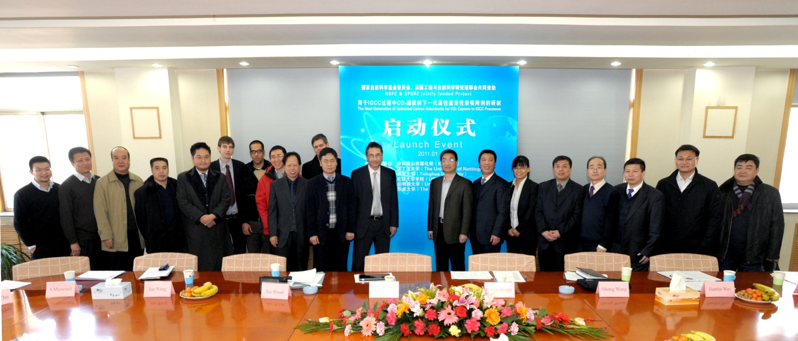
Research Project
The Next Generation of Activated Carbon Adsorbents for CO₂ Capture in IGCC Processes
A joint project led by Nottingham University with Birmingham University and UCL

Slide 12
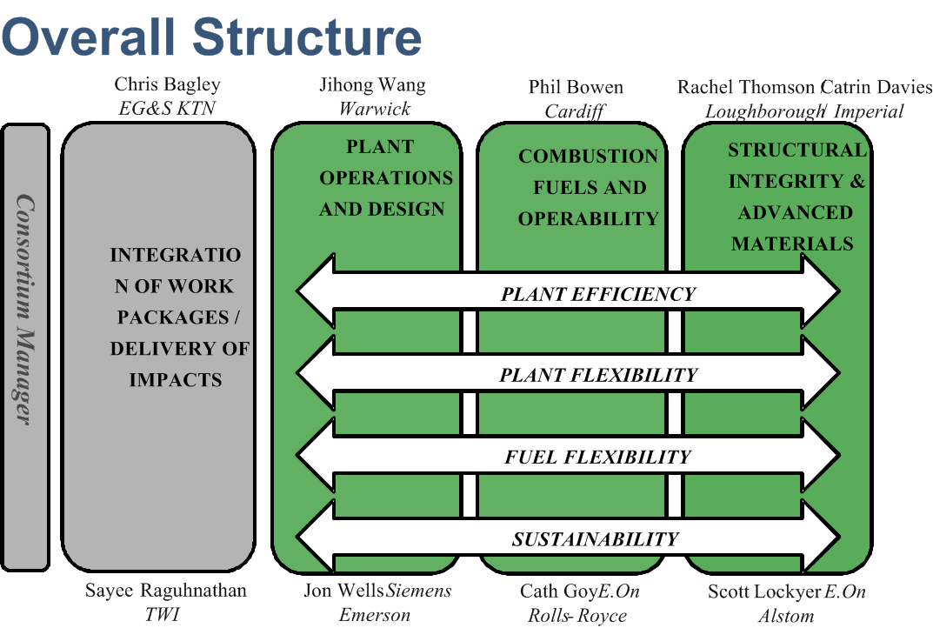
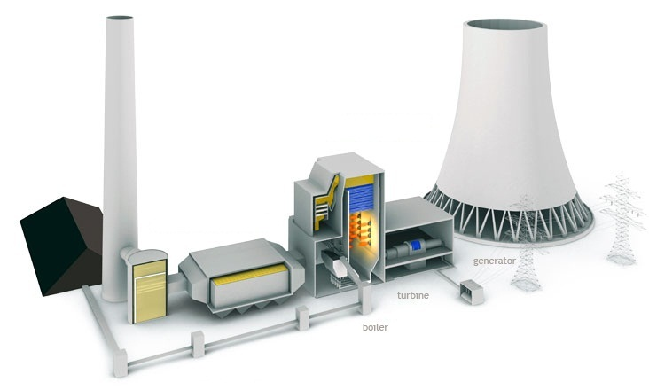
Research Project
Flexible and Efficient Future Power Plant

Slide 13
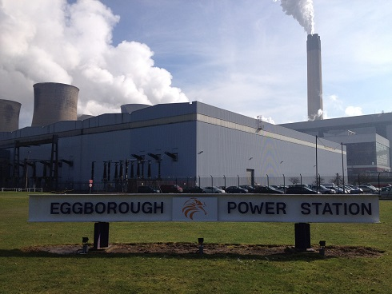

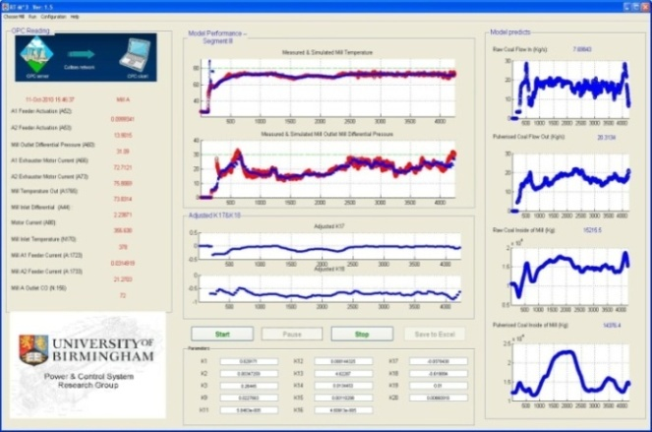
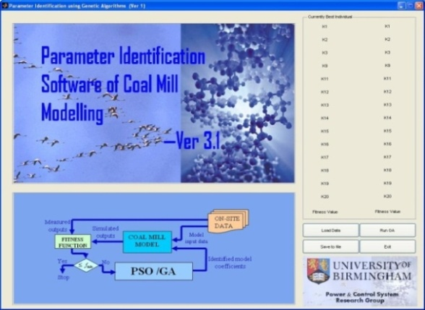



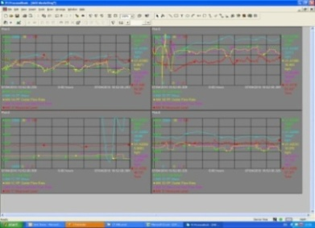
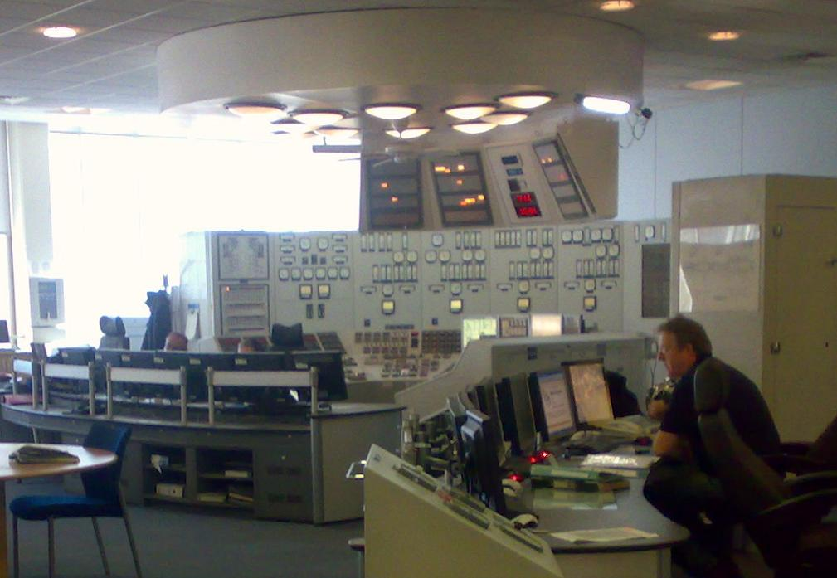

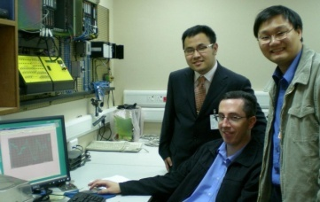

Research Project
BCURA
Power Plant Coal Mill On-line Condition Monitoring
Two software programs
The software can be installed at power stations and the operators can see the software predicted output to compare with the measured outputs. Also, the software can provide the estimated values for those immeasurable variables, for example, PF coal inside the mill.
On-line condition monitoring
Intelligent model optimisation
Observing mill conditions

Slide 14

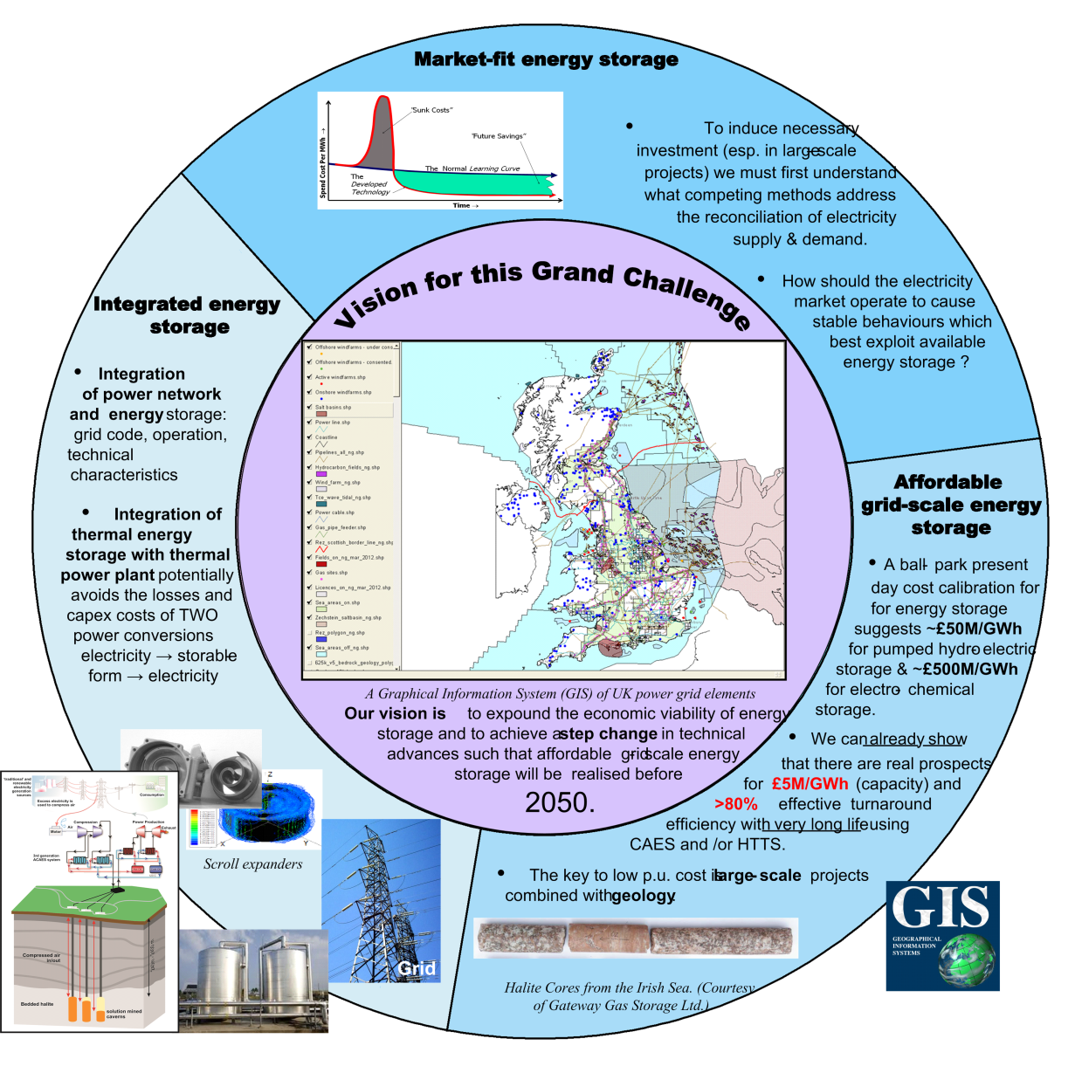




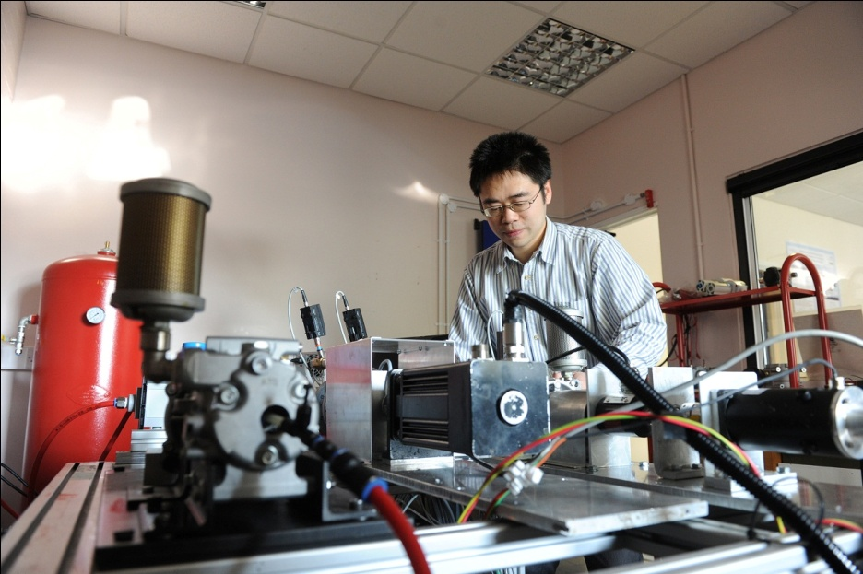
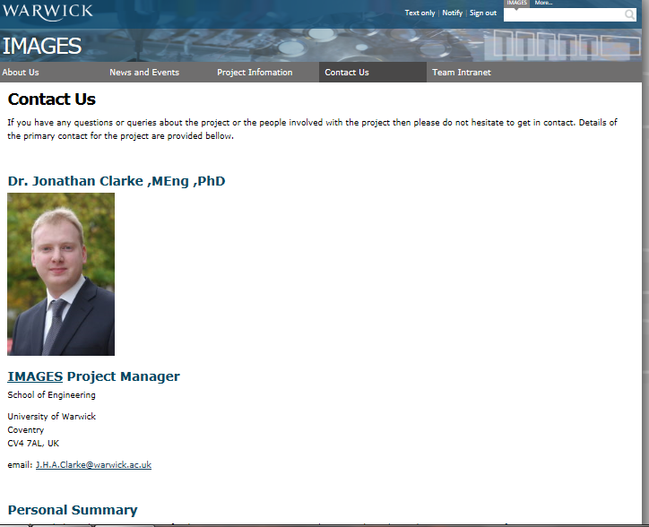
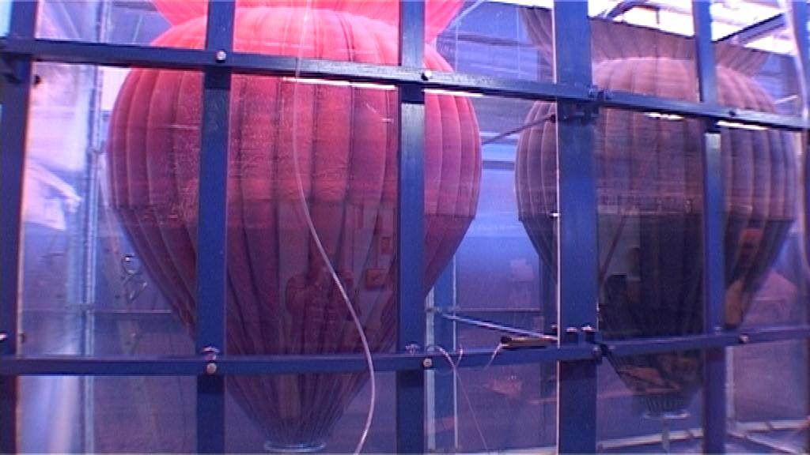
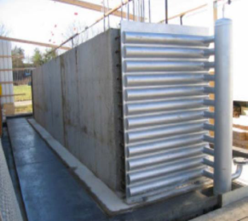
Research Project
Integrated Market-fit Affordable Grid scale Energy Storage
Website

Slide 15

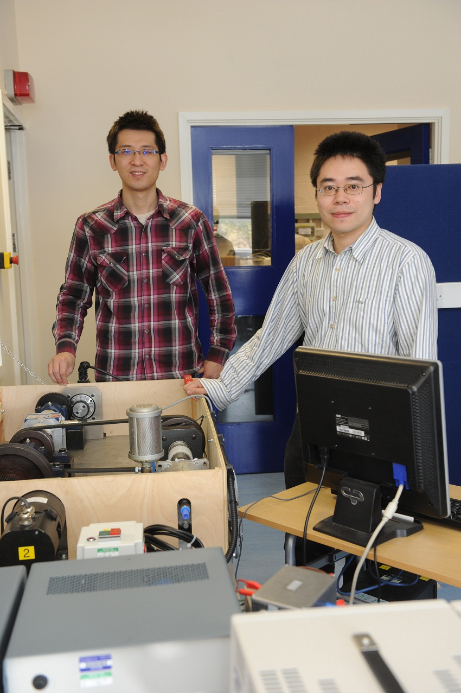
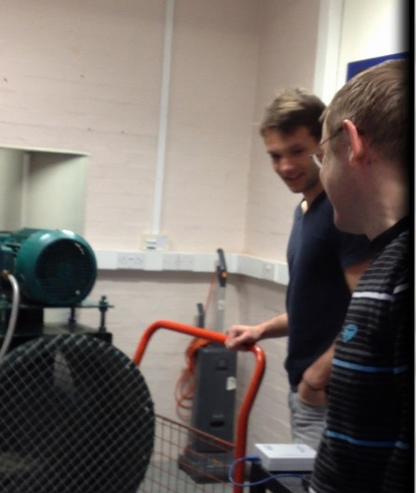
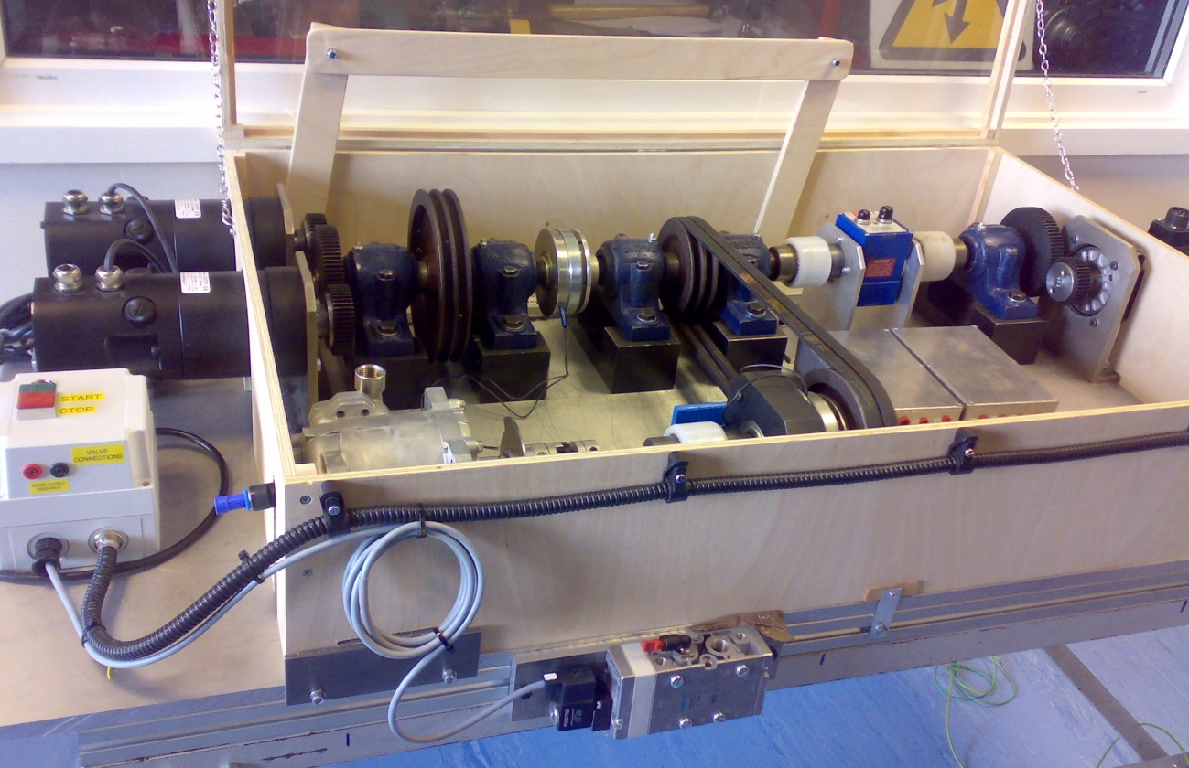
Research Project
Hybrid Wind Turbine
Wind Turbine
Power grid
Air motor
Air tank
Compressor
Wind Turbine
Power grid
Air tank
Compressor
Air motor
Generator

Slide 16
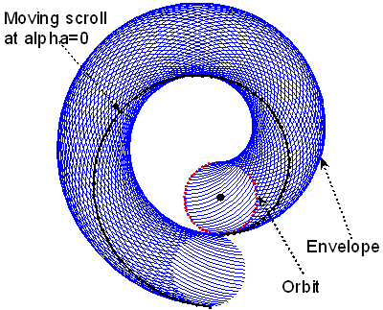
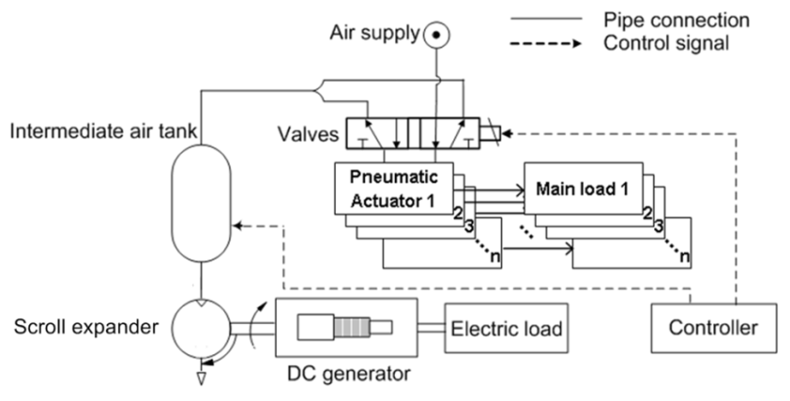
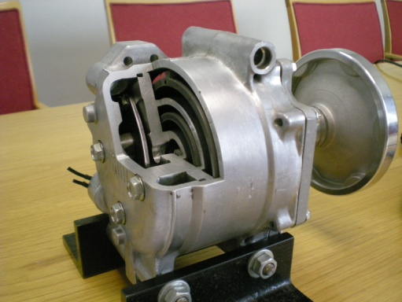
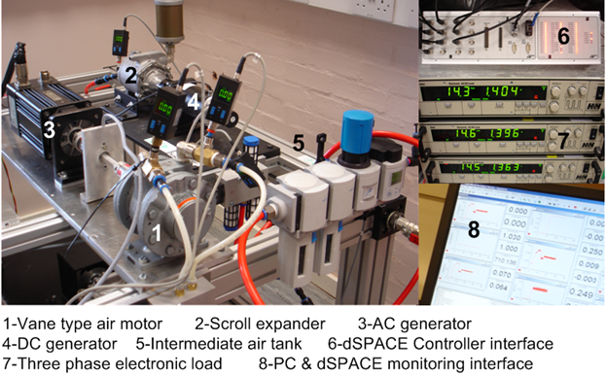
Research Project
Pneumatic actuator systems

Slide 17

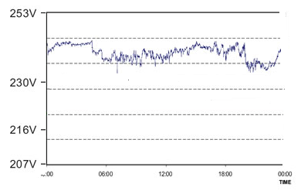
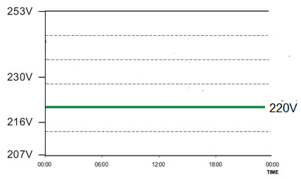
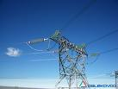

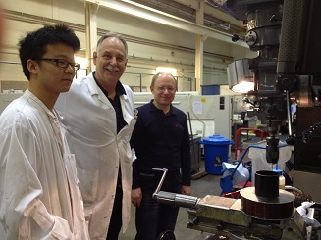
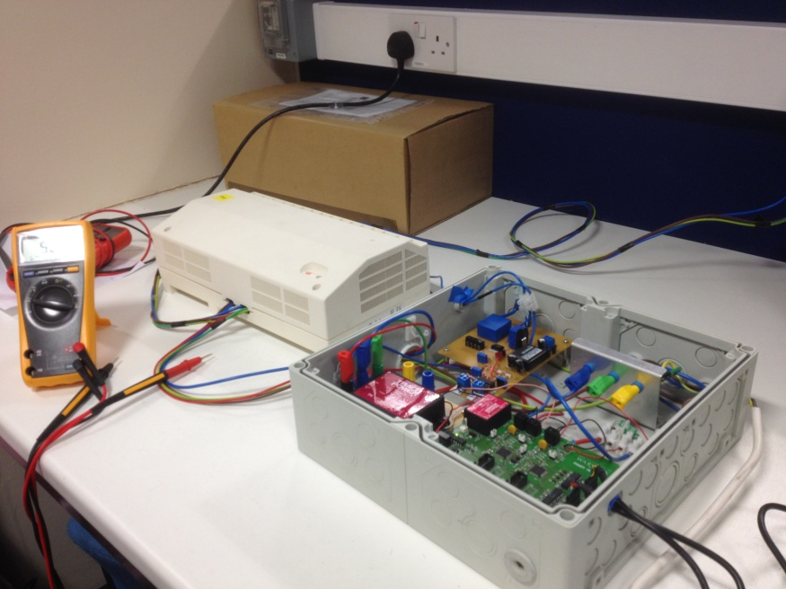
Research Project
Voltage Controller and Power Reduction Algorithms
Voltage Controller
Input
Output
Algorithms
Display
Instant Power Reduction
Or Energy Saving

Slide 18






Research Project
Wind Screen Wiper HIL Modelling and Simulation

Slide 19



Research Project
New Control Methodology for the Next Generation of Engine Management System (CONNEXT)
Kamyar Mehran

Slide 20







Research Project
Voltage Vector Control of Self-Excited Induction Generator with StatCom for Renewable Energy
ABB ACS 355 drive and synchronous motor as a prime mover simulator
Off-grid induction
generator
Goal: to stabilize generated voltage under velocity and load changes
dSpace DSP controller
Voltage and current sensors
Feedback
Control
Static synchronous compensator
Control
Resistive loads
Capacitors bank
Relay board
Deliverables: improved quality and reliability of power generation for renewable energy

Slide 21


Research Project
Cost Effective Sensorless Control of Induction Motor Driven Turbomechanisms for Energy Saving
Goal: to eliminate expensive pressure and flow rate sensors for closed loop control
Centrifugal fan
(pump/compressor)
with induction motor
dSpace DSP controller
(estimation and control algorithm)
Voltage and current sensors
Feedback
Control
Verification
Frequency converter
Deliverables: 25-30% reduction of cost of pressure (flow rate) stabilization systems
Differential pressure and flow rate sensors

Slide 22


Research Project
Battery Characterisation and Management – the key to Smart Grids and the Integration of EVs’
To start in Sept. 2013

Slide 23
Thank you!

