Slide 1
Theme 3: Packaging and Integration
Mark Johnson, Lee Empringham, Rasha Saeed, Jordi Espina
This presentation is issued by University of Nottingham and given in confidence. It is not to be reproduced in whole or in part without the prior written permission of the University of Nottingham. The information contained herein is the property of the University of Nottingham and is to be used for the purpose for which it is submitted and is not to be released in whole or in part or the contents disclosed to a third party without the prior written permission of the University of Nottingham.

Slide 2
Challenges for Power Electronics
Integration Opportunities
Integrated Thermal Management
Integrated Electromagnetic Management
VESI Power module Vision
Demonstrators
Conclusions

Slide 3

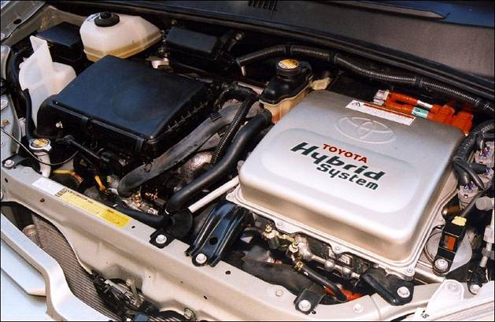
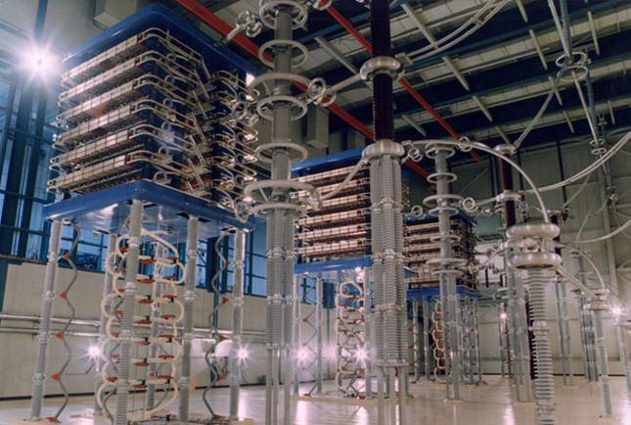
Challenges for Power Electronics
Increased power densities
Higher efficiency
Lower electromagnetic emissions
Increased robustness
Modular plug-
and-go systems
Lower cost

Slide 4
Performance Targets & Constraints
Mission Profile
Power Quality
Weight
Efficiency
Energy Efficiency
Volume
Power Density
kW/kg kW/m³
Reliability/ Availability
Through-life Cost
Cost Density
kW/$
Robustness

Slide 5
Meeting the Challenge
Mission Profile
Power Quality
Weight
Efficiency
Energy Efficiency
Volume
Power Density
kW/kg kW/m³
Reliability/ Availability
Through-life Cost
Cost Density
kW/$
Emphasis of one design criterion may adversely affect others
Robustness

Slide 6
Meeting the Challenge
Mission Profile
Power Quality
Weight
Energy Efficiency
Volume
Reliability/ Availability
Concurrent Optimisation is Essential!
Through-life Cost

Slide 7
Challenges for Power Electronics
Integration Opportunities
Integrated Thermal Management
Integrated Electromagnetic Management
VESI Power module Vision
Demonstrators
Conclusions

Slide 8
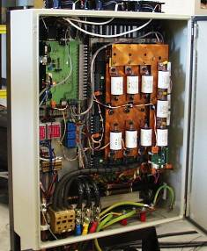
Converter Packaging
Typical power converter consists of
semiconductor power modules
a physically separate DC-link
a separate input and/or output filter
EMI filters
gate drivers
controllers and sensors
Demarcation of technological disciplines means electrical, mechanical and thermal aspects are treated separately by separate teams
Each component is designed separately, cooled separately and has its own operational requirements

Slide 9
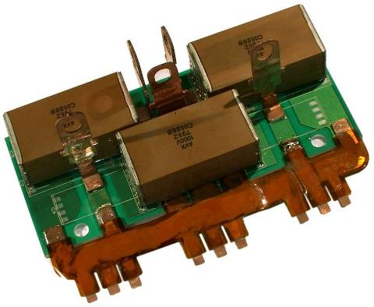
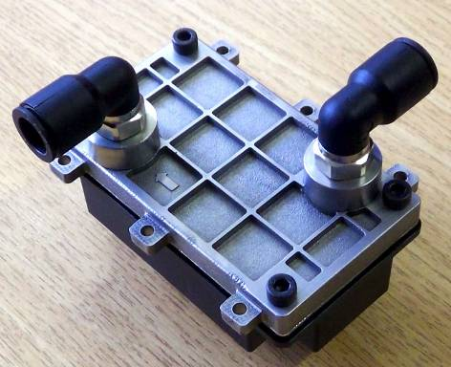
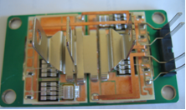
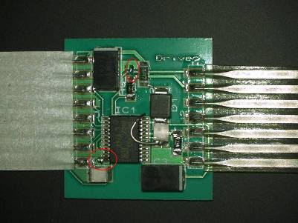
Integration Opportunities?
Half-bridge sandwich (one per phase)
DC+
C_{DC}
20μF, 1000V
S_{A+}
D_{A+}
S_{A-}
P_{C}
600 V
D_{A-}
P_{B}
DC-
Integrated thermal management
Integrated passive components
GDU_{A}
GDU_{B}
GDU_{C}
P_{A}
Gate drives and health management
Power module: die & packaging materials

Slide 10
Challenges for Power Electronics
Integration Opportunities
Integrated Thermal Management
Integrated Electromagnetic Management
VESI Power module Vision
Demonstrators
Conclusions

Slide 11
Heat Transfer Limitations
Description | Heat transfer coeff. (W/(m²K)) | Array heat transfer coeff. (W/(m²K))
Natural convection (air) | 3-25 | up to 200
Forced convection (air) | 10-200 | up to 1,000
Forced convection (water) | 50-10,000 | up to 50,000
Condensing steam | 5,000-50,000
Boiling water | 3,000-100,000
Combination of solid conduction and convection
Heat spreading: limiting thermal resistance increases with heat source size
Convection: high film heat transfer coefficients eliminate the need for additional heat spreading

Slide 12
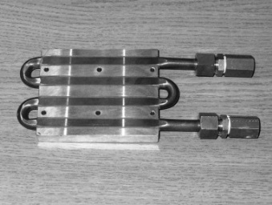
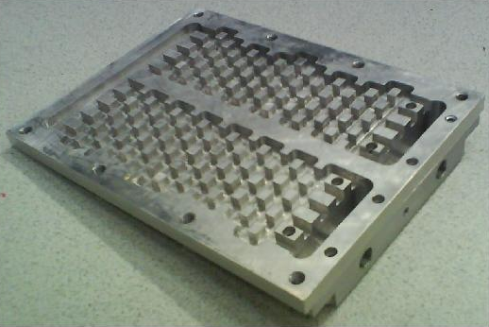
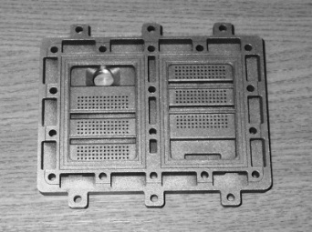
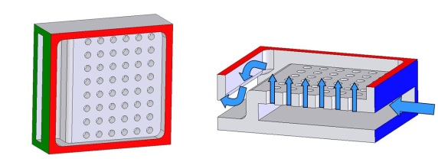
Integrated Cooling
Target overall reductions in weight and volume for liquid-cooled systems
Comparison of cooler options:
Conventional base-plate and separate coldplate
Integrated base-plate impingement cooler
Direct substrate impingement cooler
Direct substrate impingement cooler with optimised spray-plate
9 layers 8 interfaces
7 layers 6 interfaces
5 layers 4 interfaces

Slide 13
Integrated Cooling Comparison
Cooler Type | Specific Thermal Resistance mm²K/W
Coldplate | 63.52
Baseplate Impingement | 45.00
Substrate Impingement | 38.59
Direct Targeted Substrate (optimised)* | 30.39
* 6 x 6 array of 0.5mm diameter jets operating at a jet-to-target distance of 1.43mm and 2mm spacing
Cooling solutions compared at same specific pumping power (W/mm² die area)
Optimising spray plate design by targeting dies improves cooler effectiveness

Slide 14
Thermal Integration Summary
Thermal path design is dictated by the cooling medium
Air-cooled designs will always benefit from heat flux spreading (solid conduction or 2-phase):
Heat spreading is more effective for smaller heat sources
Partitioning of modules into smaller blocks permits lower thermal resistance
Solution will be bulky for solid heat spreaders
Cooling methods with higher effective heat transfer coefficients can be applied without flux spreading (where h >10 kW/(m²K) for typical substrates)
Lower overall thermal resistance
Compact, scalable solution but…
Needs secondary heat exchanger to e.g. air
Some designs have high pumping power requirements

Slide 15
Challenges for Power Electronics
Conventional Approach and Limits
Integration Opportunities
Integrated Thermal Management
Integrated Electromagnetic Management
VESI Power module Vision
Demonstrators
Conclusions

Slide 16
Electromagnetic Management
L_{BB}
R_{BB}
External parasitics:
R_{S} L_{S}
C_{P+}
Rs
L_{S}
C_{INT}
L_{SP}
Internal bus-bar and substrate parasitics:
L_{BB} R_{BB} L_{SP} C_{PP} C_{P+} C_{P-}
L_{F}
C_{EXT}
L_{SP}
C_{PP}
C_{F}
Filter components:
C_{INT} L_{F} C_{F}
C_{P-}
Impact of module layout and partitioning on parasitic inductance
Potential for inclusion of filter components:
Commutation loop decoupling
Output filtering

Slide 17
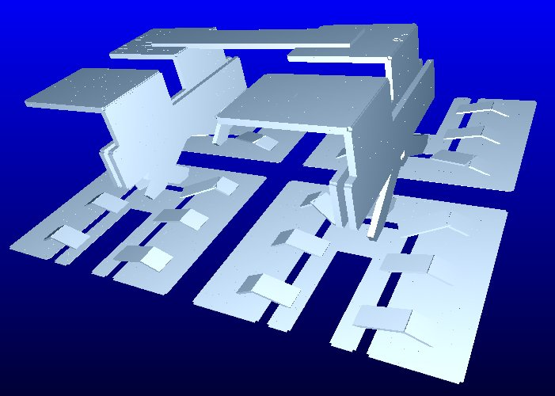
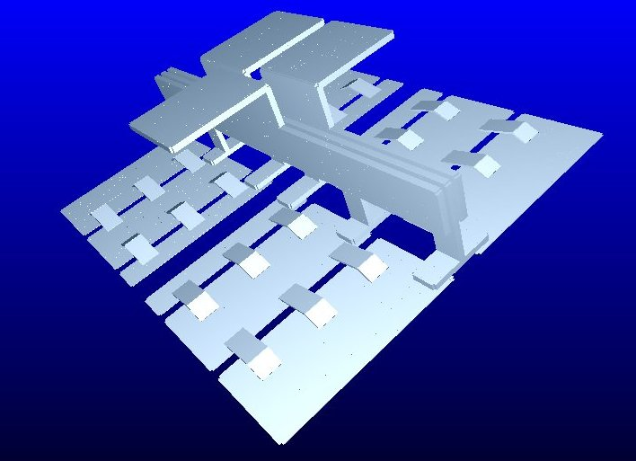
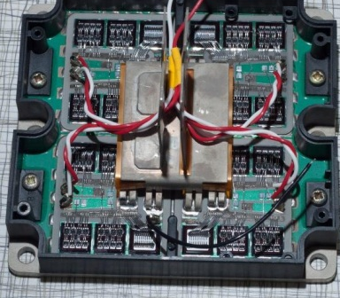
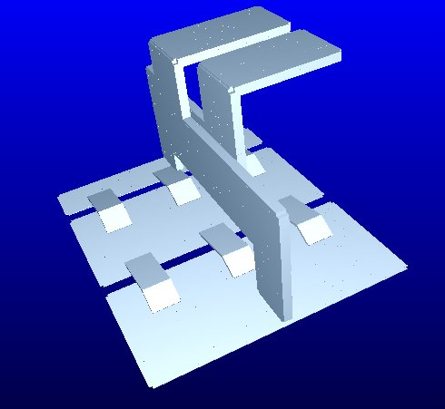
Layout Optimisation
C1
E2
E1
(- Vdc)
C1
E2
C2
(+Vdc)
Four tile half bridge module 140 mm square
Option 1: Tiles configured as switch and APD with common bus-bar and terminals: L_{S}=115nH
Option 2: Tiles configured as half bridges with common bus bar and terminals: L_{S}=42nH
Option 3: Tiles configured as half bridges each with separate terminals: L_{S}=54nH (each tile) L_{S}=13.5nH (total)
E1
C2
DC-
DC+
+Vdc
-Vdc
+Vdc
DC+
C1
C2
C3
C4
-Vdc
DC-
E1
E2
E3
E4

Slide 18
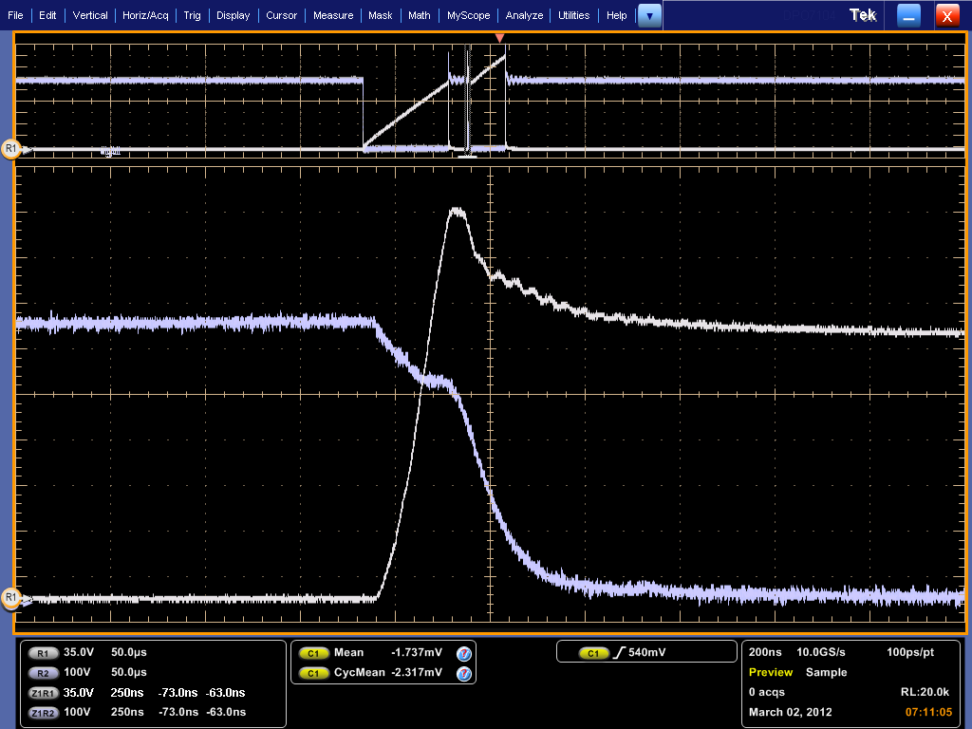
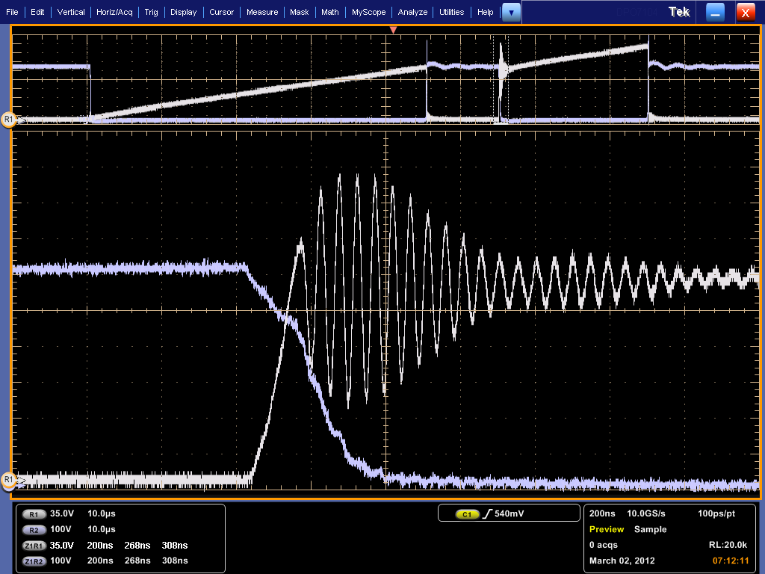
Integrated Passives
SiC/GaN devices produce fast transitions and have low output capacitance:
good decoupling essential
possible output filter to reduce EMI
Si IGBT turn-off with Si diode
Si IGBT turn-off with SiC diode
“Standard” package with ~70nH parasitic inductance

Slide 19
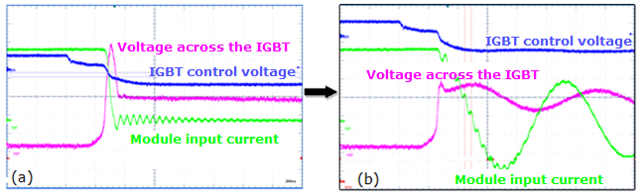
Impact of Integrated Decoupling
100A commutation cell with stray inductance ~100nH. Left figure without internal decoupling, right figure with internal decoupling of 200nF
Voltage overshoot is significantly reduced by incorporating decoupling capacitance on substrate
Note additional oscillations introduced between internal decoupling and external decoupling capacitances

Slide 20
Challenges for Power Electronics
Integration Opportunities
Integrated Thermal Management
Integrated Electromagnetic Management
VESI Power module Vision
Demonstrators
Conclusions

Slide 21
Flexible Modular Commutation Cells
Smaller, high speed, low current modules in parallel to create high power converters
Optimized commutation paths – reduced parasitics / component electrical stress
Inbuilt passive components
Ability to interleave gate signals
Flexible thermal management
Novel packaging concepts
Advantages:
Building block approach to high power converters
Contain the EMI at source
Low weight solution
Certification of different converters simplified

Slide 22
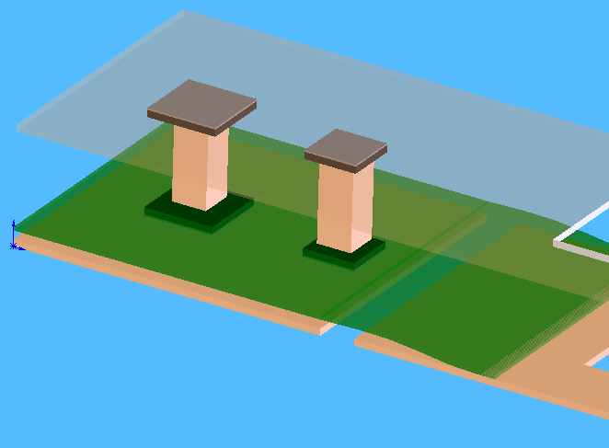
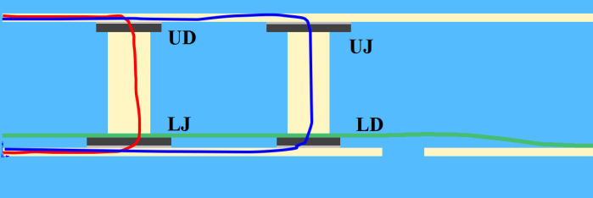
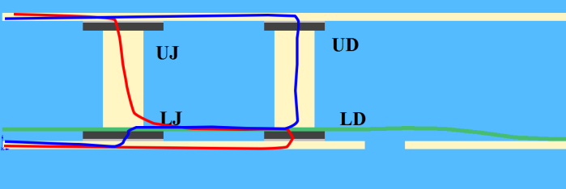
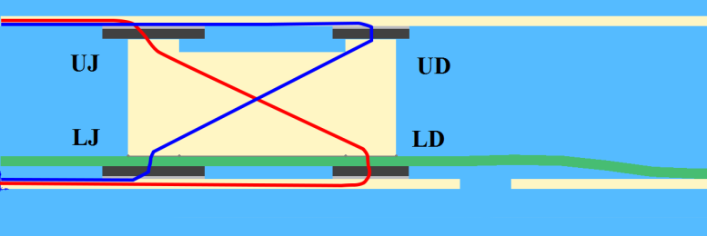
Double sided ‘Sandwich’ Structure
Double sided, jet impingement cooled substrates
Optimised commutation cell layout
Multiple commutation cells per power module
But how do we use them in parallel?
UD-LJ | UJ-LD
4.69nH | 6.85nH
UJ-LD | UD-LJ
5.32nH | 6.75nH
UJ-LD | UD-LJ
4.59nH | 4.92nH

Slide 23
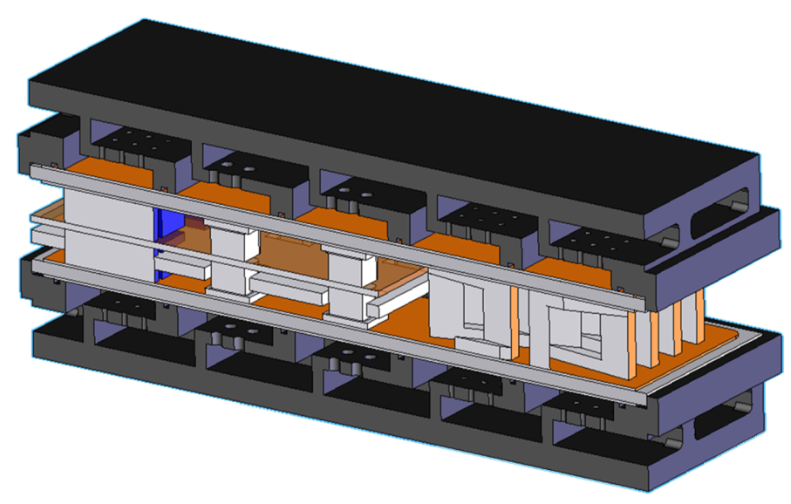
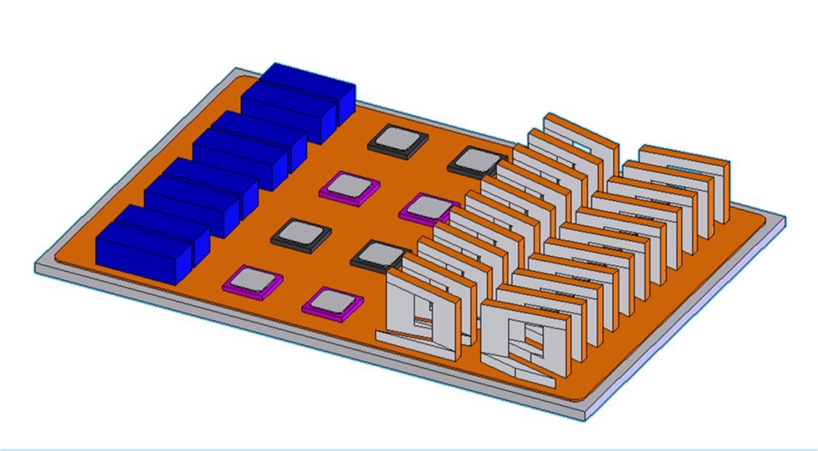
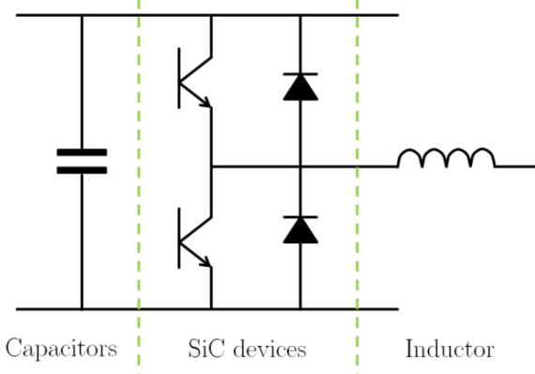
Integrated Inductors?
Energy density of inductors typically too low to allow effective integration at power module level
Using substrate for cooling permits much higher current density & energy density
Inductors suitable for inter-leaving of phases
Integrated commutation cell under investigation
Input Capacitance
SiC Devices
Output Inductances

Slide 24
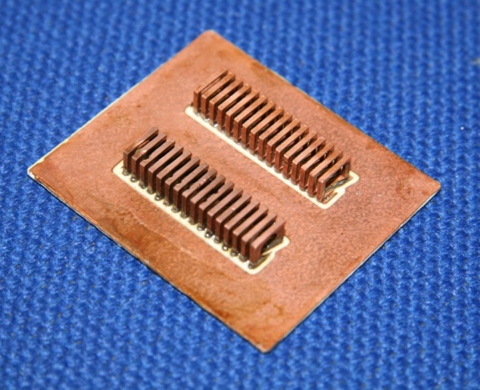
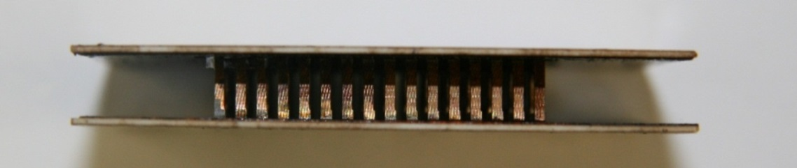
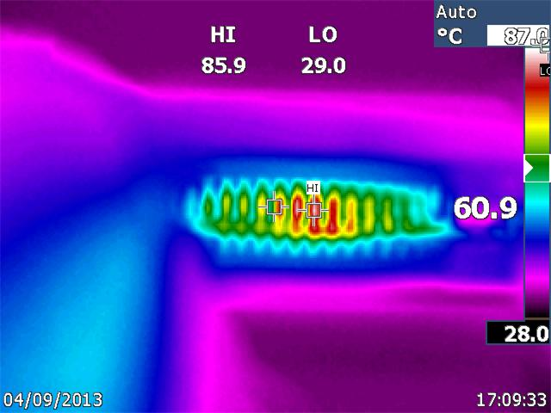
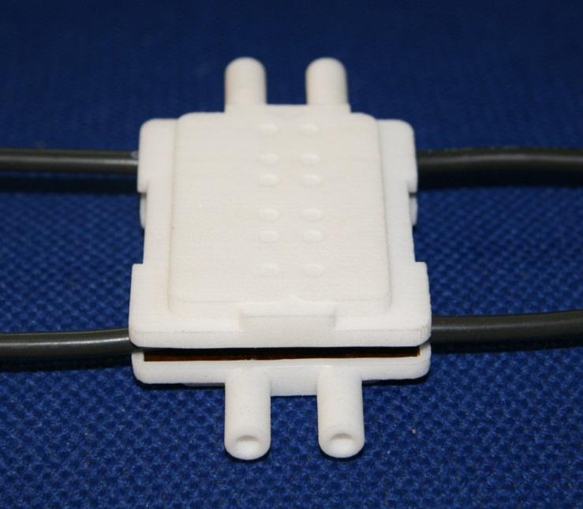
Double-Sided Cooling
Inductors soldered into place
Operation at 100A/mm² current density: temperature rise ~ 57K at 0.36litres/min flow rate
Inductor with double-sided turbulator cooler

Slide 25
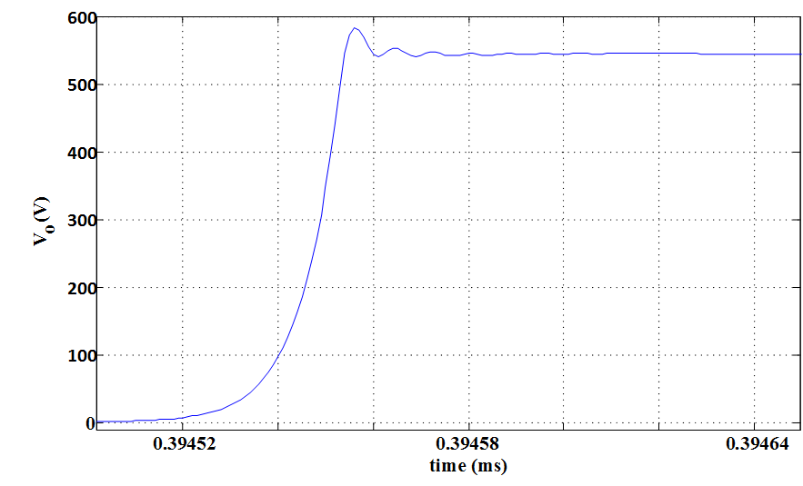
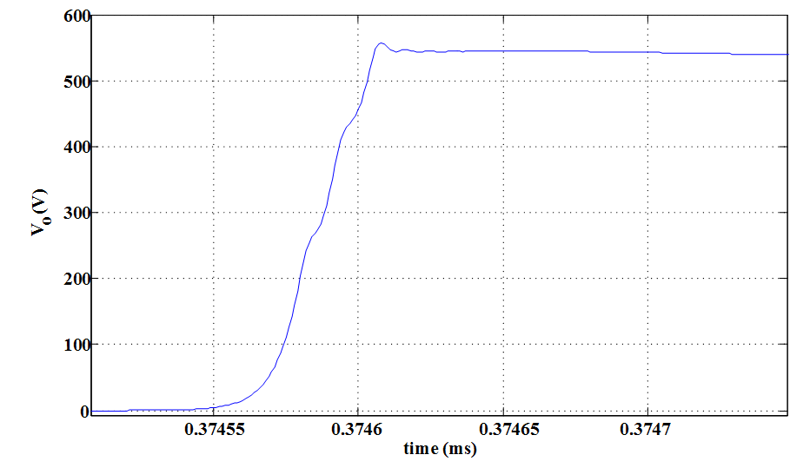
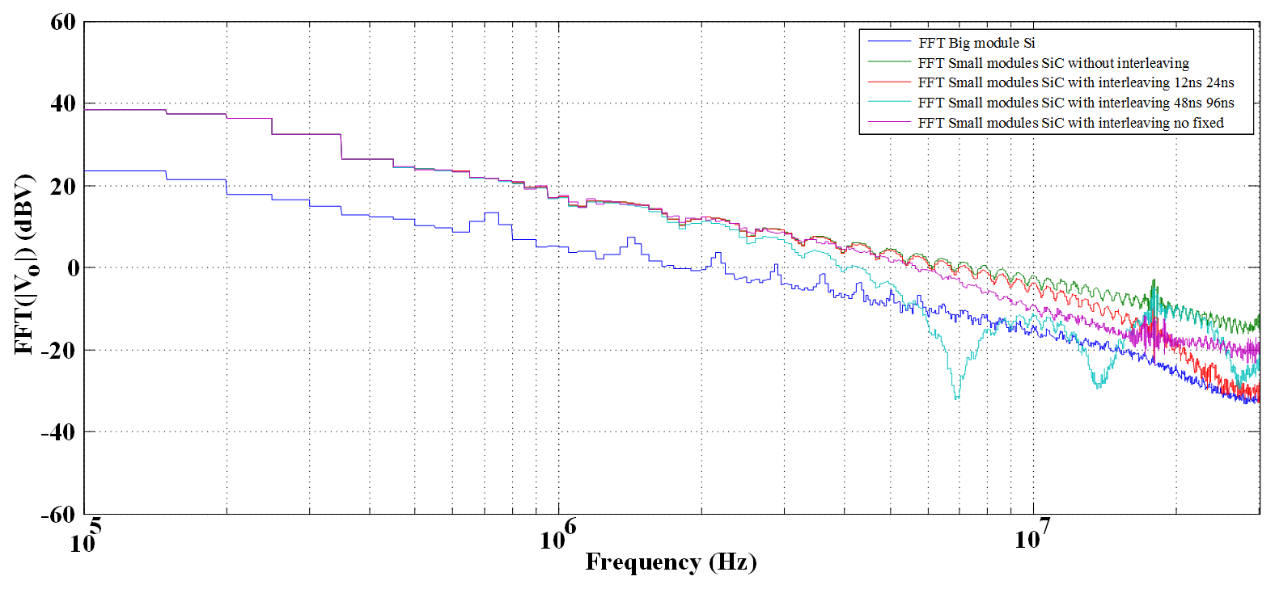
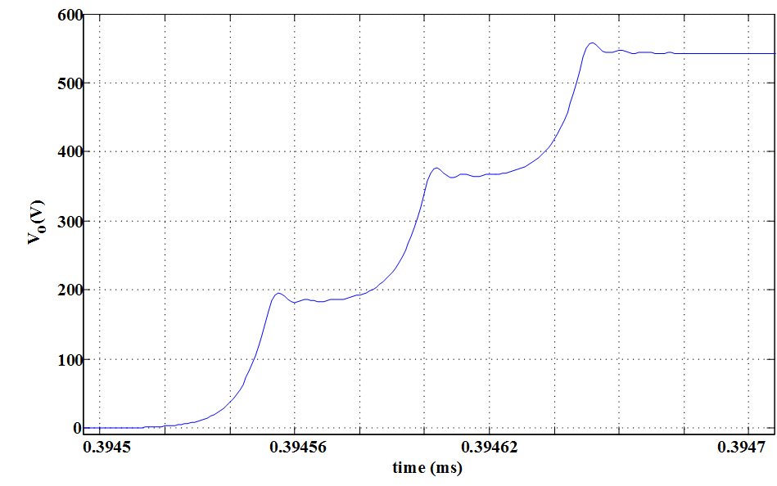
Edge Shaping for EMI reduction
0ns
Multiple-parallel outputs gives an extra degree of freedom
EMI emissions can be modified by interleaving or delayed edge, effectively shaping the output waveform.
12ns
48ns

Slide 26
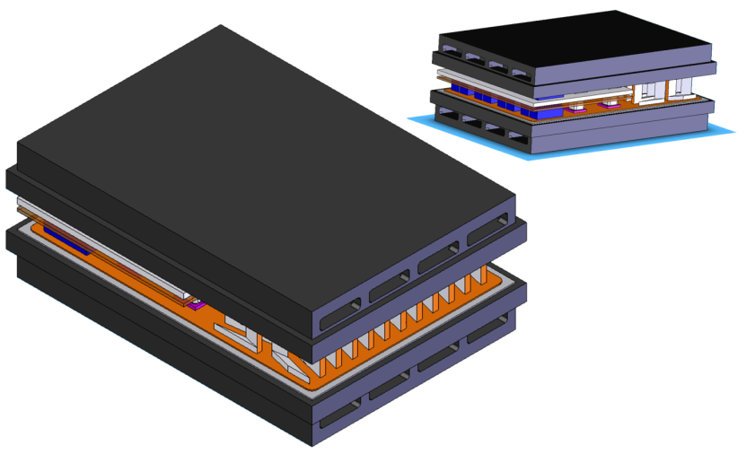
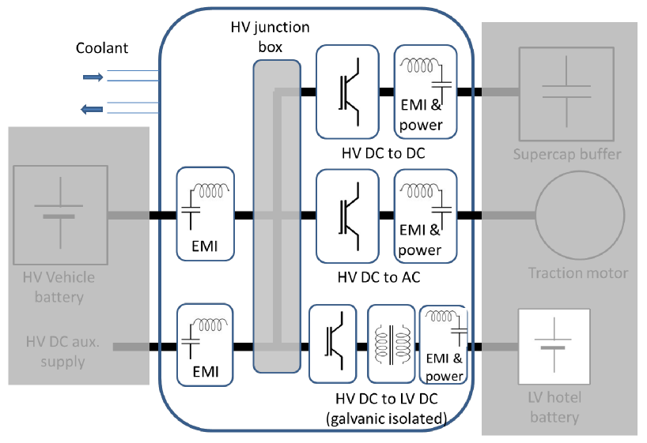
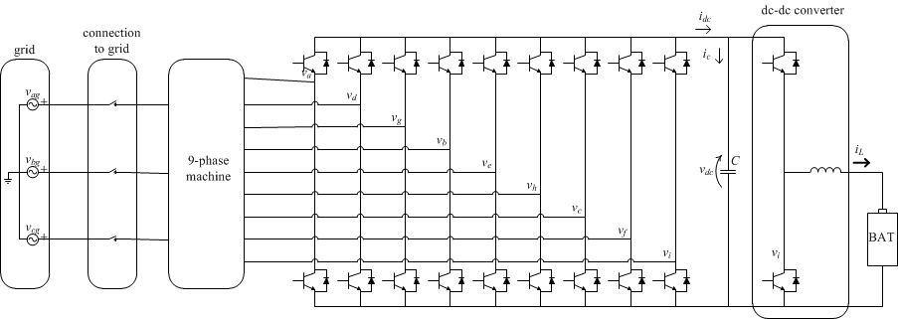
VESI Technology Demonstrators
Integrated Power Conversion for Reduced EMI
Integrated cooling
Integrated passive components
High speed SiC Devices
Multiple, Optimised commutation cells
An integrated on-board battery charger using a highly integrated drive and a nine-phase machine, with V2G capability

Slide 27
Conclusions
Integrated modules based on functional commutation cells offer better electromagnetic performance and greater flexibility in the choice of thermal management system
Mechanical partitioning of modules allows adaptation for thermal management
Electrical partitioning can aid electromagnetic management and increase control flexibility
Integrated passives (filters) and close-coupled gate drives are essential to gain best performance from fast devices e.g. SiC, GaN
New assembly methods must be employed to achieve optimum thermal & electromagnetic performance with long life under extended range thermal cycling
Higher levels of structural integration demands multi-physics integrated design optimisation

