Slide 1
Biomimetic microsystem for the generation and detection of ratiometrically encoded semiochemicals
Z. Racz, M. Cole. J.W. Gardner, S. Pathak
University of Warwick, United Kingdom
H. Gardeniers, W. Bula, N. Dimov
MESA+ Institute for Nanotechnology, Netherlands
D. Markovic, J. Challiss
University of Leicester, United Kingdom

Slide 2
Contents
Fundamentals of Surface Acoustic Waves
Chemoemission
Atomization by acoustic waves
Emission by micromachined device
Wind tunnel results
Chemodetection
Detection by quartz crystal microbalance
Detection by SAW device
Outlook and applications

Slide 3
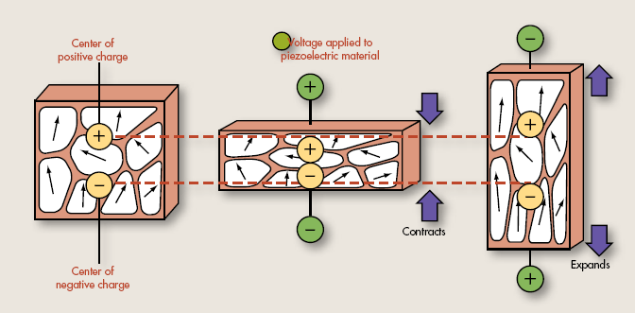
Fundamentals of Surface Acoustic Waves
Piezoelectric and reverse piezoelectric effect
Electric potential is generated in response to mechanical stress
Mechanical deformation occurs when electric field is applied
Surface acoustic wave generation using periodic electrodes
IDT spacing
Gold electrode
Periodic alternating potential creates acoustic surface wave
Piezoelectric substrate

Slide 4
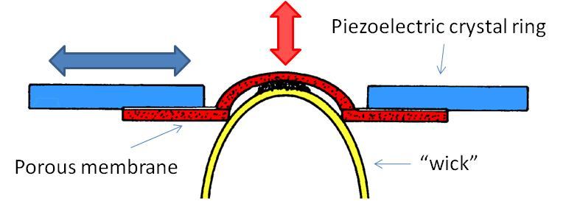
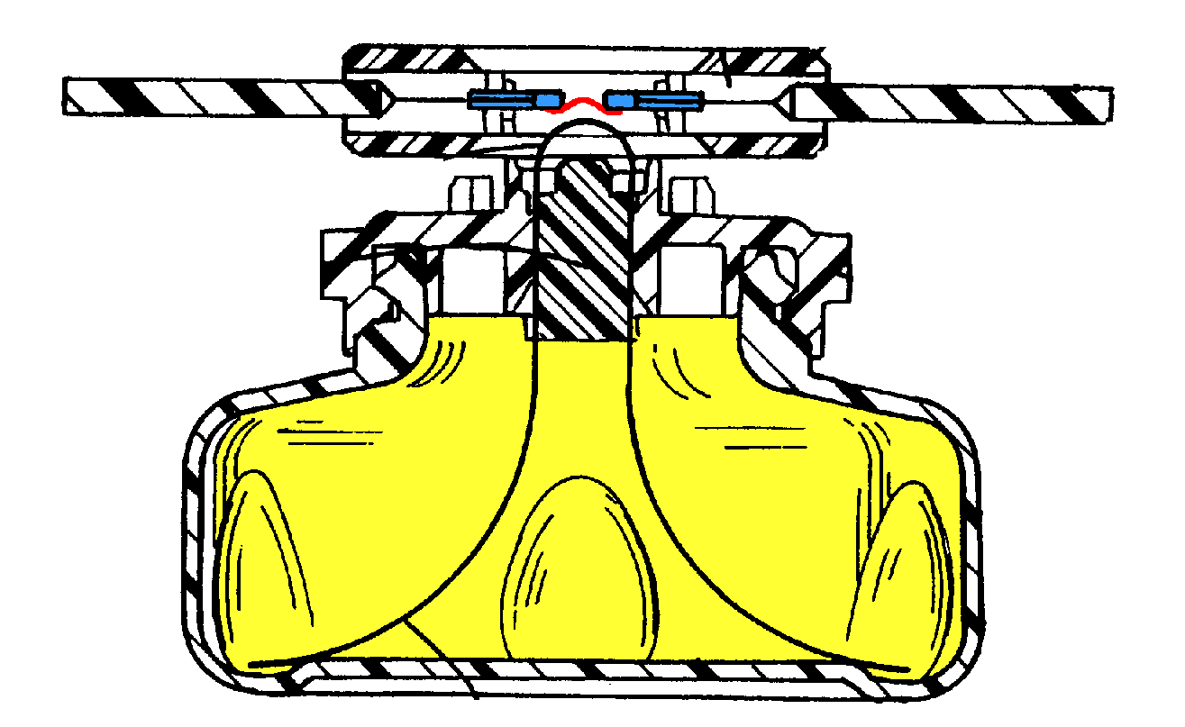
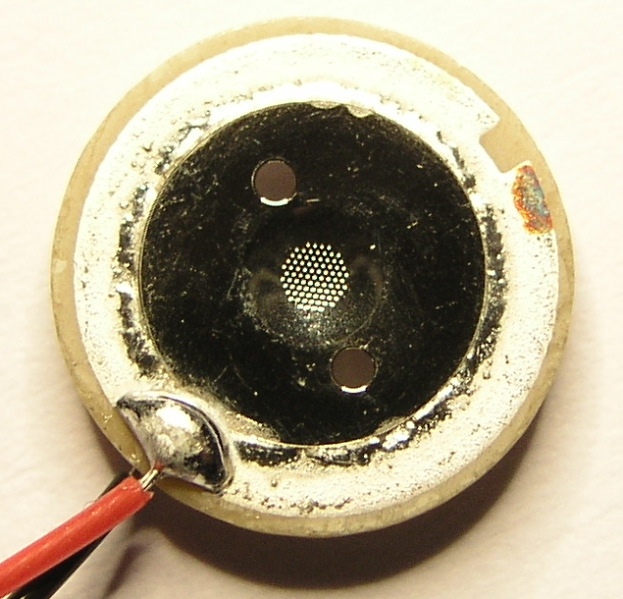
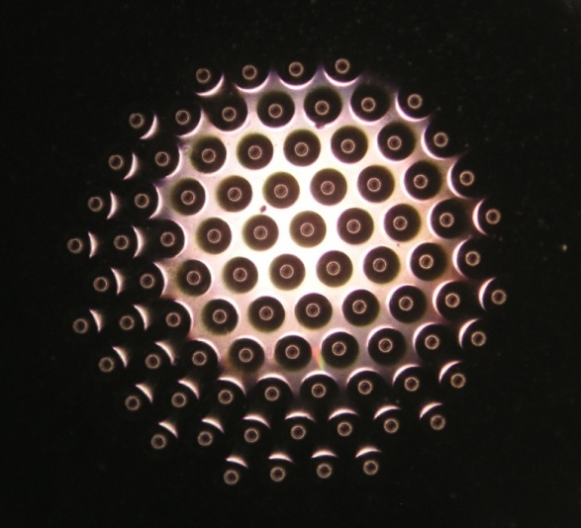
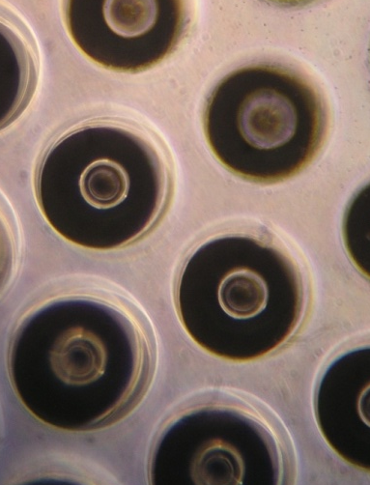
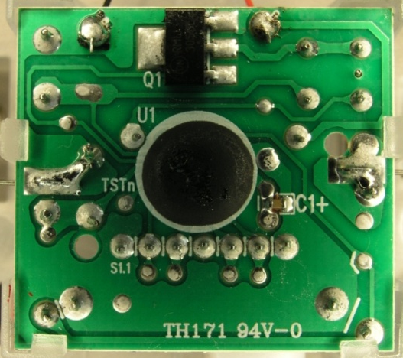
Particle emission with piezoelectric-atomizer
Pheromone container
Piezoelectric aerosol nozzle
Control circuit
3 mm
Notes:
Advantage: frequency can be modified
Disadvantage: wetting properties must be properly designed

Slide 5

Control of odorant droplet size
Estimated droplet diameter for water:
f [Hz] | 50k | 100k | 500k | 1M | 3M | 5M | 10M
d [µm] | 22.5 | 14.2 | 4.8 | 3.0 | 1.5 | 1.0 | 0.7
Droplet size can be controlled by frequency but wetting properties must be designed carefully

Slide 6
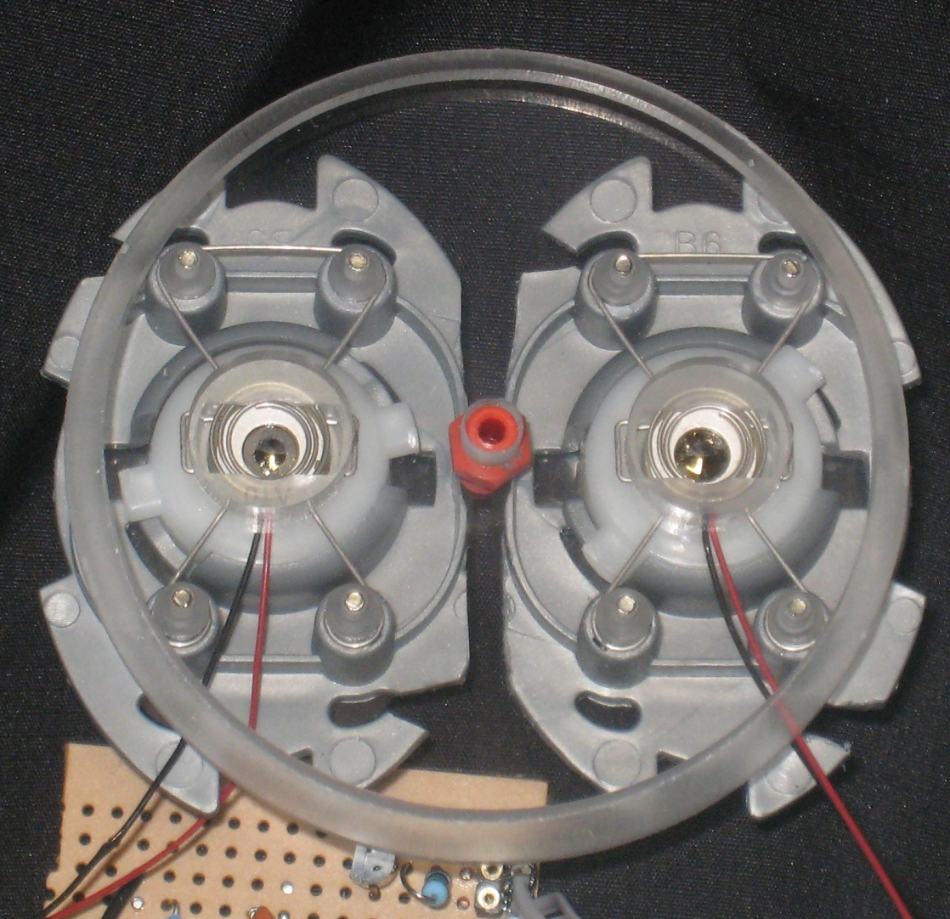
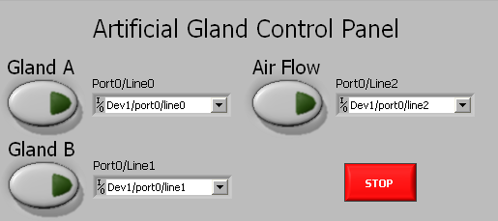
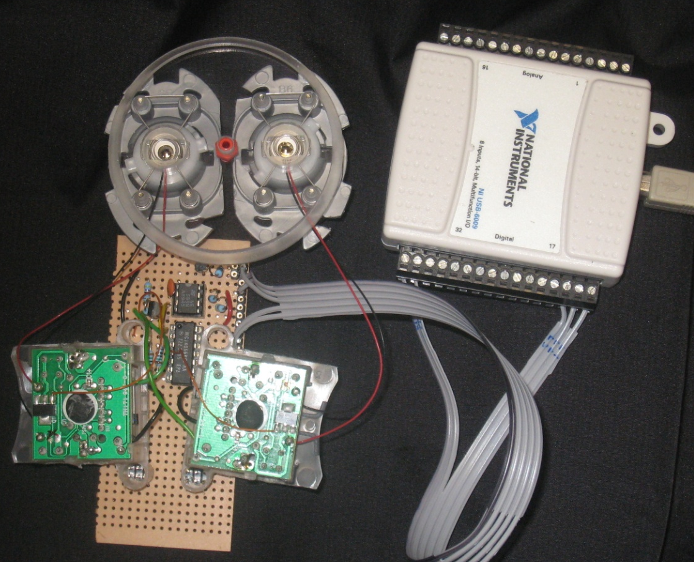
LabVIEW interface
USB data acquisition unit
141 kHz square wave generator
Ni/Co membranes on piezoelectric atomizers
CMOS analog switch
Microcontroller

Slide 7
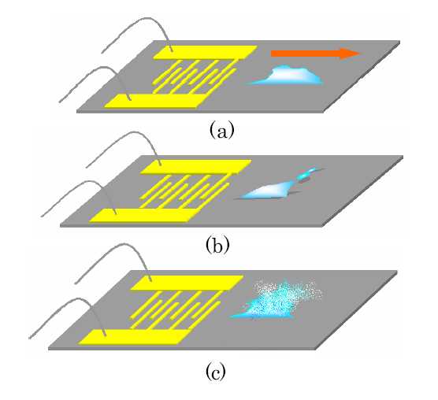
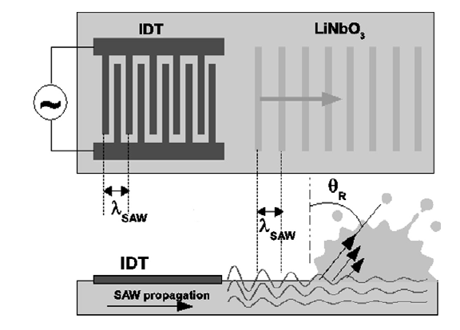

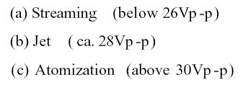
Atomization by Surface Acoustic Waves
M. Alvarez et. al. Nanotechnology 19 (2008)
Provides three modes of particle generation but frequency is fixed
K. Chono et. al. IEEE Ultrasonics Symposium (2003)
Notes:
Advantage: Three modes of particle generation
Disadvantage: Frequency is fixed

Slide 8
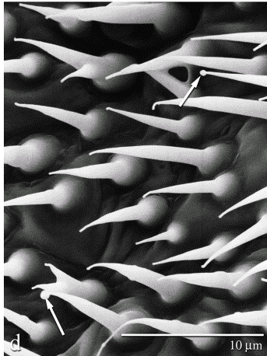
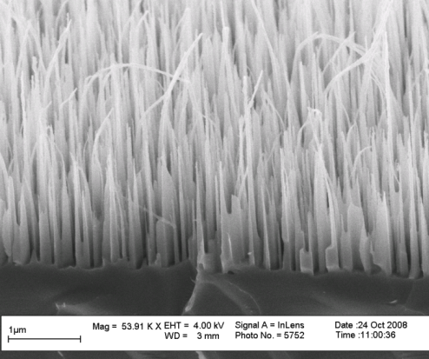
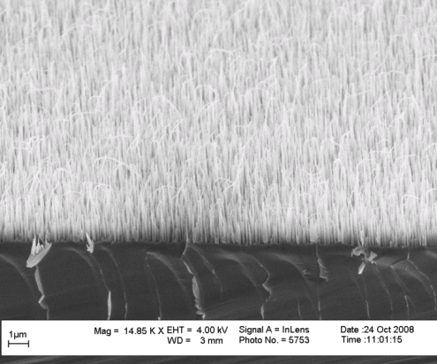
Micromachined device for ligand emission: Artificial gland
Evaporation drives emission
Rate of emission controlled by surface morphology and temperature
Cuticular hairs of Helicoverpa zea, showing droplets of extraction
(Raina et al., 2000)
Porous silicon
Black silicon

Slide 9
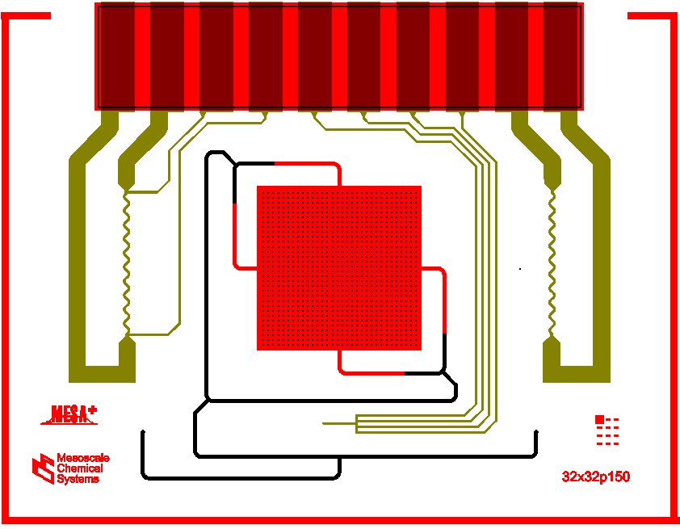
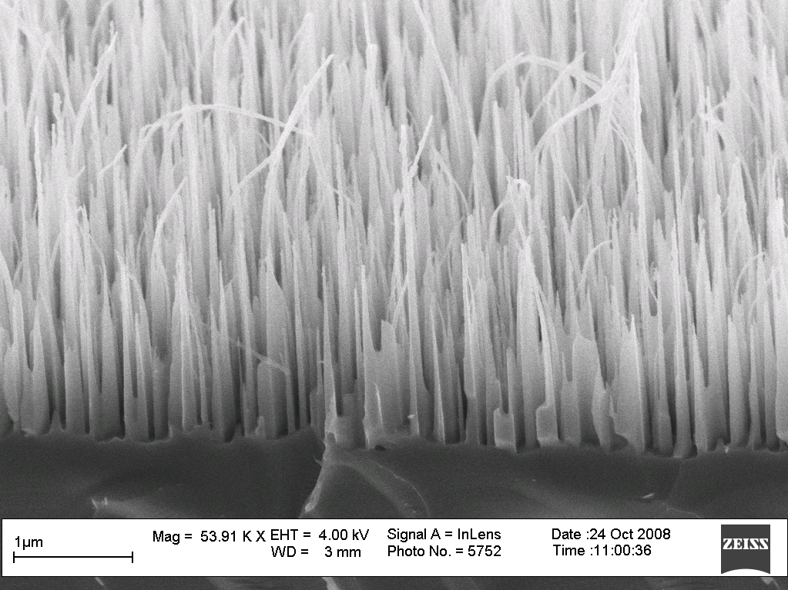
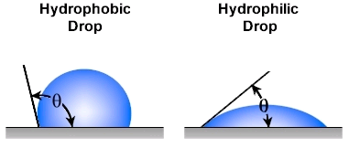
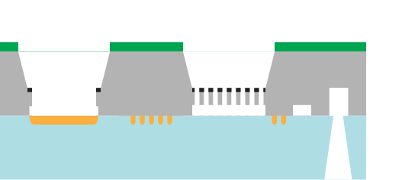
Second generation of Artificial gland for integration with biosynthetic microreactor
biomimic: black silicon surface
to micro reactor
heaters
membrane
membrane has tuned wettability

Slide 10
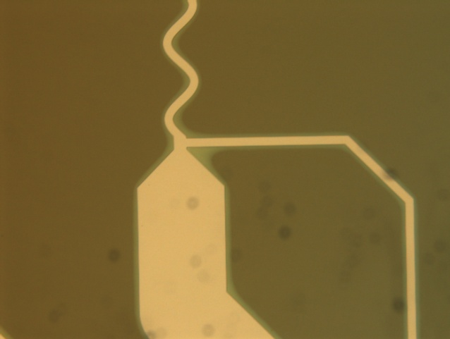
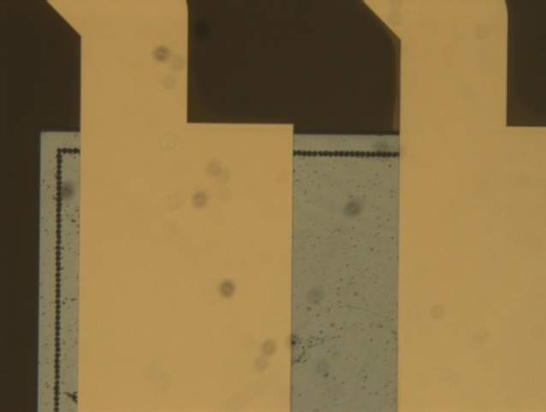
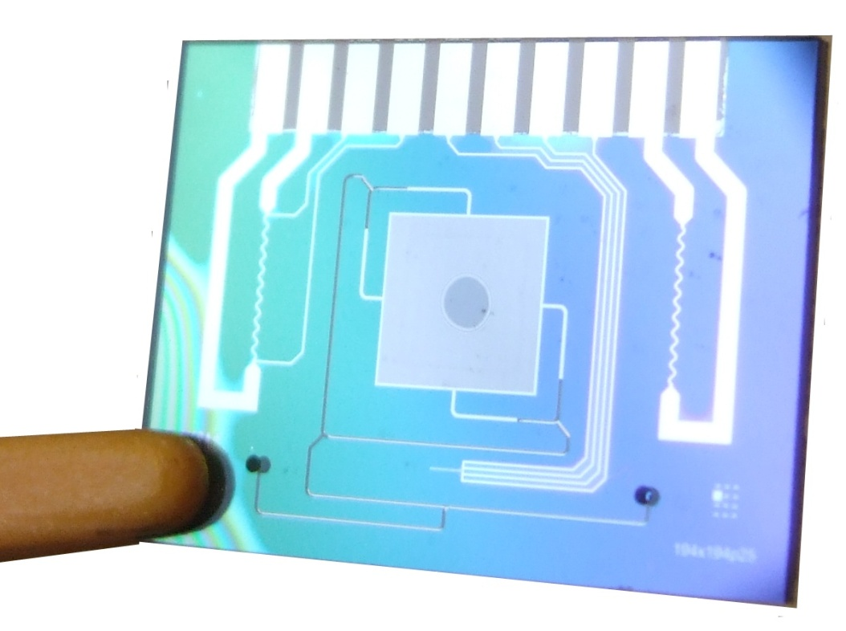
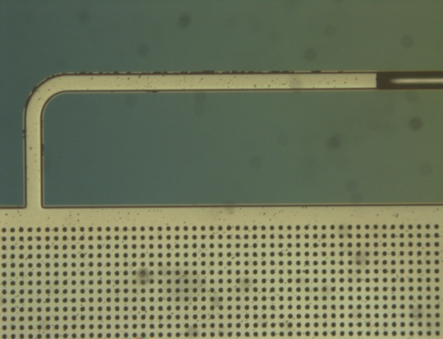
Artificial gland – fabrication results
Chip size:
20 mm x 15 mm

Slide 11
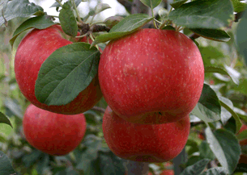
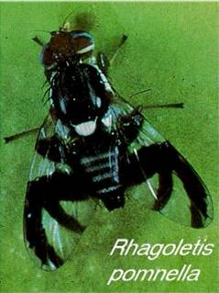


Ligand selection: Fruit volatiles and pheromones
Chemical | GC (%)
butyl hexanoate | 37
pentyl hexanoate | 5
propyl hexanoate | 4
butyl butanoate | 10
hexyl butanoate | 44
butyl hexanoate | 0.01
3-methylbutan-1-ol | 4
isoamyl acetate | 1.5
4,8-dimethyl-1,3(E),7-nonatriene | 0.09
ethyl acetate | 94.3
dihydro-β-ionone | 0.10
β-caryophyllene | 5.8
3-methylbutan-1-ol | 27.5
isoamyl acetate | 0.9
1-octen-3-ol | 9
ethyl acetate | 54.9
dimethyl trisulfide | 1.9
Apple
Hawthorn
Dogwood
(Linn et. al, 2005)

Slide 12
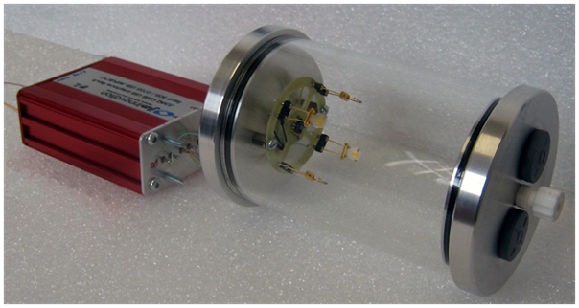
Ligand transfer – Volatile fluid dynamics
Wind tunnel experiments for evaporation rates and detection limits (Dr. Carot)
Mini-scale wind tunnel: odour chamber
Computer interface
Odour chamber
Inlet ports
Sensor array

Slide 13
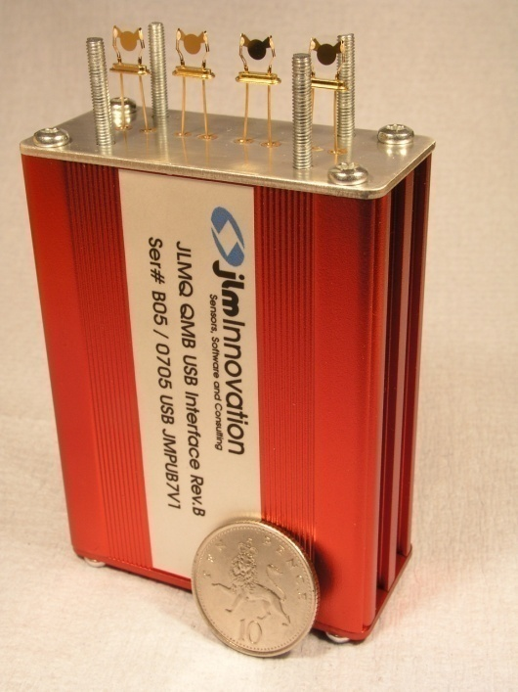
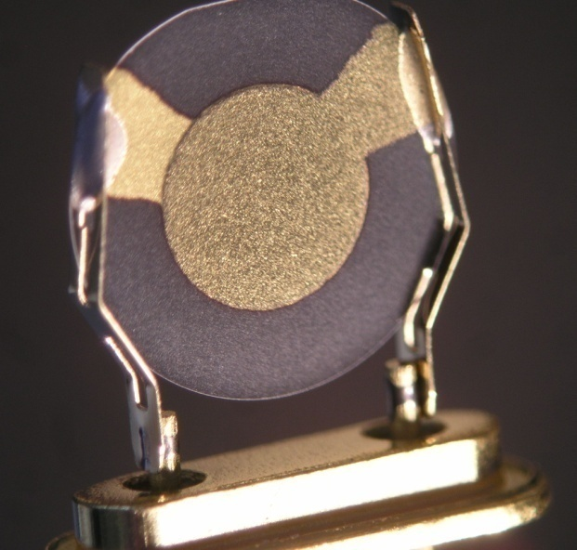
Detection: Quartz crystal microbalances (QCMs)
Frequency shift due to mass change:
Sauerbrey equation
Sensitivity: ∆f = 7.2 Hz/ng
Gas sensitive coating
Gold electrode
AC
Quartz crystal
Gold electrode
3 mm

Slide 14
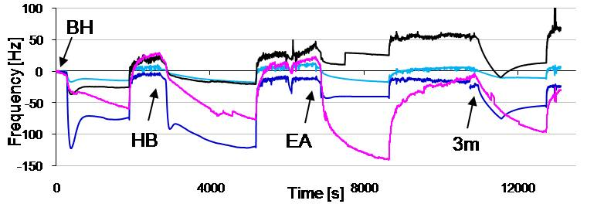
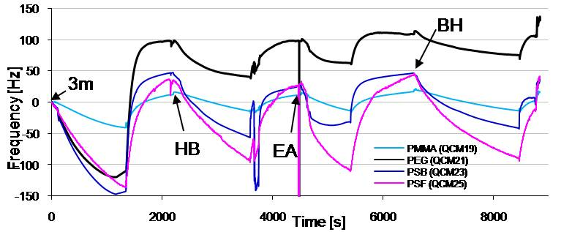
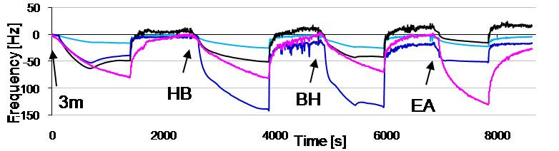
Ligand detection using QCMs
 | Odorant | PSF | PSB | PEG | PMMA
1. seq. | 3m | 137 | 144 | 110 | 42
 | HB | 127 | 103 | 58 | 29
 | EA | 136 | 57 | 35 | 28
 | BH | 134 | 87 | 33 | 32
2. seq. | BH | 59 | 77 | 26 | 15
 | HB | 98 | 127 | 31 | 14
 | EA | 157 | 28 | 59 | 26
 | 3m | 90 | 39 | 46 | 18
3. seq. | 3m | 80 | 39 | 49 | 16
 | HB | 82 | 138 | 57 | 24
 | BH | 69 | 118 | 53 | 22
 | EA | 130 | 33 | 31 | 22
4
3m
EA
2
DF2: 30.9%
0
-2
BH
HB
-4
-4
-2
0
2
4
6
DF1: 40.3%

Slide 15
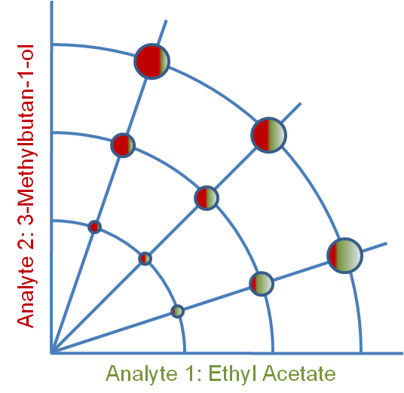
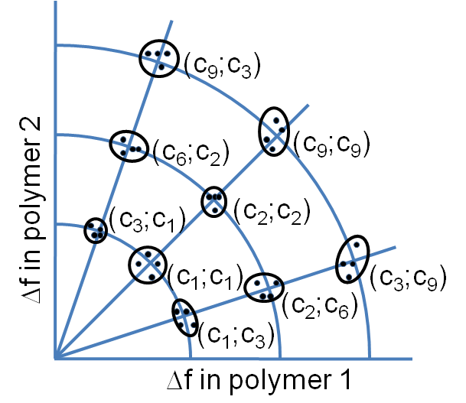
Blend Coding for Fruit Components
3:1
1:1
1:3
Plots showing the concept of ratiometric coding using two chemical components (a) and the target results of such an experiment (b).

Slide 16
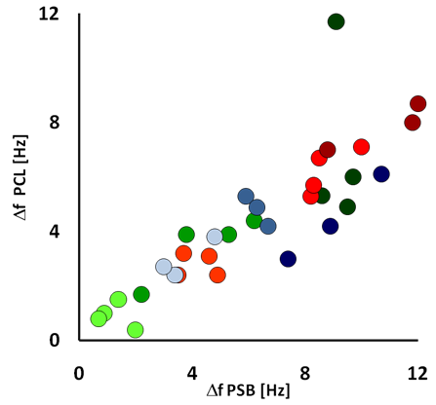
Output from first prototype system
Frequency change of PCL coated QCM vs. Frequency change of PSB coated QCM in response to a randomized sequence of 36 injections of an ethyl acetate/3-methylbutan-1-ol mixture of varying concentration and mixing ratio

Slide 17
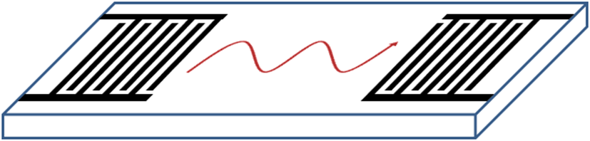
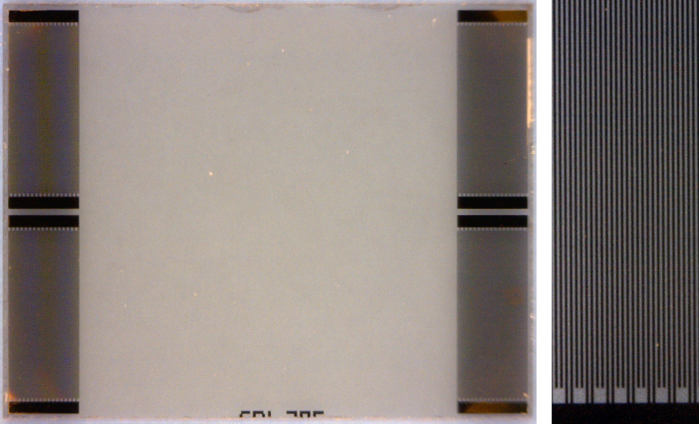
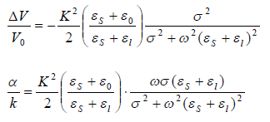
Detection II: SAW Delay Line Device
Similar principle of operation as QCMs:
Input IDT
Output IDT
Launched surface wave
Very sensitive to mechanical and electrical perturbations
Simple, robust design
Uniform sensing area
Large sensing area
Sensing area
Piezoelectric substrate
Output: attenuation and phase
a)
b)

Slide 18
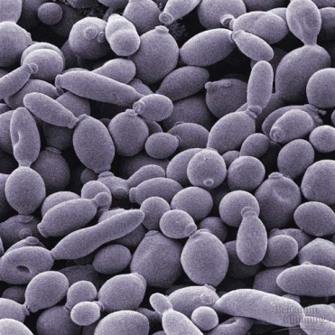
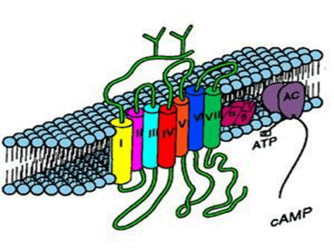
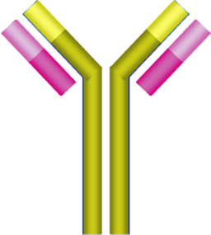
Principle of SAW bio-probe
25 MHz SAW
penetrates yeast cells
Nucleus
Bilipid layer
www.bio.miami.edu
PDL
Cell edge
5 GHz SAW penetrates
10 nm coating
LiTaO₃ substrate
 | Thickness [nm] | Frequency [MHz] | Feature size [nm]
Poly-D-lysine | 15 | 39,901 | 26
Bilipid layer | 22.5 | 26,600 | 39
Edge of cell | 615 | 973 | 1,069
Middle of cell | 7,515 | 80 | 13,064
Upright cell | 15,015 | 40 | 26,102
ardb.bjmu.edu.cn
GHz for GPCR or antibodies
www.unm.edu

Slide 19
Dual SAW biosensor output
Cell + OR22a + ligand
Cell + ligand
-
=
SAW sensor
SAW sensor
FREE DUAL SAWs
SHORTED DUAL SAWs

Slide 20

Simplified Artificial Antennal Lobe!
Cell + OR22a + ligand
Cell + ligand
-
SAW sensor
SAW sensor
Cell + OR67d + ligand
Cell + ligand
Interface circuitry
-
FPGA with neuromorphic model
SAW sensor
SAW sensor
Cell + OR83b + ligand
Cell + ligand
-
SAW sensor
SAW sensor

Slide 21
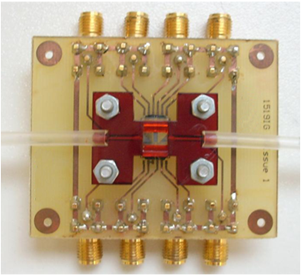
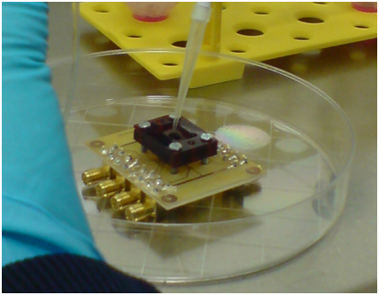
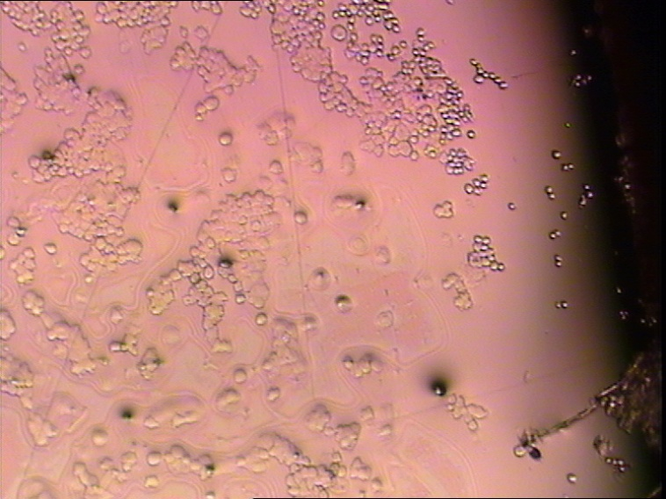
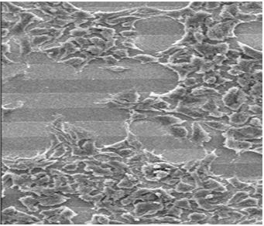
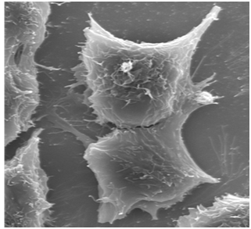
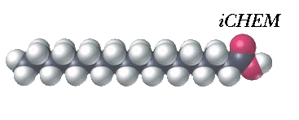
HEK cell coated SAW sensors
Cell deposition
SAW device
Liquid chamber
HEK cells on SAW device
HEK cells on SAW device
20 μm
2.5 μm

Slide 22
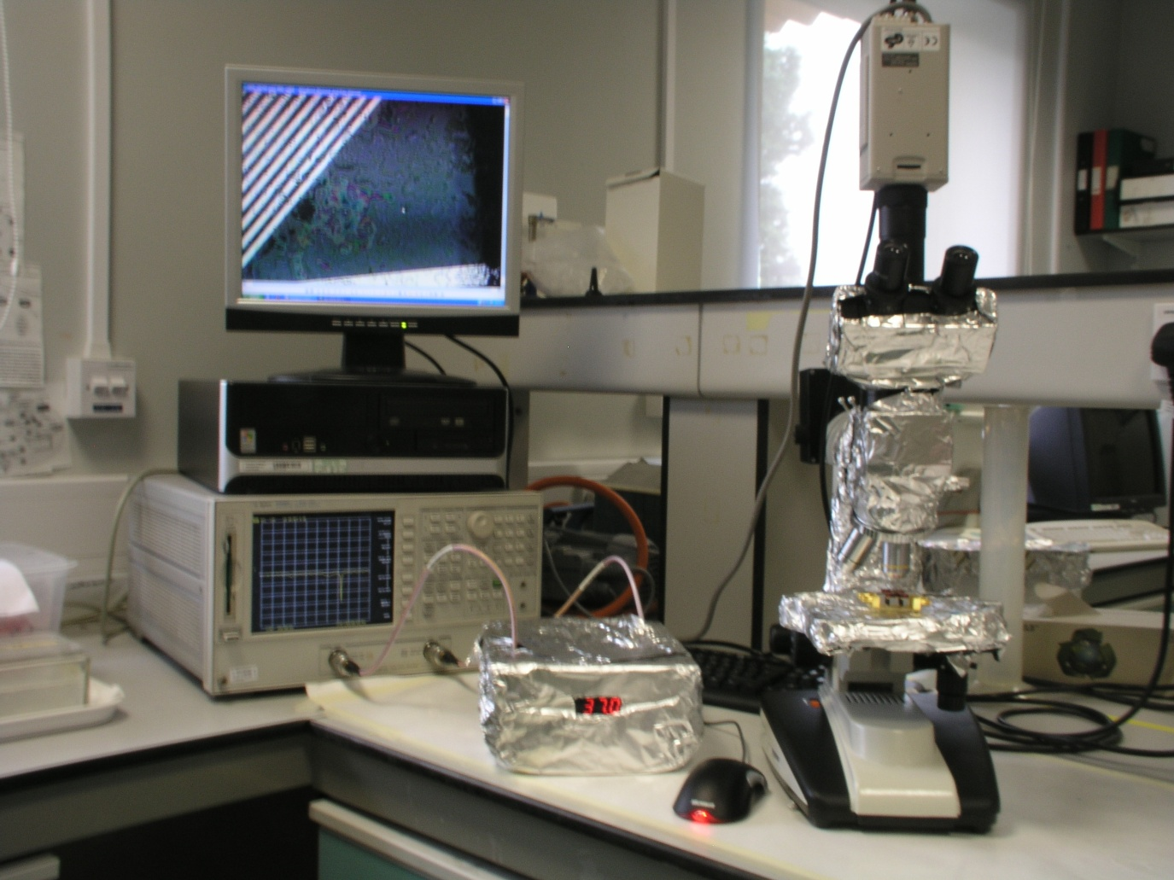
Biosensor characterization setup
Real time cell monitoring
Optical Microscope
SAW Sensor with HEK293 cells
Network Analyser
Dry-Block Heater for Temperature Control
Notes:
Main advantages of the measurement setup
provides temperature control
allow simultaneous optical microscopic and electrical characterization
enables continuous measurement and monitoring
allows characterization without disturbing or stressing the cells

Slide 23
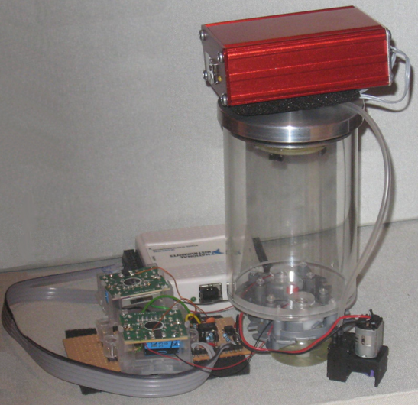
Prototype Infochemical System
QCM interface
Receiver
Emitter
Gland
interface
Pump

Slide 24
Summary
Piezoelectric chemoemitter and micro-evaporator presented
Cell based piezoelectric chemodetector with insect ORs designed
Prototype infochemical system shown
Ratiometrically encoded food volatiles discussed
Pheromone bioreactor under construction

Slide 25
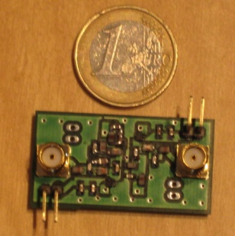




Outlook
Integrate artificial gland and biosensors into CMOS compatible microsystem
Real world applications:
platform to explore semiochemistry)
insect semiochemistry (interference with insect communication, crop protection)

Slide 26
Acknowledgements
Financial support from EU FP6 FET programme – iCHEM project
See: www.warwick.ac.uk/go/iCHEM

