Slide 1




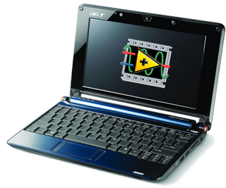
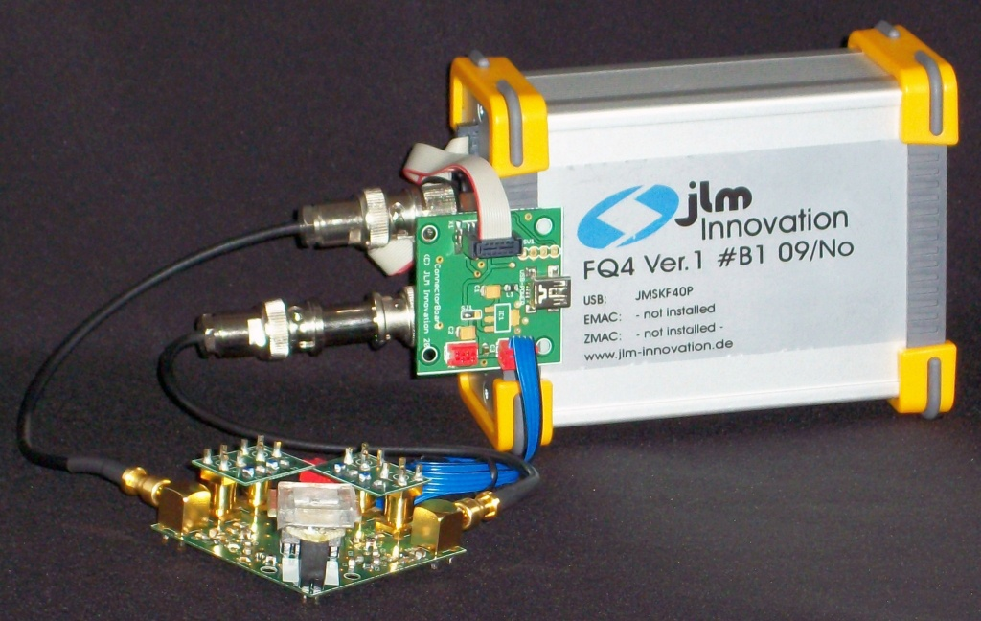
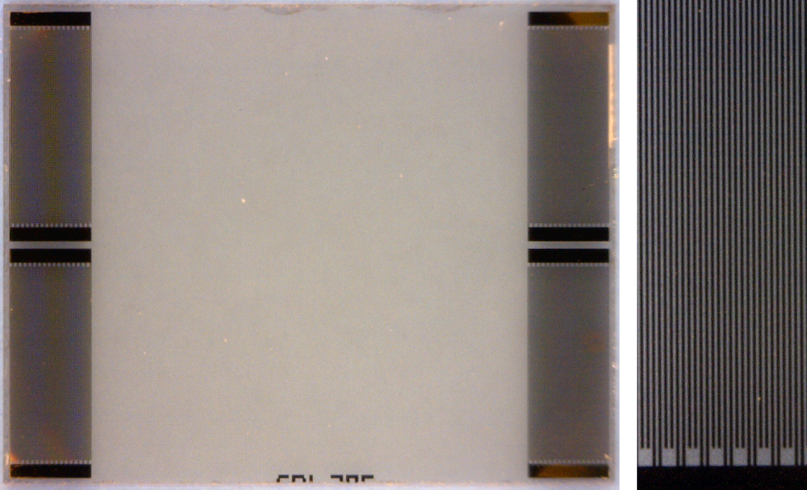
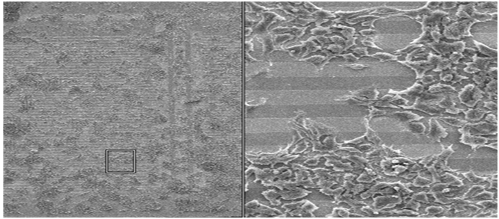
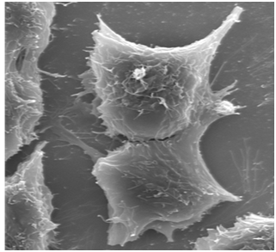
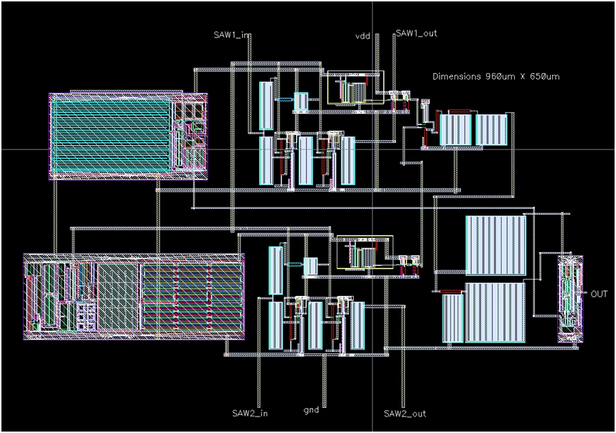
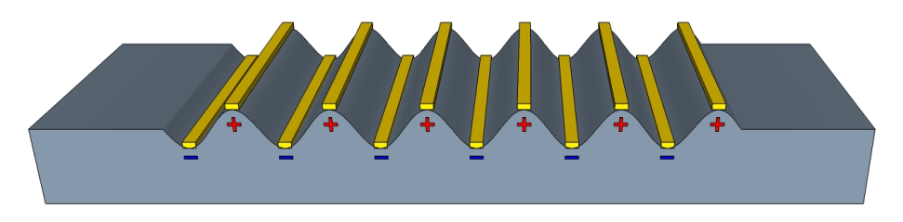
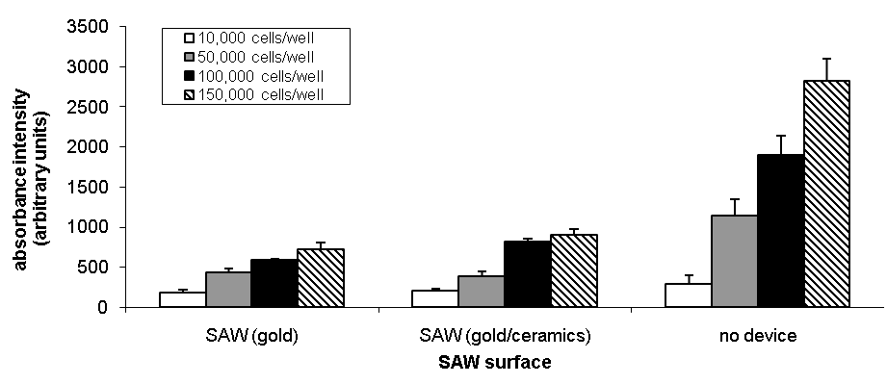

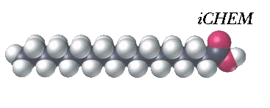



Biomimetic microsystem for the detection of ratiometrically encoded semiochemicals
M. Cole^{*1}, J. Gardner¹, S. Pathak¹, M. Chowdhury¹, Z. Rácz¹ and D. Markovic², M. Jordan², J. Challis²
*M.Cole@warwick.ac.uk, ¹University of Warwick, Coventry, United Kingdom, ²University of Leicester, Leicester, United Kingdom
Abstract – The development of a novel surface acoustic wave biosensor for liquid phase ligand detection is presented. The functional layer of the biosensor comprises human embryonic kidney cells that efficiently express specific ligand receptors and is coupled to the acousto-electric transducer. A low-loss shear horizontal surface acoustic wave device was developed and fabricated for the detection of receptor-ligand interactions in heterologous systems. The proof of concept implementation of a protocol to immobilize cells expressing insect olfactory receptors on the device surface has been successful. This biological sensor also can be used more generally to monitor cell viability when challenged with toxins, drugs or other substances.
Introduction
Sensor design
Sensor interface circuitry
Pheromone mediated chemical communication in insects provides the key form of information exchange between individuals and the chemical cues often have associated behavioural changes via the neuroendocrine function. These semiochemicals are complex and diverse as most species rely upon a number of different compounds to convey specific information. This complex form of information exchange in invertebrates, mediated by chemicals, represents an unexplored form of communication and labelling technology that is yet to be exploited. The objective of our study was to:
Engineer biosynthetic components for chemical signal generation and detection based on insects’ pheromone production and sensing pathways.
Integrate these biosynthetic modules into a communication system.
Changes inside and on the cell membrane of the HEK293 cells induced by the ligand-receptor interaction are detected by surface acoustic waves that – depending on the frequency – penetrate into different regions of the cells, such as the nucleus, the cytoplasm and the bilipid layer.
A sensor interface circuitry for automated electro-acoustic HEK cell monitoring have been developed. The SAW sensors are placed in the feedback loop of an oscillator circuit that is connected to a laptop via an USB interface board that performs data processing as well.
Poly-D-lysine
Nucleus
Olfactory receptors
Power supply board
Cell edge
Bilipid layer
Filter boards
SAW₁
SAW₂
USB powered interface board
Blend ratio information
LiTaO₃ substrate
Oscillator board
-2c
-2c
Δ9
Δ11
OAc
TD
T
Figure 4. Schematic ‘fried-egg’ representation of a human embryonic kidney 293 cell on a lithium tantalate surface acoustic wave device showing the different wave penetration depths required to monitor ligand binding-induced changes inside and on the surface of the cells
Figure 8. Diagram of the sensor interface electronics consisting of a SAW sensor board and two filter boards mounted on the oscillator board, a power supply board and a main interface board.
Concentration Ratios
Δ12
OAc
Q
WORLD
TD
T
Concentration Ratios
18:CoA
Δ11
OH
TD
T
The SAW biosensors were designed in dual delay-line and dual resonator configuration to allow differential measurements in which only one device of the pair is coated with functionalized HEK293 cells expressing olfactory receptors while the other is coated with non-functionalized (i.e. wild type) HEK293 cells. Measuring the difference between the signals of the two delay-lines ameliorates environmental and other common mode variations and ensures that the measured responses are produced purely by the functionalized cells.
The prototype of the SAW-based sensor integrated with the interface circuitry is shown below:
Chemoemitter
OAc
TD
T
Chemoreceiver
Power supply board
USB powered interface board
MFC
mass flow
mass change/optical
electrical
local interneuron
projection neuron
synapse
Figure 1. Biosynthetic modules forming an infochemical communication system. The chemoemitter exploits several subunits to produce infochemicals based on the enzymatic activity within the exocrine system of a moth and a microevaporator or a nebulizer (Q) releases the infochemical blend. The chemoreceiver exploits transmembrane domain (TD) olfactory receptors, which are transduced (T) using binding specific changes. Infochemical binding signals are processed in a ratiometric neuronal model based on the antennal lobe of the same animal.
For the chosen model biological system, each of these biological processes will be characterised and deployed in MEMS-based microreactors, novel biological microsensors, and artificial neuronal algorithms with VLSI implementation.
SAW oscillator board with sensor
Bio-reactor
Wind tunnel/Chamber
Osc. Mixer₁
Figure 9. Photograph of the SAW-based biosensor prototype.
SAW₁
Osc. Mixer₂
Output
Interface
VLSI integration
Ratiometric mixing/dilution
SAW₂
Temperature and
Other Controls
Chemoreceiver
Work towards integrating the SAW-based biosensors and the associated interface circuitry into a single monolithic analogue VLSI system have been started. The main components of this sensor implementation are shown below:
Chemoemitter
SAW_{n}
Osc. Mixer_{n}
FPGA
a)
b)
Evaporator/
Artificial Gland
Flash memory
Figure 5. (a) Optical microscope image of a dual delay line SAW sensor fabricated using Au/Cr electrodes and a LiTaO₃ substrate. (b) Higher magnification image of the interdigitated transducer electrodes.
Sensing Oscillator (Immobilised)
Classified signal
Temperature Control Unit
Figure 2. Block diagram of the proposed engineering implementation of the Infochemical Communication System.
Cell growth and monitoring
SAW
Resonator
Amplifier
Low Pass Filter
SAW-based biosensor development
Buffer
Low Pass Filter
Signal Converter
Micro-controller Interface
A surface acoustic wave (SAW)-based sensor was developed that is functionalized with a biological layer and enables the detection of chemicals at very low concentrations. For the development of an olfactory receptor-based sensor for detecting pheromone signaling, a heterologous expression system, human embryonic kidney 293 (HEK293) cells, were employed because olfactory receptors can be efficiently expressed and then coupled to the artificial acousto-electric system for ligand detection.,
HEK293 attachment and viability on LiTaO3 and Au/Cr/LiTaO₃ surfaces were confirmed by immobilizing HEK293 cells onto pre-sterilized SAW sensor chips. The cells were allowed to grow in an incubator environment for a period of 2 days and to confirm this the cell morphology on the sensors was examined under a scanning electron microscope via MTT cell viability assay. Both the electron micrographs and the MTT assay confirmed that HEK293 cells had grown on both metallised and unmetalized sensing areas on LiTaO₃.
Mixer
1 0 1 0
SAW
Resonator
Amplifier
Low Pass Filter
Buffer
Temperature Control Unit
Reference Oscillator
(Non-Immobilised)
Theory of SAW sensors
Figure 10. System diagram of aVLSI interfacing stage of individual sensing elements .
In SAW-based sensors, the input interdigital transducer (IDT) sets up an electric field in the substrate that by means of the piezoelectric effect generates a surface acoustic wave propagating towards the output IDT which in turn converts this wave into an electrical signal. Changes in the properties of the adjacent biological layer or liquid change the propagation characteristics of the wave (i.e. attenuation, phase, frequency), thus, allowing detection.
The physical layout of the initial aVLSI stage is shown below:
IDT spacing
Metal electrode
200 μm
20 μm
2.5 μm
Figure 6. Scanning electron micrographs (increasing magnification, left to right) of HEK293 cells grown on a LiTaO₃ SAW device with Au/Cr electrodes.
wavelength
Piezoelectric substrate
Figure 11. System diagram of aVLSI interfacing stage of individual sensing elements .
Input transducer
Selective coating
Output transducer
Conclusions and Future work
AC
Surface wave
AC
We have described the development of a biosensor consisting of a low-loss SAW biosensor, associated interface circuitry and a biological functional layer of HEK293 cells that was deposited and grown on the SAW devices. Work is under way to instantiate this sensor as a fully integrated analogue VLSI system.
Figure 3. The basic principle of exciting surface acoustic waves by an interdigital transducer created by micro-patterned metal electrodes on a piezoelectric substrate (top). Schematic diagram of a SAW sensor consisting of input and output transducers( bottom).
Figure 7. Results of the MTT cell viability assay showing that HEK293 can be grown on both LiTaO3 and Au surfaces and the cells do not have a preferred growth region.
Acknowledgement: This work is supported by the EC Framework 6 IST Programme under iCHEM Project Reference FP6-032275.

