Slide 1


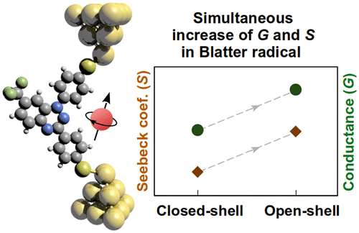


Title here
Presenting Author, Additional Author(s), Sara Sangtarash, Hatef Sadeghi*
Device Modelling Group, School of Engineering, University of Warwick, Coventry, UK
* Corresponding author: Hatef.Sadeghi@warwick.ac.uk
Abstract here
Organic thermoelectric materials have potential for wearable heating, cooling, and energy generation devices at room temperature. Here, we demonstrate that a simultaneous enhancement of S and G can be achieved in single organic radical molecules. These results open a new avenue for the development of organic thermoelectric materials operating at room temperature.
Graphical abstract here
Introduction
Impact
Result and Discussion
References
Acknowledgements
This research is supported by the UKRI for Future Leaders Fellowship number MR/S015329/2 and the Leverhulme Trust for Early Career Fellowship no. ECF-2018-375.

