Slide 1

100-words Workshop
28th November 2018
Duncan Lockerby

Slide 2
Why is REF important?
  Crucial to the School’s reputation, potentially affecting:
      your ability to win research grants;
      your ability to establish external partnerships;
      your ability to attract the best PhD students and researchers;
      the quality of your undergraduate students;
      the standing of the School in the University;
      the quality of your CV…
  Crucial to the School’s reputation, potentially affecting:
      your ability to win research grants;
      your ability to establish external partnerships;
      your ability to attract the best PhD students and researchers;
      the quality of your undergraduate students;
      the standing of the School in the University;
      the quality of your CV…
  Has a direct impact on the School’s finances:
      Determines how much we get from HEFCE’s Quality-related Research (QR) fund;
      Our REF2014 performance (16th out of 62 in General Engineering), is worth over £2M p.a. to the School;
      Future QR income may be even more sensitive to REF2021 performance.
  Has a direct impact on the School’s finances:
      Determines how much we get from HEFCE’s Quality-related Research (QR) fund;
      Our REF2014 performance (16th out of 62 in General Engineering), is worth over £2M p.a. to the School;
      Future QR income may be even more sensitive to REF2021 performance.

Slide 3

The Rules of the Game
The headlines from Research England:
  Single Engineering Unit of Assessment
  Outputs/Impact/Environment (60/25/15%)
  Every independent researcher submitted
  1 to 5 outputs per FTE (2.5 average)
The headlines from Research England:
  Single Engineering Unit of Assessment
  Outputs/Impact/Environment (60/25/15%)
  Every independent researcher submitted
  1 to 5 outputs per FTE (2.5 average)
Highly likely:
  Joint Engineering and WMG submission;
  Fiercer competition than 2014;
  Percentage of 4* research the key indicator;
  Vast majority of funds to go to 4* research.
Highly likely:
  Joint Engineering and WMG submission;
  Fiercer competition than 2014;
  Percentage of 4* research the key indicator;
  Vast majority of funds to go to 4* research.

Slide 4
REF2021: submission of outputs
  This year’s story so far:
      January: you submitted details of 5 outputs;
      Spring: these outputs were internally graded and submitted to “REG” (a University panel chaired by Pam Thomas);
      June: you received some feedback on the submission.
  What you need to do next?:
      deadline for submission of outputs with full 100-word summaries is by end of December 14th (one week after end of term);
      expected number of outputs submitted is 5;
  Then what?:
      Jan-Apr 19: All outputs internally reviewed and submitted to REG.
      Spring-Summer 19: Select outputs externally reviewed alongside WMG’s.

Slide 5
Some good journals…
AIChE Journal (A*)
Applied Optics (A*)
Applied Physics Letters (A*)
Engineering Fracture Mechanics (A*)
IEEE Transactions on Industrial Informatics (A)
IEEE Transactions on Fuzzy Systems (A*)
IEEE Transactions on Power Systems (A*)
IEEE Transactions on Robotics (A*)
IEEE Transactions on Software Engineering (A*)
IEEE Transactions on Power Delivery (A)
IEEE Transactions on Neural Networks (A*)
IEEE Transactions on Knowledge and Data Engineering (A)
International Journal of Machine Tools and Manufacture (A*)
Journal of Engineering Design (A)
Journal of Applied Physics (A)
Journal of Sound and Vibration (A*)
Journal of the Acoustical Society of America (A*)
Mechanical Systems and Signal Processing (A*)
Microfluidics and Nanofluidics (A)
Optics Letters (A*)
Optics Express (A*)
Proceedings of the Royal Society A: Maths, Physical & Engineering Sciences (A*)
Renewable Energy (A)
Tribology Letters (A*)
Water Research (A*)
Wear (A)

Slide 6
Some good journals…
…submitted to REF2014 by:
Anglia Ruskin University
Bournemouth University
University of Derby
University of Greenwich
University of Hertfordshire
University of Huddersfield
Liverpool John Moores University
Southampton Solent University
University of Wales Trinity Saint David
… who didn’t get a single 4* output.

Slide 7
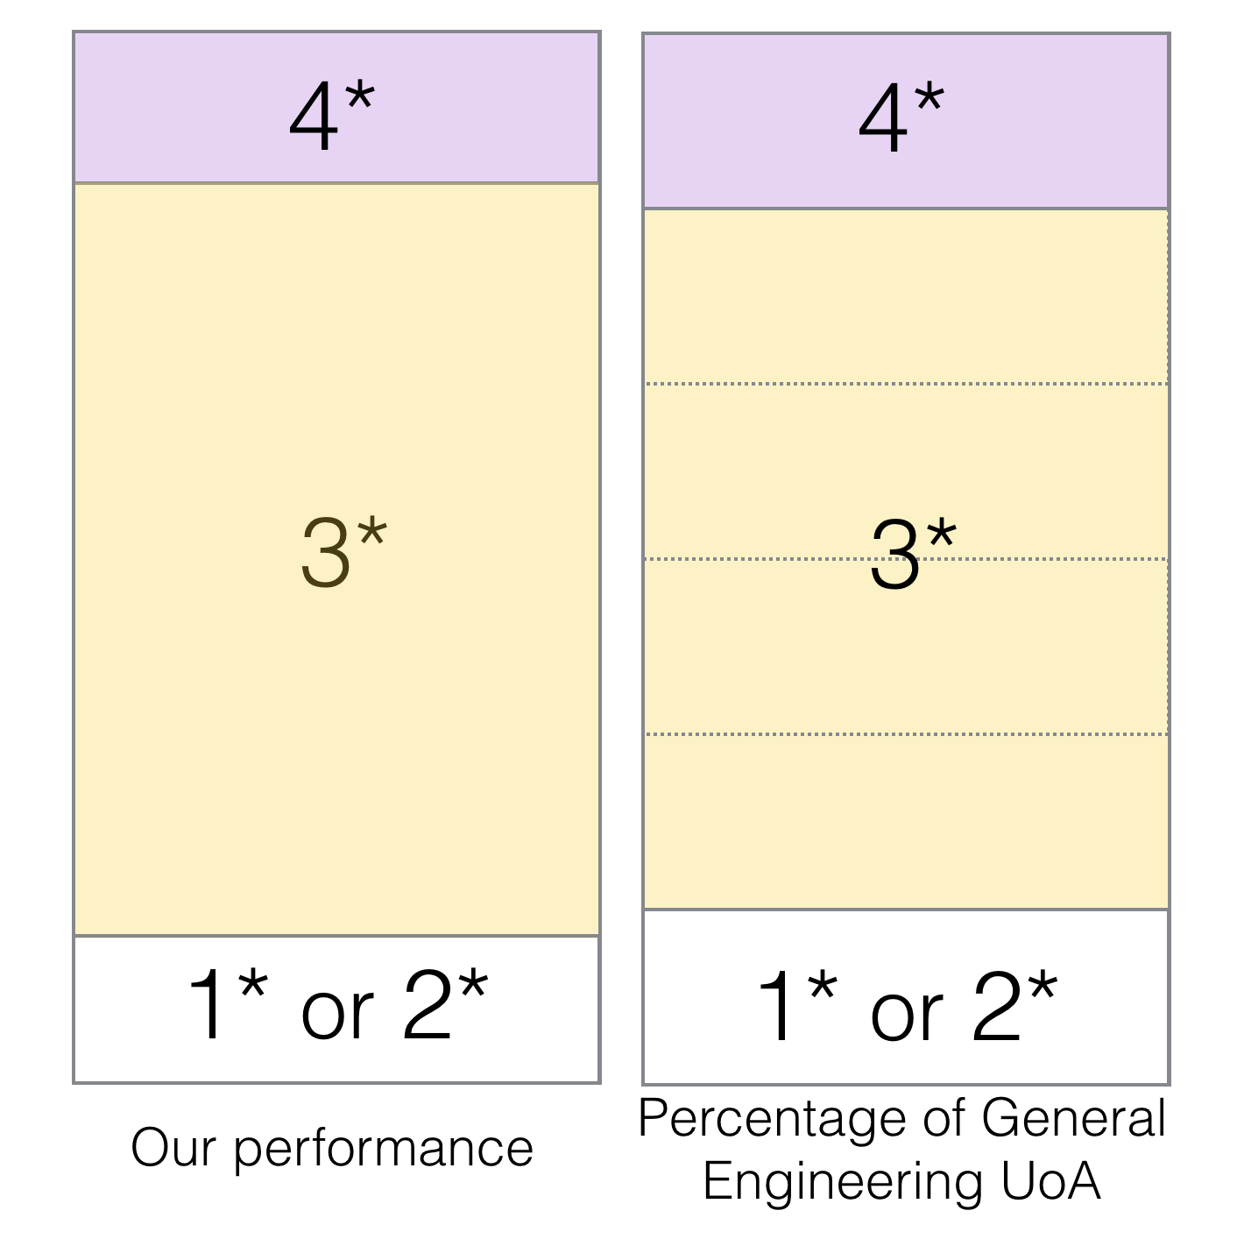
Our performance (on outputs):
  4* (15%) , 3* (70%) , 2* (14%)
Lessons from REF2014
  It is not just about the journal
  The 100-words is the crucial differentiator between 3* and 4*

Slide 8

Break-out session (your assignment)
  10 ideas for things to include in the 100 words
  3 tips, tricks, dos and don’ts
  2 nuggets of wisdom (about REF, outputs, and/or the impact agenda)
  Resources here:
warwick.ac.uk/engineeringref2021

