Slide 1
Research Funder’s Perspective of Industry Collaboration
Roger Singleton Escofet

Slide 2
Research Development Manager
Horizon scanning for funding opportunities; understand drivers from funders
Provide support for strategic bids across the school (and partner up with other departments/ universities if needed)
Help maintain relationship with key sponsors and industry
Work with early career members of staff to provide support in understanding funders needs

Slide 3










Flow of funding to Research Councils UK
~£3 billion Annual Investment
Economic growth
Job creation
Knowledge exchange
Investing in research in all areas of human thought and endeavour
Notes:
RCUK invests annually around £3 billion in research.
Focus is on excellence with impact.
Nurture highest quality research, as judged by international peer review providing the UK with a competitive advantage.
Global research requires us to sustain a diversity of funding approaches, fostering international collaborations, and providing access to the best facilities and infrastructure, and locating skilled researchers in stimulating environments.
Our research achieves impact – the demonstrable contribution to society and the economy made by knowledge and skilled people. To deliver impact, researchers and businesses need to engage and collaborate with the public, business, government and charitable organisations.

Slide 4
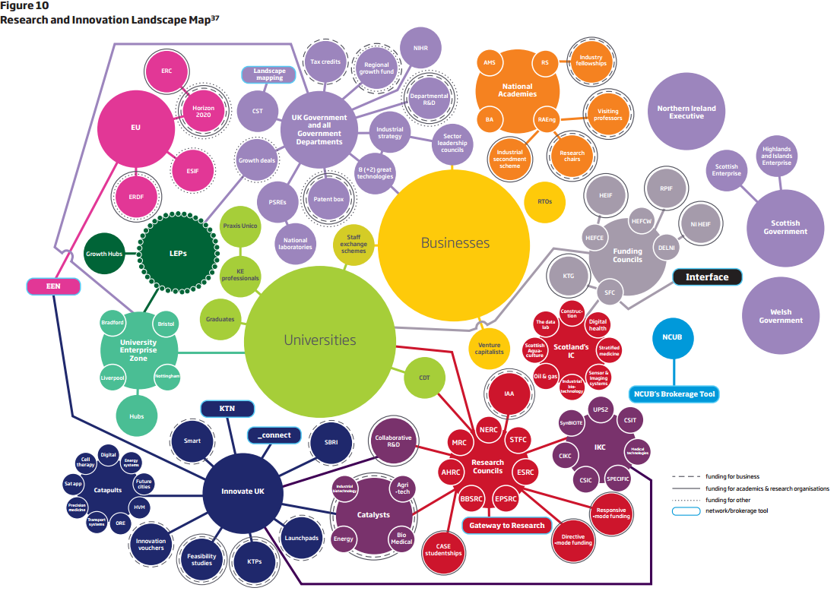
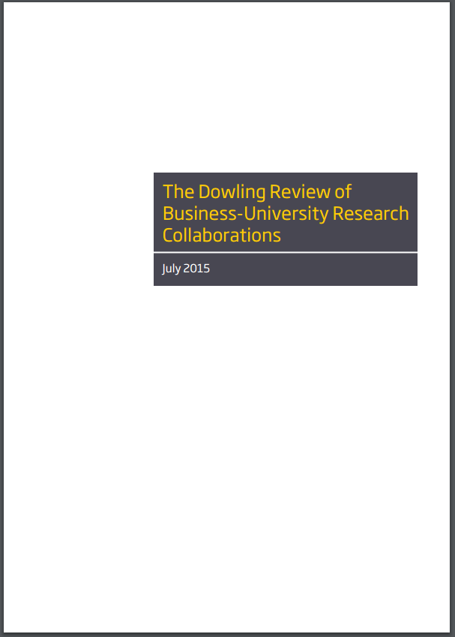
Dowling Review – July 2015
Need a simplification of support available
  Greater co-ordination across funding bodies
Importance of people in the innovation process
Increase visibility of collaboration and successful stories

Slide 5
Dowling Review – July 2015
Need a simplification of support available
  Greater co-ordination across funding bodies
Importance of people in the innovation process
Increase visibility of collaboration and successful stories

Slide 6
Why do Research funders focus on business collaboration :
Political Drivers – need to align to government policy
Help define their strategy – co creation of research challenges
Opportunity for leveraged funding – for both research & training
Help innovation pipeline and reinvestment into research
Use industry as advocates for research

Slide 7
EPSRC Strategic Vision
For the UK to be the best place in the world to research, discover and innovate
Research and Discover
Balancing Capability
Building Leadership
Research and Innovate
Accelerating Impact
One Vision
Two Goals
Three Strategies

Slide 8
Accelerating Impact
We are seeking to maximise the economic and social benefits arising from our research and training portfolio - to make it more likely that impact will arise, will arise more quickly and will bring benefit to the UK.
Our Approach to Accelerating Impact
Partnering with Universities
Partnering with innovation funders e.g. IUK, Charities
Partnering with Business and Government
Impact
Pathways
Enabling timely and responsible innovation e.g. PtI, IAA
Building user / academic research and innovation environments e.g. IKC, Hubs
Investing in people for the innovation System e.g. CDT, ICase
Supporting ‘use led’ priorities and emerging technologies e.g. Quantum Technologies

Slide 9

Working with Academia and Business
Enabling the research base to respond to industry challenges
Strengthening and optimising links with research users
Creating opportunities for collaboration
Research Base
Framework
Universities
Strategic Partners
Business
Notes:
Unlike most of the other slides, this could be used in an external presentation.

Slide 10
Vision for Business Engagement
“to ensure the investments made by EPSRC are relevant to business, evidenced by increased business involvement and investment and resulting in impact and growth creation.”
That EPSRC and its investments have high levels of visibility and accessibility for business communities
That EPSRC investments continue to attract high levels of business investment and EPSRC policies and processes aid, rather than hinder, business engagement and investment.
That our strategy and investments are influenced by the views of business and that we influence the ways in which business consider and interact with the research base.
Visibility
Engagement
Influence

Slide 11
Success Feature A - Visibility
Implement a revised stakeholder engagement and communication structure that promotes a more open culture and reflects the breadth of engagement
A more proactive and targeted communications plan for companies
EPSRC input and engagement to the coordinated industry leadership councils
Act as a proactive broker and provider of intelligence to the business community to assist their engagement
Targeted approach to other brokers, such as KTNs, UKTI, Science parks and trade bodies
Critical mass investments to support our sector engagement strategies
Engage more proactively with a broader range of businesses
Focus is currently Advanced Materials, Aerospace, Automotive, Chemicals and Robotics
Increased use of online tools

Slide 12
Success Feature B - Engagement
Establish a University-Business strategic partnership fund to
Toolkit for industrial engagement
Monitoring engagement
promote, catalyse and reward long term partnership between businesses
More overt details on how to engage and rules of engagement
Work with Innovate UK to align university and business support
Develop a programme of work to look at more representative ways to measure and monitor business engagement throughout the lifetime of an award and outcomes

Slide 13
Success Feature C - Influence
Advisory Structures and peer review
Outcomes framework
Universities and business
introduce a simplified process for attracting industry members to Strategic Advisory Teams
Engage in more three-way dialogue to influence the nature and scope of partnerships in the EPS landscape
Establish opportunities for increasing user engagement in peer review
Use the outcomes framework and ambitions from the delivery plan to promote and encourage more regular industry input to the shaping and delivery of our investments.

Slide 14

EPSRC’s proposition to business
Access to existing EPSRC investment portfolio
one-off projects
networks and large-scale programmes
Joint, co-funded calls for proposals with EPSRC
Partnering with academics on individual grants or clusters of research and training grants
ICASE
Commitment
impact acceleration accounts
Commitment from companies
  How can you make the most from this?

Slide 16
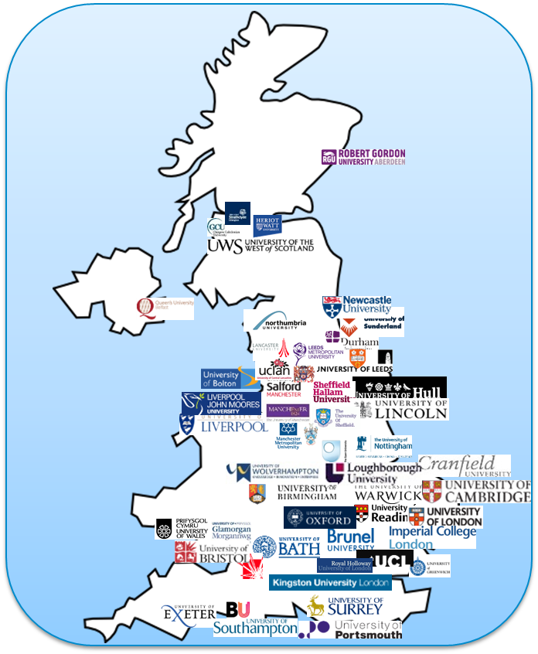
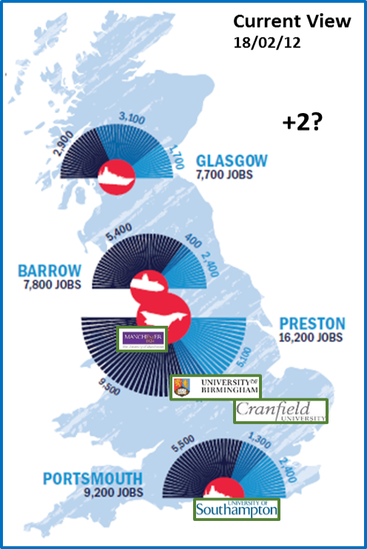



Why?
No. of joint bids, access to facilities, network access
Seminars/lectures, secondments, visitors, board memberships, student supervision, training,
CiK contributions, 3rd party leveraged income, funding targets
Query response times, contract times, publication approval times, shared processes
Publications, patents, ICASE
University Perspective
  Enhanced strategic profile
  Demonstrable increase in reputation/influence
  Strengthened bids
  Single PoC University & Business
  Increase corporate intelligence
  Demonstrably impact & value
  Understand business - drivers, structure, requirements & how to add value
  Direct industrial funding
Current View 04/04/16
2015
2016+
Access
Influence
Efficiency
☑
World Class
Technology
Facilities
People
Simple Contracting
Focussed relationships
“One stop shop” for all LoB
Improve leverage
Wider Government
Perception with MoD
Internationally linkage
BAE Systems Perspective

Slide 17
  What we hope to get from our partnerships…?
Expertise that helps us address key challenges and opportunities
Access to critical mass expertise complementing what we have in house
Networking/Development/Inspiration for our own experts
Lower/shared risk
More compelling cases for investment: internal and external benefits
Better leverage on investment
Enhanced reputation for the quality of our work
Opportunity to guide/shape/support academic training
Attracting and gaining access to talent

