Slide 1
Working with Industry
Warwick School of Engineering
Professor Phil Mawby
Rootes Building - 14/7/2016

Slide 2
Research Structure
Electrical &
Electronic
Mechanical
& Process
Systems & Information
Civil & Environmental
Electrical Power
Sensors & Devices
Connected Systems
Sustainable Thermal Energy Technologies
Fluid Mechanics
Reaction & Material Engineering
Measurement, Machines and Manufacturing
Computational Modelling
Systems Modelling & Control
Biomedical & Biological Systems
Information Engineering
Structural Engineering
Ground Engineering
Water

Slide 3

What does Industry Want - Impact
Impact - Not Knowledge per se
  Publications – not their interest
  Patents – far more important
  Outcomes – must affect products
  Value for money
  Future proofing
  Time
  Credibility
They are the customer

Slide 4

What Attracts Industry?
Expertise – or reputation – not h factor!
Enthusiasm – willingness to understand
Empathy – speaking the same language
Track record – you must deliver
Realism – don’t over promise
Communication – can you explain yourself

Slide 5

What can industry deliver?
Exciting real world problems
  This is where engineers win out
Resource
  Direct Funding
  Facilities
  Experience
  Pedigree when applying for public funds

Slide 6
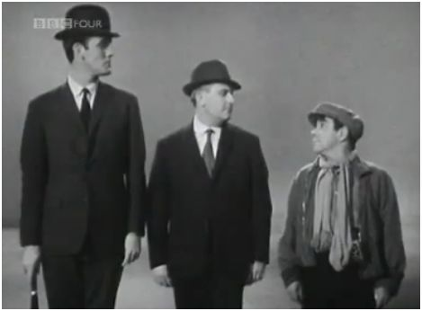
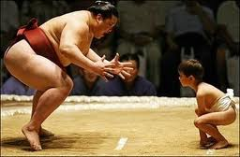
SME vs. Large companies
SMEs
  Want a solution to a particular problem
  Want a solution yesterday
  Don’t have a great deal of money to spend
  Can be very innovative and fast moving
Large Companies
  Interest in a wide area of problems
  Can see the longer term
  Do have money
  Take time to build a relationship

Slide 7
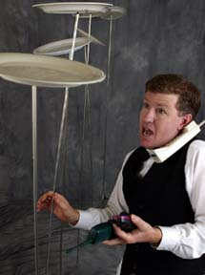
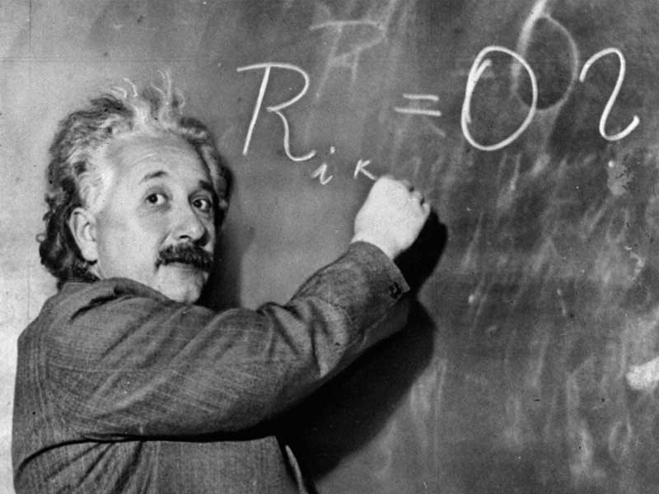
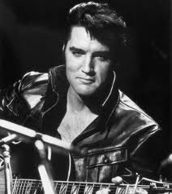
What does this make an academic?
A plate spinner?
  Perform many tasks simultaneously with equal dedication and expertise
  Don’t drop any!
  Bigger plates are better
    Easier to show off
    But make bigger smashes
  Only high quality porcelain

Slide 8

NDAs
Most companies want one in place
Protects what they tell you and vice versa
  Allows them to talk openly about their problems
  Stops them walking off with your ideas
This is a bottleneck at Warwick so allow time
Academics not allowed to sign an NDA but expected to adhere to them
Expect this process to be simple

Slide 9
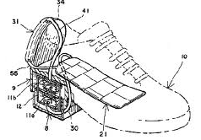
Patents
Protection of IP
Companies will want ownership if they are paying
Very valuable when setting up a spin-out company
Very expensive past 1st year
  University will want someone to bear these costs
Companies use them as protection
  Allows them to continue to operate

Slide 10

Making Contacts
Conferences
Visiting companies
May contact you
Training courses in industry
Ex-students act as ambassadors
Professional bodies - committees

Slide 11

Final thoughts …
Concept of a PI
  Industry is confused by this
Speak to the right people
  Need to convince those with the purse strings as well
Contracts can take a long time
  Don’t lose heart

Slide 12

Where to start
Start Small to build up confidence
KTPs, Case Awards
Work with others
  Use a mentor
  Get involved with projects led by others

Slide 13
Notes:
1) Oxbridge and the School have grown industrial income..levels are negligible in other depts.

Slide 14
Notes:
Research Council income/capita looks to be inline with (better than) some larger faculties
Industrial income /capita looks low compared to faculties; this suggests that, with the exception of Oxbridge, larger specialist departments are significantly better at attracting industrial funding compared to smaller general departments. [Need to do more analysis to check this.]

Slide 15
Funding Year | Sum of Industry Awards | Sum of Engineering Awards | % Industry Funding
2010-2011 | £714,134.00 | £3,884,770.00 | 18.38%
2011-2012 | £485,272.00 | £5,453,451.00 | 8.90%
2012-2013 | £1,105,595.00 | £10,371,125.00 | 10.66%
2013-2014 | £2,074,063.55 | £9,415,718.00 | 22.03%
2014-2015 | £603,067.54 | £7,742,147.00 | 7.79%
Grand Total | £4,982,132.09 | £36,867,211.00 | 13.51%

