Slide 1
Research for Industry

Slide 2
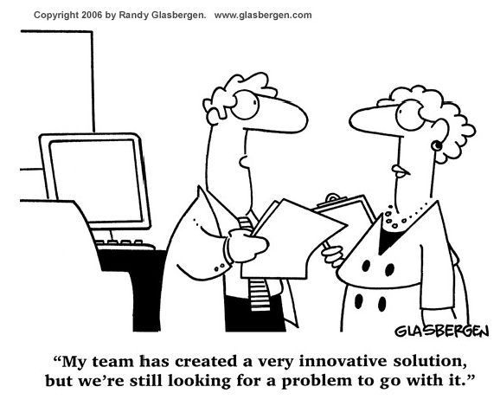
2

Slide 3
Innovation is needed at every part of a lifecycle
Create, Manufacture, Build
Research,
Design and Develop
Decommission
and Dismantle
Operate, Maintain
and improve
Notes:
What do engineers do?
Engineers do all of the above so which engineer do you think you would like to be.

Slide 4
Financial and strategic support
All innovations go through the ‘valley of death’
Financial support to guide innovations over the ‘valley of death’
Strategic support to make sure that the organisation mobilised to help and adopt
We love it!
Eventual
reality
Expectations
Let’s stop it
Time

Slide 5
What is innovation?.....
Developing brand new technologies
New uses of existing technology
Enhancement of existing technologies or technology transfer from other sectors
Can be at component, sub-system or system level
Developing enabling/underpinning technologies

Slide 6
Open innovation pipeline – using people that know to solve problems not always solving it yourself
Engaging solvers
Turning ideas into businesses
Adoption
WHO?
Customers
Suppliers
Internet
Universities
Retirees
Start-ups
Competitors
Inventors
Open source
HOW?
Licensing
Spin offs
Existing businesses
Ventures
JVs
Investments £
Gate
Gate
Gate
Gate
Target
Ideas
Abandon
Adapted: H. Chesbrough

Slide 7
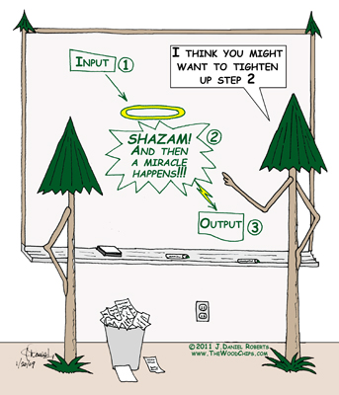

Slide 8
It’s all about people - Successful innovation causes
stress to mature organisations…..
The need to standardise
The need to innovate
Vs
Work flows and procedures
Risk management
Reduce costs
Regulations
Explore new things
Questioning the status quo
Distracting from the task
Unclear priorities
It’s not easy and often not welcome!!

Slide 9
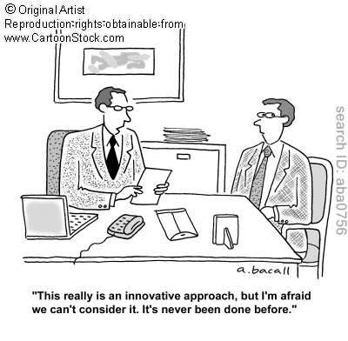
9

Slide 10
Research shows a consistent relationship between innovation and growth
On average, top quartile innovators have:
2.5 times higher sales of new products than companies in the bottom quartile
10 times higher returns from their innovation investment
Achieving Innovation Excellence can boost the earnings before interest and tax (EBIT) margin by 4 percentage points through both top line growth and bottom line improvements
Source: Arthur De Little Innovation Excellence Study

Slide 11
The next time you want to make real change happen in your organization, get ready to experience this sequence:
1. People deny that the innovation is required.
2. People deny that the innovation is effective.
3. People deny that the innovation is important.
4. People deny that the innovation will justify the effort required to adopt it.
5. People accept and adopt the innovation, enjoy its benefits, attribute it to people other than the innovator, and deny the existence of stages 1 to 4.
(Inspired by Alexander von Humboldt’s ‘Three Stages Of Scientific Discovery’, as referenced by Bill Bryson in his book, ‘A Short History Of Nearly Everything’.)

