Slide 1


Race Car Aerodynamics:
The Effect of Cooling System Layout on Race Car Performance
In Association with Perry Cohn of Angle Consulting.
Kellieann Hukins

Slide 2
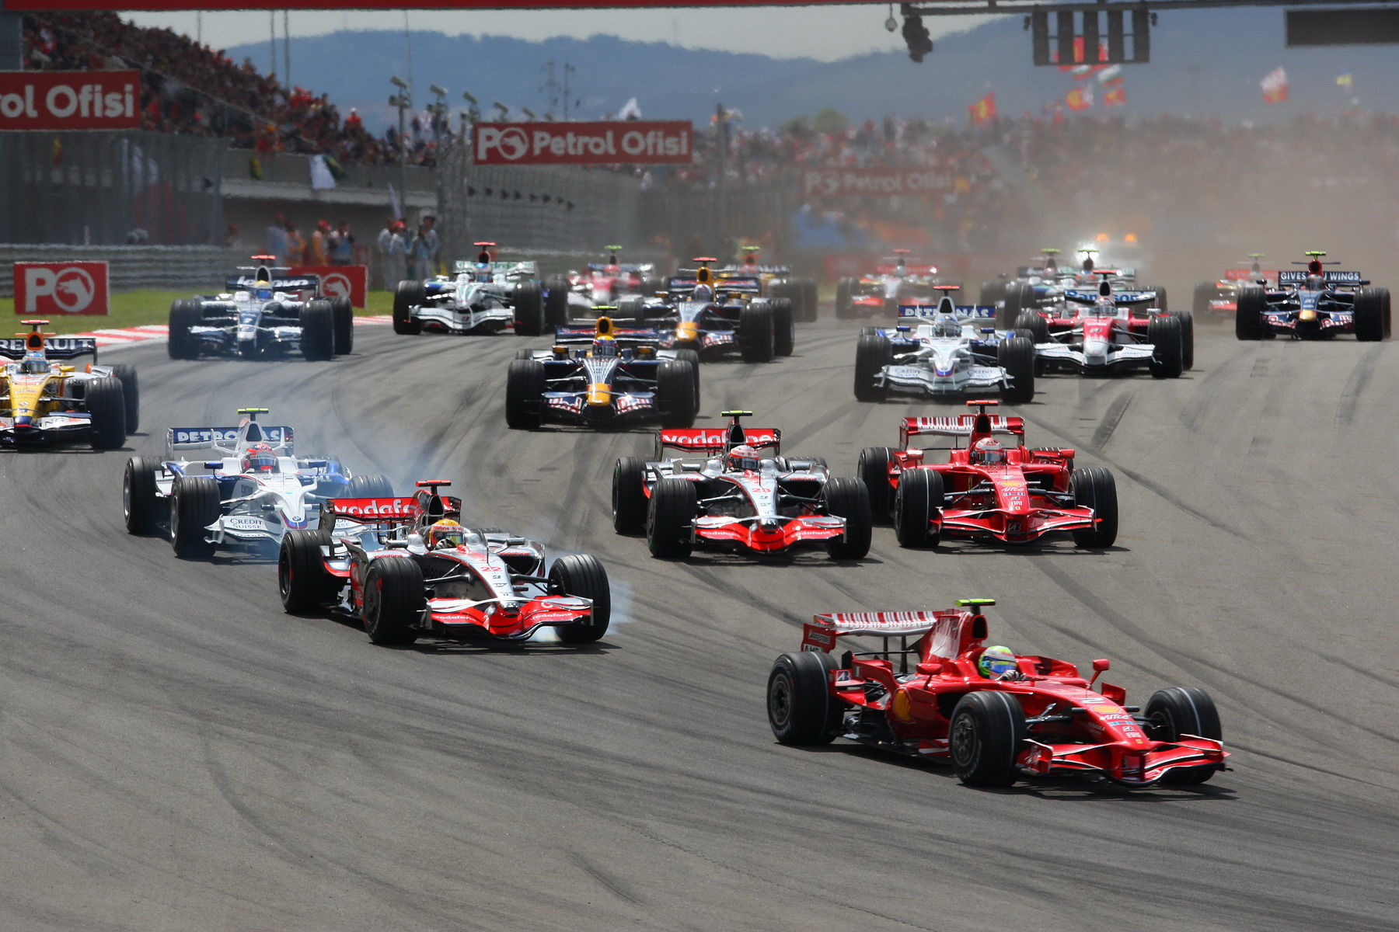
Project Outline
The project will assess the effects of airflow through a race car cooling system, and how this affects the performance of the car.
Performance of the car is also affected by mechanical effects of the cooling system layout;
  fluid pressure drop
  moments of inertia
  (centre of gravity and polar moments)
To assess the performance, focus will be on:
  Engine power
  Weight
  Drag
Image: http://www.f1-site.com/wallpapers/2008/turkish/f1/race/turkish-f1-wallpaper-2008-1.jpg
Kellieann Hukins

Slide 3
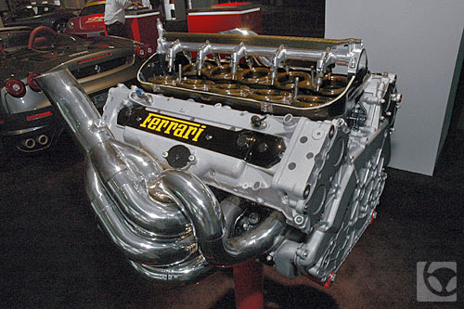
Project Aim
Balance engine temperature with cooling system drag
to provide optimum performance and engine life.
Image: http://www.automotive.com/auto-shows/59/569/2006/laas/-ferrari-f1+engine--front.html
A standardized engine rule may be introduced into Formula 1 racing in order to cut costs.
2008 regulations state:
“Drivers must use the same engine for two consecutive events,
an event comprising final practice, qualifying and the race.”
http://www.formula1.com/inside_f1/rules_and_regulations/sporting_regulations/6844/
Kellieann Hukins

Slide 4
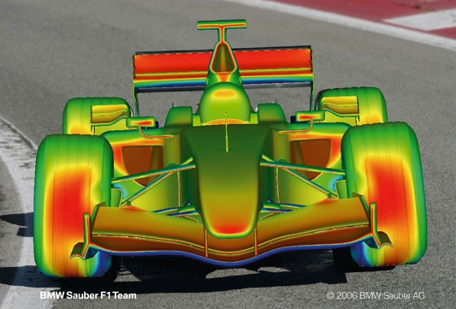
Plan
Research
Collect real cooling system data and estimated engine data
Obtain geometry of a general cooling system
Aerodynamic analysis of the cooling system geometry – CFD – Star CCM+
Analysis of data and results
Evaluate the geometry to improve car performance.
Image: http://www.ansys.com/special/news-images/images/bmw-11-1-07/cfd-1-thumb.jpg
Kellieann Hukins
Notes:
Image shows Pressure distribution across car caused by fluid flow.

Slide 5
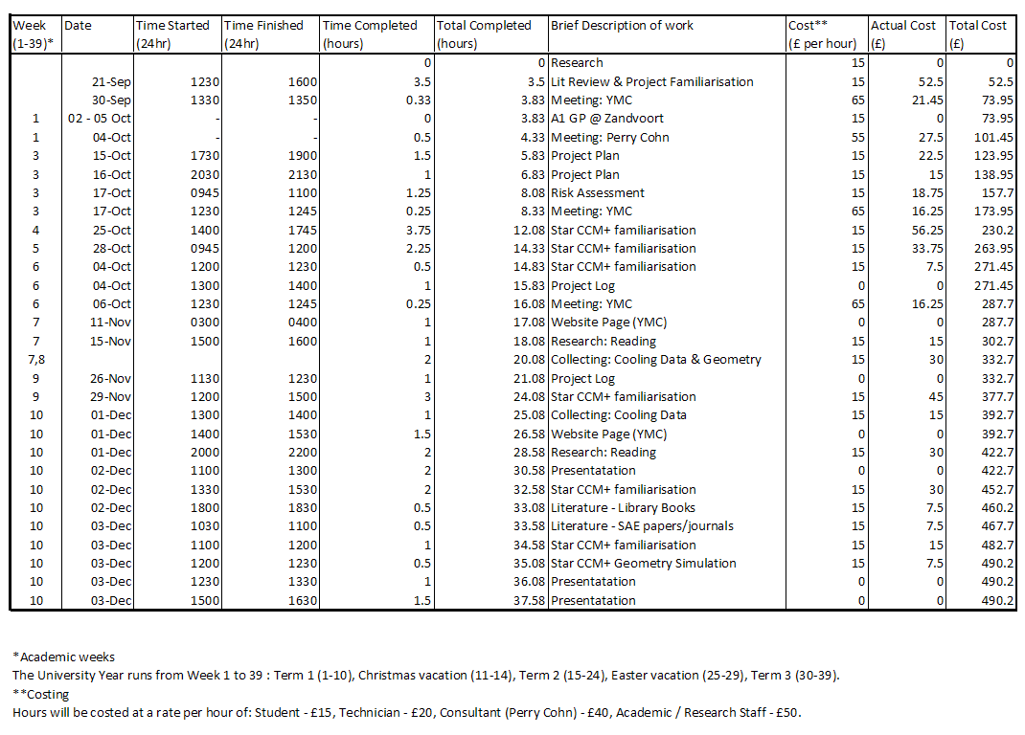
Term 1 Progress
Kellieann Hukins

Slide 6
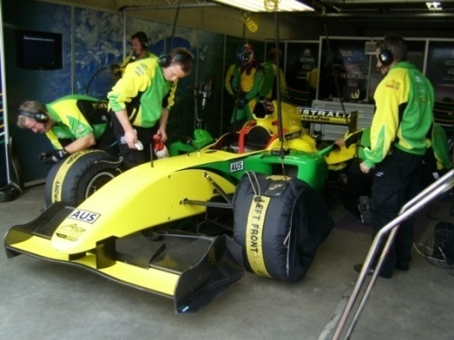
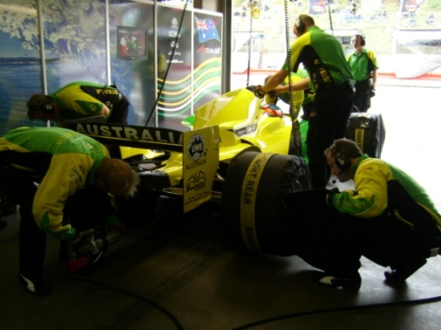
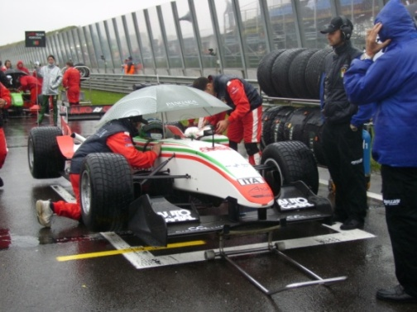
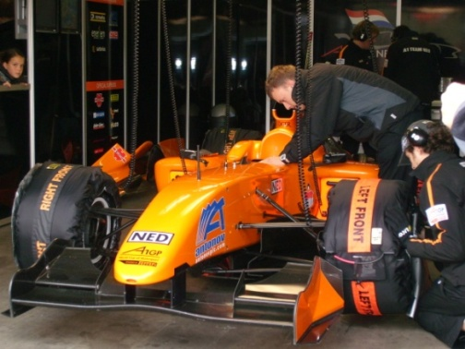
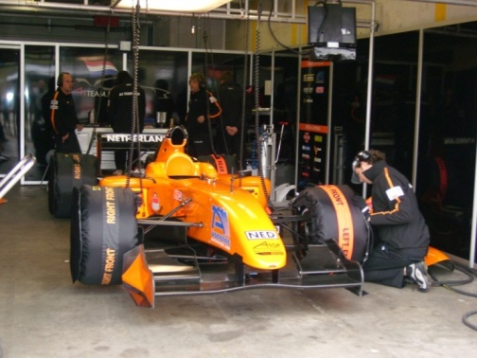
Term 1 - Research
A1 GP – Netherlands (Zandvoort) 2nd-5th October 2008
Photographs: A1 GP – Amsterdam October 2008
Literature
  Textbooks
  Journals/Papers
  Reliable Internet websites
  Lecture Notes
    ES3D6 Fluid Mechanics for Mechanical Engineers (Follow on from ES2A7 Heat & Fluid Flow)
Kellieann Hukins

Slide 7
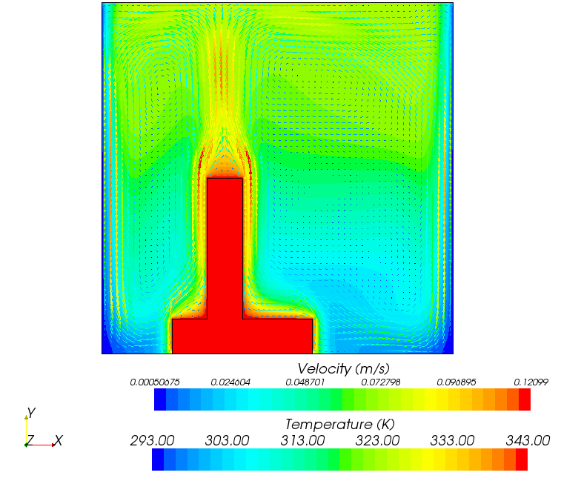
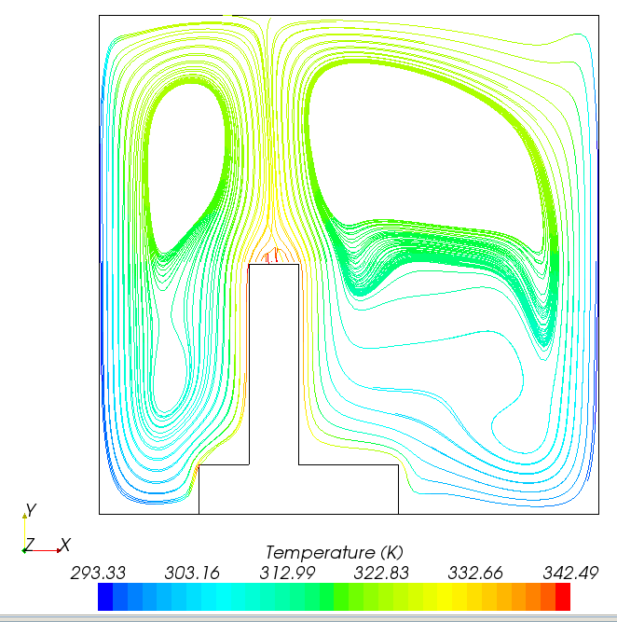
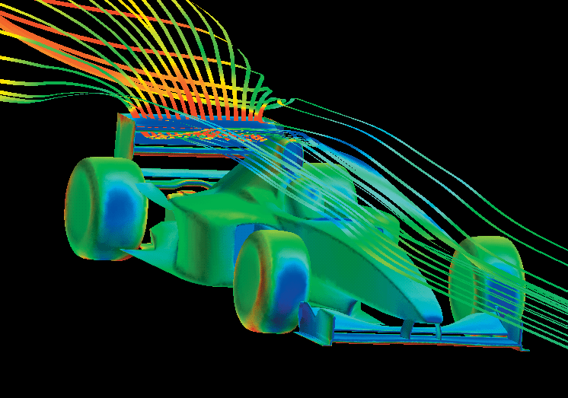
Term 1 – CFD Familiarisation
  CFD SOFTWARE: STAR CCM+
  ES440 Lab: INTRODUCTION TO STAR-CCM+ (Help Topics)
  Star CCM+ HELP: Training Guide: Introduction
  ES440 Lab: INTRODUCTION TO STAR-CCM+ (Mixed Pipe Flow)
  ES440 Lab: SETTING UP A SIMULATION (Bump)
  Star CCM+ HELP: Training Guide: Heat Transfer (Heated fin)
  (http://www2.warwick.ac.uk/fac/sci/eng/euo/modules/year4/es440/resources/lab)
Image (Bottom Right): http://www.fluent.com/about/news/newsletters/02v11i1/a16.htm
Images (Left): STAR CCM+ -Heated Fin Tutorial Simulation
  CFD SOFTWARE : Alternative
  Fluent
Kellieann Hukins
Notes:
Fluent CFD software is widely used for simulating radiator cooling flows

Slide 8
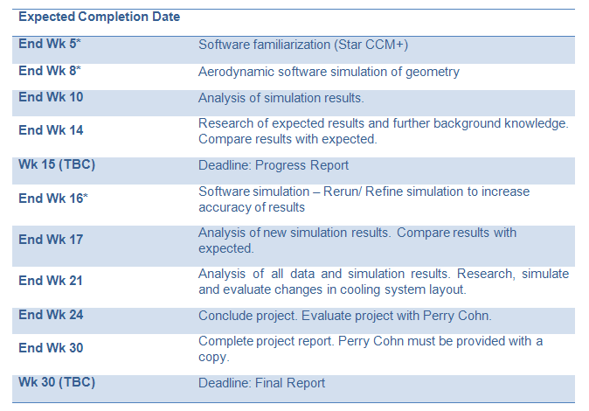
Proposed Timetable
*Assumption: No problems or points of difficulty with Star CCM+ software in order to meet the expected completion date.
Kellieann Hukins

Slide 9
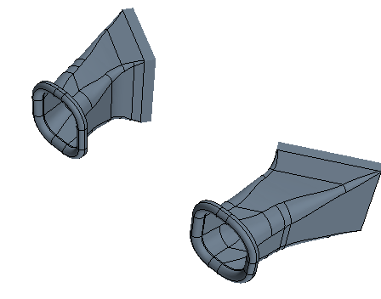
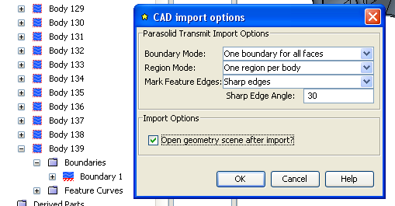
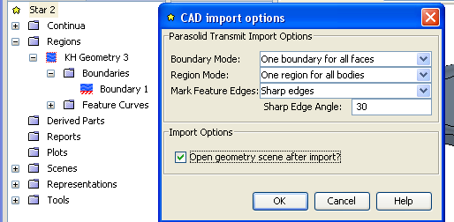
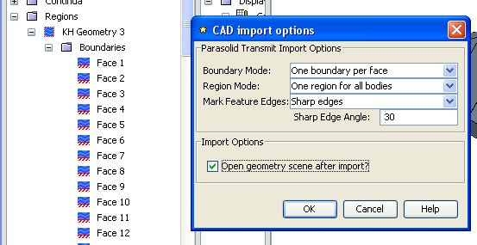
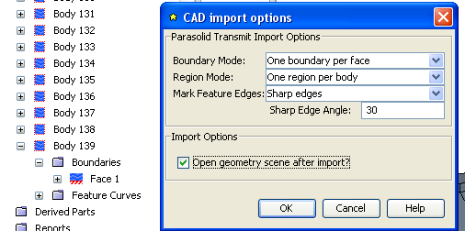
Term 1 – Geometry CFD Simulation
Images: STAR CCM+ -Simulation
Kellieann Hukins

Slide 10
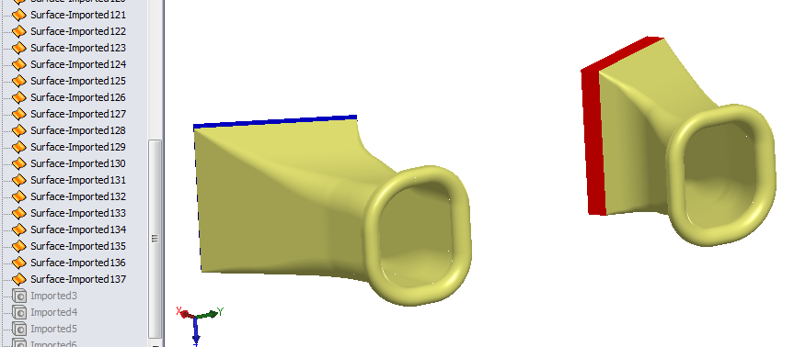
Further Progress
Over Christmas Holiday
  Run simulation
  Analyse results
Next term
  Evaluate and refine simulation
  Analyse geometry layout
  Edit and Refine* layout
  Run simulation with new geometry
  Analyse and Evaluate cooling layout
Image: SolidWorks –Cooling System Geometry
Kellieann Hukins

