Slide 1
Term 1 Project Progress Presentation
Simon Royle

Slide 2
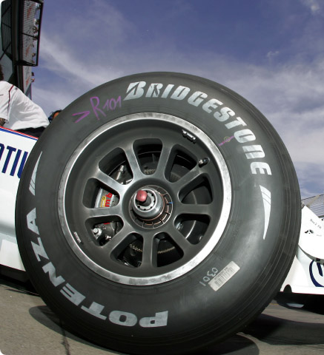
Introduction
Project Title:
The Aerodynamics of a Rotating Wheel on a Race Car

Slide 3
Introduction
Project Aims:
  To investigate the flow around and over a rotating wheel
  Gather quantitative data of the lift and drag forces
  Alter wheel diameter, depth and inset
  Decide on idealised wheel and discuss feasibility of this for different class’ of race vehicle including the University Of Warwick Formula Student Car 2009.

Slide 4
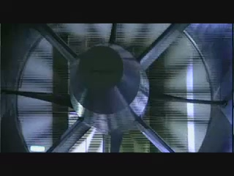
Introduction
Plan:
  Research prior experiments/investigations, compile useful data/findings to compare to my results
  Create a range geometries using Solidworks, and import into Star CCM+ to run CFD simulations
  Run a number of simulations
  to compile results and analyse.

Slide 5
Project Timetable – Term 1
Background reading
  Reading texts from the library and reliable internet sources, as well as revision on relative lecture topics.
    Constant
Familiarisation with software, both Solidworks and Star CCM+.
  This involves using the walk through tutorials in both Software Packages and running simple simulations of CFD.
    By week 5
Run an animated model in the Star CCM+.
  Getting the setup of the rotating wheel and moving road within star CCM+
    By week 10

Slide 6
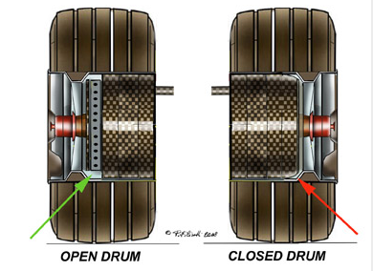
Project Timetable
I have read a range of books from the library.
The most useful book so has been Racecar aerodynamics by Josef Katz because of this I have been trying to get more literature by him.

Slide 7
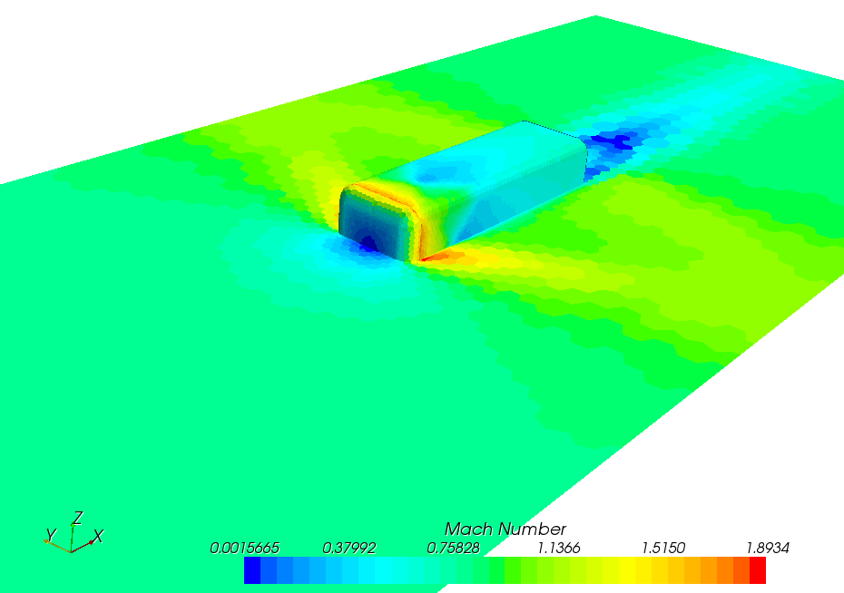
Progress
Walk through tutorials in Star CCM+ have all been completed
By running through these I have become familiar with the software, it has raised areas that I am not familiar with.
    K-Epsilon turbulence model, this is a set of equations that represent the turbulent properties of the flow. A model must be used as there is currently no way of computing the Navier-Stokes equation, as there are more unknowns than equations
Screen cap of ‘bluntbody’ tutorial

Slide 8
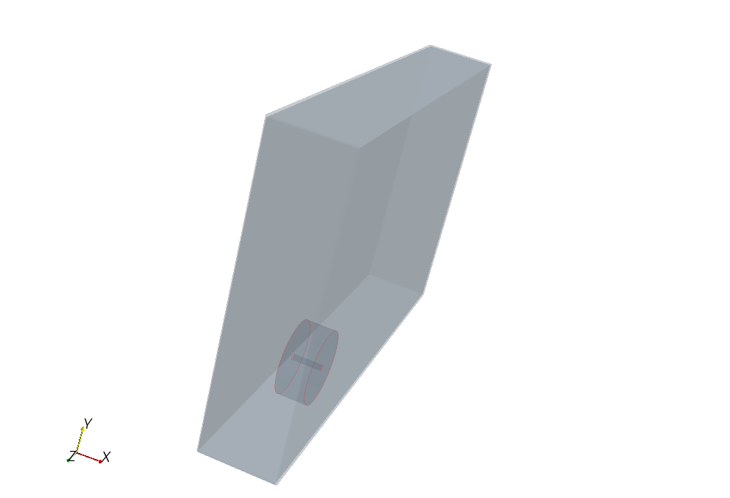
Star CCM+
I have managed to import my simplified geometry into Star CCM+, I have had a few issues getting the correct setup.
I will refer to the tutorials and investigate my errors
Image of a greatly simplified geometry in Star CCM+

Slide 9
Problem Areas
In the last few days, when trying to import my own geometry from Solidworks to Star CCM+, I continually got error messages, I have now re-designing my geometry so that Star CCM+ will allow me to import it.
Gathering information; much of the available literature is not held in the University Library, this means each paper I wish to read must be applied for, this takes a lot of time.

Slide 10
Ongoing Reading
The aerodynamics of an isolated wheel rotating in contact with the ground
    Fackrell, John Edward. 1974.
Racing Car Wheel Aerodynamics - Comparisons Between Experimental and Cfd-Derived Flow-Field Data
    Robert G. Dominy & Paul Mears - Univ. of Durham
Wind tunnel testing of racing cars - the importance of the road simulation technique
    J\axg Wildi - Swiss Federal Aircraft Factory
Investigation of Negative Lifting Surfaces Attached to An Open-Wheel Racing Car Configuration
    Joseph Katz - Faculty of Mechanical Engineering, Automotive Program, Techn

Slide 11
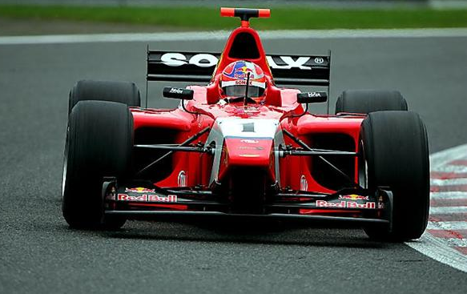
Just for a laugh
I have booked a day driving an open wheeled race car, this may or may not give me more of an insight into my project and a feel of the air flow around the open wheel.
If it doesn’t then I am sure its going to be fun anyway.

Slide 12
Holiday Work - Plan
Run Star CCM+ for all of my selected geometries
Produce a quantitative Results table
Begin qualitative analysis of flow diagrams
Continue to gather information,
books, journals etc

Slide 13
Term 2 - Plan
Begin to bring all parts of the project together
Look at more idealised wheels and suggest a possible wheel and analyse
Look into what difference front splitters can have

Slide 14
Term 2 - Plan
Begin write up of theory behind the flow patterns
Bring together all of my conclusions
WRITE THE REPORT!!!!

