Slide 2
Construction of finite difference schemes, used for approximating derivatives of functions
Examples of different schemes
Analysis of different schemes

Slide 3
Constructing Finite Difference Schemes
Can be done by using Taylor Series
A representation of a function as an infinite sum of terms calculated from the values of its derivatives at a single point
Simpler examples: forward difference, backwards difference, central difference

Slide 4
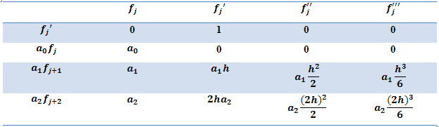
How can we construct more accurate schemes?
We want the order of O(h) to be as high as possible
Say we want to construct a scheme for f’_{j} involving values at points j, j+1 and j+2
Use a Taylor Table. This displays the first four terms in the Taylor Series expansion of the functional values in the first column

Slide 5
In this case
Once we have the scheme, we can construct the coefficient matrix

Slide 6
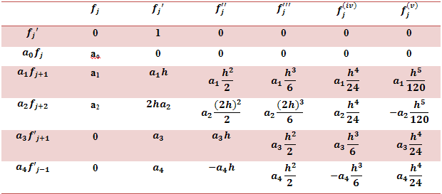
Padé approximations
Say we want to construct a scheme that includes f_{j}’, f’_{j+1}, f’_{j-1}, as well as f_{j}, f_{j+1}, f_{j-1}
Use a Padé table:
Compact schemes based on Padé approximations

Slide 7
For partial differential equations, we first have to discretize our equation, and then write in matrix form
For uniform grids our discretization equation will take the form
Take the convection equation
on a uniform grid
Use central order difference method
Writing this in matrix form gives A =

Slide 8
We will look more closely at these discretization matrices by considering three different schemes on non-uniform grids.
For non-uniform grids, our discretization equation will take the form
A is built out of the grid spacings
B is the coefficient matrix

Slide 9
Scheme 1: Backward Difference
The coefficient matrix will be non-zero (will have 1 for every diagonal entry)

Slide 10
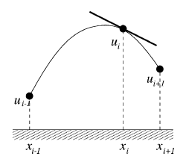
Scheme 2: Lagrangian Interpolation
The coefficient matrix will again be non-zero for diagonal entries

Slide 11
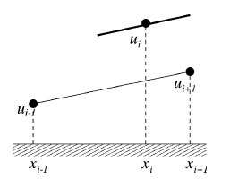
Scheme 3: Non-uniform Central Order Difference
The coefficient matrix will have zero for all diagonal entries

Slide 12
What is the fundamental difference between coefficient matrices with non-zero diagonal entries and zero diagonal entries?
It turns out that schemes which have zeros on the diagonal of the coefficient matrix
preserve the kinetic energy of the system
have lower global discretization errors

Slide 13
