Slide 1

MSc Welcome Week 2023
School of Engineering
Jose Ortiz Gonzalez – Director of MSc Programmes
26th of September 2023 – Physics Lecture Theatre (PLT)

Slide 3
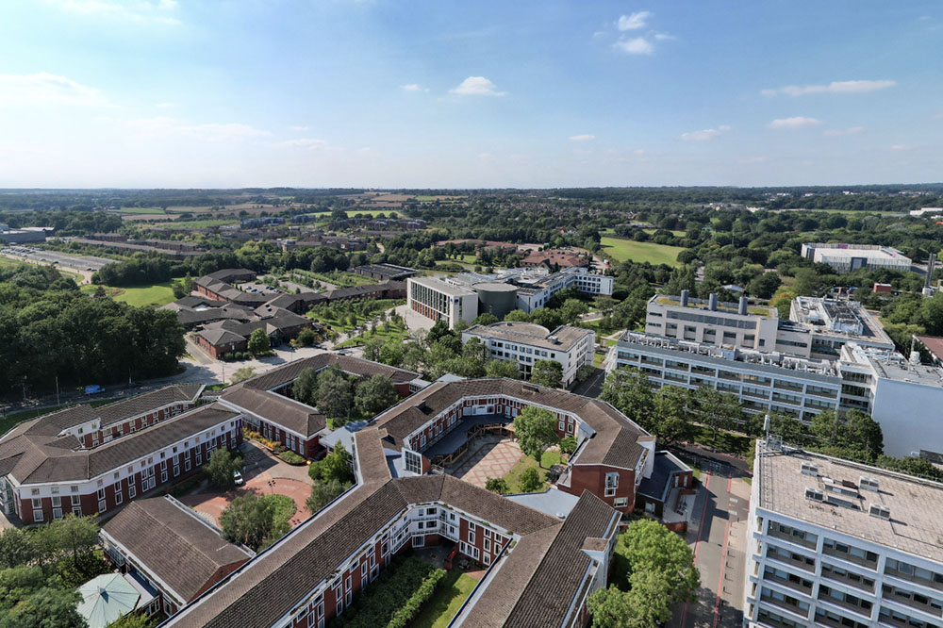
Welcome to Warwick
The University is a “young” University
1965 (Only 58 years old)
Top 10 ranking in the UK
Top 100 ranking in the World
Top target for employers

Slide 4
Welcome to Warwick
What about the School of Engineering (SoE)?
6th for General Engineering according to Complete University Guide 2024
10th for General Engineering according to Times and Sunday Times University Rankings 2024
100% graduate prospects score. We are placed 1st in the UK - tied with Cambridge (Complete University Guide 2024 for General Engineering)
Unified approach to teaching engineering
Research
Research Excellence Framework 2021 (REF 2021)
92% of our outputs are world-leading or internationally excellent in terms of originality, significance and rigour

Slide 5
Welcome Week
Monday 26th September - Wellbeing, Careers and Library Services
Tuesday 27th September – Your home department, your course…

Slide 6
School of Engineering Staff
Head of Department
Prof. John Murphy
Organisation
Head of Teaching
Prof. Georgia Kremmyda
Senior Tutor
Dr Gary Fowmes
Director of MSc Programmes
Dr Jose Ortiz Gonzalez
Director of Student Experience
TBC
Deputy Senior Tutor
Nigel Denton
Course Coordinators
Advanced Mechanical Engineering
Dr Stan Shire
Electrical and Electronic Engineering
Prof. Marina Cole
Communications and Information Engineering
Dr Subhash Lakshminarayana
Electrical Power Engineering
Dr Oleh Kiselychnyk
Biomedical Engineering
Prof. Christopher James

Slide 7
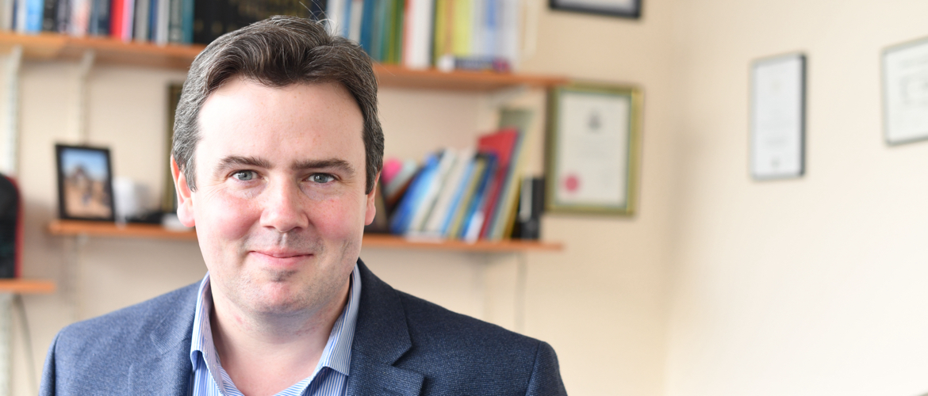

School of Engineering Staff
Head of Department
Prof. John Murphy
F314
Head of Teaching
Prof. Georgia Kremmyda
F312

Slide 8
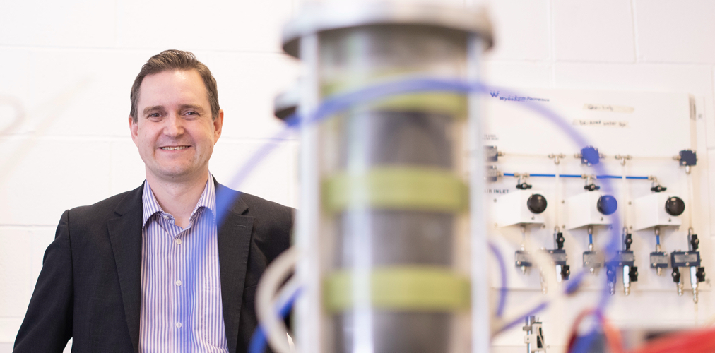
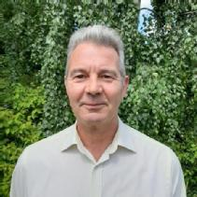
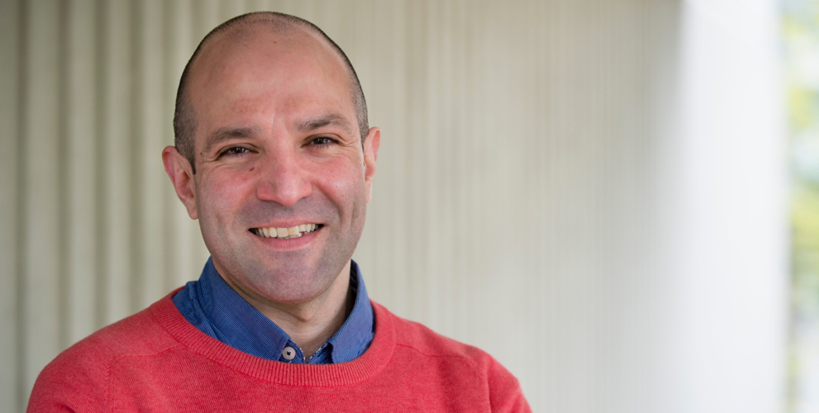
School of Engineering Staff
Senior Tutor
Dr Gary Fowmes
F325
Deputy Senior Tutor
Nigel Denton
Director of MSc Programmes
Dr Jose Ortiz Gonzalez
D204

Slide 9
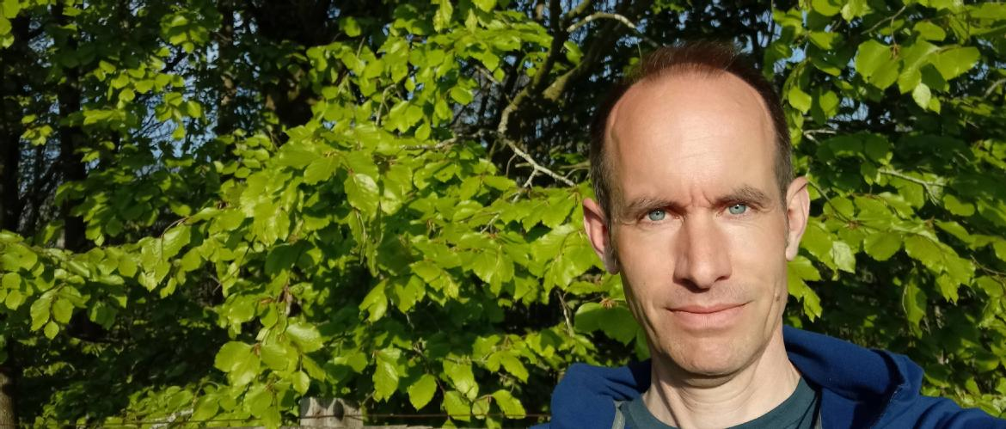
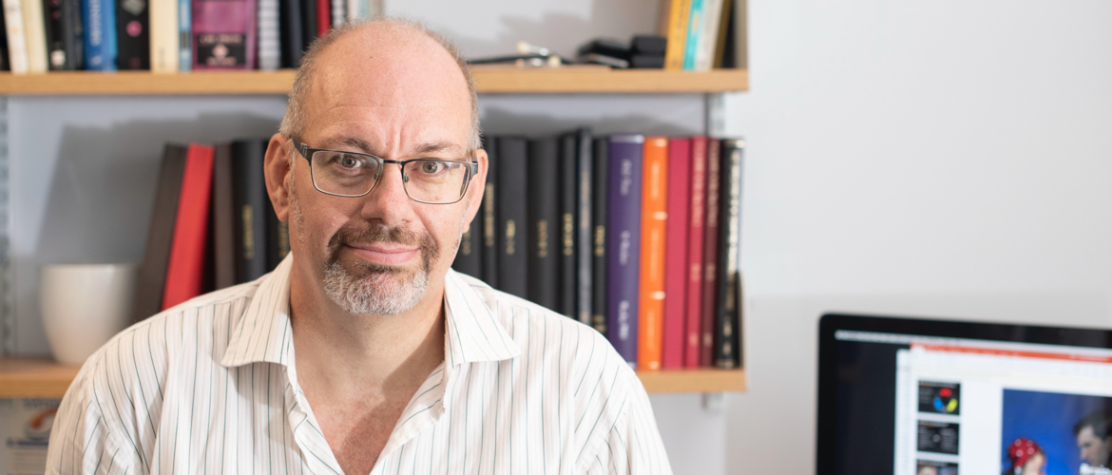
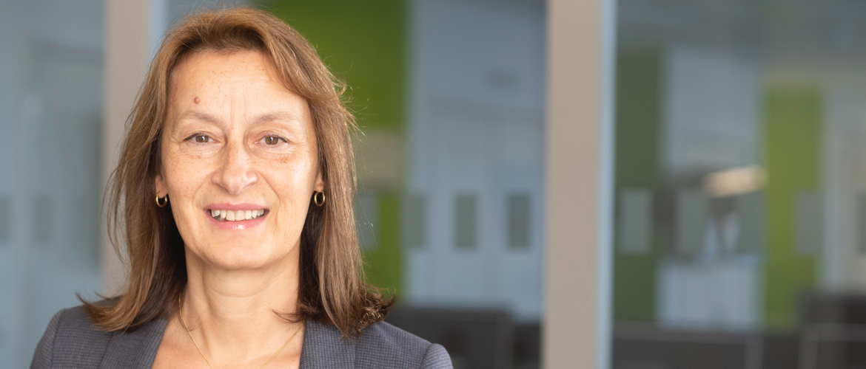
Course Coordinators
Advanced Mechanical Engineering
Dr Stan Shire
F322
Biomedical Engineering
Prof. Christopher James
D218
Electrical and Electronic Engineering
Prof. Marina Cole
A330

Slide 10
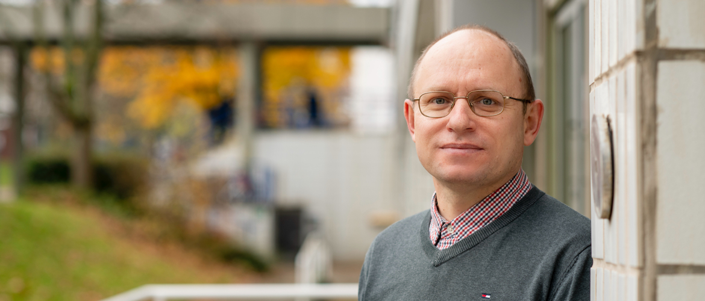
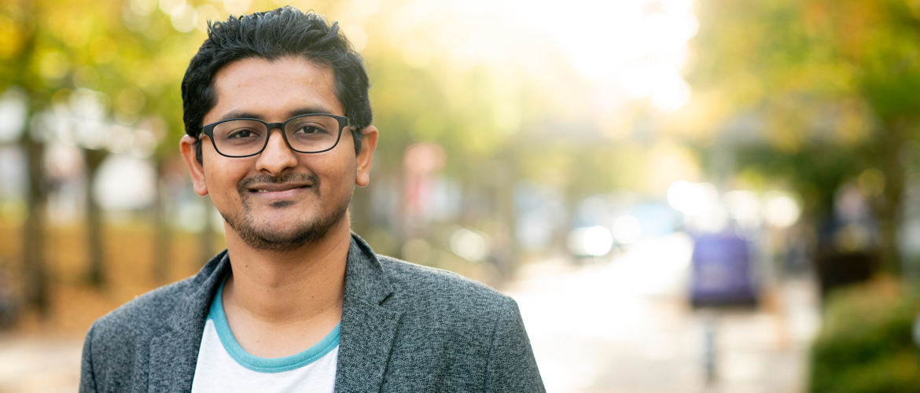
Course Coordinators
Electrical Power Engineering
Dr Oleh Kiselychnyk
A411
Communications and Information Engineering
Dr Subhash Lakshminarayana
A410

Slide 11
Staff Student Liaison Committee (SSLC) and Feedback
SSLC is an opportunity for you to express concerns through a representative
Staff and students
Course Coordinators will hold informal feedback sessions with students on their courses to help us improve the delivery of the courses and for us to help you during your time here.
Module feedback will be by means of on-line questionnaires
Your feedback is very important for us.

Slide 12
Personal Tutor
Personal Tutor
Your Personal Tutor is an accessible, approachable point of contact for your department.
They can:
Suggest ways to get involved in your department and the wider university
Offer advice on how to develop your academic performance
Signpost to development opportunities and support
Supply references to support applications for jobs or further study
If you have health or other issues that might affect your studies, discuss these with your Personal Tutor. They can ensure you find the right support.
https://warwick.ac.uk/services/dean-of-students-office/informationforstudents/

Slide 13
Personal Tutor
Your individual project supervisor will act as your personal tutor
(Before projects are allocated, the Course Coordinators will perform this role)
For personal issues that you may wish to discuss, especially if you feel that they will affect your performance or ability to make a deadline
They may refer you to the School’s Senior Tutor (Dr Gary Fowmes)
Only the School Senior Tutor can grant special consideration of your circumstances

Slide 14
MSc Courses in Engineering
In this welcome week event, we are covering 5 MSc courses
Advanced Mechanical Engineering -
Biomedical Engineering -
Communications and Information Engineering -
Electrical and Electronic Engineering -
Electrical Power Engineering -
These courses are 180 credit courses
120 credits – 8 taught modules
60 credits – Individual Project Dissertation

Slide 15
MSc Courses in Engineering
Students will take several core modules (each 15 credits) and will select some optional modules (each 15 credits).
For guidance, the typical workload for a 15 credits module is as follows:
20-30 hours of lectures/seminars
5 hours of laboratory work
45 hours of private/directed study
70 hours of assessed work
Assessment can be:
100% Exam
100% coursework
Mixture Exam/coursework
https://courses.warwick.ac.uk/

Slide 16

MSc Courses in Engineering
Exams:
Written exams – in person
Online remote /online in person

Slide 17
MSc Courses in Engineering
Project

Slide 18
MSc Courses in Engineering
Engineering Student Office (ESO)
https://warwick.ac.uk/fac/sci/eng/eso/
eng.eso@warwick.ac.uk
OFFICE -
Tabula
https://tabula.warwick.ac.uk/
Access to your timetable, online submission of coursework, mitigating circumstances
Moodle
https://moodle.warwick.ac.uk/my/
Access to module material: lectures, slides, briefings…

Slide 19


Attendance Monitoring
The MSc programmes are full-time courses and any "free" time is intended for personal study and research.
You are expected to attend the lecture, laboratory and seminar sessions that are timetabled since the self-managed nature of your MSc course means that the information provided in these is essential to your success.

Slide 20
Attendance Monitoring
The University monitors student attendance and progress.
The Tabula system will indicate your monitoring points throughout the year.
Missing many monitoring points will trigger an interview with the Director of Studies and Director of MSc Programmes.
Ultimately, you may be required to withdraw if your poor attendance continues.
It is recommended that students do not attempt to undertake part-time work during their registration period.

Slide 21
Absences
Absences through illness or relevant personal reasons such as hospital appointments, attendance at funerals, family crises and so on should be reported to the Senior Tutor
To obtain extensions, relevant proof will be needed, e. g. doctor’s note covering the period of the extension.
Although these can also be discussed with personal tutors and/or the MSc course Director, the Senior Tutor is the only member of staff who can grant and approve extensions

Slide 22
Policies
SoE Online Learning Monitoring Policy
SoE Extensions Mitigating Circs policy
SoE Missed Lab Policy
SoE Self-certification
SoE Wrong File Upload Policy
SoE_Policy for return of marks_high levels of self cert
MSc Handbook 2023/2024

Slide 23
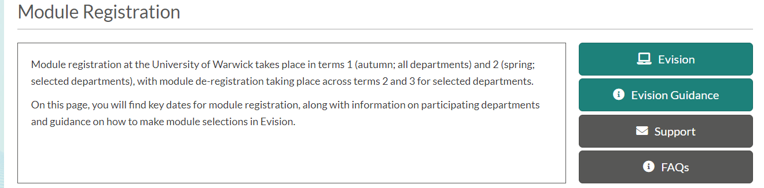
Module Registration
Module Registration and Selection
https://warwick.ac.uk/services/academicoffice/modules_marks_assessments/module_registration/

Slide 24
Module Registration
Selection of optional modules will be completed before Friday week 1 Term 1,via the online system.
You will have received information via email on the online registration process before arriving. A help page and a list of FAQs is available.
Options can be changed after the deadline (subject to approval) provided no more than 10 % has already been assessed

Slide 25
IN SESSIONAL ENGLISH LANGUAGE SERVICES FOR INTERNATIONAL STUDENTS ACROSS THE UNIVERSITY
Term 1
Workshops for Writing and Speaking in weeks 2 & 3. No registration required.
Weekly group classes in Writing & Reading, and Speaking & Listening in weeks 4 to 10. Registration required.
Term 2
Bookable one-to-one surgeries in weeks 1 and 2.
Weekly group classes in Writing & Reading, and Speaking & Listening; in weeks 3 to 10.
Term 3
Weekly Dissertation Writing workshops in weeks 4 to 8.
Presentation skills workshops in Weeks 4 to 8.
Bookable one-to-one surgeries in weeks 1 to 2 and weeks 7 to 10.
Specialist English classes for students which focus closely on subject-specific language can also be arranged. See English for Academic Purposes - Home (sharepoint.com) for more information.

Slide 26
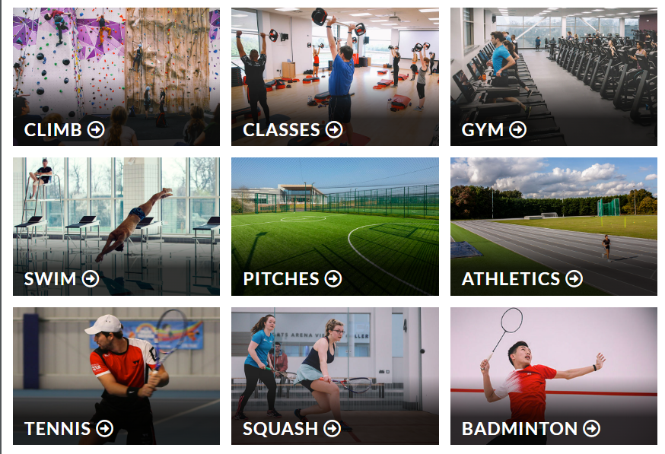

Societies and Sports Clubs
There are over 250 societies at Warwick and over 60 sports clubs.
Make the most of your time at Warwick
https://warwick.ac.uk/services/sport/active/

Slide 27
Wellbeing
The Wellbeing Support Services is available to students and no fee is charged: https://warwick.ac.uk/services/wss
Help and advice related to psychological and emotional issues
You can access:
Face-‐to-‐face individual counselling
Talk through your issues in person
Email counselling
Therapy groups
Specific issue workshops
Self-help resources
Help with disabilities

Slide 28
Disability Team
Advice, guidance and support to students with disabilities such as sensory impairments, long-term medical conditions, mental health disabilities, specific learning differences, autism, etc. Appointments offered Mon –Fri all year.
Reasonable adjustments including special exam arrangements to facilitate study – liaison with academic departments, accommodation team
Information on available funding e.g. Disabled Student Allowances
One to one specialist support and practical enabling support (mentoring, study skills, note taking etc.)
Raising awareness of disability, accessibility and inclusive teaching & learning practices for all; offering staff awareness sessions

Slide 29
Diversity
One of Warwick’s great strengths is its diversity.
During your time at Warwick you will be working with, and forming friendships with people whose circumstances, values, or beliefs are different to yours.
The University is committed to ensuring a working and learning environment in which all University members: Staff, Students and Visitors (including Contractors) are treated fairly and with dignity and respect.
Bullying, harassment or other breach of the Dignity at Warwick Policy would normally be considered a Major Offence under the Disciplinary Regulations http://www.warwick.ac.uk/calendar/section2/regulations/disciplinary/
You need to be aware that the UK Equality Act 2010 outlaws discrimination on grounds of the following protected characteristics:
Age Disability Gender reassignment
Race Sex Marriage and civil partnership
Sexual orientation Religion or belief Pregnancy and maternity
Please be responsible and respectful in the way that you interact with others at Warwick, including your use of Social Media

Slide 30


Athena Swan
School of Engineering holds Silver Chartermark
Removing barriers to gender equality in Science, Technology, Engineering, Maths, and Medicine
Engineering Society affiliation with the Women’s Engineering Society
https://warwick.ac.uk/fac/sci/eng/about/equality_and_diversity/athena_swan/

Slide 31



Warwick Values
A
This programme is aimed at all University of Warwick students and should be completed as part of your enrolment .
It communicates your rights and responsibilities as members of the Warwick community, as well as the support options available throughout your time at Warwick:
Where everyone feels welcomed and safe to be themselves.
Where everyone is treated with dignity and respect.
Where there is equal opportunity for all to reach their potential.
You can access the course by clicking on the following Moodle link:
https://moodle.warwick.ac.uk/course/view.php?id=38595
By completing this course you confirm that they have read and understood the Principles of the University and that you agree to be bound by them. If you do not complete the online Warwick Values Moodle your Department will be notified and access to IT account potentially suspended.
“This Programme is underpinned by our five principles and how we behave as a University community.”

Slide 32


Slide 33
Next Welcome Week Events
Wednesday 28th September – Social Event 2 PM – 4PM
Thursday 29th September
School of Engineering Tours for PGT Students 11:30 AM to 12:20 PM
IT Training – 12:20 PM 1:30 PM
Social Event – Rootes Panorama – 2:15 PM to 3:45 PM

Slide 34
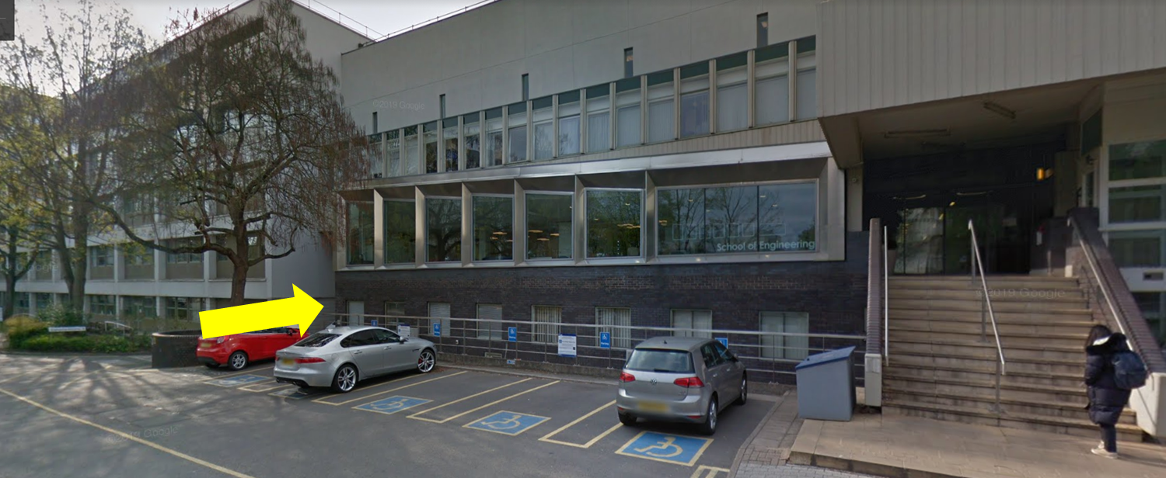
Next Welcome Week Events
PPE Collection
Wednesday 27 and Thursday 28: 9.30am - 4.30pm
SoE Loading Bay/Civil Strong Floor

Slide 35
Thank you for listening
Any questions?
The info in these slides is accurate to the best of our knowledge at point of issue (26/9/2023) and may change in due course to improve student experience or in response to external factors.

