Slide 1

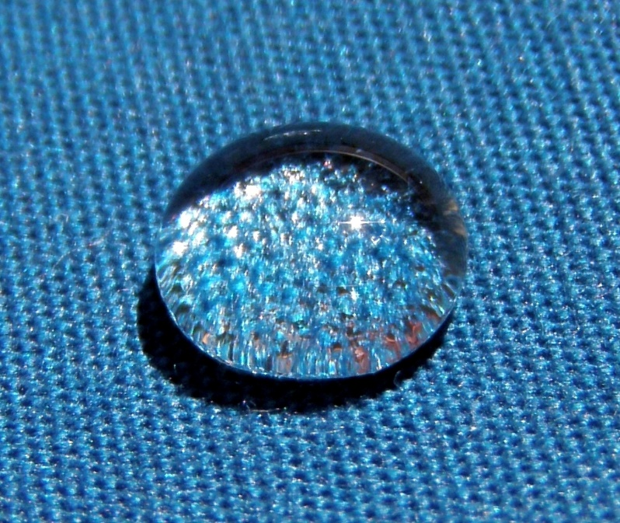
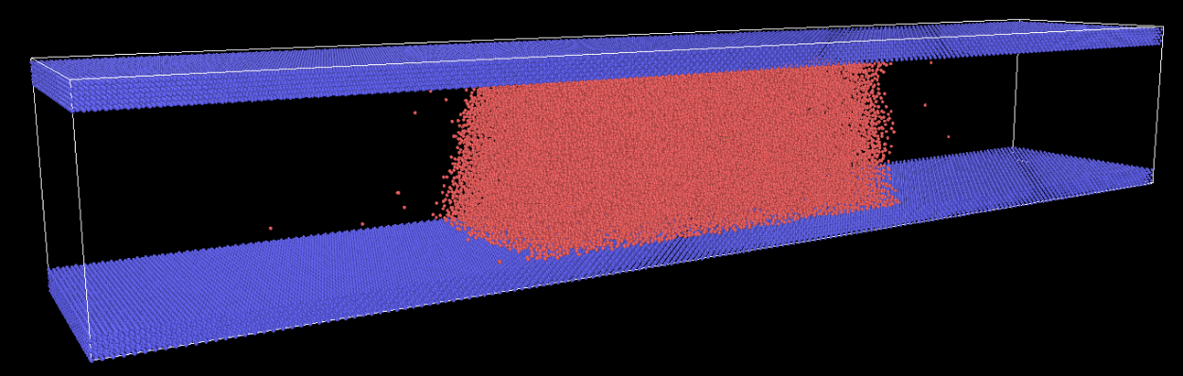
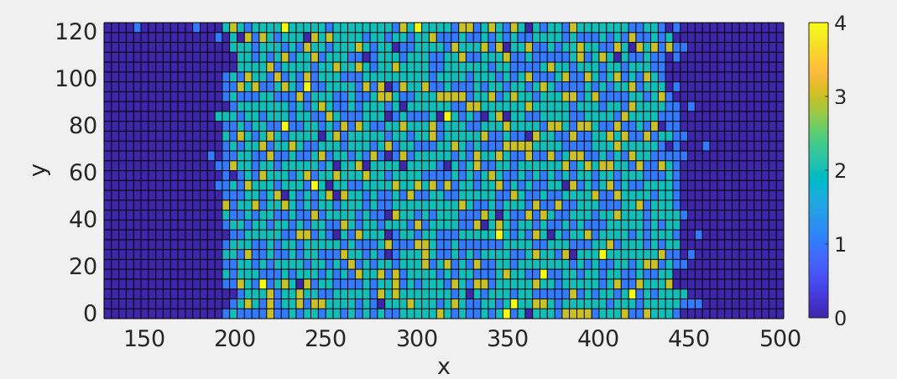

Thermal Fluctuations and Dynamic Wetting
Jingbang Liu, James Sprittles and Duncan Lockerby
University of Warwick, Coventry, CV4 7AL
Context and Motivation
Next Steps
Wetting is a common phenomenon in nature and has many applications in printing, coating and nanotechnologies. Despite being studied for decades, the precise physics behind dynamic wetting is still vague leading to heated debates. Some recent papers suggested a link can be established between thermal fluctuations and the position of the contact line using the MKT (molecular kinetic theory). In this mini project we would like to first verify the results from the literature. We then hope to explore the possibility of linking the fluctuation of the contact line to certain properties of the free surface.
Analyse the position of the contact line and verify the results from literatures.
Extract the position of the free surface using method similar to extracting the position of the contact line.
Apply the Fourier analysis and extract the wave profile of the free surface.
Explore the effect of certain key parameter: the solid-liquid coupling coefficient, the width of the liquid bridge, the height of the liquid bridge, temperature of the simulation etc.
References
Preliminary Results
[1] J-C.Fernández-Toledano, T.D.Blake, J.De Coninck. Contact-line fluctuations and dynamic wetting, Journal of Collide and Interface Science, 2019, vol 540, 322-329
[2] J-C.Fernández-Toledano, T.D.Blake, J.De Coninck. Moving contact lines and Langevin formalism, Journal of Collide and Interface Science, 2020, vol 562, 287-292
[3] Yixin Zhang, James E. Sprittles, Duncan A. Lockerby. Molecular simulation of thin liquid films: Thermal fluctuations and instability, Physical Review E, 2019
Shear viscosity and surface tension obtained from MD simulation agree with literatures.
The simulation box is uniformly divided into small bins. By binning the particles and calculating the number density in each bin a density profile
can be generated. The position of the contact line is found where the density is around half of the density in bulk.

