Slide 1
Modelling crystal nucleation and growth
David Quigley

Slide 2
Overview
Why study nucleation?
Strategies for atomistic nucleation
How quantitative can we be and under what circumstances?
Polytypes and stacking disorder in ice nuclei
Nucleation via metastable phases - ice 0

Slide 3
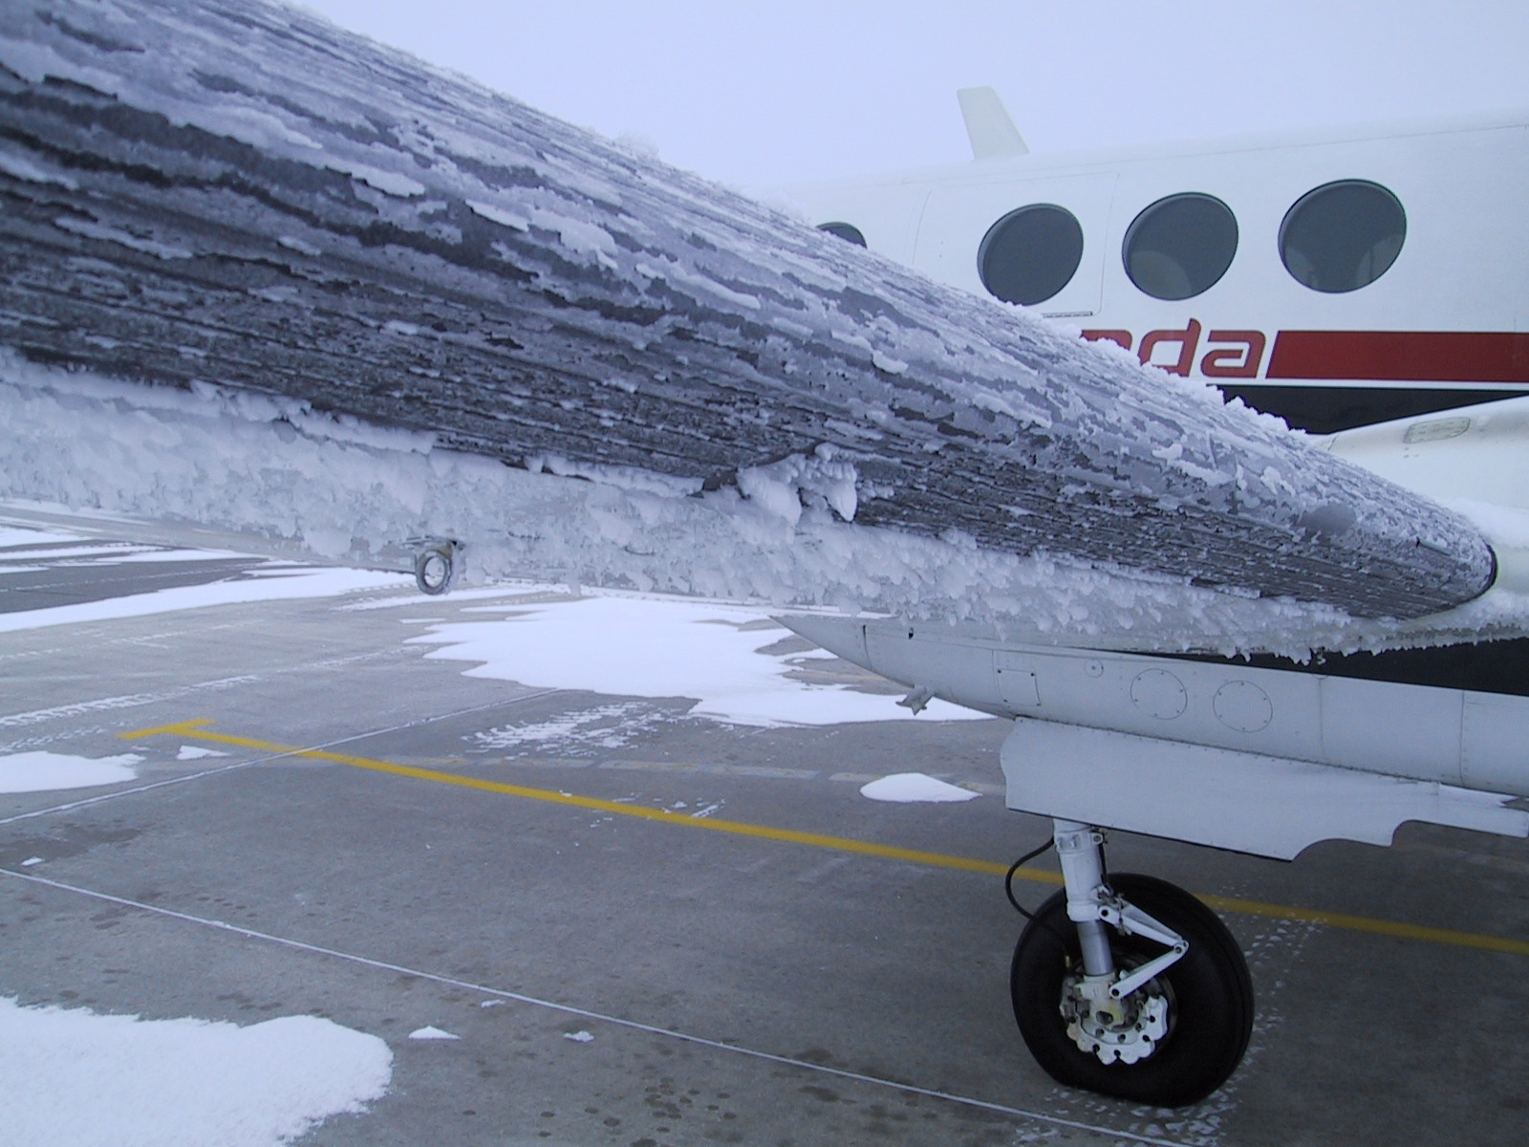
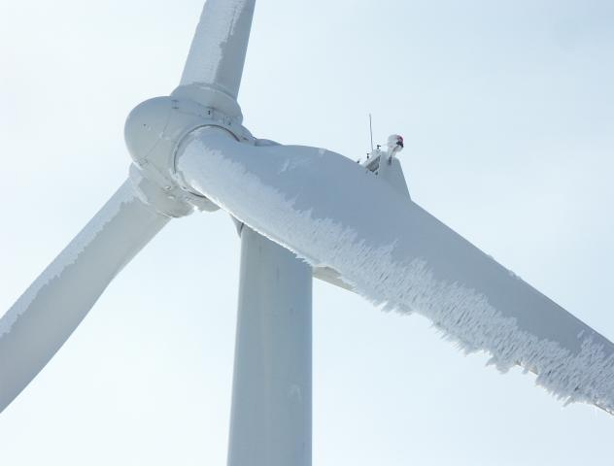
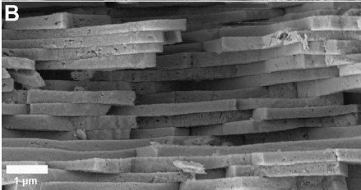
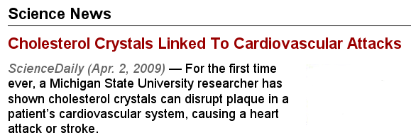
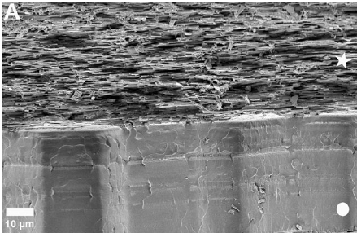
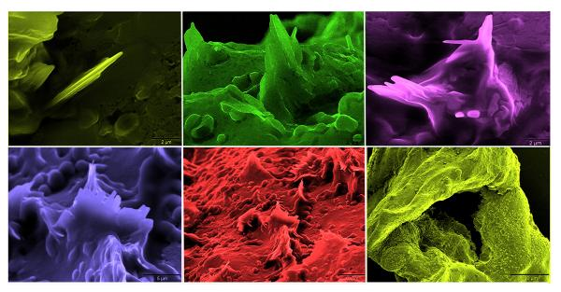
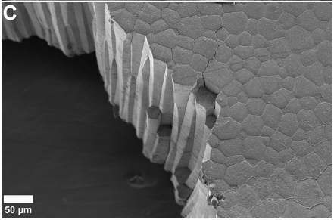
Motivation
Sheets of aragonite tablets
https://www.youtube.com/watch?v=0JtBZGXd5zo
Mollusc shells
Nudelman et al Faraday Discuss. 136, 9-25 (2007)
Columns of calcite
[Vedre et al Atherosclerosis, March 2009, Abela et al American Journal of Cardiology, April 2009]

Slide 4
Classical nucleation theory (CNT)
Energy benefit (bulk) :
Energy penalty (surface) :

Slide 5
Classical nucleation theory (CNT)
Nucleation rates connect directly to experiment
Diffusivity of
Density of liquid
Zeldovich factor, related to curvature at barrier top
For spherical nuclei

Slide 6
Strategies for computer simulation
Use classical nucleation theory (CNT)
Use biased sampling (MD/MC) method to measure
Fit and to resulting curve to calculate and
Simulate at and compute from MSD of
Requires specialist codes, but structure of critical nucleus extracted from the MD/MC
Useful when barrier is high and dynamics are slow and diffusive
Reinhardt, A. & Doye, J. P. K. J. Chem. Phys., 2012, 136, 054501
Notes:
Unlikely to get as far as 4

Slide 7
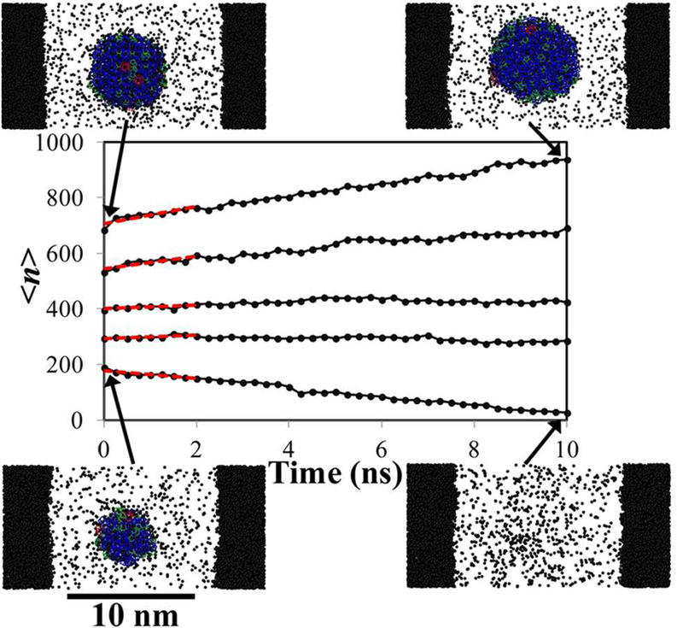
Strategies for computer simulation
Use classical nucleation theory (CNT)
Run swarms of standard MD trajectories with seed nuclei of size
Compute mean drift velocity at each
Identify as with zero mean drift
Compute from gradient of at
Fit and to CNT using
Requires assumption of particular nucleus structure, but only off-the-shelf MD codes
Useful when barrier is high, and dynamics are slow and diffusive
Knott et al. J. A. C. S., 2012, 134, 19544
Notes:
Unlikely to get as far as 4

Slide 8
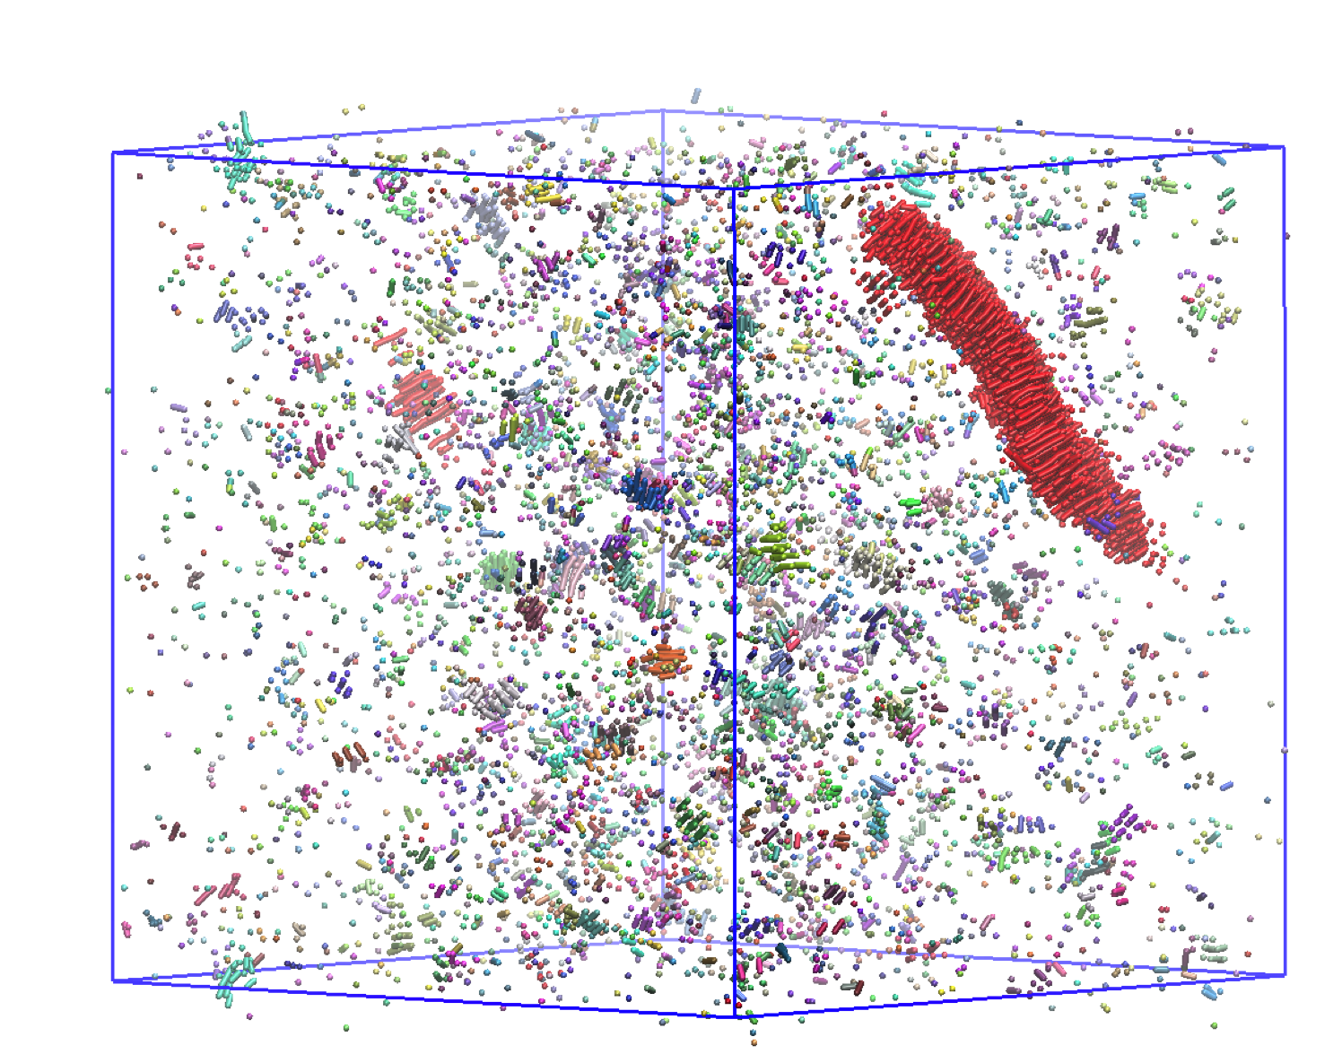
Strategies for computer simulation
Brute force molecular dynamics simulation
Useful when barrier is low and dynamics are fast
B. Vorselaars and DQ, in preparation 2015

Slide 9
Strategies for computer simulation
Use a transition path sampling method
Count the rate at which some small is reached
Use specialist methods (FFS/TIS) to sample pathways crossing
Determine fraction of these pathways which reach solid phase
Various attempts to implement as wrapper to standard MD packages, however how best to compute is an issue
Useful when barrier is high and dynamics are fast enough to sample a large number of trajectories
Li et al PCCP., 2011, 13, 19807

Slide 10
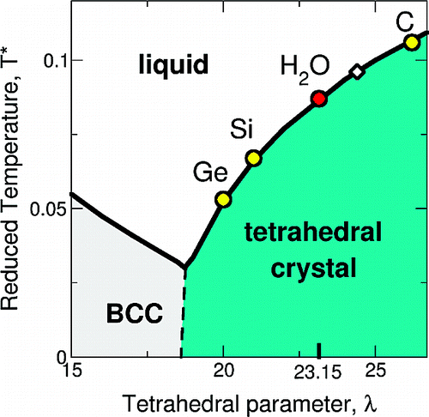
Modelling water
Short-ranged two and three-body potential

Slide 11
Nucleation simulations with mW
Forward Flux Sampling from 220K to 240K
Critical nuclei contain ~ 50% cubic
Brute force molecular dynamics at 180K
Critical nuclei ~ 66% cubic
Umbrella sampling Monte Carlo at 220K
Critical nuclei “predominantly cubic”

Slide 12
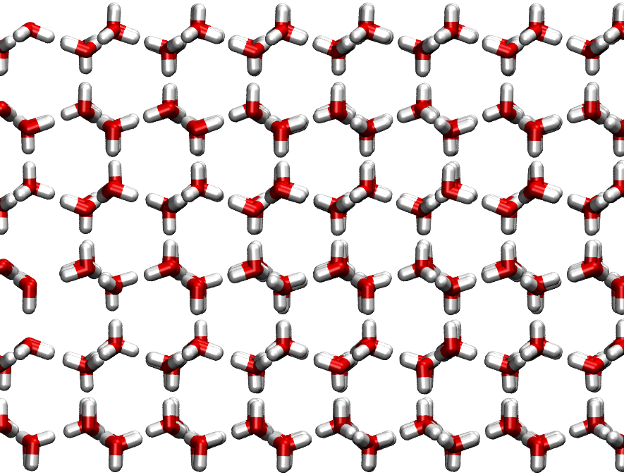
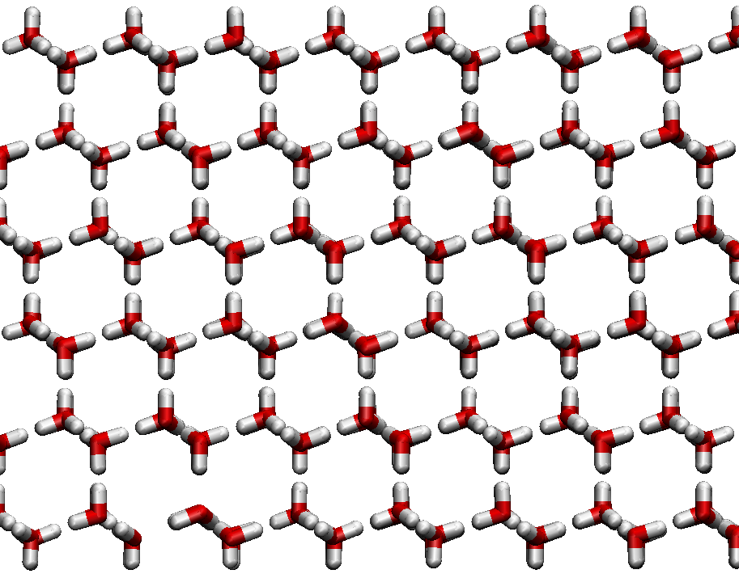
Ice 1 has two polytypes
Hexagonal ice 1h
Layers stack as ABABABA…..
Cubic ice 1c
Layers stack as ABCABCABC…

Slide 13
Growing ice from supercooled water
Temperature (Kelvin)
Amorphous ice
180
200
273.15
120
Malkin et al. P.N.A.S. (2012)
Hexagonal Ice
Ice homogeneously nucleated at low temperatures is stacking disordered.
NOT cubic OR hexagonal but a mixture.

Slide 14
Stacking fault statistics in nuclei
Stacking model
E.g. L = 5
Sequence
Energy
Entropy
ABABA | 0 | 0
ABCBC ABACA | N_{l} Δg | kln(2)
ABCAC ABCBA | 2N_{l} Δg | kln(2)
ABCAB | 3N_{l} Δg | 0
Δg = free energy difference per
molecule between cubic and hexagonal ice.
N_{l} = molecules per layer.
(Removing sequences identical under cyclic permutations of labels or reversal)

Slide 15
ΔG and classical nucleation theory
Expectation of % cubic molecules
Points show CNT estimate of critical nucleus size using:
ΔG = 30 J mol⁻¹
Units:
10 J mol⁻¹ ≈ 0.0001 eV per H₂O
≈ 0.006 k_{B}T per H₂O (200K)
ΔG = 50 J mol⁻¹

Slide 16
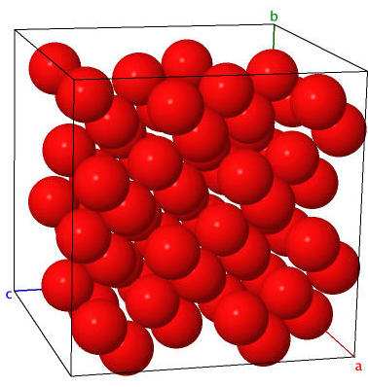
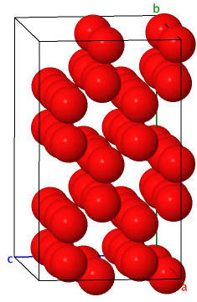
Lattice switching Monte Carlo
200K, 64 molecule unit cells
200-400 times faster than TIP4P
cubic
(diamond)
hexagonal
(lonsdalite)

Slide 17
Finite size effects at 200K
ΔG = 0.4 to 2.6 J mol⁻¹ in thermodynamic limit
c.f. published estimate 0 ± 30 J mol⁻¹
(Moore and Molinero PCCP 2011)

Slide 18
Temperature dependence
N = 384
T (K) | ΔG / J mol⁻¹
180 | 2.47(3)
200 | 4.15(2)
220 | 3.55(3)
240 | 5.77(4)
cubic
hexagonal

Slide 19
Comparison of stacking energetics
mW has almost exactly zero penalty for formation of cubic stacking faults
Will nucleate stacking disordered ice at all temperatures
ΔG = 30 J mol⁻¹
Li, Donadio & Galli 2011
Reinhardt & Doye 2011
Moore & Molinero 2011
mW
DQ J. Chem. Phys. 2014, 141, 121101

Slide 21
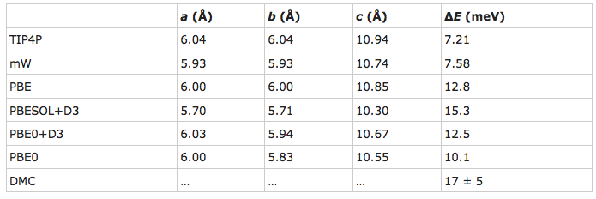
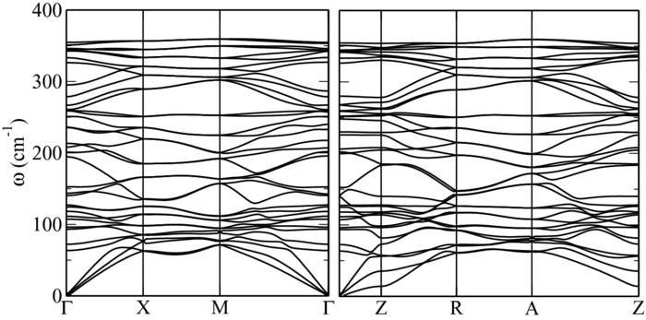
Is ice 0 real?
Slater, B. & DQ
Crystal nucleation: Zeroing in on ice Nat. Mater., 2014, 13, 670-671
DQ; Alfè, D. & Slater, B. J. Chem. Phys., 2014, 141, 161102

Slide 22
Summary
Quantitative (if inaccurate) calculation of nucleation rates from molecular simulation is becoming possible for ‘real’ systems..
.. provided (very) cheap models are available.
Unlikely to be be predictive for some time, but trends should be accessible.
Quantifying sources of error likely to be very challenging.
Existing simulations do open up new questions!

Slide 23


Acknowledgements
Ice 0 stability
Ben Slater (UCL)
Dario Alfé (UCL)

