Slide 1
Predictive modelling: a view from the atomic level
P.M. Rodger
Department of Chemistry
& Centre for Scientific Computing
University of Warwick

Slide 2
Acknowledgements
David Quigley, Igor Khovanov, Matt Bano, Yuriy Bushuev, Aaron Finney, Ritchie-Mae Gamot, Yuanwei Xu, Salvatore Cosseddu (Warwick)
John Harding, Colin Freeman and Riccardo Innocenti Malini (Sheffield)
Paul Smeets, Heiner Friedrich, Jozua Laven, Nico Sommerdijk (Eindhoven), Wouter Habraken (Postdam), Fabio Nudelman (Edinburgh)
Mike Allen (Warwick), Dorothy Duffy (UCL), Julian Gale (Curtin)
Warwick CSC
HECToR & ARCHER
MidPlus
EPSRC (mIb: Materials Interfacing Biology)

Slide 3
Philosophy
Complex materials
  complete model is not possible
Mechanistic information
  “predictions” not reliable without the correct underlying physics/chemistry
Dimensionality
  identify key degrees of freedom
  target analysis
  drive or simplify modelling

Slide 4
Unexpected Mechanisms: old examples

Slide 5
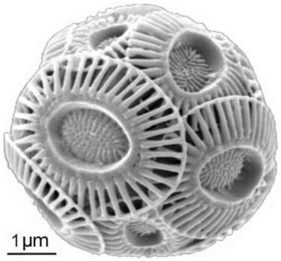
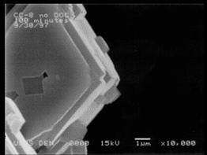
Motivation: Biominerals
Nature:
  Exquisite control of crystal morphology & aggregation found in nature
  Leads to very well “designed” functional materials
  Ability to simulate implies ability to guide synthesis
Emiliania huxleyi coccoliths
Henriksen, K., S. L. S. Stipp, et al. American Mineralogist 89, 1709-1716 (2004)
Laboratory:
Reddy, M. M. and A. R. Hoch. Journal of Colloid and Interface Science 235, 365-370 (2001)

Slide 6
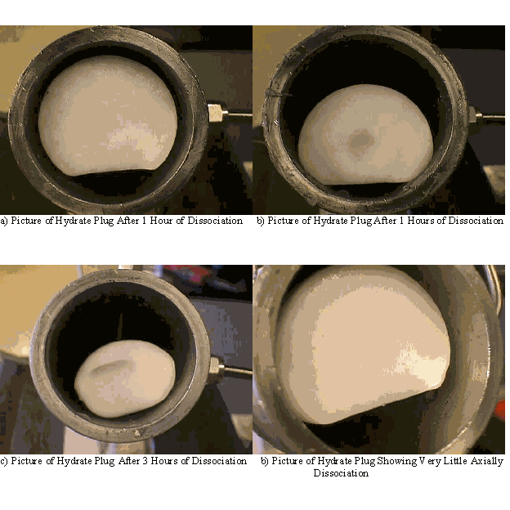
Motivation: additives for inhibition
Often need to suppress crystal growth
  Scale, wax, hydrate
“kinetic” inhibitors
  Delay nucleation or slow growth
  Active at low concentrations
  Require molecular understanding of nucleation and growth

Slide 7
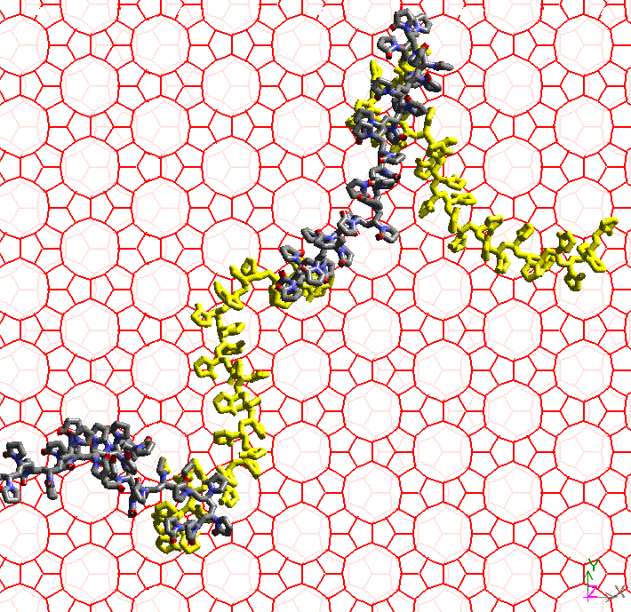
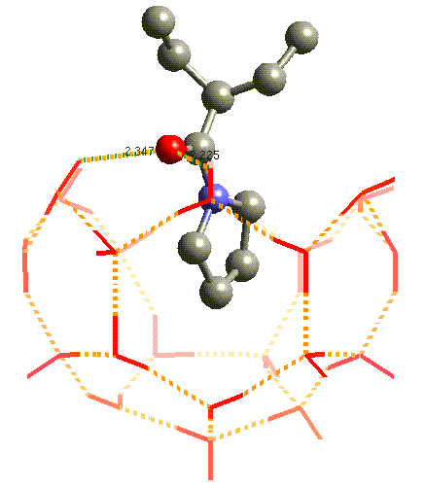
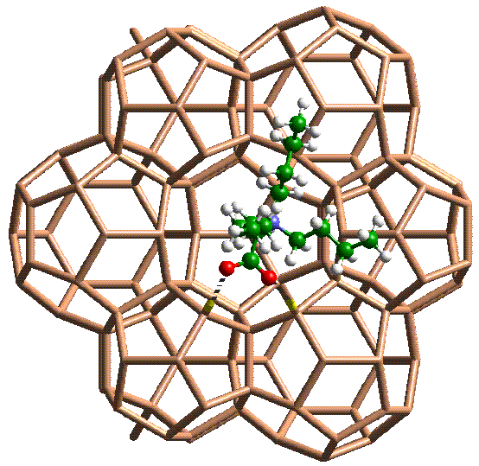
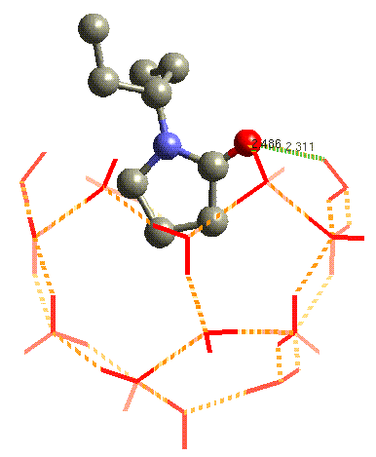
Mechanistically inspired prediction?
Inhibition by surface adsorption
validate
screen
new modes?

Slide 8
Synthesise and test
THF Hydrate Tests
induction times for 0.5% mixtures of tba3S (the “quat”, or Q) and PVP (P). The Control contains no inhibitor. Bars indicate ± one standard deviation
Ethane Hydrate Tests
Induction times, nucleation rates (R_{nucl}) and growth rates (R_{growth}). Standard deviations are given in parentheses

Slide 9
2nd generation
Test
KI
Gas
Test P/T
Subcooling
Induction
No.
psia/C
/C
Time/ hrs
1
JI-C003:1
NG
1023 / 5.3
10.7
5
2
JI-C003:1
NG
1023 / 5.3
10.7
>67
3
JI-C003:1
NG
1015 / 5
11
>67
4
JI-C003:1
NG
1023 / 5
11
>150
5
JI-C003:1
Methane
1700 / 4.5
10
>150
Commercial
NG
10
16
Commercial
Methane
10
5
6
JI-C002:1
NG
1095 / 4.5
12.3
3
7
JI-C002:1
NG
1095 / 4
12.8
40
8
JI-C002:1
NG
1095 / 5
11.8
>42
2nd generation inhibitors perform about 4 times better than current commercial inhibitor

Slide 10
But!
Experiments not repeatable!
  Oil companies can’t repeat each other’s screens
  Heriot-Watt: activity changed with test-cell stirrer design
  Scale of activity with new compound by test-site
    Heriot-Watt > Toulouse > Halliburton > Heriot-Watt
Similar story with wax inhibition (model oil using well characterised edible oil mixture)
Experimentalists working with nanotoxicology want legislative standards based on computational tests because experiments are too irreproducible!
Simplistic model: dynamic interface; nucleation; …

Slide 11
Nucleation from MD?
Homogeneous nucleation?
  Experimental nucleation rates < O(10⁶) nuclei per cm³ per second
  MD simulation 10,000 molecules:
    1 nucleation event every 32 millenia!
Heterogeneous nucleation?
  (some) success with seeding
  (some) success with interfaces

Slide 12
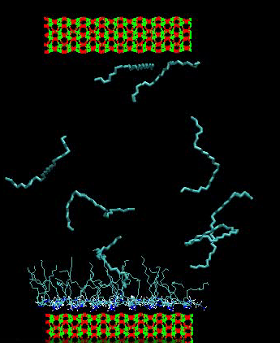
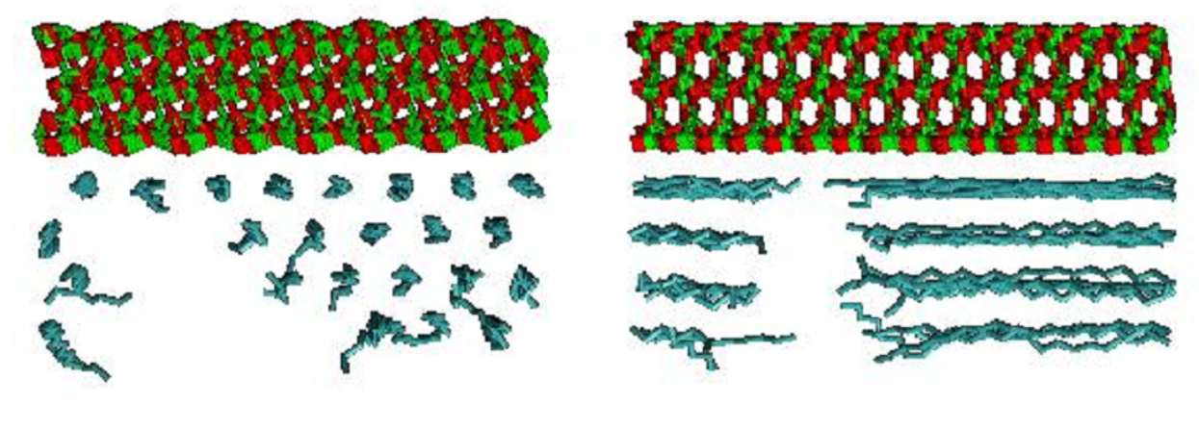
Standard MD: modelling surfaces
Deposition of wax on Fe₂O₃
  C₂₈ from C₇

Slide 13
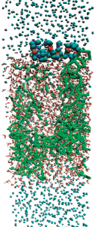
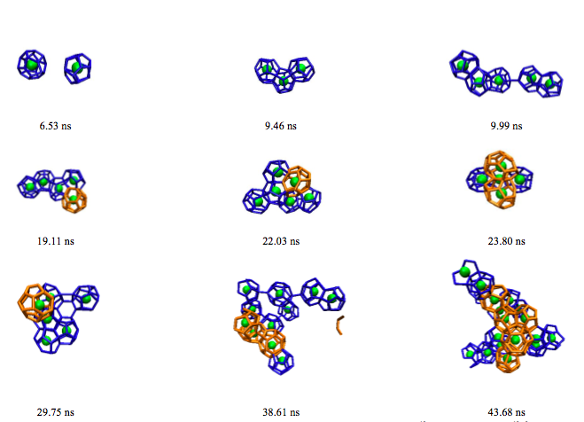
Standard MD: crystal nucleation
heterogeneous and/or
high supersaturation/subcooling

Slide 14
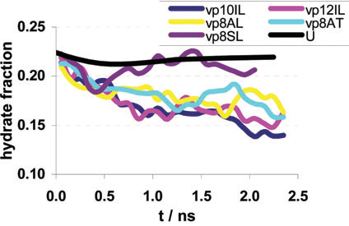
Polydispersity in inhibitors
molecular weight
  amount of hydrate present
  PVP
molecular shape
  growth of hydrate clusters
  pDMAEMA

Slide 15
Nucleation more generally
Project onto “important” manifold
  Define key dimensions (order parameters / reaction coordinates / collective variables)
  Project analysis onto these dimensions
  Bias simulations to explore these dimensions
    constrain to portion of manifold (umbrella sampling)
    trap fluctuations that explore the manifold (adaptive bias force)
    disfavour current portion of manifold (Wang-Landau; metadynamics)

Slide 16
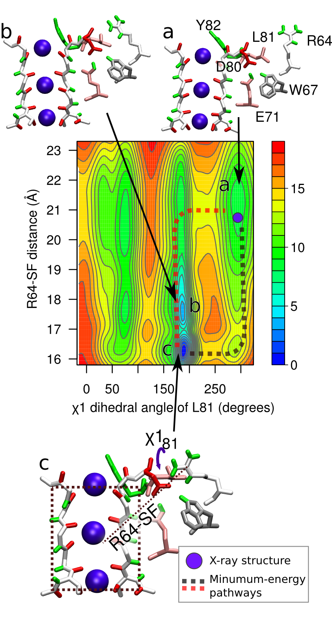
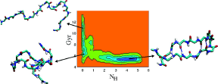
⇒ Free energy hypersurfaces
3-basin model
Quigley, PMR
KcsN ion channel
Cosseddu, PMR, Khovanov
peptide folding
Bussi, …, Parrinello

Slide 17
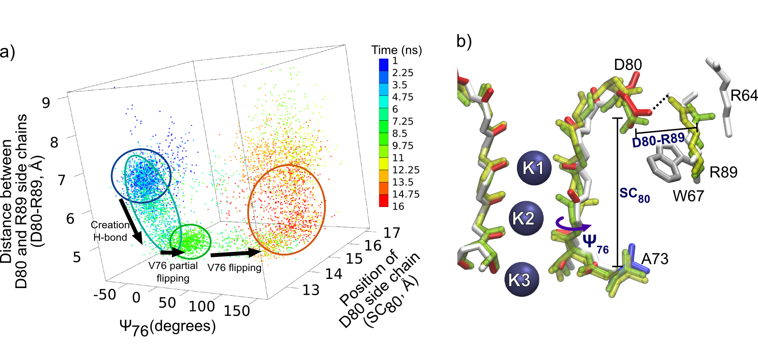
Limitations and Pitfalls: dimensionality!
Equilibrium /
comprehensive sampling
  Typically 1–2D
  (≤ 6; can do ~100 for basin
  escape & rough sampling)
  projection merges
  basins
Adiabatic Surfaces
  dynamics defined by
  metastable substates?
KcsN
Potential of mean force
Kramers potential

Slide 18
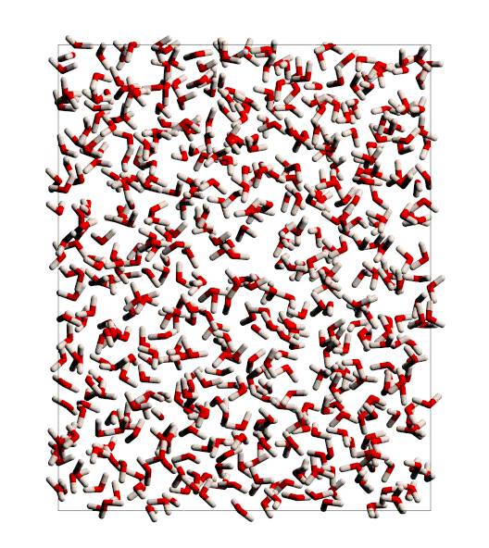
Nucleation with metadynamics: ice
4D bias:
  Q4, Q6, ς and potential energy (simaltaneous)
NPT simulation
  density change is spontaneous
T = 180 K; ca. 11 “ns” simulation
Results independent of periodic
boundaries

Slide 19
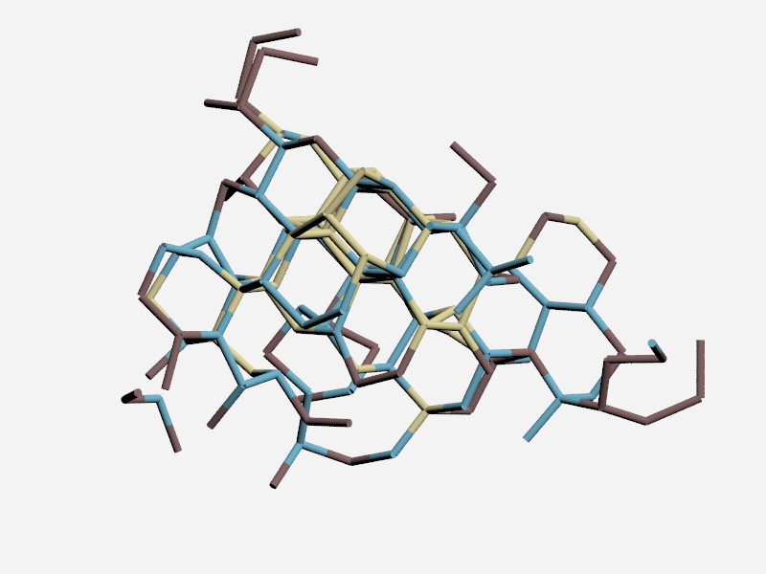
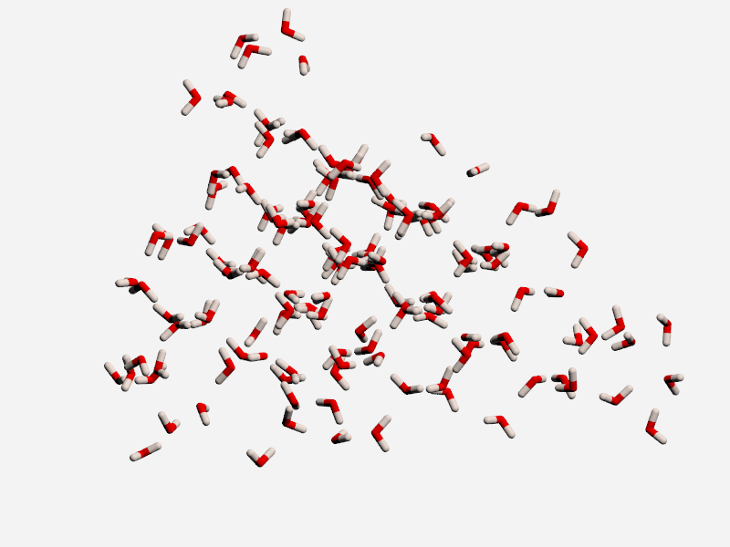
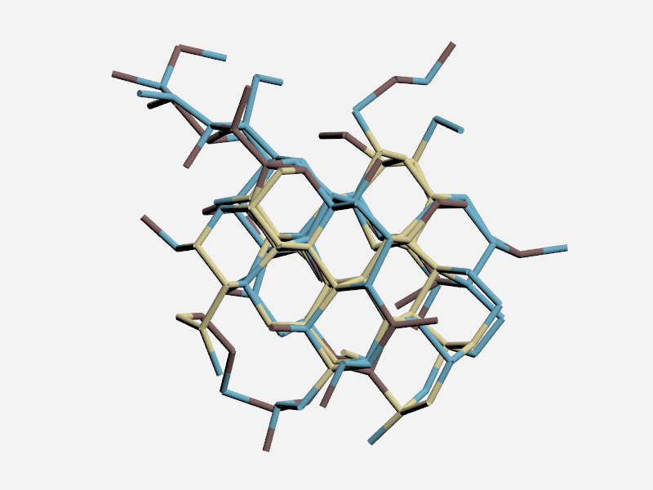
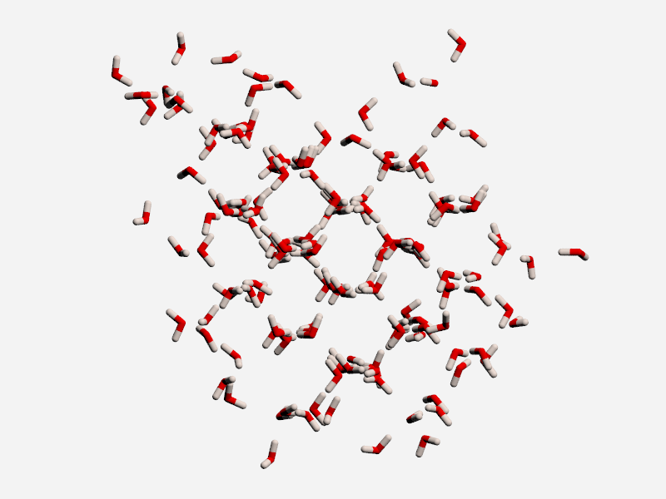
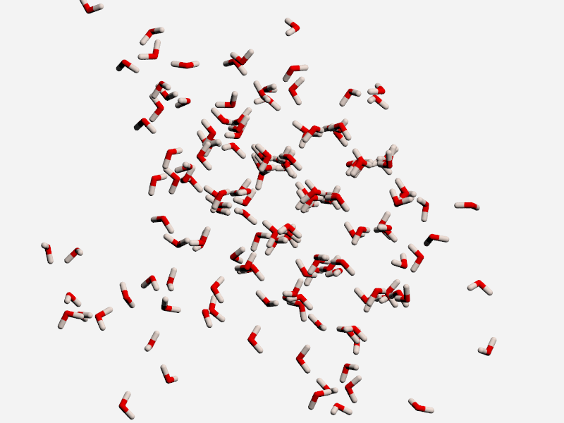
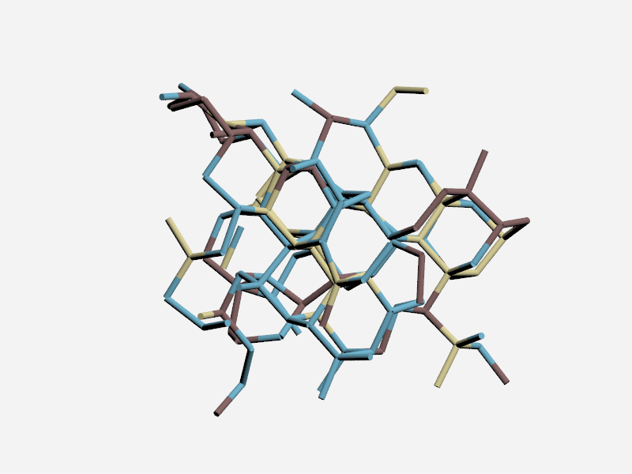
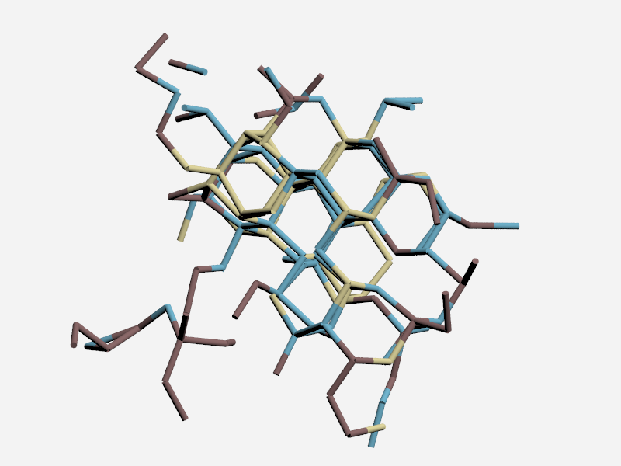
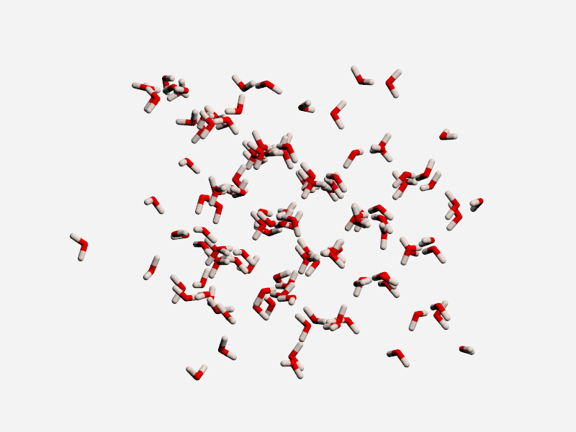
An ensemble of critical nuclei
ice I_{c}
ice I_{h}
both
N = 147
N = 157
N = 138
N = 161

Slide 20
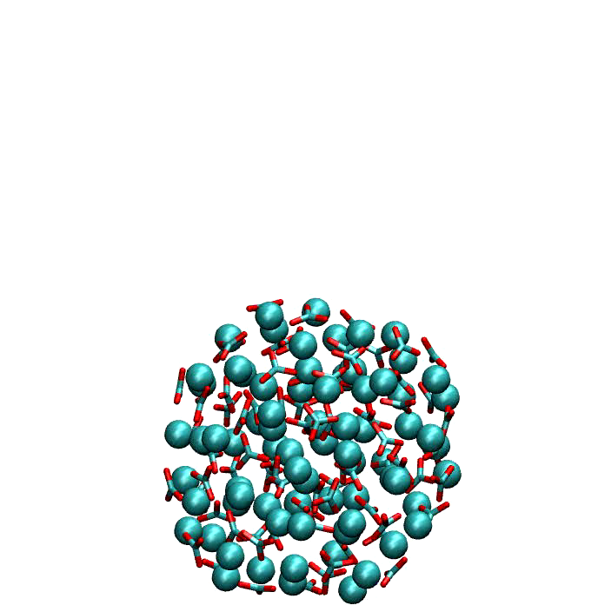
Nucleation with metadynamics: CaCO₃
6 order parameters
  Q₄ for: Ca-Ca, Ca-C, Ca-O, C-C, C-O
    measures orientations of X about Y
  energy associated with CaCO₃
ca. 10 ns of MD
Exploring configurations
for 75 units (water not shown)

Slide 21
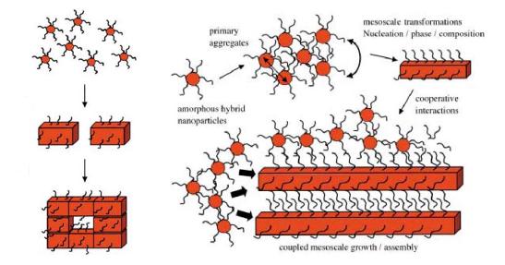
Calcium Carbonate Biominerals
Multi-stage hierarchical formation
organic “control”
Colfen & Mann
Angew. Chem, 2003

Slide 22
Early stages of carbonate biomineralisation
ions & ion pairs → hACC → ACC → crystalline
ions & ion pairs → hACC → ACC → crystalline
hACC: hydrated amorphous calcium cabonate
composition ca. CaCO₃.H₂O
ACC: (anhydrous) amorphous calcium carbonate
Crystalline: calcite, aragonite, vaterite

Slide 23
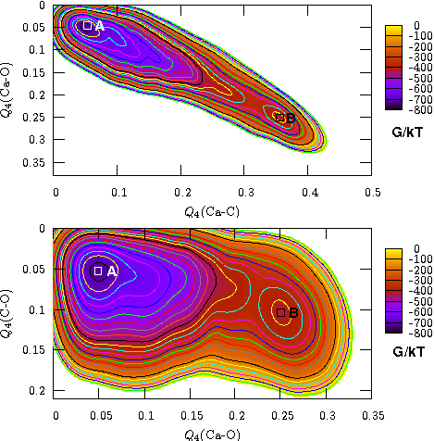
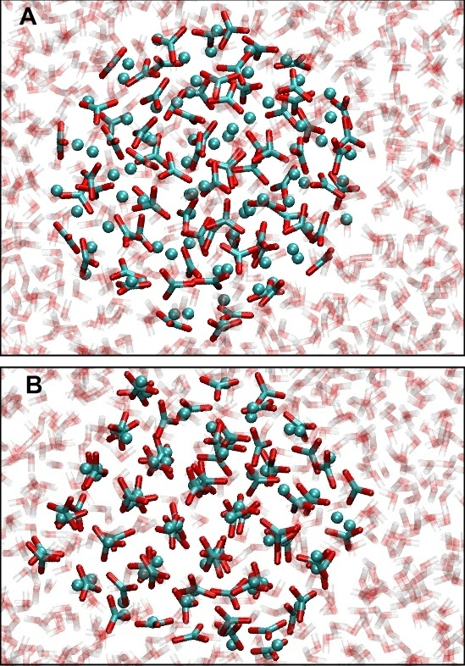
Free energy maps: 75 CaCO₃ units
NVT
favours amorphous
DQ and PMR, J. Chem. Phys. 128 (2008) 221101

Slide 24
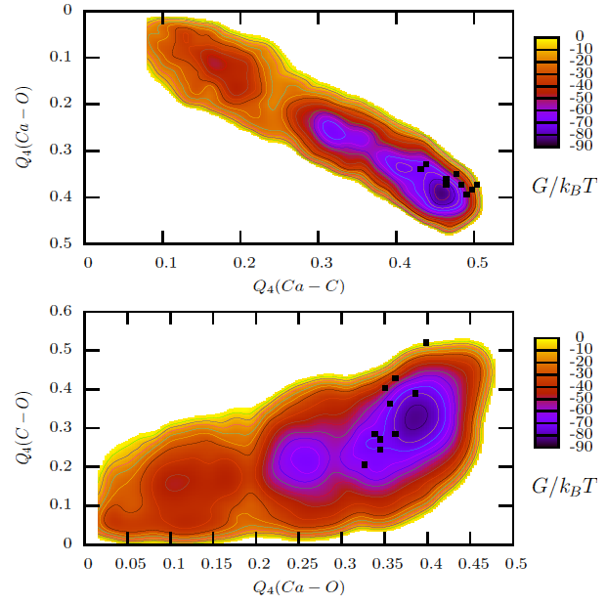
Free energy maps: 75 CaCO₃ units
NPT
Dominated by calcite
  very low barrier (10–20 kT)
DQ, CLF, JHH and PMR, J. Chem. Phys. 134 (2011) 044703

Slide 25
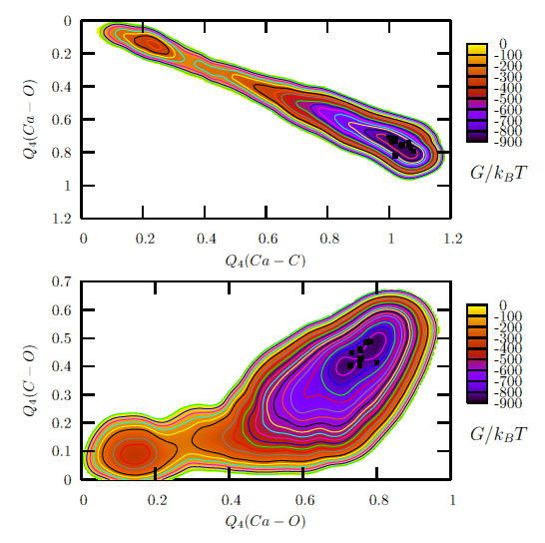
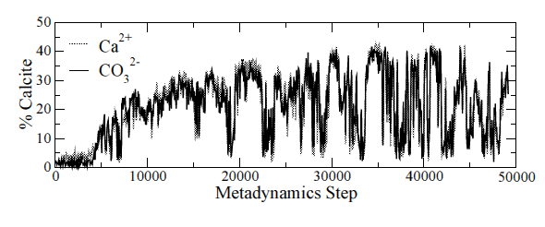
300 CaCO₃ Units in water
two stable states
calcite (dominant)
amorphous
energy barrier > 10² kT
multiple transitions

Slide 26
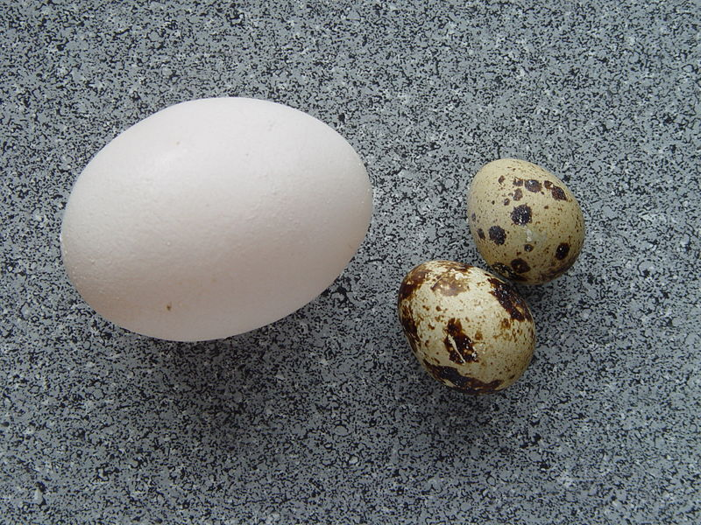
Biomineralisation: egg shells

Slide 27
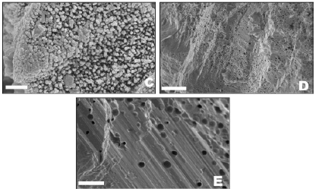
Structure of an eggshell

Slide 28
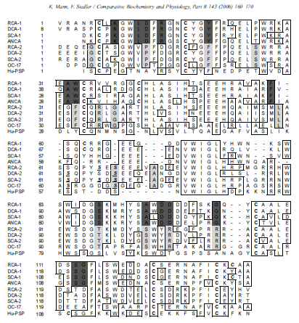
G-type lectin-type proteins
found in
  Rhea
  Duck
  Chicken
  Emu
  Ostrich

Slide 29
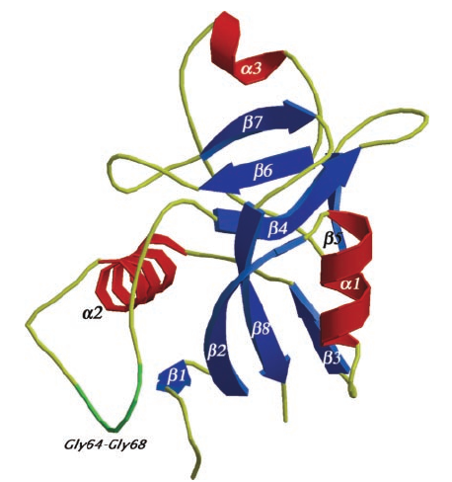
Ovocleidin-17
Reyes-Grajeda, Moreno, Romero;
J. Biol. Chem., 2004

Slide 30
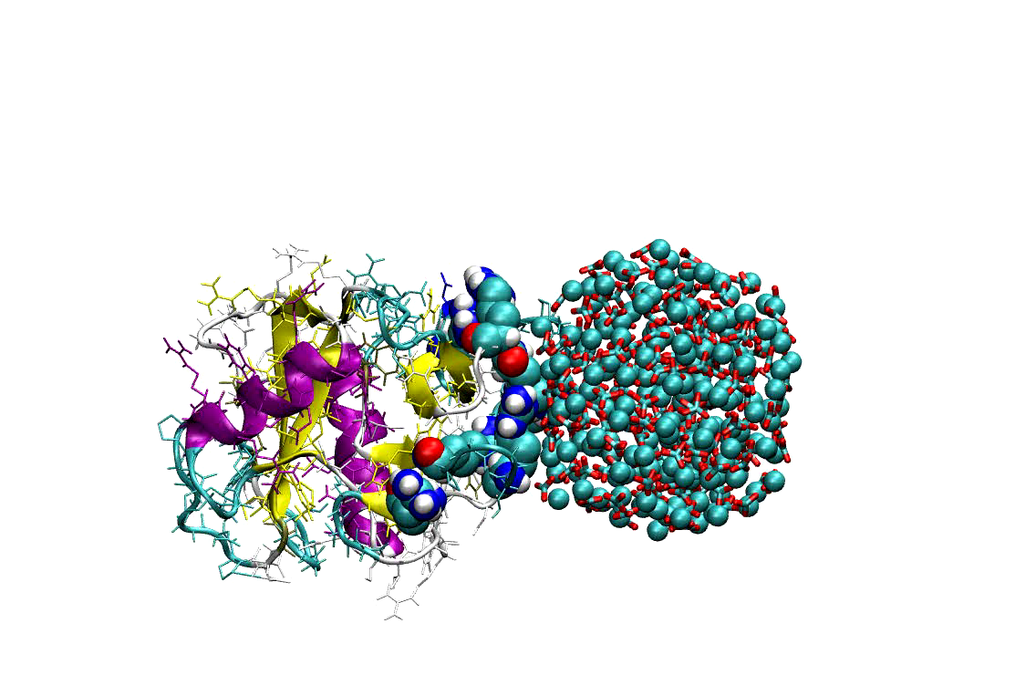
metaDynamics of OC17 + CaCO₃
192 & 300 unit nanoparticles
  22,000 water molecules
20 different protein/nanoparticle orientations
Select “best” 4 for long meta-dynamics
Potentials: due to Freeman et al.
  Pavese CaCO₃ ; Amber protein; Tip3p water;
  cross terms derived from crystals with scaled charges

Slide 31
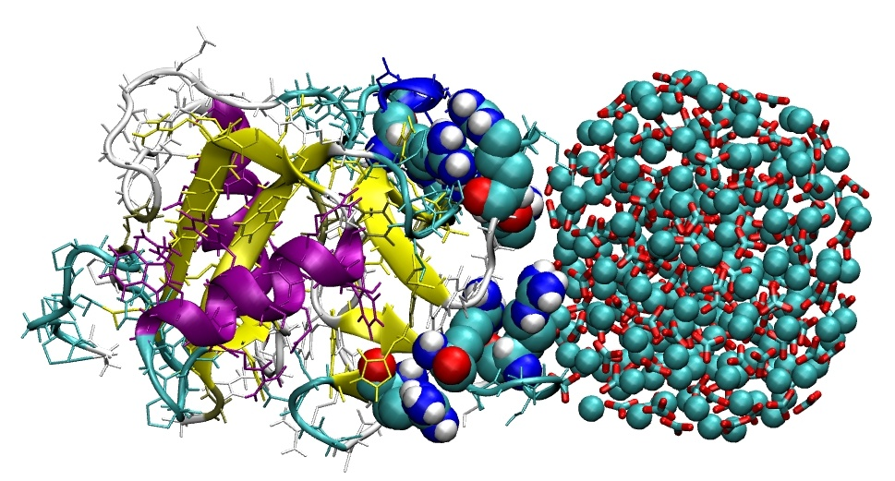
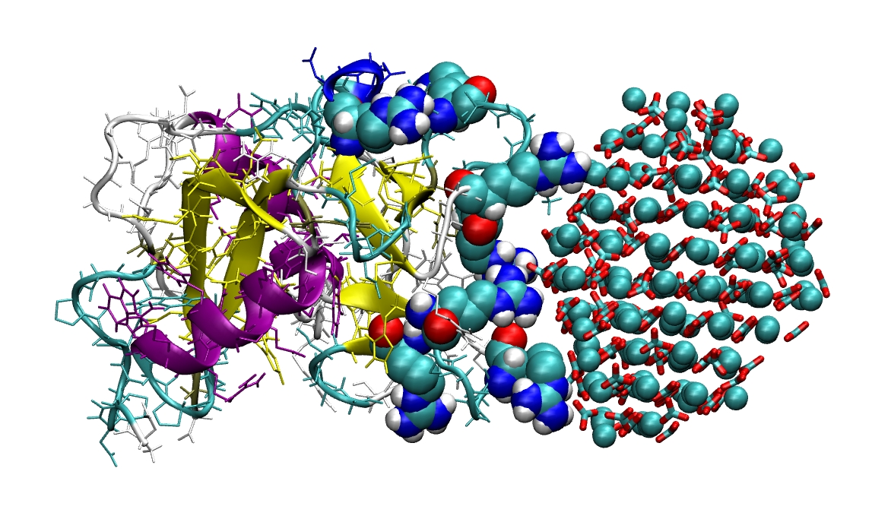
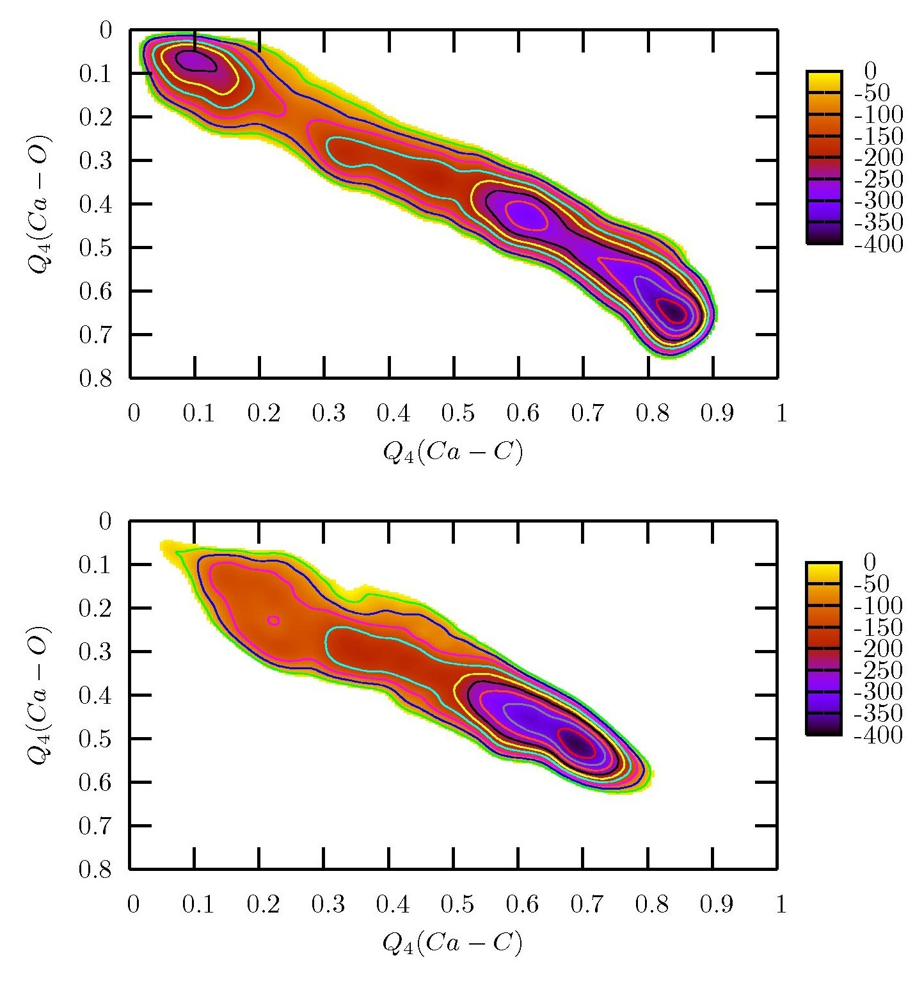
Free energy landscapes
Initial
Crystallised
metadynamics
192 units of CaCO₃ in water
192 units of CaCO₃ bound to Ovocleidin-17 in water

Slide 32
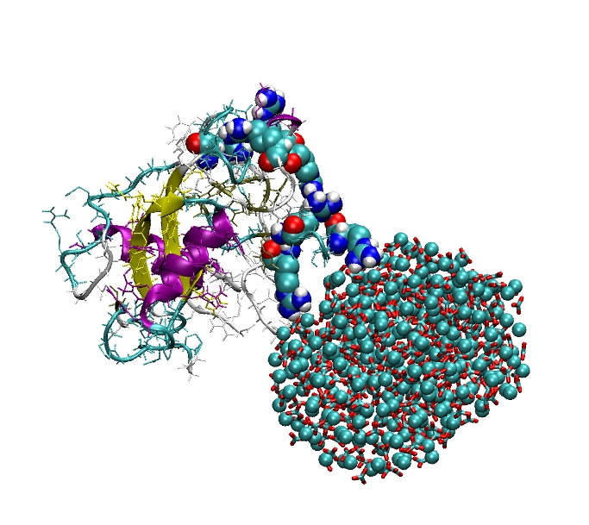
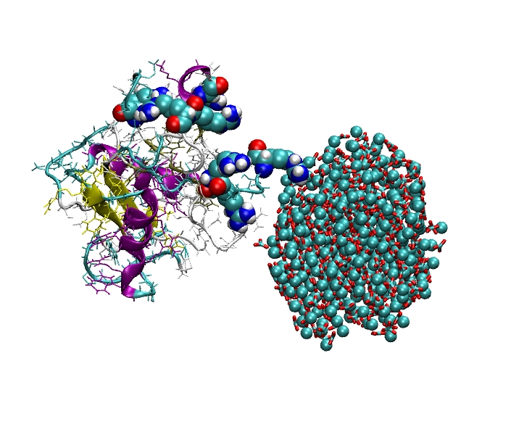
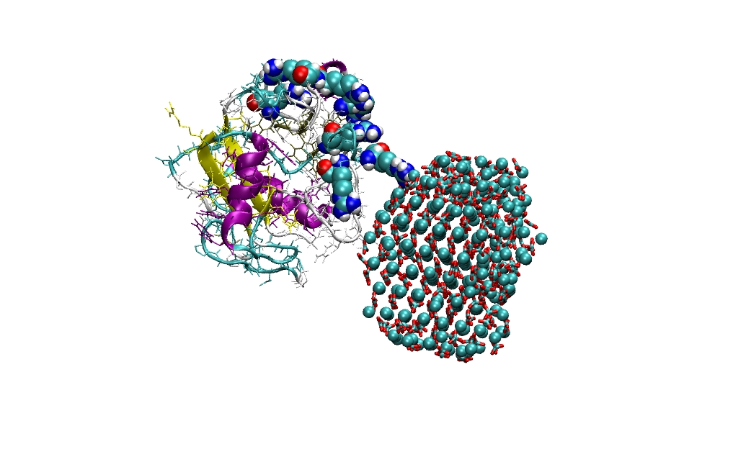
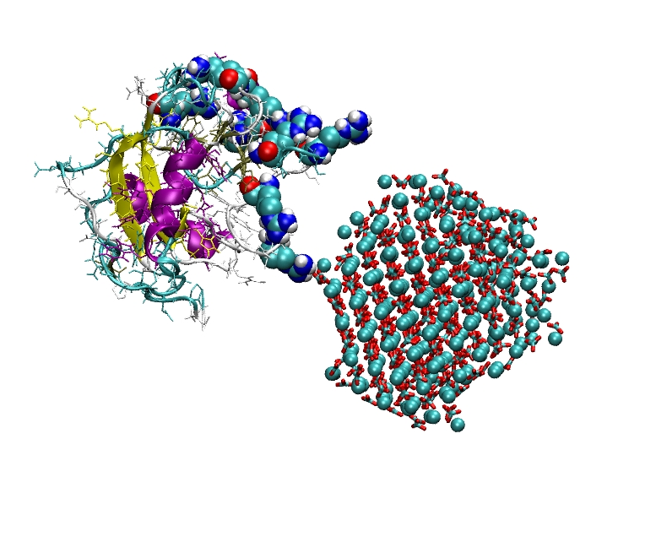
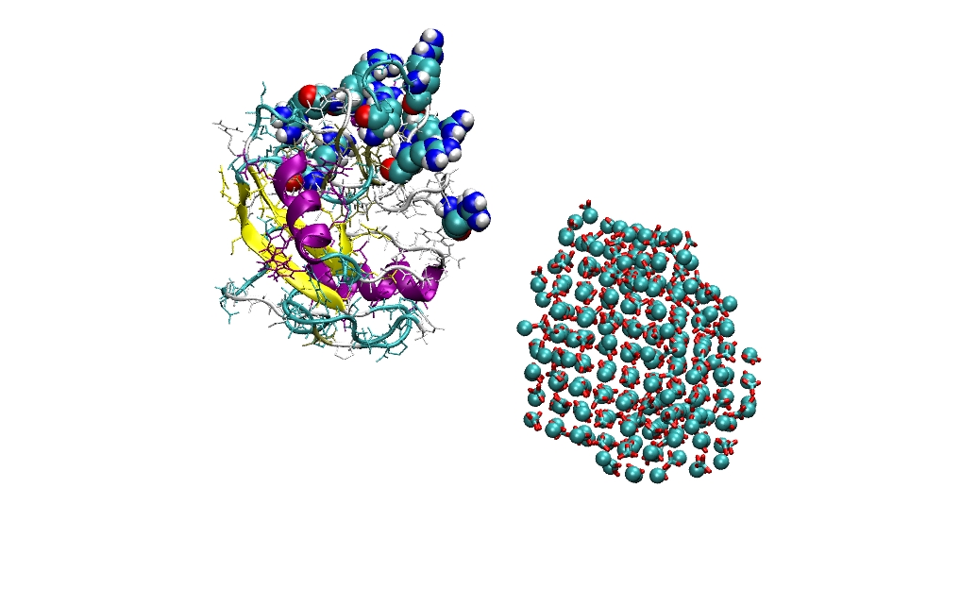
Larger nonaparticles?
300 CaCO₃ unit particles don’t stay bound on crystallisation
Mechanism for proteins
  Bind to small nanoparticles
  Facilitate transformation to calcite
  Desorb as crystal grows
Gives catalytic cycle for polycrystalline mamillary layer

Slide 33
OC17: catalytic cycle?
Cryst.
adsorb
grow
desorb

Slide 34
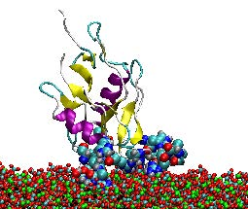
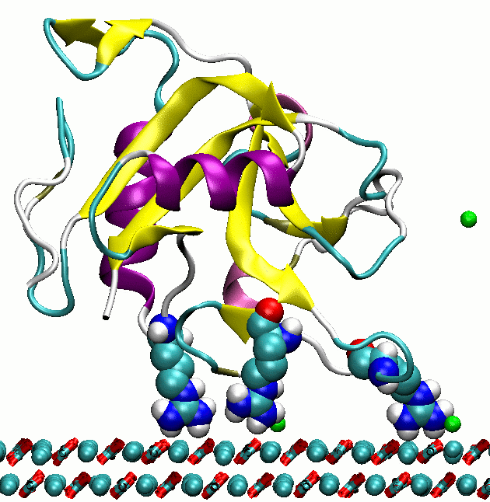
Surface binding & structured water
Binding is seen to planar surfaces
  Structured water dominates adsorption energy on large crystalline surfaces
  Calcite nanoparticles and ACC do not give structured water layer; leads to “flat” adsorption

Slide 35
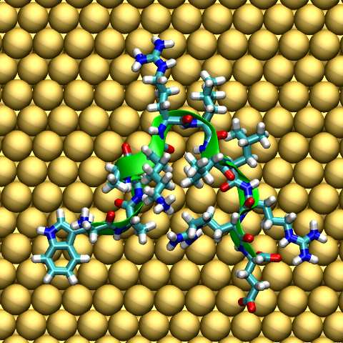
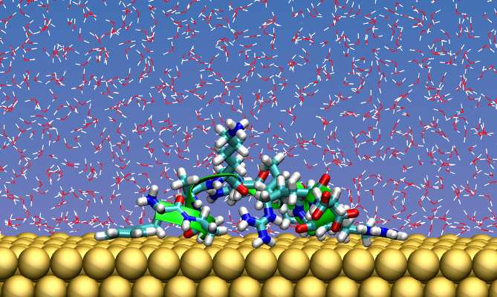
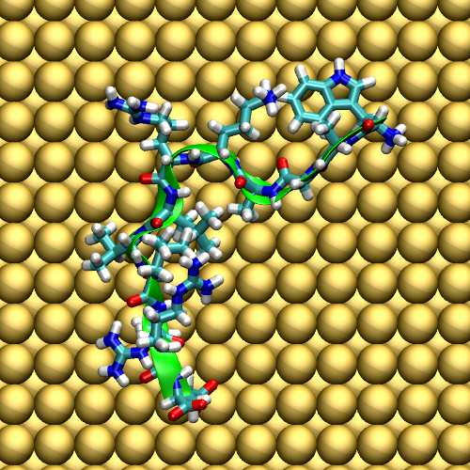
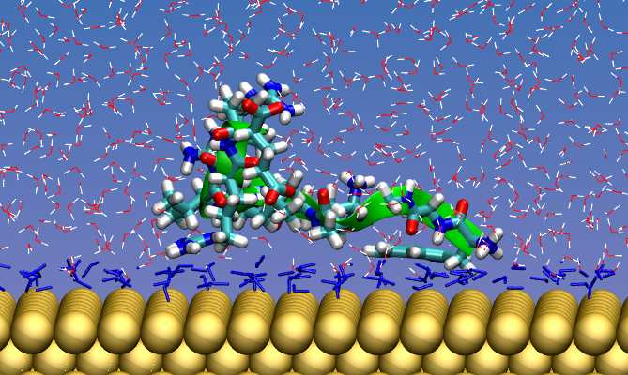


Also seen with AuBP1 on gold
(100) 5x1
(100)
(111)

Slide 36
hACC nulcleation
Problem
  intermolecular potentials
Controversy

Slide 37


Aragonite?
needs a better potential (Gale & co workers)
Pavese, Catti, Parker, Wall, Phys Chem. Miner. , 1996
Raiteri, Gale, Quigley, Rodger, J. Phys. Chem. C, 2010

Slide 38

Structure of hACC
create with several protocols
  melt monohydrocalcite; melt and dehydrate ikaite; anneal random distribution …
Good agreement with expt structure factor

Slide 39


Water in hACC
zones of stability for hACC
carbonate-mediated H-bond networks

Slide 40




Percolating water clusters
Universal scaling behaviour
percolation threshold ~ n = 0.9
underlying hexagonal lattice

Slide 41


correlated water dynamics
correlated large hops along chains of water

Slide 42
Classical nucleation
Activated process:
  Favourable “bulk” energy
  Unfavourable interfacial energy
  Critical “cluster” size
Classical Nucleation Theory
Fundamentally Stochastic
Favourable
Unfavourable

Slide 43




hACC nucleation: classical?
pre-nucleation clusters
Gebauer et al., Science 2008
DOLLOP, Raiteri et al.,
Nature Comms, 2011
dense liquid phase
Wallace et al., Science, 2014

Slide 44
Nature of the clusters?
spontaneous clusters dominate?
Random Structure searches
  random arrangement of ions; minimise; repeat
Intelligent Water Drop algorithm
  nature-inspired global optimsation
  erosion of soil to define river valleys
  applications to binary LJ mixtures and Janus particles
    (not yet carbonates)

Slide 45


Random Structure Searches
random arrangement of ions within sphere
Conjugate Gradient optimisation
~10,000 initial structures for each cluster size (1–40 formula units)
variety of cluster properties
  e.g. energy vs radius of gyration

Slide 46

Energetics of solvated clusters

Slide 47



Free energy Landscape
F / eV
~2 kT
n_{O–Ow}

Slide 48




Long timescale MD: 20–50 mM
“slow” dissolution: convergence from dispersion or initial clusters
dissolution slows with cluster size (concentration)
(requires free energy barrier)

Slide 49


Long timescale MD: ca. 0.5 M
stable “DOLLOP” behaviour; large clusters

Slide 50




And higher concentrations: 0.5–1.5 M
0.57 M
stable clusters
DOLLOP
1.1 M
infinite, liquid like
(phase transition?)

Slide 51
Conclusions
Source of new mechanistic insight
  kinetic inhibition; eggshell proteins
  does your predictive model have the right features?
Can capture some elements of intrinsic complexity
  inhibitor polydispersity; nanoparticle structure
  need for intelligent sampling
Progress through data dimensionality reduction
  excellent methods for a handful of dimensions
  need to identify key dimensions
  need to recognise and avoid pitfalls of too few (or wrong) dimensions

