Slide 1





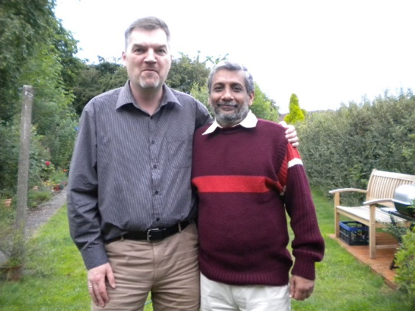
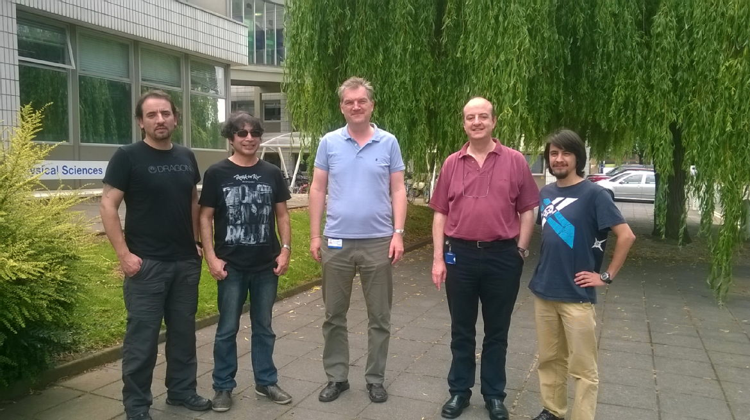
Quantum engineering for electrons and spins
Rudolf A Römer, Physics

Slide 2
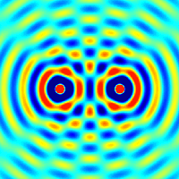
The physics of waves
Waves interfere due to the superposition principle
Wave interference can be destructive or constructive

Slide 3

Interference of electrons from a double slit
http://www.hitachi.com/rd/portal/highlight/quantum/index.html#anc04 (Tonomura, 1980’s)

Slide 4
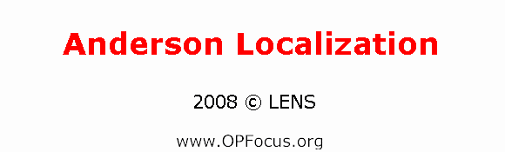
Interference from disorder:
Anderson localization
Light, water, sound (ultra), electrons, atoms …
J. Billy et al., Direct observation of Anderson localization of matter waves in a controlled disorder, Nature (2008) 453, 891-894; G. Roati et al., Anderson localization of a non-interacting Bose-Einstein condensate, Nature (2008) 453, 895-898
Segev, M., Silberberg, Y., & Christodoulides, D. N. (2013). Anderson localization of light. Nat Photon, 7(3), 197–204.

Slide 5
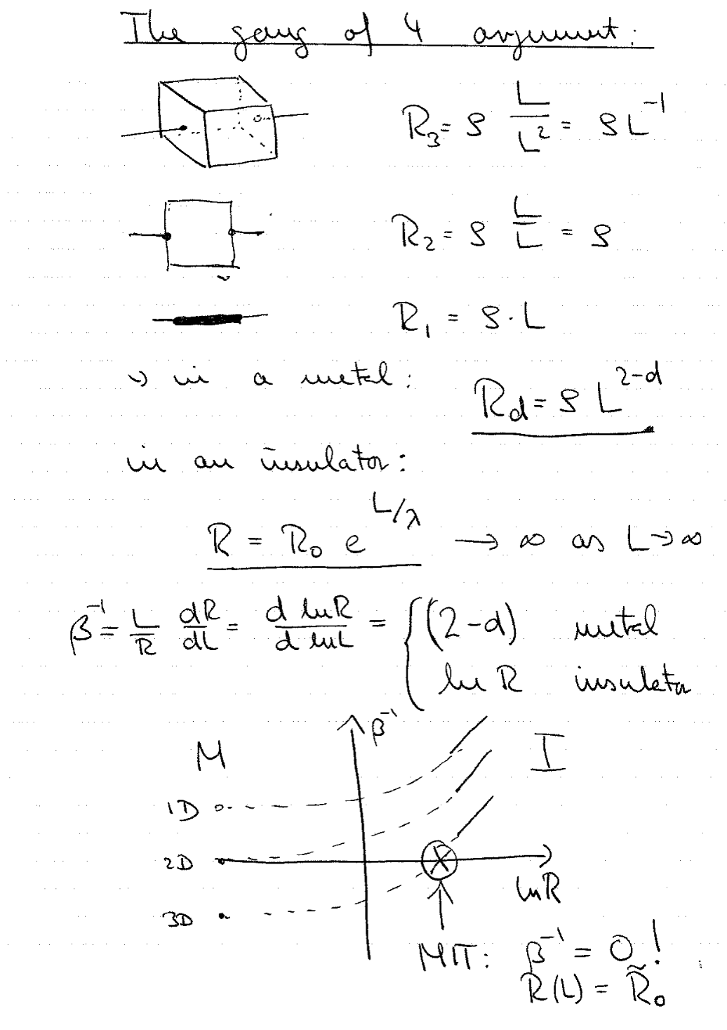
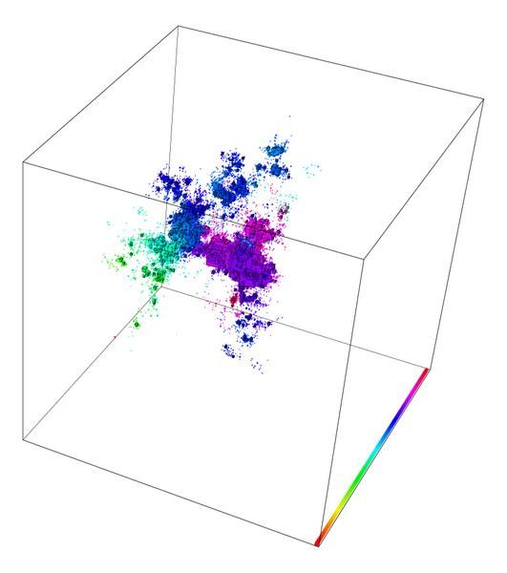
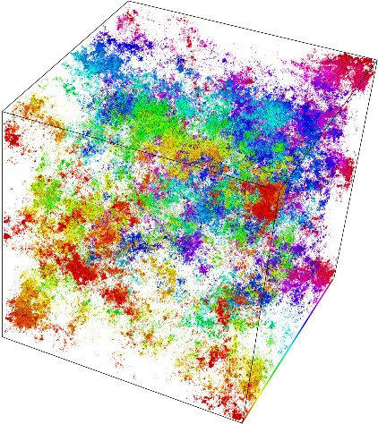
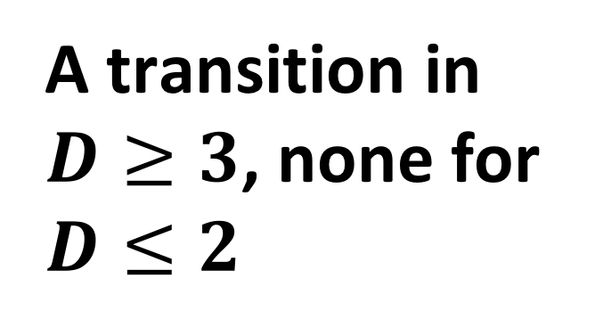
A transition in $D≥3$, none for $D≤2$
Abrahams E., Anderson P. W., Licciardello D. C. and Ramakrishnan T. V. 1979 Phys. Rev. Lett. 42 673

Slide 6
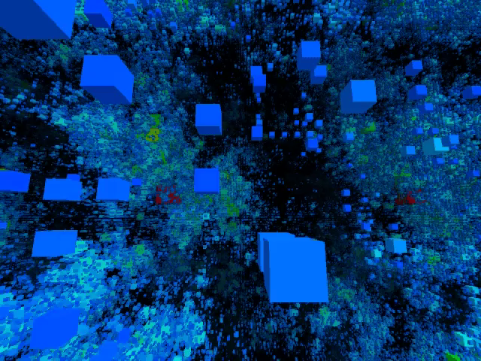

Slide 7
How to “cheat” the gang of 4!
Many-body physics
  Magnetism, superconductivity, …
Correlated randomness
  Changes of “universality”
  Perfect correlation = clean system
  Short-range (irrelevant in large systems) versus long-range correlation (relevant whenever correlation length comparable/larger than system)
Goldsborough, A. M., Römer, R. A., (2014). Self-assembling tensor networks and holography in disordered spin chains. Physical Review B, 89(21).
de Moura, F. A. B. F., & Lyra, M. L. (1998). Delocalization in the 1D Anderson Model with Long-Range Correlated Disorder. Physical Review Letters, 81(17), 3735–3738.
“Charge Puddles in Graphene Near the Dirac Point”, S. Samaddar, I. Yudhistira, S. Adam, H. Courtois, and C.B. Winkelmann, arXiv:1512.05304
Ndawana, M. L., Römer, R. A., & Schreiber, M. (2004). The Anderson metal-insulator transition in the presence of scale-free disorder. Epl, 68(5), 678–684.

Slide 8
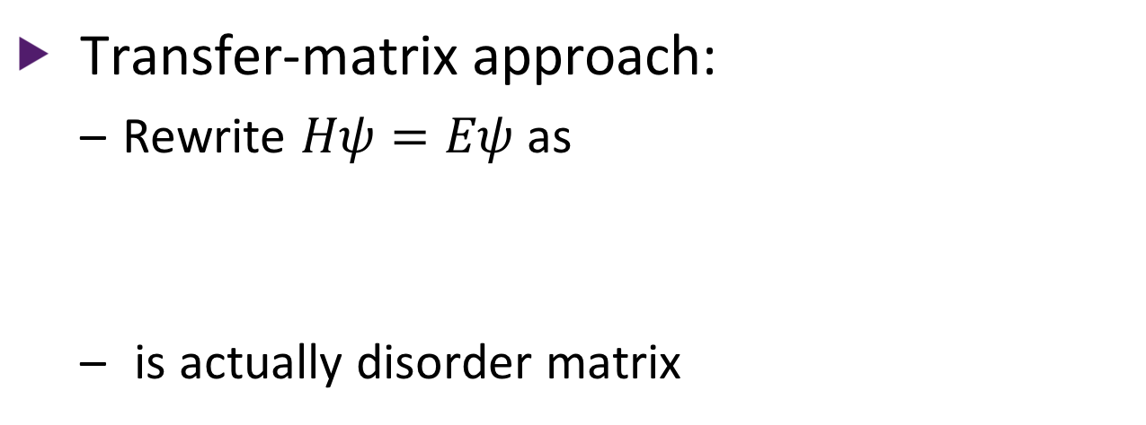
Controlled engineering of extended states in disordered systems
Transfer-matrix approach:
  Rewrite $Hψ=Eψ$ as
  is actually disorder matrix
Rodriguez, A., Chakrabarti, A., Römer, R. (2012). Controlled engineering of extended states in disordered systems. Physical Review B, 86(8).

Slide 9
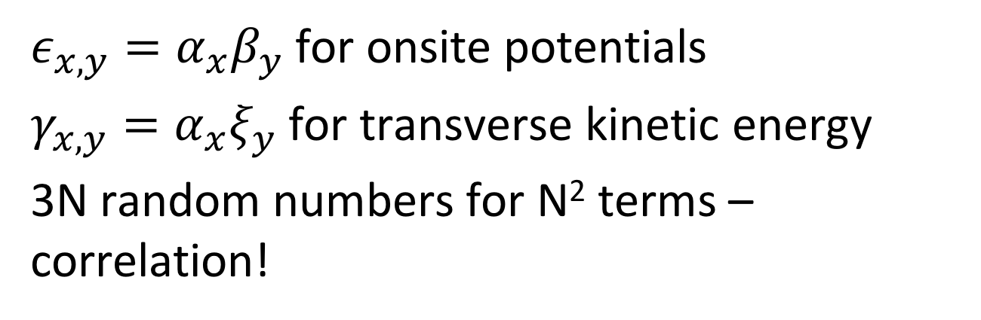
Resonance condition
$ε_{x,y}=α_{x}β_{y}$ for onsite potentials
$γ_{x,y}=α_{x}ξ_{y}$ for transverse kinetic energy
3N random numbers for N² terms – correlation!

Slide 10
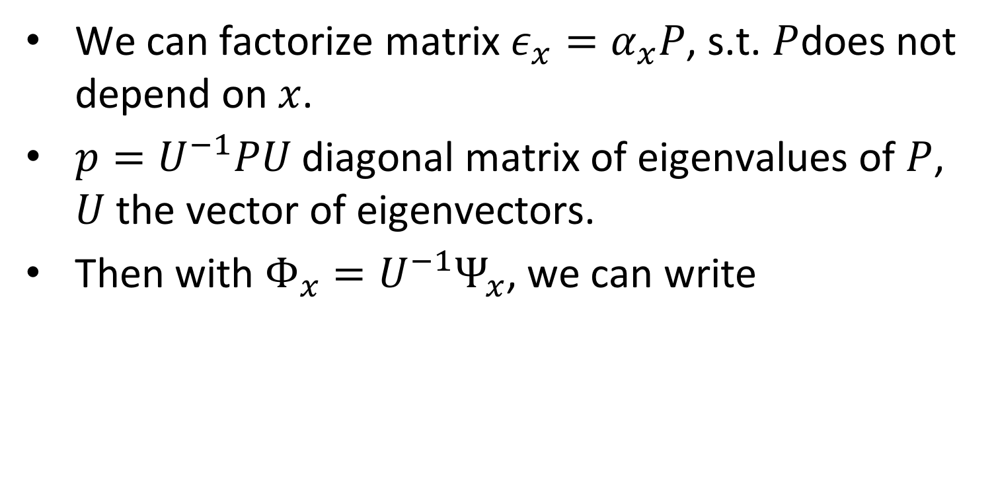
A transformation
We can factorize matrix $ε_{x}=α_{x}P$, s.t. $P$does not depend on $x$.
$p=U^{−1}PU$ diagonal matrix of eigenvalues of $P$, $U$ the vector of eigenvectors.
Then with $Φ_{x}=U^{−1}Ψ_{x}$, we can write

Slide 11
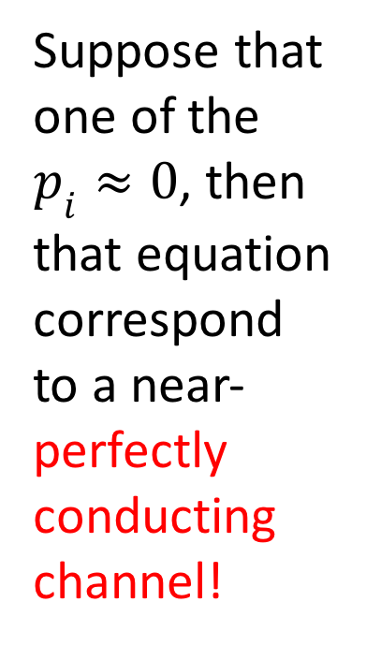
Trafo cont’d:
Explicitly, this gives
Suppose that one of the $p_{i}≈0$, then that equation correspond to a near-perfectly conducting channel!

Slide 12
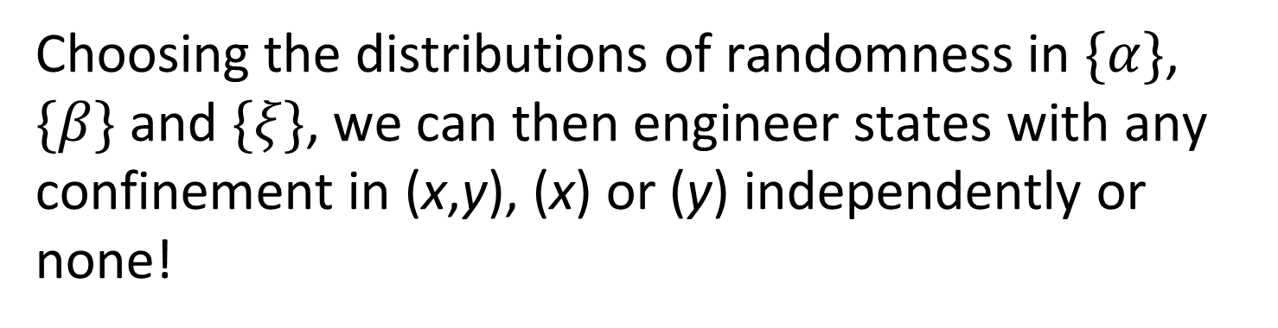
Quantum engineering with electrons
Choosing the distributions of randomness in $\{α\}$, $\{β\}$ and $\{ξ\}$, we can then engineer states with any confinement in (x,y), (x) or (y) independently or none!
Rodriguez, A., Chakrabarti, A., Römer, R. (2012). Controlled engineering of extended states in disordered systems. Physical Review B, 86(8).

Slide 14
“Phase” diagram of delocalization in 2D
Dashed lines indicate analytic estimates for “phase” boundaries

Slide 15
Quantum engineering with spins
Spintronics (spin transport electronics), also known as spinelectronics or fluxtronics, is the study of the intrinsic spin of the electron and its associated magnetic moment, in addition to its fundamental electronic charge, in solid-state devices. https://en.wikipedia.org/wiki/Spintronics
Applications: metal-based (GMR, TMR), doped semiconductor materials with dilute ferromagnetism (ZnO, GaMnAs, …), all for logic/storage devices

Slide 16
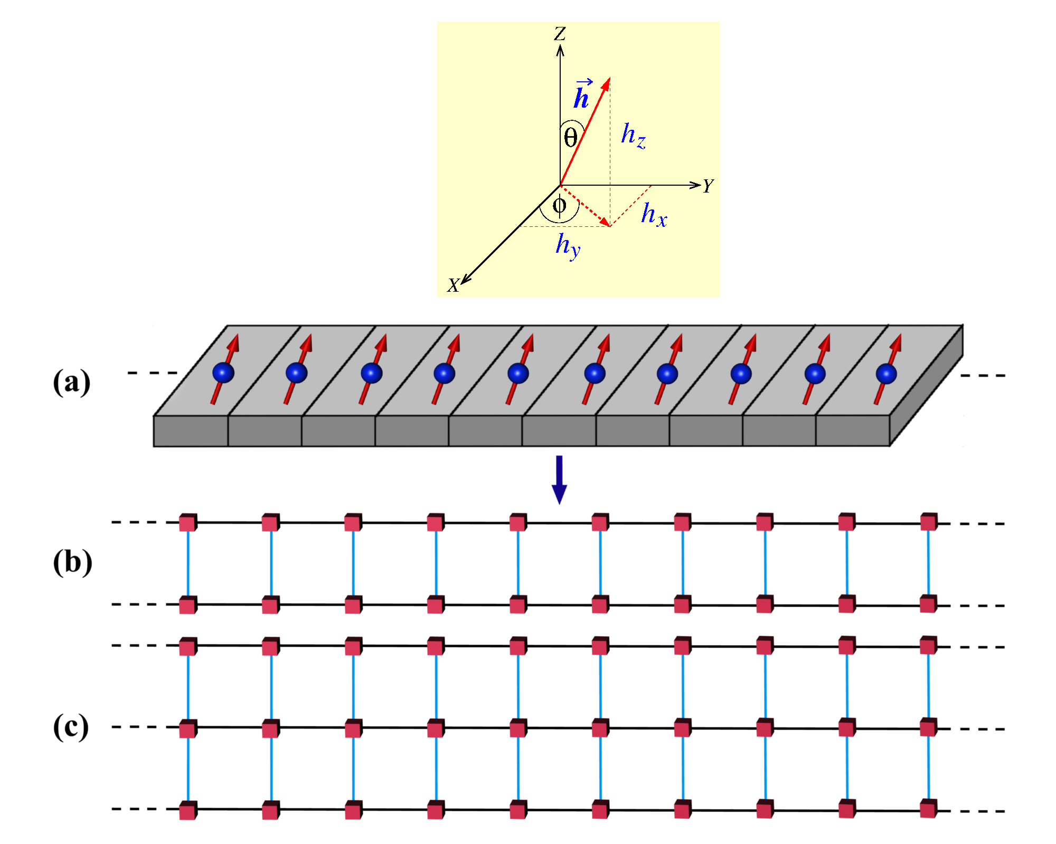
Magnetic chain in 1D:
Magnetic substrate
B. Pal, A., Chakrabarti, A., Römer, R. (2016). “Spin filter for arbitrary spins by substrate engineering”, to be submitted to Physical Review B, 86(8).

Slide 17
The model
Additional “Heisenberg term” adds energy if spin is not aligned with magnetic field in substrate and reduces otherwise
Leads to alignment of spins across system

Slide 18
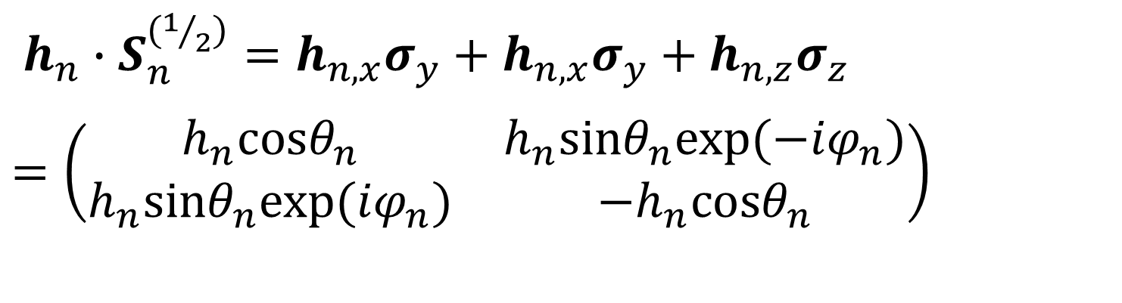
Variations in substrate magnetization
$h_{n}∙S_{n}^{\left(1/2\right)}=h_{n,x}σ_{y}+h_{n,x}σ_{y}+h_{n,z}σ_{z}$
$=\left(\begin{matrix}h_{n}\text{c}\text{os}θ_{n} & h_{n}\text{sin}θ_{n}\text{exp}(−iφ_{n}) \\ h_{n}\text{sin}θ_{n}\text{exp}(iφ_{n}) & {−h}_{n}\text{c}\text{os}θ_{n}\end{matrix}\right)$

Slide 19

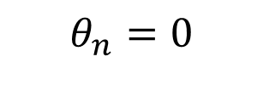
Transport and density of states
Heisenberg term splits spin-bands
Spins transport only in appropriate energies
$$θ_{n}=0$$
$$θ_{n}=π/4$$

Slide 20
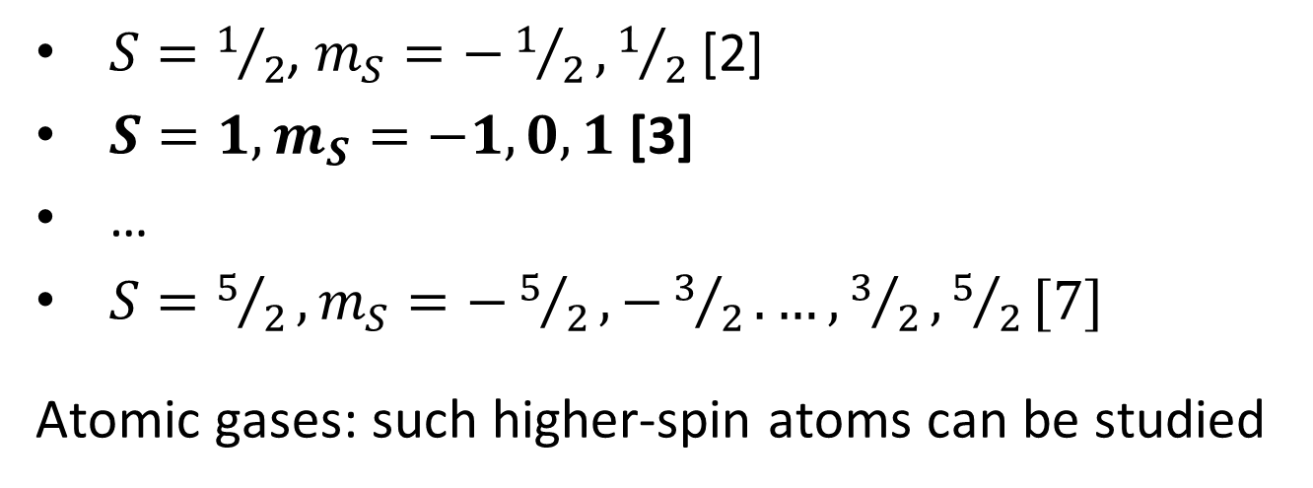
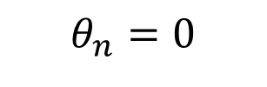

Higher-spin cases
$S=1/2$, $m_{S}=−1/2, 1/2$ [2]
$S=1, m_{S}=−1, 0, 1$ [3]
…
$S=5/2, m_{S}=−5/2, −3/2. …, 3/2,5/2[7]$
Atomic gases: such higher-spin atoms can be studied
$$[2S+1]$$
$$θ_{n}=0$$

Slide 21
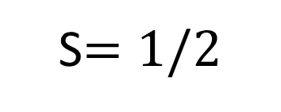

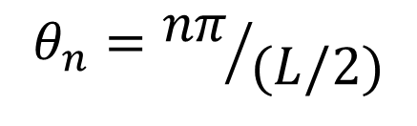
Spiral: flipping spins
$$θ_{n}={nπ}/L$$
S$=1/2$
$$θ_{n}={nπ}/{(L/2)}$$

Slide 22
Spin-spiral for S=1
Perfectly analoguous results for all higher S
A simple model for a spin filter with perfect polarization

Slide 23
Combining localization and spins: using disorder to select the spin
Silicene:
hexagonal lattice of Si atoms, buckles and has larger spin-orbit (SO) coupling
Suggestions that gap opens and can be controlled by electric field
Use SO/substrate to separate spins, and disorder/vacancies to localize spins in different energy ranges
Liu C C, Feng W and Yao Y 2011 Physical Review Letters 107 076802

Slide 24
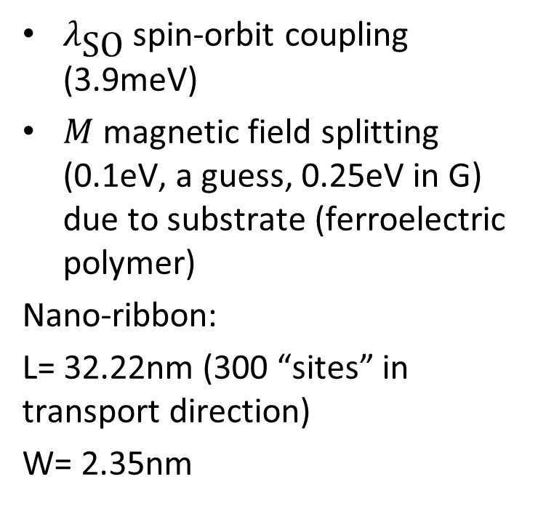

Transport calculations
$$c=0.05$$
$λ_{\text{SO}}$ spin-orbit coupling (3.9meV)
$M$ magnetic field splitting (0.1eV, a guess, 0.25eV in G) due to substrate (ferroelectric polymer)
Nano-ribbon:
L= 32.22nm (300 “sites” in transport direction)
W= 2.35nm

Slide 25



Results
$$c=0.05$$
"Silicene-based spin-filter device: Impact of random vacancies“, C. Nunez, F. Dominguez-Adame, P. A. Orellana, L. Rosales, R. A. Römer, accepted for publication in 2D Mat. (2015)
$$c=0.1$$
[errors within symbol size]
$$ε_{\text{Fermi}}=0.95e\text{V}$$

Slide 26
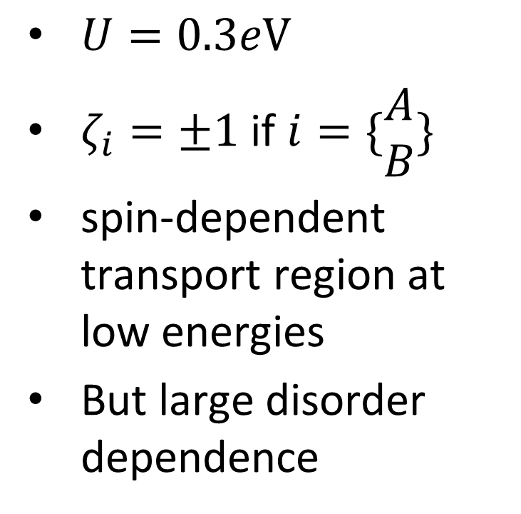

Adding an electric field
$$c=0.05$$
$U=0.3e\text{V}$
$ζ_{i}=±1$ if $i=\{\begin{matrix}A \\ B\end{matrix}\}$
spin-dependent transport region at low energies
But large disorder dependence

Slide 27
Conclusions
Extended transport channels can open even in low-D disordered systems
Simple models to show possibilities
Probably hard to achieve experimentally (but who knows!)
Thanks for the attention!

Slide 28
Disordered Quantum Systems
Localization: E. Carnio, A Chakrabarti (Calcut), N Hine, R Lima (Maceio), A Rodriguez-Gonzales (Freiburg), E Prodan (New York), D Quigley, H Schulz-Baldes (Erlangen)
Nano Science: F Dominguez-Adame (Madrid), C Nunez (Chile), L Rosales (Chile), P Orellana (Chile)
Numerical Methods: M. Bollhoefer (Braunschweig), O Schenk (Basel)
Protein Rigidity: R Freedman, E Jimenez, SA Wells, J Heal
Many-Body Physics: ME Portnoi, A Goldsborough
Quantum Hall: J Oswald (Leoben)
DNA: C Paez (Brasil), A Rodriguez (Madrid), C-T Shih (Taichung), SA Wells
Rogue Waves: A Savojardo, M Eberhard (Aston)
Funding: DFG, EPSRC, Leverhulme Trust, Nuffield Foundation, Royal Society; HECToR, ARCHER, Hartree Centre

