Slide 1


HetSys Welcome Week 2022
EPSRC Centre for Doctoral Training in Modelling of Heterogeneous Systems
HetSys Welcome Week 2022
Julie Staunton (Department of Physics), HetSys Director
Notes:
1

Slide 2

Management Team
Julie Staunton (Phys)
James Kermode (Eng)
Nicholas Hine (Phys)
Helen Knight (Admin)
+ rest of core team of PhD supervisors
Chemistry
Livia Bartok-Partay
Scott Habershon
Bora Karasulu
Becky Notman
Reinhard Maurer
Gabriele Sosso
Phill Stansfeld
(w. SLS)
Physics
Tony Arber
Animesh Datta
David Quigley
Tom Goffrey
Łukasz Figiel (WMG)
Tim Saunders (WMS)
Jürgen Branke (WBS)
HetSys Community
Engineering
Peter Brommer
Duncan Lockerby
Mohad Mousavi-N.
Phytos Neophytou
Hatef Sadeghi
Albert Bartok-Partay
RSE (SC RTP)
Chris Brady
Heather Ratcliffe
Mathematics
Radu Cimpeanu
Thomas Hudson
Susana Gomes
Tim Sullivan
James Sprittles
Centre for Scientific Computing
(CSC)
Warwick Centre for Predictive Modelling
(WCPM)
EPSRC CDT in Modelling of Heterogenous Systems
(HetSys)
Whole community together for lunchtime seminars every Monday, 1-2pm

Slide 3
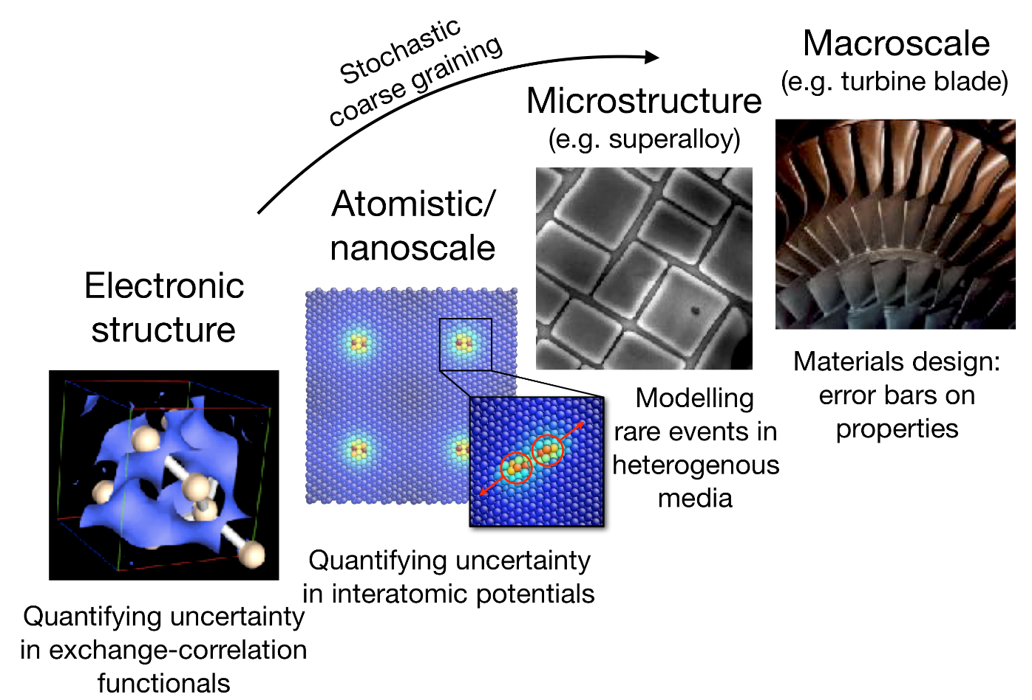
HetSys Key Training Needs
Cross-disciplinary barriers, integrating modelling approaches
Assess reliability of results – uncertainty quantification
Emphasise robust, sustainable software development
Notes:
3

Slide 4
PhD Projects 2022
EPSRC Centre for Doctoral Training in Modelling of Heterogeneous Systems
HetSys Welcome Week 2022
James Kermode (School of Engineering), HetSys Co-Director
Notes:
4

Slide 5
Student | Project | Supervisor | Student Mentor
Chantal Baer | Hopping through the interfaces: a multiscale chemo-mechanic model for energy materials | Lukasz Figiel, Bora Karasulu | Joe Gilkes
Fraser Birks | How amorphous carbon breaks: atomistic models and machine learning | James Kermode, Albert Bartok-Partay | Ziad Fakhoury
Laura Cairns | Machine learning and quantum theory of magnets for energy efficient and renewable energy technologies | Julie Staunton, Albert Bartok-Partay | Geraldine Anis
Sebastian Dooley | Fundamental physics or data science? Why not both: a data-driven modelling framework for interfacial microflows | Radu Cimpeanu, James Sprittles, Albert Bartok-Partay | Matyas Parrag
Joseph Duque-Lopez | Data-driven modelling of irradiation induced defects in fusion materials | Tom Hudson, James Kermode | Ben Gosling
Jacob Eller | Applying machine learning to understand photoprotection: how do triazine-based UV-filters really work? | Nick Hine, Vas Stavros, Reinhard Maurer | Jeremy Thorn
Arielle Fitkin | Harnessing Molecular Simulations to advance Electronics and Photovoltaics: design rules for the selective deposition of metals by novel condensation techniques | Gabriele Sosso, Ross Hatton, Nick Hine | Tom Rocke
Anson Lee | When the dust settles: predicting deposition of particulate and aerosols | Duncan Lockerby, James Kermode | Oscar Holroyd
Hubert Naguszewski | Memory matters: Beyond Markovian models of rare event kinetics | David Quigley, Peter Brommer | Anas Siddiqui
Mariia Radova | Optimising power grids and chemical reactions with graph neural networks | Albert Bartok-Partay, Reinhard Maurer | Matt Nutter
Yu Lei | Artificial Intelligence (AI)-enabled Cryogenic Electron Ptychography For Bio-macromolecule Imaging | Peng Wang, Julie Staunton, Tim Saunders | Dylan Morgan

Slide 6
Training Programme
EPSRC Centre for Doctoral Training in Modelling of Heterogeneous Systems
HetSys Welcome Week 2022
Nicholas Hine (Department of Physics),
HetSys Director of Studies
Notes:
6

Slide 7
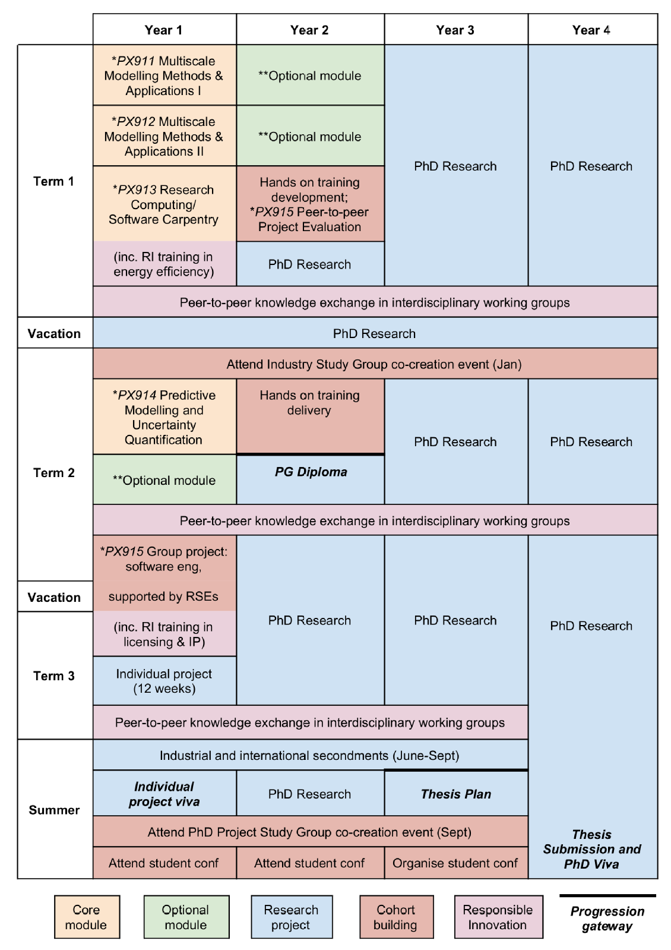

Overview of Training Programme
Some elements of the CDT training will run throughout the four year PhD programme but most are concentrated in the first 18 months.
Students associated with projects from the start, enabling bespoke programme for each student, with a common core ensuring a broad knowledge of multiscale modelling methods, plus high-level software engineering and UQ techniques.
Training culminates in the award of a Postgraduate Diploma (PGCert and MSc also available as exit qualifications for those choosing not to progress to PhD).
Years 2-4 predominantly research, with some cohort activities.
Notes:
7

Slide 8
Core Module Syllabus Overviews
PX911: Multiscale modelling methods and applications I
Term 1, weeks 1-10
Provides an introduction to atomistic modelling techniques including OFT, classical force field methods and an appreciation of how they interact with other modelling frameworks.
Students will learn how to design atomistic simulations of condensed matter or molecular systems, and how to identify simulation methodologies appropriate to bridging multiple length scales, balancing accuracy vs. cost.
Multiscale Modelling case studies by guest lecturers will show how problems involving heterogeneous systems are tackled at multiple length & time scales.
PX912: Multiscale modelling methods and applications II
Term 1, weeks 6-10, Term 2 weeks 1-5
Provides a grounding in macroscopic and multiscale modelling techniques, emphasizing applications and the links between methods and across scales
Lectures on foundations of continuum mechanics, thermodynamics, fluid dynamics, solid mechanics, and recent developments in multiscale fluid, plasma and solid mechanics
Topics covered will range from the basics of continuum mechanics and thermodynamics concepts through to demonstrating the route from underlying models via algorithms to practical implementation in simulation packages.
Notes:
8

Slide 9
Core Modules:
PX911: Multiscale modelling methods and applications (15 CATS)
PX912: Multiscale modelling methods and applications II (15 CATS)
PX913: Introduction to Scientific Software Development (15 CATS)
PX914: Predictive Modelling and Uncertainty Quantification (15 CATS)
PX915: Software engineering group project; Peer-to-Peer Uncertainty Quantification Project (30 CATS)
Notes:
9

Slide 10
Core Module Syllabus Overviews
PX913: Introduction to Scientific Software Development
Term 1, weeks 1-10
Provides bespoke Software Carpentry training developed by our RSE group to ensure students understand the core principles of programming and software development, gain experience with writing, debugging and reading code in high- and low-level languages, and learn to use common tools for data analysis and visualization.
Lectures will cover fundamental operation of a computer, use of version control, debugging tools, and approaches to group-based software development.
Where necessary for individual projects, C or Fortran training will be provided, positioning students to follow further programming option modules, eg PX425: High Performance Computing.
PX914: Predictive Modelling and Uncertainty Quantification
Term 2, weeks 1-10
Provides an introduction to predictive modelling techniques including statistics, machine learning, data analytics and data mining, essential for solving problems in the interdisciplinary area of predictive modelling.
Lectures will cover random processes, statistical learning, Bayesian inference, Monte Carlo methods, model selection, and supervised and unsupervised machine learning techniques.
Focus on scalable approaches to UQ and propagation in multiscale models, and concludes with an overview of Bayesian inverse problems
Notes:
10

Slide 11
Core Module Syllabus Overviews
PX915 Part I: Software engineering group project
End of Term 2 to middle of Term 3
Undertaken collectively by the cohort, with students designing, specifying, optimising and implementing a small-scale simulation package to model heterogeneous systems
Examples include density functional theory, molecular dynamics, computational fluid dynamics and finite element analysis. Careful division of responsibilities and integration of work will be required.
Module will include seminars on intellectual property and software licensing with input from Warwick Ventures, who commercialise innovations produced from research carried out in the University.
PX915 Part II: Peer-to-peer Project Evaluation (Year 2)
Around week 3, term 1 of year 2
Builds on output of individual research projects: another cohort member will be assigned to evaluate the quality of a student’s model error estimates and/or compliance with research software engineering principles
Run models with an ensemble of inputs to enable sensitivity analysis, or on a selection of architectures, with opportunities for power-usage profiling.
Software testers will be encouraged to discuss the process with the software authors, fostering dialogue across the cohort.
Notes:
11

Slide 12
Optional Modules:
At least 2 optional modules, to total 30 credits, including 15 credits from this list:
PX917: Computational Plasma Physics (15 credits)
PX918: Electronic Structure Theory for Experiments and Models (15 credits)
PX919: Quantum Chemistry (7.5 credits)
PX920: Micromechanics of Materials (7.5 credits)
PX921: M​icro & Nano Flows across scales (7.5 credits)
PX923: Biomolecular Simulation (7.5 credits)
PX425: High Performance Computing in Physics (7.5 credits)
MA4K0: Introduction to Uncertainty Quantification (15 credits)
Modules confirmed to run in 2022/23: PX425 ,PX918 (term 1), PX919 (term 2), PX923 (term 2)
Please discuss best options to complement your PhD project with your supervisor.
Notes:
12

Slide 13
Other Optional Modules:
Any module of an appropriate level (usually 9- or 4- coded), for example:
MA4J1: Continuum Mechanics (15 credits)
MA933: Stochastic Modelling and Random Processes* (15 credits)
MA934 Numerical Algorithms and Optimisation* (15 credits)
MA930 Data Analysis and Machine Learning* (15 credits)
* Core modules of the Mathematics of Real-World Systems (MathSys) CDT programme.
These are pre-approved. Others are subject to approval by supervisor, module leader and
HetSys Director of Graduate Studies
Notes:
13

Slide 14
Computing
You are being supplied with a Dell Laptop, which has been pre-installed with Ubuntu Linux and a range of scientific software packages (in a 300GB partition). See:
https://warwick.ac.uk/fac/sci/hetsys/studentinformation/computing/
Unlike in previous cohorts, we have left Windows 10 on there (in a 200GB partition). If you have no intention of using this feel free to zap it and use the space. If you do particularly want to use it, you may need to do some sort of recovery / data-unlocking procedure on it as it will detect that the BIOS has changed due to the Ubuntu launcher.
Please sign up ASAP for an SCRTP account:
http://www2.warwick.ac.uk/research/rtp/sc/desktop/myaccount
Notes:
14

Slide 15
Support:
Stay in regular contact with your supervisor(s) and your student mentor;
Approach module leaders early if you feel you are falling behind on a particular module, not understanding the material, or struggling in any way;
Approach your supervisor or one of the HetSys management team (Julie, James or Nick) if you are having difficulties with the course as a whole.
We are all here to help!
Notes:
15

Slide 16
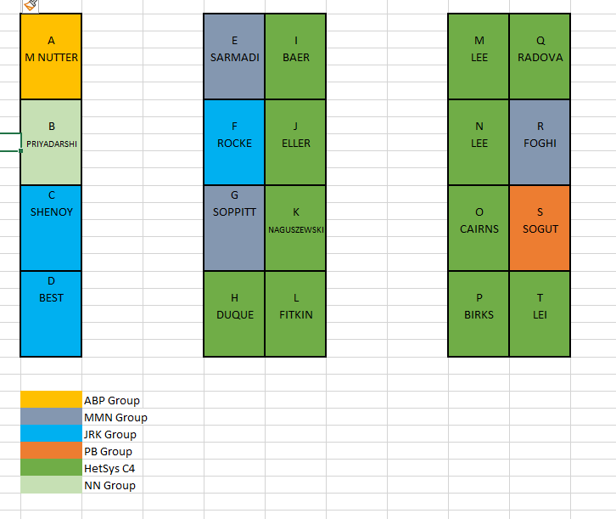
Office Space
You have all been allocated a desk in the D2.15 open plan office space, with docking stations for your HetSys laptops
Risk assessment for this area allows full occupancy. Full details of RA and online training courses to be completed before you work there will be sent out via email.
If you want to work elsewhere on campus, space is available in the Library or in the Postgraduate Hub
Notes:
16

Slide 17
Welcome Week Schedule
EPSRC Centre for Doctoral Training in Modelling of Heterogeneous Systems
HetSys Welcome Week 2022
James Kermode (School of Engineering), HetSys Co-Director
Notes:
17

Slide 18

Monday 27th September | Tuesday 28th September | Wednesday 29th September | Thursday 30th September | Friday 1st October
10:00 – 12:00 Welcome and Introduction from HetSys Directors MAS 2.05/6 | Free day Arrange meetings with your supervisors and student mentors | 10:00 – 12:00 Laptop troubleshooting MAS 2.05/6 | 10:00 – 12:00 Mathematics Induction James Kermode MAS 2.05/6 & MS Teams | 10:00 – 12:00 Python Programming Induction Nick Hine MAS 2.05/6 & MS Teams
 |  |  | 13:30 – 15:30 Quantum Mechanics Induction Julie Staunton MAS 2.05/6 & MS Teams
Save the date!
Curry and Quiz social 20 October
Notes:
18

Slide 19
Health and Safety
There are some University Health and Safety videos on Moodle that you should watch
Health & Safety Induction
Fire Safety Training
Display Screen Equipment
Information is linked here: https://warwick.ac.uk/fac/sci/hetsys/studentinformation/induction/healthandsafety/
There are also tips on setting up your work environment
Up to date guidance from the University in relation to COVID-19 and support for those having to self-isolate on campus can be found here: https://warwick.ac.uk/coronavirus
These slides will be uploaded to the HetSys student information page.
Notes:
19

Slide 20
Useful Contacts
Julie Staunton (Department of Physics), Director
Room PS1.41, Physical Sciences, Department of Physics
J.B.Staunton@warwick.ac.uk
James Kermode (School of Engineering), Co-Director
Room D2.10, School of Engineering
J.R.Kermode@warwick.ac.uk
Nick Hine (Department of Physics), Director of Graduate Studies
Room PS1.40, Physical Sciences, Department of Physics
N.D.M.Hine@warwick.ac.uk
Helen Knight (Department of Physics) HetSys Administrator
Room P5.22, Department of Physics
hetsys@warwick.ac.uk
Notes:
20

Slide 21
Administrative Matters
EPSRC Centre for Doctoral Training in Modelling of Heterogeneous Systems
HetSys Welcome Week 2022
Helen Knight (Department of Physics)
HetSys Administrator
Notes:
21

Slide 22
Research Support and Training Grant
Each student has a budget (£6000) for directly incurred costs required to carry out the PhD project such as travel to conferences, workshops and specialist resources.
All expenses should be directly relevant to the PhD project’s research outputs and must follow the University's expenses policy.
Your individual expenditure code will be set up on the university’s SAP finance system, which is to be used for all RTSG expenditure. https://warwick.ac.uk/fac/sci/hetsys/studentinformation/costcodes/
It is your responsibility to ensure that you monitor their expenditure and do not exceed the budget allocation.
Notes:
22

Slide 23
Research Support and Training Grant
Examples of allowable costs are:
  Software essential to your PhD
  Books and other reading material not available in the library
  Printing posters and lecture notes
  PhD travel and subsistence for external conferences, workshops, short courses, summer schools
  Support for internships where external partner is not able to support
In additional to this, all students can either have a desktop computer or a docking station for their campus workspace from year 2 onwards
Notes:
23

Slide 24
Research Support and Training Grant
Examples of ineligible costs are:
  Repair or replacement of your HetSys laptop
  Costs of alcohol under any circumstances
  Any costs incurred for moving to the UK, eg visa fees, health surcharge
  Any costs incurred outside of your funding period.
Further information can be found online: https://warwick.ac.uk/fac/sci/hetsys/studentinformation/costcodes/
Notes:
24

Slide 25
Research Support and Training Grant
Full guides to claiming expenses and booking travel can be found online:
https://warwick.ac.uk/fac/sci/hetsys/studentinformation/bookingguidance
Save the date:
Expenses and Opera workshop
Wednesday 19th October at 1pm
Notes:
25

Slide 26
Annual Leave
Full-time PGR students are entitled to take a maximum of eight weeks/40 days holiday in the year (incl. the statutory (i.e. Bank Holidays) and customary University holidays).
If a student is supported by a student visa, they must refer to the Immigration Team for advice prior to requesting a leave of absence as this may affect their visa.
No single period of annual leave should exceed four weeks.
No official monitoring through HetSys, just agree with your supervisor and keep a record of the leave you have taken – feel free to email HetSys@warwick.ac.uk if you would like me to keep a record
Notes:
26

