Slide 1
Journal Metrics
SLS/WMS Postgraduate Academic Writing Workshop
Research and Academic Support Librarians
academicsupport@warwick.ac.uk

Slide 2
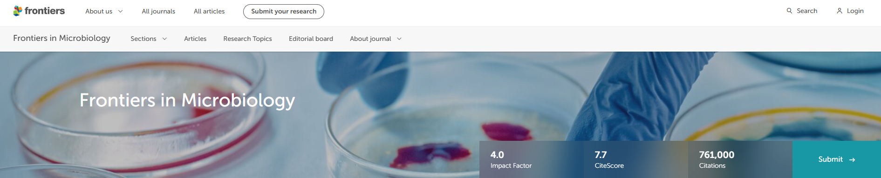
Frontiers in Microbiology has a 4.0 Impact Factor and 7.7 CiteScore, and claims to be “the most cited microbiology journal”
What is an Impact Factor and CiteScore? How do you find journal metrics? How does this journal compare with others in its field?
Journal metrics

Slide 3

Journal metrics
Research metric to measure journals
Journal Impact Factor = Number of citations ÷ Number citable items
Average measure of all articles published in a journal over a given time-period
Journal Impact Factor (JIF) is published by Clarivate in Journal Citation Reports (JCR)
  Calculated using citation data in Web of Science over previous 2 years
CiteScore is published by Elsevier in Scopus
  Calculated using citation data in Scopus over previous 3 years

Slide 4


Other research metrics
Citation based measures of research
Citations
Counts of the number of times an article is cited in other publications
Journal impact factor
Average number of citations to an article published in a journal
H Index
Counts the number of an author’s publications and their citations

Slide 5


Altmetrics
Non-citation measures of research
Altmetrics use alternative (non-citation) indicators to measure research publications:
Usage: page views, downloads, bookmarks, favourites, export to reference manager
Mentions: social media, blogs, newspapers, policy papers, Wikipedia
Altmetric providers use visual badges to display alternative research metrics:
Altmetric
PlumX Metrics

Slide 6
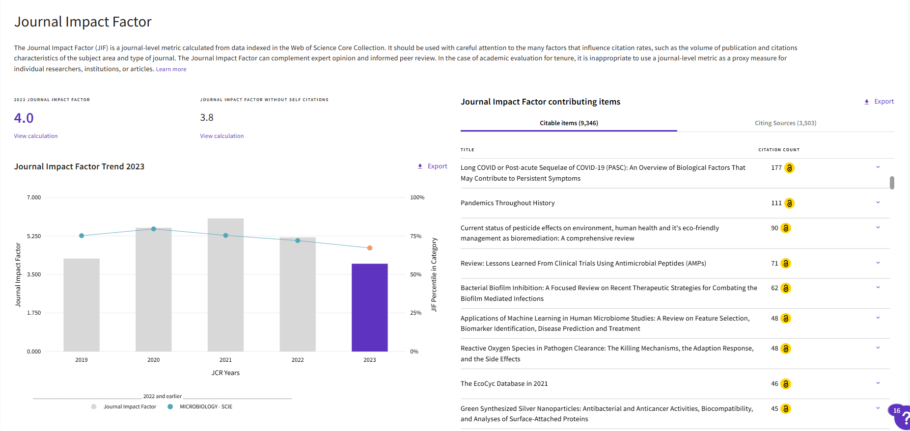
Journal Citation Reports
Journal Impact Factor using Web of Science data
Find the metric: Journal Citation Reports > Journals > Frontiers in Microbiology
      Journal Impact Factor = 4.0
      Journal Citation Indictor = 0.89
      Journal ranking = 53/161 (67.4 percentile)

Slide 7
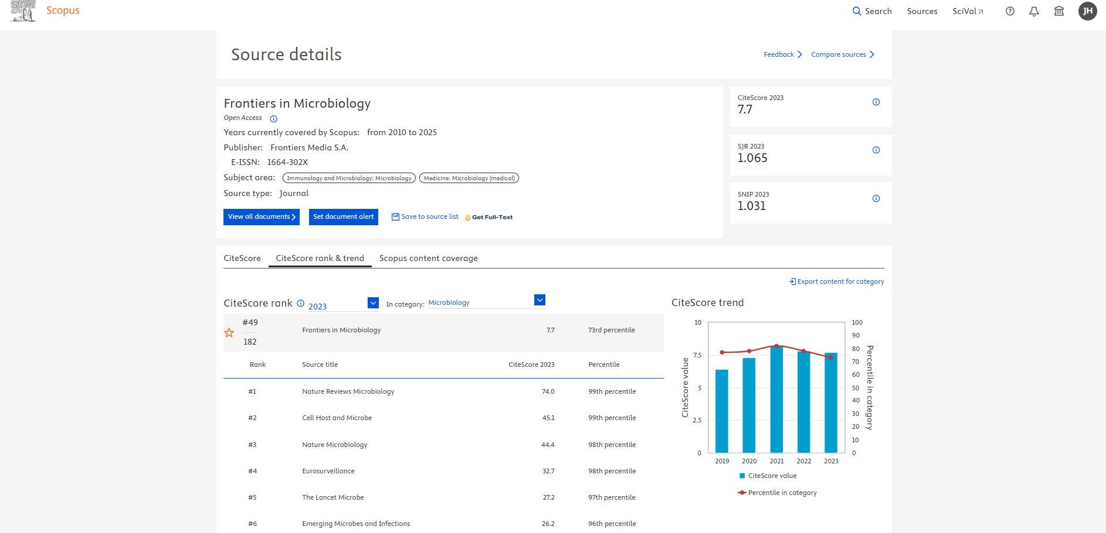
Scopus (Sources)
CiteScore using Scopus data
Find the metric: Scopus > Sources > Title > Frontiers in Microbiology
      CiteScore = 7.7
      SNIP = 1.031
      Journal ranking = 49/182 (73.0 percentile)

Slide 8
Normalised journal metrics
1.0 = normal expected citations within the discipline
Score of below 1.0 = below average & above 1.0 = above average
JCI: Journal Citation Index published by Journal Citation Reports
SNIP: Source-Normalised Impact per Paper published by Scopus
SJR: SCImago Journal Rank published by SCImago using Scopus data

Slide 9

Journal rankings
List of journal titles ranked by their impact factor
Journal rankings list show journal titles ordered by JIF, CiteScore and SNIP:
Access a complete list of all journals in a discipline (with a journals score)
Find the relative position and percentile of a journal title in the rankings list
Follow trends in the journals score and ranking over a period of time
Journal Citation Reports by Clarivate (ranks by Journal Impact Factor)
Sources in Scopus by Elsevier (ranks by CiteScore, SNIP and others)
Journal rankings lists are updated annually – with cycle of new journal impact scores

Slide 10

Microbiology journal rankings
List of journal titles ranked by their impact factor in 2023
Journal Citation Reports (161 journals) Ranked by Journal Impact Factor | Scopus (182 journals) Ranked by CiteScore
1. Nature Reviews Microbiology (69.2) | 1. Nature Reviews Microbiology (74.0)
2. iMeta (23.8) | 2. Cell Host & Microbe (45.1)
3. Lancet Microbe (20.9) | 3. Nature Microbiology (44.4)
4. Cell Host & Microbe (20.6) | 4. Eurosurveillance (32.7)
5. Nature Microbiology (20.5) | 5. Lancet Microbe (27.2)
6. Clinical Microbiology Reviews (19.1) | 6. Emerging Microbes & Infections (26.2)
7. Trends in Microbiology (14.0) | 7. Trends in Microbiology (25.3)
8. Microbiome (13.8) | 8. ISME Journal (22.1)
9. Gut Microbes (12.2) | 9. Microbiome (21.9)
10. Clinical Microbiology & Infection (10.9) | 10. Microbiology & Molecular Biology Reviews (18.8)
53. Frontiers in Microbiology (4.0) | 49. Frontiers in Microbiology (7.7)
Notes:
Agree on #1 ranked journal (Nature Reviews Microbiology)
Agree on 6 of the top 10 ranked journals (but disagree with order of top 10)
Index a different number of microbiology journals
CiteScore is generally a larger number than Journal Impact Factor

Slide 11
Using journal metrics
Evaluating journals using impact factors
Impact factors can be a useful tool to identify and evaluate journals
Many different types of journal metrics - using different data and calculations
Impact factors are not comparable between databases and across disciplines
Other factors can also help you evaluate journals:
Purpose and scope of journal, including topics that are published
Does the journal publish articles that are similar to your topic?
Peer review process and acceptance rate of the journal
Ability to publish Open Access articles (does university have publishing deal?)

Slide 12
Responsible research metrics
Responsible Metrics focuses on appropriate and fair use of quantitative research metrics, alongside qualitative and narrative methods, to measure research
Refocus on the quality (not quantity) of research publications
Use of altmetrics to measure the usage, engagement with and impact of publications
Use of qualitative and narrative methods to set context and tell research story
Acceptance that research metrics are not comparable across disciplines and career stage
Avoid the misuse of research metrics e.g. not measuring an article or author by an impact factor
University is committed to COARA - the Coalition for Advancing Research Assessment
https://warwick.ac.uk/services/library/research-support/responsible-metrics/coara/

Slide 13

Introduction to Open Access
SLS/WLS PGR Writing Workshop
8th May 2025
Dr Josh Caldicott (he/him), Open Access Officer

Slide 14






What is Open Access?
Open Access (OA) is the practice of providing free, unrestricted access to peer-reviewed scholarly research outputs via the internet.
Benefits of Open Access
Open Access Requirements
Able to Reach:
  Practitioners
  Policy Makers
  Industry
  Media
  General Public
  Researchers in Developing Countries
Improved Metrics
More Collaboration Opportunities
Comply with Requirements

Slide 15
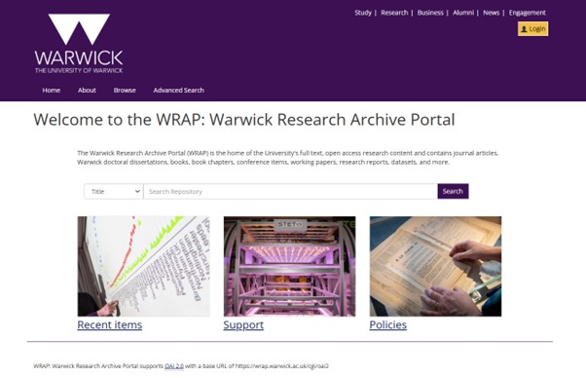

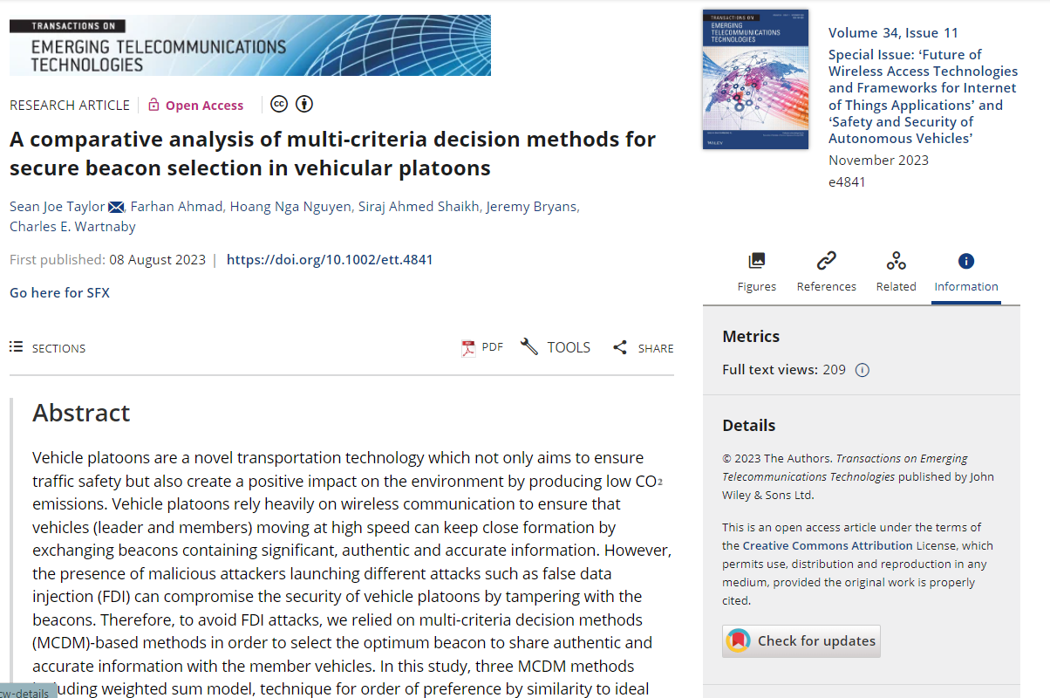



Routes to Open Access
Green OA – Repository Supported
Gold OA – Publisher Supported
AAM
Subscription Journals: publish articles behind paywalls, to be accessed by subscribers, often through institutional subscriptions
Hybrid Journals: Publish a mix of both subscription access only articles and open access articles
Open Access Journals: publish all of their articles open access, such that anyone can access them without any form of payment

Slide 16

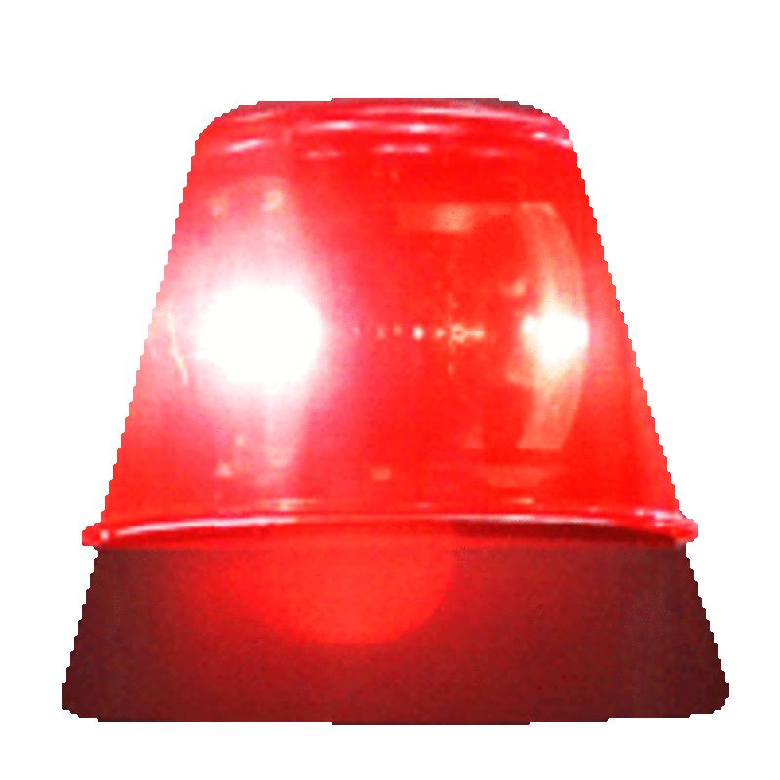
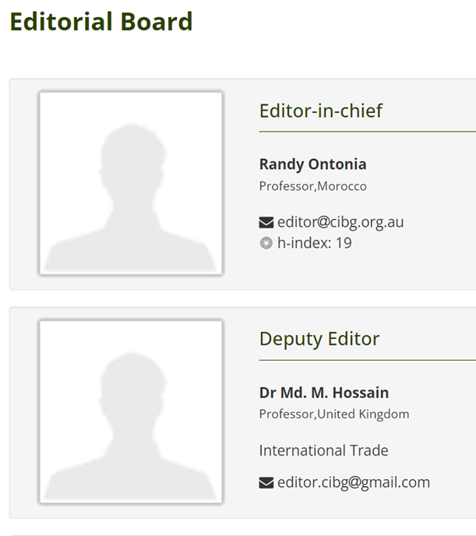

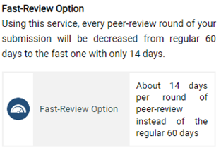


Predatory Journals
The ‘Publish or Perish’ mantra can evoke pressure to publish quickly ​and some publishers are much more efficient at publishing than others.
Watch Out For Predatory Publishers!
Look out for:
Publications fees with little peer review
Advertises quick turn-around time
Lack of identifiable editors
Exaggerated Impact Factor (using Google Scholar)
Misleading about where they are indexed
Wide scope / publishing out of scope
Errors, typos and incomprehensible titles
Think Check Submit have useful guidance around the types of checks you may want to consider when scoping Journals (https://thinkchecksubmit.org/)
The Directory of Open Access Journals (DOAJ) lists Open Access journals that have been checked to ensure they have adopted ethical publishing practices. (https://doaj.org/​)

Slide 17
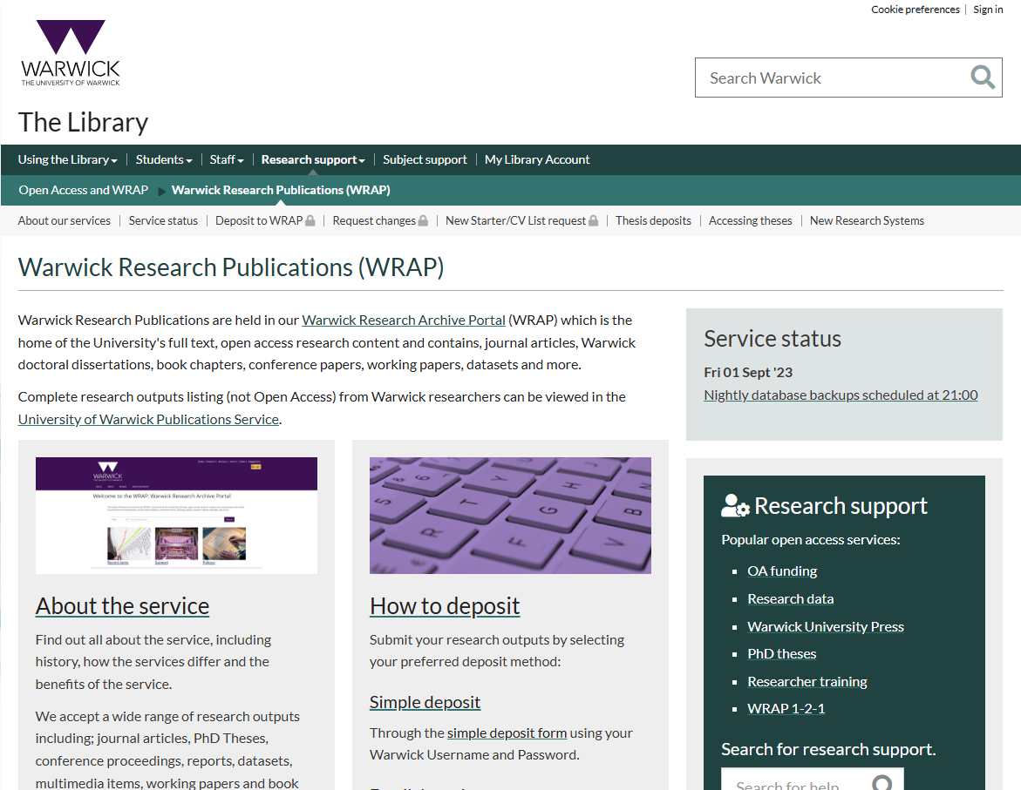

Support for Green Open Access
The WRAP team in the Library checks all publications deposited in the repository to ensure they meet all Open Access Requirements, while complying with publisher policies.
At the point of acceptance, you should deposit the acceptance manuscript with the acceptance date in WRAP.
You may wish to apply a Rights Retention Statement to the Submitted Manuscript, to allow your article to be Open Access via the Green Route without an embargo.
Rights Retention is neccessary to be comply with funders like UKRI, NIHR, Horizon and Wellcome.
Full guides on how to deposit your research can be found on the WRAP website.
WRAP Repository: https://wrap.warwick.ac.uk/
Website: https://warwick.ac.uk/services/library/research-support/open-access/warwick-research-publications/
Email: publications@warwick.ac.uk

Slide 18
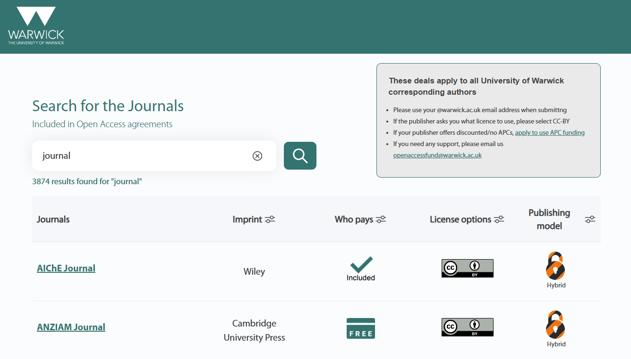









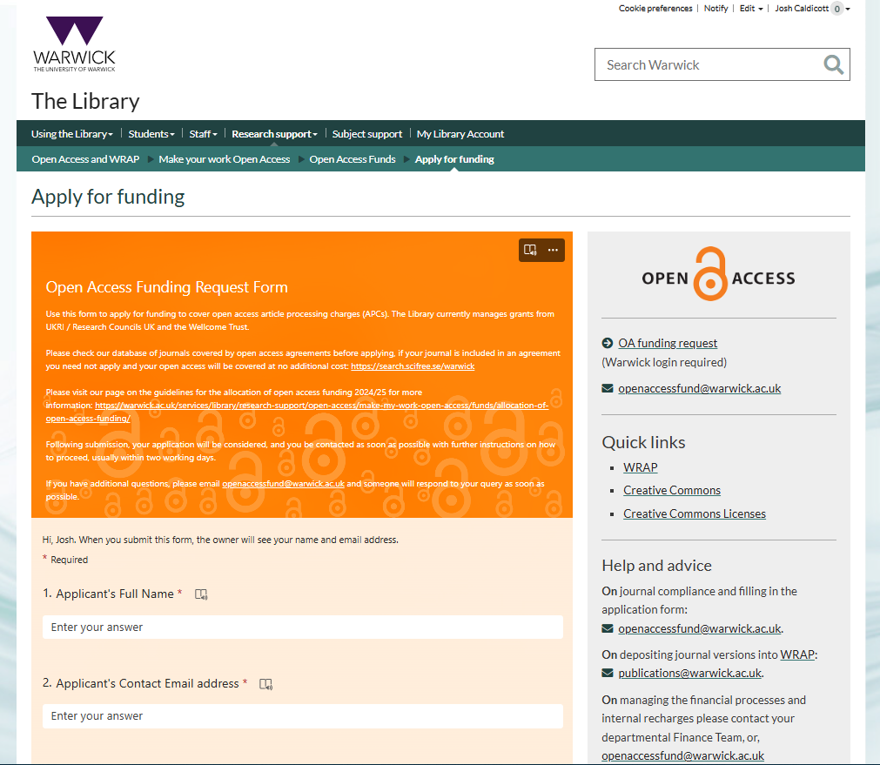

Support for Gold Open Access
Read and Publish Agreements
The University has agreements with many publishers, allowing journal articles to be published Gold Open Access at no further cost, if the corresponding author is affiliated with the University of Warwick
Website: https://warwick.ac.uk/services/library/research-support/open-access/make-my-work-open-access/agreements/
List of Agreements: https://search.scifree.se/warwick
Open Access Funds
Library manages a few different funds to support researchers with paying Article Processing Charges (or APCs). These include the UKRI Block Grant, the Wellcome Trust Block Grant and the Library OA Fund.
Website: https://warwick.ac.uk/services/library/research-support/open-access/make-my-work-open-access/funds/
Funding Request Form: https://warwick.ac.uk/services/library/research-support/open-access/make-my-work-open-access/funds/form/

Slide 19
Further Support with Open Access
Websites:
Open Research Page: https://warwick.ac.uk/services/library/research-support/open-access/
Open Access Requirements: https://warwick.ac.uk/services/library/research-support/open-access/why-open-access
Make your Research Open: https://warwick.ac.uk/services/library/research-support/open-access/make-my-work-open-access
WRAP Repository: https://warwick.ac.uk/services/library/research-support/open-access/warwick-research-publications/
Research Training: https://warwick.ac.uk/services/library/research-support/researcher-training/
Book a Meeting: https://warwick.ac.uk/services/library/research-support/open-access/support-booking/
Email:
Open Research Team: Open.Research@warwick.ac.uk / OpenAccessFund@warwick.ac.uk
Research Data Team: ResearchData@warwick.ac.uk
WRAP Team: Publications@warwick.ac.uk

