Slide 1





Warwick Crop Centre School of Life Sciences Wellesbourne Innovation Campus

Slide 2
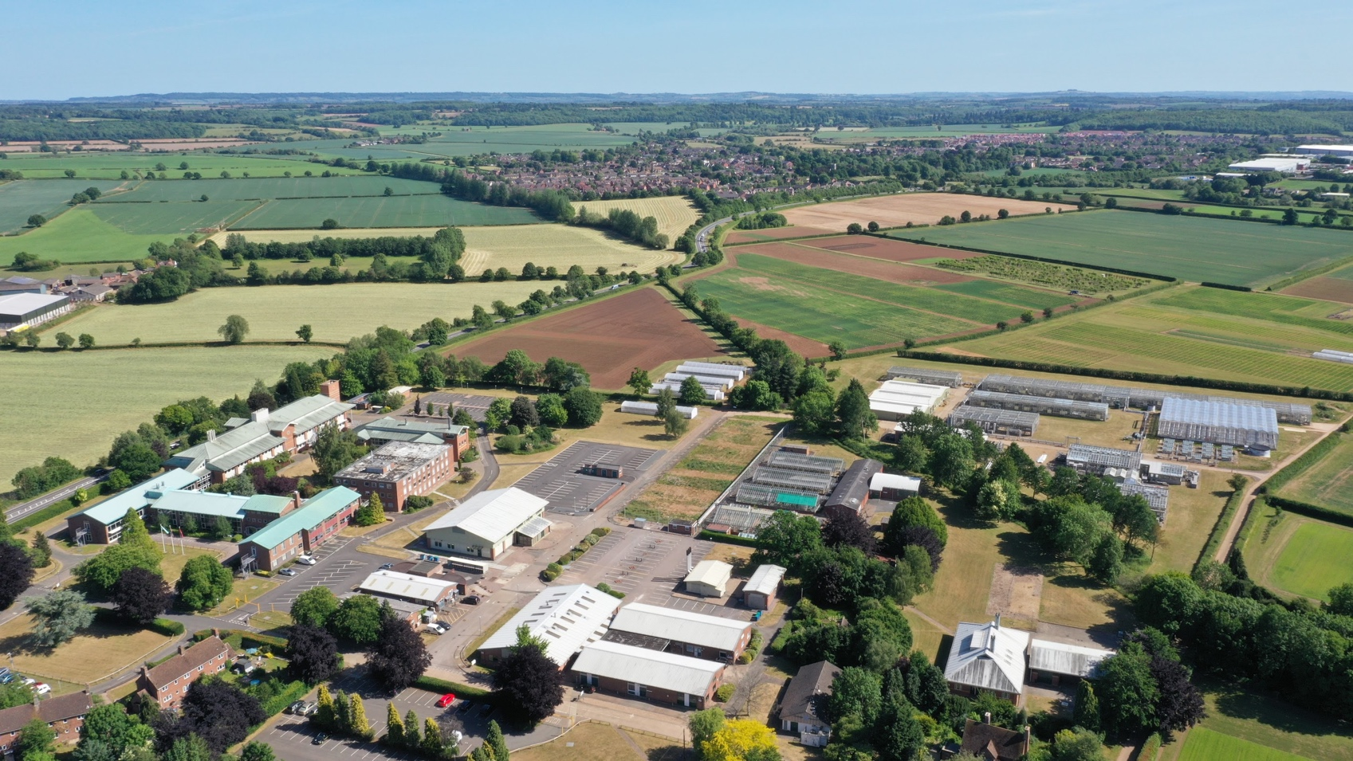
Warwick Crop Centre
We deliver expertise, knowledge and technology to the agricultural and horticultural industries to promote innovation, sustainable crop production and environmental protection

Slide 3
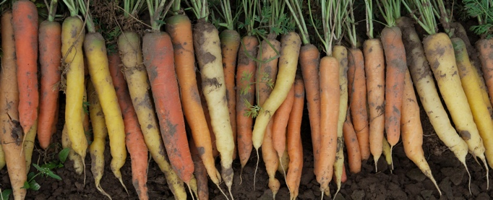
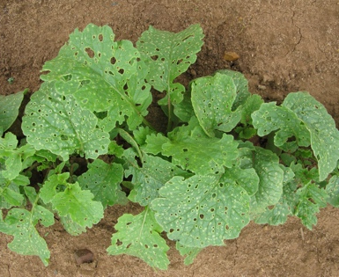
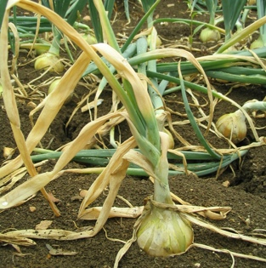
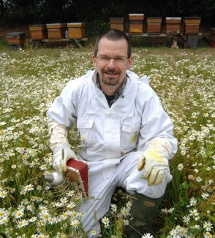
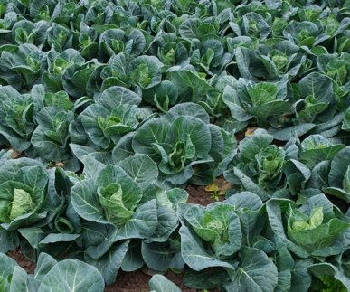
Expertise
Crop genetic improvement: identification of novel crop traits and genetic analysis, collaborative pre-breeding research
Plant pests and diseases: pest and pathogen biology, epidemiology, biological control, forecasting and integrated approaches to crop protection
Soil microbiology: soil health and microbe-root ecosystems and interactions
Crop physiology: crop nutrition and development
Resource and environment management: low carbon farming, land use, ecosystem services, nutrient and water use efficiency
Bee and pollinator health: honey bee genomics, biological control

Slide 4
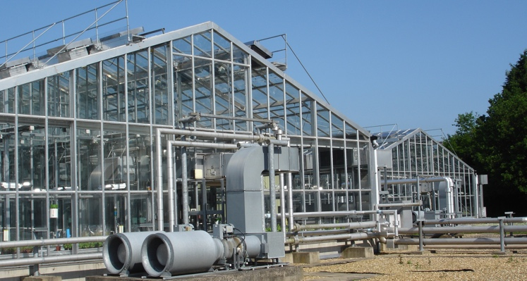
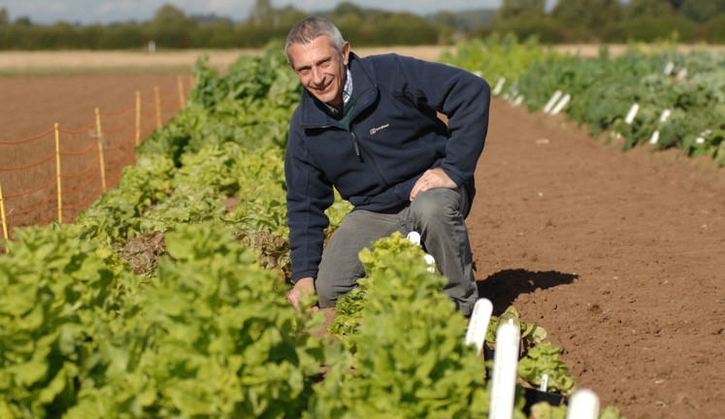
Facilities
High quality labs: for all aspects of crop science, microbiology, molecular biology, pest and pathogen research
Controlled environment: dedicated insect rearing unit, growth rooms and cabinets
Glasshouses and polytunnels: with environmental control and containment
Field trials areas: 40 ha land including specialist areas for pests and pathogens and low nutrient status field
Weather station and insect suction trap: part of national networks
UK Vegetable Genebank: conserves major international collections of vegetable seed including brassica, lettuce, carrot and onion underpinning crop improvement
The Natural Light Growing Centre: novel ETFE greenhouse, major asset for the Crop Health and Protection Agri-Tech Centre funded by Innovate UK

Slide 5
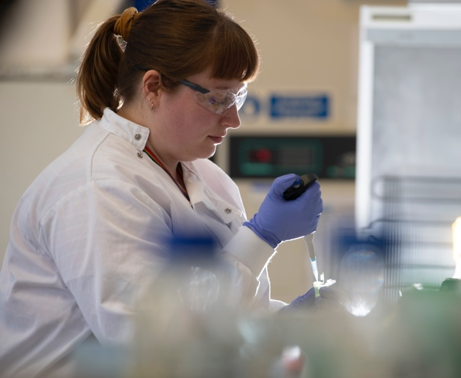
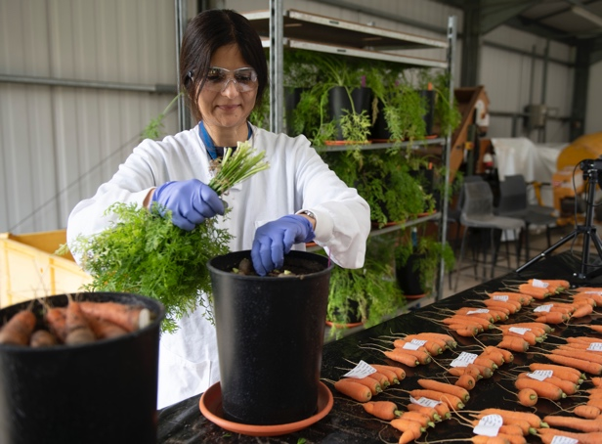
Research
Wellesbourne has been an internationally recognised centre for horticultural crop science for >70 years
Fundamental to applied and translational research in sustainable agriculture, horticulture and in food security funded by BBSRC, DEFRA, AHDB, UKRI and directly from industry
Examples of major research programmes
VeGIN (Defra): exploitation of genetic diversity of brassica, lettuce, onion and carrot crops to identify improved traits such as pest and disease resistance and increased crop resilience. Companies have adopted new technologies to accelerate the development of improved crop varieties for growers.
Sceptre+ (AHDB): developing sustainable plant protection products for high priority disease, pest and weed problems in fresh produce and ornamental crops to support and develop integrated pest management programmes.
AMBER (AHDB): research to identify practical ways for growers to improve the performance of biopesticides and integrate into crop protection strategies
World class facilities at Wellesbourne and at Main campus include latest genomic and bioinformatic capabilities.

Slide 6

Funding and activity ecosystem
Teaching and training
PhD / MSc projects
MSc teaching
AHDB
Applied research
Knowledge exchange
Innovate UK
Industry research
Industry
Applied research
Knowledge exchange
EU
Thematic networks
Knowledge exchange
Strategic & applied research
BBSRC
Basic Research
Defra VeGIN
UK Vegetable Genebank

Slide 7
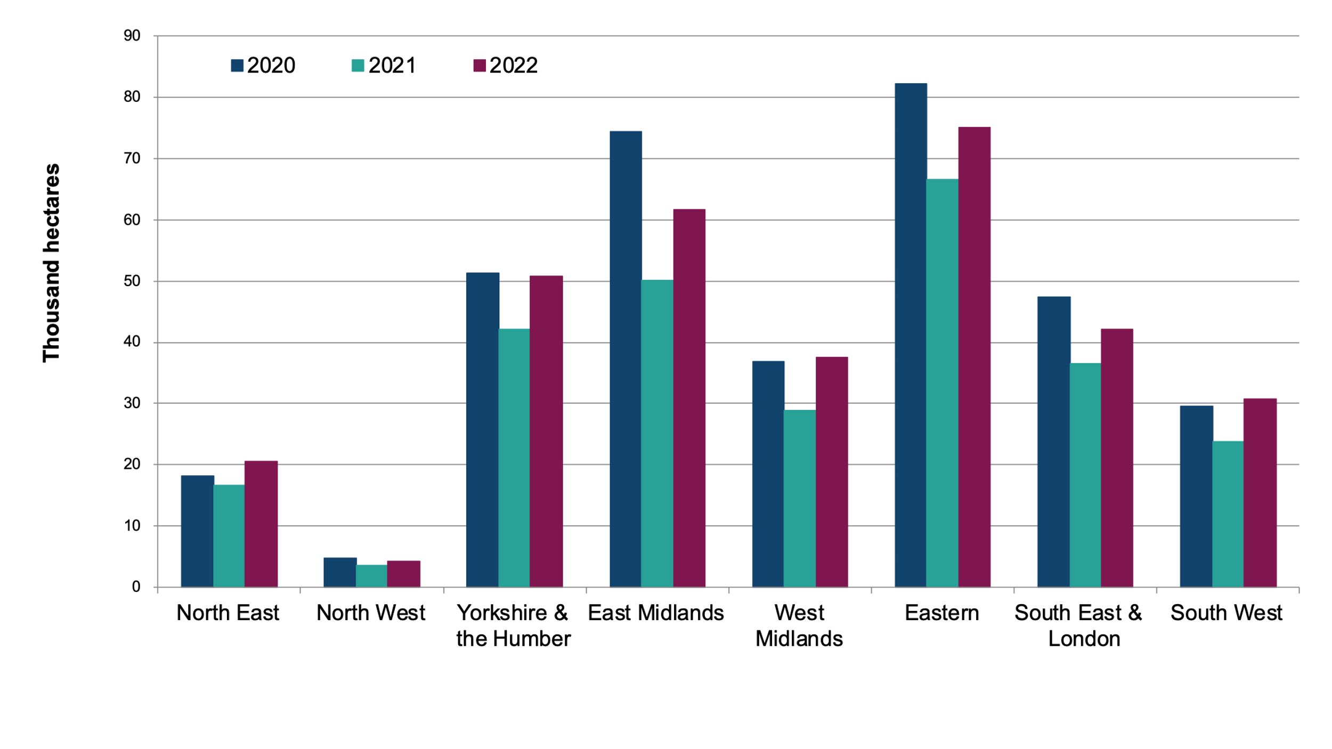
Regional oilseed rape areas: 2020 to 2022 (thousand hectares)
The total area of oilseed rape increased by 20% from 268 thousand hectares in 2021 to 323 thousand hectares in 2022. The overall downward trend in area of winter oilseed rape continues since the peak seen in 2012.
https://www.gov.uk/government/statistics/cereal-and-oilseed-rape-areas-in-england/cereal-and-oilseed-rape-areas-in-england-at-1-june-2022

Slide 8
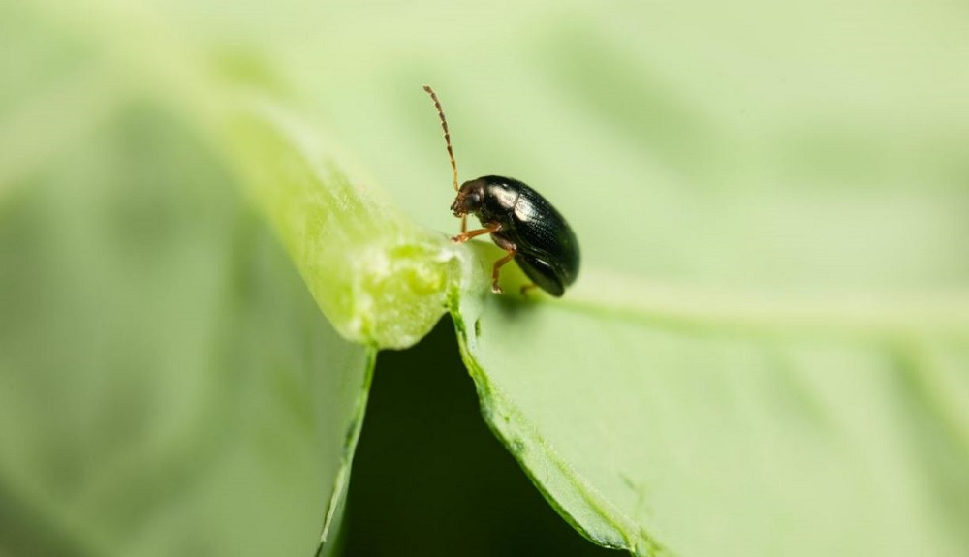
Cabbage stem flea beetle
The pest can destroy a plant’s growing point and cause crop failure!
Oil seed rape is also a key rotation crop. If oil seed rape losses are so high, that farmers abandon it as a crop, it could lead to shortages in other crops, such as wheat
Can Sunflower offer a solution?

Slide 9

Room for improvement?
Global predictions are that the sunflower oil market will grow dramatically from $19.53 billion in 2021 to $29.59 billion in 2028

Slide 10
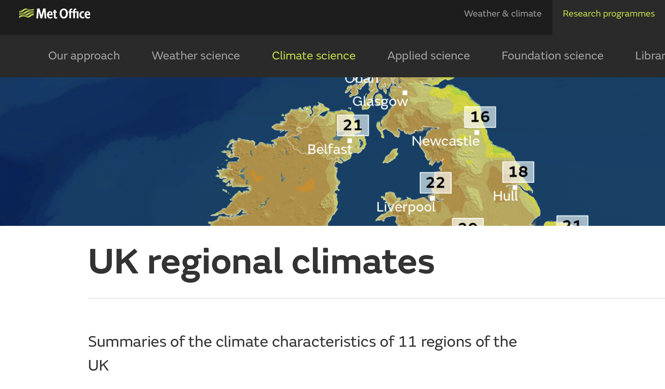
Met Office Modelling
What impact will climate change have on our crops?

Slide 11
Is there sufficient interest in building a business case for sunflower as an alternative oilseed crop when grown in rotation with cereals.
To understand the barriers which currently prevent sunflower becoming a viable crop for wide scale use in the UK

Slide 12
Build a network of partners and exchange knowledge on best practice.
Establish a database of germplasm and define traits for genetic improvement.
Identify pests and pathogens that could threaten sunflower growers in the UK.
Develop appropriate assays in order to breed for resistance.
Carry out life cycle analysis (LCA) for UK growers.
Undertake a detailed market analysis.

Slide 13
^{December 13th 10:30-4pm}

Slide 14
Experiment exploring varital interactions with microbiome

Slide 15
What would it take to make sunflowers commercially viable in the UK?
Areas for focus:-
Agronomic barriers
Pest and disease.
Commercial barriers
Climate change
Priorities for making the breakthrough?
Any others?

Slide 16

Is the Sunnyside up?

