Slide 1
Sunflower and other oilseed crops
HelianthNet Sunflower Meeting 2022

Slide 2
Content
Current limitations preventing sunflowers from being more widely used.
Comparing sunflower to other oilseed crops,

Slide 3
Main drivers for alternative crops
Profitable
Market – on farm e.g. lupins, specialty market e.g. borage
What does a spring breakcrop provide for the grower in their rotation?
Weeds, pests and diseases
Is investment in new machinery required
Pesticide availability
Variety development
Climate

Slide 4
Sunflower background
Two major constraints on sunflower production
  Soil temperature at sowing
  Amount of heat available during the growing season
  Not just limited to sunflowers

Slide 5
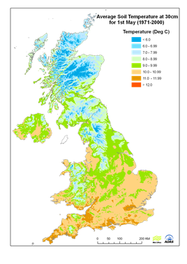
Warm soils at drilling
The soil temperature at drilling should be 6-8°C in the top 10 cm of soil.
Map is mean soil temperatures on 1 May at 30cm (°C)
At 30cm deep temperatures need to be >10°C (beige brown colours)

Slide 6
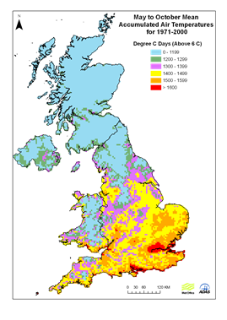
Requires a level of heat accumulation for harvest
Mean daily air temperature above a base level of 6 °C
Areas that achieve 1400 day degrees are best suited to production
Map is average accumulated temperature (May-September >6°C)
These areas are yellow orange and red.

Slide 7
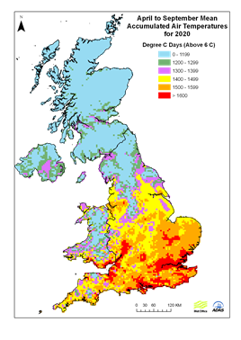
Last time we looked was 2009
In 2009 we said that rising global temperatures will make sunflowers a viable proposition on 50% of the area of England by 2020
Map is average Accumulated Temperatures (April to September >6°C) 2020’s Scenario
These areas are yellow orange and red.

Slide 8
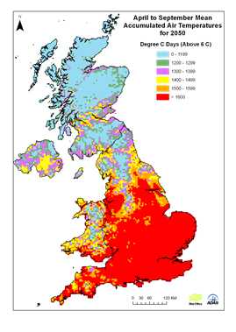
Increasing possibilities by 2050
By 2050 rising global temperatures would make 79% of the UK suitable.
Map is of Average Accumulated Temperatures (April to September >6°C) 2050’s Scenario
These areas are yellow orange and red.

Slide 9
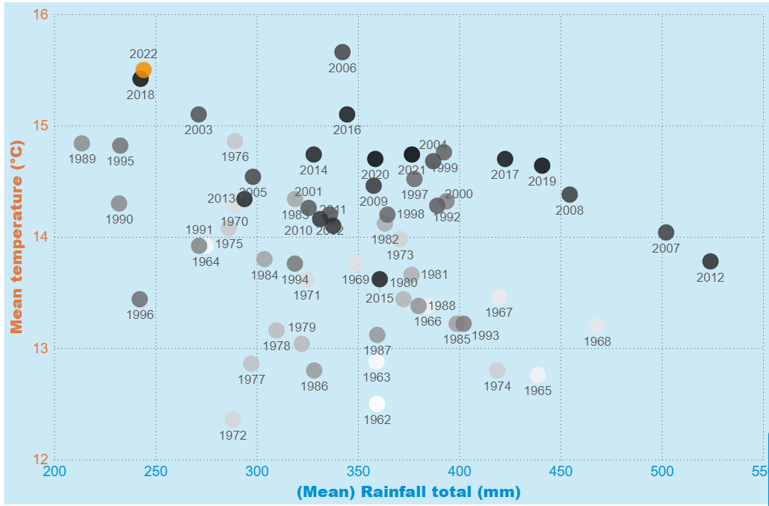
So how are we doing in real time
Looks like the years from 2010 are warmer than early 2000’s and considerably warmer than 1970s – with some exceptions.
But this is associated with increasing rainfall
1960-2022 mean temperature vs rainfall, England and Wales May to September

Slide 10
Alternative oilseed crops
 | Spring Linseed | Spring rape | Sunflowers
£/tonne | 395 | 350 | 350
Yield (t/ha) | 1.8 | 2.3 | 2.0
Gross income (£/ha) | 711 | 805 | 875
Variable costs (£/ha) | 209 | 283 | 375
Gross margin (£/ha) | 502 | 522 | 500

Slide 11
Alternative spring crops
Crambe
Poppy
Lupin
Soya bean
Millet
Camelina
Borage
Chickpea
Echium
Hemp
Flax
Grain maize
Evening primrose
Linseed
Navy bean
Sunflower

