Slide 1





Diseases of Sunflower
John Clarkson & Lauren Chappell
Warwick Crop Centre, School of Life Sciences, University of Warwick

Slide 2
Sclerotinia disease
John Clarkson

Slide 3
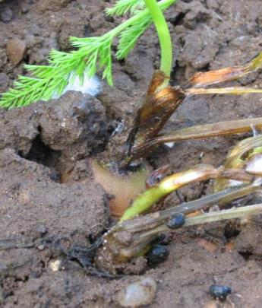
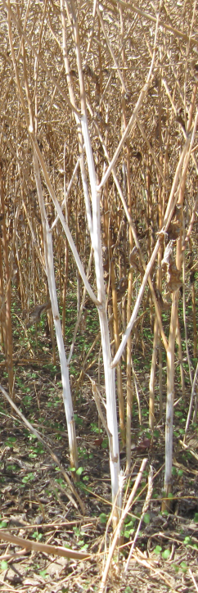
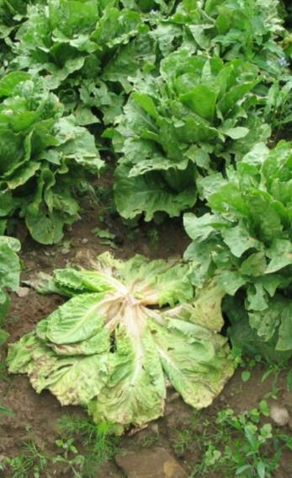
Sclerotinia disease in the UK
Caused by Sclerotinia sclerotiorum
  Little S. minor
  Some S. subarctica in Scotland
Significant losses in many crops
Incidence increases with shortened rotations
Main control approach is fungicides but timing can be an issue
Notes:
Build up of sclerotia in the soil

Slide 4
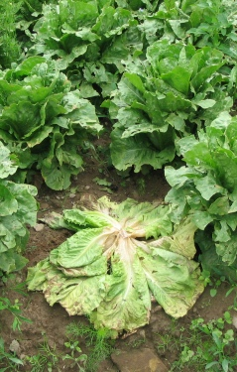
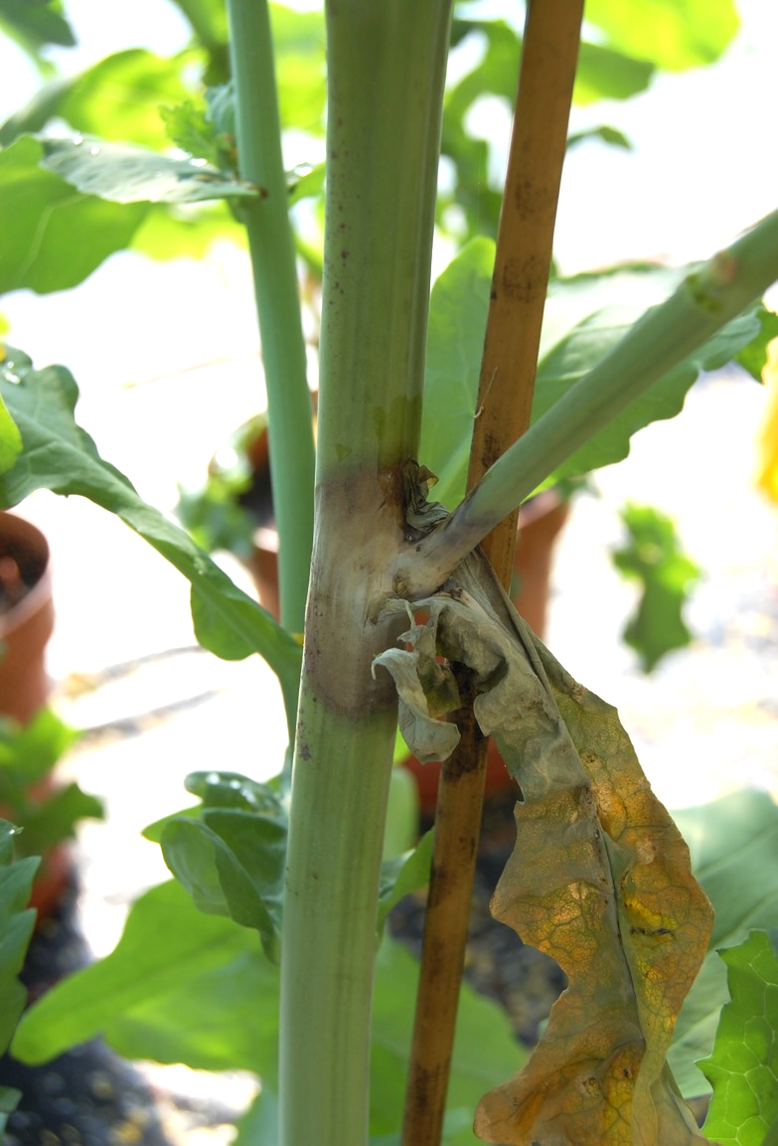
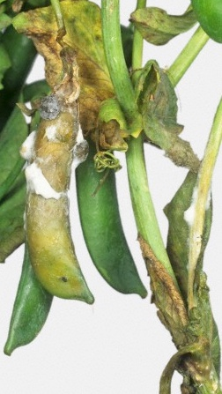
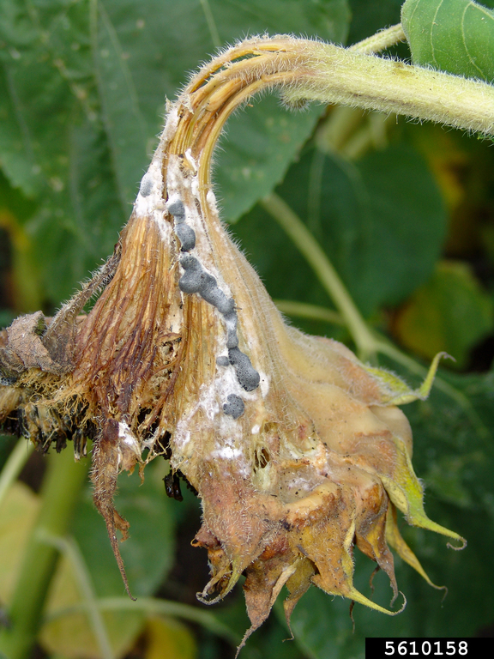
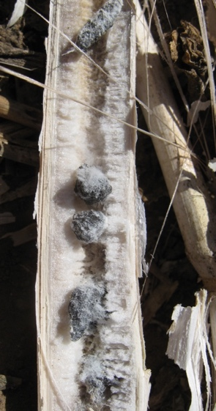
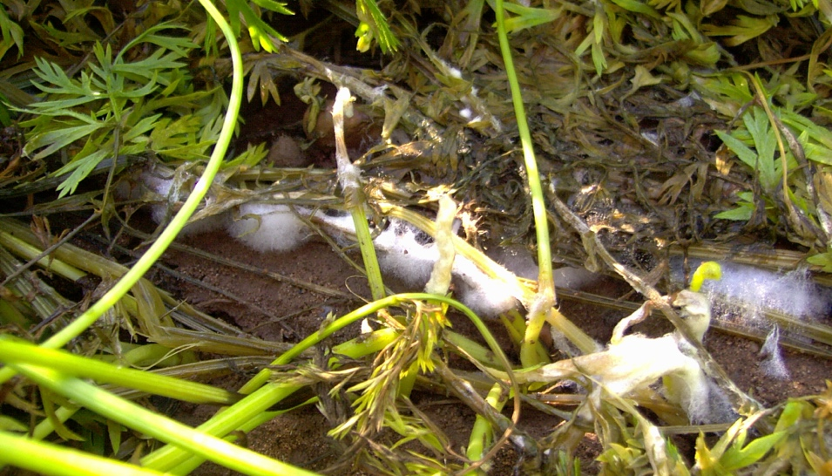
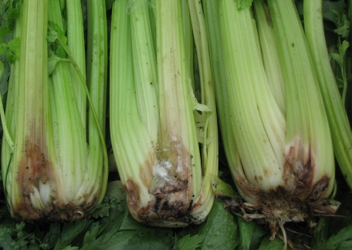
Lettuce
Oilseed rape
Pea
Sunflower
Carrot
Celery
Notes:
2005-2009 diff locations and crops

Slide 5
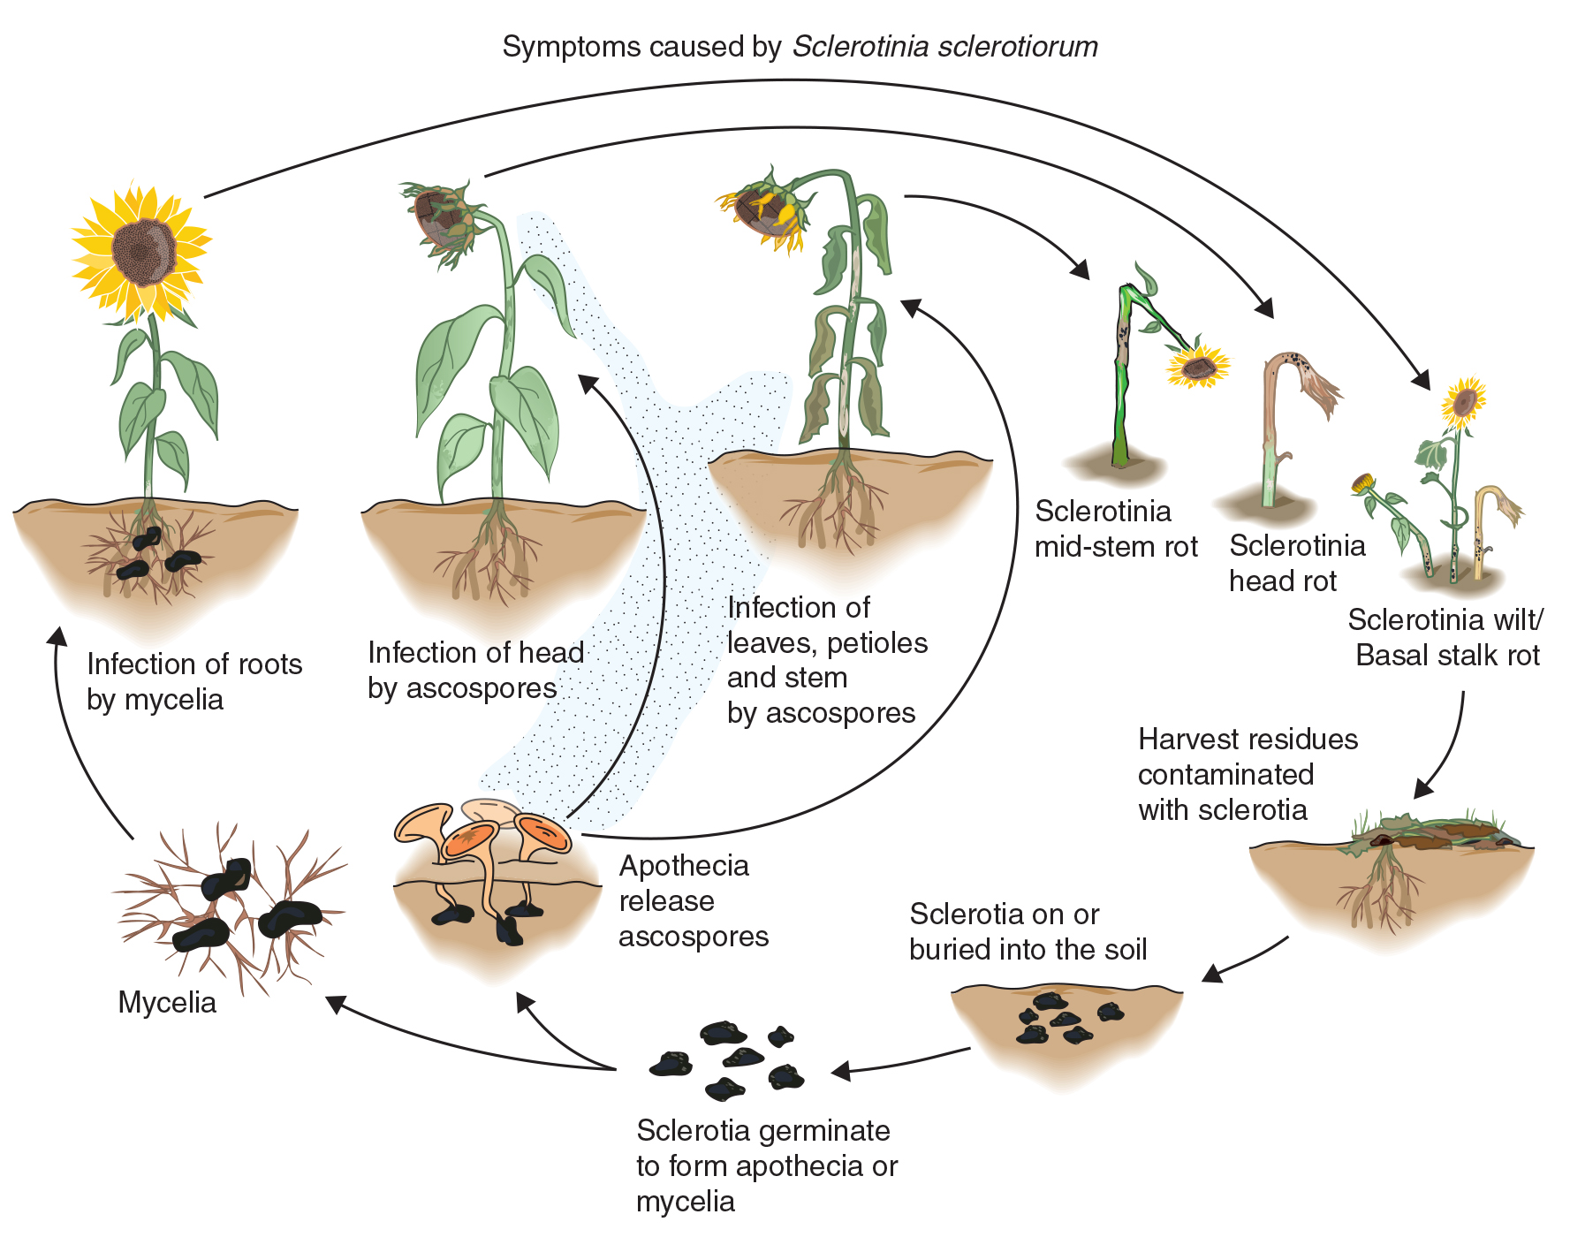
Lifecycle

Slide 6
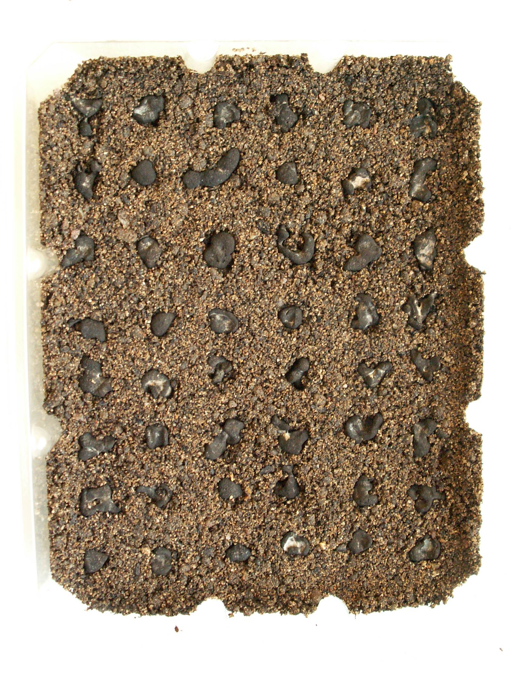
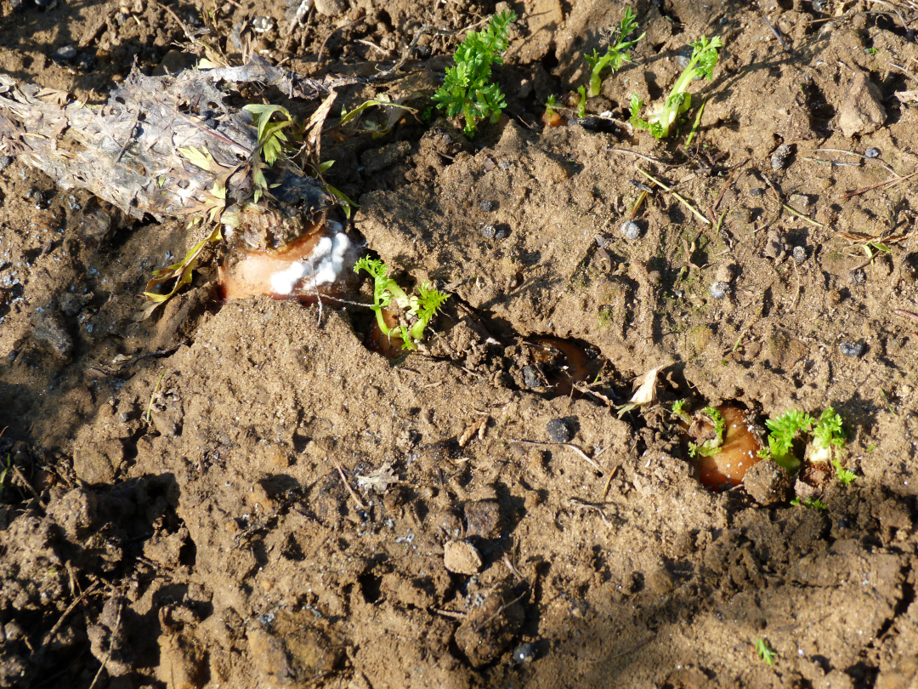

Slide 7
Sclerotinia research
Sclerotinia diversity and population structure (genetics)
Defined conditions for spore infection / germination of sclerotia (modelling approaches) for forecasting models
Control using fungicides, biologicals, biofumigation, solarization
Identification of new sources of plant resistance

Slide 8
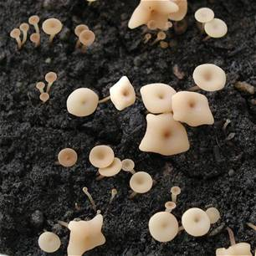
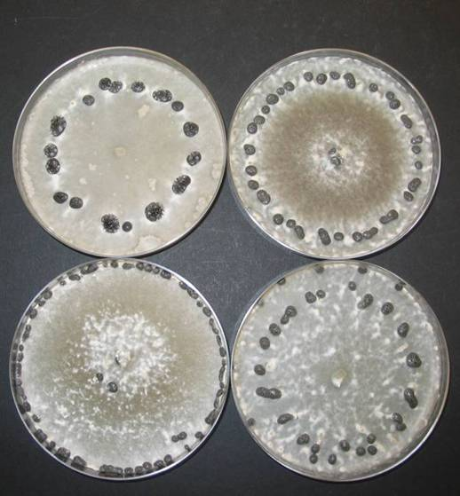
Screening for Sclerotinia resistance
S. sclerotiorum diverse – select common genotype(s) with known pathogenicity
Screening methods must be robust, reproducible and if possible high throughput
Mycelium / spore inoculum used for S. sclerotiorum

Slide 9
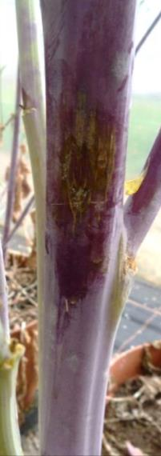
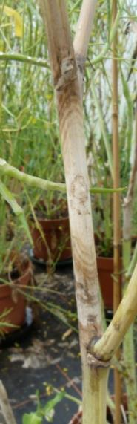
Screening a B. napus diversity set for Sclerotinia resistance (mature plants)
Most Resistant Least Resistant

Slide 10
Itersonilia disease
Lauren Chappell

Slide 11
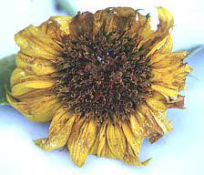
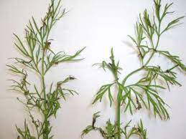
Itersonilia Petal Blight
Caused by Itersonilia spp.
  Itersonilia perplexans – anything but parsnip
  Itersonilia pastinacae - parsnip
  Itersonilia pyriformis - ?
Seed borne fungal pathogen
Family of cold yeasts

Slide 12
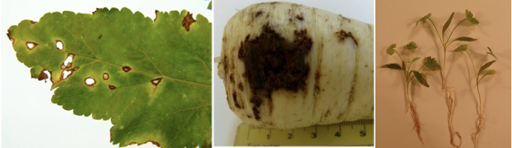
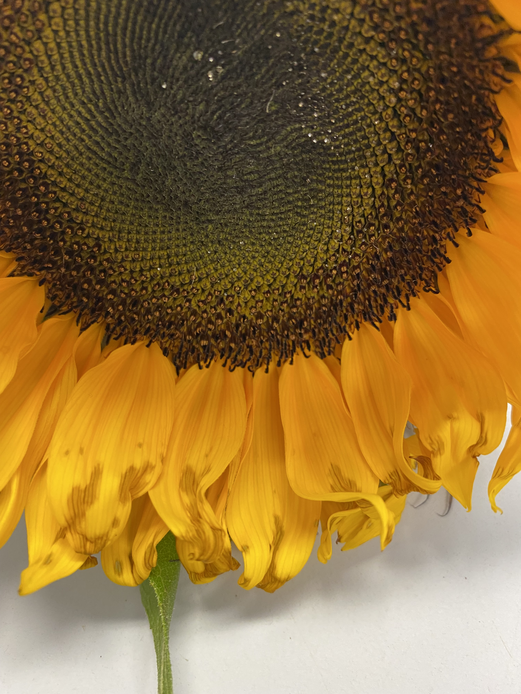
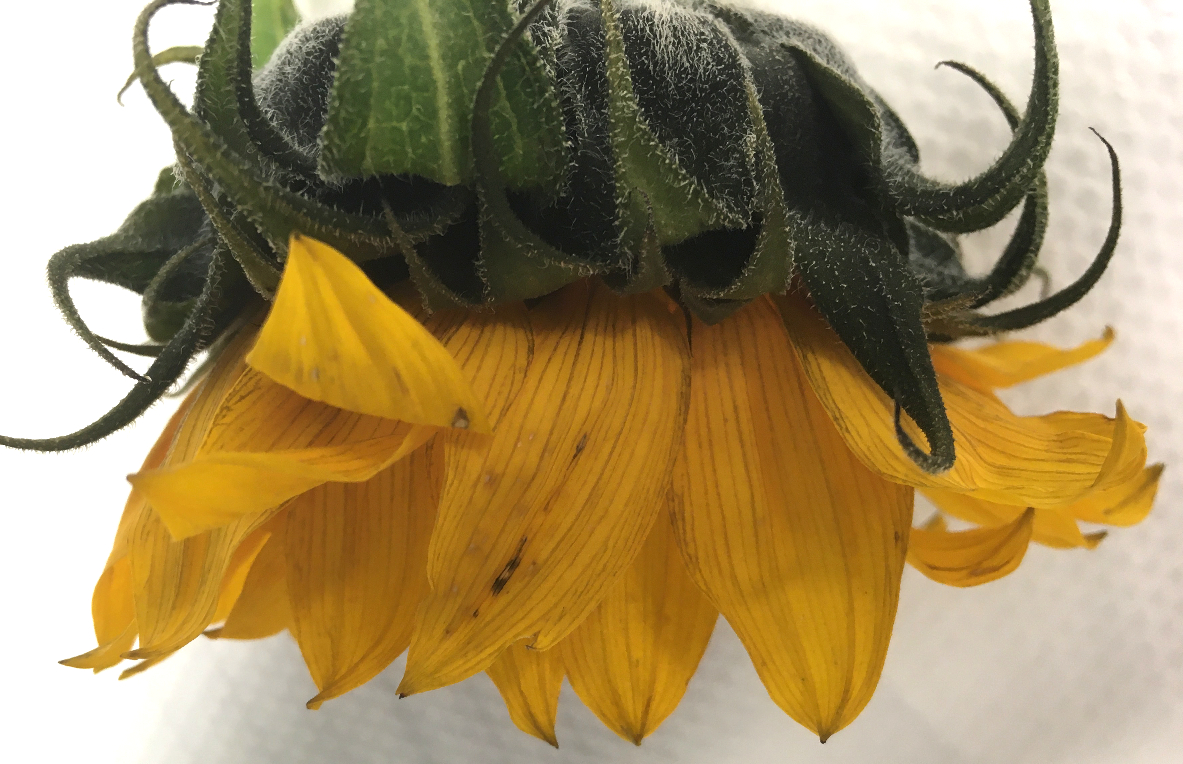
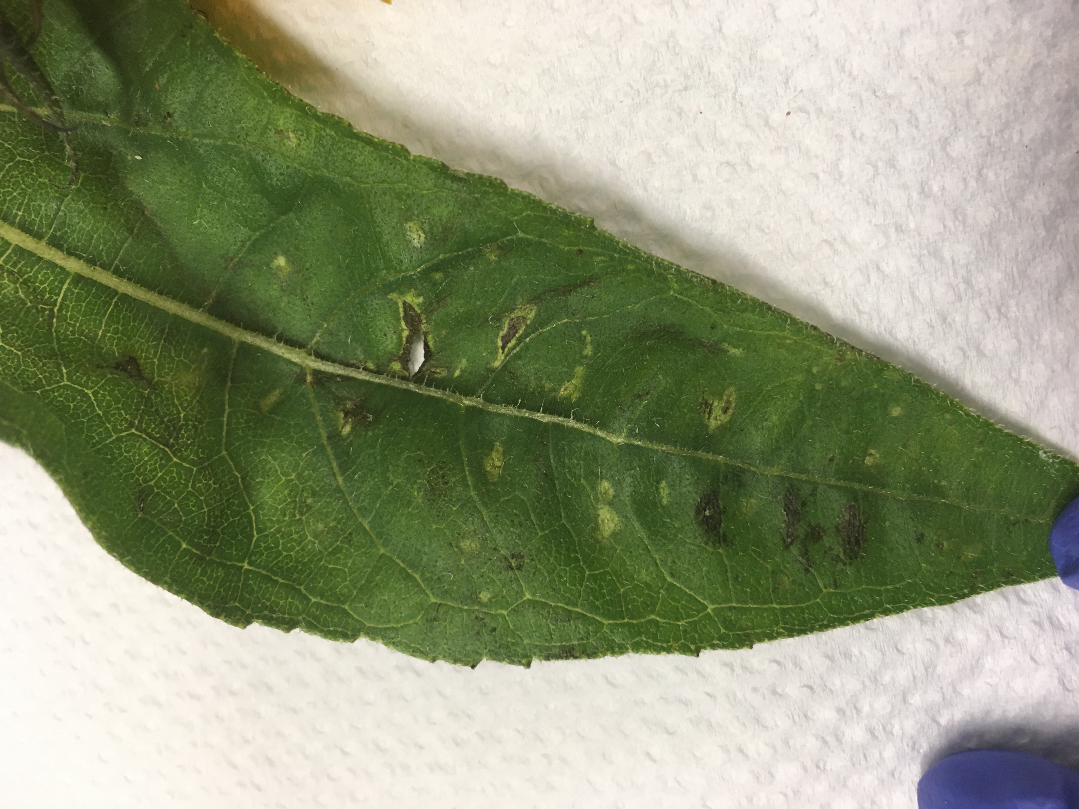

Slide 13
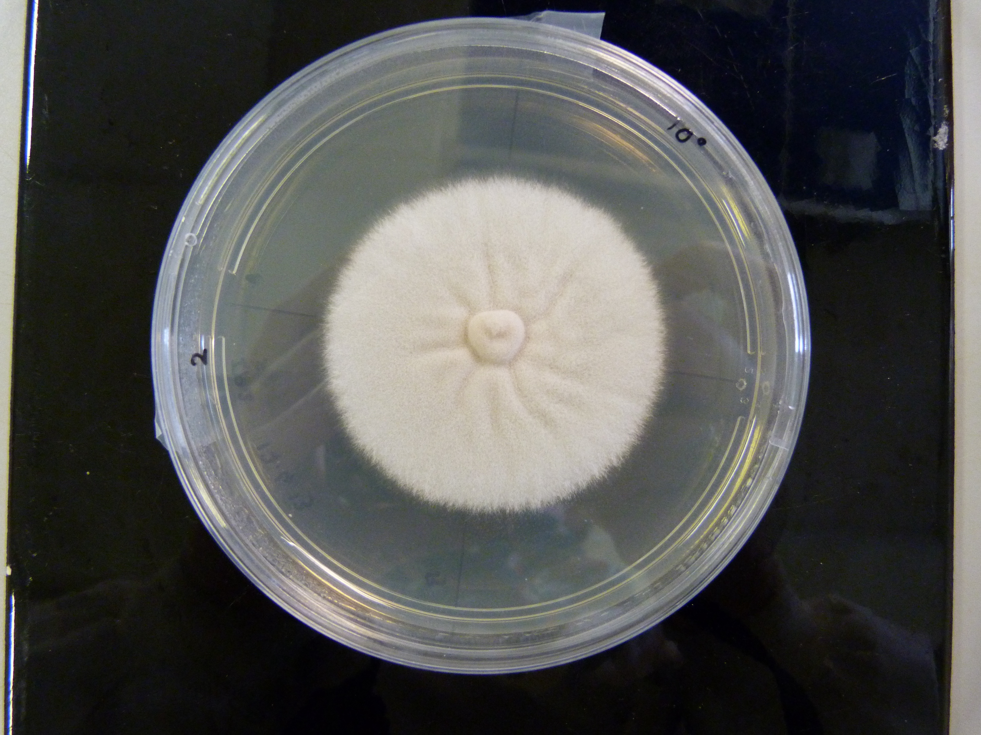
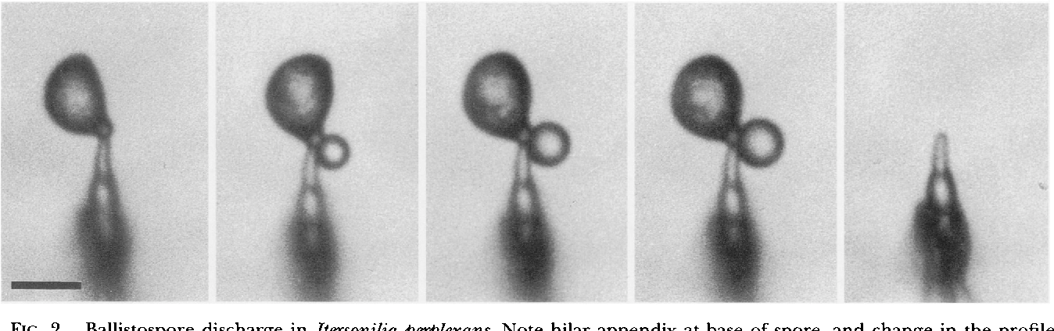
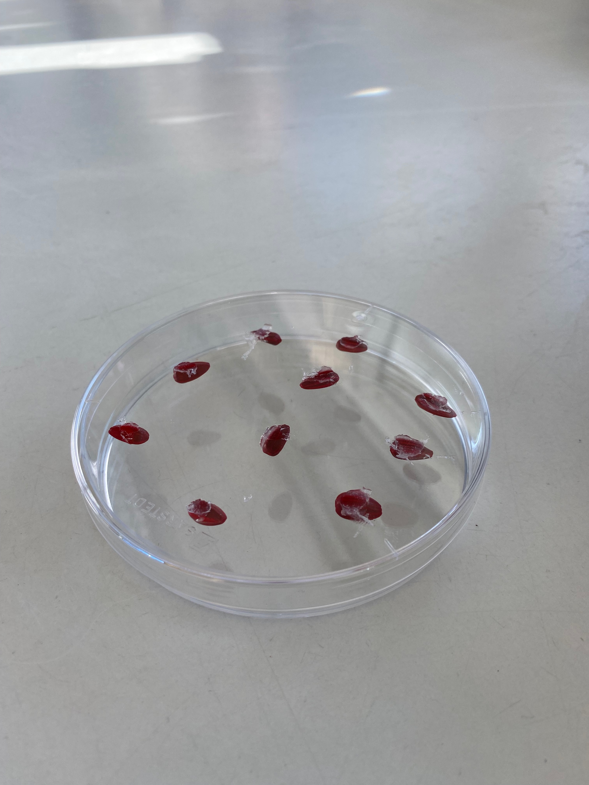
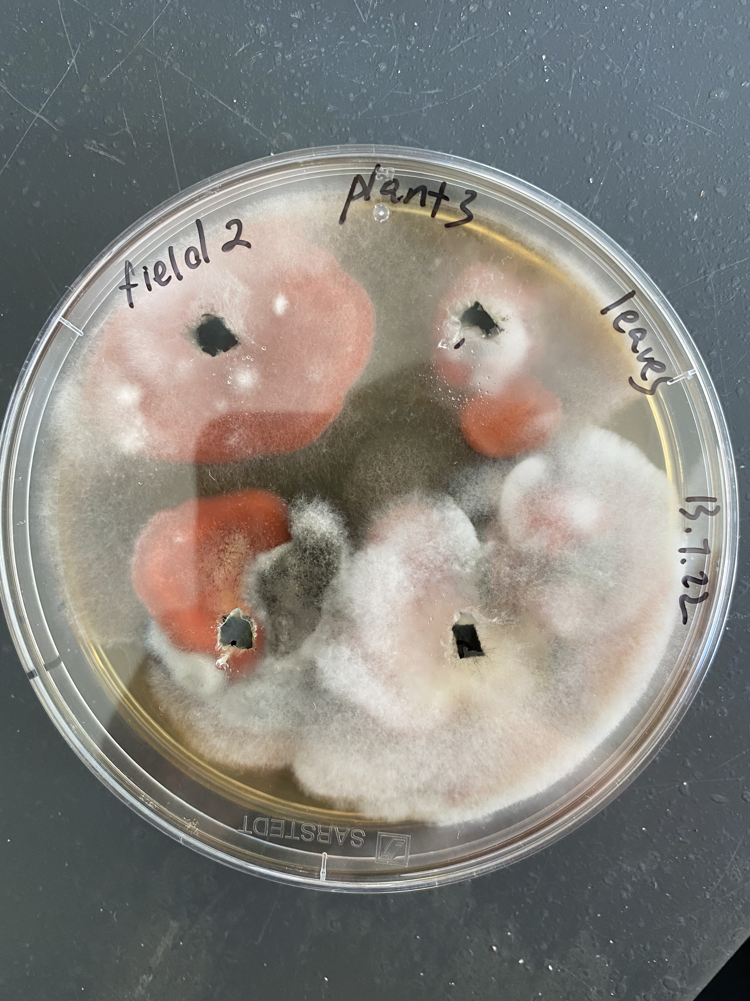
Itersonilia Lifecycle
Itersonilia produces two spore types:
  Ballistospores - summer
  Chlamydospores - winter

Slide 14
Itersonilia Research
Itersonilia diversity and species identity
Defined mycelial growth and spore production temperatures
Development of leaf and root resistance assay

Slide 15
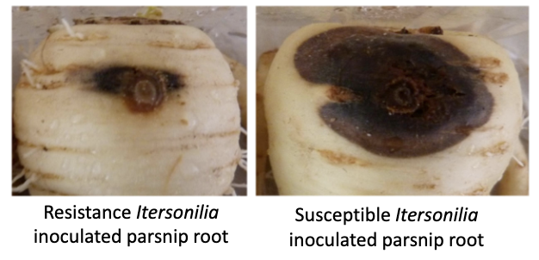
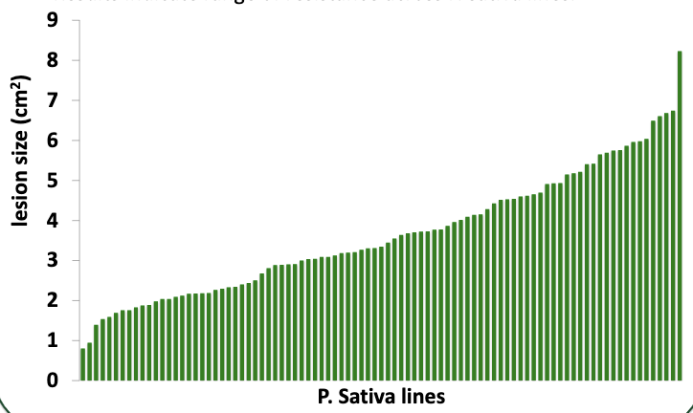
Itersonilia Resistance
Resistant
Susceptible

