Slide 1
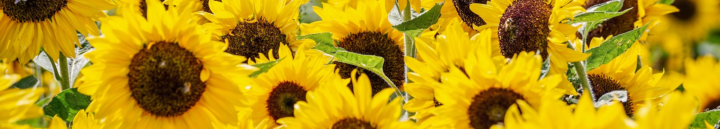

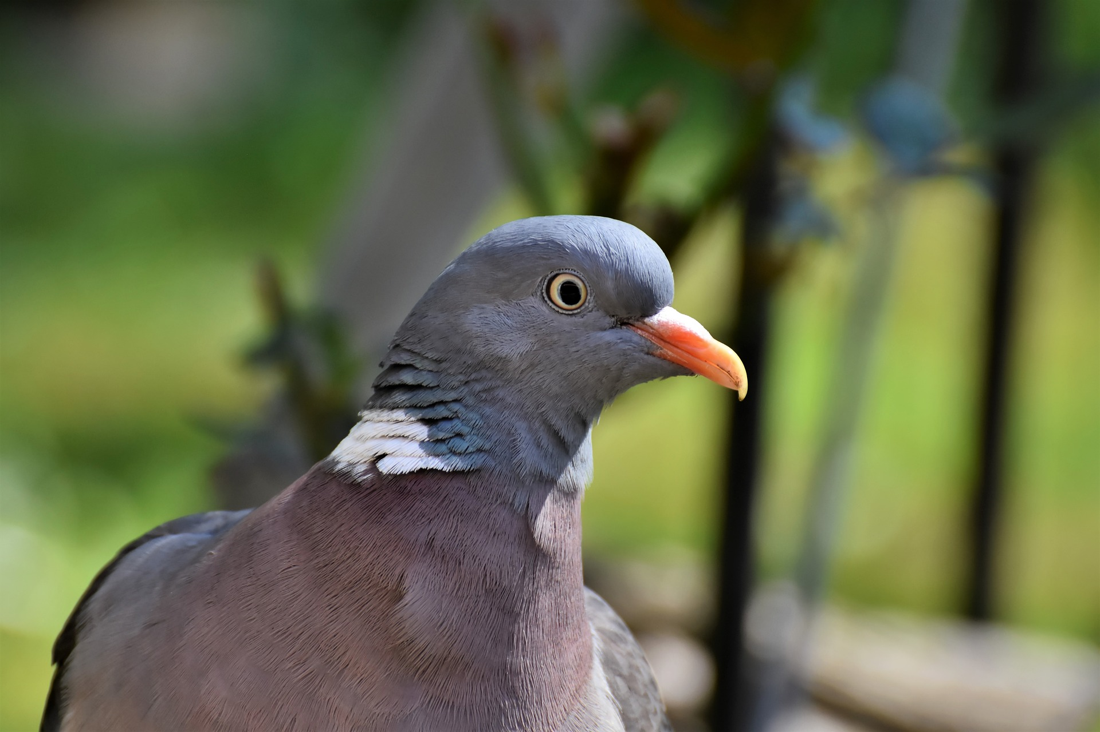
Sunflower pests?
Rosemary Collier, Warwick Crop Centre, School of Life Sciences

Slide 2
Insects
Hundreds, if not thousands, of species of insects use wild sunflowers (Helianthus spp.) for food and/or shelter.
Fortunately, the majority of these species do not attack the common annual sunflower H. annuus L.
Of those that do, a relatively small percentage actually become an economic threat to profitable sunflower cultivation.
Rogers, C.E., 1992. Insect pests and strategies for their management in cultivated sunflower. Field Crops Res., 30: 301-332.

Slide 3

Sunflower is the only row crop in North America coexisting with its wild relatives.
When extensive commercial planting of sunflower began in the 1970s, many of the insects which evolved on native Helianthus (51 species) transferred to the cultivated crop – due to there being lots of plants available!
Over 150 phytophagous insect species have been reported from cultivated and native sunflower.
However, only a few insect species have adapted to cultivated sunflower and have become economic pests.
Rogers, C.E., 1992. Insect pests and strategies for their management in cultivated sunflower. Field Crops Res., 30: 301-332.

Slide 4
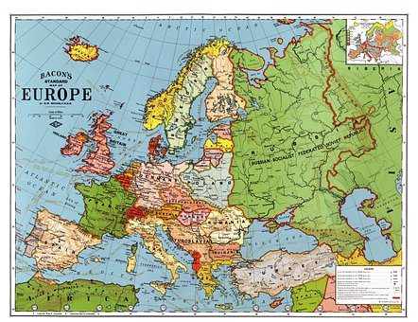
Insects appear to be less of a deterrent to sunflower production in southern and western Europe than in eastern Europe, the Soviet Union, and the Americas.
In western Europe there have been reports of bugs, aphids, leafhoppers, caterpillars, beetles
Rogers, C.E., 1992. Insect pests and strategies for their management in cultivated sunflower. Field Crops Res., 30: 301-332.

Slide 5
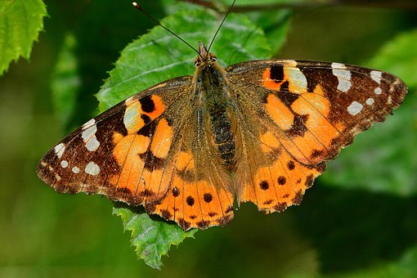
Painted Lady (Vanessa cardui) is probably the most widely distributed butterfly species in the world and has a host range of over 100 species of food plants.
H. annuus is a common host in America and the Painted Lady has been an occasional pest of sunflower in Canada, the US, and Mexico.
Long-distance migrant, which causes spectacular butterfly migrations observed in Britain and Ireland.
Each year, it spreads northwards from the desert fringes of North Africa, the Middle East, and central Asia, recolonising mainland Europe and reaching Britain and Ireland.

Slide 6
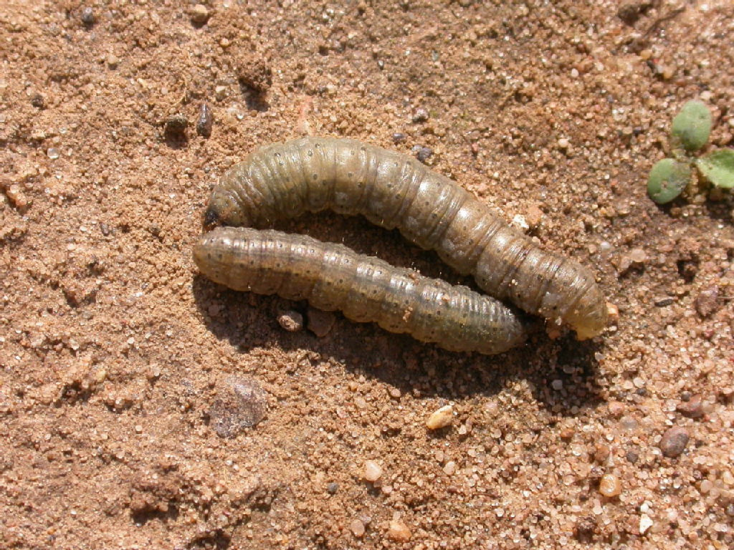
Cutworms
Generalist caterpillar pests
Sporadic outbreaks in the UK – hot dry years
There is a cutworm forecast

Slide 7
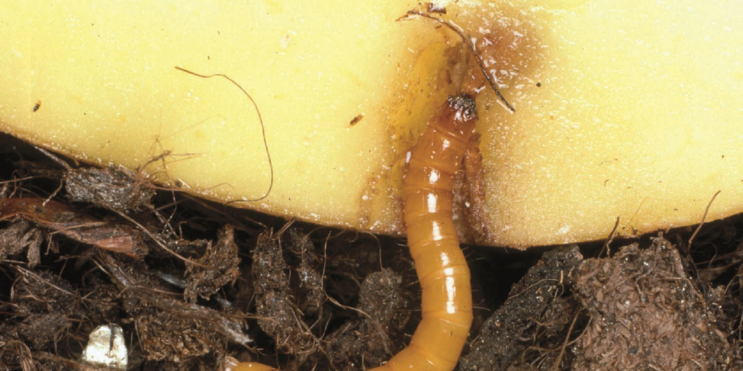
Wireworms
Wireworms
Beetle larvae
Live in grassland
When grass is ploughed they can cause problems for the following crop
Long life-cycle
©Bayer Crop Science

Slide 8
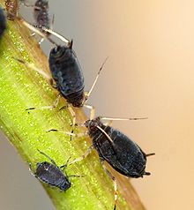

Aphids – several species
$©$Joaquim Alves Gaspar

Slide 9
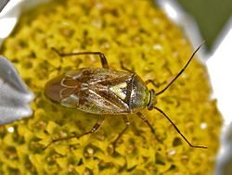
European tarnished plant bug (Lygus rugulipennis) can be a damaging pest e.g. damage to ca. 12% of the immature seed resulted in a 3% yield loss and a 60% loss in germination.
Very common in the UK
Can be pest of crops in the UK – particularly strawberry
Work on management within AHDB Sceptreplus project

Slide 10
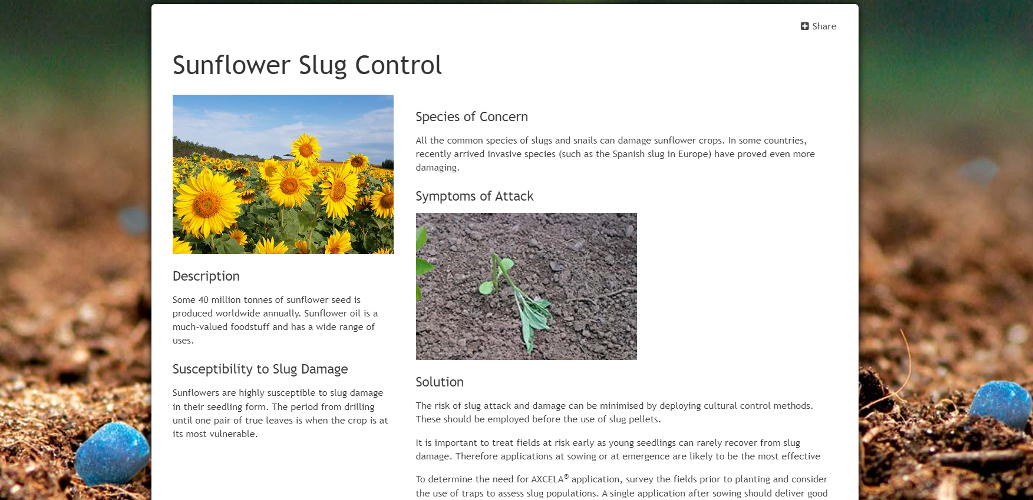

Slide 11
Sunflower is one of the crops most vulnerable to bird attacks.
All production areas are affected by flowerhead damage at maturity.
Damage at emergence has recently become more visible in France, Italy and Switzerland, probably as a result of global changes and evolving farming practices.
Highly mobile pests with complex behaviour. The distribution of damage is asymmetrical: few fields are affected, but with a high severity.

Slide 12
No single effective method for preventing damage.
Need coordination at the landscape scale and an integrated approach combining partially effective methods, the association of several stakeholders, and the coordination of several policies (agricultural, environmental, and recreational hunting or wildlife management).
In France, wood pigeon is the main species, followed by the carrion crow and rook.

Slide 13
Thank you and any thoughts please?

