Slide 1

The use of digestates as a nutrient source in fertigated strawberries
Rob Lillywhite
Warwick Crop Centre

Slide 2
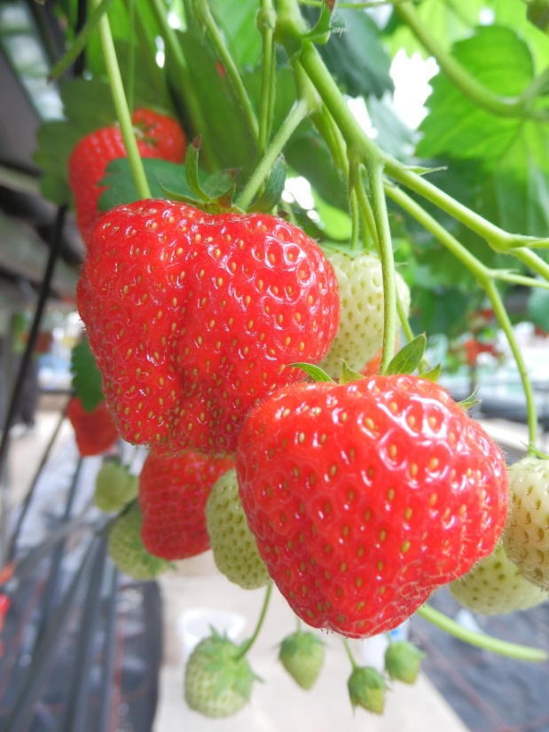
Introduction
Practical aspects:
  Environmental issues
  System assumptions
  Digestate storage
  Operational issues
  Cost benefit analysis:
    Value as fertilizer
Conclusions

Slide 3
Environmental Issues
  The use of digestates requires a new approach and has the potential for environmental risk
  Pathogens, PTEs, stability & contaminants
  PAS110 and Quality Protocol – no waste management controls – a ‘passport’ to safe use
New leak proof storage required - uncontrolled releases to the environment might be a problem
Odours - health & neighbour/worker issues

Slide 4
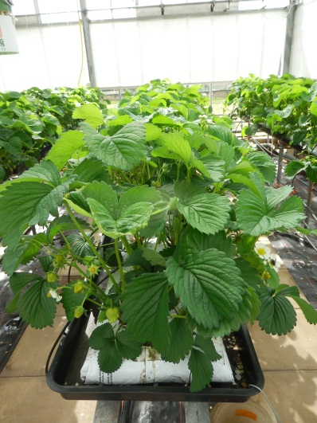
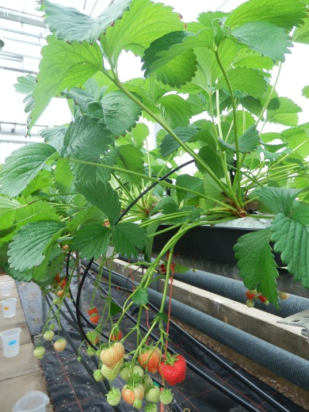
Assumptions
Dilution scenarios | High | Low
Digestate dilution factor | 50 | 20
Plant density | 8 /m² | 12 /m²
Volume of feed /plant /season | 30 l | 30 l
Volume of feed /ha /season | 2400 m³ | 3600 m³
Volume of digestate (undiluted) /ha /season | 48 m³ | 180 m³

Slide 5
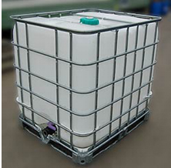
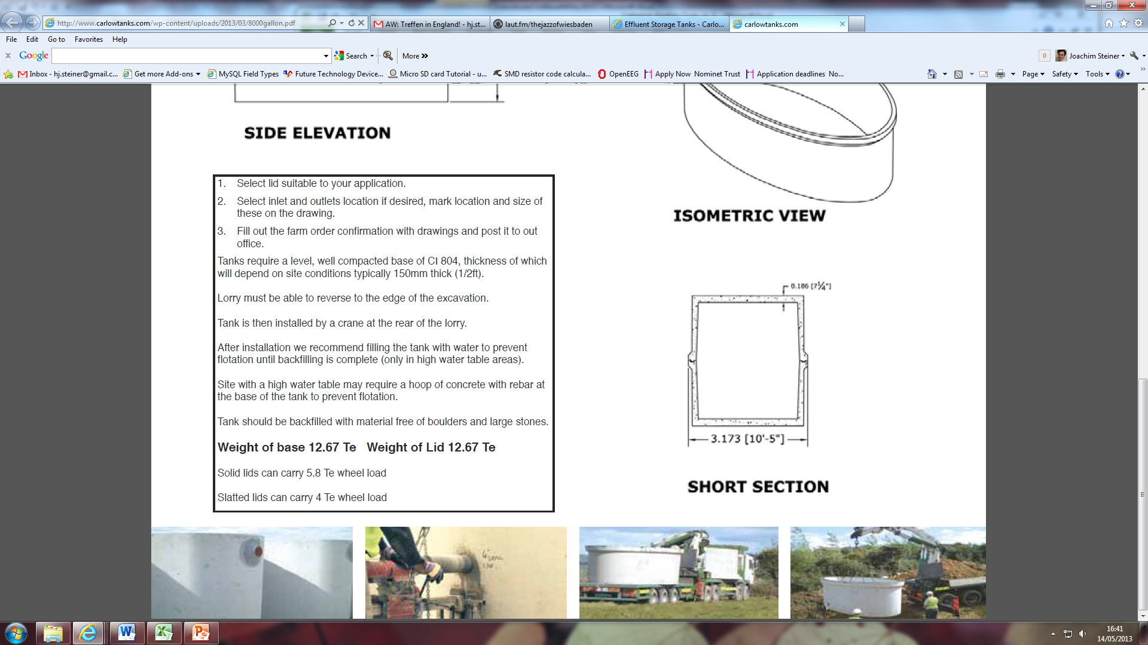
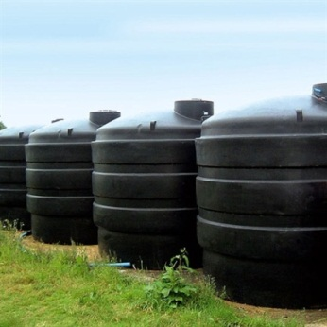
Digestate Storage
Volume | Type | Cost /m³/year over 10 yr | 20 m³ upfront cost | 40m³ upfront cost
1 m³ | White 1000 Litre IBC container | £ 7 | £1400 | £2400
1 m³ | New IBC, timber pallet | £ 10 | £2000 | £4000
10 m³ | CT2200JA Tank | £ 12 | £2400 | £4800
19 m³ | V19000 | £ 13 | £2600 | £5200
36 m³ | Elliptical Concrete Tank | £ 15 | £3000 | £6000
72 m³ | Small AD storage unit | £ 24 | £4800 | £9600

Slide 6
Operational Issues
  The use of digestates requires some changes to existing production practices
  Install (agitated) storage capacity
  Total solids content & existing fertigation equipment
  Adjusting digestate nutrient and pH levels
  Customer acceptability (not yet an issue but likely to become one)

Slide 7
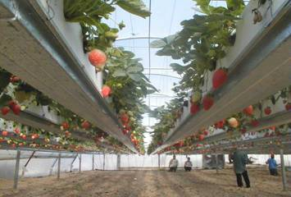
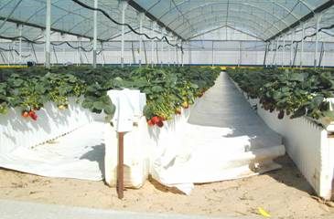
Cost benefit analysis
  Value as fertilizer
  Net cost savings
  Risk vs benefit

Slide 8
Value as Fertilizer
 | Amount added per 100l |  | Cost /ha /season (8 plants /m²)
 | Diluted digestate | Control | Diluted digestate | Control
KNO₃ | 36 g | 15 g | £ 806 | £ 249
Ca(NO₃)₂ |  | 24 g |  | £ 1,672
Mono-potassium phosphate | 21 g | - | £ 720 | -
1-1-3 NPK | - | 52 g |  | £ 345
(TEC SF + Mg) | Same amounts in both |  | - | -
Total |  |  | £ 1,527 | £ 2,266
Total Saving |  |  | £740 (-33%)

Slide 9
Net cost savings
 | Cost /ha /season (min) | Cost /ha /season (max)
Fertiliser cost saving through the use of digestate | - £ 740 | - £ 740
Digestate transport cost | £ 185 | £ 480
Digestate storage cost | £ 33 | £ 108
Total savings | - £ 522 | - £ 152
Total fertiliser cost (conventional method) | £ 2,266 | £ 2,266
Percentage of total fertiliser cost saved | - 23 % | - 7%

Slide 10
Summary - Risk vs benefit
Value of strawberries /ha /season | £43,000 – £99,000
Typical cost saving due to the use of digestate /ha /season | £152 - £522
Savings relative to value of fruit /ha /season | 0.15% - 1.2%
Risk of yield being affected by introducing a novel fertilizing system | >> 1.2% ?

Slide 11
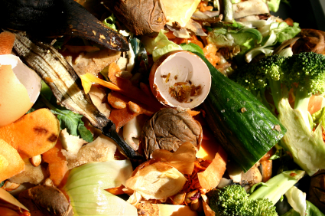
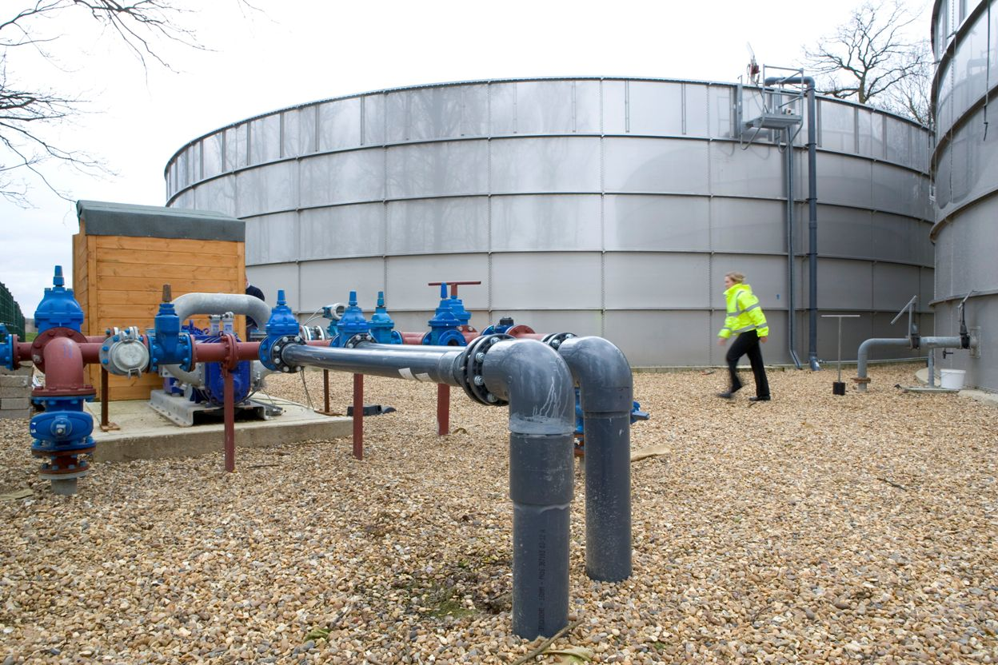
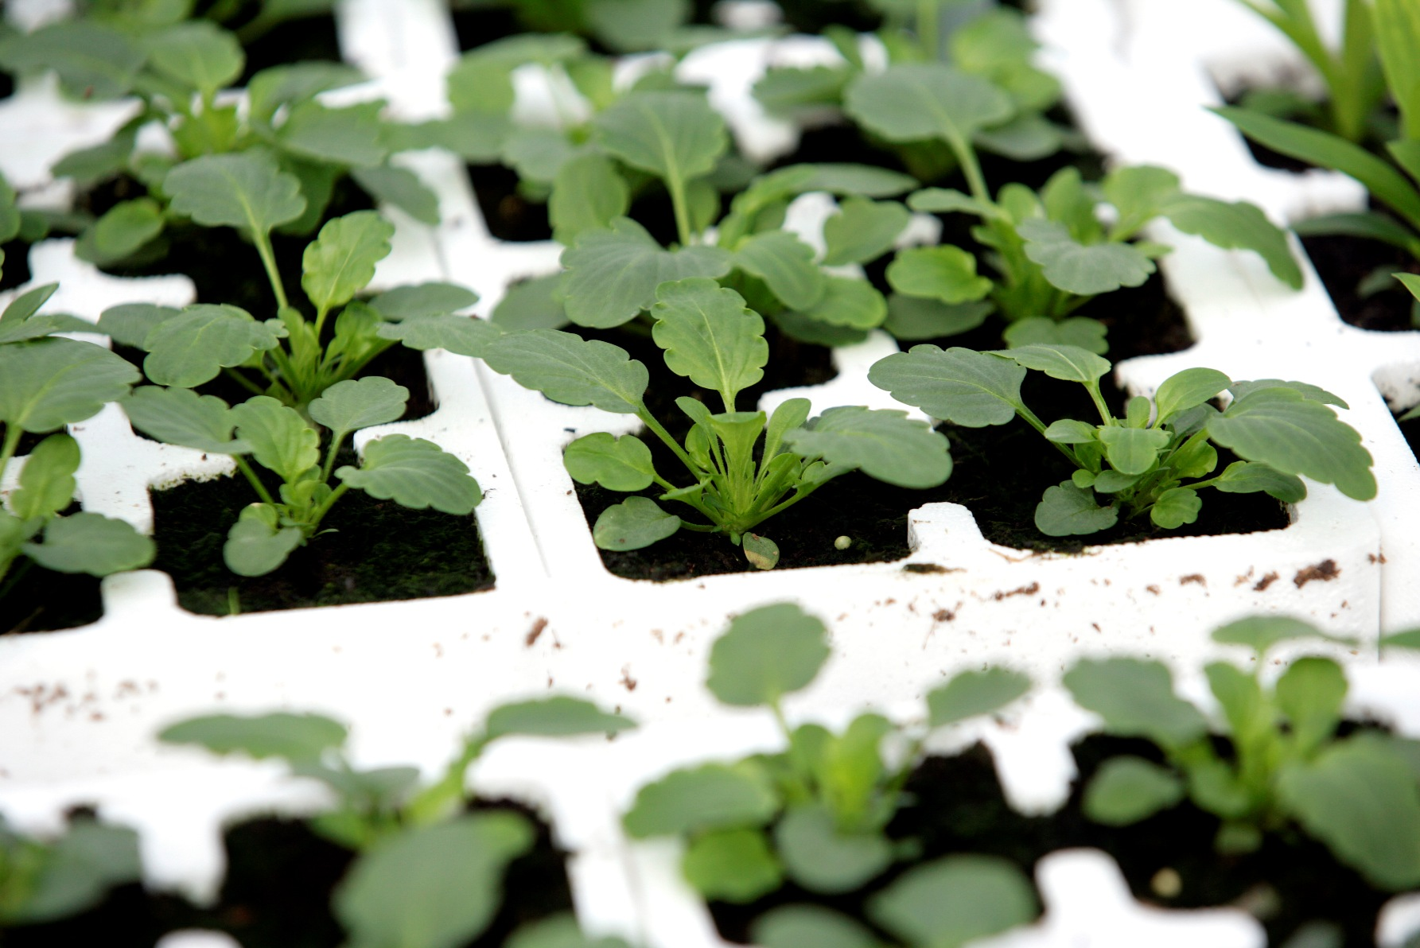
WRAP Horticulture pre-feasibility trials
    Key questions:
      Can digestate be used in these applications?
      What are the constraints?
      Can these be overcome?
      Are there business benefits?
      Should the ADQP be changed?
Notes:
NOTE – these uses are not currently allowed under ADQP

Slide 12
Conclusions
Amended digestates can successfully be used to supply the nutrients required by a fertigated strawberry crop
Fruit yield and quality yield are (mostly) maintained (under experimental conditions)
Small financial saving are possible but are unlikely to out-weigh potential risks (loss of yield and quality, inexperience, additional material handling)
Most viable where AD and protected production is integrated
Unknown (but predictable) issues surrounding customer acceptance of fruits grown using digestates

Slide 13
Questions?

